Slide 1

ENTERPRISE SECURITY PROGRAM
AMERICAN ELECTRIC POWER
June 2021
UPDATE FOR KENTUCKY INTERIM COMMITTEE ON NATURAL RESOURCES AND ENERGY

Slide 2

RECENT EVENT:
COLONIAL PIPELINE RANSOMWARE
DarkSide Ransomware Attack
Saturday May 8, 2021 – Reports of Colonial Pipeline ransomware event began appearing
Colonial and Government reporting - only IT systems and network impacted, Pipeline shutdown was precautionary
Nearly 100GB of data ex-filtrated prior to launch of encrypting ransomware – threat of public data release
2. ENTERPRISE SECURITY PROGRAM UPDATE

Slide 3

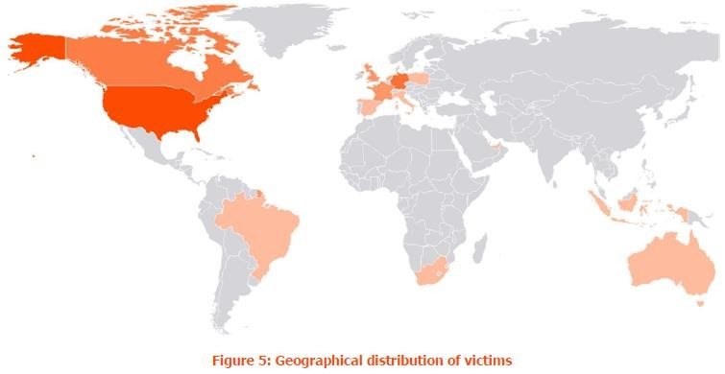

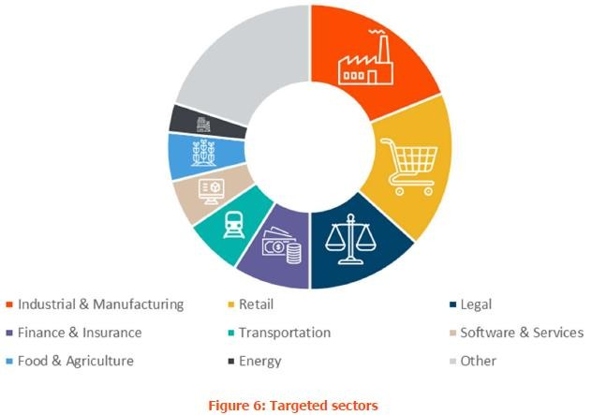
DARKSIDE RANSOMWARE
- Not targeting Energy
Source: BAE SYSTEMS INTEL – 2021-05-10
3. ENTERPRISE SECURITY PROGRAM UPDATE

Slide 4
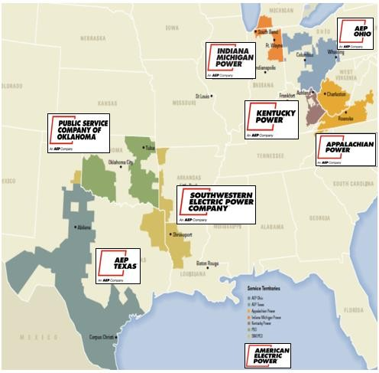

WHO IS AEP?
AEP is one of the largest electric utilities in the U.S., serving nearly 5.4 million customers in 11 states, with the nations largest Transmission Network
Revenues: | $15.6 billion
Assets: | $79 billion
Employees: | Approximately 18,000
Service Territory: | More than 200,000 square miles
Miles of transmission lines: | More than 40,000 miles Nations largest 765kv network
Miles of distribution lines: | Approximately 221,000 miles
Generating capacity: | Approximately 24,000 megawatts

Slide 5
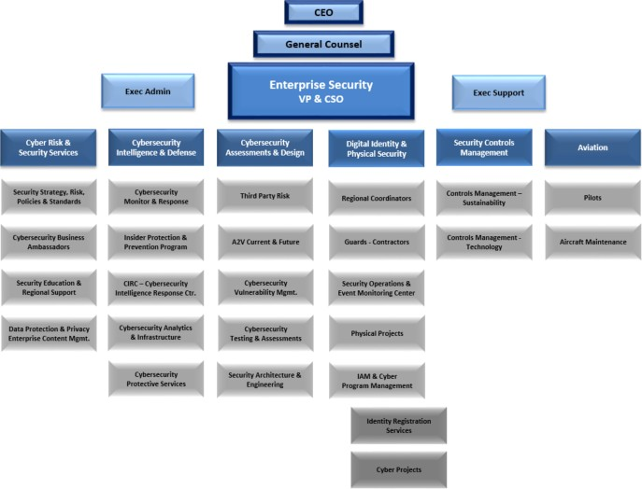

AEP ENTERPRISE SECURITY
Responsible for all Operating Companies, BU’s, IT/OT and Nuclear
Approx. 195 FTE’s
20 Physical
20 Aviation
155 Cyber
200 Contract Guards
5. ENTERPRISE SECURITY PROGRAM UPDATE

Slide 6
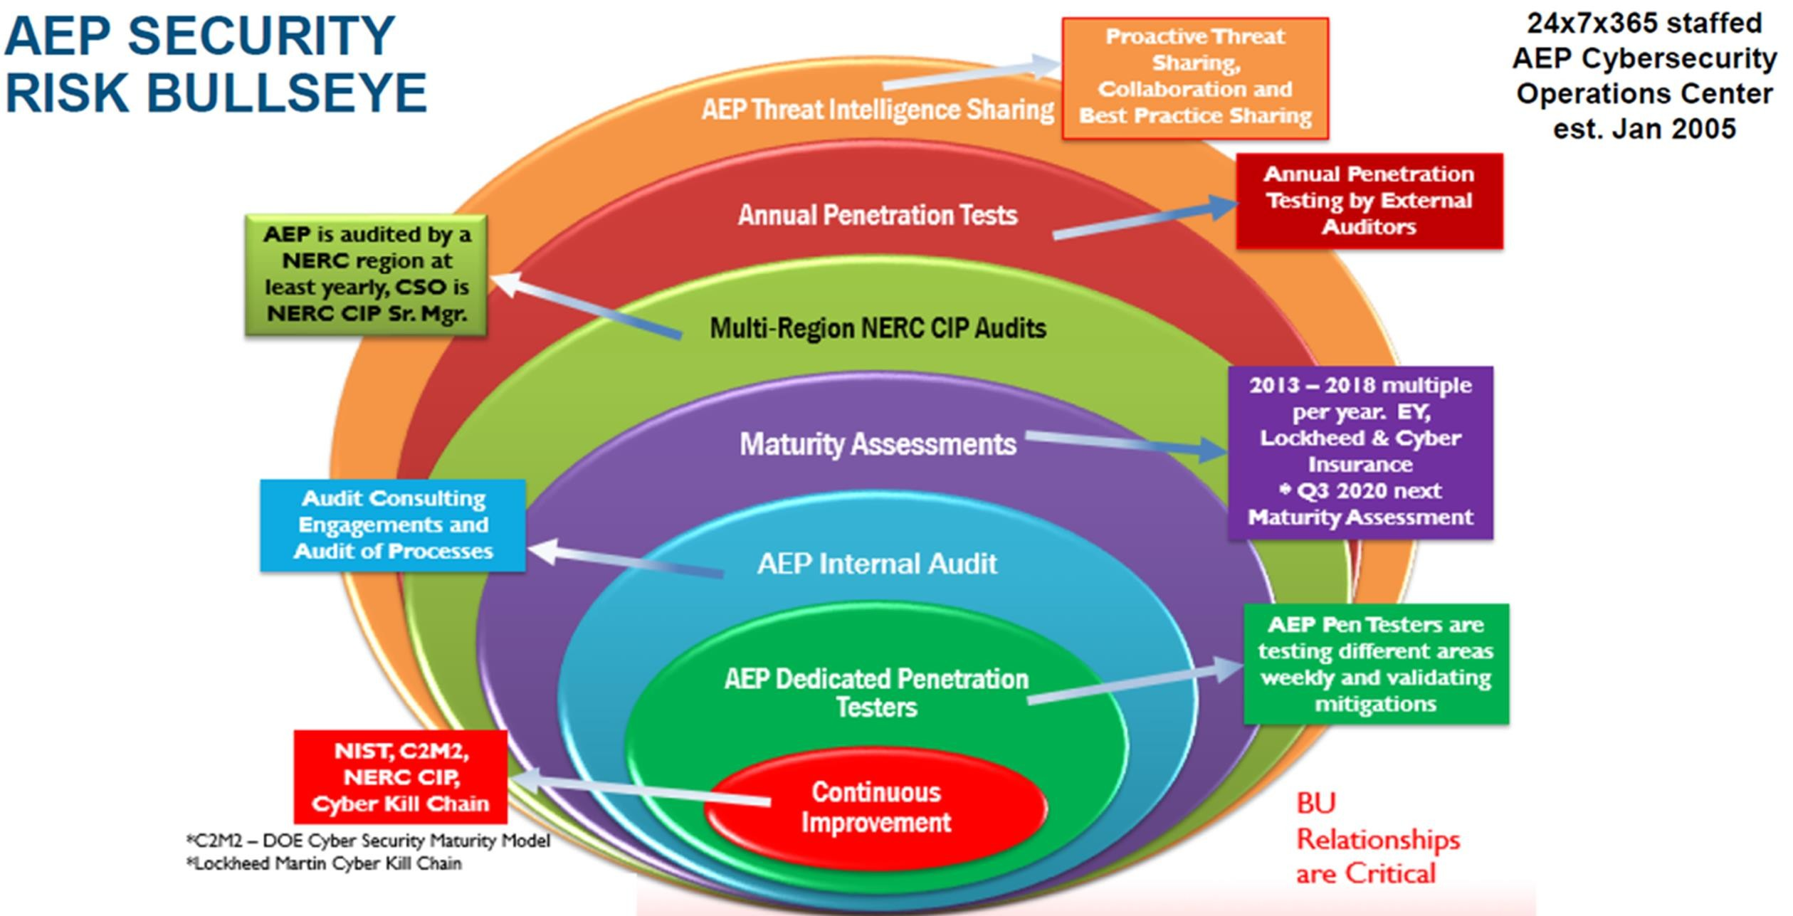
AEP SECURITY RISK BULLSEYE
Key Takeaway – AEP Security Risk is continually evaluated through a variety of efforts
Maturity assessments from EY, Lockheed & Cyber Insurance
Future assessment from DOE or DHS
6. ENTERPRISE SECURITY

Slide 7
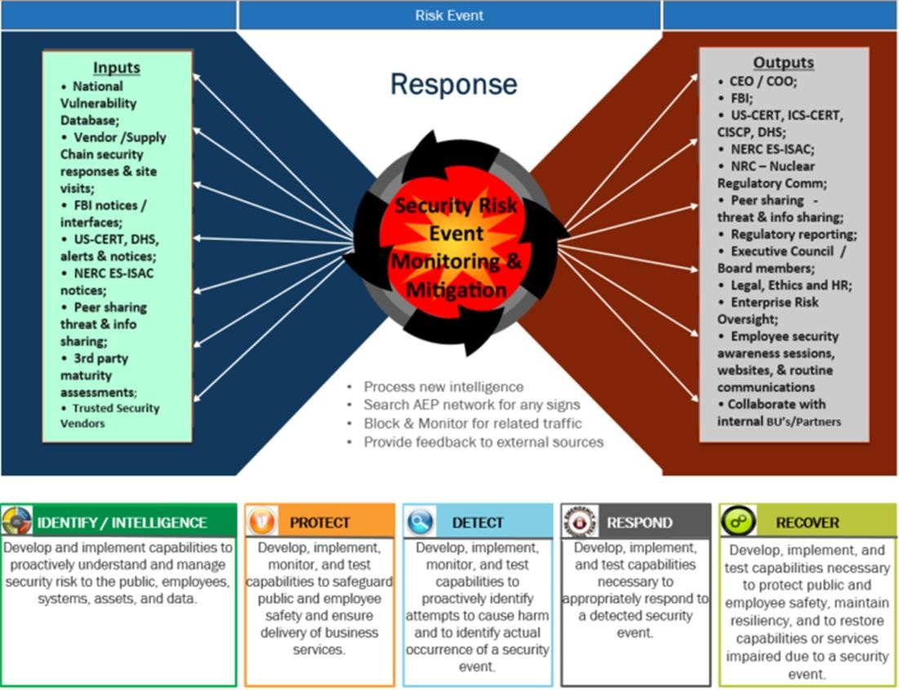
AEP 24X7 CYBER INTELLIGENCE RESPONSE CENTER
Established 2005
Key Takeaway – AEP is managing cyber risk 24x7x365
7. ENTERPRISE SECURITY

Slide 8
PANDEMIC SECURITY RISK MGMT
Key Takeaway – COVID- 19 change in work practices has not impacted AEP’s Security
Cyber Team is operating 100% remote - full mitigation, monitoring & response
Physical Security continues to staff 24x7 Monitoring and Field Investigations
User Activity / Connectivity
All user activity from home is routed into AEP through secure communications. Allowing full security capabilities.
Good, stable & secure connectivity provided by AEP Telecommunications and Information Technology
No significant change in threat countries targeting AEP.
Email & Text/SMS Phishing and Malware Activity
COVID-19 crisis has created further opportunities for state-sponsored cyber actors to perform cyber espionage operations
AEP monitoring and controls are performing as expected

Slide 9

NERC CRITICAL INFRASTRUCTURE PROTECTION (CIP) STANDARDS – MANDATORY COMPLIANCE SINCE 2007
These standards address the security of cyber assets that are critical to the operation of the North American electricity grid.
CIP-002 BES Cyber System Categorization
CIP-003 Cyber Security Management Controls
CIP-004 Security - Personnel & Training
CIP-005 Cyber Electronic Security Perimeter(s)
CIP-006 Physical Security of BES Cyber Systems CIP-007 Cyber System Security Management
CIP-008 Cyber Security — Incident Reporting and Response Planning
CIP-009 Recovery Plans for BES Cyber Systems
CIP-010 Configuration Change Management and Vulnerability Assessments
CIP-011 Information Protection
CIP-013 Supply Chain Risk Management CIP-014 Physical Security

Slide 10
APPENDIX

Slide 11
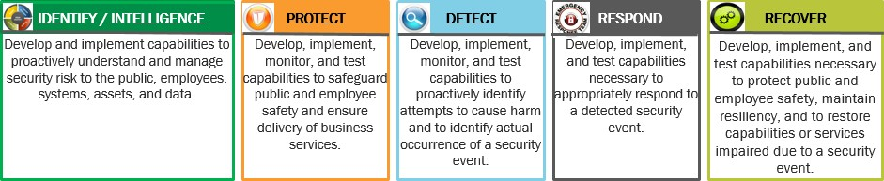
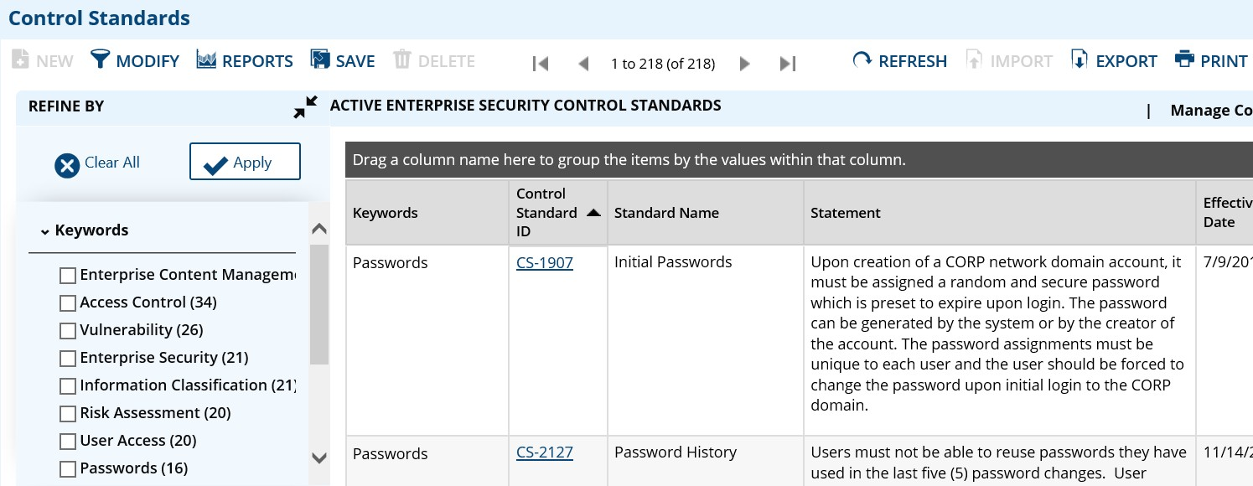
AEP NIST FRAMEWORK
Key Takeaway – AEP Security aligns with industry standards across Projects, Policies and even operational areas like Incident Response. NIST framework can be mapped to other existing frameworks which AEP Security also aligns
Discussion
AEP Incident Response Mapping to NIST
National I Standards Technology (NIST) Cybersecurity Framework industry standards and best practices to help organizations manage their cybersecurity risks
AEP Policies & Standards Mapping to NIST

Slide 12

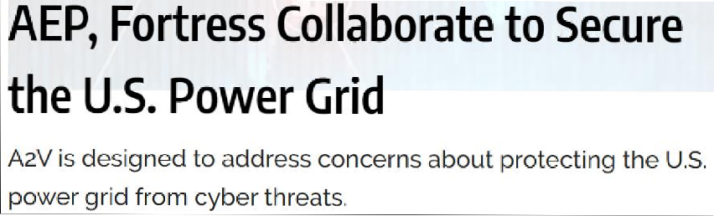



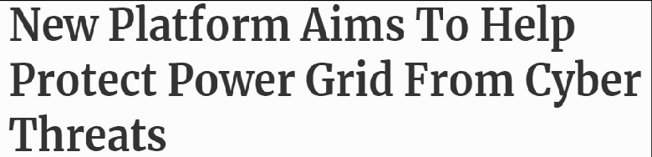
FORTRESS/AEP – A2V TPRG
Key Takeaway – A2V is well received by industry
A2V (Asset to Vendor) Update – Third Party Risk Service Offering
Facilitates CIP 013 compliance
All vendors are Risk Ranked
Assess vendor security
Scan software provided by vendors
Communication to vendors

