Slide 1
Cybersecurity
David McLeod
Director IT Security and Risk Management

Slide 2
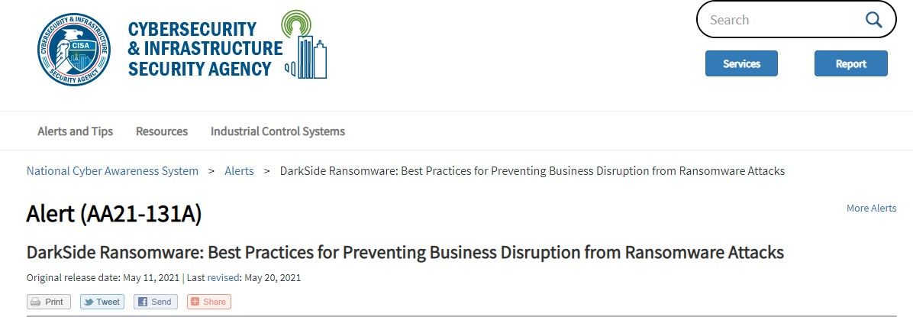
Government Guidance on Ransomware
Cybersecurity and Infrastructure Security Agency (CISA) and the Federal Bureau of Investigation (FBI) published a joint cybersecurity advisory alert
Released May 11, 2021
Recommended mitigations for Critical Infrastructure Asset Owners

Slide 3
Reduce the Risk of Ransomware Attacks
https://us-cert.cisa.gov/ncas/alerts/aa21-131a
Secure remote access to IT or OT – multi factor Email filter to block phishing attempts Phishing Exercises
Filter network traffic Patching
Limit remote access across networks
Set antivirus/antimalware programs to conduct regular scans Harden devices and company systems

Slide 4
Reduce the Impact of Ransomware
https://us-cert.cisa.gov/ncas/alerts/aa21-131a
Implement network segmentation between IT and OT Further network segment critical OT systems
Alternative plans to ensure ICS can be isolated if the connections cannot be trusted
Test manual controls so that critical functions can be kept running if ICS or OT networks need to be taken offline
Secure and test backups Protect privileged accounts

Slide 5
Additional Mitigations
Ransomware tabletop exercises
Industry cyber information sharing
Penetration exercises using hacking tools that adversaries would use

