Slide 1
KENTUCKY WETLAND AND STREAM
FEES-IN-LIEU-OF MITIGATION
(FILO) PROGRAM
Clean Water| Restored and Improved Habitats| Increased Outdoor Recreational Opportunities| Economic Growth

Slide 2
KDFWR’s MISSION
Conserve, Protect and Enhance Kentucky’s fish and wildlife resources and,
Provide outstanding opportunities for fishing, hunting, trapping, boating, shooting sports, wildlife viewing, and related activities.

Slide 3
HOW DOES STREAM AND WETLAND MITIGATION UNDER THE CLEAN WATER ACT WORK
The basic premise of the § 404 permitting program is that no discharge shall be permitted if (1) a practicable alternative exists that is less damaging to the aquatic environment, or (2) the discharge would cause the nation’s waters to be significantly degraded.

Slide 4
The objective of the Clean Water Act (“CWA”), 33 U.S.C. §1251 et seq., is to restore and maintain the chemical, physical, and biological integrity of the waters of the United States.
The Act prohibits the discharge of any dredged or fill material in “waters of the United States,” including wetlands, without a permit. 33 U.S.C. § 1311; CWA § 301.
Streams and Wetlands are regulated under CWA § 404 which is administered by the U.S. Army Corps of Engineers with oversight by the U.S. Environmental Protection Agency (EPA). 33 U.S.C. § 1344.
  The Corps of Engineers administers the program and issues permits under § 404 that are needed for any work, including construction and dredging, affecting the waters of the US.

Slide 5
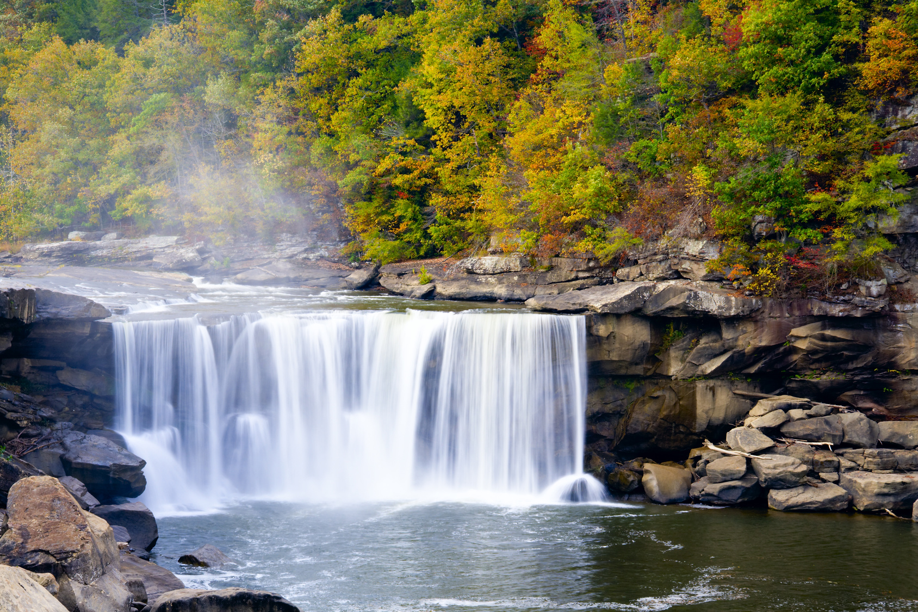
Waters of the United States: The definition was revised and extremely limited in scope during the Trump administration. The CWA now only expressly includes the following as waters of the United States:
The territorial seas, and waters which are currently used, or were used in the past, or may be susceptible to use in interstate or foreign commerce, including waters which are subject to the ebb and flow of the tide;
Tributaries;
Lakes and ponds, and impoundments of jurisdictional waters; and Adjacent wetlands.

Slide 6
The Following Are Not Waters of the United States: Under the revisions, the CWA expressly excludes certain waters and water features from the definition, many of which significantly affect Kentucky:
Waters or water features not listed above;
Groundwater, including groundwater drained through subsurface drainage systems;
Ephemeral features, including ephemeral streams, swales, gullies, rills, and pools (Ephemeral streams are dry stream beds that flow as rivers or streams after periods of rainfall);
Diffuse stormwater run-off and directional sheet flow over upland;
Ditches that are not “waters which are currently used, or were used in the past, or may be susceptible to use in interstate or foreign commerce, including waters which are subject to the ebb and flow of the tide;” Tributaries;
Non-ephemeral wetlands that are adjacent to waters of the United States;
Prior converted cropland;
Artificially irrigated areas, including fields flooded for agricultural production, that would revert to upland should application of irrigation water to that area cease;
Artificial lakes and ponds, including water storage reservoirs and farm, irrigation, stock watering, and log cleaning ponds, constructed or excavated in upland or in non-jurisdictional waters, so long as those artificial lakes and ponds are not impoundments of jurisdictional waters;
Water-filled depressions constructed or excavated in upland or in non-jurisdictional waters incidental to mining or construction activity, and pits excavated in upland or in non-jurisdictional waters for the purpose of obtaining fill, sand, or gravel;
Storm water control features constructed or excavated in upland or in non-jurisdictional waters to convey, treat, infiltrate, or store storm water runoff;
Groundwater recharge, water reuse, and wastewater recycling structures, including detention, retention, and infiltration basins and ponds, constructed or excavated in upland or in non-jurisdictional waters; and
Waste treatment systems.

Slide 7
Permitting Under CWA §404:
Avoidance, Minimization and Compensatory Mitigation
In administering the program, before issuing a permit, the Corps generally applies the following sequentially in the following order:
1) Avoidance means mitigating an aquatic resource impact by selecting the least-damaging project type, spatial location and extent compatible with achieving the purpose of the project. Avoidance is achieved through an analysis of appropriate and practicable alternatives and a consideration of impact footprint.
2) Minimization means mitigating an aquatic resource impact by managing the severity of a project's impact on resources at the selected site. Minimization is achieved through the incorporation of appropriate and practicable design and risk avoidance measures.
3) Compensatory Mitigation means mitigating an aquatic resource impact by replacing or providing substitute aquatic resources for impacts that remain after avoidance and minimization measures have been applied, and is achieved through appropriate and practicable restoration, establishment, enhancement, and/or preservation of aquatic resource functions and services.

Slide 8
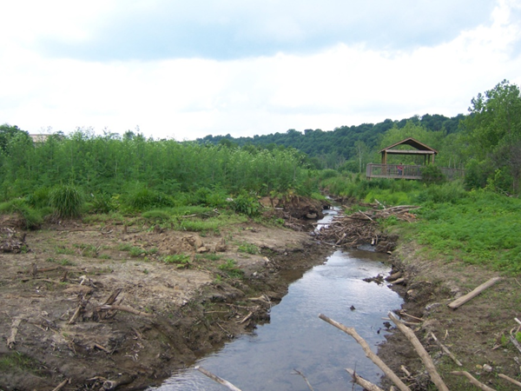
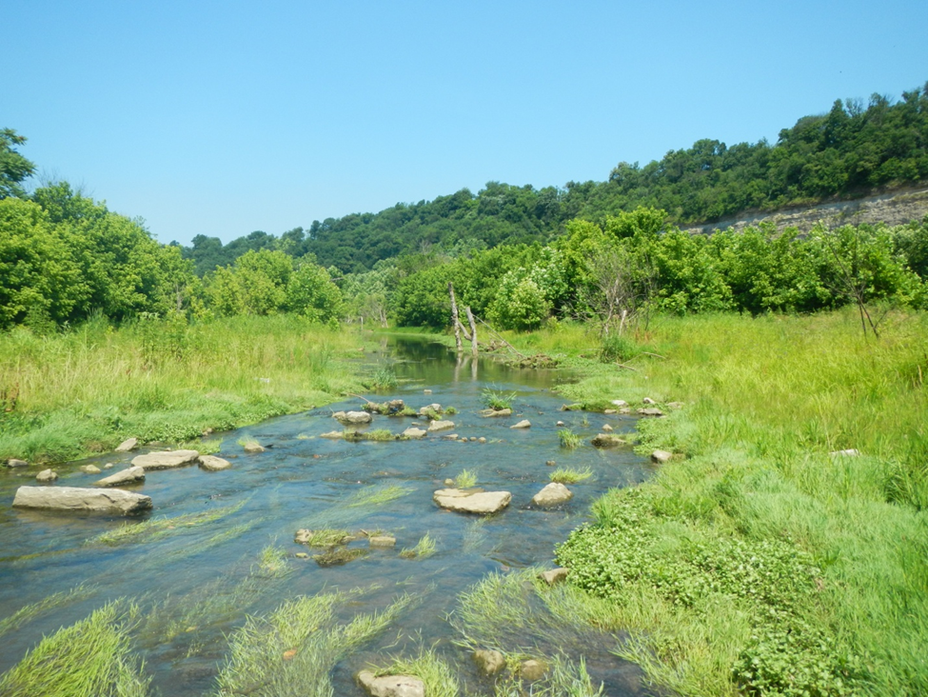
Cove Spring, Franklin Co., Before:
COMPENSATORY MITIGATION
§ 404 of the CWA requires compensatory mitigation for projects that cause unavoidable impacts to streams, wetlands, and other waters of the United States.
Compensatory mitigation is used to offset these unavoidable impacts to the environment. It involves the restoration, establishment, enhancement, and/or preservation of the environment, including threatened or endangered species and/or their habitats.
When a development project occurs the will cause a permanent loss or significant impairment to streams, the Corps requires developers to mitigate the losses of stream and wetland habitat through a permit system. Developers may perform their own mitigation on their own; elect to purchase mitigation credits from a mitigation bank ; or pay fees to a FILO program “in-lieu of” doing mitigation on their own, and the FILO program performs the restoration to create the necessary credits.
The value of these “credits” is determined by quantifying the stream and wetland functions or acres restored or created through a mitigation project
After:

Slide 9
• Restoration: Re-establishment or rehabilitation of a wetland or other aquatic resource with the goal of returning natural or historic functions and characteristics to a former or degraded wetland. Restoration may result in a gain in wetland function or wetland acres, or both.
• Establishment (Creation): The development of a wetland or other aquatic resource where a wetland did not previously exist through manipulation of the physical, chemical and/or biological characteristics of the site. Successful establishment results in a net gain in wetland acres and function.
• Enhancement: Activities conducted within existing wetlands that heighten, intensify, or improve one or more wetland functions. Enhancement is often undertaken for a specific purpose such as to improve water quality, flood water retention or wildlife habitat. Enhancement results in a gain in wetland function, but does not result in a net gain in wetland acres.
• Preservation: The permanent protection of ecologically important wetlands or other aquatic resources through the implementation of appropriate legal and physical mechanisms. Property may be bought in fee by a conservation organization that is a Corps’ approved sponsor or by a designated state agency such as the Kentucky Department of Fish and Wildlife Resources. Alternatively, a property owner may also agree to encumber their property with a conservation easement dedicated to a public agency or conservation organization. Preservation may include protection of upland areas adjacent to wetlands as necessary to ensure protection or enhancement of the aquatic ecosystem. Preservation does not result in a net gain of wetland acres and may only be used in certain circumstances, including when the resources to be preserved contribute significantly to the ecological sustainability of the watershed.

Slide 10
MECHANISMS FOR COMPENSATORY MITIGATION
When wetland impacts are unavoidable, compensatory mitigation may be accomplished through three mechanisms created under the rule.
Permittee-responsible mitigation (PRM), where the mitigation can is performed by the permittee and the permittee maintains liability for the construction and long-term success of the site.
Mitigation banking; and
In-lieu fee programs
Mitigation banking and In-lieu fee programs are forms of "third party" compensation where the responsibility for site selection and construction is transferred to the mitigation bank or in-lieu fee sponsor.

Slide 11
2008 CWA AMENDMENTS ESTABLISH PREFERENTIAL ORDER
Following amendments to the CWA is 2008 , federal rules establish a hierarchal preference for mitigation:
(1) When a mitigation bank in good standing exists within a service area, permit applicants are directed to use mitigation banks;
(2) When there is no established mitigation bank in good standing within a service area, permit applicants are directed to use in-lieu fee programs; and/or
Permit applicants may do their own mitigation when there is no bank available.

Slide 12
Permittee-Responsible Mitigation
Restoration, establishment, enhancement or preservation of wetlands undertaken by a permittee in order to compensate for wetland impacts resulting from a specific project.
The permittee performs the mitigation after the permit is issued and is ultimately responsible for implementation and success of the mitigation.
Permittee-responsible mitigation may occur at the site of the permitted impacts or at an off-site location within the same watershed.

Slide 13
Mitigation Banking
A wetland mitigation bank is a wetland area that has been restored, established, enhanced, or preserved, which is then set aside to compensate for future conversions of wetlands for development activities.
A stream mitigation bank is a segment of a stream that’s been improved to benefit the watershed. Improvements include reshaping slopes for stabilization, adding in-stream structures or removing dams and other obstructions.
Mitigation banks create and develop credits prior to impact
Permittees, upon approval of regulatory agencies, can purchase credits from a mitigation bank to meet their requirements for compensatory mitigation.
The value of these “credits” is determined by quantifying the stream/wetland functions or acres restored or created.
The bank sponsor is ultimately responsible for the success of the project.
Mitigation banking is performed "off-site," meaning it is at a location not on or immediately adjacent to the site of impacts, but within the same watershed.

Slide 14
MITIGATION PLAN/SITE PROTECTION INSTRUMENT
Each site must have a mitigation plan between the bank sponsor and the Corps. which details the number of credits the bank can generate, and the types of habitat the mitigation bank intends to create, restore, or enhance.
The agreement also includes a site protection instrument, baseline information, a Work Plan, Maintenance plan, performance standards, monitoring requirements, financial assurances, site selection factors, credit determination, a long-term management plan, and an adaptive management plan.
The mitigation plan must specify parameters to be monitored, length of the monitoring period, the party responsible for monitoring, and the content of the monitoring reports.
The agreement’s site protection instrument establishes the mechanism that ensures the mitigation area will be utilized and will retain its function as a natural conservation area in perpetuity.
The SPI imposes conditions which significantly restricts the long term use of the site which often limits or prohibits future development.

Slide 15
IN- LIEU FEE PROGRAMS
An ILF program sponsor (usually a public agency of a non-profit conservation group) conducts wetland, stream, or threatened or endangered species habitat restoration, creation, enhancement, or preservation activities after receiving funds from a permittee.
The ILF sponsor is responsible for the success of the mitigation. Like banking, in-lieu fee mitigation is also "off-site," but unlike mitigation banking, it typically occurs after the permitted impacts have occurred. Key distinction is that banks operate pre-impact and hold credits until needed while an ILF is designed to accept funds and perform mitigation after a permit is issued.
Unlike banks, ILFs may perform various environmental enhancement activities throughout a watershed rather than at one particular site.
Funds collected by the FILO program is restricted by federal rules and use/expenditures are subject to Corps of Engineers approval. FILO funds are used to acquire mitigation properties and used to design, construct, monitor, and manage mitigation/restoration projects, which compensates for permanent loss of streams and wetlands caused by the permit applicants’ development.

Slide 16
There are six basic characteristics associated with FILO Programs:
In-lieu fee program instrument- An ILF program instrument is “the legal document for the establishment, operation, and use of an in lieu fee program.” 33 C.F.R. § 332.2. The instrument must include: 1. Service area(s) 2. Accounting procedures 3. Assumption of legal responsibility 4. Default and closure provisions 5. Reporting protocols ▪ Plus 4 additional elements 6. Compensation planning framework 7. Specification of initial allocation of advance credits 8. Methodology for determining project-specific credits and fees 9. Description of ILF program account.
Review by interagency review team- An Interagency Review Team (IRT) is “an interagency group of federal, tribal, state, and/or local regulatory and resource agency representatives that reviews documentation for, and advises the district engineer on, the establishment and management of a mitigation bank or an in-lieu fee program.” 33 C.F.R. § 332.2;
Geographic service area(s) - A service area is “the geographic area within which impacts can be mitigated at a specific mitigation bank or an in-lieu fee program, as designated in its instrument.” 33 C.F.R. § 332.2 It is also defined as “the watershed, ecoregion, physiographic province and/or other geographic area within which the... in-lieu fee program is authorized to provide compensatory mitigation required by DA permits.” 33 C.F.R. § 332.8(d) (6) (ii) (A);

Slide 17
  Compensation planning framework- A compensation planning framework is a plan, included in the ILF program instrument that is used “to select, secure, and implement aquatic resource restoration, establishment, enhancement, and/or preservation activities.” The framework must “support a watershed approach to compensatory mitigation,” and all of the compensation projects proposed by the in-lieu fee program must be consistent with the approved framework. 33 C.F.R. §§ 332.2, 332.8(c) (1);
  In-lieu fee program account- An ILF program account is an account established by the program sponsor to track the fees accepted and disbursed. The account must track funds accepted from permittees separately from those accepted from other entities and for other purposes (e.g., fees arising out of an enforcement action, “such as supplemental environmental projects”). 33 C.F.R. §§ 332.2, 332.8(i); and
  Allocation of advance credits-Advance credits are “any credits of an approved in-lieu fee program that are available for sale prior to being fulfilled in accordance with an approved mitigation project plan. Advance credit sales require an approved in-lieu fee program instrument that meets all applicable requirements including a specific allocation of advance credits, by service area where applicable. The instrument must also contain a schedule for fulfillment of advance credit sales.” 33 C.F.R. § 332.2.

Slide 18
ILF Program Advance Credits
In order to generate and deliver advanced credits:
  Approved instrument required.
  A cap on advanced credits per each service area.
  # advance credits based on:
  ► Compensation planning framework.
  ► Sponsor’s past performance/qualifications.
  ► Financing needed for mitigation implementation.
  As projects produce released credits, advance credits are fulfilled and available again.
  Land acquisition and ecological improvements must be initiated by the 3rd growing season after first advance credit is acquired. However, once a project is approved by the Corps and sponsor is obligated, the 3 year responsibility may extended upon a request and Corps approval.

Slide 19
KEY Differences Between Banks & ILF’s
In-lieu Fee Program:
► Government or non-profit conservation organization.
► Fees often received before mitigation construction.
► Property is suitable for public use due to SPI restrictions.
► Fee rates set according to costs incurred.
► Sites can be specific or throughout a watershed.
►Temporal lag between money taken in a credit produced, although § 404 permit has been issued.
Mitigation Banks:
► Public or Private sponsor.
► Site secured & project initiated in advance of credits.
► Fee Rates unlimited.
► Banks are often site specific.
► Development driven.

Slide 20
Contracting: Design-Bid-Build & Design-Build
      Process where In-Lieu Fee Program (ILF) identifies a site for compensatory mitigation, acquires ownership interest in property (fee simple or easement), contracts for the design and construction management of the project (restoration). This process involves multiple contracts with several companies throughout for project components such as acquisition, design, construction, and monitoring. This methodology creates multiple job opportunities for a variety of companies.
Pros:
ILF controls each phase of project decisions, minimizing risk and maximizing quality along the way.
More flexibility to identify and complete very small, complex, or demonstration projects as needed.
Property remains in public ownership.
Jobs are created by using a variety of companies and local labor can be a component of RFP.
ILF has discretion to find larger and more ecological important sites and sites that can expand or create WMAs.
Utilize ILF staff with unique and highly-specialized skills directly related to the biology, natural resources, and ecological needs of a project, especially with regard to the regulatory mitigation process.
Cons:
ILF is responsible for all aspects of the projects, including designer/contractor error, repairs, and credit delivery.
Government procurement systems may slow the process.
Contract management as there are multiple contracts per project with multiple vendors (HOWEVER this also creates more jobs).
Coordination of contract activates between ILF and vendor.
Little cost certainty. Increased chance that cost of credit delivery will exceed the fee.

Slide 21
Full Delivery
Process where ILF contracts for delivery of mitigation credits from a mitigation provider through a Request for Proposal. The mitigation provider identifies a compensatory mitigation site(s) and provides a technical proposal to deliver mitigation credits to the ILF. Sites are ranked technically, and proposals are evaluated on cost and ecological importance. The mitigation provider develops compensatory mitigation site and delivers mitigation credits to the ILF. Property ownership remains in a 3rd party.
Pros:
Mitigation provider delivers compensatory mitigation credits or does not receive payment.
Ease of contract administration as only one contract for delivery of mitigation credits to one entity.
Based on RFP can produce larger sites.
Cost certainty at time of contracting.
Credits can be delivered quicker than design-build.
Ability to procure multiple projects at one time to meet credit demand.
Greatly reduced administrative time and dependence on multiple companies (However less jobs).
Cons:
Contract bidding and modifications can be cumbersome dependent upon state procurement guidelines.
Government procurement systems.
Use of property extremely restricted and limited opportunity for public use.
Potential for less jobs as multiple companies are not used as project delivered by 1 company.
ILF personnel’s experience limited as ILF personnel is mainly contract management.

Slide 22
KENTUCKY STATE PROCUREMENT
As interpreted and applied by Finance Cabinet/DECA, under KRS CHAPTERS 45 and 45A, we have been advised, the state cannot have a property interest in full delivery contracts because having such interest would classify the contract as capital construction.
This becomes problematic for vendors and limits the pool of vendors. It also shapes the request and determination of property selection because the state will not own the property.
As a result, all full delivery contracts require vendors to identify non-state agency third party holders and must seek approval from the state and the Corps on the third party holder and property protection mechanisms.

Slide 23
FILO PROGRAM UNDER KRS 150
Following the passage of KRS 150.255, the FILO (fees-in-lieu-of) program has operated since 2002 under the authority of the Corps of Engineers pursuant to the Federal Clean Water Act and associated federal regulations (CFR Vol. 73 No. 70, p 19670-19705; 33 U.S.C. 401 et seq.; 33 U.S.C. 1344; and Pub. L. 108-136), and state statute (KRS 150.255).

Slide 24
^{MISSI}
Upon request of any state agency or any other entity, the department may contract with the agency or party to undertake any compensatory mitigation project, including, but not limited to, wetland or stream mitigation.
(2) The department may establish and manage wetland or stream compensatory mitigation banks, the purpose of which shall be to restore, create, or enhance wetlands and streams as compensatory mitigation where a state agency or other party is required to provide compensatory mitigation, and where the use of banked mitigation is approved by the agency requiring mitigation. The department may create the bank in advance of requests for banked mitigation credits.
(3) There is established and created in the State Treasury the "Kentucky Wetland and Stream Mitigation Fund" for the purpose of restoring, creating, enhancing, or preserving the Commonwealth's wetlands or streams that may be damaged or destroyed due to any project, recovering costs associated with performing these projects, and administering these programs. The fund shall be deemed a trust and agency fund account and made available solely for the purposes and benefits of the Kentucky wetland and stream mitigation projects. The fund may receive state appropriations, gifts, grants, federal funds, revolving funds, and any other funds both public and private. Money deposited in the fund shall be disbursed by the State Treasurer upon the request of the commissioner with the approval of the commission. Any unallocated or unencumbered balance in the fund shall be invested as provided in KRS 42.500(9), and any income earned from the investments, along with the unallocated or unencumbered balance in the fund, shall not lapse
Conserve, protect and enhance Kentucky’s fish and wildlife resources and provide outstanding opportunities for fishing, hunting, trapping, boating, shooting sports, wildlife viewing, and related activities
150.255 Wetland or stream compensatory mitigation projects -- Mitigation fund -- Purposes.

Slide 25
When KRS 150.255 was passed in 2000, it was created to vest the KDFWR with the discretion and control of the program and oversight of the funds because of the Department’s expertise as a conservation agency and its history of being fiscally responsible with public resources.
The Wetland and Stream Mitigation Fund was designated as a “trust and agency” fund to ensure that monies in the fund would be utilized for stream and wetland restoration, enhancement and preservation. Mitigation fund receives monies from land development projects causing the permanent loss of streams and wetlands.
No KDFWR license dollars or state tax dollars are used to fund the program.
In addition to creating an avenue to restore streams and wetlands, the statute also created a mechanism to provide the KDFWR with funds to acquire land that could be made available for hunting, fishing and other outdoor recreational opportunities after the mitigation project was completed.

Slide 26
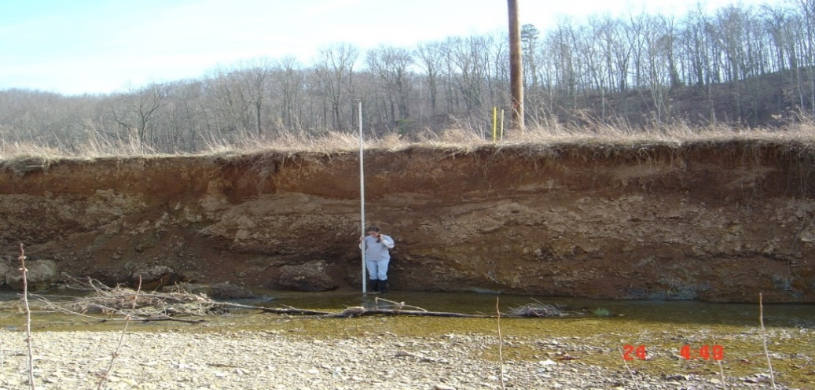
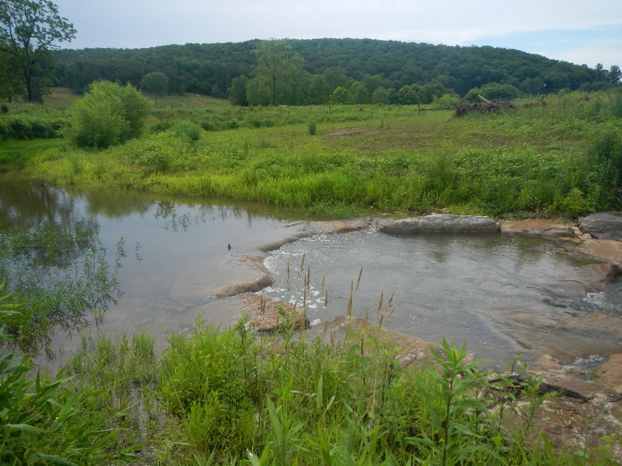
Kentucky Wetland and Stream Mitigation Fund
Fees In-Lieu-of Mitigation (FILO) Program
To date, the department has improved and protected more than 130 miles of headwater streams and 39 acres of wetland habitat through its FILO program.
The program has mitigation projects covering more than 1.5-million feet of streams and 375 acres of wetlands in 48 counties in various phases of restoration.
  Among these projects, 47 have been constructed, five are under construction, 17 are in the design phase, and another 13 are new projects in the initial stage of securing easements or acquiring property for stream restoration.
Before: Severe Stream Bank Erosion, Water Pollution
After: Stable Banks, Improved Water Quality and Habitats

Slide 27
FILO Contract and Expenditure History
152 capital accounts
FILO projects have an economic stimulus component for a wide variety of Kentucky companies: 141 companies including 24 legal and title firms, appraisers, environmental consultants, surveyors, 31 design engineering firms, 23 construction companies, quarries, and numerous others vendors and small purchase suppliers have been used on various phases of mitigation projects.
$87Million spent on projects

Slide 28
IMPORTANCE & BENEFITS OF FILO PROJECTS
The FILO program is beneficial for development, conservation, and regulatory interests. Through the utilization of FILO, development can occur and continue while it is ensured that environmental impacts are compensated for and there is no net loss of aquatic resources. This process does not delay the issuance of a 404 permit.
Projects are delivered using both the design-build methodology as well as a full-service delivery method.
Developers benefit from using FILO by cutting Corps’ permit approval time and being relieved of complex, lengthy mitigation requirements. Conservation interests use the funds for habitat improvement. Regulatory actions are streamlined and assurances are gained and protected.
In addition to restoring streams, FILO construction projects also create KENTUCKY jobs by utilizing surveyors, engineering design firms, construction companies, contractors and other professions.
In 2020 alone, 20 development projects in 13 counties used FILO services, purchasing $9M in mitigation credits to help get their development projects started. Since 2018, developers have purchased over $65M in mitigation credits from the FILO program to help obtain Corps’ permits for projects including the large airport expansion in Northern Kentucky which has lead to credits in that service area being sold out.

Slide 29
FILO BENEFITS COMPLIMENT AND SUPPORT THE MISSION OF THE KDFWR
KDFWR FILO design-build projects allow the KDFWR to purchase easements and properties which can create hunting/fishing/hiking/biking/boating/bird watching opportunities.
  Property acquired provides added access to outdoors-people at no cost of general fund or license dollars.
  Acquired lands can be used as or to add to existing WMAs. To date FILO has acquired 6,300+ acres.
Banking and the full-delivery model under existing statutory interpretation keeps land in private ownership but with significant, binding restrictions which drastically limit the future use of the property.
KDFWR FILO mitigation projects create hunting and fishing opportunities in addition to achieving and accomplishing mitigation, and also create job opportunities for a wide variety of Kentucky companies.

Slide 30
Fish & Wildlife Recreation
A Vital Force for Kentucky’s Economy
Big Business in the Bluegrass State
$5.9 Billion in total economic impact
70,000 jobs supported
1.5 Million + participants
Kentucky tourism is an $11.8 billion industry
ILF Mitigation is a business which contributes to and supplements a larger business

Slide 31
Fish and Wildlife Recreation
A Vital Force for Kentucky’s Economy
Tax Revenues from Participant Expenditures in Kentucky
Local & State - $344 Million/year
Federal - $373 Million/year
Millions of dollars

Slide 32
$182/acre/year for total economic benefit from hunting, fishing, wildlife watching and outdoor recreation.
---FILO Program funded Properties---
  Veterans Memorial WMA 51% FILO funds acquired and graveled the road, installed culverts.
  Clay WMA: added over 800 acres to the WMA and Licking River frontage.
  FILO Claysville project on the Licking River acquired by KSNPC using FILO project as match, helping federally listed species.
  Ed Mabry-Laurel Gorge WMA over 1,400 acres and 6 + miles of trout stream.
  Ping-Sinking Valley WMA 804 acres.
  Buck Creek WMA 859 acres- acquired by FILO in a watershed identified in KDFWR’s SWG plan as important for mussel conservation.
  Ross creek project Lee/Estill Counties: acquired nearly 1,000 acres with Kentucky River frontage near lock and dam #13 for a large project that will open to the public when completed.
  Rich WMA: KDFWR added 601 acres to this WMA using FILO as the match without any license dollars.

Slide 33
INCIDENTAL BENEFITS TO THE KDFWR and KENTUCKY
DUE TO THE FUND BEING CREATED BY KRS 150.255
In addition to FILO funds being used in mitigation projects, FILO funds can and have been used as non-federal match conserving Sportsmen’s dollars, and in addition, leverages federal dollars into Kentucky without requiring the expenditure of any fish and game funds, license dollars, state general funds or any other contribution from local governments.
Dating back to the beginnings of the program, FILO dollars were also used as the non-federal match for US EPA 319 watershed planning and implementation grants.

Slide 34

Pittman-Robertson Act:
Wildlife Restoration Grants
Federal Excise Taxes

Slide 35
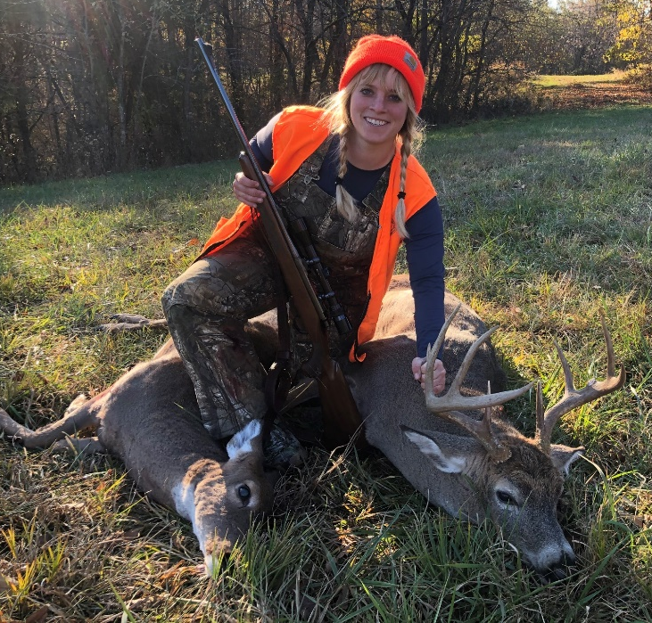
Wildlife Restoration Grants
Grants can be used for:
  Species management
  Population surveys
  Species research
  Hunter education
  Public land acquisition
  Habitat enhancement
  Shooting ranges

Slide 36
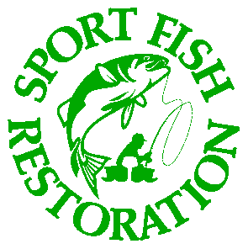
Dingell-Johnson Act:
Sport Fish Restoration Grants
Excise Taxes

Slide 37
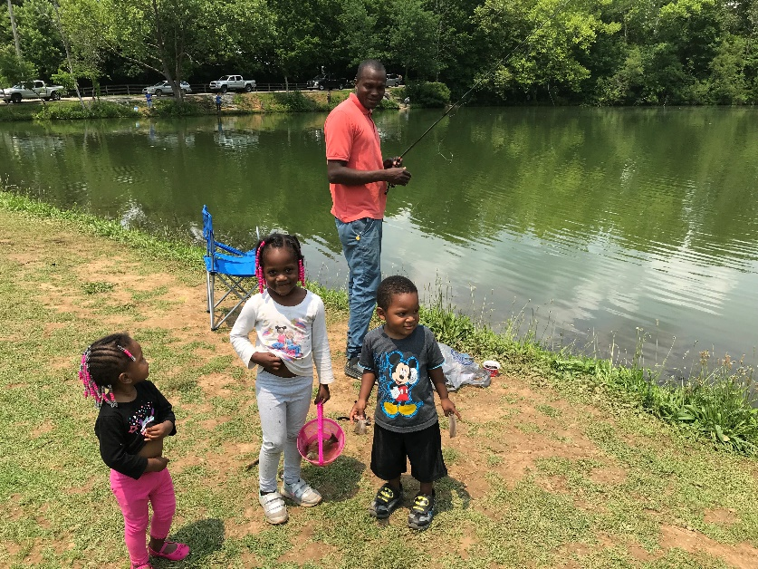
Sport Fish Restoration Grants
Grants can be used for:
  Fish research
  Fish management
  Habitat improvement
  Education programs
  Boating/fishing access sites
  Hatcheries

Slide 38
Recovering America’s Wildlife Act (H.R. 2773/ S. 2372)
Fund conservation efforts for more than 12,000 species of wildlife and plants in need of assistance by providing $1.3 billion in dedicated annual funding for proactive, on-the-ground efforts across the country.
Provide Tribal nations $97.5 million annually to fund proactive wildlife conservation efforts on roughly 140 million acres of land.
Ensure wildlife recovery efforts will be guided by the Congressionally-mandated State Wildlife Action Plans, which identify specific strategies to restore the populations of species of greatest conservation need.
Accelerate the recovery of 1,600 U.S. species already listed as threatened or endangered under the Endangered Species Act.
Include improvements to ensure funds are appropriately targeted to the areas of greatest need and facilitate additional investments in protecting at-risk plant species.
In the Senate, RAWA also directs fees and penalties assessed for environmental violations to help fund RAWA, using fee and penalty amounts that aren’t already targeted for existing environmental funds.

Slide 39
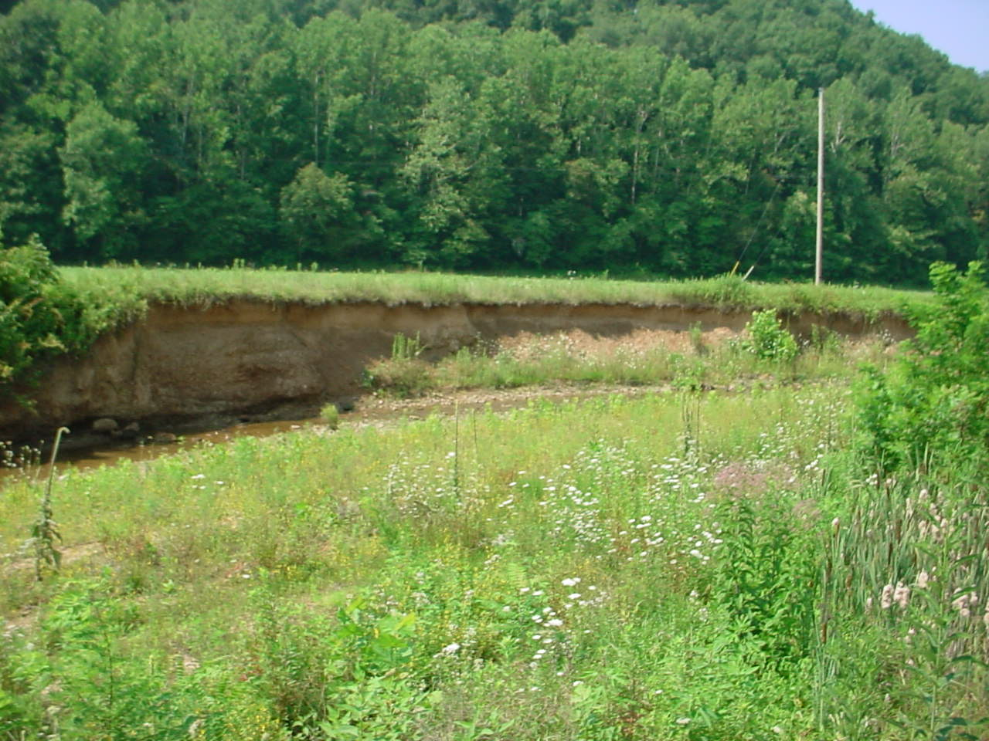

WHAT TYPES OF MITIGATION PROJECTS ARE DONE
      A leading cause of impairment to Kentucky waters comes from physical sources such as sedimentation and siltation from erosion of stream banks and drainage or run-off from other non- point sources such as agriculture, industry, mining and logging.
        Threatens downstream fisheries
        Suppresses fish reproduction
        Smothers invertebrates and fish eggs
        Fills small spaces in substrate reducing water quality functions
        Siltation adds excessive nutrients causing water quality impairment, contributes to HAB’s
        Fills in downstream lakes, streams, rivers
By selling mitigation credits, KDFWR is obligated by the Corps to implement mitigation projects that will fulfill an equal number of credits sold. Within 3 years from the time of sale, the program must begin initial biological improvements on projects, unless the Corps grants more time.
The program collects funds, then uses the funds to undertake mitigation projects in the same service area.
FILO projects address this major state issue by rehabilitating, redesigning and repairing streams and streambanks.
The FILO program has over 900,000 linear feet (170 miles) of stream projects across the state in various stages of development.
Severe erosion, no instream or riparian zone habitat

Slide 40
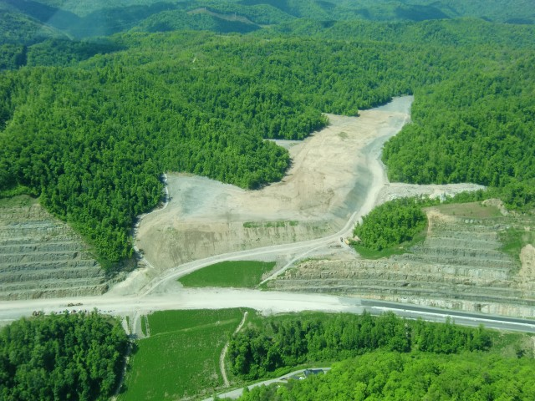
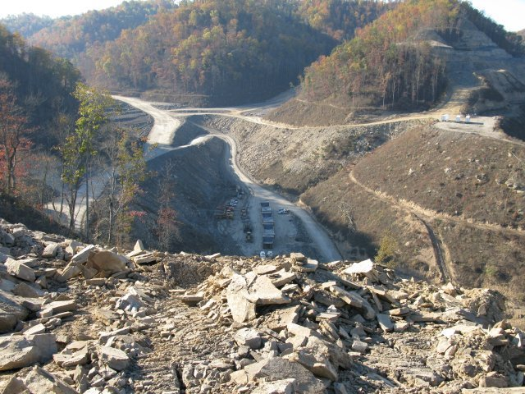
EXAMPLE OF AN IMPACT REQUIRING MITIGATION
The project on this slide is construction on US460 in Pike County. The spoil from the cut was placed in the valley causing the loss of streams which required mitigation. KYTC has utilized the program extensively, making up approximately 51% of fees paid since inception.

Slide 41
Permanent protection on a site is required of mitigation project either through a fee purchase or conservation easement.

Slide 42
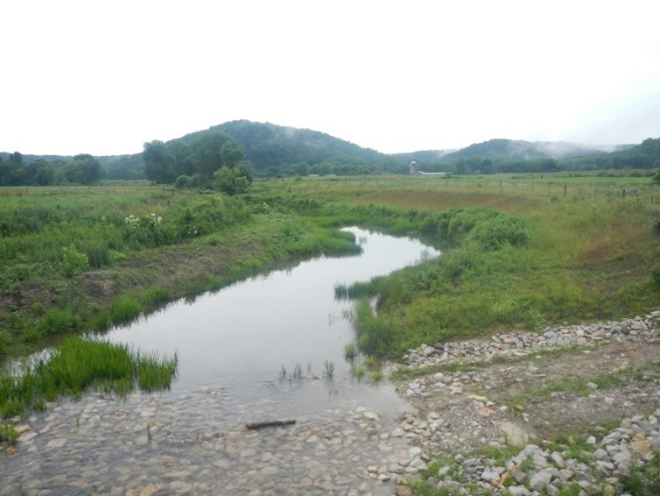
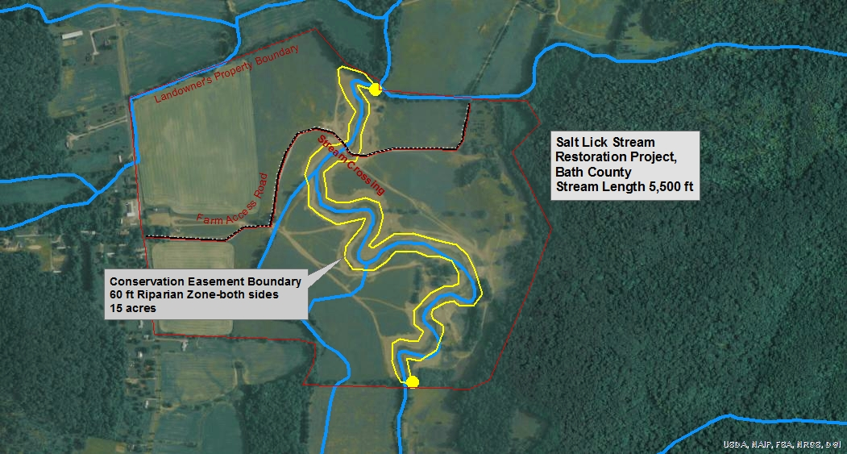
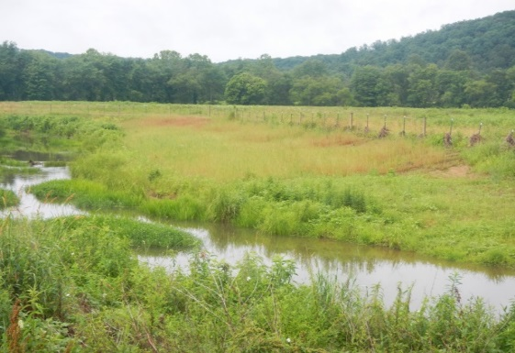
Permanent Protection:
Easements (private lands)
Project funded stream xing for landowner

Slide 43
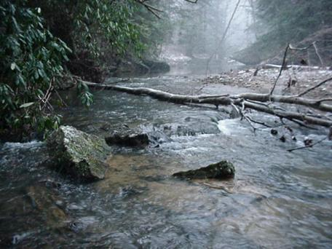
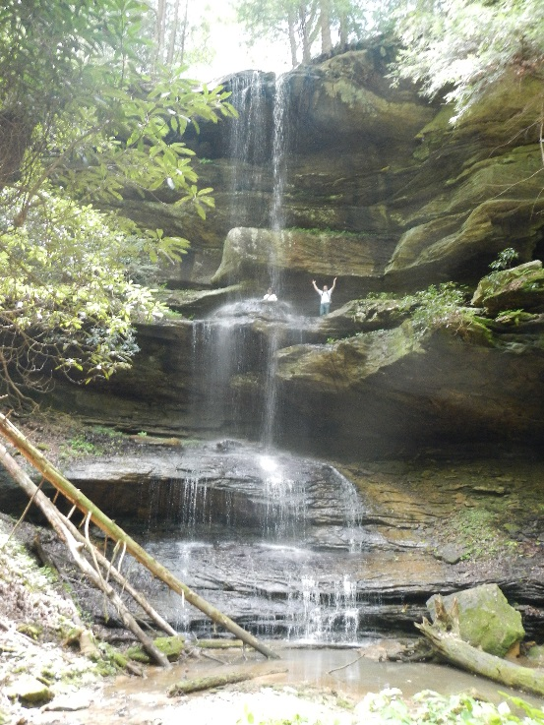

Preserving Exceptional Streams
6 Miles of Trout Stream Acquired

Slide 44
Permanent Protection: Fee Purchase
Mitigation Buffer: purchase better than easement:
-Landowner interest
-Small Headwater mitigation

Slide 45
2020-21 PROPERTY ACQUISITIONS

Slide 46
PROPERTY Purchased in Fee
PRICE ACRES
Anderson (Boone) $589,003.06 165.683
LIM (Boone) $1,347,970.50 299.549
COX (Graves) $61,210.49 40.270
HG Lands (Morgan) $442,310.25 520.365
WALDEN-FERGUSON (Monroe) $72,882.00 40.490
WALDEN TRUST (Monroe) $1,022,364.00 567.98
EDINGTON DUNCAN (Lewis) $78,577.50 104.77
EDINGTON TRENT (Lewis) $434,469.75 445.61
MOREHEAD STATE (Rowan) $398,694.80 142.391
Marbut-Weaver/Little Sexton (Clay &Jackson) $1,076,154.96 1,112.88
Reneau/Crow Creek (Clinton/Cumberland) $ 1,220,758.00 871.97
Whites Creek-(Boyd) $56,320 39.52
York-(Elliott) $67,989.40) 46
TOTAL: $6,887, 704.71 4,397.41

Slide 47
Land under contract pending title work and corrective actions
Embry Gabbard-Butler $2100/acre ($94,500) +/- 45
S&W Gabbard-Butler $1900/acre ($1,449,293.40) +/- 762.786
Hall Mart Whitt-Elliott $1,055/acre ($237,375) +/- 225
Dinsmore (Boone Co.) $3448/acre ($99,992) +/- 29
Boone Conservancy (Boone) $3000/acre ($150,000) +/- 50
Middle Creek Park (Boone ) $3,291/acre ($263,280) +/- 80
Stites $3200/acre ($320,000) +/- 100
Massey (Warren) $1645 ($1,438,000) +/-874
Morgan County ( 2 parcels) (1) $1550/acre ($119,350) +/-77
(2) DONATION +/- 245 acres
Singleton Bender Hollow-Lincoln $1,186/acre ($185,016) +/- 156 acres
Singleton 72 $ 771.00 ($55,512.00) +/1 72
Broke Leg DONATION +/- 245 acres
Wolf (Jefferson) DONATION Stream restoration
TOTAL $ 4,412,318.40 +/2,940 acres

Slide 48
INITIAL TITLE Work being performed prior to land contract ACRES
Boone Co. Extension 20
YMCA Gunpowder 30
Boone Co. Gunpowder 40
Browne Gunpowder 50
Benton Tributary 40
Ross Creek 4 25
Ross Creek 5 26
Ross Creek 6 374
Perin/Helmer 675
St. Anne 15
Robinson 5
Mill Creek (Louisville) 200
Total 1,500

Slide 49
FUNDING

Slide 50
FUNDING
The FILO program operates solely from funds collected from sales of mitigation credits to Corps permit applicants. The program does not operate off current-year receipts, as do many state tax funded programs. Instead, the program operates in arrears, collecting funds through mitigation credit sales first and spending funds to identify and construct stream and wetland mitigation projects in the future.
As FILO receipts increase in volume, the program must respond proportionately both operationally and in the number of projects undertaken. The amount of funds and their geographic origin dictates 1) the level of effort needed to operate the program, 2) the amount of funding available for projects, and 3) the geographic area in the state where projects must be developed.
The Corps has authority over the use and expenditures of FILO funds.
Dollars spent on Property Acquisition is the first major component of a FILO project. In addition to the purchase price, a site protection instrument must be developed which permanently protects the mitigation work which is then followed by design and construction. After construction, the site must be monitored and maintained in accordance with site protection instrument. Which causes the project to be paid out of a period of years,, or the length of the project.

Slide 51
BALANCE OF ADVANCE CREDITS to SELL
DEVELOPERS PURCHASE ADVANCE CREDITS
ADVANCE CREDIT BALANCE REDUCED
MITIGATION PROJECTS COMPLETED
ADVANCE CREDITS ADDED BACK TO BALANCE
FILO Credit Accounting:
Revolving Credit Cycle

Slide 52
Most of the project funds are allocated to mitigation projects in progress. It is important to understand that the entire amount of the FILO cash balance is NOT available or intended to cover only projects.
A portion of FILO funds are required to operate the program and to provide financial assurances and contingency funds to assure regulatory agencies that, “promises made are promises kept.”
Current 134s account consists of the following elements:
  FILO Administrative funds
  $3Million non-wasting (prescribed by instrument)
  Long-term management funds
  Financial Assurances for projects
  Full Delivery project estimates (~$18Million)
  Reserve funds not assigned to projects
  Unbudgeted (but obligated) project funds
  Available project funds
As of FY 2022, the FILO Fund is $166,333,617.98, HOWEVER ~85% of this amount is allocated to current and on-going obligated projects.
$ 18,855,156.68 of 134s is the sum of all funds from all service areas (stream and wetland) with past-due obligations.

Slide 53
The unallocated funds shown in the pie chart represent the current outstanding obligation to the Corps of Engineers for existing approved projects; that is, funds not allocated to projects. These funds CANNOT be redirected without Corps approval
The unallocated funds will pay for individual stream and wetland mitigation projects in fulfillment of the obligation and projects are identified and become available as needed.
There are 3 main categories, or ‘buckets,’ that the FILO funds go into: the administrative, reserve, and service areas (11 service areas). Each service area is divided into Stream and Wetland. Service area funds are not mixed.

Slide 54
In-lieu Fee Fund Receipt Summary (CY2021)
Service Area | Ending CY2020 Balance (collected serv area funds) | CY2021 Credit Sales Receipts | CY2021 Reserve(10%) | CY2021 Admin (15%) | CY2021 Admin (10%) | Stream | Wetland | Collected (since transition) Service Area Balance
Upper Kentucky River | $ 19,060,863.58 | $ 3,205,155.00 | $ 320,515.50 | $ - | $ 320,515.50 | $ 20,629,474.18 | $ 995,513.40 | $ 21,624,988
Lower Kentucky River | $ 6,239,044.92 | $ - | $ - | $ - | $ - | $ 5,768,096.52 | $ 470,948.40 | $ 6,239,045
Big Sandy River | $ 18,749,173.09 | $ - | $ - | $ - | $ - | $ 18,597,031.99 | $ 152,141.10 | $ 18,749,173
Upper Cumberland River | $ 7,864,658.33 | $ 52,272.00 | $ 5,227.20 | $ - | $ 5,227.20 | $ 7,314,583.22 | $ 591,892.71 | $ 7,906,476
Lower Cumberland River | $ 13,281,314.40 | $ 1,899,040.00 | $ 189,904.00 | $ - | $ 189,904.00 | $ 14,139,603.84 | $ 660,942.56 | $ 14,800,546
Green/Tradewater Rivers | $ 12,483,251.38 | $ 2,414,250.00 | $ 241,425.00 | $ - | $ 241,425.00 | $ 12,396,102.46 | $ 2,018,548.92 | $ 14,414,651
Jackson Purchase | $ 936,130.51 | $ 2,688,675.00 | $ 268,867.50 | $ - | $ 268,867.50 | $ 2,603,281.51 | $ 483,789.00 | $ 3,087,071
Salt River | $ 31,215,204.81 | $ 2,146,350.00 | $ 214,635.00 | $ - | $ 214,635.00 | $ 29,594,282.46 | $ 3,338,002.35 | $ 32,932,285
Upper Licking River | $ 7,900,226.35 | $ - | $ - | $ - | $ - | $ 7,411,342.75 | $ 488,883.60 | $ 7,900,226
Lower Licking River | $ 8,298,972.52 | $ 123,000.00 | $ 12,300.00 | $ - | $ 12,300.00 | $ 8,213,553.52 | $ 183,819.00 | $ 8,397,373
NKY | $ 30,217,209.50 | $ 86,100.00 | $ 8,610.00 | $ 12,915.00 | $ - | $ 28,974,984.50 | $ 1,306,800.00 | $ 30,281,785
Totals | $ 156,246,049.38 | $ 12,614,842.00 | $ 1,261,484.20 | $ 12,915.00 | $ 1,252,874.20 | $ 155,642,336.94 | $ 10,691,281.04 | $ 166,333,617.98
In-lieu Fee Fund Receipt Summary (CY2021)
Service Area | Ending CY2020 (collected service area funds) | CY2021 Credit Sales Receipts | CY2021 Reserve(10%) | CY2021 Admin (15%) | CY2021 Admin (10%) | Stream | Wetland | Collected (since transition) Service Area
Upper Kentucky River | $ 19,060,863.58 | $ 3,205,155.00 | $ 320,515.50 | $ - | $ 320,515.50 | $ 20,629,474.18 | $ 995,513.40 | $ 21,624,988
Lower Kentucky River | $ 6,239,044.92 | $ - | $ - | $ - | $ - | $ 5,768,096.52 | $ 470,948.40 | $ 6,239,045
Big Sandy River | $ 18,749,173.09 | $ - | $ - | $ - | $ - | $ 18,597,031.99 | $ 152,141.10 | $ 18,749,173
Upper Cumberland River | $ 7,864,658.33 | $ 52,272.00 | $ 5,227.20 | $ - | $ 5,227.20 | $ 7,314,583.22 | $ 591,892.71 | $ 7,906,476
Lower Cumberland River | $ 13,281,314.40 | $ 1,899,040.00 | $ 189,904.00 | $ - | $ 189,904.00 | $ 14,139,603.84 | $ 660,942.56 | $ 14,800,546
Green/Tradewater Rivers | $ 12,483,251.38 | $ 2,414,250.00 | $ 241,425.00 | $ - | $ 241,425.00 | $ 12,396,102.46 | $ 2,018,548.92 | $ 14,414,651
Jackson Purchase | $ 936,130.51 | $ 2,688,675.00 | $ 268,867.50 | $ - | $ 268,867.50 | $ 2,603,281.51 | $ 483,789.00 | $ 3,087,071
Salt River | $ 31,215,204.81 | $ 2,146,350.00 | $ 214,635.00 | $ - | $ 214,635.00 | $ 29,594,282.46 | $ 3,338,002.35 | $ 32,932,285
Upper Licking River | $ 7,900,226.35 | $ - | $ - | $ - | $ - | $ 7,411,342.75 | $ 488,883.60 | $ 7,900,226
Lower Licking River | $ 8,298,972.52 | $ 123,000.00 | $ 12,300.00 | $ - | $ 12,300.00 | $ 8,213,553.52 | $ 183,819.00 | $ 8,397,373
NKY | $ 30,217,209.50 | $ 86,100.00 | $ 8,610.00 | $ 12,915.00 | $ - | $ 28,974,984.50 | $ 1,306,800.00 | $ 30,281,785
Totals | $ 156,246,049.38 | $ 12,614,842.00 | $ 1,261,484.20 | $ 12,915.00 | $ 1,252,874.20 | $ 155,642,336.94 | $ 10,691,281.04 | $ 166,333,617.98

Slide 55
Fund | Fund Name | County | Project Estimate
Active Accounts
C1KU | FILO - TRAMMEL CREEK-ALLEN COUNTY | Allen | $ 862,500
C3GN | FILO - SLABCAMP/STONECOAL BRANCH | Rowan | $ 1,905,000
C3Y6/C6CD | HARRISON FORK PROJECT (Bernheim Forest) | Nelson | $ 1,700,000
C40J | FILO - MILL CREEK | Fayette | $ 187,050
C40K | FILO - OBION CREEK II | Hickman | $ 781,000
C40N | FILO - EAST FORK INDIAN RIVER | Menifee | $ 1,192,910
C4TR | FILO - SALT LICK | Bath | $ 1,647,800
C4TS | FILO - BOLTS FORK | Boyd | $ 1,212,900
C5EF | FILO - HATCHERY CREEK | Russell | $ 2,200,000
C5EG | FILO - ELM FORK | Owen | $ 1,468,000
C5UA | FILO - EAGLE CREEK TRIBUTARY | Union | $ 1,529,290
C5XD | FILO - ROGERS GAP | Scott | $ 10,100,000
C64C | FILO - ROSS CREEK | Lee | $ 4,438,760
C68P | FILO - LAUREL GORGE GREENE JOHNSON | Elliott | $ 1,739,233
C692 | FILO - GOOSE CREEK | Casey | $ 3,500,000
C6A5 | FILO - BLUE SPRING CREEK PROJECT | Trigg | $ 6,325,007
C6NB | FILO - WHITES CREEK | Boyd | $ 1,811,888
C6SQ | FILO - ROSS CREEK II | Lee | $ 954,416
C6SW | MINOR'S CREEK-OWEN COUNTY | Owen | $ 4,442,429
C6V9 | FILO - OLD TRACE CREEK | Lewis | $ 3,866,593
C6VA | FILO - BURNETT BRANCH | Wayne / McCreary | $ 7,851,352
C6VB | FILO - MART WHITT FORK | Elliott | $ 1,786,995
C6VC | FILO - STREAM RESTORATION OTTER CREEK | Meade | $ 3,975,966
C6X2 | FILO - MYER'S STATION, NICHOLAS COUNTY (Clay WMA) | Nicholas | $ 1,892,600
C71P | FILO - LAUREL GORGE-YORK | Elliott | $ 119,408
C71Q | FILO - LAUREL GORGE-SMITH TRACT | Elliott | $ 842,925
C71R | FILO - BIG FARM | Bath | $ 5,000,000
C71U | FILO - RICH WMA-RED OAK CREEK | Owen | $ 2,347,192
C7Q6 | FILO - WOLF RUN - JEFFERSON CTY MEM FOREST | Jefferson | $ 3,840,758
C7SZ | FILO - FARMER'S CREEK (Lee K Nelson) | Webster | $ 950,000
C7TJ | FILO - POND CREEK | Owen | $ 133,620
C86M | FILO-JP WETLAND CREDITS (Kaler Bottoms) | Hickman | $ 386,476
C8HC | FILO-BROKE LEG CREEK | Morgan | $ 4,252,299
C8U1 | FILO-ROCK LICK (MAXEY FLATS) | Fleming | $ 7,616,000
C8U8 | FILO-ROSS CREEK III, LEE COUNTY | Lee | $ 1,007,232
C8W9 | FILO-BIG RIVERS WETLAND | Crittenden/ Union | $ 1,810,449
C9D2 | FILO-ROLLING FORK WMA STREAM & WETLAND | LaRue | $ 14,753,053
C9JW | FILO-BENDER HOLLOW | Lincoln | $ 4,534,316
C9Q0 | FILO-UL20200114 MORGAN CO WETLAND | Morgan | $ 145,000
C9Q1 | FILO-UL20200114 HORSE MILL | Morgan | $ 5,406,169
C9Q2 | FILO-UK20200114 LITTLE SEXTON | Clay/Jackson | $ 5,132,968
C9Q3 | FILO-UL20200114 SLABCAMP BR | Rowan | $ 1,055,000
C9Q4 | FILO-GR20200114 GARY | Butler | $ 1,600,000
C9Q5 | FILO-GR20200114 GR WETLAND |  | $ -
C9Q6 | FILO-GR20200114 TRAMMEL II | Allen | $ 843,354
C9Q7 | FILO-NK20200114 MIDDLE I (LIM) | Boone | $ 4,134,818
C9Q8 | FILO-NK20200114 MIDDLE II (Dinsmore) | Boone | $ 7,202,621
C9Q9 | FILO-NK20200114 MIDDLE III (Anderson) | Boone | $ 1,731,634
C9V1 | FILO-MUD CAMP (Walden) | Cumberland | $ 7,058,906
C9V2 | FILO-STAGGS CREEK | Lewis | $ 3,385,766
C9XW | FILO-STEEP CREEK | Boone | $ 4,857,064
C9Z9 | FILO-CROW CREEK | Clinton | $ 1,508,000
CA0H | FILO-MILL CREEK, JEFFERSON COUNTY | Jefferson | $ -
CA2M | FILO-GABBARD BRANCH | Butler
N/A | BIG LICK FULL DELIVERY (Paid from Restricted Fund) | Nelson | $ 6,720,000
N/A | MEADOWLAND FULL DELIVERY (Paid from Restricted Fund) | Boone | $ 7,218,750
Active Accounts
Fund | Fund Name | County
C1KU | FILO - TRAMMEL CREEK-ALLEN COUNTY | Allen
C3GN | FILO - SLABCAMP/STONECOAL BRANCH | Rowan
C3Y6/C6CD | HARRISON FORK PROJECT (Bernheim Forest) | Nelson
C40J | FILO - MILL CREEK | Fayette
C40K | FILO - OBION CREEK II | Hickman
C40N | FILO - EAST FORK INDIAN RIVER | Menifee
C4TR | FILO - SALT LICK | Bath
C4TS | FILO - BOLTS FORK | Boyd
C5EF | FILO - HATCHERY CREEK | Russell
C5EG | FILO - ELM FORK | Owen
C5UA | FILO - EAGLE CREEK TRIBUTARY | Union
C5XD | FILO - ROGERS GAP | Scott
C64C | FILO - ROSS CREEK | Lee
C68P | FILO - LAUREL GORGE GREENE JOHNSON | Elliott
C692 | FILO - GOOSE CREEK | Casey
C6A5 | FILO - BLUE SPRING CREEK PROJECT | Trigg
C6NB | FILO - WHITES CREEK | Boyd
C6SQ | FILO - ROSS CREEK II | Lee
C6SW | MINOR'S CREEK-OWEN COUNTY | Owen
C6V9 | FILO - OLD TRACE CREEK | Lewis
C6VA | FILO - BURNETT BRANCH | Wayne / McCreary
C6VB | FILO - MART WHITT FORK | Elliott
C6VC | FILO - STREAM RESTORATION OTTER CREEK | Meade
C6X2 | FILO - MYER'S STATION, NICHOLAS COUNTY (Clay WMA) | Nicholas
C71P | FILO - LAUREL GORGE-YORK | Elliott
C71Q | FILO - LAUREL GORGE-SMITH TRACT | Elliott
C71R | FILO - BIG FARM | Bath
C71U | FILO - RICH WMA-RED OAK CREEK | Owen
C7Q6 | FILO - WOLF RUN - JEFFERSON CTY MEM FOREST | Jefferson
C7SZ | FILO - FARMER'S CREEK (Lee K Nelson) | Webster
C7TJ | FILO - POND CREEK | Owen
C86M | FILO-JP WETLAND CREDITS (Kaler Bottoms) | Hickman
C8HC | FILO-BROKE LEG CREEK | Morgan
C8U1 | FILO-ROCK LICK (MAXEY FLATS) | Fleming
C8U8 | FILO-ROSS CREEK III, LEE COUNTY | Lee
C8W9 | FILO-BIG RIVERS WETLAND | Crittenden/ Union
C9D2 | FILO-ROLLING FORK WMA STREAM & WETLAND | LaRue
C9JW | FILO-BENDER HOLLOW | Lincoln
C9Q0 | FILO-UL20200114 MORGAN CO WETLAND | Morgan
C9Q1 | FILO-UL20200114 HORSE MILL | Morgan
C9Q2 | FILO-UK20200114 LITTLE SEXTON | Clay/Jackson
C9Q3 | FILO-UL20200114 SLABCAMP BR | Rowan
C9Q4 | FILO-GR20200114 GARY | Butler
C9Q5 | FILO-GR20200114 GR WETLAND
C9Q6 | FILO-GR20200114 TRAMMEL II | Allen
C9Q7 | FILO-NK20200114 MIDDLE I (LIM) | Boone
C9Q8 | FILO-NK20200114 MIDDLE II (Dinsmore) | Boone
C9Q9 | FILO-NK20200114 MIDDLE III (Anderson) | Boone
C9V1 | FILO-MUD CAMP (Walden) | Cumberland
C9V2 | FILO-STAGGS CREEK | Lewis
C9XW | FILO-STEEP CREEK | Boone
C9Z9 | FILO-CROW CREEK | Clinton
CA0H | FILO-MILL CREEK, JEFFERSON COUNTY | Jefferson
CA2M | FILO-GABBARD BRANCH | Butler
N/A | BIG LICK FULL DELIVERY (Paid from Restricted Fund) | Nelson
N/A | MEADOWLAND FULL DELIVERY (Paid from Restricted Fund) | Boone

Slide 56
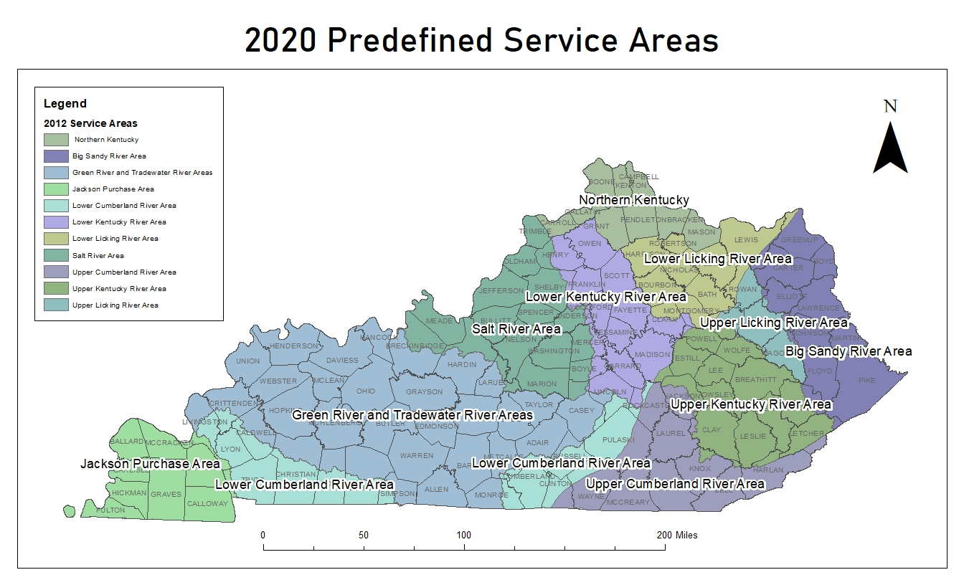
CURRENT SERVICE AREAS
Under the current operating instrument between the KDFWR and the Corps, the FILO program has 11 service areas statewide.
Funds must be used in the same service area they were received.
Funds are pooled with other sales in the same service area to pay for larger more beneficial projects
Service area size is an important part of mitigation for banks and FILO programs (FILO)
2012

Slide 57
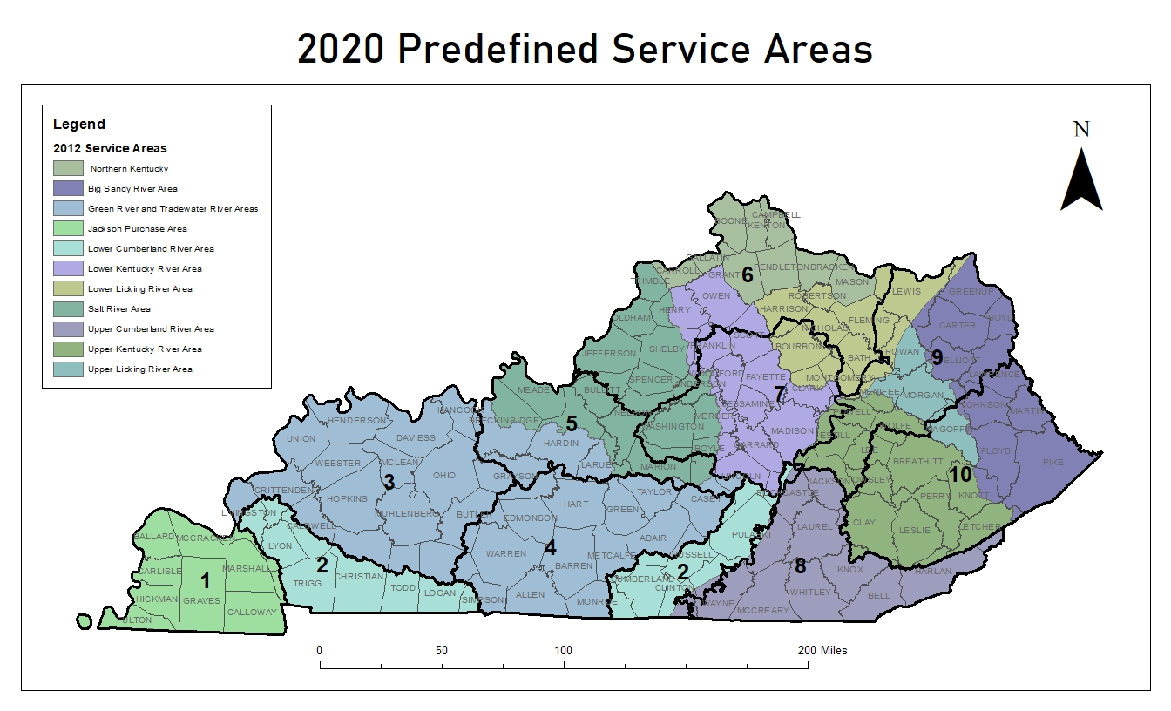
FILO Issues going forward with the revisions to the operating instrument
New Service Areas Established by Corps of Engineers
Expands Northern KY Service Area
No changes in Nashville District (Cumberland, Tennessee Rivers)
Eastern KY Coalfield Changes

Slide 58
3-YR Implementation Obligation Under the Current Operating Instrument
$ 18,855,156.68
For streams there are 3 service areas that have funds past due the 3-yr obligation. It is anticipated when the new service areas are redrawn there will be no areas without projects:
1.) Big Sandy Service Area
2.) Jackson Purchase Service Area
3.) Upper Kentucky River Service Area
For Wetlands there are 5 service areas that have funds past due the 3-yr obligation with no projects current. Eastern Kentucky remains a problem:
1.) Big Sandy River Service Area
2.) Upper Cumberland River Service Area
3.) Lower Cumberland River Service Area
4.) Upper Kentucky River Service Area
5.) Lower Kentucky River Service Area

Slide 59
CORRECTIVE ACTIONS
Extensions and deadlines are at the Army Corps discretion, but FILO has undertaken significant steps to meet the obligations:
1) Property Acquisition has been greatly streamlined as indicated by performance since FY21;
2) RFP for a full service delivery in the Upper Cumberland is being reviewed and finalized with Finance Cabinet OPS. ETA is end of the month. Once approved, this can be a template for other Service Areas RFPs.
Currently using 2 full delivery methods in Boone and Nelson Counties totaling over $ 18 Million.
4) On Monday, we received a proposal for credit purchase in 4 Service Areas which is currently being evaluated.
5) In the Big Sandy, we currently have 1 project in the monitoring phase, 3 projects in construction, 3 in design and 1 in acquisition with an estimated value of $ 12.2 million.
6) In the Upper Kentucky, we have 1 project in monitoring, 2 in design and 3 in acquisition with an estimated value of $ 9.2 million.

Slide 60
QUESTIONS
Contact Info:
Scott Porter
502-564-5116
scott.porter@ky.gov
Rob Lewis
502-545-4772
rob.lewis@ky.gov

