Slide 1
Interim Joint Committee on Natural Resources and Energy Fee-in-Lieu-Of (FILO) Program Thursday, August 5, 2021
Notes:
Why am I here?

Slide 2
HISTORY OF SUCCESS
Established in 1987
First Regional Economic Development Entity in Kentucky
Serves Boone, Campbell, and Kenton Counties
717 business projects > 69,000 primary industry jobs > $8.7B capital investment

Slide 3
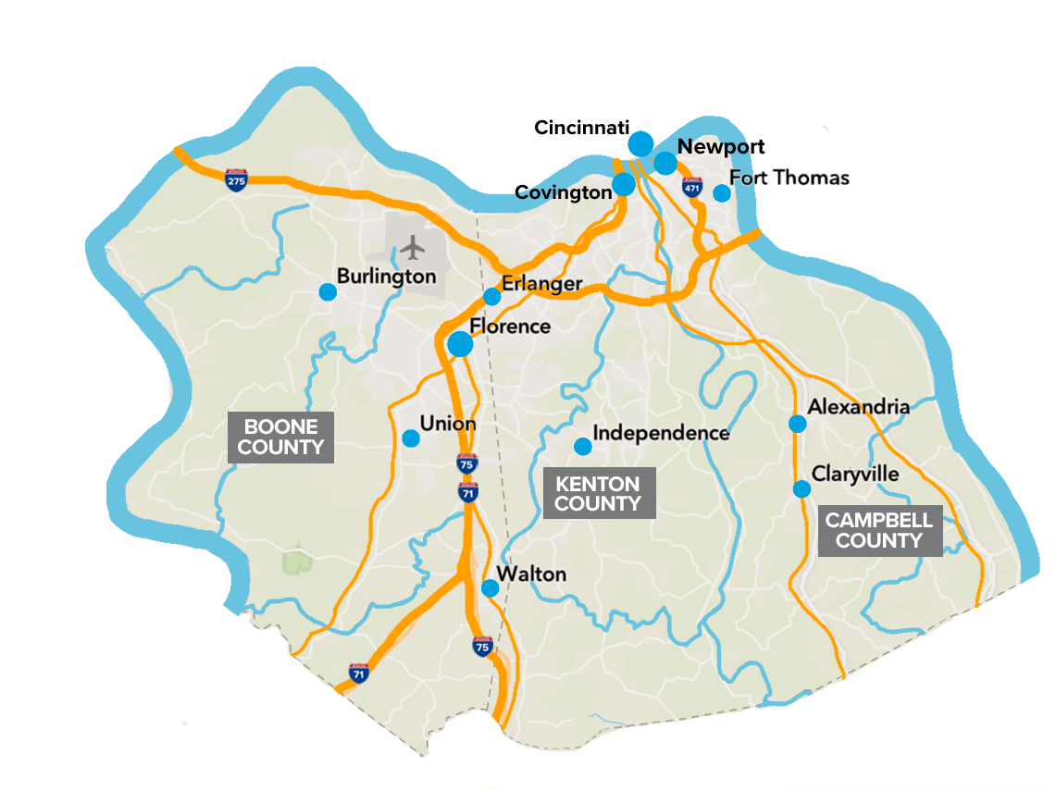
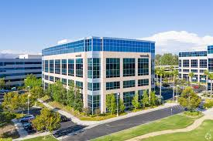
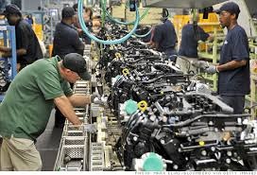
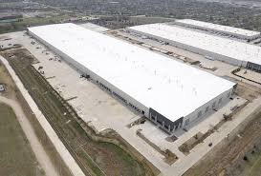
DEVELOPMENT IN NKY IS HOT
$270MM in Capital Investment announced in 2020
$157MM in Commercial/
Industrial Capital Investment (Q1 2021, BIA)

Slide 4
Development growth
Industrial Growth
Good Land to Grow
 | Growth | %
Cincinnati | 24,061,449 | 100%
NKY | 16,425,732 | 68%

Slide 5
SECTION 404 OF THE CLEAN WATER ACT

Slide 6
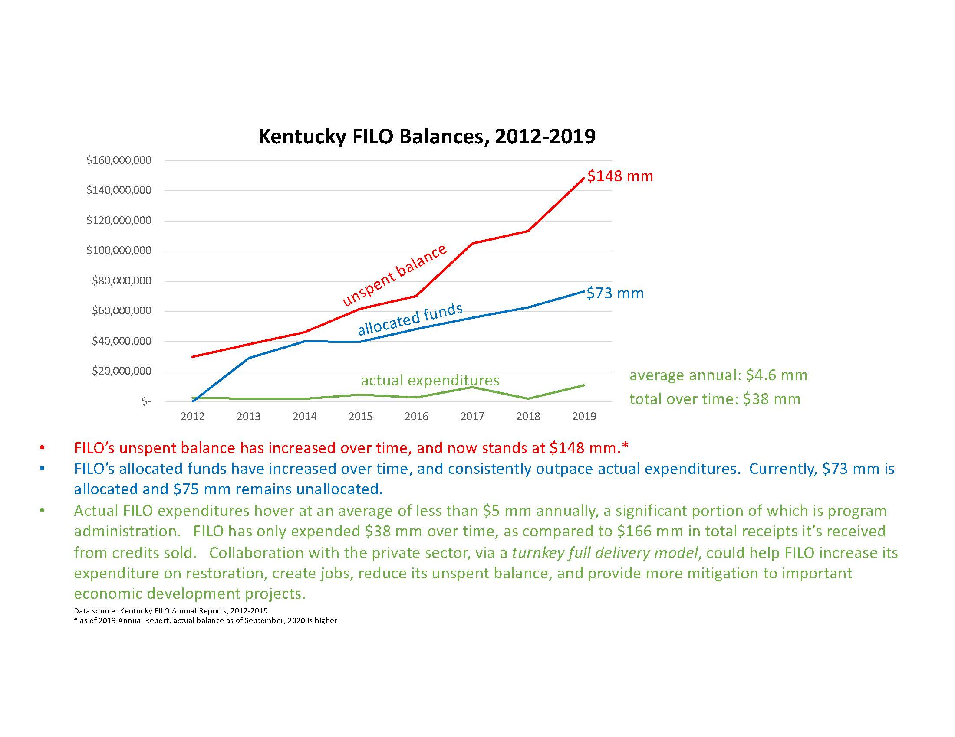
SECTION 404 OF THE CLEAN WATER ACT

Slide 7
REQUESTS
FILO Needs to Spend $$$
Spend $$$ in same or adjoining watershed
Credits need to be more affordable

Slide 8
NORTHERN KENTUCKY TRI-ED TRI-COUNTY ECONOMIC DEVELOPMENT CORPORATION 8/5/21 Lee Crume lac@northernkentuckyusa.com www.NorthernKentuckyUSA.com

