Slide 1
Large Scale Solar and Land Use
Rebecca Goodman and Kenya Stump
Kentucky Energy and environment cabinet

Slide 2
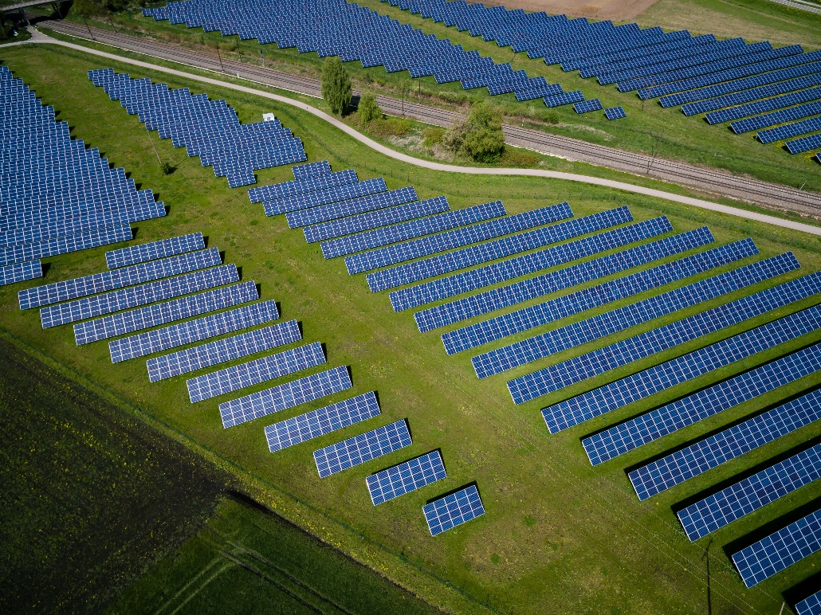
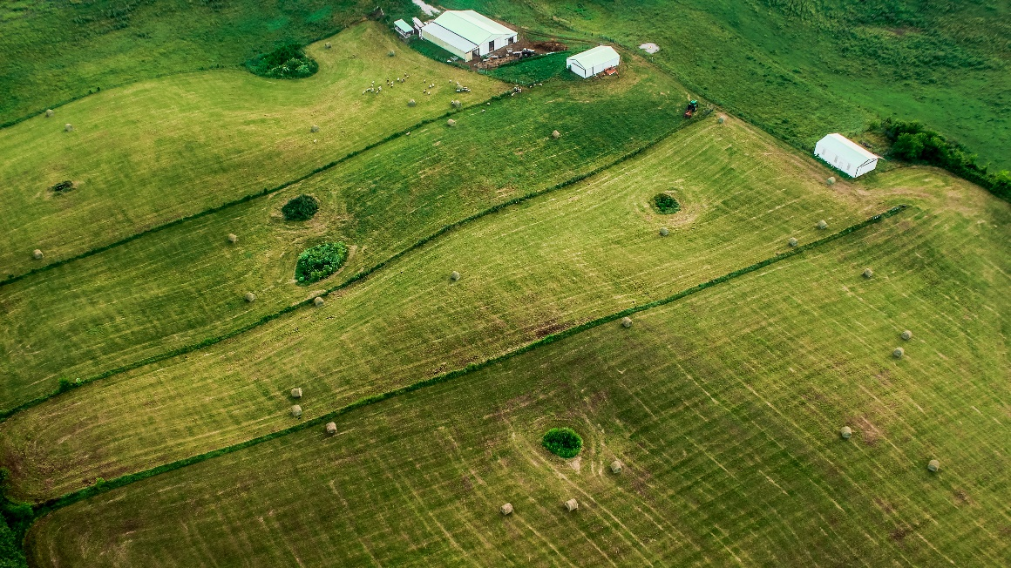
Agenda
Why Kentucky for Large Scale Solar?
About the Office of Energy Policy
Large Scale Solar in Kentucky
Land Use Considerations and Resources
Tools for Policymakers

Slide 3
Why Large Scale Solar Interest in Kentucky?
Declining costs of solar installations have made solar competitive as a resource option.
Access to two wholesale electricity markets.
Robust and reliable transmission infrastructure.
Land areas with favorable characteristics, in proximity to transmission infrastructure.
Corporate procurement demand for renewable electricity.
Wholesale market conditions that are attractive for renewable resources.

Slide 4
Kentucky Office of Energy Policy (OEP)
Mission is to utilize all of Kentucky’s energy resources for the betterment of the Commonwealth while protecting and improving our environment.
The Kentucky Office of Energy Policy (OEP) is Kentucky’s non-regulatory State Energy Program.
Established by the Kentucky Legislature during 2018 legislative session through a reorganization of the Department for Energy Development and Independence (“DEDI”) with the legislative directives identified in KRS 152.712, the OEP is designated as the state authority on energy policy issues affecting the citizens of the Commonwealth.
Provide policy and technical assistance to the Commonwealth and leadership on energy issues.
Administer grant programs across the Commonwealth to support the state’s energy goals: Affordability, Reliability, and Resilience.
Monitor, track, and analyze energy data and policies nationwide and in Kentucky to proactively identify trends, opportunities, and potential issues affecting Kentucky’s energy sector.
Increase energy literacy by proactively leveraging communication pathways and a variety of stakeholders to deliver relevant and reliable energy information across the Commonwealth.
Oversee the state Energy Assurance Plan and support the Kentucky Emergency Operations Center during energy disruptions.

Slide 5
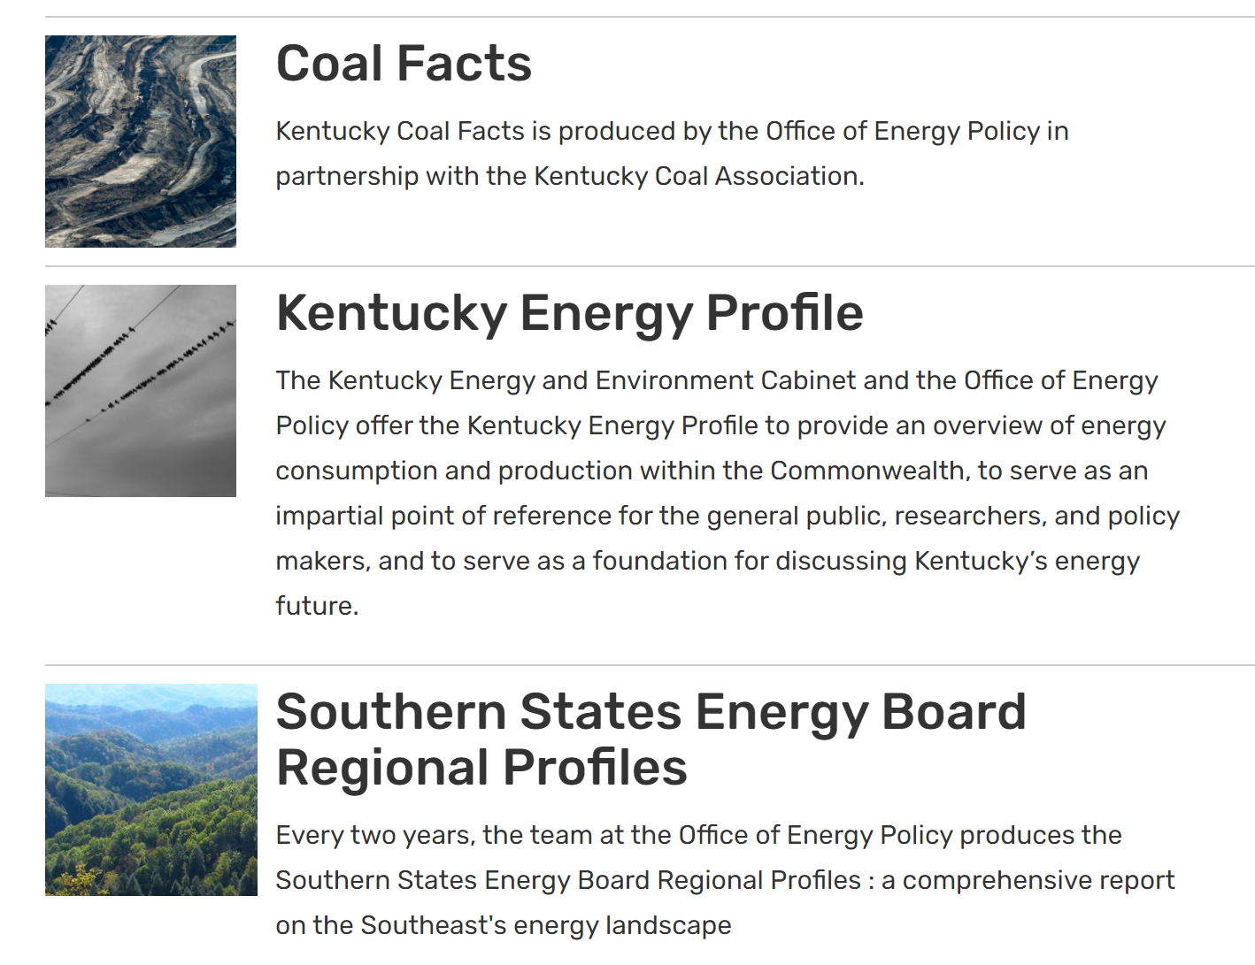
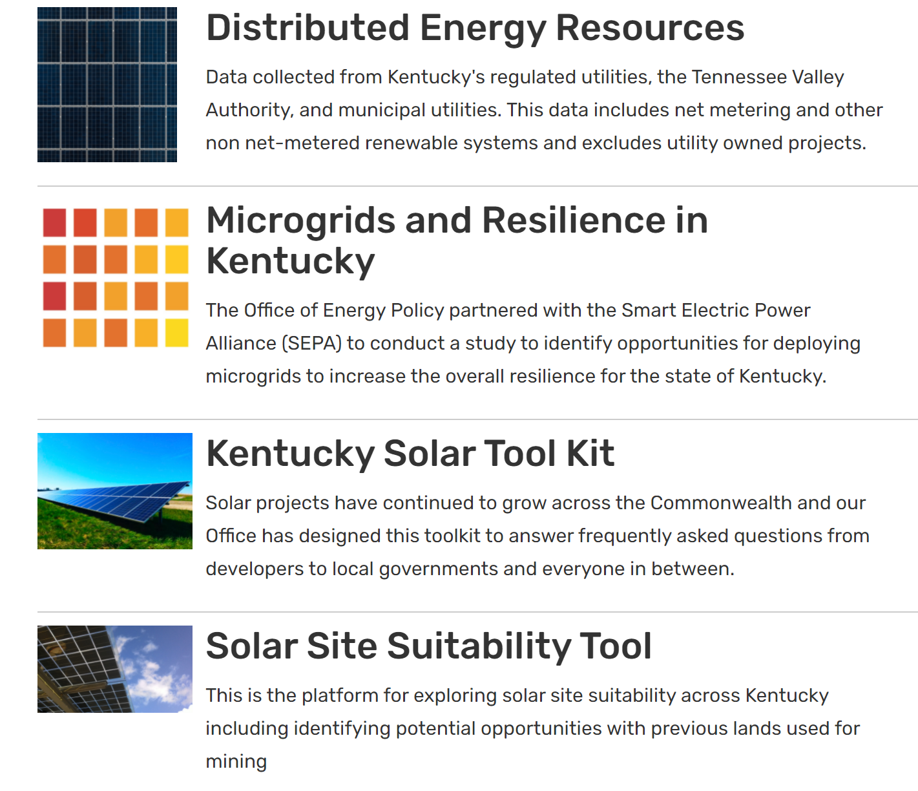
Data Products

Slide 6
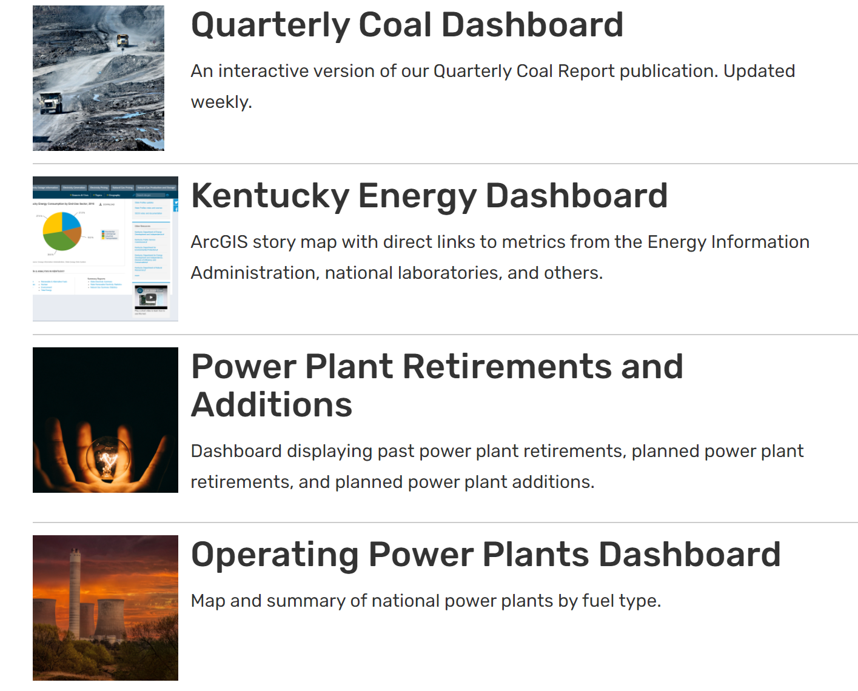
Interactive Data Products

Slide 7
OEP Solar Siting Position
Solar siting in Kentucky is a local land use planning decision.
Kentucky has an established process through the Kentucky Electric Generation and Transmission Siting Board for review of independent solar projects meeting the definition of a merchant generating facility.
The OEP remains resource neutral and provides information to all stakeholders for informed decision making.

Slide 8
Large Scale Solar Statistics
Renewable generating technologies accounted for ~8% of Kentucky’s total net electricity generation in 2020.
Utility solar generating technologies accounted for ~0.07% of Kentucky’s total net electricity generation in 2020.
Kentucky has ~18,670 MW of utility electric generating operating capacity.
Source: EIA Electricity Data Browser and S&P Global Market Intelligence
Notes:
Fort modeling of future scenarios in terms of capacity, generation, and emissions, visit https://cambium.nrel.gov/

Slide 9
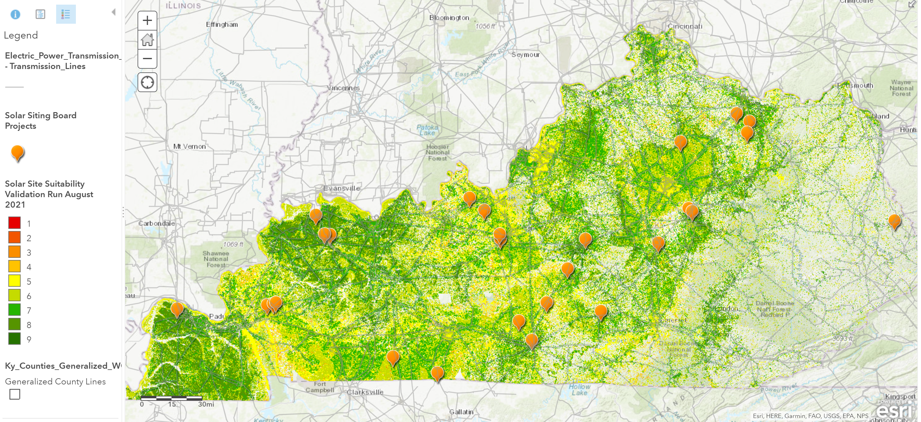
Land Use for Merchant Solar Project Development and Suitability Modeling
Currently, there are 28 merchant solar projects pending with the Kentucky Electric Generation and Transmission Siting Board.
These independent merchant cases represent ~3,267 MW of proposed capacity.
In general 1 MW of installed solar requires ~10 acres of land area.
Consequently, the proposed projects represent ~ 30,000 acres

Slide 10
Solar Project Timeline

Slide 11
Installation Options

Slide 12
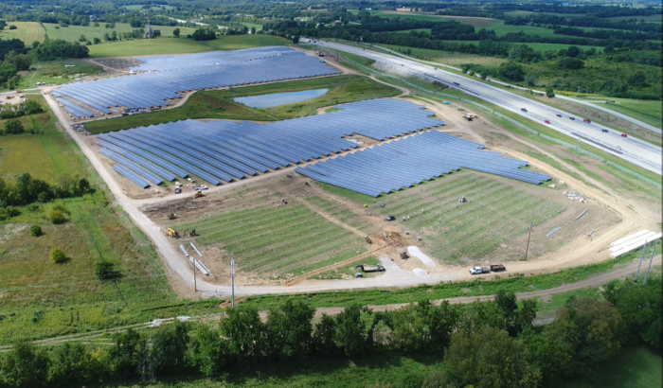
Typical Installations

Slide 13
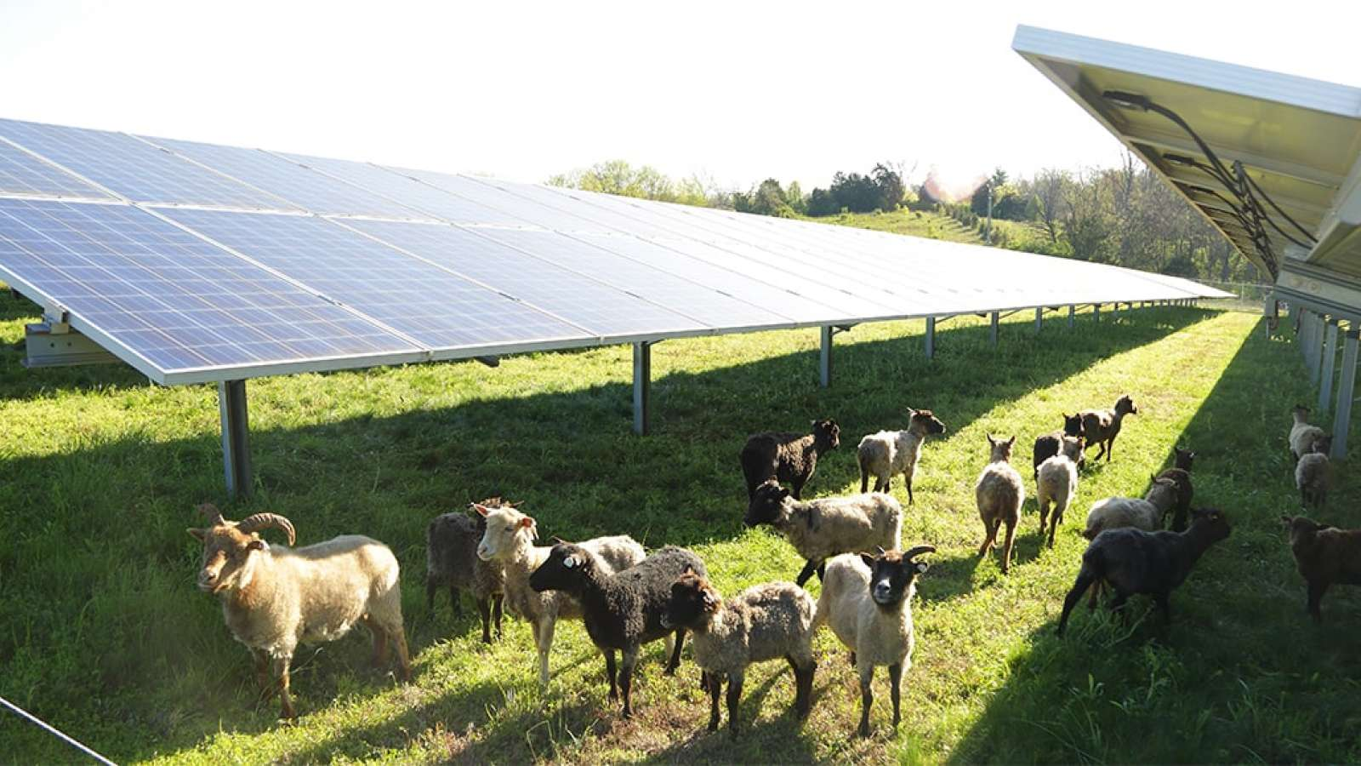
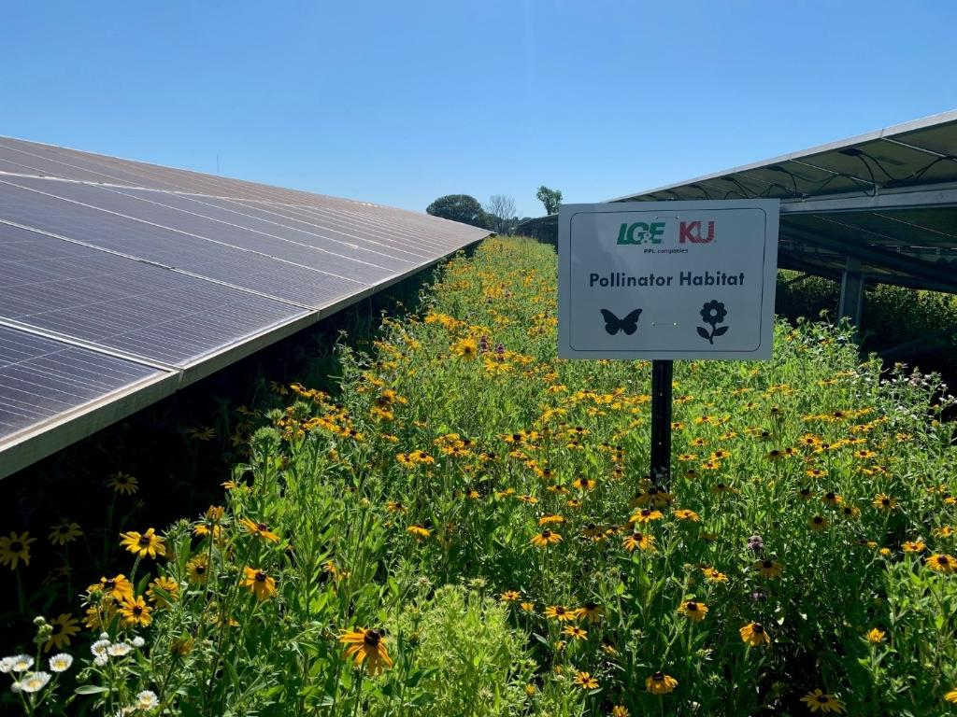
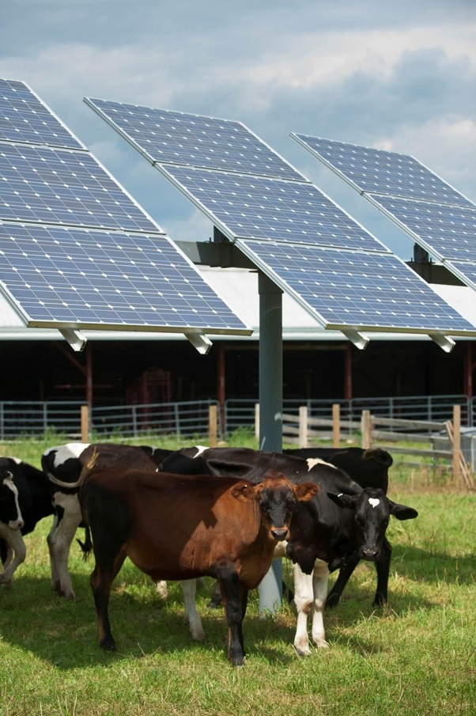
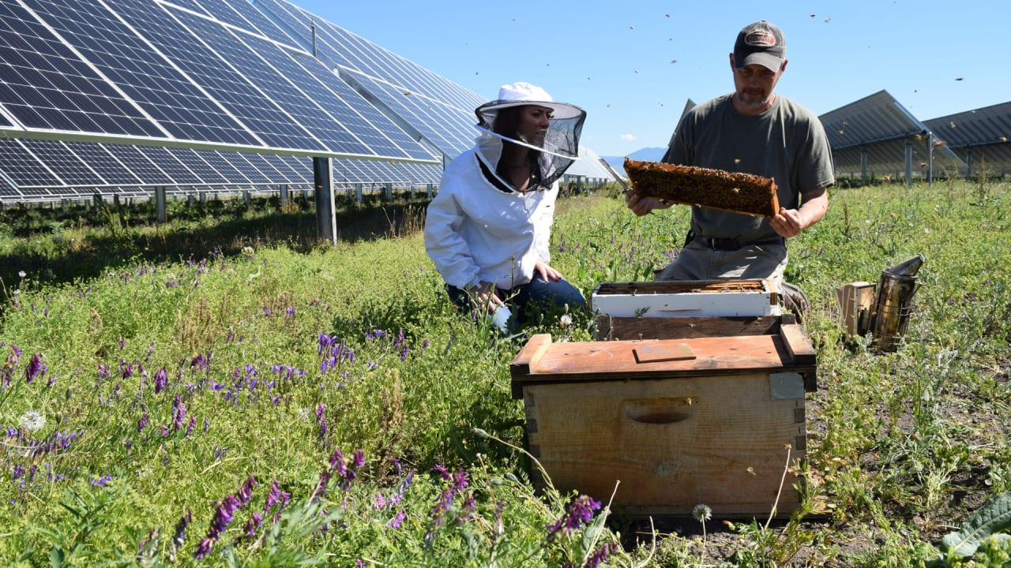
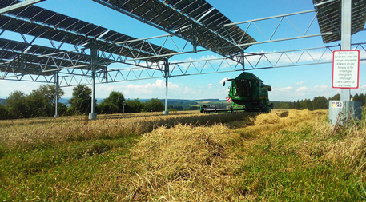
Agrivoltaic or Dual Use Large Scale Solar Installation Options

Slide 14
Tools for Decision Makers

Slide 16
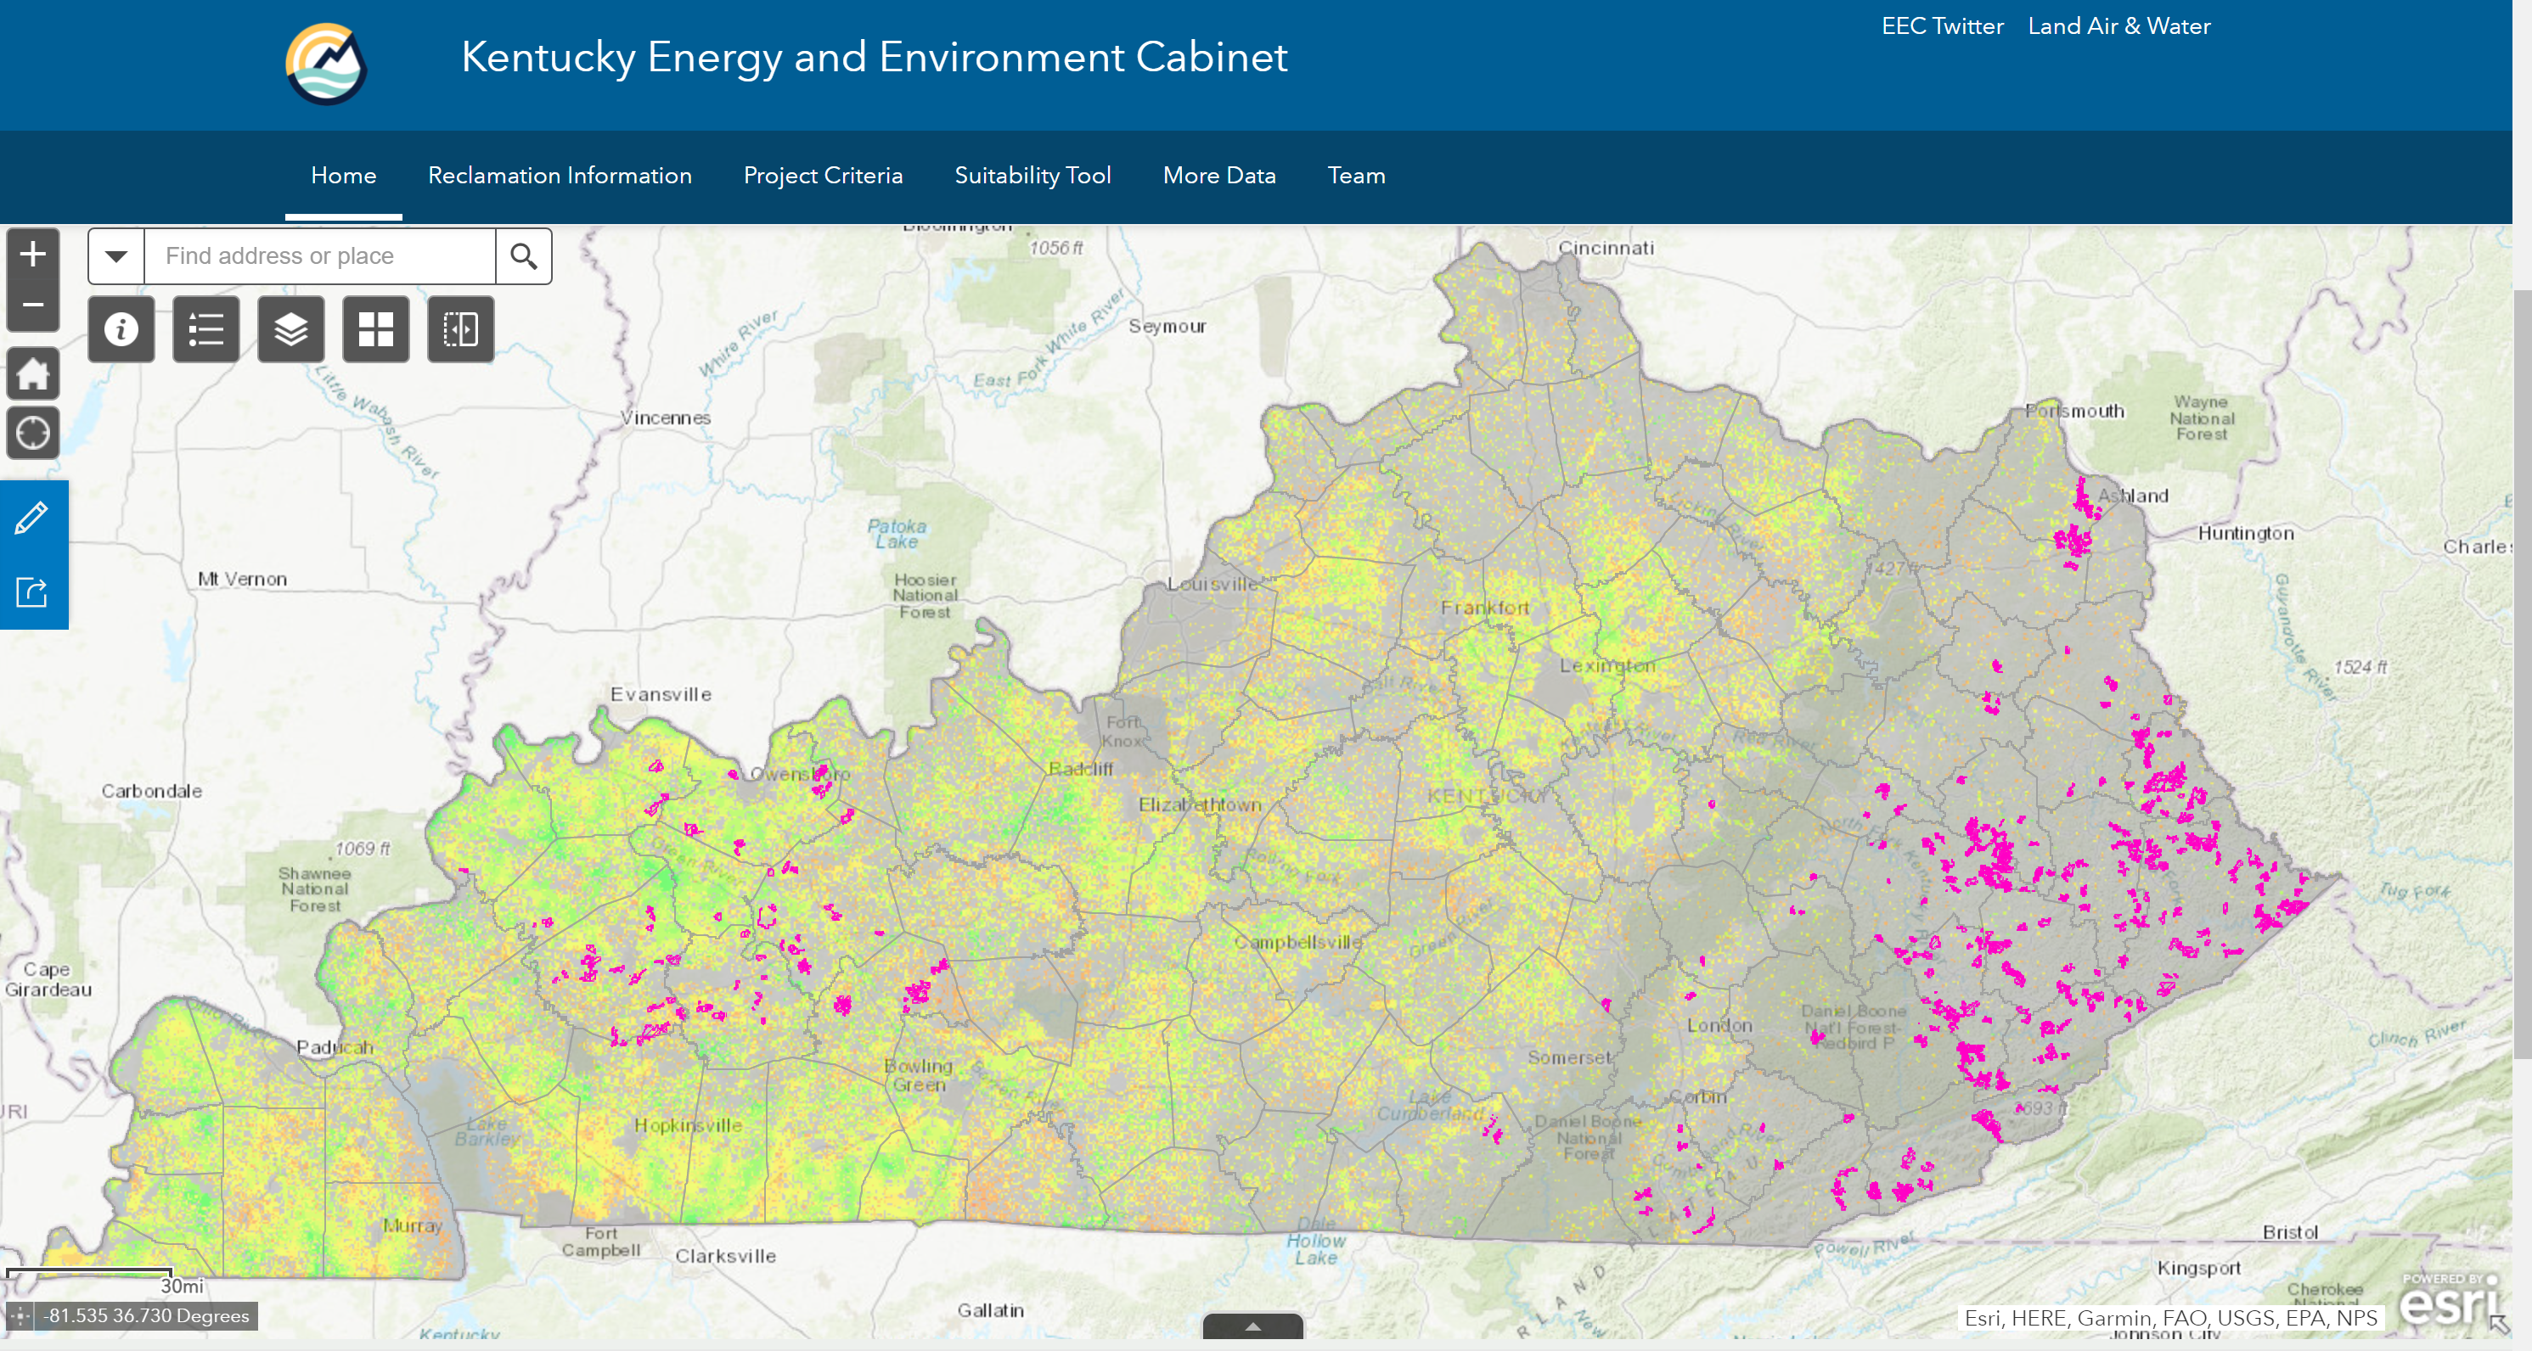
Solar Siting and Reclaimed Mine Lands

Slide 17
National Conference of State Legislators

Slide 18
Contacts
Kenya Stump
https://eec.ky.gov/Energy/Pages/default.aspx
Kenya.stump@ky.gov
502-782-7083

Slide 19
APPENDIX

Slide 20
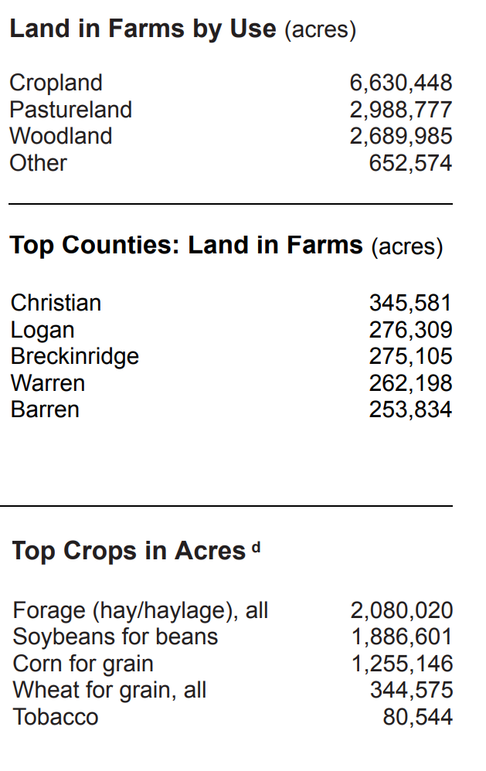
Overview Agricultural Land in Kentucky
Kentucky’s total land area
= 25,860,200 acres.
Kentucky land area in farm operation for 2017
= 12,961,784 acres.
https://www.nass.usda.gov/Quick_Stats/Ag_Overview/stateOverview.php?state=KENTUCKY
https://www.nass.usda.gov/Publications/AgCensus/2017/Online_Resources/County_Profiles/Kentucky/cp99021.pdf
Notes:
In 2016, ~5,690,500 acres were considered nationally significant agricultural land according to the American Farmland Trust.

Slide 21
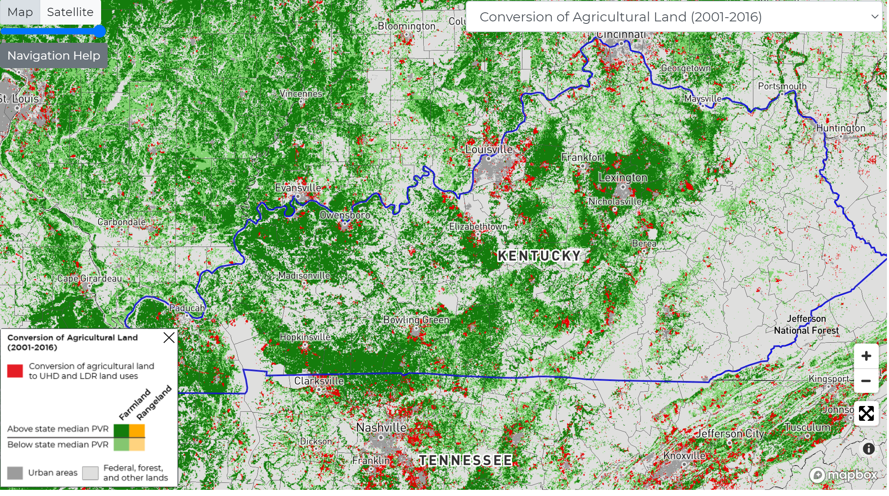
Agriculture Land Conversion Statistics
According to American Farmland Trust, between 2001 and 2016, In total, 265,300 acres of Kentucky's agricultural land were converted to urban and high developed land use as well as low density residential development.
https://csp-fut.appspot.com/

Slide 22
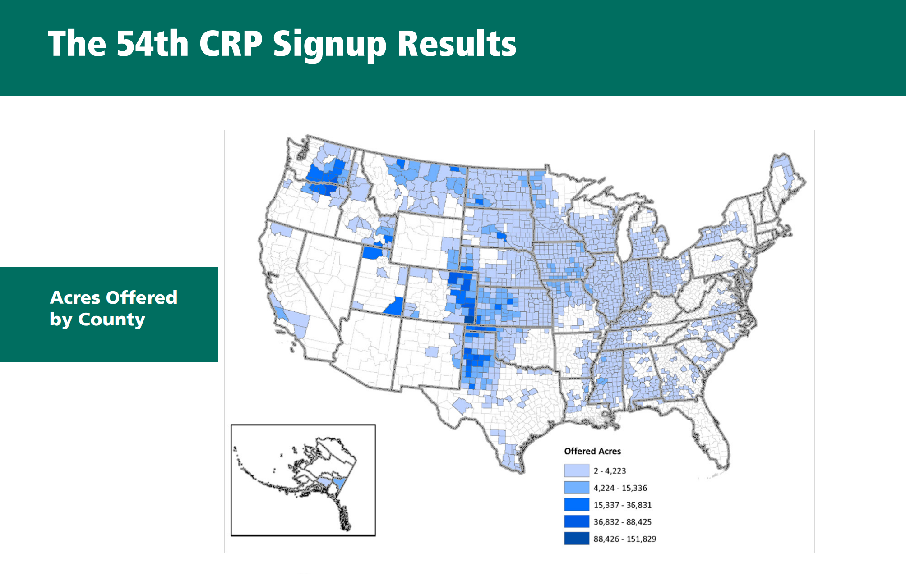
Agricultural Land in the Conservation Reserve Program
In 2020, the USDA Conservation Reserve Program reported ~194,628 acres of Kentucky agricultural lands enrolled in the program.
CRP is a land conservation program administered by FSA. In exchange for a yearly rental payment, farmers enrolled in the program agree to remove environmentally sensitive land from agricultural production and plant species that will improve environmental health and quality.
Contracts for land enrolled in CRP are 10-15 years in length.

