Slide 1
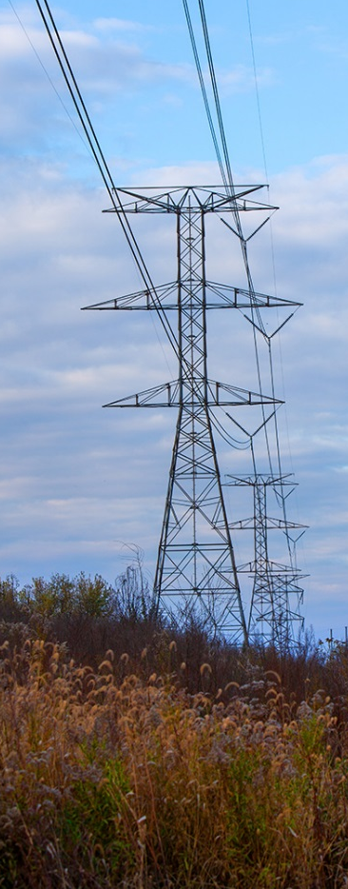
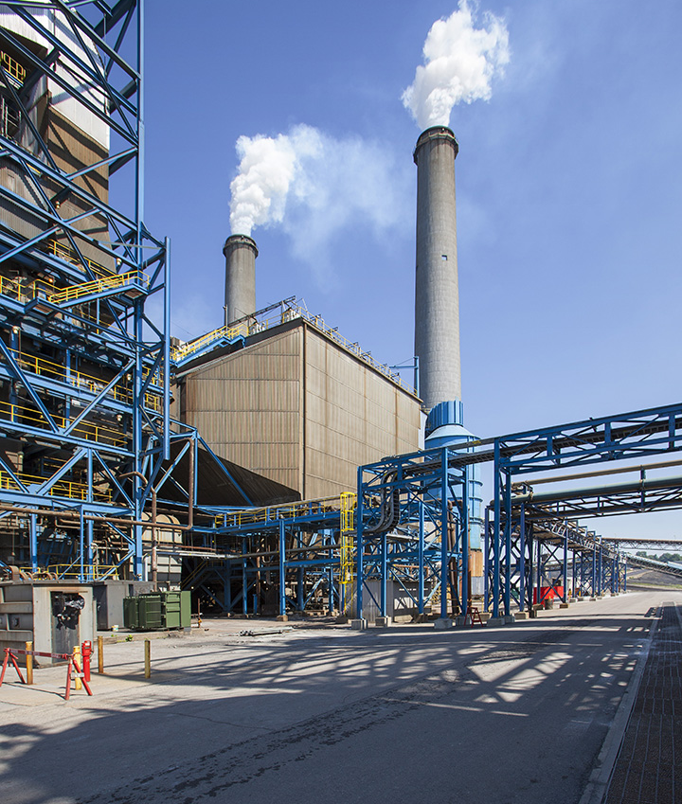
Interim joint committee -natural resources
October 7, 2021

Slide 2
History & Values
Environmentally Conscious
Excellence
Integrity
Teamwork
Member-Owners and Community Service
Respect for Employee
Safety
Founded in 1961… Big Rivers now employs nearly 400 people in four locations.
VALUES
2

Slide 3
serving Three member-owner cooperatives
We serve more than 121,000 homes and businesses
1,303 miles of transmission line
936 MW of Generating Capacity from three power stations
178 MW Available Hydro Power from SEPA
260 MW from three upcoming Solar PPAs in KY
Big Rivers and our Member-Owners are regulated by the Kentucky Public Service Commission and are generally exempt from regulation by the Federal Energy Regulatory Commission.
3

Slide 4
Big Rivers generation resources
Owned Generation (936 MW)
Reid CT (Sebree) – 65 MW
Robert Green (Sebree) – 454 MW
D.B. Wilson (Centertown) – 417 MW
Other Available Generation (178 MW)
Southeastern Power Administration (SEPA) (Hydro) – 178 MW
Solar PPA’s (260 MW)
Unbridled Solar (160 MW) - Dec. 31, 2023
McCracken County Solar (60 MW) - Dec. 31, 2022
Meade County Solar (40 MW) - Dec. 31, 2022
TOTAL AVAILABLE RESOURCES: 1,374 MW
4

Slide 5
1,303 miles of transmission line
16,000 acres of right-of-way
24 substations and switching stations
20 transmission interconnections with 6 surrounding utilities
Big Rivers transmission resources
5

Slide 6
Safety is at the core of our strategy
53 Governor’s Health and Safety Awards, more than any other entity in KY
Awarded five consecutive Kentucky Employers’ Mutual Insurance Destiny Awards. The award honors Kentucky companies for their commitment and success in maintaining a safe workplace.
2020 Notable Safety Milestones:
10 years without a lost-time incident and 6 years without an OSHA recordable incident completed by Transmission employees.
11 years without a lost-time incident completed by Green Station employees.
9 years without a lost-time incident and 4 years without a recordable incident completed by Headquarters employees.
6

Slide 7
The beginning of a Transformation…
Century Aluminum first announced plans in 2012 to end power contract and buy wholesale market power. Contract termination at a second location followed shortly after.
CENTURY ALUMINUM THREATENS TO LEAVE
The power contracts with the two aluminum smelters equated to more than 60% of Big Rivers’ Load and Revenue.
BIG RIVERS LOSES 850 MW
Big Rivers idled Coleman Station (443 MW) in 2014 in response to smelter loss. Plans to keep Wilson Station (417 MW) in Centertown open succeeded. Coleman Station is currently being dismantled.
CLOSING COLEMAN STATION
7

Slide 8
Building back with a Mitigation plan
Big Rivers Began Aggressive Plan to Replace Lost Load
After idling Coleman in 2014, Big Rivers focused on securing short-term and long-term power contracts in a plan that was often called “overly-optimistic.”
Short-term contracts stabilized power prices while Big Rivers sought and negotiated long-term contracts.
In 2015, the PSC approved a wholesale power contract with cities and a public power district in Nebraska extending through 2026.
Big Rivers developed an ambitious economic development rate to both encourage local industry expansion and draw in new industries.
Long-term power contracts were approved with a coalition of Kentucky cities (KYMEA) and later with the city of Owensboro.
8

Slide 9
Mitigation plan success
1,215 MW of Length Mitigated in Only 6 Years
Idled Coleman
Nebraska Sale
Aleris Expansion
KYMEA
OMU
NUCOR Steel
HMPL Contract Exit
Pratt and Blockware
Short (MW)
(640 MW New Load + 640MW Idled Capacity)
8 Years Until Contracts Totaling 240 MW Mature
9

Slide 10
We have achieved what most thought was impossible
Record-Breaking Safety
Load Replacement
Investment Grade Credit Ratings
Carbon Reductions
Rate Stabilization
Returned $33.3 Million back to Members/end users this year.
10

Slide 11
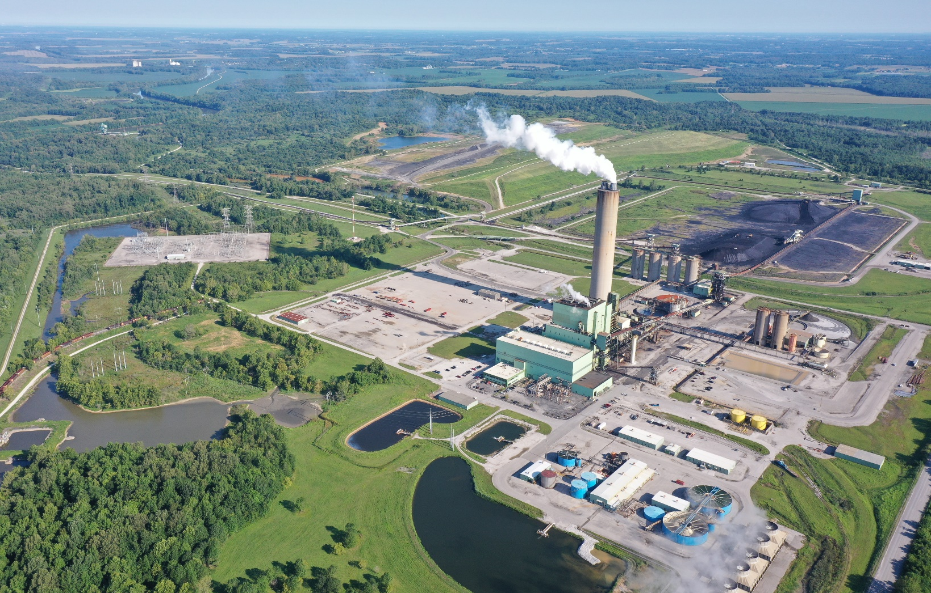
Coal-fired power plants (Coal fleet) are important
Reliability
Resilience
Affordable electricity
Fuel security
Fuel diversity
Dispatchable
11

Slide 12
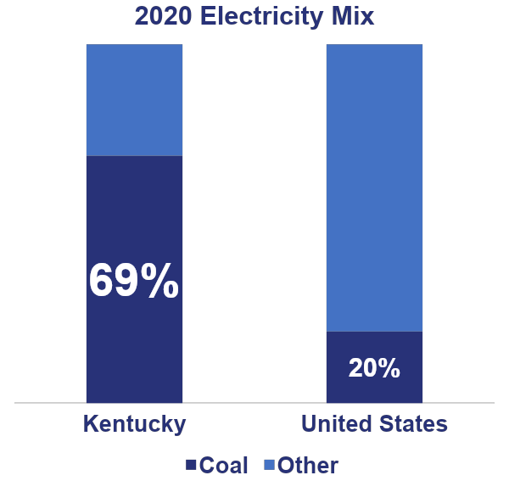
Coal keeps KY electricity rates affordable
Last year, Kentucky’s electricity rates were 20 percent lower than the national average
Kentucky relies on coal for almost 70 percent of its electricity
By comparison, coal provides only 20 percent of the nation’s electricity supply
12

Slide 13
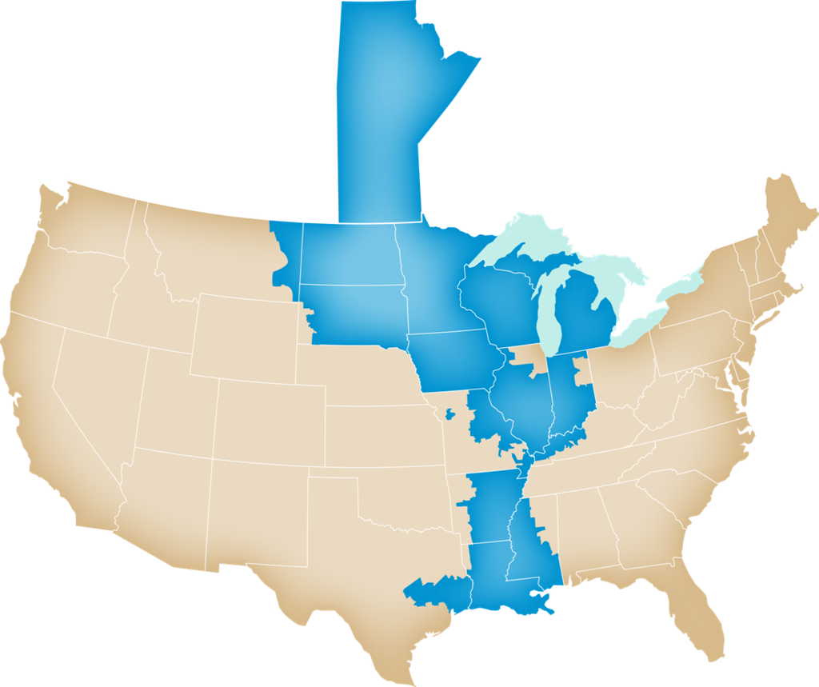
Midcontinent independent system operator MISO
Big Rivers is a member of MISO
MISO operates the electricity grid across 15 states and part of Canada and serves 42 million people
MISO relies on coal and has the largest coal fleet of any region with almost 60,000 megawatts (one-fourth of the nation’s coal fleet)
Premature coal retirements jeopardize reliability, resilience and affordability
13

Slide 14
President biden’s carbon goals
One of his goals is “carbon-free” electricity by 2035 to be achieved through a “clean energy standard.”
Not possible to achieve this goal and maintain grid reliability and resiliency with the current technology.
Need dispatchable resource when the sun is not shining and the wind is not blowing.
Carbon Capture technology has not yet been proven on a full scale project.
Battery Storage could be a game changer but is not economical at this time.
Coal and natural gas, which provide 92 percent of Kentucky’s electricity, would have to be replaced with wind and solar which is unrealistic and unaffordable.
The customer would be responsible for the cost of new renewable generation and the stranded asset of their current coal and gas plants.
14

Slide 15
President biden’s carbon goals
To replace coal and natural gas with solar in Kentucky, it would take:
39,000 MWs
391,000 acres of solar panels
611 sq. miles
U.S. would need at least 600 times more wind and solar power than we have today
Electric Power Research Institute estimates that new wind and solar, plus more transmission to deliver the wind and solar power, would cost $1.7 trillion
Other countries, especially China, continue to build new coal-fired power plants and increase carbon emissions at the same time the U.S. is retiring its coal fleet and reducing carbon emissions
15

Slide 16
China vs. us coal fleets
16

Slide 17
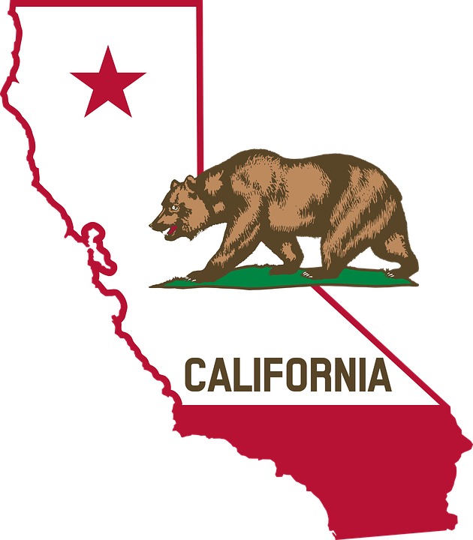
California illustrates consequences of going “too far, too fast”
California relies more on solar and wind than any other state; they provide 30 percent of the state’s electricity
Last August, California was forced to impose rolling blackouts on as many as 2 million people for several reasons, including the lack of dispatchable electricity sources, like fossil fuels, to generate power when the sun sets
In other words, California’s electricity grid was not reliable with 30 percent renewables
MISO has expressed concern about the difficulty of planning and operating its grid with an electricity supply that is 30 percent renewables
There are no studies showing the nation’s electricity grid can be reliable with mostly wind and solar power
Battery technology is not yet proven or economic at this time.
17

Slide 18
Big Rivers is building a sustainability plan that protects both the environment and the impact to our Member-Owners. A balanced and diverse portfolio (All Above Approach) will maximize the potential for each resource while ensuring reliability remains high and rates remain competitive.
BIG RIVERS HAS REDUCED CARBON EMISSIONS BY:
71%
Today
77%
By 2030
18

Slide 19
Reduction in carbon emissions
 | 2030 | 2050
LG&E and KU | 70% (2040) | 80%
Vectren | 60% (2023) | N/A
Duke Energy | 50% | 100%
Ameren | 50% | 100%
AEP | 70% | 80%
First Energy | 30% | 100%
TVA | 70% | 80% (2035) 100% (2050)
(71%)
(74%)
(77%)
(78%)
Source: Smart Electric Power Alliance; TVA Press Release
Big Rivers already achieved competitor’s goal
Big Rivers forecasted to exceed competitor’s goal
Competitor’s goal exceeds Big Rivers’ expectation
Industry observers may be surprised to learn that Big Rivers is a preeminent leader in reducing carbon emissions during the past decade…with a significantly greater reduction planned by 2025.
19

Slide 20
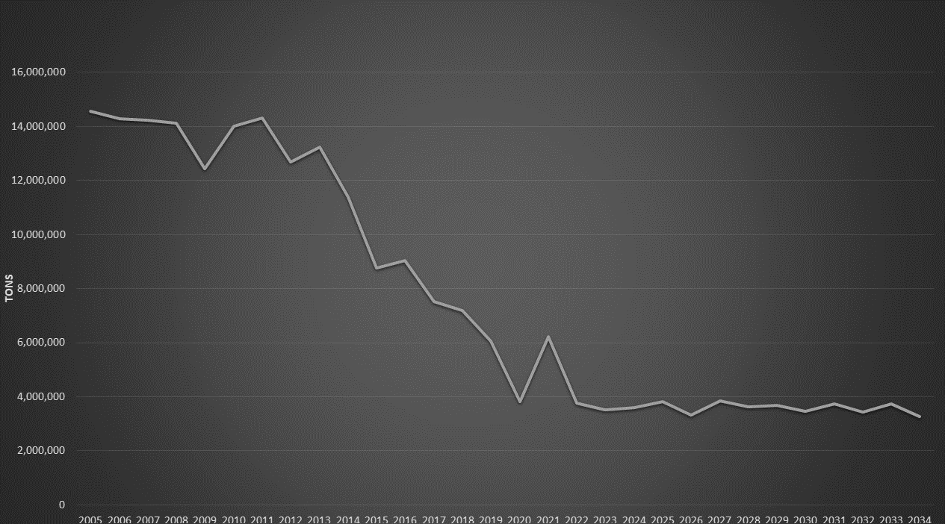
BIG RIVERS 30-YEAR CARBON EMISSIONS (2005–2034)
20

Slide 21
Future Big Rivers Energy Mix
BY 2030, BIG RIVERS WILL GENERATE AND ACCESS POWER FROM A DIVERSE PORTFOLIO
Hydropower (178 MW)
Solar (260 MW)
Wilson Station (417 MW)
Sebree Station (470 MW)
21

Slide 22
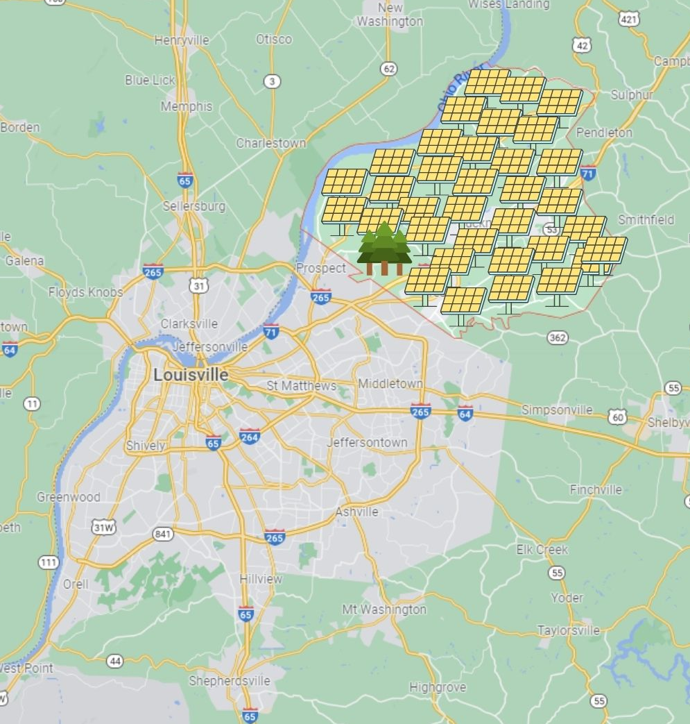
Pending solar installations
Pending KY Solar Projects (187.5 square miles) would cover an area equal to 95% of Oldham County (197 square miles).
In order to construct the solar projects planned in Big Rivers’ service territory alone, a plot of land one mile wide stretching from the outskirts of Louisville to downtown Lexington (61 square miles) would be required.
ACRES NEEDED FOR PENDING PROJECTS IN:
MISO - 90874 MW (9,087,040 Acres)
Kentucky - 12000 MW (120,000 Acres)
BREC Service Territory - 3899 MW (38,999 Acres)
22

Slide 23
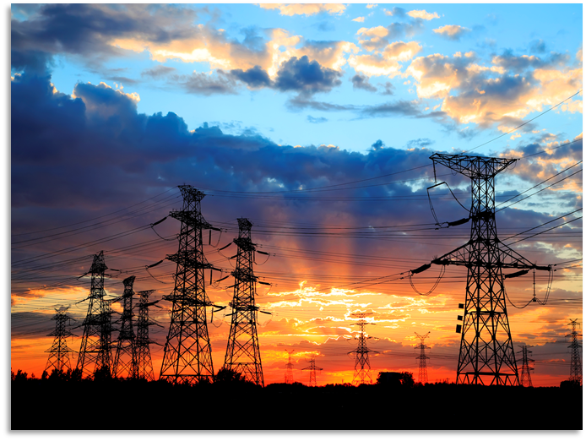
FINAL THOUGHTS
Big Rivers relies on coal but is also investing in solar power.
With the solar investment, Big Rivers will have a diverse low-cost generation portfolio of coal, natural gas, hydro and solar. (All Above Approach)
This is the best strategy for our customers.
Big Rivers supports a gradual transition of the electricity grid to avoid going too far, too fast.
23

Slide 24
Can we really be carbon free by 2035? (Video)
24

Slide 25
Questions?

