Slide 1
KRS Chapter 151 Updates &
Dam Safety Program Enhancements
Presentation to the Interim Joint Committees on Agriculture and Natural Resources and Energy
Carey Johnson, Director
Kentucky Division of Water
To Protect and Enhance Kentucky’s Environment

Slide 2
Updates to KRS 151
Kentucky Revised Statute (KRS) 151 provides authority for:
Dam safety
Floodplain development and management
Water supply planning
Stream Restoration and Mitigation
Groundwater Monitoring
Improvement of Public Drinking Water Supplies
West Fork Drakes Creek Dam and Reservoir Interstate Authority
Kentucky River Authority

Slide 3
Primary Proposed Changes to KRS Chapter 151
Update terminology to reflect current technology, programs, and practices
Many of the statutes in KRS 151 have not been revised since the 1970s and 1980s
Repeal statutes made obsolete by federal code and regulations
Require Emergency Action Plans (EAPs) for High and Significant Hazard dams
Proposed phased implementation period promulgated via regulation

Slide 4
Dam Hazard Classifications
Hazard Classification is based on potential damage in the event of a dam failure, not on the condition of the dam
High (Class C) – Structures located such that failure may cause loss of life or serious damage to houses, industrial or commercial buildings, important public utilities, main highways or major railroads.
Inspected by EEC/DOW every year
Significant (Class B) – Structures located such that failure may cause significant damage to property and project operation, but loss of human life is not envisioned.
Inspected by EEC/DOW every 3 years
Low (Class A) – Structures located such that failure would cause loss of the structure itself but little or no additional damage to other property.
Inspected by EEC/DOW every 5 years

Slide 5
Kentucky Division of Water - Dam Safety Program
A dam is defined by KRS 151 as any structure that is 25 feet in height, measured from the downstream toe to the crest of the dam, or has a maximum impounding capacity of 50 acre-feet or more at the top of the structure.
DOW Dam Safety Program primarily administers KRS 151.250 – 151.299
KRS 151 applies to all dams in Kentucky except dams owned and operated by Federal agencies
Federal requirements more stringent than state
Dams associated with surface mining permitting requirements must also meet provisions of KRS 151 and 401 KAR Chapter 4; under purview of DNR
Based on EEC analysis, approximately 45,000 Kentuckians (approximately 1% of the Commonwealth’s population) are located in potential dam inundation zones

Slide 6
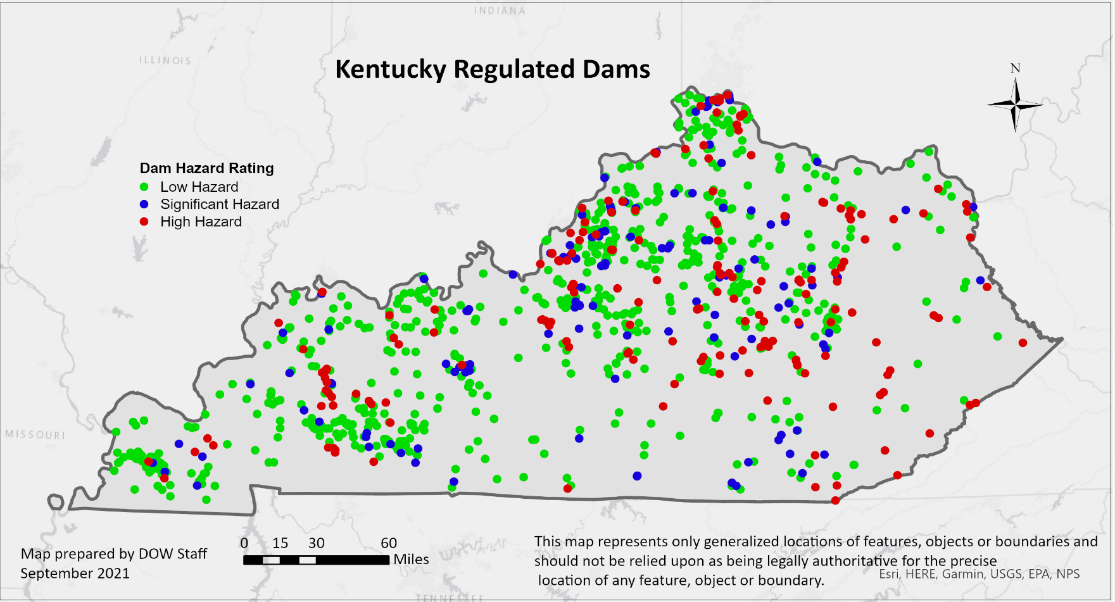
Kentucky Regulated Dam Inventory
970 total structures located in 115 counties
180 High hazard dams
127 Significant hazards

Slide 7
Dam Condition Assessment Data
A Condition Assessment is performed during each inspection conducted by EEC/DOW.
Based on criteria located at: https://eec.ky.gov/Environmental-Protection/Water/FloodDrought/Documents/KentuckyDamConditionAssessmentCriteria.pdf
Satisfactory – 111 total (25 High; 26 Significant)
Fair – 224 total (68 High; 50 Significant)
Poor – 226 total (78 High; 50 Significant)
Unsatisfactory – 12 total (7 High; 1 Significant)
Unrated – 397 total (2 High; 0 Significant)

Slide 8
Emergency Action Plans (EAPs)
FEMA 64 Federal Guidelines for Dam Safety – Emergency Action Planning for Dams
The goals of EAPs are to: encourage (1) the development of comprehensive and consistent emergency action planning to protect lives and reduce property damage and (2) the participation of emergency management authorities and dam owners in emergency action planning.
Regardless of state or federal regulatory requirements, dam owners are responsible and liable for dam operations and any related incidents. EAPs can actually limit a dam owner’s liability. Association of State Dam Safety Officials Dam Owner’s Fact Sheet
Main Components of an EAP
Summary of EAP Responsibilities
Dam Owner Responsibilities
Notification and Communication Responsibilities
Evacuation and Emergency Management Responsibilities
Notification Flowcharts
Dam Description
EAP Response Process and Preparedness
Leverages Local Emergency Management Planning Committees (LEPCs) and Emergency Operation Plans
Inundation Maps

Slide 9
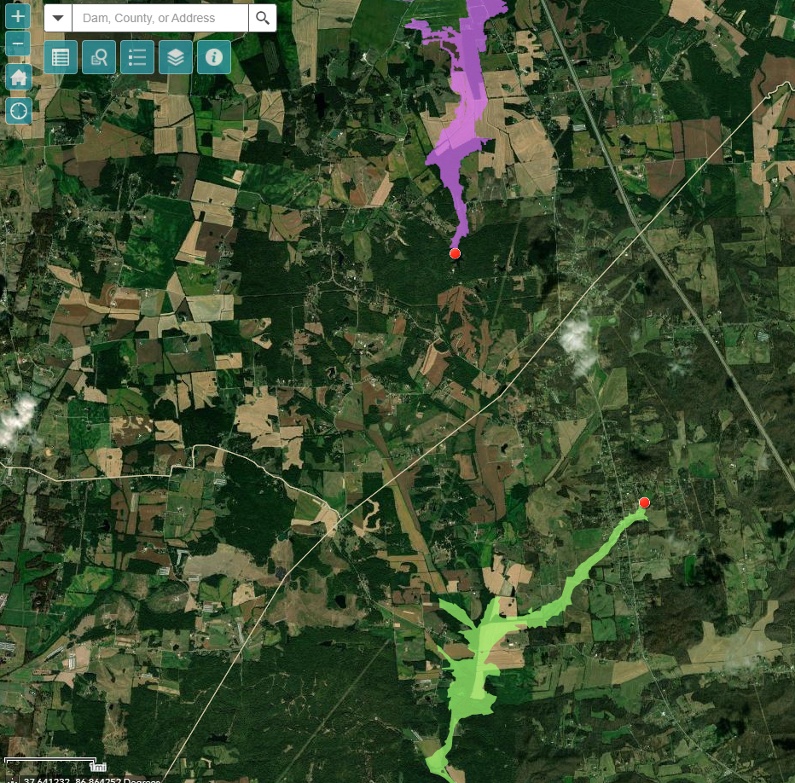
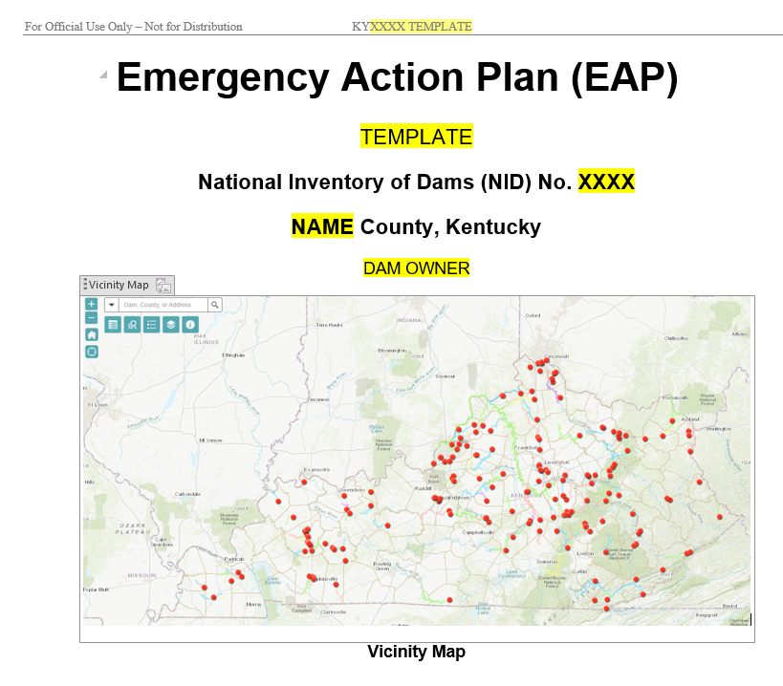
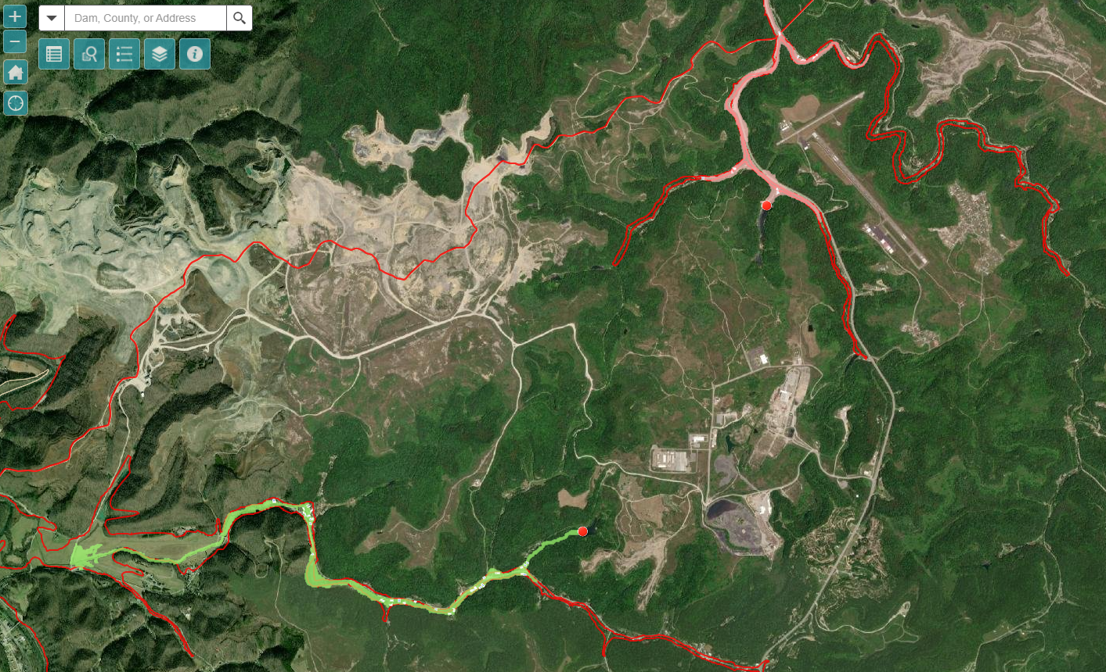
Dam Inundation Mapping
Available for all KY-regulated high hazard dams
Located at: https://kygis.maps.arcgis.com/apps/webappviewer/index.html?id=a4b89b6d79434adc9a4d3b0c9d644019

Slide 10
EAP Training and Exercises
The people and agencies involved in the implementation of the EAP should receive training to ensure that they are thoroughly familiar with all elements of the plan, the available equipment, and their responsibilities and duties under the plan.
A proposed exercise schedule and an EAP exercise program should be included in the EAP.
Plans for conducting an evaluation of the exercise and for updating the EAP based on the outcome of the evaluation should be considered.

Slide 11
Types of EAP Exercises
Tabletop – key personnel and simulated scenarios
Functional – examines or validates the coordination, command, and control across agencies, but does not involve hands-on responses in real time
Full-Scale – multi-agency, multi-jurisdictional exercise response to a simulated event

Slide 12
Cabinet resources available to assist EAP development
Digital mapping tools, including inundation mapping available for all High Hazard (Class C) dams
https://kygis.maps.arcgis.com/apps/webappviewer/index.html?id=a4b89b6d79434adc9a4d3b0c9d644019
The US Army Corps of Engineers will be releasing inundation for USACE-owned dams in late 2021
Rapid dam inundation modeling and mapping (DSS-Wise Lite) provided through a partnership with FEMA and National Center for Computational Hydroscience and Engineering (NCCHE) at the University of Mississippi.
Utilized for EEC Dam Inundation Mapping Tool
Provides data such as dam inundation mapping, flood depths, and flood arrival times that may be directly incorporated into an EAP
EEC has ability to collaborate with dam owners to provide additional analyses
EAP template based on FEMA 64 that simplifies the process for implementing EAPs for dam owners, emergency management at the local, regional and state level, and local officials
Qualified dam safety experts from EEC/DOW to advise in planning, maintaining, and executing EAPs

Slide 13
Questions?
Carey Johnson
Director, Division of Water
Department for Environmental Protection
Kentucky Energy and Environment Cabinet
300 Sower Blvd., Frankfort, KY 40601
(502) 782-6990
carey.johnson@ky.gov

