Slide 1
Resource Adequacy: Kentucky & the U.S.
Kent Chandler, Chairman
Kentucky Public Service Commission
Presentation: Natural Resources and Energy Interim Joint Committee
Nov. 17, 2021
Any views expressed in this presentation are those of the presenter and do not reflect official positions of the PSC.

Slide 2
Public Service Commission
Independent Regulatory Agency
Three-member Commission
Quasi-judicial function
Regulates rates and service provided by jurisdictional utilities:
1,100 jurisdictional utilities
Water and sewer utilities (small systems comprise the bulk of regulated utilities)
Natural gas distribution systems and intrastate pipelines
Electric utilities (investor-owned and jurisdictional cooperatives)
Telecommunications (small number)
Does not regulate municipal utilities except for gas pipeline safety.
Does not regulate cooperatives served by TVA.

Slide 3
Reliability—Service and Rates
Since 1934, the primary statutory directive of utility regulation in Kentucky revolves around:
Rates
Fair, just and reasonable
Service
Adequate, efficient and reasonable
Most everything in retail utility regulation comes back to one or both of these principles.

Slide 4
Ensuring Reliability
Resource Adequacy: “The ability of the electricity system to supply aggregate electric power and energy to meet the requirements of consumers at all times, taking into account scheduled and unscheduled outages of system components.”
(North American Electric Reliability Corporation)
System reliability depends on both resource adequacy and operational reliability to design, plan, and operate the electric grid.
(Resource Adequacy Primer for State Regulators, July 2021, NARUC)

Slide 5
Who Is Responsible for Resource Adequacy?
It depends!
Primarily the role of a state, especially in traditionally regulated, vertically integrated states such as Kentucky:
PSC—reviews and approves utility investments in generation
Integrated Resource Plans—15-year forecast filed by jurisdictional utilities every 3 years
Not all states are vertically integrated, some are deregulated/retail competition: TX, CA, MD, IL, MI, OH, PA, NJ, DE
Also—North American Electric Reliability Council; Federal Energy Regulatory Commission; RTOs/ISOs.
RTO—Regional Transmission Organization
Deregulated states depend on wholesale markets, like RTOs, for resource adequacy

Slide 6
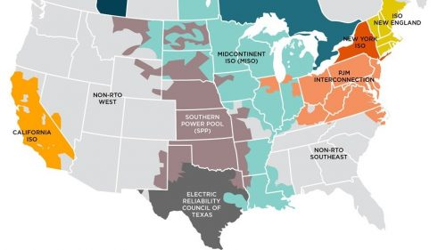
RTOs/ISOs
Four of Kentucky’s electric utilities are members of wholesale power markets.
MISO:
Big Rivers Electric Corporation
PJM:
East Kentucky Power Cooperative
Duke Energy Kentucky
Kentucky Power
Over at least the past decade—PJM and MISO have been assessing operational, planning, and market impacts of adding increasing amounts of wind and solar power.

Slide 7
Matters Complicating Resource Adequacy
Technological & Economic—technological advancements combined with declining costs of some resource options
Wind, solar, storage, smart thermostats, distributed resources, demand response, etc.
States’ policies—Renewable standards; carbon policies; enhancing resource strengths (e.g., states with wind resources); electricity restructuring; resilience planning
Economic development, corporate drivers
Federal policies—including decades’-long FERC policies to increase competitiveness of wholesale electricity markets and reduce barriers to entry via access to markets
Other market forces—growth of RTOs/ISOs; utility decision-making

Slide 8
Resource Adequacy – Retail/PSC Regulation
Integrated Resource Planning (807 KAR 5:058)—prescribes rules for regular reporting and commission review of load forecasts and resource plans of electric utilities to meet future demand with an adequate, reliable supply of power within their service areas.
Each utility files triennially—includes historical and projected demand, resource, and financial data, and other operating performance and system information.
IRPs contain a 15-year planning horizon.
IRPs include summary of forecasts of energy and peak demand; economic and demographic assumptions; planned resource acquisitions, new power plants, transmission improvements, etc.
Intervenors; Formal Hearing

Slide 9
PJM & MISO – Resource Adequacy & Reliability
Effective load carrying capability (ELCC):
Measurement of a generating resource’s ability to produce energy when the grid is most likely to experience electricity shortfalls; expressed as a percentage of a resource’s capacity.
Accurate ELCC calculations = enhanced reliability
Diminishing reliability as certain resources are added
Capacity Markets—“ensures long-term grid reliability by procuring the appropriate amount of power supply resources needed to meet predicted energy demand three years in the future.” – PJM’s is much more useful to ensure resource adequacy than MISO’s
PJM has Capacity Performance—requirement that generators must meet commitments to deliver electricity whenever PJM determines they are needed to meet system emergencies (incentives & penalties)
Reserve Pricing—increases markets prices as scarcity increases, driving reserves

Slide 10
PJM & MISO – Resource Adequacy & Reliability continued...
Futures development— forward-looking planning scenarios of the energy landscape that establish different ranges of economic, policy, and technological possibilities (such as load growth, electrification, carbon policy, generator retirements, renewable energy levels, natural gas price, and generation capital cost) over a twenty-year period.
Renewable Integration Impact Assessment—conducted to understand the impacts of renewable energy growth over the long term.
“Managing the system under such conditions, particularly beyond the 30% system-wide renewable level is not insurmountable and will require transformational change in planning, markets, and operations. RIIA concludes that renewable penetration of at least 50% can be achieved through additional coordinated action.”

Slide 11
What changes are necessary to adapt?
Greater detail in IRPs—include dynamic changes to transmission and distribution system, not just generation; better, more frequent data
Greater stratification of reliability contribution- ELCC becoming more and more important
Greater emphasis on modeling—increased and changing demand; electrification; supply and demand resources; energy efficiency
Supply side resources—what kind of generation is even available?
Contributions to reliability- DERs, renewables, etc.
More flexibility required; greater variability with reserve margins
Gas-electric coordination
Greater interconnection amongst utilities, RTOs and within entire interconnections (Eastern, Western, Texas)

Slide 12
Supply Side Resources- what is available?
Wind—Few places in Kentucky have adequate wind speeds and topography
Solar—Requires about 6-10 acres per MW, less reliability contribution in winter months
Nuclear—Currently unlikely, however emerging, advanced technologies could alter viability
Coal—New units unable to be built, primarily because of NSR requirements
Natural Gas—Often chosen by generation modeling as least-cost resource, but risks exist around ability to site infrastructure and actual useful life
Energy Efficiency/Demand Side Management—plenty of cost-effective amounts available, but inability to actually produce electricity
Batteries—limited duration (4 to 8 hours) and relatively expensive
Hybrid Resources—Promising, but relatively new
Hydrogen—Not yet proven to be cost-effective or readily available

Slide 13
A Few Key Take-Aways & Considerations
Utility planning is more difficult and involved than it has been anytime in the last 100 years
Kentucky is a traditional vertically integrated state. While most of the state’s jurisdictional utilities participate in wholesale electricity markets, issues of resource adequacy, reliability, planning, etc., are subject to state jurisdiction.
The Commission has indicated on multiple occasions it has no interest in our utilities depending on markets for generation capacity for any long (more than a year or two) period of time; will continue to emphasize a preference for “steel in the ground”
Unlike Texas, most of the electric grid east of the Rockies is largely interconnected.
We must stay engaged and active on these issues; Waiting is not an option
Energy storage—game changer?

Slide 14
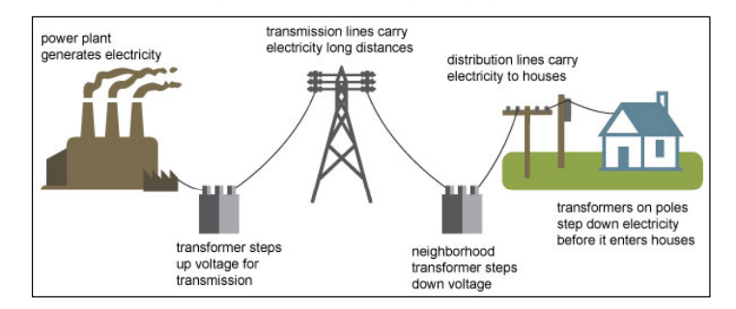
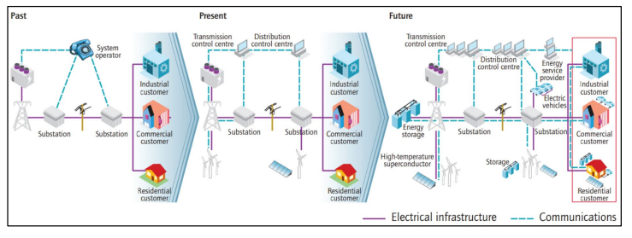
Traditional Electricity Delivery System
Mostly one-way system with dispatchable resources. Clear components of generation, transmission, and distribution
The Evolving Electric Power Grid
As more variable resources and more distributed resources are integrated into the grid, planning and operations are evolving.
Sources: EIA (How Electricity is Delivered to Consumers) and DOE (Quadrennial Technology Review)

