Slide 1
Emerging Trends in Energy Markets
Rodney Andrews PhD PE
Director
Center for Applied Energy Research
University of Kentucky

Slide 2
Currently, the primary driver in energy markets is high-levels of uncertainty in petroleum and natural gas pricing and supply

Slide 3
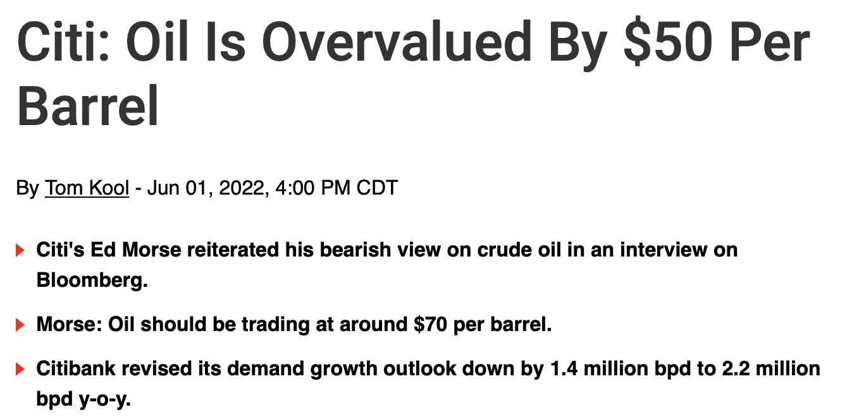
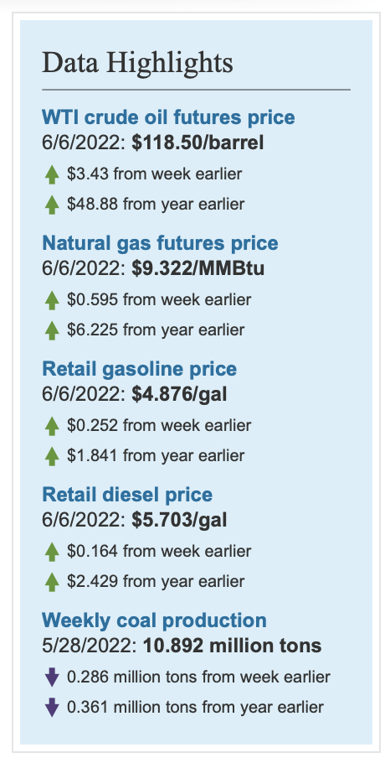
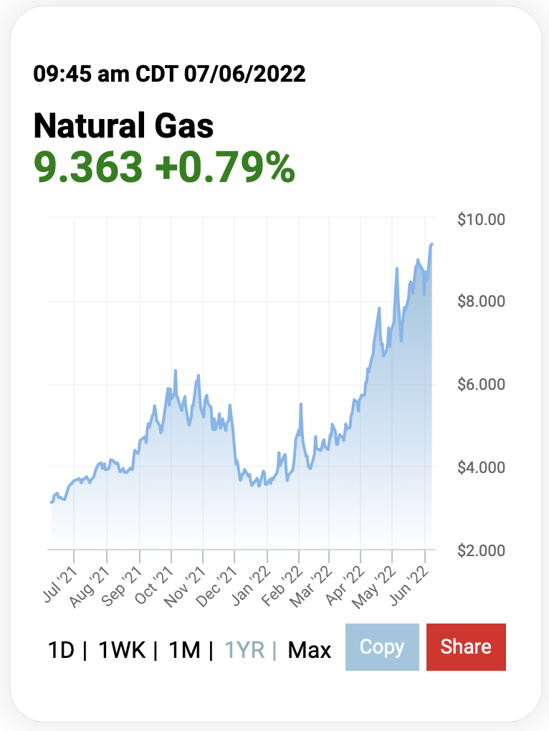
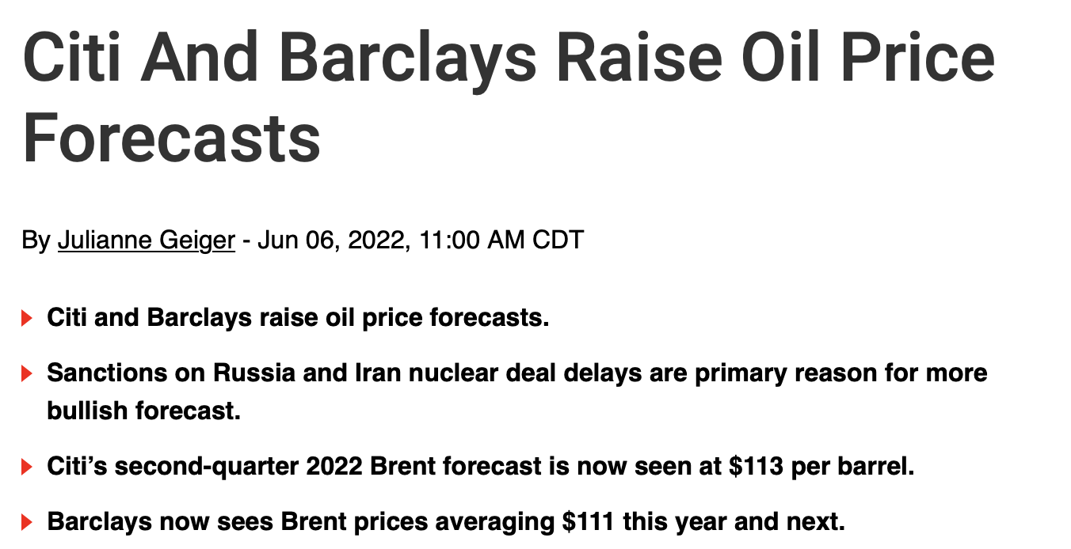

Slide 4
Petroleum (and liquid hydrocarbons)
Factors driving energy supply uncertainty
sanctions on Russia’s oil production
the production decisions of OPEC+
the rate at which U.S. oil and natural gas producers increase drilling
Brent crude prices remain strong [but lower than 2008]
EIA forecasts Brent price at $108/b for remainder of 2022 (2H22)
Forecast crude price to fall to $97/b in 2023
Oil inventory levels are low, increasing potential for oil price volatility
Gasoline and diesel prices reflect refining margins at or near record highs amid low inventory levels
EIA expects wholesale margins* to fall from $1.17/gal (May) to $0.81 /gal in 3Q22
EIA forecasts retail gasoline prices to average $4.27/gal in 3Q22.
Diesel predicted to have similar trends
*the difference between the wholesale gasoline price and Brent crude oil price

Slide 5
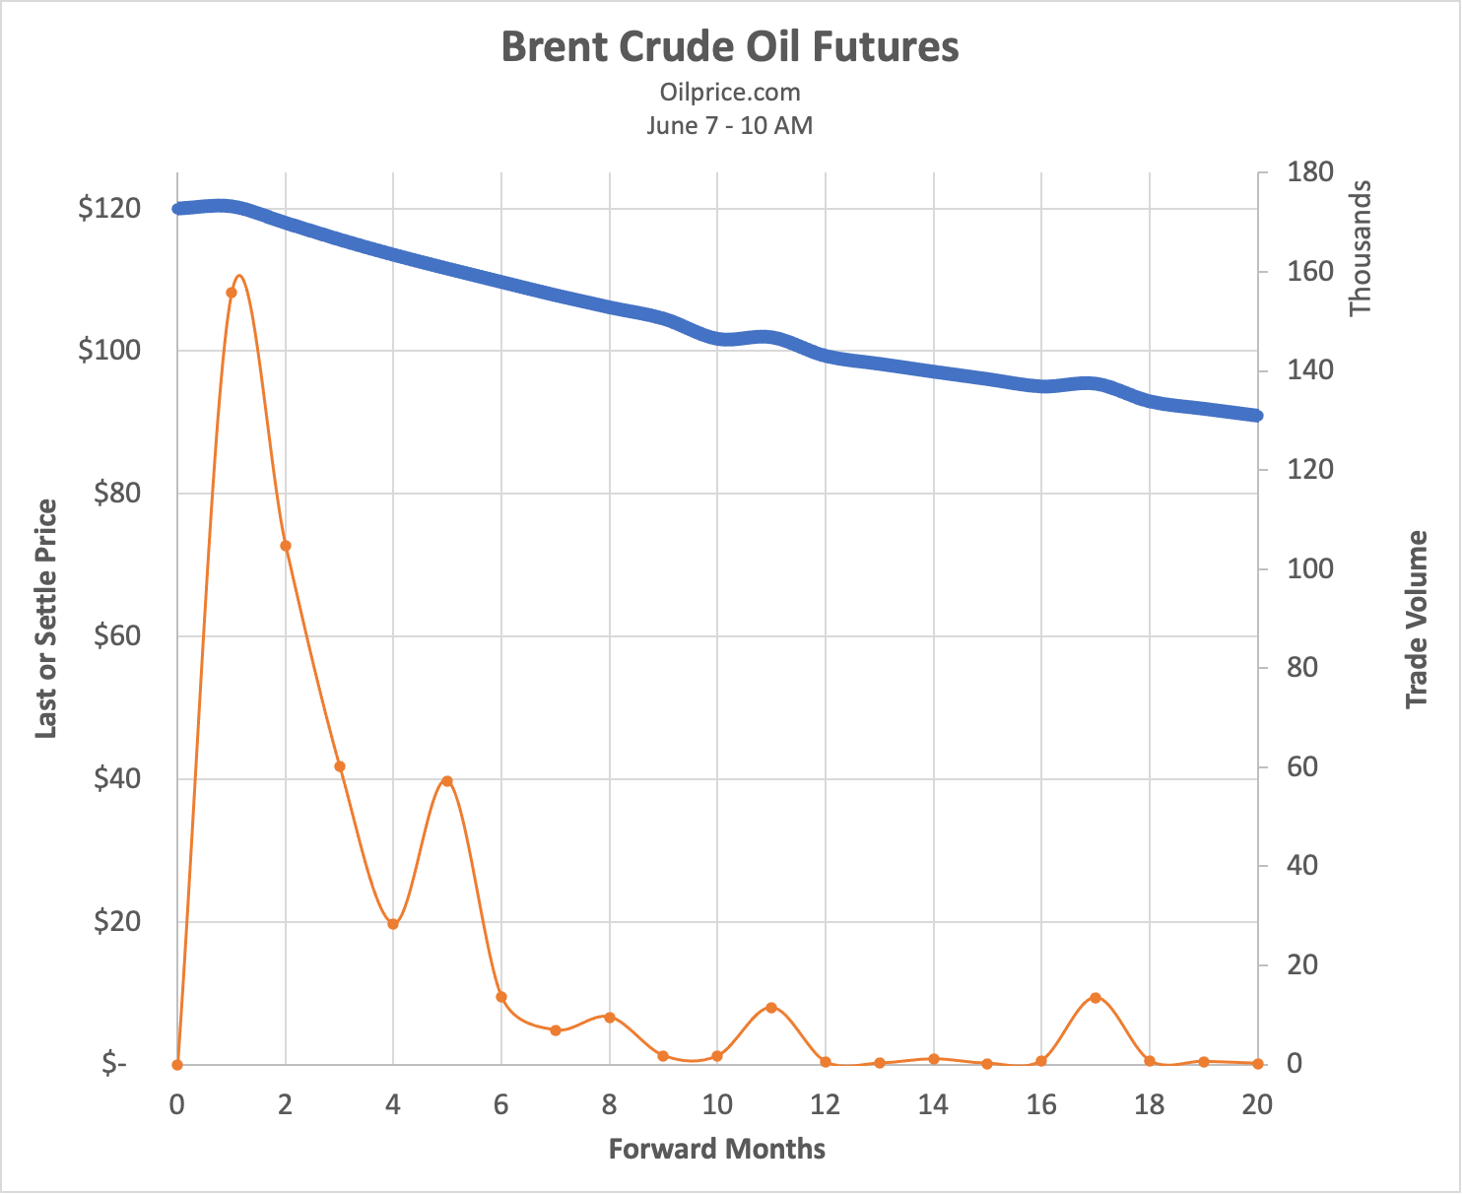
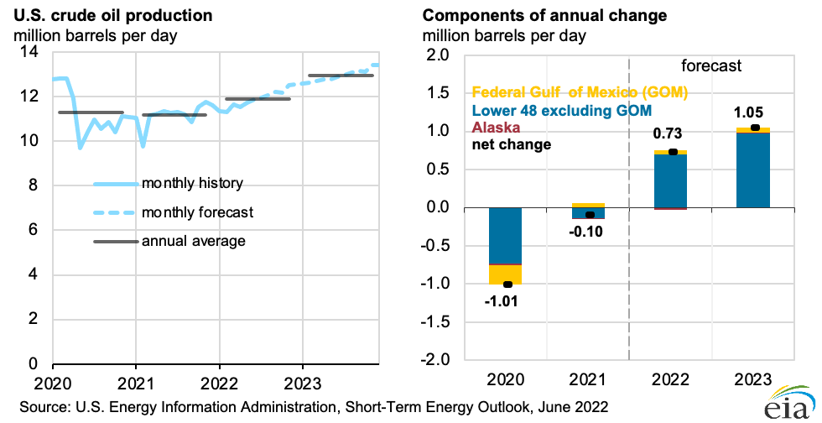
Brent futures and US pricing

Slide 6
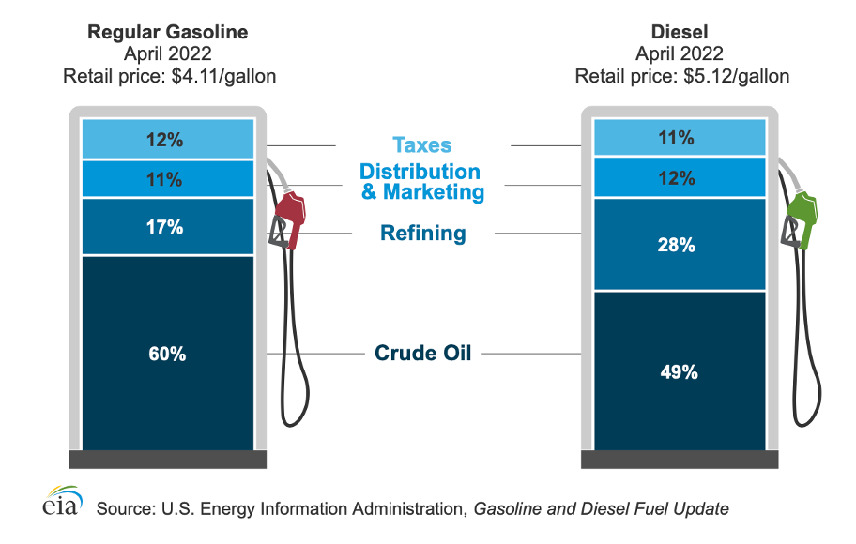
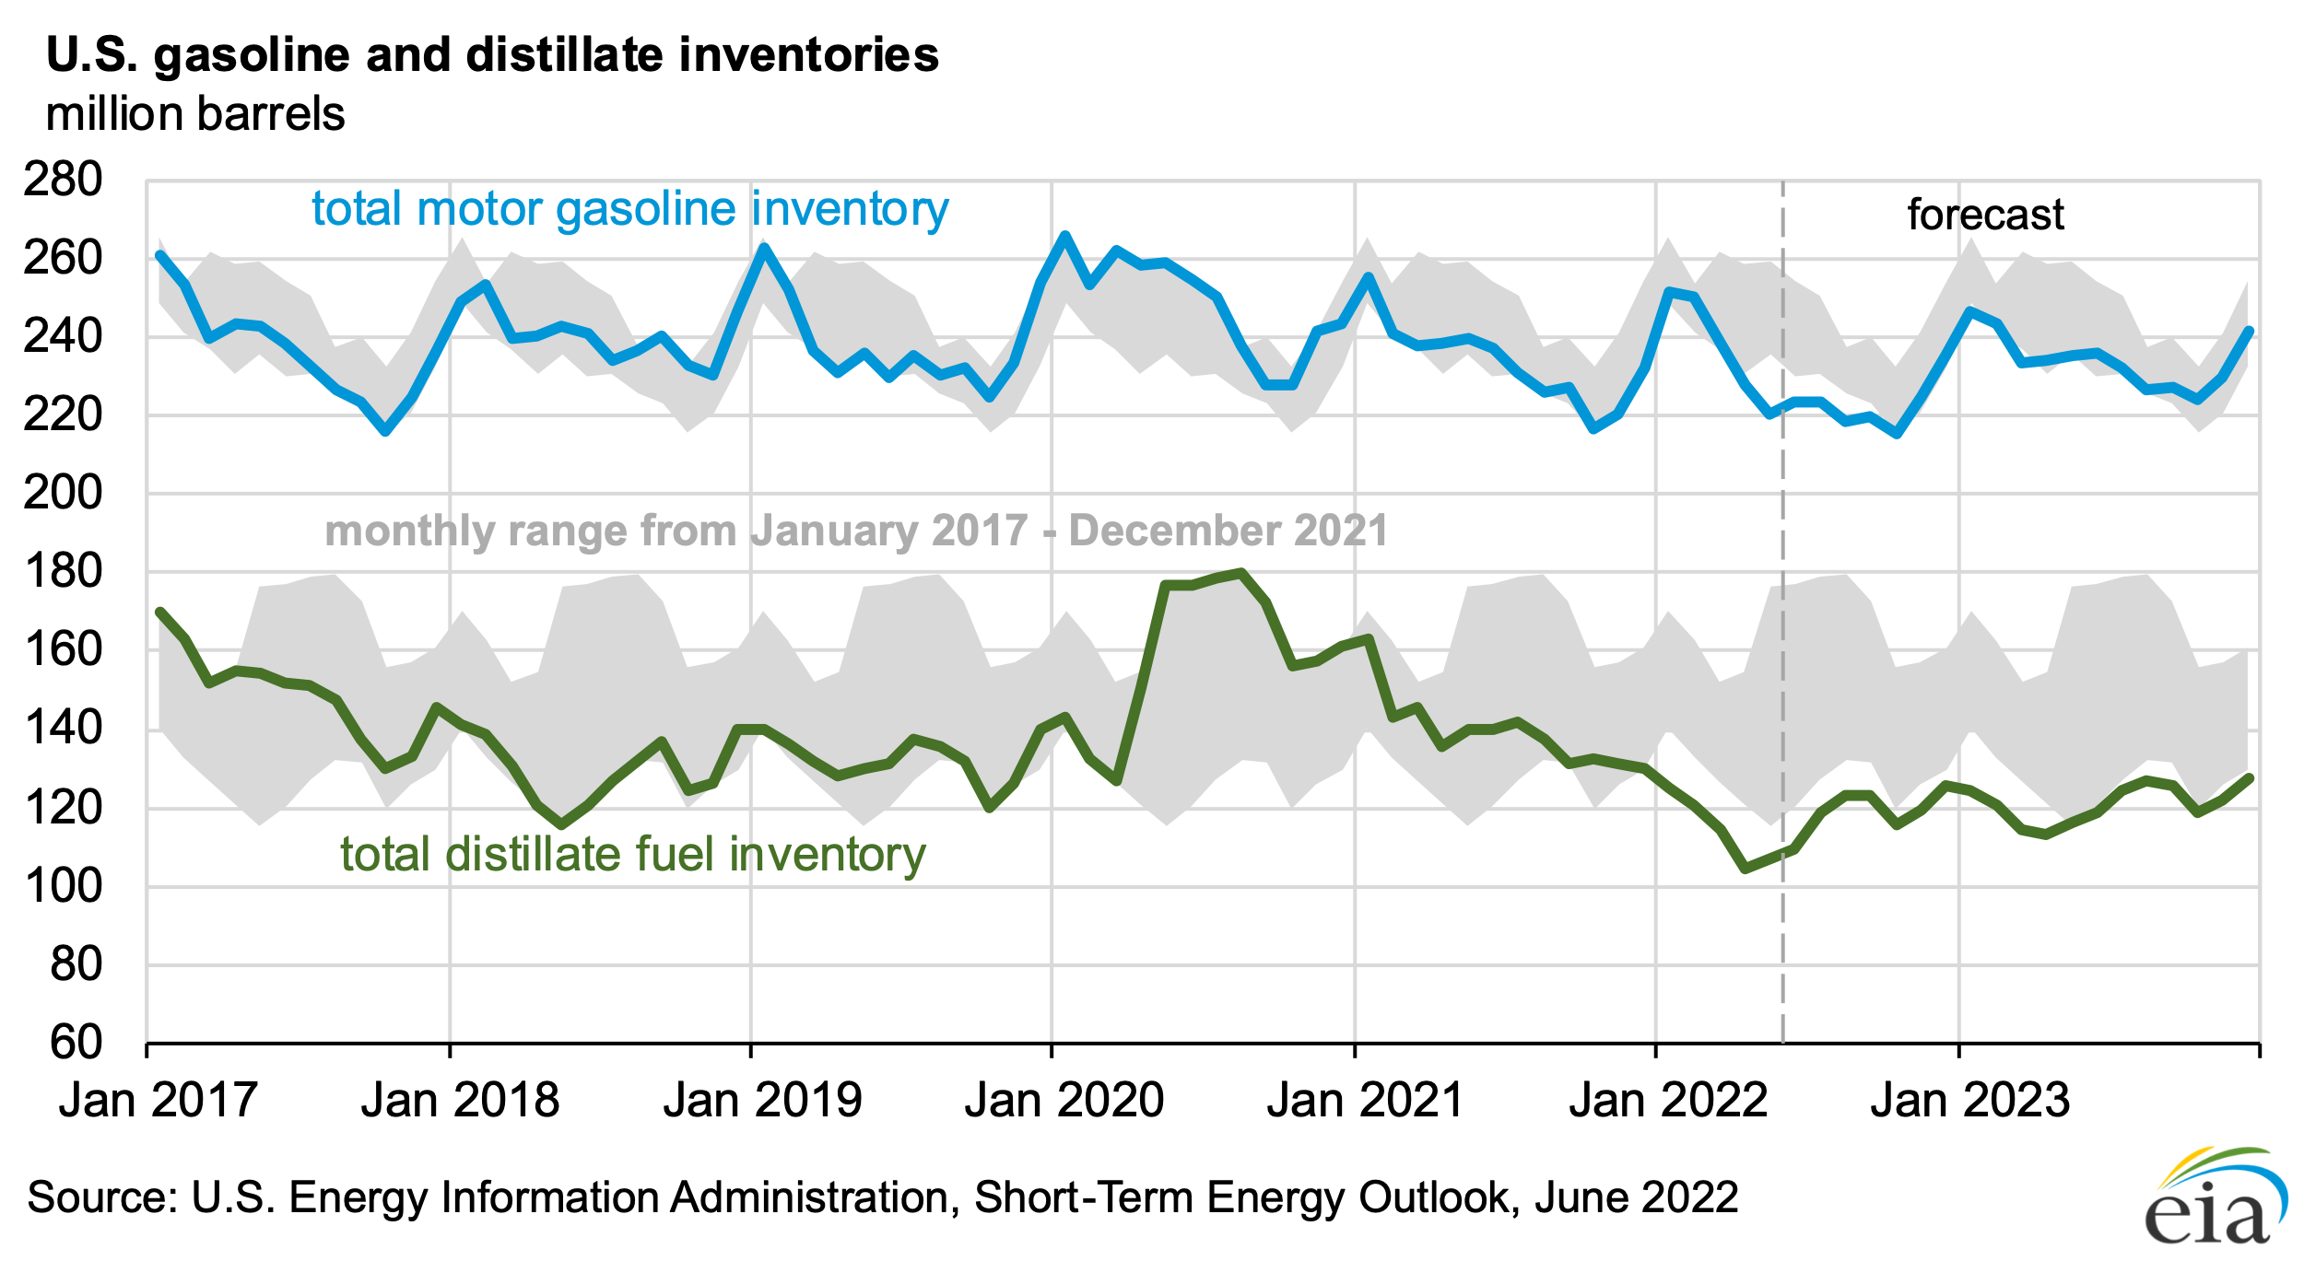
Gasoline and distillates

Slide 7
Natural Gas
Natural gas prices are rising mainly because
natural gas inventories that are below the five-year average
steady demand for U.S. liquefied natural gas (LNG) exports
high demand for natural gas from the electric power sector given limited opportunities for natural gas-to-coal switching
U.S. natural gas inventories ended at 5-yr low
May at 2.0 trillion cubic feet, 15% below the five-year average.
EIA forecast natural gas inventories will end the 2022 9% below the five-year average at 3.3 trillion cubic feet
US production forecast to increase 3% in remainder 2022 and further increases through 2023

Slide 8
Natural Gas
Demand increasing or steady
85 billion cubic feet / day
LNG exports around 11-12 billion cubic feet / day
Electric power generation continues strong demand
Coal plant closures
Renewables backup
Difficulty in gas-to-coal switching
Price remains strong through ~mid-2023
$8.70 per million Btu forecast through 3Q22
Dropping toward <$5/MMBtu
Timing remains uncertain further out
U.S. DoE

Slide 9
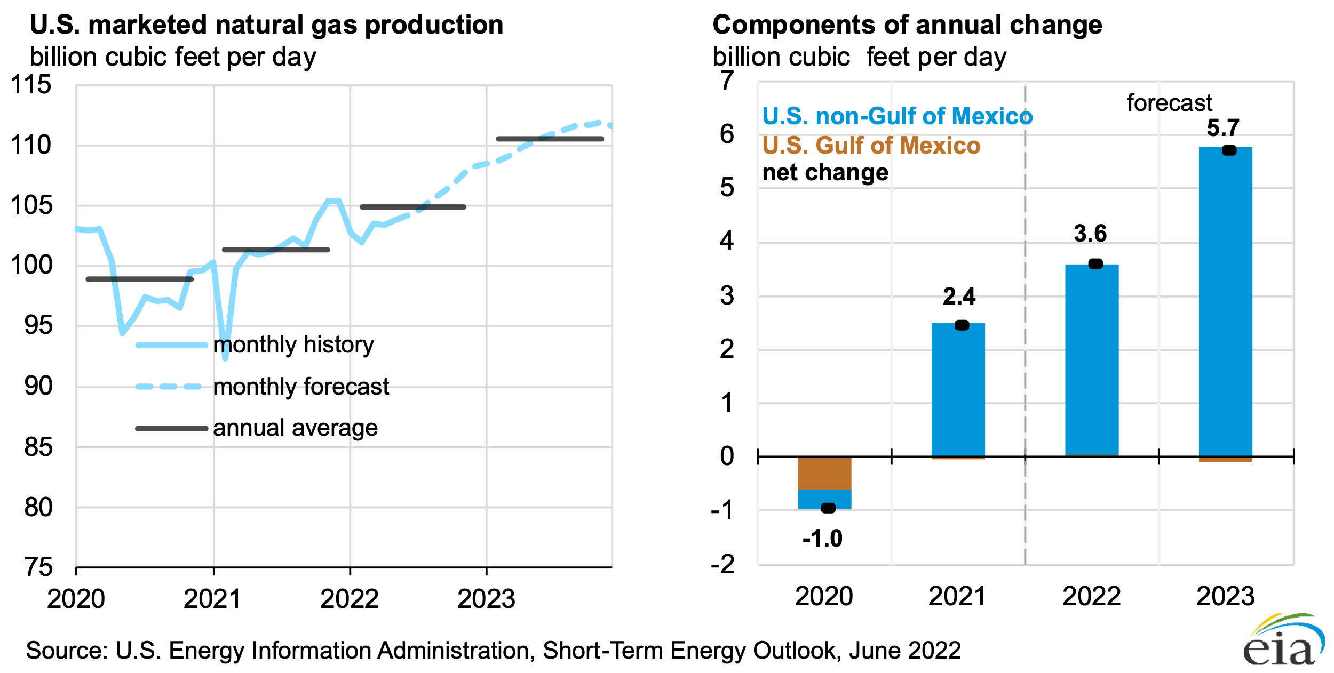

Slide 10
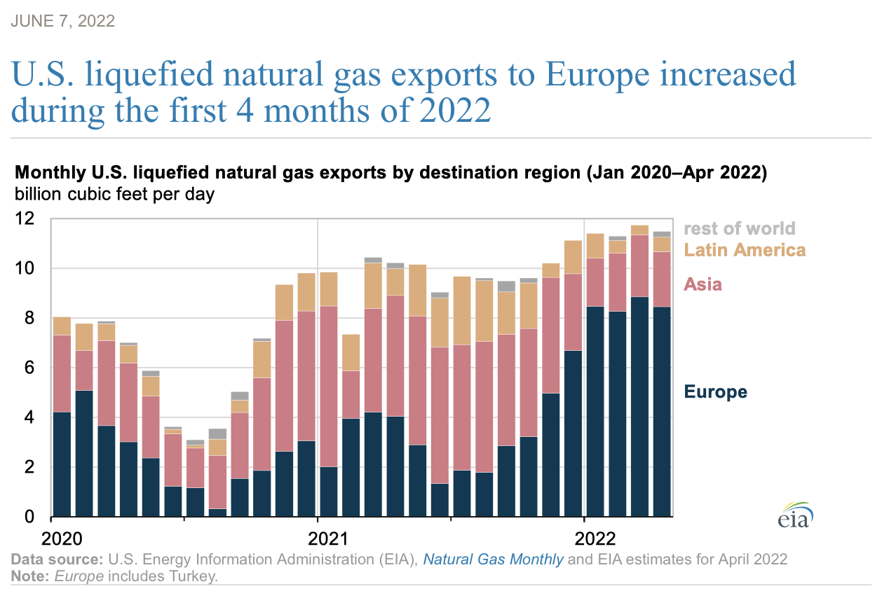
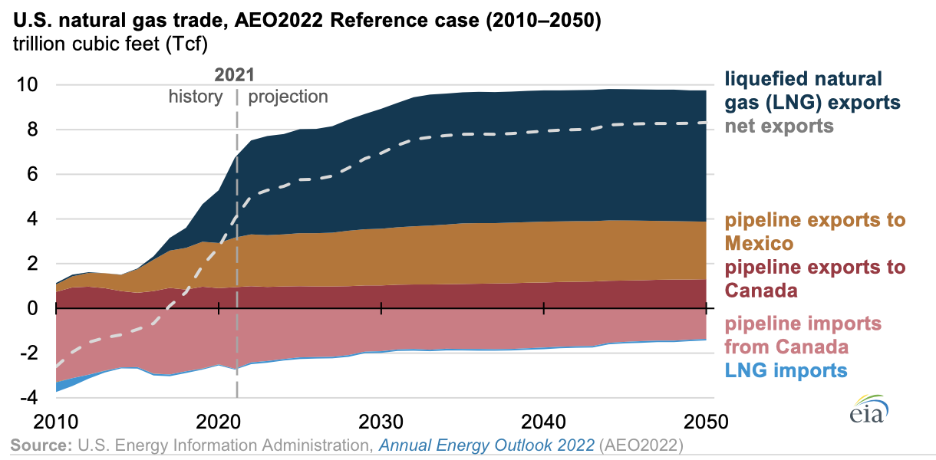
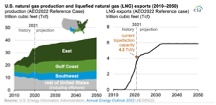
Natural gas exports continue to increase

Slide 11
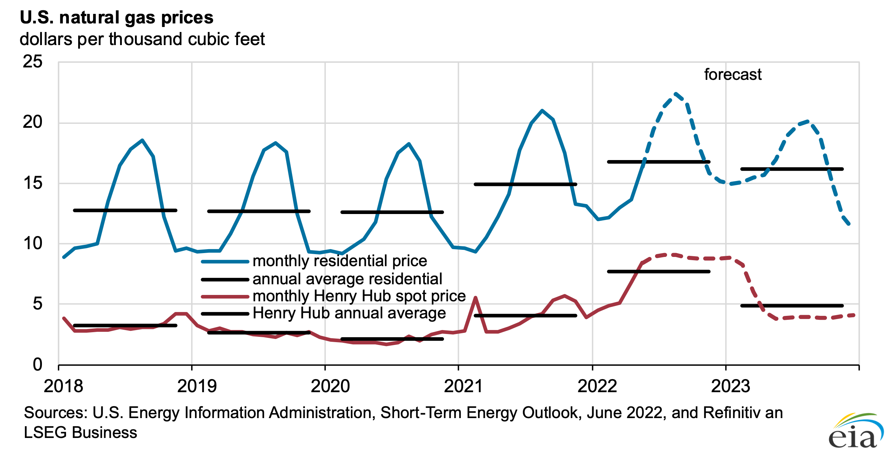
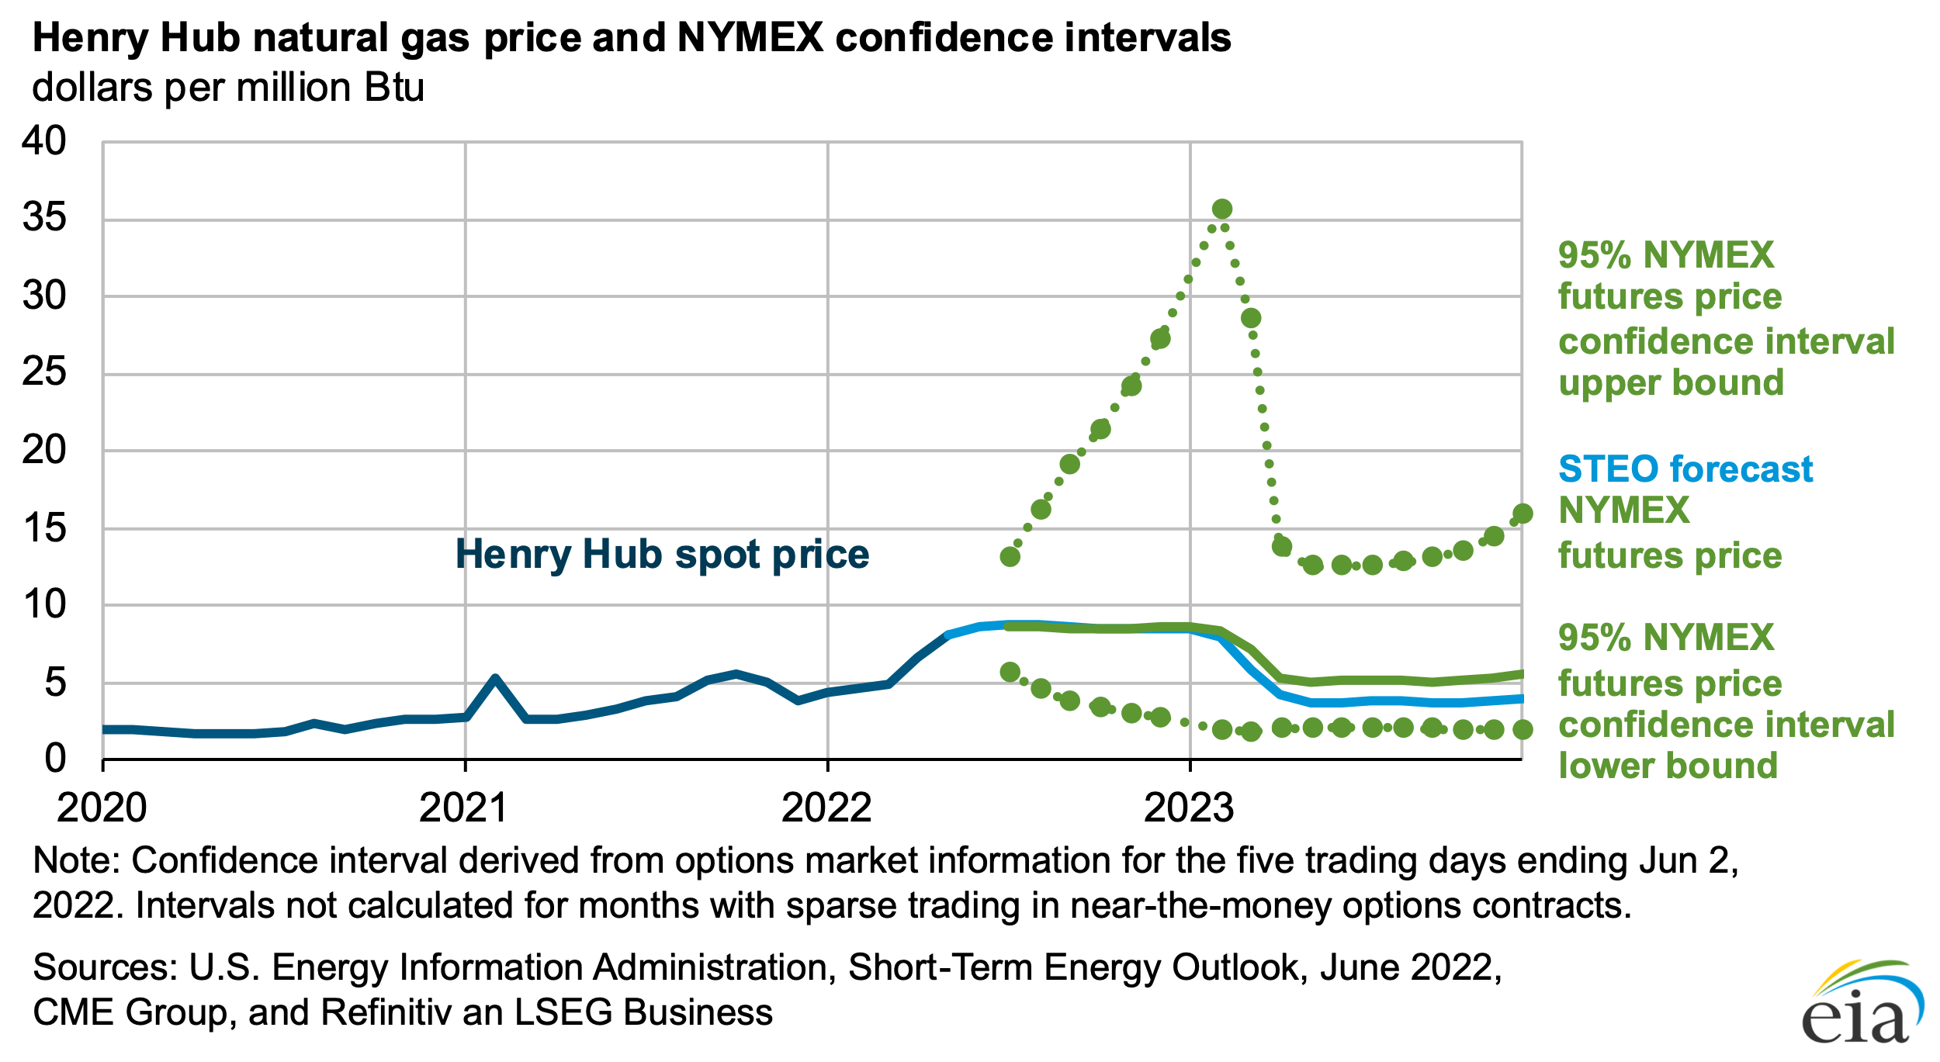
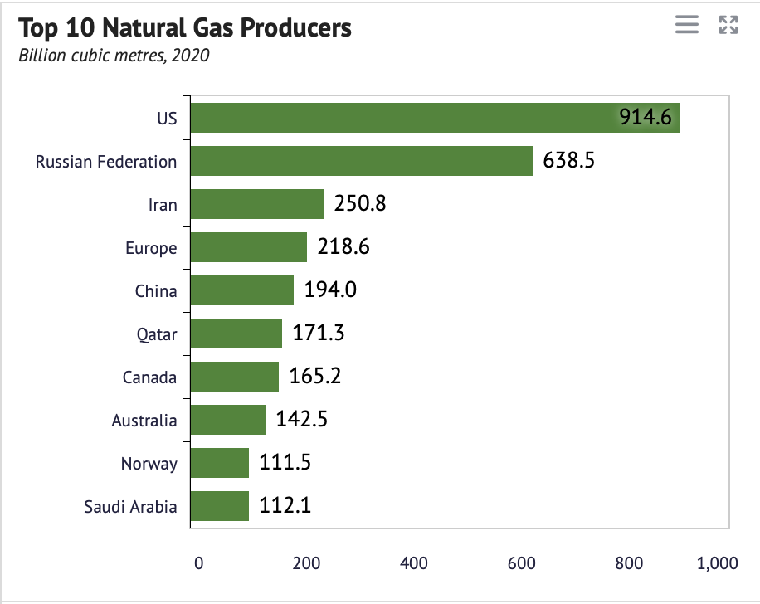
Natural gas prices ease in 2023
Knoema.com

Slide 12
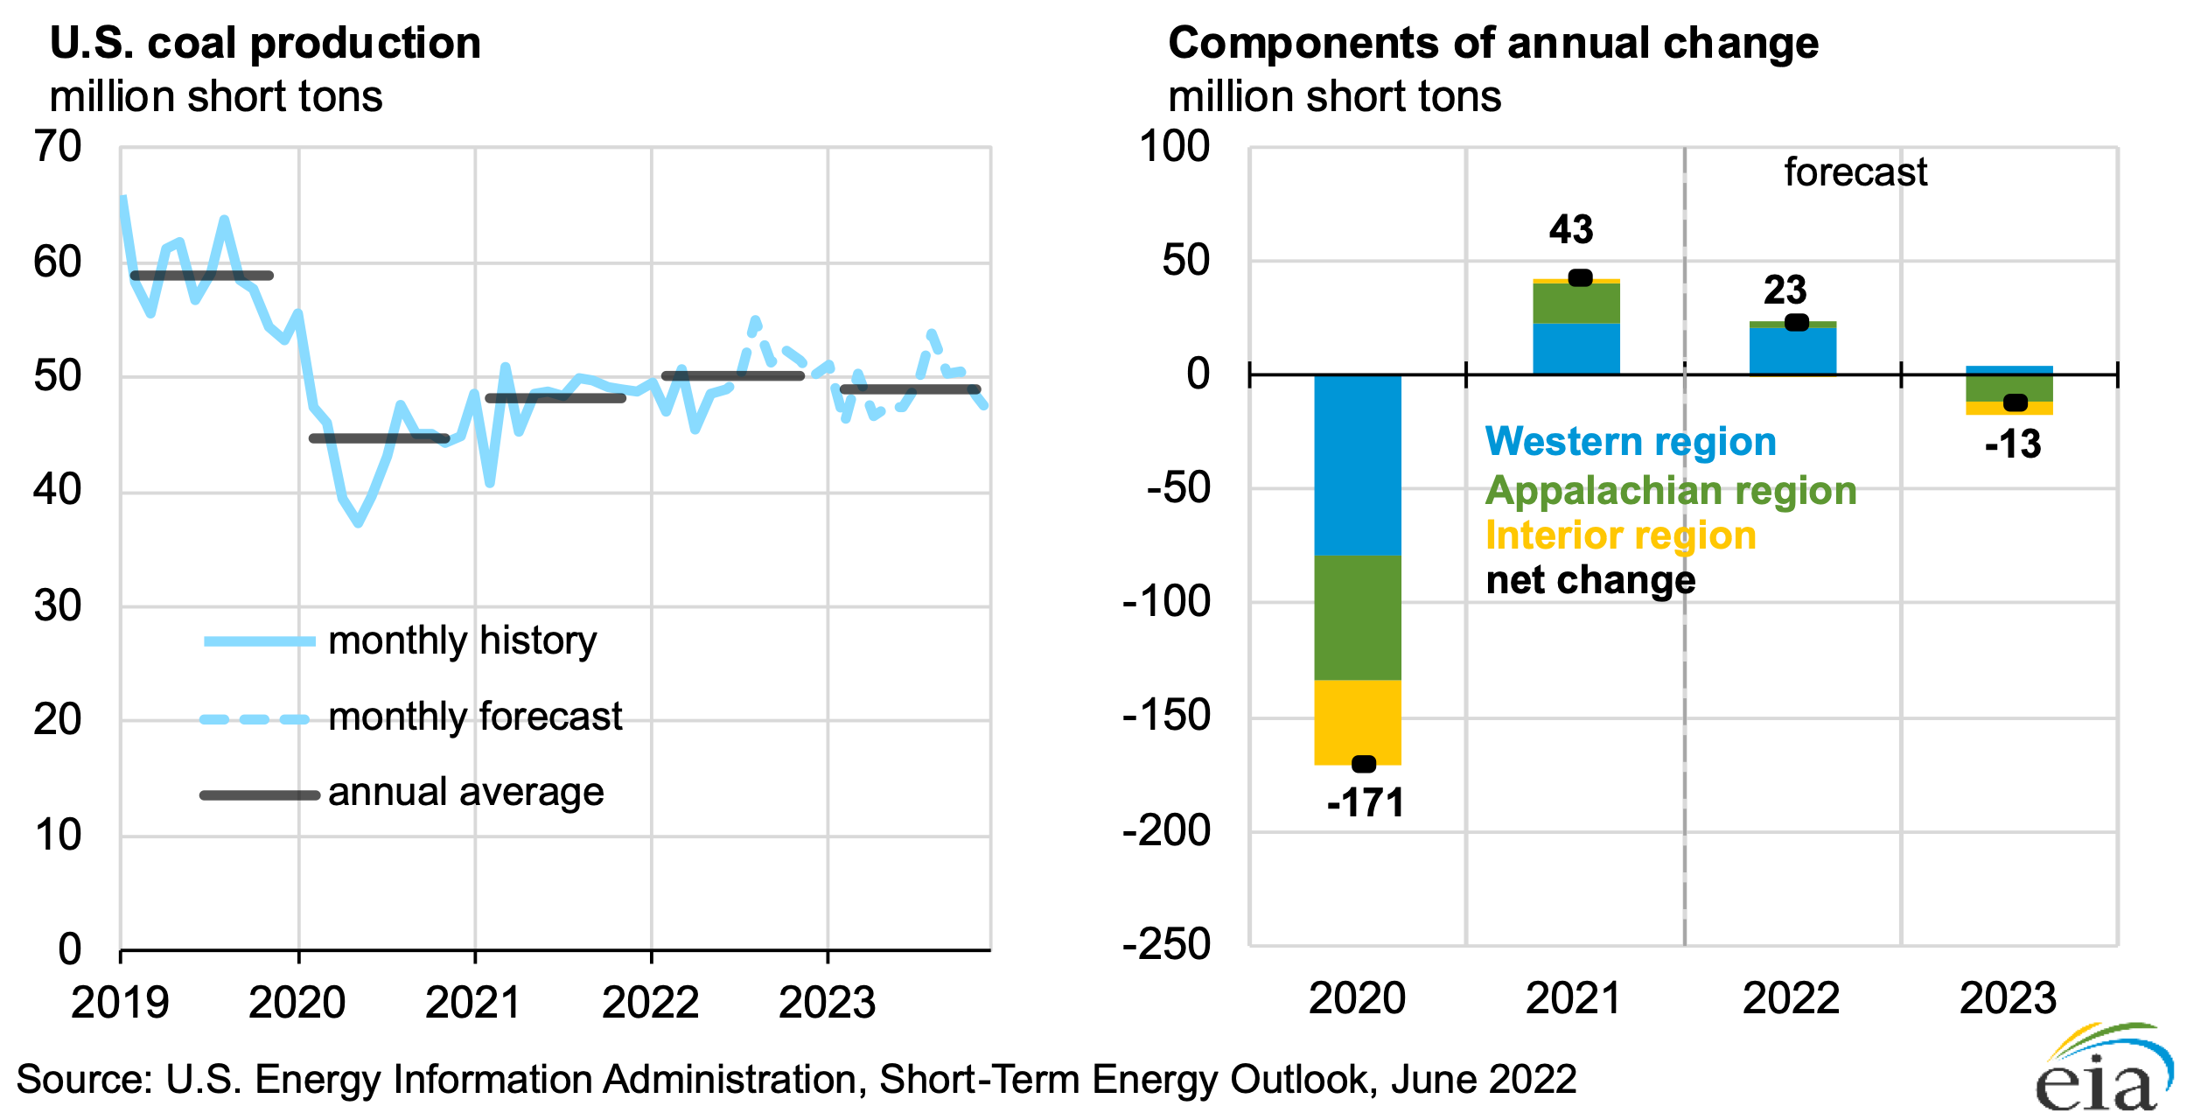
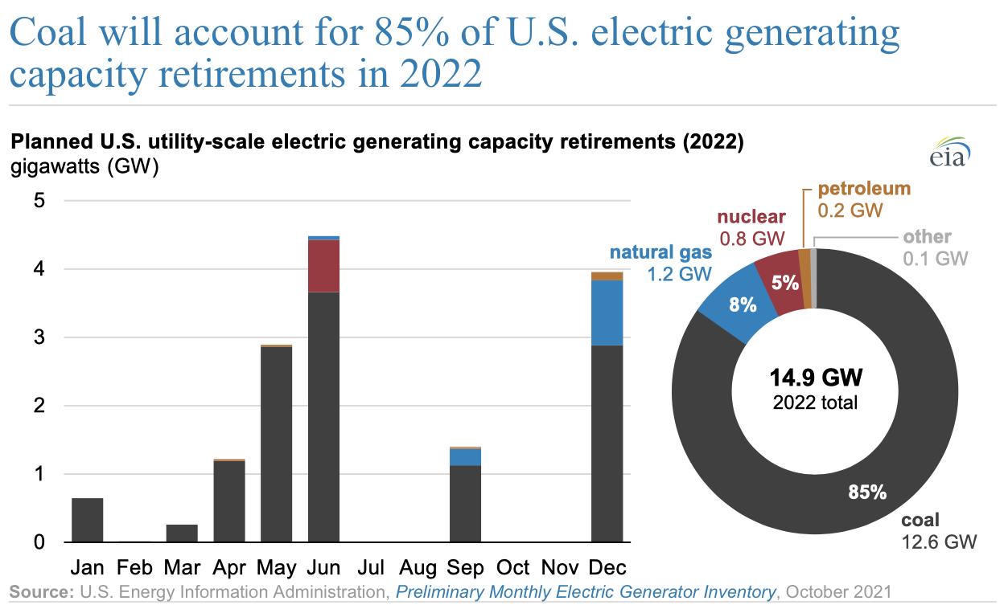
Coal
U.S. coal production forecast
increases by 23 million short tons (MMst) (3.9%) in 2022 to 601 MMst
Primarily western coal
declines 13 MMst (2.1%) to 588 MMst in 2023
Primarily App and Interior
Factors affecting increase
coal use in the electric power sector will decline
replenish electric power sector inventories
coal exports

Slide 13
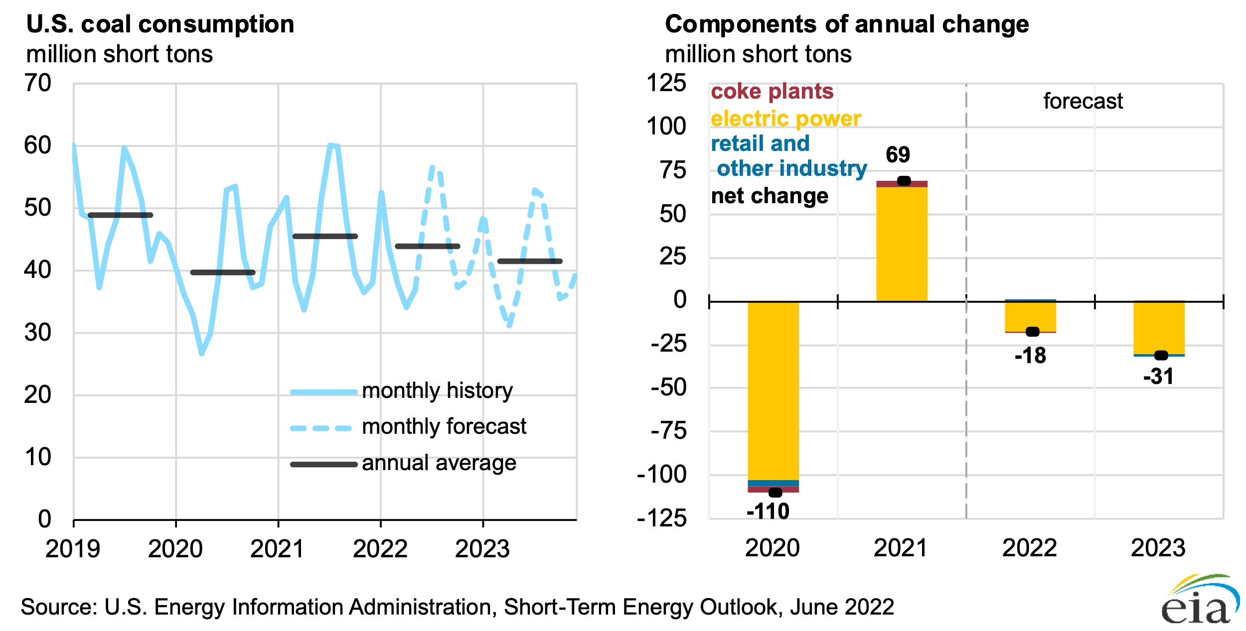
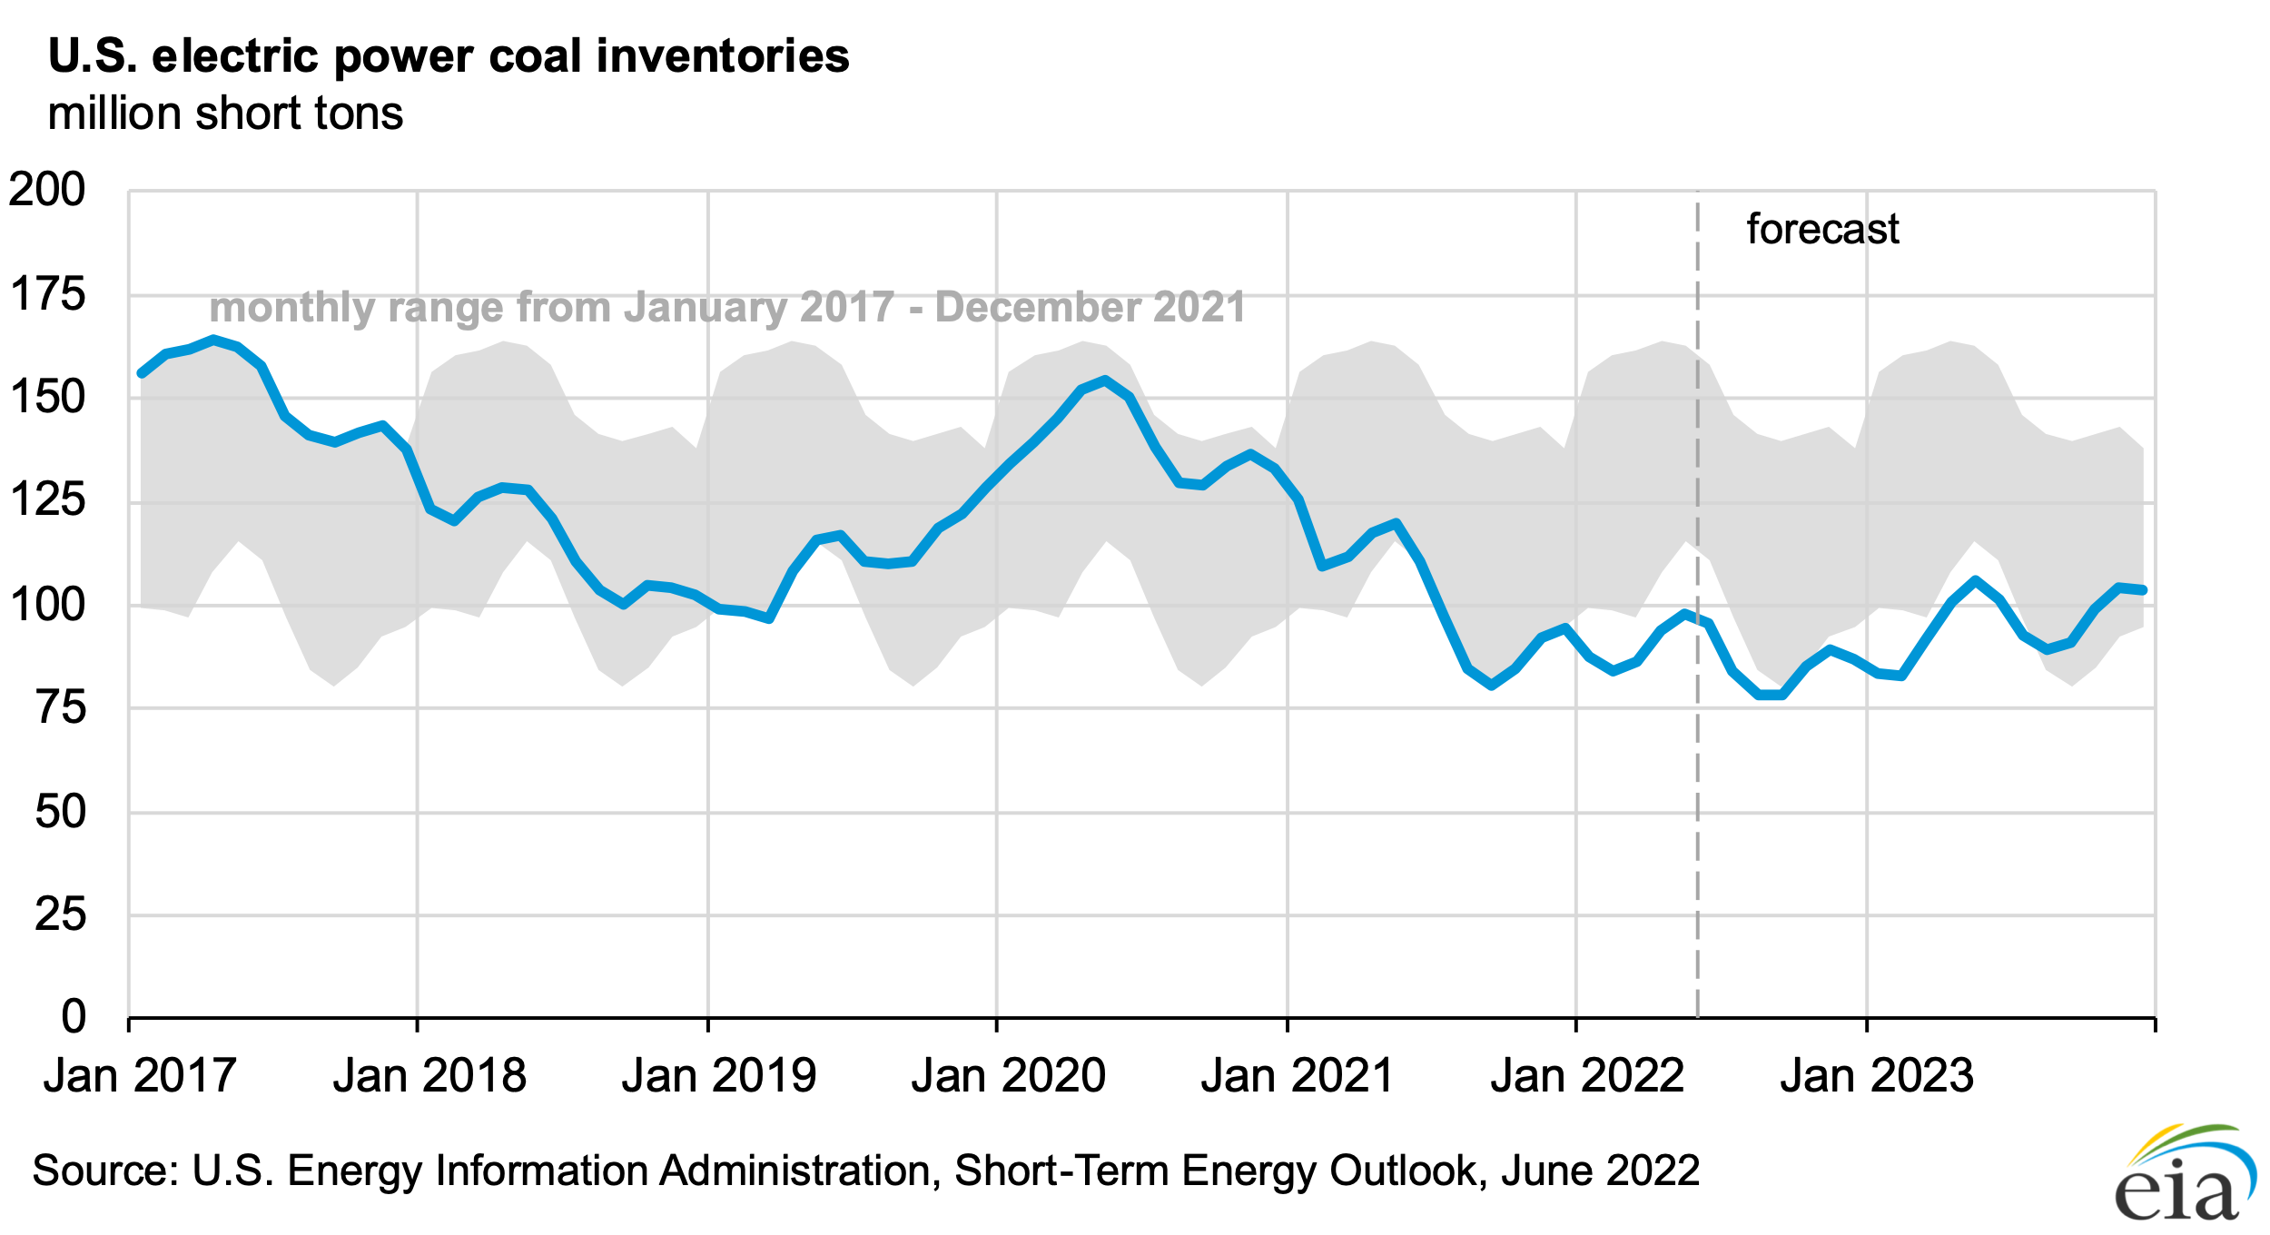
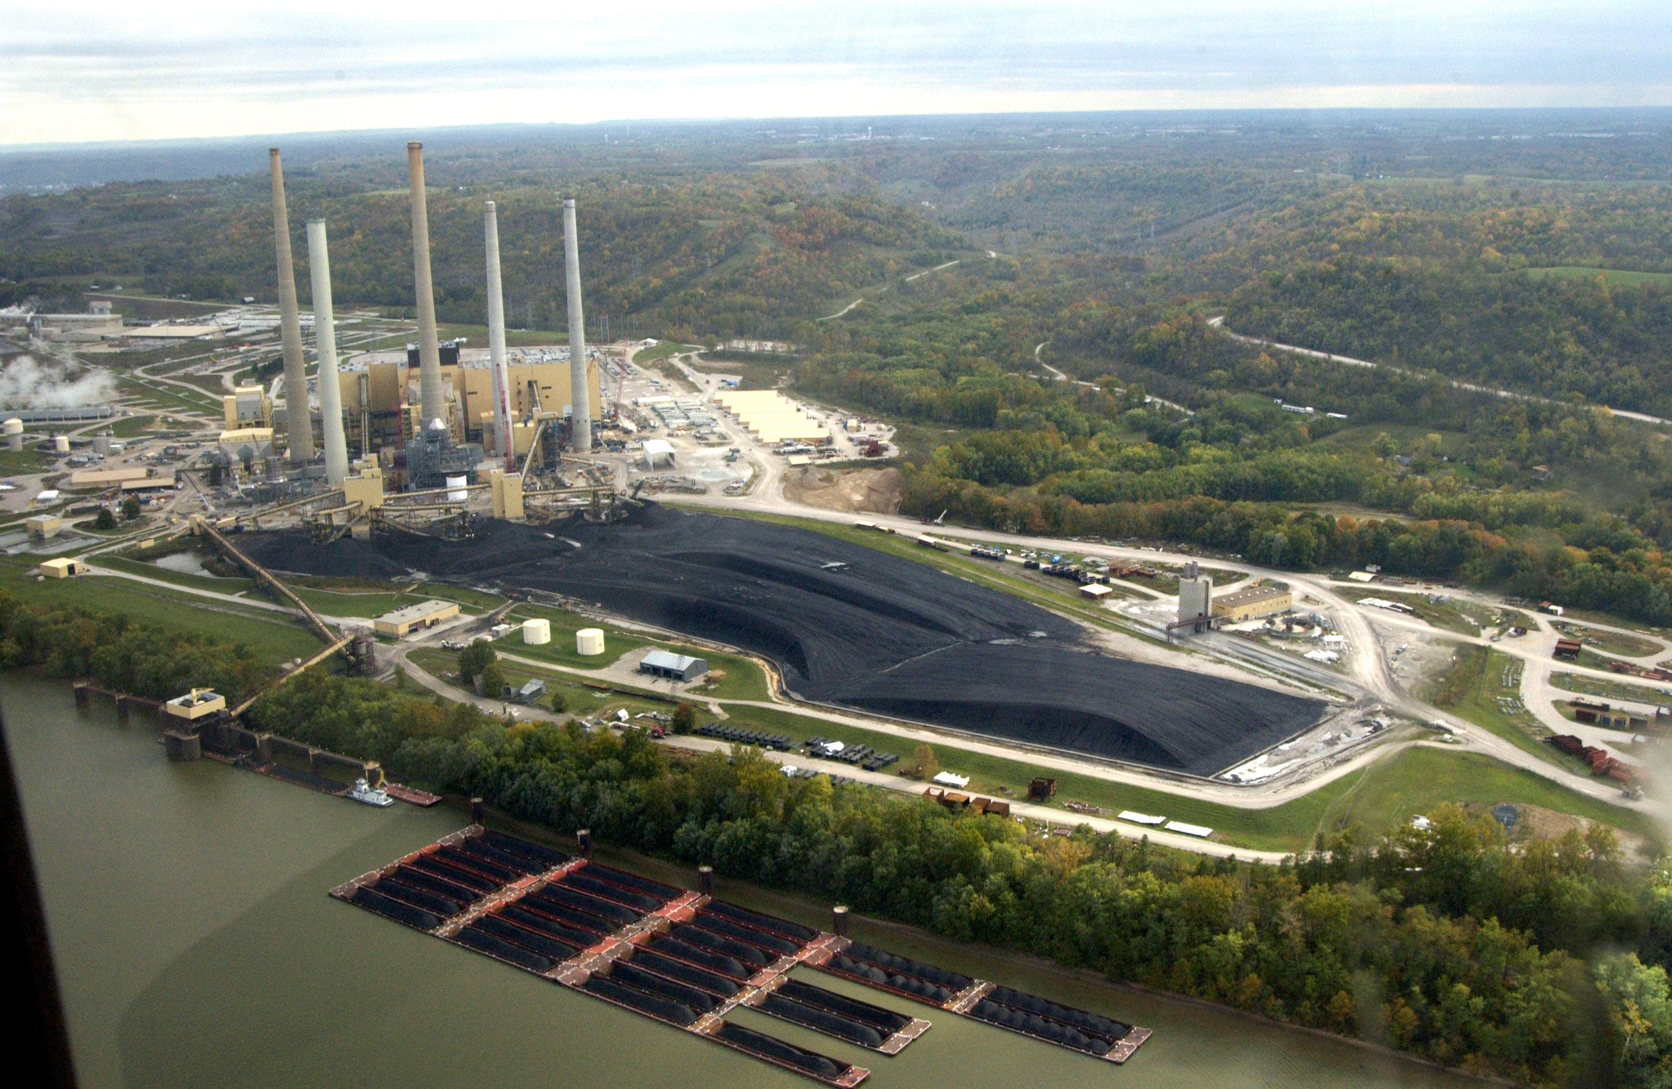
Low inventory and retirements in electric power prevent switching
EKPC

Slide 14
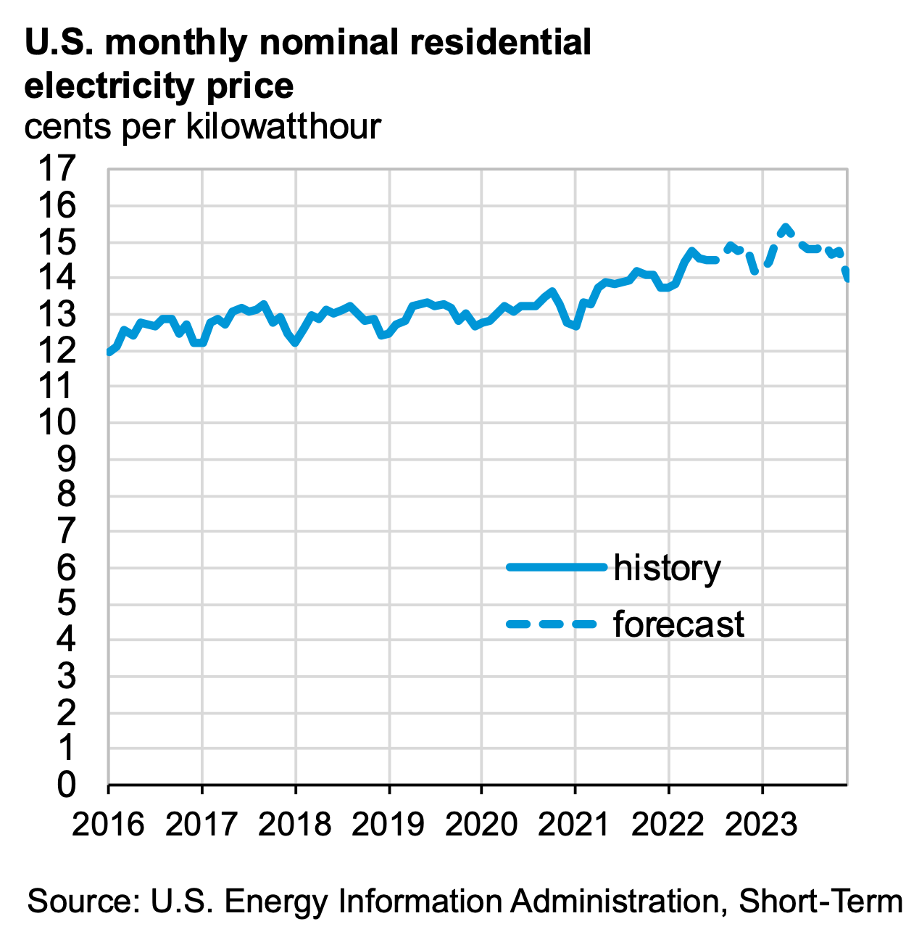
Electric Power

Slide 15
Mid-range trends in electricity
Coal-fired closures continue, but Kentucky stable
Coal delivery contracts are short-term issue
Continued decrease in costs for solar
But constrained by lack of storage
Interest in nuclear continues to expand
Reliable, ‘carbon free’, base-load power to offset renewables
Small modular reactors improve economics
Federal investment encourage technology development

Slide 16
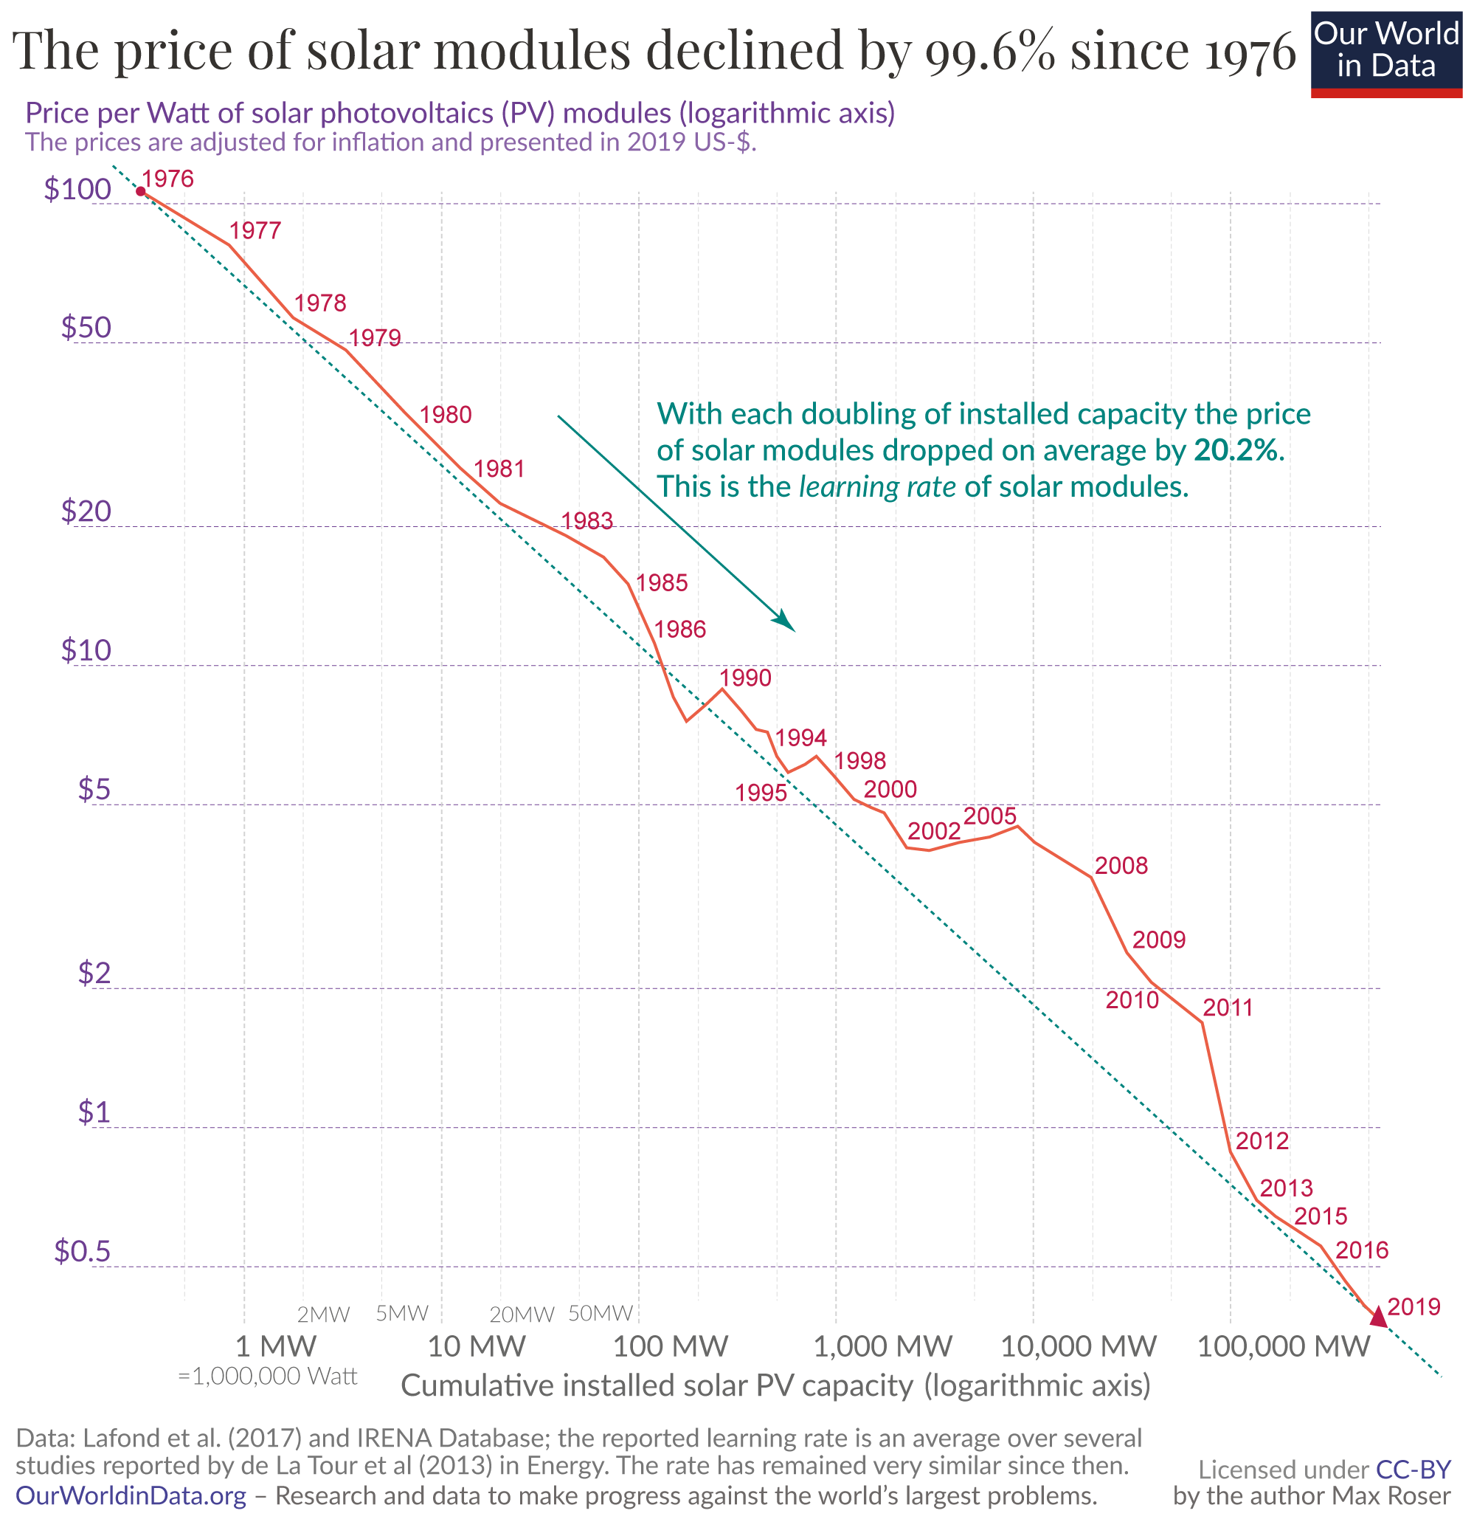
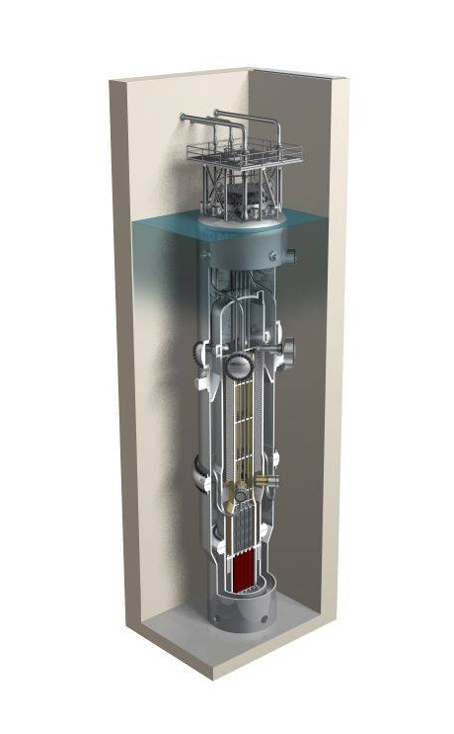
Generation options changing rapidly
NRC approval of NuScale Small Modular Reactor Design

Slide 17
Summary
Gasoline and diesel costs will ease somewhat but remain above $4/gal into early 2023
Downward adjustment expected mid-2023
Natural gas pricing likely to remain at or above current prices into 2023, but settle near $5/MMBtu
Coal remains at current demand and pricing
Natural gas pricing will drive overall electricity markets for near term, but lower solar and nuclear costs are expected
Uncertain will remain high in markets through 2023

