Slide 1
Implications of Energy Market Trends on Utility Regulation
Kent Chandler, Chairman
Kentucky Public Service Commission
Presentation: Natural Resources and Energy Interim Joint Committee
June 9, 2022
Any views expressed in this presentation are those of the presenter and do not reflect official positions of the PSC.

Slide 2
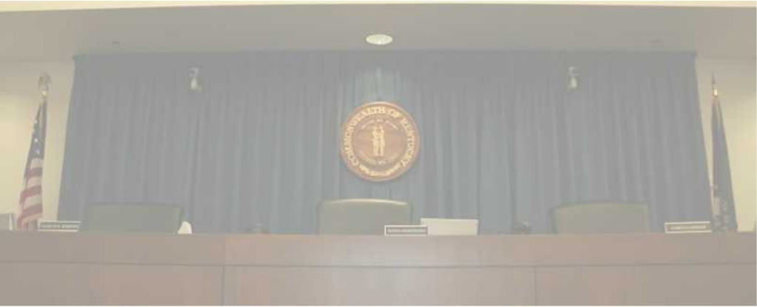
PSC Mission
To foster the provision of safe and reliable service at a reasonable price to the customers of jurisdictional utilities while providing for the financial stability of those utilities by setting fair and just rates, and supporting their operational competence by overseeing regulated activities.

Slide 3
Public Service Commission
Independent Regulatory Agency
Three-member Commission
Quasi-judicial function
Regulates rates and service provided by jurisdictional utilities:
1,100 jurisdictional utilities
Water and sewer utilities (small systems comprise the bulk of regulated utilities)
Natural gas distribution systems and intrastate pipelines
Electric utilities (investor-owned and jurisdictional cooperatives)
Telecommunications (small number)
Does not regulate municipal utilities except for gas pipeline safety.
Does not regulate cooperatives served by TVA.

Slide 4
Reliability—Service and Rates
Since 1934, the primary statutory directive of utility regulation in Kentucky revolves around:
Rates
Fair, just and reasonable
Service
Adequate, efficient and reasonable
Most everything in retail utility regulation comes back to one or both of these principles.

Slide 5
Energy Market Trends: Implications on Utility Regulation
Current and emerging trends make each of these more complex relative to prior decades:
Fuel Adjustment Clause(“FAC”) (807 KAR 5:056)
Integrated Resource Planning (807 KAR 5:058)
Certificate of Public Convenience and Necessity (KRS 278.020(1))
Rate Cases

Slide 6
Fuel Adjustment Clause (“FAC”)
The FAC regulation has been in effect for 40 years.
The FAC regulation allows jurisdictional utilities to reflect, through a line item on customers’ bills, the incremental or decremental cost of purchased power and/or fuel. Expenses incurred in a particular month appear in a subsequent month.
Fuel costs make up a significant portion of the cost of providing electricity.
For instance, in 2021, Kentucky Utilities, the largest utility in the Commonwealth, had approximately $1.64B in retail sales, while of that, $500M, or almost 1/3 of sales, was a pass through of fuel costs.
As we’ve seen in the last year, fuel expenses can fluctuate widely.
Compared to the past 10 years, all electric and natural gas utilities have experienced higher fuel and purchased power costs in recent months.

Slide 7
Fuel Adjustment Clause- How it works
The incremental or decremental amount of the FAC is set against a baseline fuel cost that is otherwise recovered through base rates- e.g. the customer and kWh charge.
If the utility’s fuel costs in a given month are above the baseline, the FAC appears as a per-kilowatt-hour surcharge (increment).
If fuel costs fall below the baseline, the FAC appears as a per-kilowatt-hour credit (decrement).
Utilities are required to fully document all of their fuel costs, including submitting fuel purchase contracts, fuel bid sheets and other materials to the PSC.
The PSC reviews a utility’s FAC filings, including conducting a detailed review every six months and then a final review, which occurs at two-year intervals.
During its review, if the PSC determines costs to be unjustified due to improper calculation or application of the charge or improper fuel procurement practices, the PSC may disallow recovery of those costs and order a refund to customers.

Slide 8
Integrated Resource Planning
Integrated Resource Planning (807 KAR 5:058)—prescribes rules for regular reporting and commission review of load forecasts and resource plans of electric utilities to meet future demand with an adequate, reliable supply of power within their service areas.
Filed every three years —15-year planning horizon—includes historical and projected usage, resource, and financial data, and other operating performance and system information.
IRPs include summary of planned resource acquisitions, new power plants, transmission improvements, etc.
Plans are reflective of expected data- fuel, environmental and operational costs play a huge role in resource choices to serve load

Slide 9
Certificate of Public Convenience and Necessity
Prior to construction or acquisition of any major facility, a utility must apply for a CPCN.
Burden of proof lies with the applicant. Must show need for the proposed facility and an absence of wasteful duplication.
Utility must show it has reviewed all reasonable options, such as various types of new facilities.
“Least cost” principle flows from the absence of wasteful duplication. Long-term costs also must be considered.
Cost of fuel is a direct input into the calculation of operating cost of resources. If fuel cost for a particular resource is expected to increase relative to other types of resources, models may not choose that resource based on fuel cost and fuel risk.

Slide 10
Regulatory Considerations
Plant retirements—end of “useful” life; cost of continuing to operate is more expensive than replacement generation
Reliability and Resource Adequacy
Effective date and impact of anticipated environmental regulations (uncertainties—court challenges, administration changes, etc.).
Technical viability and costs of emerging technologies
Impact of demand response and other distributed energy resources (customer-sited generation)
Purchased power versus “steel in the ground”
Wholesale markets
Distribution System Planning

Slide 11
Emerging Trends—Generation Options. What is available?
Wind—Few places in Kentucky have adequate wind speeds and topography
Solar—Requires about 6-10 acres per MW, less reliability contribution in winter months
Nuclear—Currently unlikely, however emerging, advanced technologies could alter viability
Coal—New units unable to be built, primarily because of NSR requirements
Natural Gas—Often chosen by generation modeling as least-cost resource, but risks exist around ability to site infrastructure and actual useful life
Energy Efficiency/Demand Side Management—plenty of cost-effective amounts available, but inability to actually produce electricity
Batteries—limited duration (4 to 8 hours) and relatively expensive
Hybrid Resources—Promising, but relatively new
Hydrogen—Not yet proven to be cost-effective or readily available

