Slide 1
Kentucky Energy Update
Interim Joint Committee on Natural Resources and Energy
October 20, 2022

Slide 2
Coal Employment

Slide 3
Coal Severance Taxes
¹
¹ Note: first quarter FY23 Coal severance tax is up 72.2% over first quarter FY22

Slide 4
Historic Kentucky Coal Production

Slide 5
Kentucky Coal Production

Slide 6
Actively Producing Kentucky Permits

Slide 7
Mines Licensed

Slide 8
Coal Mining Permit Applications Received

Slide 9
Coal Mining Permits Issued

Slide 10
Fuel Monitoring at the Office of Energy Policy
The Office of Energy Policy is responsible for maintaining Kentucky’s Energy Assurance (Security) Plan.
The Energy Security Plan is the operations manual for maintaining situational awareness of electricity and fuels during normal and disruption events.
The Office of Energy Policy along with the Public Service Commission serves as the Emergency Support Function for Energy at the Emergency Operations Center during an event activation.
Our situational awareness is based on relationships with our private sector partners and access to a variety of data sources.
For example, The State Heating Oil and Propane Program (SHOPP).

Slide 11
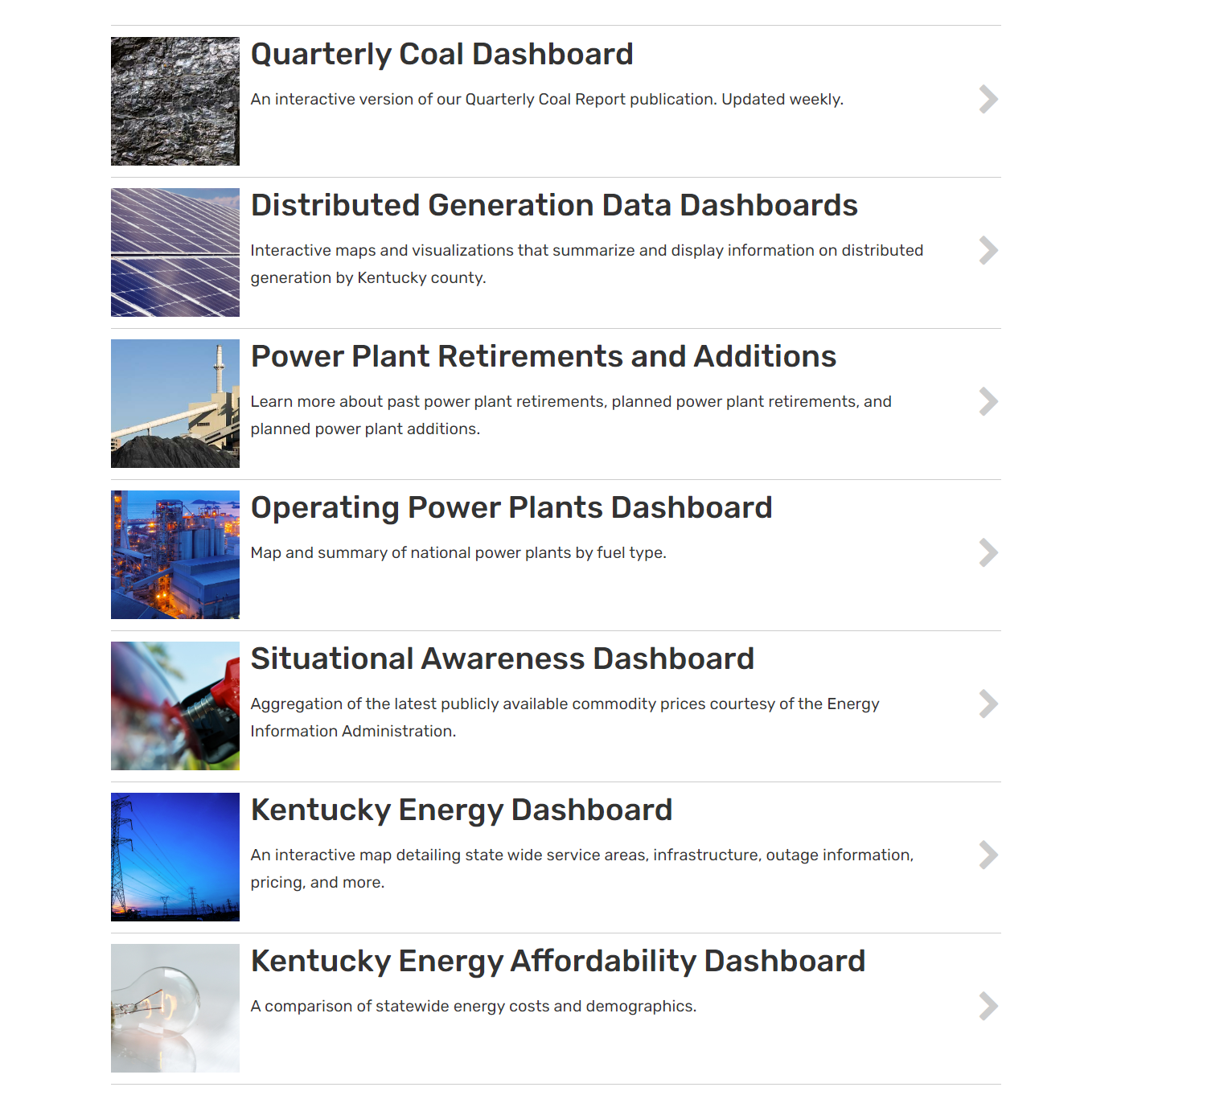
Situational Awareness Tools

Slide 12
Coal and Natural Gas Markets
Pricing, Consumption, and Exports

Slide 13
Kentucky Energy Facts
About 95% of Kentucky's coal stays in the United States, with about two-fifths of that coal remaining in Kentucky and the rest sent to nearly 20 other states, where it is burned primarily by power plants to generate electricity.
For 2021, according to U.S. Census data, foreign exports from Kentucky have increased to 5% of coal production and include Africa, Asia, Europe, South and Central America
About 42% of Kentucky's coal consumption is met with the state's own coal, and the remaining coal consumed in Kentucky is brought in from other states, primarily Illinois, Wyoming, and West Virginia.
About 70% of Kentucky’s electricity generation is derived from coal and about 20% is derived from natural gas.

Slide 14
Kentucky Energy Facts – cont.
Consumption of natural gas in Kentucky is almost five times greater than the state's production, and several interstate natural gas pipelines bring natural gas supplies to Kentucky consumers.
Kentucky has 22 underground natural gas storage facilities that can hold nearly 222 billion cubic feet of gas—about 2% of U.S. total storage capacity.
In 2021, Kentucky's industrial sector consumed record volumes of natural gas and accounted for almost two-fifths of the natural gas used in the state.
Almost 4 out of 10 Kentucky households use natural gas for home heating.

Slide 15
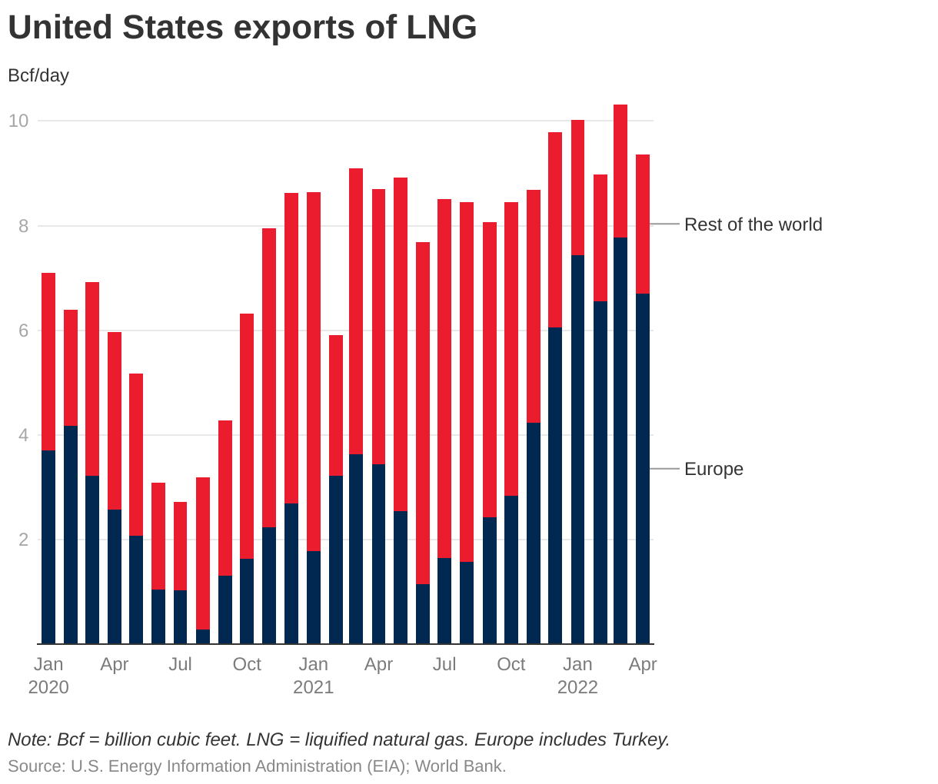
Natural Gas Exports

Slide 16
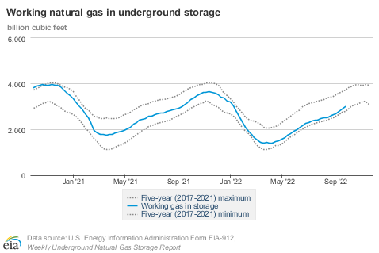
Natural Gas in Storage

Slide 17
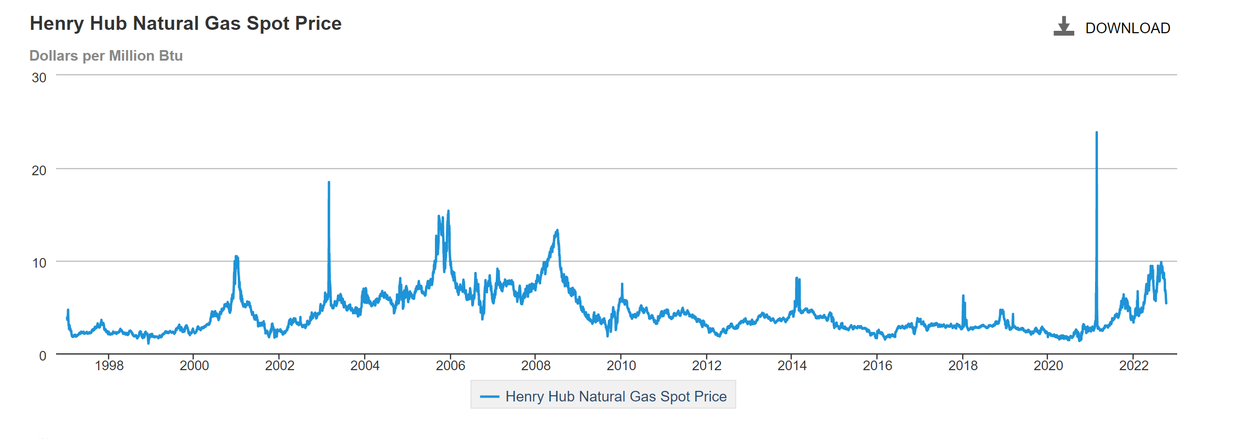
Natural Gas Spot Prices

Slide 18
Coal Consumption and Stockpiles
U.S. coal consumption totaled 118 MMst in the second quarter of 2022, which was 11.7% lower than the 133.7 MMst reported in the first quarter of 2022 and 5.3% lower than the 124.6 MMst reported in the second quarter of 2021. The electric power sector accounted for about 91% of the total U.S. coal consumption in the second quarter of 2022.
In the second quarter of 2022, coal stocks grew to 119.8 MMst from 116.8 MMst at the end of the first quarter of 2022 (a 2.6% increase). Stockpiles in the electric power sector increased to 87.3 MMst from 86.2 MMst at the end of the first quarter of 2022.

Slide 19
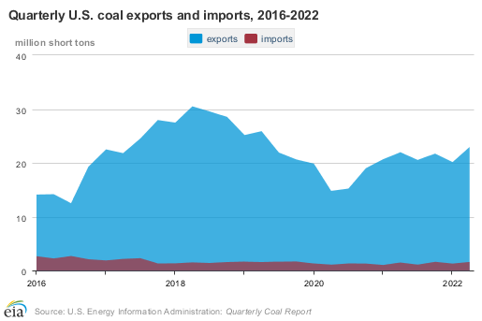
Coal Exports

Slide 20
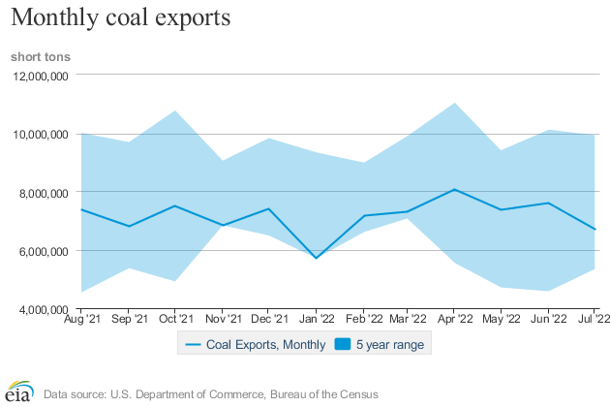
Monthly US Coal Exports
U.S. coal exports for the second quarter of 2022 (23 MMst) increased 13.9% from the first quarter of 2022. The average price of U.S. coal exports during the second quarter of 2022 was $231.68 per short ton.
Notes:
U.S. coal production during the second quarter of 2022 totaled 145.7 million short tons (MMst), which was 2.2% lower than the previous quarter and 2.1% higher than the second quarter of 2021. Production in the Western region, which represented about 54.6% of total U.S. coal production in the second quarter of 2022, totaled about 79.5 MMst (0.7% lower than the second quarter of 2021).
The United States continued to import coal primarily from Colombia (59.4%), Canada (33.4%), and Indonesia (3.6%). No imports from Australia were recorded for the second quarter of 2022. U.S. coal imports in the second quarter of 2022 totaled 1.6 MMst. The average price of U.S. coal imports during the second quarter of 2022 was $103.54 per short ton.
Steam coal exports totaled 9.9 MMst (2.3% higher than the first quarter of 2022). Metallurgical coal exports totaled 13.1 MMst (24.7% higher than the first quarter of 2022).

Slide 21
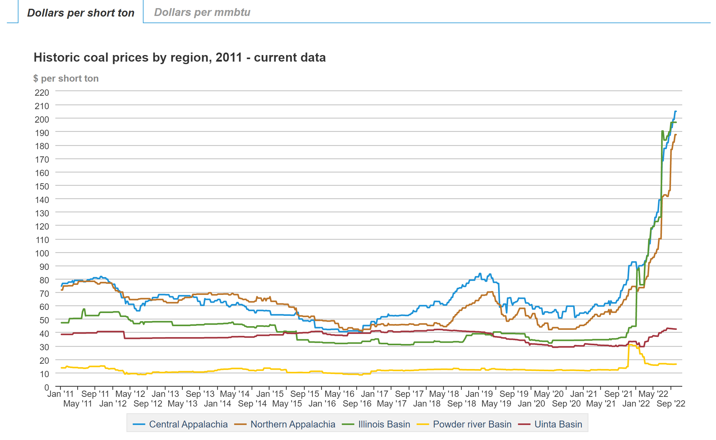
Coal Prices By Region -2011 to Present

Slide 22
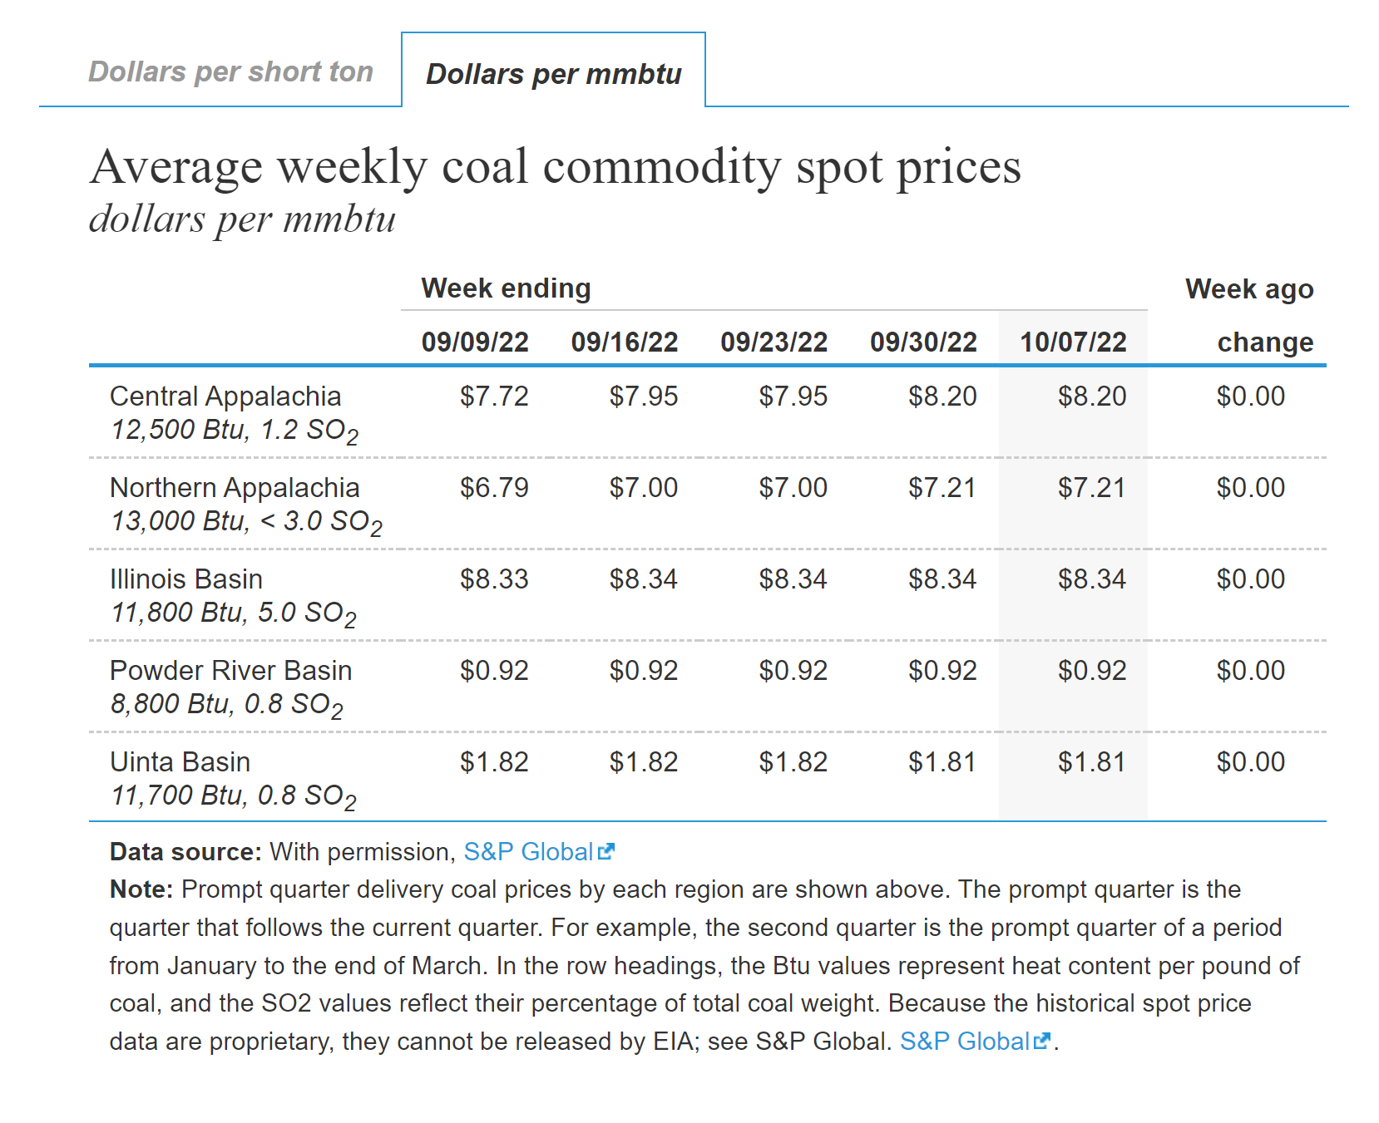
Weekly Coal Spot Price
For reference, the daily Henry Hub Natural Gas Spot Price for October 4, 2022 was
$5.4 per mmbtu.

Slide 23
Observations
Coal and natural gas are global commodities that face similar supply chain and market influences as other commodities.
Pandemics, weather events, world economic policies and geopolitical events impact demand, price, and production.
All data suggests that coal and gas prices will be lower in 2023 as supply and demand seek equilibrium; however prices are not anticipated to return to pre-pandemic levels.
Consumers will bear the additional fuel costs going into winter as associated fuel adjustment charges are expected to increase.
The Kentucky Energy Affordability Workgroup was formed to address these issues and identify long term solutions.

Slide 24
Contact Information
Rebecca Goodman, Secretary
Kentucky Energy and Environment Cabinet
RebeccaW.Goodman@ky.gov
John Lyons, Deputy Secretary
Kentucky Energy and Environment Cabinet
John.Lyons@ky.gov
Gordon Slone, Commissioner
Department for Natural Resources
Kentucky Energy and Environment Cabinet
GordonR.Slone@ky.gov
Kenya Stump, Executive Director
Office of Energy Policy
Kentucky Energy and Environment Cabinet
Kenya.Stump@ky.gov

