Slide 1
LIHEAP Preliminary State Plan Federal Fiscal Year (FFY) 2023
Jason Dunn, Director, Department for Community Based Services (DCBS)
Division of Family Support
Roger McCann, Executive Director,
Community Action Kentucky, Inc. (CAK)
July 7, 2022

Slide 2
DCBS Organization
DCBS: Marta Miranda-Straub, Commissioner
Division of Service Regions
Division of Administration and Financial Mgmt.
Division of Child Care
Division of Family Support
Division of Protection and Permanency

Slide 3
HISTORY…
LIHEAP
Established in 1982
Safety net focusing on energy conservation and heating and cooling
Meet immediate home energy needs
For households with the lowest incomes that pay a high proportion of income for home energy
LIHEAP funds spent to date FFY 2022 total $71.9M
Anticipated amount of funding for FFY 2023 $50M
100% federally funded
Low Income Home Energy Assistance Program (LIHEAP)

Slide 4
LIHEAP
Utilization…
90% of federal LIHEAP award assists Kentucky residents directly
$400,000 has been retained by DCBS for the Preventive Assistance Program to assist families receiving child protective services with a necessary energy payment
Up to 15% of this amount can be allocated for weatherization
Up to 10% of the award is used for administrative costs
Low Income Home Energy Assistance Program (LIHEAP)

Slide 5
Service Delivery Methods
Community action agencies (CAAs) utilize various means to complete applications including:
electronically
by mail
over the phone, and/or
office drop box
Additionally, some CAAs offer online scheduling for clients
Low Income Home Energy Assistance Program (LIHEAP)

Slide 6
150% of the Federal Poverty Guidelines (percent of poverty)
Household Size | Monthly Income
1 | $ 1,610.00
2 | $ 2,178.00
3 | $ 2,745.00
4 | $ 3,313.00
5 | $ 3,880.00
6 | $ 4,448.00
7 | $ 5,015.00
8 | $ 5,583.00
For each additional household member above 8, add $568.00 to the monthly income limit.

Slide 7
Assistance…
LIHEAP offers the following types of assistance to Kentucky residents:
Bill payment assistance for heating and cooling:
- Subsidy component
- Crisis component
Emergency assistance
Weatherization activities to increase the energy efficiency, health, and safety of eligible low-income individuals’ dwellings
Low Income Home Energy Assistance Program (LIHEAP)

Slide 8
Heating Subsidy…
LIHEAP Heating Subsidy Component:
Offsets home heating costs
Assistance amounts are structured according to a percentage of the household’s annual heating costs and percentage of poverty level met by the household
Application period is open from early November through Mid-December
- Early applications occur in October for the elderly and those with disabilities
- Appointments are available for working individuals
Low Income Home Energy Assistance Program (LIHEAP)

Slide 9
Heating Crisis…
LIHEAP Heating Crisis Component:
Offers assistance for an energy emergency
Application period is open from January through April
Assistance is limited to the amount necessary to relieve the crisis with the maximum amount not to exceed community action agency’s local cost for a deliverable supply of household’s primary heating fuel or $600 for gas or electric
Low Income Home Energy Assistance Program (LIHEAP)

Slide 10
Cooling Subsidy…
LIHEAP Cooling Subsidy Component:
Offsets home cooling costs
Assistance amounts are structured according to a percentage of the household’s annual cooling costs and percentage of poverty level met by the household
Application period is open from May through June
Low Income Home Energy Assistance Program (LIHEAP)

Slide 11
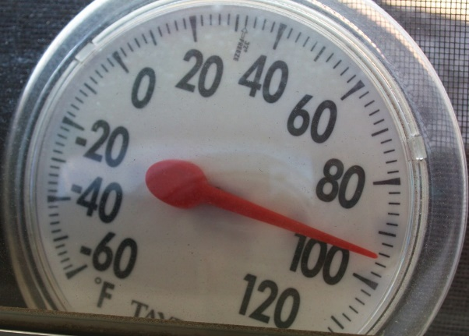
Cooling Subsidy and Crisis…
LIHEAP Cooling Subsidy and Crisis Components:
Funds made available for emergency cooling assistance
Recipients may apply more than once up to the maximum amount of $600
Application period is open from July through October
Low Income Home Energy Assistance Program (LIHEAP)
This Photo by Unknown Author is licensed under CC BY-ND

Slide 12
State Fiscal Year 2022…
77,665 households received cooling subsidy assistance
-Average assistance: $330.92
-Total of $25.7 million
59,886 households received cooling crisis assistance
-Average assistance: $263.31
-Total of $15.7 million
62,096 households received heating subsidy assistance
-Average assistance: $169.11
-Total of $10.5 million
104,734 households received heating crisis assistance
-Average assistance: $234.21
-Total of $24.5 million
Low Income Home Energy Assistance Program (LIHEAP)

Slide 13
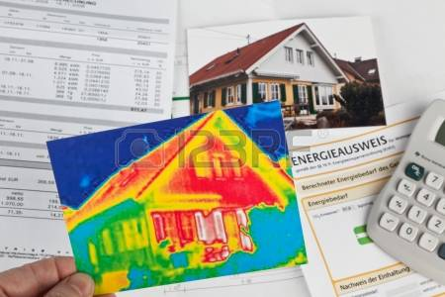
Weatherization Program…
Funds home repairs related to energy efficiency
Serves low-income households if income does not exceed 200% of the Federal Poverty Level
Low Income Home Energy Assistance Program (LIHEAP)

Slide 14
Weatherization Program…
Prioritizes:
Households containing elderly, disabled, or children
Households with young children at risk of removal from the home due to substandard conditions
High energy burden households, where the energy costs exceed 15% or more of the household’s income
Low Income Home Energy Assistance Program (LIHEAP)

Slide 15
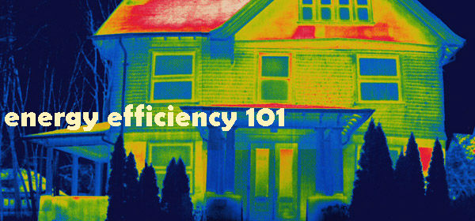
Weatherization Program…
Weatherization Program includes activities to increase the energy efficiency and reduce heating costs of dwellings:
-Installing insulation
-Sealing air infiltration
-Heating system or water heater repair or replacement
Low Income Home Energy Assistance Program (LIHEAP)

Slide 16
Weatherization Program…
Improve the health and safety of the dwelling and heating systems:
-Testing for gas leaks, carbon monoxide, and other health and safety issues
-Checking combustible appliances, such as stoves, furnaces, and water heaters
-Installing smoke and carbon monoxide detectors
-Energy education, especially for households containing elderly, disabled, or children
442 homes weatherized
Average benefit $7,000
Low Income Home Energy Assistance Program (LIHEAP)

Slide 17
New LIHWAP Program…
Low Income Household Water Assistance Program (LIHWAP)
Authorized under The American Rescue Plan Act and The Consolidated Appropriations Act as part of an emergency effort to respond to COVID-19
$18.6 million in program federal funding
Modeled off of LIHEAP
Kentucky LIHWAP launched December 2021

Slide 18
LIHWAP Eligibility & Assistance…
Households at or below 150 percent of the Federal Poverty Guidelines determined eligible
LIHWAP provides:
Bill payment assistance for water, wastewater, or a combination of both
Crisis assistance for water and/or wastewater disconnection or notification of pending disconnection
Subsidy assistance to pay water and/or wastewater invoices or arrearages
The maximum benefit is $800 in crisis assistance and $400 in subsidy assistance

Slide 19
December 2021-June 2022…
LIHWAP
33,830 households received LIHWAP subsidy assistance
-Average assistance: $305.67
-Total of $10.3 million
19,571 households received LIHWAP crisis assistance
-Average assistance: $248.62
-Total of $4.9 million

Slide 20
Partnerships…
Partnership with Community Action Kentucky, Inc. (CAK) and the Kentucky Housing Corporation (KHC)
23 subcontracting agencies
Kentucky’s Community Action Agencies administer LIHEAP in all Kentucky counties
Low Income Home Energy Assistance Program (LIHEAP)

Slide 22
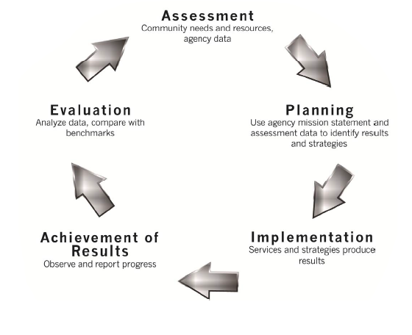
CAK employs continuous quality improvement processes, including:
Change Committee
Manual updates based on technical assistance and monitoring trends for prior year
Data collection and analysis
Training and technical assistance to the Community Action Network
Low Income Home Energy Assistance Program (LIHEAP)

Slide 23
Questions?

