Slide 1
Securitization & Energy Price Volatility and its Impact on Utility Customer Costs
Kent Chandler, Chairman
Kentucky Public Service Commission
Presentation: Natural Resources and Energy Interim Joint Committee
November 2022
Any views expressed in this presentation are those of the presenter and do not reflect official positions of the PSC.

Slide 2
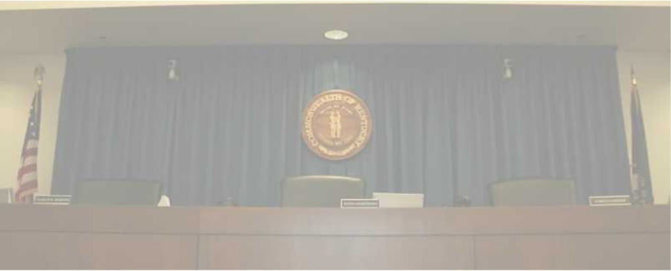
PSC Mission
To foster the provision of safe and reliable service at a reasonable price to the customers of jurisdictional utilities while providing for the financial stability of those utilities by setting fair and just rates, and supporting their operational competence by overseeing regulated activities.

Slide 3
Public Service Commission
Independent Regulatory Agency
Three-member Commission
Quasi-judicial function
Regulates rates and service provided by jurisdictional utilities:
1,100 jurisdictional utilities
Water and sewer utilities (small systems comprise the bulk of regulated utilities)
Natural gas distribution systems and intrastate pipelines
Electric utilities (investor-owned and jurisdictional cooperatives)
Telecommunications (small number)
Does not regulate municipal utilities except for gas pipeline safety.
Does not regulate cooperatives served by TVA.

Slide 4
Reliability—Service and Rates
Since 1934, the primary statutory directive of utility regulation in Kentucky revolves around:
Rates
Fair, just and reasonable
Service
Adequate, efficient and reasonable
Most everything in retail utility regulation comes back to one or both of these principles.

Slide 5
Ratemaking
Utilities in Kentucky are not competitive businesses, but instead have their rates and service regulated by the PSC
Historically, there was a concern around the duplication of the same service, leading to the inefficient investment of capital
Electric Utilities, for instance, were provided defined service territories: They have an obligation to serve everyone who demands service in that territory
A state granted monopoly creates two primary problems: risk of poor service, and monopoly profits in excess of costs
Solution: regulate the utility’s rates and service

Slide 6
Ratemaking, continued.
The rate regulation of monopoly, investor-owned utilities is a function of costs
Of course, in the idealized version of competition, and in particular a “perfect market,” in the short run prices will reflect the marginal cost of a particular product.
The introduction of monopolies leads to an expectation that the firm will charge prices well in excess of costs, leading to the sale of less goods, and resulting in deadweight loss
Under this scenario, the producer has more surplus, consumers have less surplus and there is also a complete loss of potential gains that neither accrue to the producer or consumer; that is deadweight loss.

Slide 7
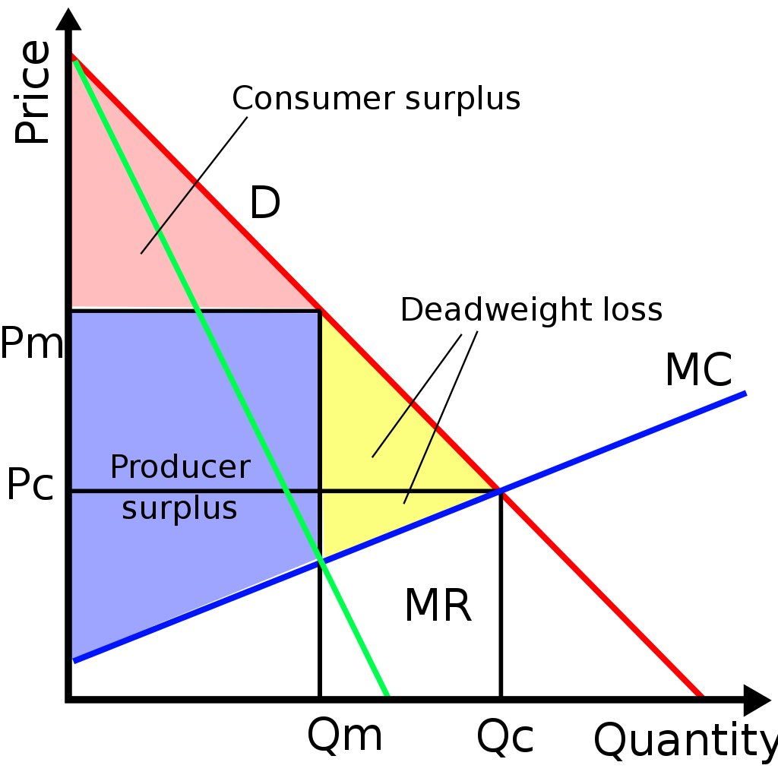
Ratemaking, continued.
Deadweight loss

Slide 8
Ratemaking, continued.
Again the rate regulation of monopoly, investor-owned utilities is a function of costs
Since we have concerns about the prices a monopoly would charge, particularly charging rates in excess of costs, rates are created based on the costs incurred or expected to be incurred by a utility
The first step in ratemaking is to determine all of the costs a utility incurred or expects to incur in a year that are deemed to be recoverable from customers
This includes operations and maintenance expenses, the investments made by the utility, and a return on the capital reflected by the investments.

Slide 9
Ratemaking, continued.
This determination of the utility’s annual expenses that are recoverable from customers is called the “revenue requirement,” and is calculated below
Revenue Requirement= O & M expenses + (original investments- amount of investments already recovered)* Rate of return
O&M expenses includes repairs, taxes, depreciation expense, labor, fuel, insurance, etc.
Original Investments is the gross value of the utility’s property (costs that are depreciated)
Amount of investments already recovered is referred to as accumulated depreciation
Rate of Return is the cost of the debt and equity capital underpinning the investments

Slide 10
Ratemaking, continued.
The rate of return is reflective of the cost and relative type of capital used to fund investments.
Debt capital is less expensive than equity capital because of the rights and risk of each type of capital
If 50% of investments were funded by debt, provided at a cost of 4%, and the other 50% was funded by equity investments at a cost of 10%, the cost of capital is: (.5*.04)+(.5*.1)=.07 or 7%
If you originally invested 100 dollars, and recovered 50 of it over the last 10 years, in this year your return on investment would be: (100-50)*.7= $3.50
However, $3.50 isn’t profit, because lenders will demand their payment on the debt. $1, or ($50/2)*4% of the $3.50 will pay the cost of the debt
The “profit” of the utility in this year would be $2.50

Slide 11
Ratemaking, continued.
Utilities make more profit the more they invest
This is assuming the cost of equity capital is constant
The PSC determines the cost of equity capital in rate cases, to ensure that the utility shareholders’ rate of return on their equity investments are commiserate with the risk experienced by the utility
This should create a natural equilibrium over time
If the cost of equity capital is set too low, you may have underinvestment in the utility (not necessarily by the utility)
If the cost of equity capital is set too high, you may see investors flock to invest in the utility

Slide 12
Securitization
Is the process of financing cash flows from a specific asset or pool of assets, and issuing claims on these assets, through the issuance of asset-backed securities.¹
More simply, securitization is a process set out by a state statute that can permit customers of a utility to effectively buy an asset from a utility using money provided by bonds financed by lenders.
Effectively, since the utility earns an equity and debt return on their own investments, replacing that investment with only debt capital reduces the financing costs of that asset.
The bonds used to “buy out” the utility are sometimes referred to as ratepayer-backed bonds because they are financed on the premise that a utility’s customers, pursuant to a statute, have guaranteed the repayment of the bond according to predetermined schedules.

Slide 13
Securitization - Simple scenario
Scenario: A utility has a powerplant/generator that has $200M left of investment that the utility has not recovered yet
Recent federal environmental laws require the generator to either upgrade that generator to come into compliance with law ABC, or retire by 2028
Upgrading the generator to comply with the law would cost $500M, while retiring it and replacing it with the necessary replacement generation would cost only $175M, and the replacement generation would have the same operating costs as the current generation and the same expected useful life as the current facility after it would be retrofitted.
The utility determines the least cost, most reasonable option is to retire the current generation and replace it with the new one

Slide 14
Securitization - Simple scenario
Scenario, cont.: The utility proposes to a PSC to build the new generator as the least cost, most reasonable option, given the need for generation after its retirement of the old generator.
At the same time, the utility requests PSC approval for the deferral and subsequent recovery of the remaining value of the retiring power plant as a “regulatory asset.”
A regulatory asset is a paper asset that reflects a cost that otherwise would have to be incurred in a single year, like an expense, but is treated like an asset and is recovered over a number of years.
Generally, regulatory assets earn a return like other investments, including a return on the equity capital portion

Slide 15
Securitization - Simple scenario
Scenario, cont.: Deferral accounting in this situation makes economic sense. Without the regulatory asset, accounting rules would require the utility to expense the remaining value of the retiring generator($200M).
The retirement and replacement of the generator is better for customers ($500M v $175M).
If the utility didn’t expect to receive approval for the regulatory asset, they would be incentivized to find ways to go with the retrofit, so that it recovered all its investment, but doing so would be bad for customers, to the tune of $325M, plus a profit on that extra $$$.

Slide 16
Securitization - Simple scenario
Scenario, cont.:
Assuming the PSC agrees the replacement generator is the least cost, most reasonable way to serve customers, here is where the scenario stands:
Old power plant retired
Value of old plant is a regulatory asset of $200M
New generator at a value of $175M
Utility earning a return, and charging customers that return, on $375M
Securitization provides an opportunity to replace the $200M of the utility’s investment in the regulatory asset with $200M financed by ratepayer-back bonds

Slide 17
Securitization - Simple scenario process
Assuming the state has a statute permitting securitization, the “ordinary” process may be the following:
Utility applies to the PSC for an order approving it to market bonds, impose, and collect charges from customers to pay the debt and to create a security interest in the underlying property. Application may include:
Description of the costs represented by the regulatory asset
Testimony describing the proposal
Proposed transaction, including customer impact, savings, etc.
Estimated cost of financing
Proposal for nonbypassable customer charges to recover costs

Slide 18
Securitization - Simple scenario process
PSC reviews the application to make sure the proposal is good for customers and in the public interest, including:
A net present value benefit to customers over the alternative or status quo
No unnecessary impairment of the utility’s financial health
The level and allocation amongst customers and customer classes of nonbypassable charges
PSC may employ professionals, either financial or legal, to help assist in considering the application. Those costs would be included in benefit calculations and recovered as part of the securitized costs

Slide 19
Securitization - Simple scenario process
PSC order approving the proposal may include
Finding that securitization is a net benefit to customers
Financing details, such as amount of the bonds, estimate of financing costs, length of the bonds, and what the proceeds should be explicitly used for
Explanation of the mechanism for repayment of the bonds, including periodic updates to the nonbypassable charge to customers
Requirement that customers pay until bond is paid
Authorization for the utility to market the bonds (if utility is designated)
Any other rules on the utility related to these charges or the bonds
Finally, a term that the order stays in effect and can’t be amended, modified or revoked, and that the securitized property interest can’t be impaired

Slide 20
Securitization- Why?
Some costs are nonrecurring, one-time, extreme, or are otherwise not ordinary property that makes utility financing of those costs expensive for customers and unnecessarily burdensome for a utility
Debt costs less than equity capital
Although the principal amount is the same, the reduction in the interest rate, coupled with the time value of money, can lead to significant customer “savings” compared to the status quo
Utilities make investments in assets for the public benefit; they are not financing entities. Having them hold investments and receive a return on paper assets may not be the best use of their limited capital
Securitization allows the utility to get out of investing in a paper asset, and put that capital to use, likely to invest in the assets to replace whatever the regulatory asset is related to (like the replacement generator in the scenario)
Reduce the costs to customers of decisions or outcomes beyond most any stakeholder’s control

Slide 21
Securitization Facts
About half of states have legislation on the books allowing securitization
Some are more prescriptive than others
Some permit different types of bond marketing (utility v. state bonding authority)
Different states allow securitization to apply to certain types of assets or costs, while some have complicated criteria that have to be met in an application:
Retired generation
Extreme fuel costs (winter storm Uri)
Wildfire costs
Extreme storm damage, such as hurricanes
Debt is not backed by full faith and credit of the state- They are the obligation of the captive ratepayers
As of May 2022, $62 billion of utility securitization bonds nationwide have been issued by electric utilities, ranging from $22M to $4B issuances

Slide 22
Securitization – Need for statute
Securitization “works” only because of the low-cost debt financing that replaces the combo debt and equity financing providing by the utility
The reason that bondholders are willing to finance these ratepayer-back bonds that are not part of utility debt, is because of the strict language of statutes, PSC orders, security interest in the property, nonbypassable charges and other characteristics that ensure timely repayment of the debt.
“The ability to segregate the collateral in a bankruptcy-remote [special purpose entity] and the ability to make periodic adjustments to the Securitization Charges are critical to the rating agencies’ analysis to reach the highest possible rating category (AAA).”³

Slide 23
Energy Market Trends: Implications on Utility Regulation
Current and emerging trends make each of these more complex relative to prior decades:
Fuel Adjustment Clause(“FAC”) (807 KAR 5:056)
Integrated Resource Planning (807 KAR 5:058)
Gas Cost Adjustments
Certificate of Public Convenience and Necessity (KRS 278.020(1))

Slide 24
Fuel Adjustment Clause (“FAC”)
The FAC regulation has been in effect for 40 years.
The FAC regulation allows jurisdictional utilities to reflect, through a line item on customers’ bills, the incremental or decremental cost of purchased power and/or fuel. Expenses incurred in a particular month appear in a subsequent month.
Fuel costs make up a significant portion of the cost of providing electricity.
For instance, in 2021, Kentucky Utilities, the largest utility in the Commonwealth, had approximately $1.64B in retail sales, while of that, $500M, or almost 1/3 of sales, was a pass through of fuel costs.
As we’ve seen in the last year, fuel expenses can fluctuate widely.
Compared to the past 10 years, all electric and natural gas utilities have experienced higher fuel and purchased power costs in recent months.

Slide 25
Fuel Adjustment Clause- How it works
The incremental or decremental amount of the FAC is set against a baseline fuel cost that is otherwise recovered through base rates- e.g. the customer and kWh charge.
If the utility’s fuel costs in a given month are above the baseline, the FAC appears as a per-kilowatt-hour surcharge (increment).
If fuel costs fall below the baseline, the FAC appears as a per-kilowatt-hour credit (decrement).
Utilities are required to fully document all of their fuel costs, including submitting fuel purchase contracts, fuel bid sheets and other materials to the PSC.
The PSC reviews a utility’s FAC filings, including conducting a detailed review every six months and then a final review, which occurs at two-year intervals.
During its review, if the PSC determines costs to be unjustified due to improper calculation or application of the charge or improper fuel procurement practices, the PSC may disallow recovery of those costs and order a refund to customers.

Slide 26
Gas Cost Adjustments
Tariff provisions that permit a gas distribution utility to pass through commodity cost changes
Filed on a prospective basis quarterly
Includes
New gas costs
Under or over recovery during last quarter
Difference between actual and expected gas cost last quarter (if estimated)
Provision for balancing adjustment

Slide 27
What are we seeing?
Gas example- Gas Cost Adjustment
Atmos
General Sales Gas Cost Recovery
Oct. 2022- $9.5833 per McF
Oct. 2020- $3.9108 per McF
Electric example
AEP- Kentucky Power
FAC Billed Rate per kWh
Oct. 2022- $.04064
Oct. 2020- ($.00243)
Fuel issues
Coal
Gas- electric coordination

Slide 28
Emerging Trends—Generation Options. What is available?
Wind—Few places in Kentucky have adequate wind speeds and topography
Solar—Requires about 6-10 acres per MW, less reliability contribution in winter months
Nuclear—Currently unlikely, however emerging, advanced technologies could alter viability
Coal—New units unable to be built, primarily because of NSR requirements
Natural Gas—Often chosen by generation modeling as least-cost resource, but risks exist around ability to site infrastructure and actual useful life
Energy Efficiency/Demand Side Management—plenty of cost-effective amounts available, but inability to actually produce electricity
Batteries—limited duration (4 to 8 hours) and relatively expensive
Hybrid Resources—Promising, but relatively new
Hydrogen—Not yet proven to be cost-effective or readily available

Slide 30
Endnotes
1, 3. Testimony of Eric Chang, Managing Director, Securitized Products Origination, Barclays Capital, Inc., IURC Cause No. 45722

