Slide 1
Low-Income Home Energy Assistance Program (LIHEAP) Preliminary State Plan Federal Fiscal Year (FFY) 2024
Todd Trapp, Director, DCBS Division of Family Support
Roger McCann, Executive Director, Community Action Kentucky, Inc. (CAK)
July 20, 2023

Slide 2
Department for Community Based Services (DCBS) Overview
DCBS: Lesa Dennis, Commissioner
Division of Service Regions
4,393 full-time employees statewide
Offices in all 120 counties
Division of Administration and Financial Mgmt.
Division of Child Care
Division of Family Support
Division of Protection and Permanency
Division of Prevention and Community Wellbeing
Low Income Home Energy Assistance Program (LIHEAP)

Slide 3
HISTORY…
LIHEAP
Established in 1982
Safety net program focusing on energy conservation and heating and cooling
Meets immediate home energy needs
Designed to help households with the lowest incomes that pay a high proportion of income for home energy
LIHEAP funds spent to date FFY 2023 total $60.6 million
Anticipated amount of funding for FFY 2024 is $58 million
100% federally funded
Low Income Home Energy Assistance Program (LIHEAP)

Slide 4
LIHEAP
HISTORY…
90% of federal LIHEAP award is used for benefits to Kentucky citizens
$64,000 is retained by DCBS for the Preventive Assistance Program to assist families receiving child protective services with a needed energy payment
Up to 15% of the amount can be allocated for weatherization
Up to 10% of the amount can be used for administrative costs
Low Income Home Energy Assistance Program (LIHEAP)

Slide 5
150% of the Federal Poverty Guidelines (percent of poverty)
Household Size | Monthly Income
1 | $1,823
2 | $2,465
3 | $3,108
4 | $ 3,750
5 | $ 4,393
6 | $ 5,035
7 | $ 5,678
8 | $ 6,320
For each additional household member above 8, add $643 to the monthly income limit.

Slide 6
Benefits…
LIHEAP offers the following types of benefits to Kentucky citizens:
Bill payment assistance year-round for heating and cooling:
- Subsidy component
- Crisis component
Emergency assistance
Weatherization activities to increase the energy efficiency, health, and safety of eligible low-income individual’s dwellings
Low Income Home Energy Assistance Program (LIHEAP)

Slide 7
Subsidy…
LIHEAP Heating Subsidy Component:
Offsets home heating costs
Has benefit amounts structured by a percentage of the household’s annual heating costs and percentage of poverty met by the household
Application process runs early November through Mid-December
- Early applications accepted in October for the elderly and individuals with disabilities
- Appointments are available for working individuals
Low Income Home Energy Assistance Program (LIHEAP)

Slide 8
Crisis…
LIHEAP Heating Crisis Component:
Offers assistance for an energy emergency
Application process runs from January through April unless funds are depleted before April
Benefits are limited to the amount necessary to relieve the crisis, with the maximum amount not to exceed Community Action Agency’s local cost for a deliverable supply of household’s primary heating fuel or $400 for gas or electric
Low Income Home Energy Assistance Program (LIHEAP)

Slide 9
Subsidy…
LIHEAP Cooling Subsidy
Offsets home cooling costs
Assistance amounts are structured according to a percentage of the household’s annual cooling costs and percentage of poverty level met by the household
Application period was open from April 17 through June 2, 2023
Low Income Home Energy Assistance Program (LIHEAP)

Slide 10
State Fiscal Year 2023…
13,170 households received cooling subsidy benefits
-Average benefit: $351.75
-Total of $4.6 million
13,483 households received cooling crisis benefits
-Average benefit:$248.10
-Total of $3.3 million
62,668 households received heating subsidy benefits
-Average benefit: $167.82
-Total of $10.5 million
Low Income Home Energy Assistance Program (LIHEAP)

Slide 11
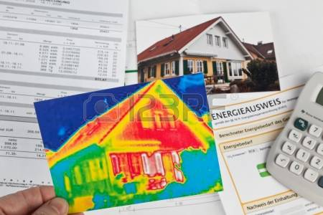
Weatherization Program…
Funds home repairs related to energy efficiency
Serves low-income households if income does not exceed 200% of the Federal Poverty Guidelines
Low Income Home Energy Assistance Program (LIHEAP)

Slide 12
Weatherization Program…
Prioritizes
Households containing elderly, disabled, or children
Households with young children at risk of removal from the home due to substandard conditions
High energy burden households, where the energy costs exceed 15% or more of the household’s income
Low Income Home Energy Assistance Program (LIHEAP)

Slide 13
Weatherization Program…
Weatherization Program includes activities to increase the energy efficiency and reduce heating costs of dwellings:
Installing insulation
Sealing air infiltration
Heating system or water heater repair
Low Income Home Energy Assistance Program (LIHEAP)

Slide 14
Weatherization Program…
Improve the health and safety of the dwelling and heating systems:
Testing for gas leaks, carbon monoxide, and other health and safety issues
Checking combustible appliances, such as stoves, furnaces, and water heaters
Installing fire and carbon monoxide detectors
Energy education prioritizes households containing elderly, disabled, or children
442 homes were weatherized, with an average benefit of $7,000 each
Low Income Home Energy Assistance Program (LIHEAP)

Slide 15
Partnerships…
Low Income Home Energy Assistance Program (LIHEAP)

Slide 16
Partnerships…
Partnership with Community Action Kentucky, Inc. (CAK) and the Kentucky Housing Corporation (KHC)
23 subcontracting agencies
Kentucky’s Community Action Agencies administer LIHEAP assistance in all Kentucky counties
Low Income Home Energy Assistance Program (LIHEAP)

Slide 18
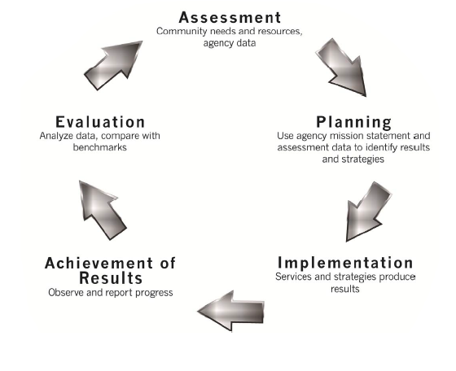
CAK employs continuous quality improvement processes, including:
Change Committee
Manual updates based on technical assistance and monitoring trends for prior year
Data collection and analysis
Training and technical assistance to the Community Action Network
Low Income Home Energy Assistance Program (LIHEAP)

Slide 19
Low Income Home Energy Assistance Program (LIHEAP)
Questions?

