Slide 1
Interim Joint Committee on Natural Resources and Energy
Anthony R. Hatton, P.G., Commissioner
Department for Environmental Protection
July 20, 2023

Slide 2
Per-/Poly Fluroalkyl Substances PFAS
PFAS are a group of chemicals first developed in the 1940’s that have been widely used around the world.
They consist of a carbon-fluorine bond which is very strong.
They are heat and stick resistant.
They have been widely used in consumer and industrial products.
Teflon® and Scotchgard®
Food packaging and paper products
Aqueous Film Forming Foam (AFFF)
Industrial products
Because of the tenacious bond, PFAS do not break down in the environment so they migrate readily in groundwater and do accumulate in aquatic organisms.

Slide 3
Potential Costs to Drinking Water Facilities
Leitchfield Facility to add Granular Activated Carbon:
$1M initial
$150K annually
State Revolving Fund (SRF) request:
$115M in 2024 requests

Slide 4
Drinking Water Exposure Route The Top Priority
In 2019 the Cabinet collected finished drinking water samples from 81 drinking water plants across the state.
The study included facilities located in urban areas, rural areas, and facilities that use surface water as a source and those that use groundwater as a source.
PFAS were detected in finished water at 41 of the 81 drinking water treatment facilities:
Ohio River Basin
South Shore, Kentucky
The 2019 report is located at: https://eec.ky.gov/Environmental-Protection/Water/Protection/Pages/PFAS.aspx
The Cabinet has recently completed sampling at the remaining 113 drinking water plants in the state.

Slide 5
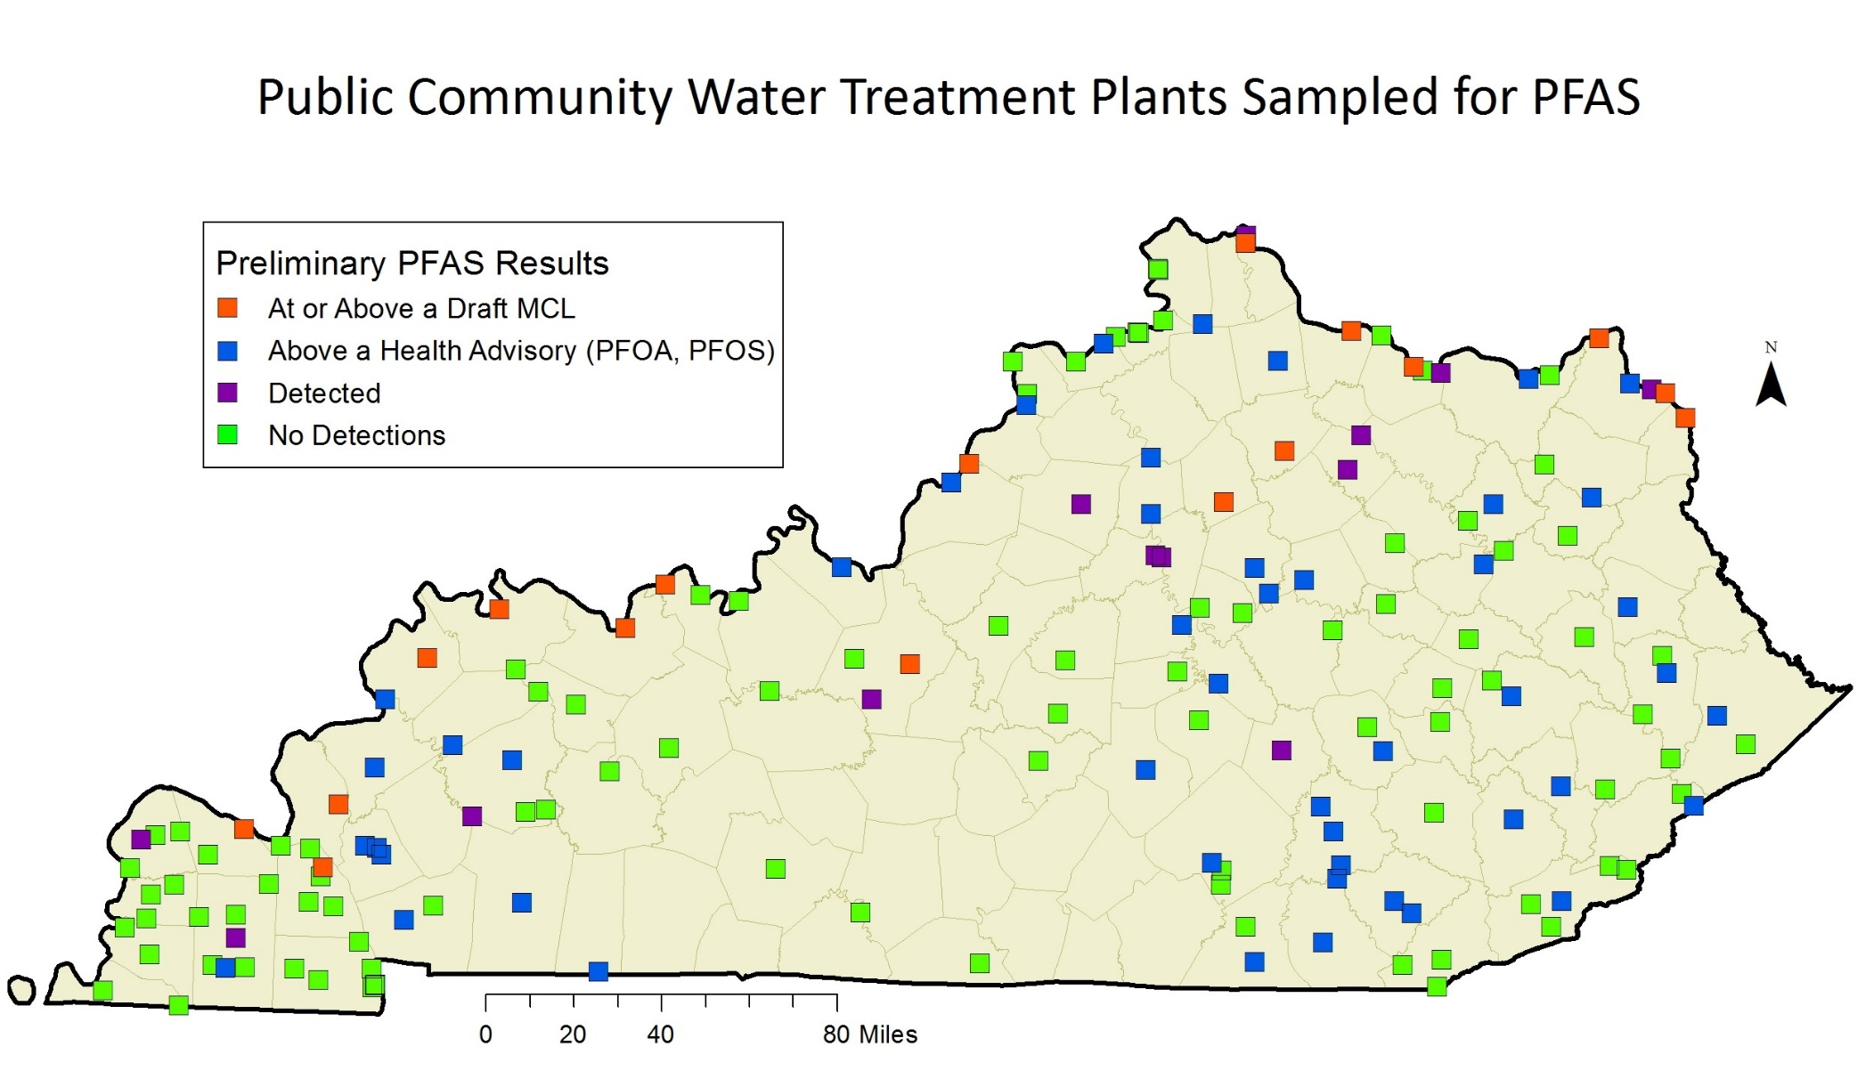
PFAS Detects in Drinking Water Systems

Slide 6
Surface Water and Fish Tissue PFAS Pathways Ongoing
In 2020, the Cabinet collected surface water samples from some of the state’s different river basins. Many of these waters provide source water to drinking water facilities.
The Cabinet began collecting fish tissue samples in 2021 and testing them for PFAS. Sampling has been conducted in rivers, lakes, and streams and will continue as part of the Cabinet’s routine sampling program.
To date, all fish tissue samples that have been analyzed at the Cabinet’s laboratory have contained detectable amounts of PFAS compounds.
PFOS in particular, bioaccumulates in fish tissue.
The surface water study report can be found at: https://eec.ky.gov/Environmental-Protection/Water/Protection/Pages/PFAS.aspx
The initial fish tissue report can be found at: https://eec.ky.gov/Environmental-Protection/Water/Protection/Pages/PFAS.aspx

Slide 7
Identifying Sources Across the State A Top Priority and Long-Term Priority
Likely and Potential Sources of PFAS to the Environment
Aqueous Film Forming Foam Applications, Including Training Operations
Municipal Solid Waste Disposal Facilities
Paper and Cardboard Manufacturing and Recycling
Biosolids from Public Owned Treatment Works
Various Industrial Manufacturing Operations
Recycling of PFAS Containing Materials (Teflon is an example)

