Slide 1
House Bill 9
Kentucky GRANT Program
Interim Joint Committee on Natural Resources
October 19, 2023

Slide 2
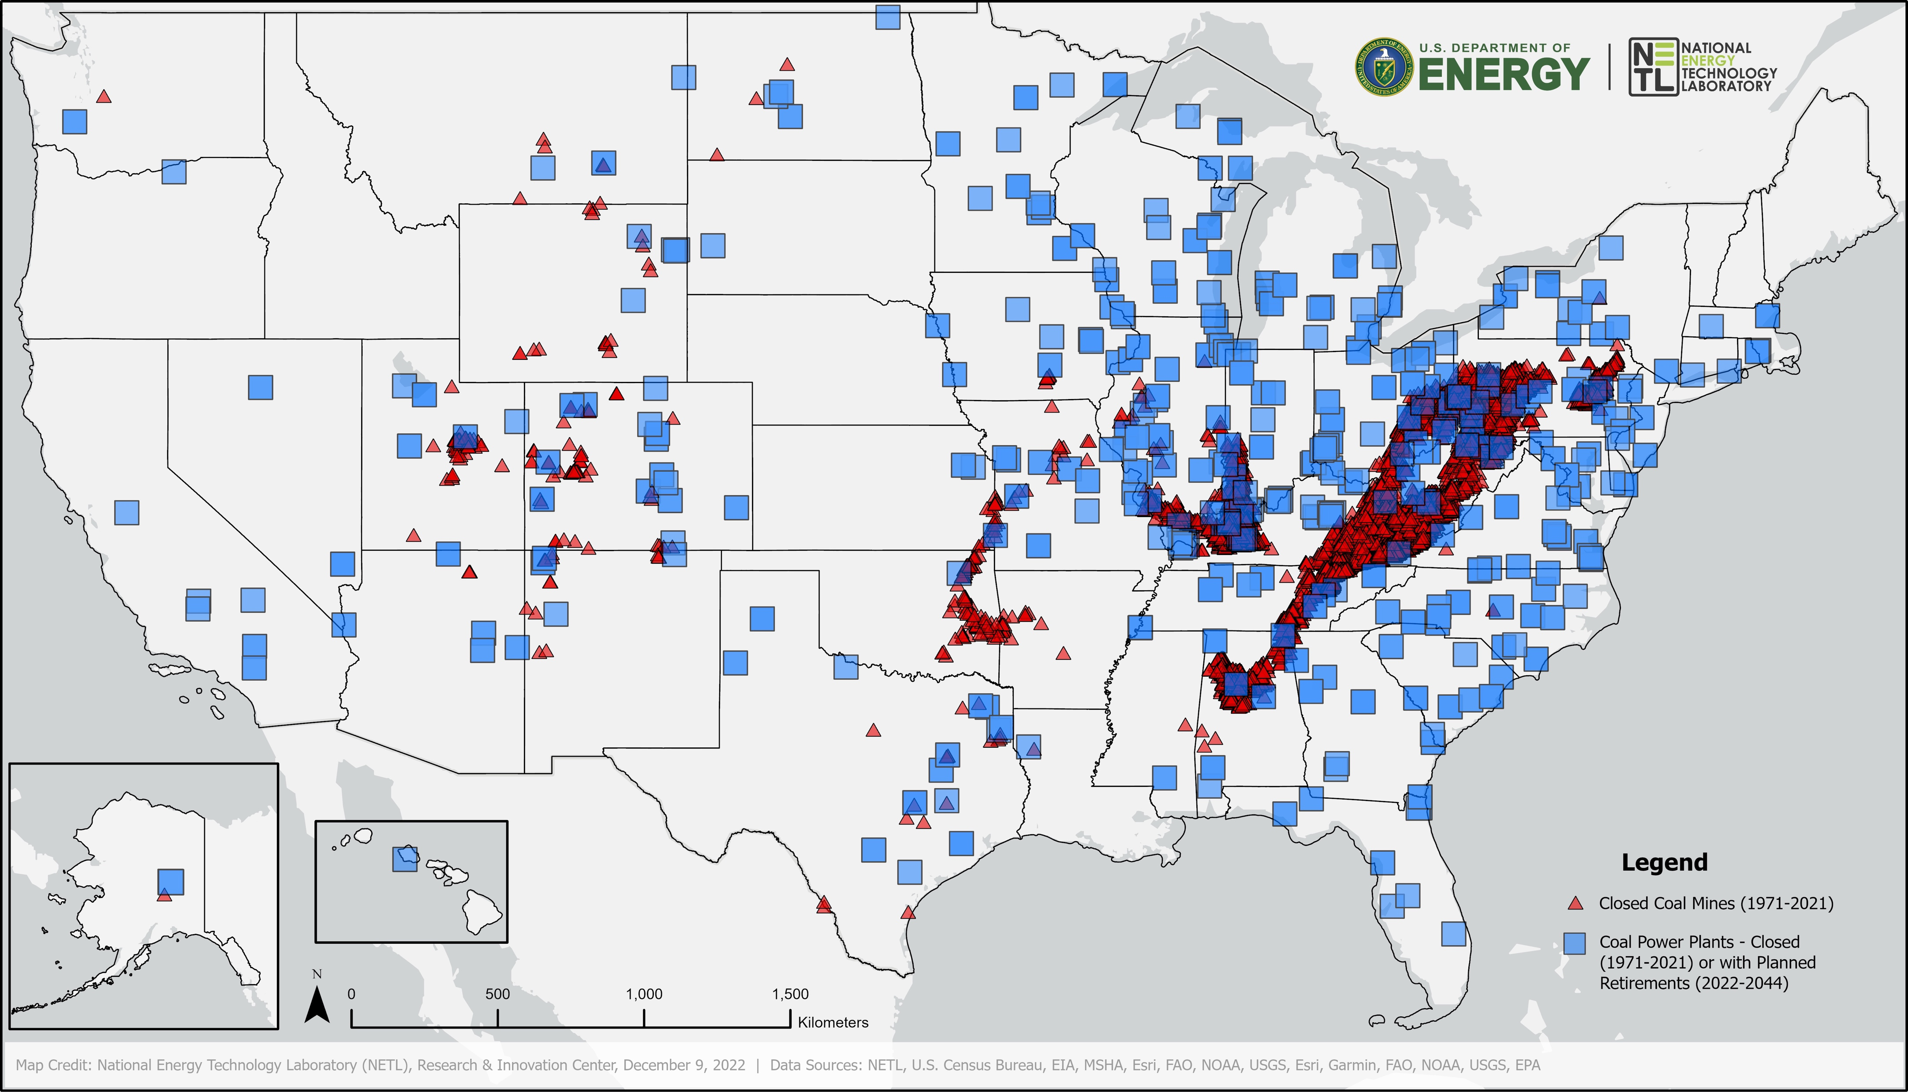
Coal Jobs Hard Hit
Notes:
Topline Message: The clean energy transition is occurring across the country.
The energy communities here in Kentucky who once relied on a thriving coal, oil or gas economy are now struggling as the nation and the world transition to a clean energy economy.
Since 2015, more than 900 coal mines have closed across the country.
The energy communities across the country who once relied on a thriving coal, oil or gas economy are now struggling as the nation and the world transition to a clean energy economy.
Closures are leaving many traditional fossil energy workers left behind, despite their critical role in powering our nation’s economy for several generations.
The numbers tell a devastating story nationally. Coal mining employment declined from more than 175,000 in 1985 to roughly 39,000 in 2021, with close to 15% of remaining workers now at or approaching retirement age.
The decline in coal mining jobs has also resulted in an immediate need for workforce development and training to ensure dislocated workers can successfully transition into new clean energy jobs.
Since 2009, 315 coal-fired power plants have retired generators or closed entirely. Of the 242 coal-fired plants that continue operating in the United States, 60 are expected to retire by 2040.

Slide 3
Challenges Facing Kentucky Communities
“All federal programs are ‘competitive grants.’ We do not have the resources to hire outside engineers/consultants to assist in writing these grants.” – KY RFI Respondent
“Our economy must be diversified, and only an increase in the availability and affordability of broadband accompanied by remote jobs provides that solution.” – KY RFI Respondent
“It seems that there is lots of money available, but you need to hire someone full-time to figure out how to access it, devote endless hours writing proposals, and then be able to wait for months+ to find out if you qualify and another six months to access it.” – KY RFI Respondent
Notes:
Topline Message: The Energy Communities IWG released a Request for Information to gather input from energy community leaders about challenges they face - here are a few comments from Kentucky respondents.
Common theme: lack of capacity
Technical assistance programs can support capacity building
Philanthropic investment and assistance can also support this
Economic diversification and broadband expansion are also challenges facing Kentucky’s energy communities
There are funding opportunities for broadband expansion through NTIA, USDA and Department of Commerce
Though not highlighted here, we’ve also heard that housing is a challenge. Some federal programs to assist with housing include:
Single-Family Housing Loans and Grants (USDA)
Multifamily Housing Loan Guarantees (USDA)
Rental Assistance (USDA and HUD)
Low Income Housing Tax Credit Program (HUD)
Low Income Home Energy Assistance Program (HHS)

Slide 4
House Bill 9 – GRANT Program Events
June 13-15 – KCJEA & KMCA Joint Summer Conference
July 26 – Western Ky ADD HB 9 Workshop
July 27 – Kentucky Nonprofit Network Townhall
October 6 – KACo Sponsored HB 9 Townhall
October 17 – Eastern KY ADD HB 9 Workshop
More to come!

Slide 5
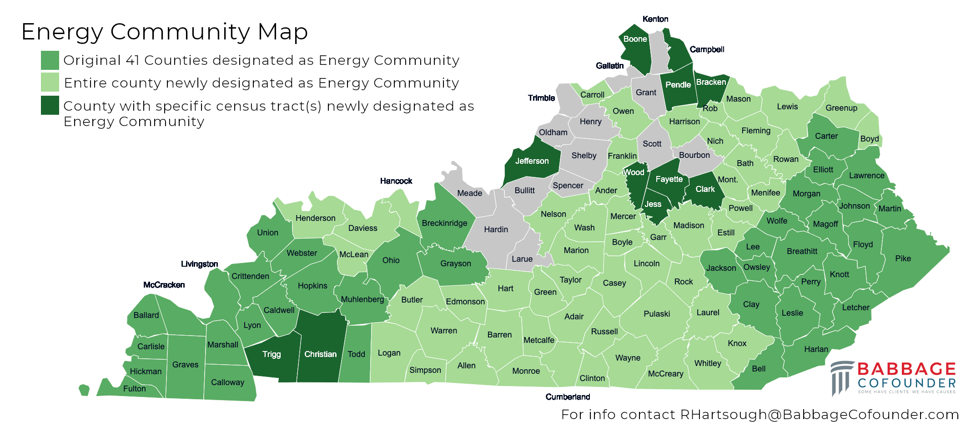
New Federal Energy Community Designations

Slide 6
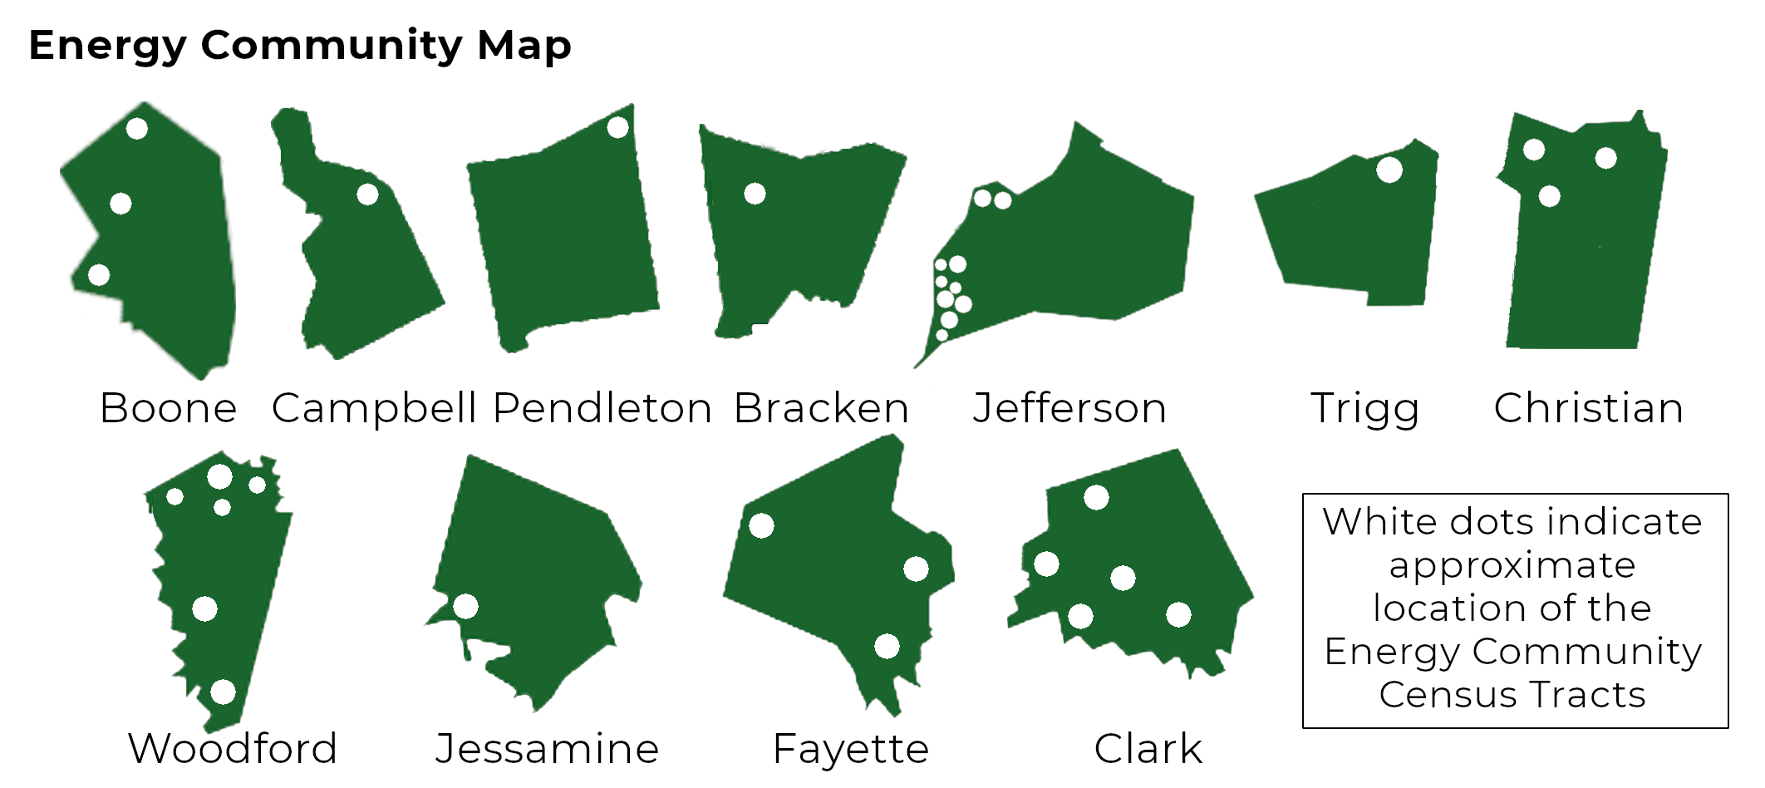
New Federal Energy Community Designations

Slide 7












Coal & Power Plant Communities & Economic Revitalization
The Interagency Working Group (IWG) was established by Executive Order 14008, Sec. 218, on Jan. 27
Initially identified $38 billion in federal funding for energy communities… that number is now more than $600 billion
Two public reports outlining recommendations to catalyze economic activity
Notes:
Topline Message: During his first week in office, the President signed Executive Order 14008 on tackling the climate crisis. This order included many initiatives, one being the creation of the Energy Communities IWG to support and urgently direct resources to energy communities.
The IWG is comprised of 11 federal agencies and the White House, who collaborate to direct federal resources to support economic revitalization and create good-paying jobs in America’s energy communities.
The Energy Communities IWG released its initial report to the President in April 2021 identifying $38 billion in federal funding available and relevant to energy communities and prioritizing 25 communities across the nation for immediate engagement.
The IWG has since identified more than $600 billion in available federal funding for energy communities.
The IWG is focused on good governance. Instead of operating in silos, federal agencies are working in close coordination to help people in an integrated way.
This approach allows us to reduce barriers and increase awareness to help communities find and secure the right resources that best suit their needs.
To accomplish this, stakeholder engagement is key. The IWG serves as a hub of stakeholder engagement between federal agencies and energy communities to inform the working group’s efforts.
The IWG works to support state and local efforts by engaging with stakeholders as part of our ongoing effort to connect energy communities with the billions of dollars in federal funding dedicated for energy communities.

Slide 8

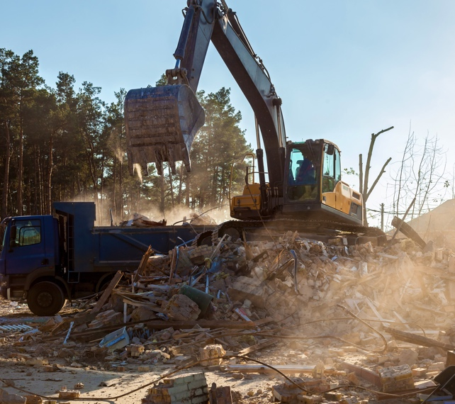


Allocating Funding to Energy Communities
Clean Up Environmental Damage
Upgrade Infrastructure
Promote Entrepreneurship
Support Workforce Development
Notes:
Topline Message: The IWG is laser focused on helping drive more investments to more communities, more quickly.
As coal and power plants close in these communities, the IWG is working with energy communities to drive funding that will create long-term capacity through:
Infrastructure – our communities deserve access to reliable broadband, good roads, clean water, modern sewer systems and affordable local transportation.
Environmental clean-up – our communities deserve support for land and industrial transformation, including deploying low-carbon technologies at sites of former power plants, and industrial facilities programs to remediate abandoned mines, orphaned wells, and brownfields.
Entrepreneurship – our communities deserve thriving small businesses that drive innovation, including support for them from community development financial institutions, non-profits, and innovation hubs.
Workforce development – our communities deserve support for training programs to align their workforces with actual industry growth in each key region.

Slide 9



Bipartisan Infrastructure Law (BIL)
IWG agencies are preparing more than $100 billion of infrastructure investments and funding opportunities in areas such as:
Transportation
Broadband
Clean water
Energy infrastructure
Energy-specific programs include:
Regional clean hydrogen hubs | Carbon capture and storage | Clean energy demonstrations on former mine lands | Orphaned wells | Critical materials and rare earth elements | Energy improvements in rural and remote areas
Notes:
Topline Message: Through the passage of the Inflation Reduction Act and Bipartisan Infrastructure Law, the IWG can continue to provide communities with federal resources that will help support the clean energy transition by driving down energy costs, enhancing energy security, and jump-starting a new era of clean energy jobs.
The BIL provides foundational infrastructure assistance such as transportation, transmission, and broadband.
As of June, $4.1 billion in BIL funding has been announced for Kentucky to fund more than 202 specific projects
$119.7 million for capping orphaned oil and gas wells and reclaiming abandoned mine lands
$6.5 million for cleaning up brownfield sites.
$2.3 billion for roads, bridges, roadway safety, and major projects.
$5 million through the Broadband Equity, Access, and Deployment Program
$229 million to provide clean/safe water and improve water infrastructure
$555.6 million for clean energy, energy efficiency, and power
$542.4 million for infrastructure resilience
Some examples of general BIL funding include:
$450 million for clean energy demonstration projects on current or former mine lands
$127 million for R&D projects to develop critical minerals for the clean energy economy from coal-based resources
$300 million through the Energy Improvements in Rural or Remove Areas program
$750 million in grants to make clean energy manufacturing investments in energy communities with coal mine or power plant closures.
$65 billion to expand affordable and reliable high-speed internet access

Slide 10


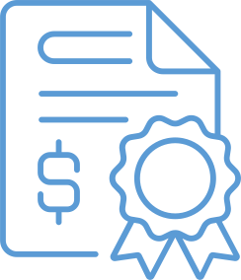
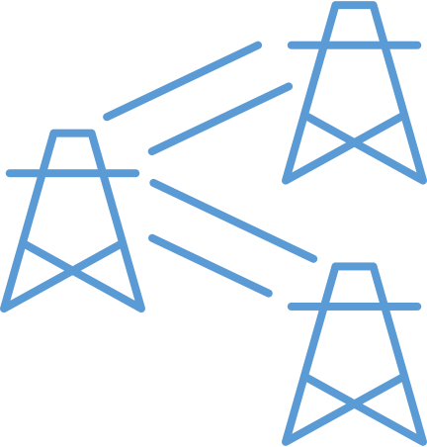



The Inflation Reduction Act (IRA)
Tax Credits & Loan Guarantees
Workers/Community/EJ
IRA provides targeted investments in energy communities.
IRA supports energy workers, and their families, who built this country.
Black Lung Disability Trust Fund Reinstated | $27 Billion Green House Gas Reduction Fund | $3 Billion for Environment and Climate Justice | $145 Million Tribal Electrification
$250 Billion in Authority for Redeveloping & Repurposing | Bonus Tax Credits for Clean Energy Projects in Energy Communities | $4 Billion Clean Energy Manufacturing Tax Credits for Energy Communities
Notes:
The Inflation Reduction Act provides further investments that will bolster economic revitalization and support good-paying manufacturing jobs in energy communities, including:
10% bonus tax credit for clean power projects built in eligible energy communities
$4 billion allocation of tax credits for clean energy manufacturing investments in energy communities
$5 billion in guaranteed loans (up to $250 billion in total loan authority) for projects that repurpose idled energy infrastructure (like retired power plants) or reduce emissions at operating energy infrastructure.
$27 billion to mobilize financing and leverage private capital for projects that reduce greenhouse gas emissions – with an emphasis on projects that benefit low-income and disadvantaged communities.
Permanent extension of the Black Lung Excise Tax to help coal miners and their families get reliable access to health support and benefits.
$3 billion in grants for environmental and climate justice

Slide 11
Funding For Kentucky
Recently Announced
As of June, $4.1 billion in BIL funding has been announced for Kentucky to fund more than 202 specific projects
  $119.7 million for capping orphaned oil and gas wells and reclaiming abandoned mine lands
  $6.5 million for cleaning up brownfield sites.
  $2.3 billion for roads, bridges, roadway safety, and major projects.
  $5 million through the Broadband Equity, Access, and Deployment Program
  $229 million to provide clean/safe water and improve water infrastructure
  $555.6 million for clean energy, energy efficiency, and power
  $542.4 million for infrastructure resilience

Slide 12
Funding Opportunities in the Clearinghouse
$270B+
Value of Open/Planned
Competitive Funding
$414B+
Value of Open/Planned
Formula Funding
148
Open/Planned
Opportunities
50
Opportunities w/
no cost share
22
IRA tax credits
https://energycommunities.gov/funding/
Notes:
Topline Message: To publicize BIL and IRA opportunities and to deliver on our mission to get more dollars to more communities more quickly, the IWG launched an easy-to-access online clearinghouse.
The clearinghouse currently includes 148 open and planned opportunities, $270 billion in competitive funding and $414 billion in formula funding, which is particularly relevant to this group. There are also 22 IRA tax credits.
50 of these opportunities do not require cost share, which is a barrier many communities face when applying to funds.
The IWG has already announced more than $14 billion awarded to energy communities, which includes more than $6 billion from the Bipartisan Infrastructure Law and nearly $3 billion in energy infrastructure investments.
Recent funding announcements include:
DOE’s Energy Improvements in Rural or Remote Areas program - $50 million
USDA’s Empowering Rural American (New ERA) and Powering Affordable Clean Energy (PACE) programs - $11 billion
DOE LPO released updated guidance on Title 17 Clean Energy Financing program
EPA’s Brownfields Job Training Grants (not BIL/IRA)
48C final guidance and map
Right now, our online clearinghouse includes 31 open BIL and IRA grant opportunities, both match and no match, that could directly benefit your energy communities.

Slide 13
Energy Community Funding Opportunities
Specific Grants, Loans, Tax Credits
USDA – Rural Development Grants and Loans
EDA – Assistance to Coal Communities Grants
DOI – Abandoned Mine Land Economic Revitalization Program Grants
DOE – Clean Energy Related Tax Credits and Loans
ARC – POWER and INSPIRE Grants

Slide 14
For More Information:
energycommunities.gov
grantreadykentucky.org
rhartsough@babbagecofounder.com

Slide 15
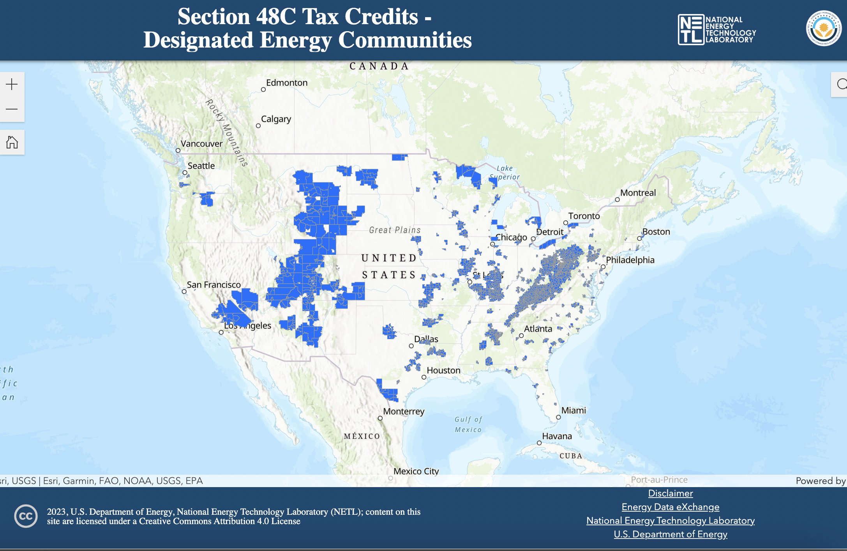
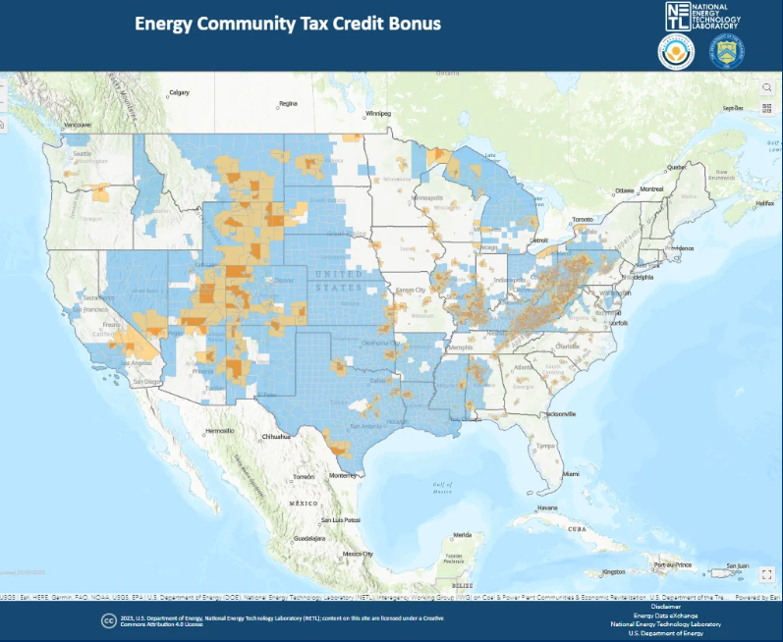
Energy Community Tax Credits Eligibility Maps
Notes:
Topline Message: The Energy Communities IWG website is currently home to the 48c tax credit map, and also houses a one-stop-shop clearinghouse featuring 22 tax credits in one centralized location to reduce barriers to accessing federal funding.
Tax credits available through the Inflation Reduction Act will bring new good-paying jobs and economic opportunities to energy communities.
The Advanced Energy Project Tax Credit (48C) provides a 30% credit to projects meeting eligibility, prevailing wage and apprenticeship requirements. The program allocates $10 billion, at least $4 billion of which must be allocated to energy communities – communities with coal mine and power plant closures.
To qualify your project must either:
Re-equip, expand, or establish an industrial or manufacturing facility for the production or recycling of a range of clean energy equipment and vehicles
Re-equip an industrial or manufacturing facility with equipment designed to reduce greenhouse gas emissions by at least 20 percent
Re-equip, expand, or establish an industrial facility for the processing, refining, or recycling of critical materials
We are working to connect our stakeholders with private sector investors considering investments in clean energy manufacturing or recycling, critical minerals, or industrial projects to reduce greenhouse gas emissions.
Many communities across Kentucky are eligible for these tax credits.

Slide 16
Types of Funding
Formula Funding
Competitive Funding
Formula funding is when the federal government allocates funds to a state agency or tribal entity which then has authority to re-allocate or award to eligible groups and users.
Funds are usually administered and managed at the state level to ensure that they are distributed appropriately to designated recipients.
Each grant award amount is calculated by a formula, and actual funding amounts vary.
Competitive funding is available to eligible recipients who submit an application for a funding opportunity.
Each application is reviewed through a competitive evaluation process and awardees are selected based on the merits of their application and alignment with the agency’s mission.
The IWG Clearinghouse identifies Direct Awards. Grants, and Loans as competitive funding opportunities.
Notes:
Topline Messaging: Formula funding and competitive funding are the two most common types of funding distributed by the federal government and it’s important to know the difference.
Formula Funding
Formula funding is when the federal government allocates funds to a state agency or tribal entity which then has authority to re-allocate or award to eligible groups and users.
You do not compete for formula funding, but you are typically required to submit an application and meet other specified requirements.
Funds and are usually administered and managed at the state level to ensure that they are distributed appropriately to designated recipients.
Each grant award amount is calculated by a formula, and actual funding amounts vary.
Exactly how funds are distributed is most often governed by statutes or congressional appropriations acts that specify which factors are used to determine eligibility, how the funds will be allocated among eligible recipients, and the method by which an applicant must demonstrate its eligibility for that funding.
Examples:
Highway Formula Funds (DOT/FHA)
Formula Grants for Rural Areas (DOT)
Preventing Outages and Enhancing the Resilience of the Electric Grid Formula Grants (DOE)
Competitive Funding
Competitive funding is available to eligible recipients who submit an application for a funding opportunity.
Each application is reviewed through a competitive evaluation process and awardees are selected based on the merits of their application and alignment with the agency’s mission.
Competitive grants are discretionary, which means they don’t have to be awarded if the granting agency doesn’t like any of the proposals.
The IWG Clearinghouse identifies Direct Awards, Grants, and Loans as competitive funding opportunities.

