Slide 1
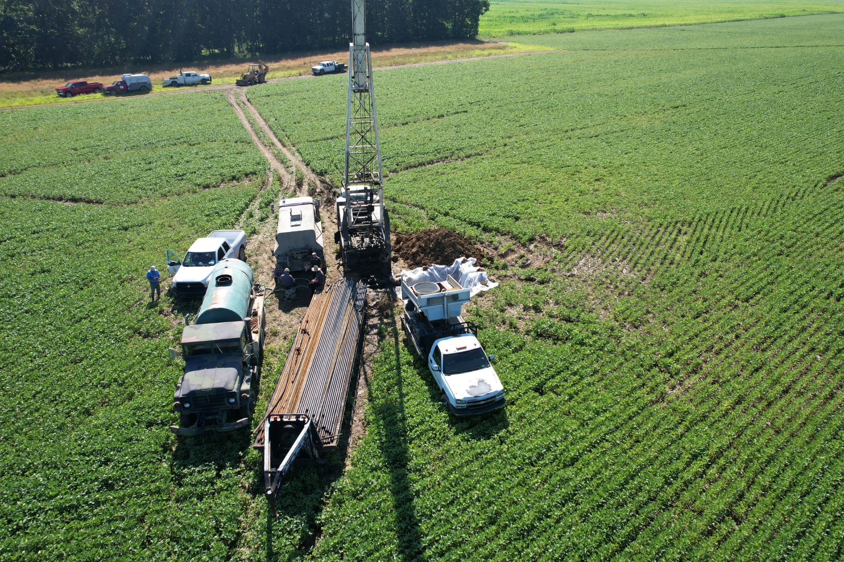
INTERIM JOINT COMMITTEE UPDATE ON FEDERAL PLUGGING PROGRAM
KENTUCKY DIVISION OF OIL AND GAS October 19, 2023
Notes:
BIL Plugging Project in Hopkins County P 26310 July 2022

Slide 2
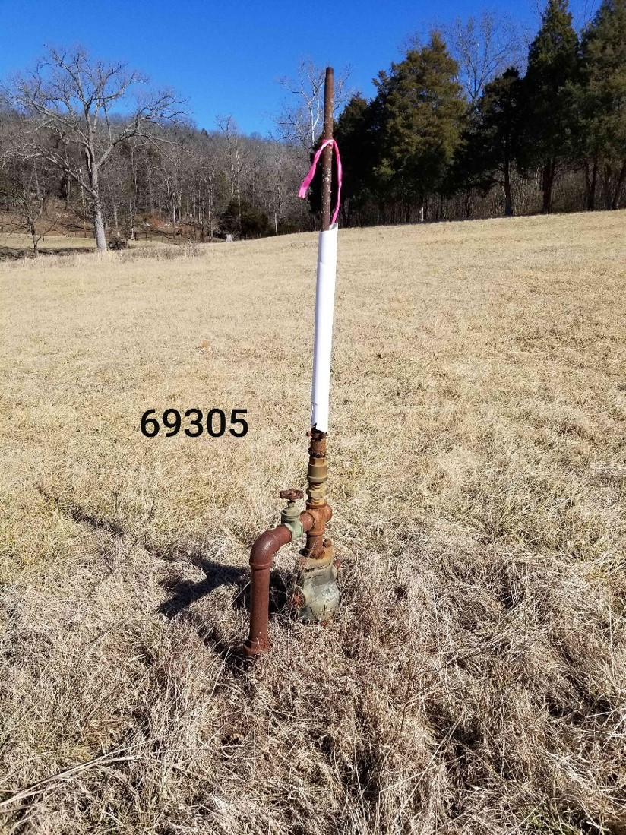
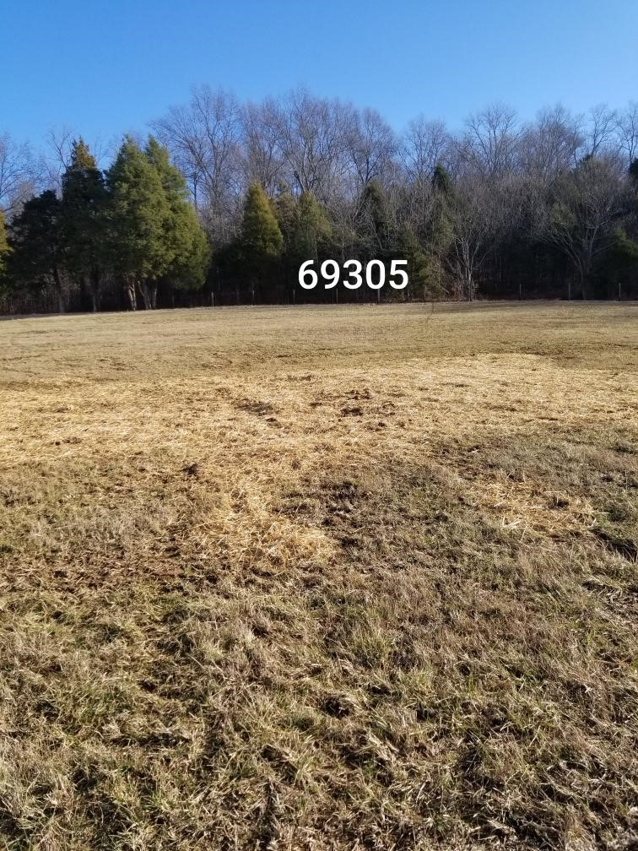
BIPARTISIAN INFRASTRUCTURE LAW: (BIL)
Notes:
Congress Passed the BIL November 2021, Providing State Grant Opportunities to Plug Orphan Oil and Gas Wells. This is One that was Plugged by that Effort!
Warren County BEFORE AND AFTER PHOTOS

Slide 3
BIL Initial Grant Overview
Kentucky applied in May 2022, and was subsequently awarded a BIL Initial Plugging Grant in the amount of $25M to plug orphan wells effective October 1, 2022.
A requirement of the Initial Grant was to obligate 90% of the $25M within 90 days of the award date. For Kentucky, this was accomplished on December 19, 2022.
Another requirement was that states must obligate 100% of the $25M within 1 year of the award date. Kentucky met the 100% obligation requirement on September 25, 2023.
A total of 43 separate plugging packages were assembled for RFP solicitation through the Finance Cabinet to plug 635 orphan wells.

Slide 4
BIL Initial Grant Overview
To date, the Division of Oil and Gas has completed plugging 627 orphan wells in 27 counties. Active plugging continues today in Wayne County, the last plugging package awarded.
Average cost to plug a well in the BIL Plugging Program has been about $33,000.
The BIL also required that states determine the methane emissions eliminated by the orphan well plugging. The Division of Oil and Gas has partnered with the Kentucky Geological Survey to physically measure emissions from 100 sites. That data will be utilized to statistically model and estimate the orphan well emissions eliminated based upon location, geology, and well configuration.

Slide 5
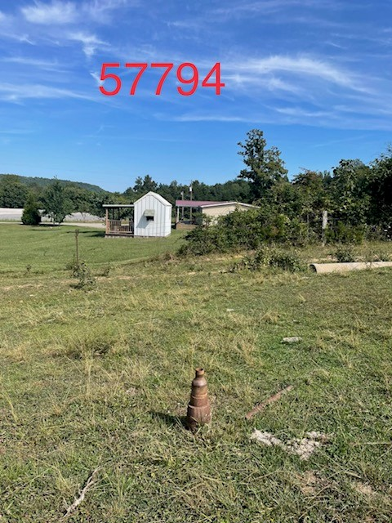
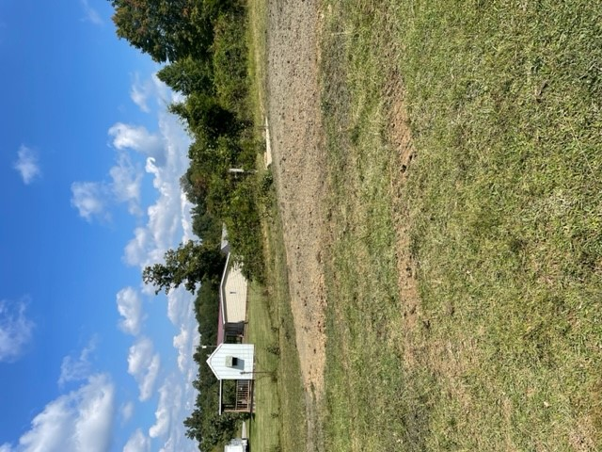
Notes:
CASEY COUNTY, BEFORE AND AFTER PHOTOS.

Slide 6
CONTRACTOR AWARDS
Notes:
17 Different Contracting Companies participated in the statewide plugging projects, most from Kentucky.

Slide 7
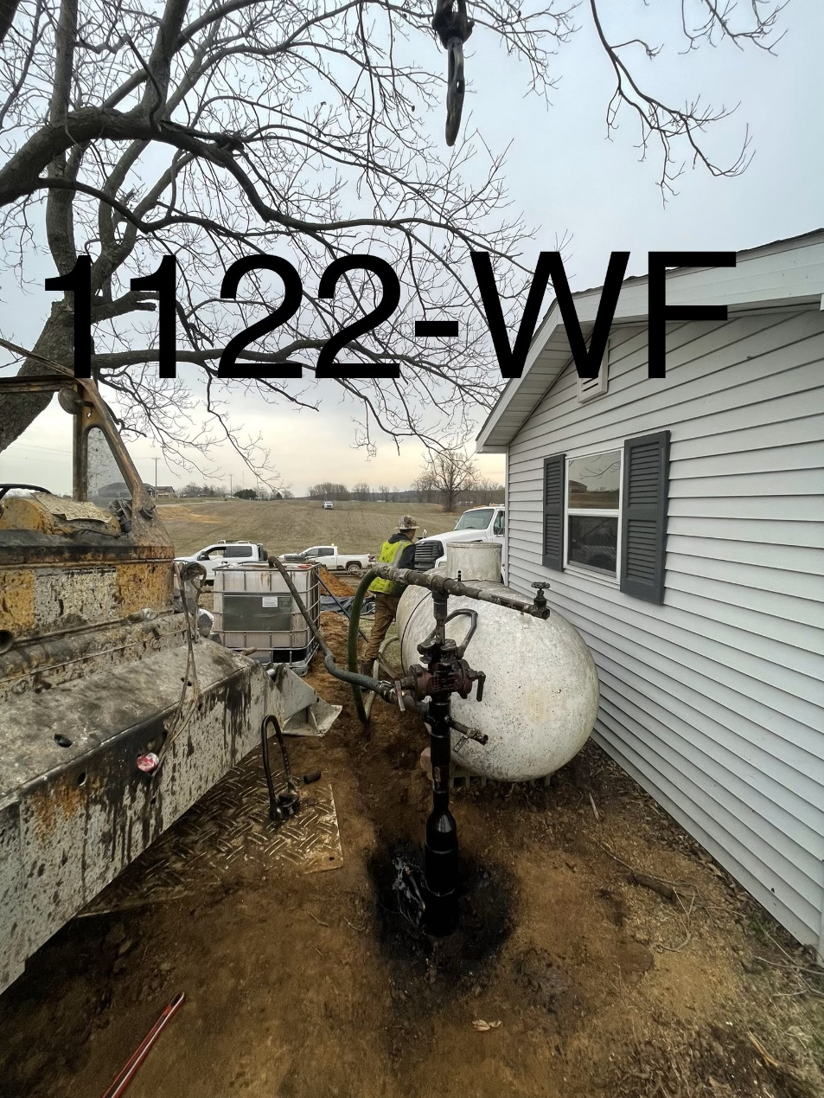
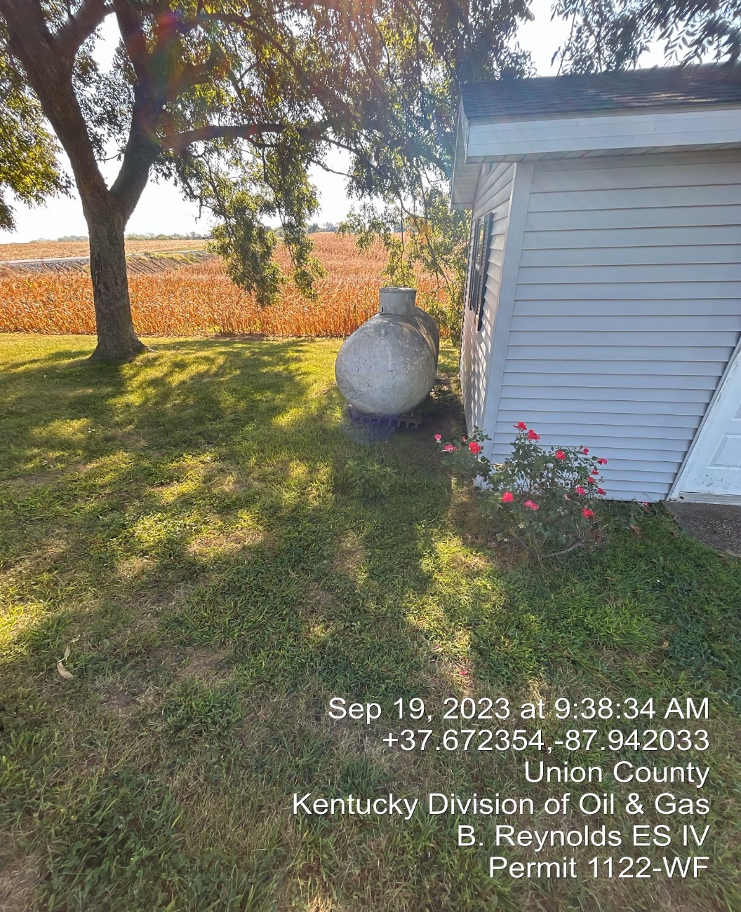
Notes:
Union County: BEFORE and AFTER Photos

Slide 8
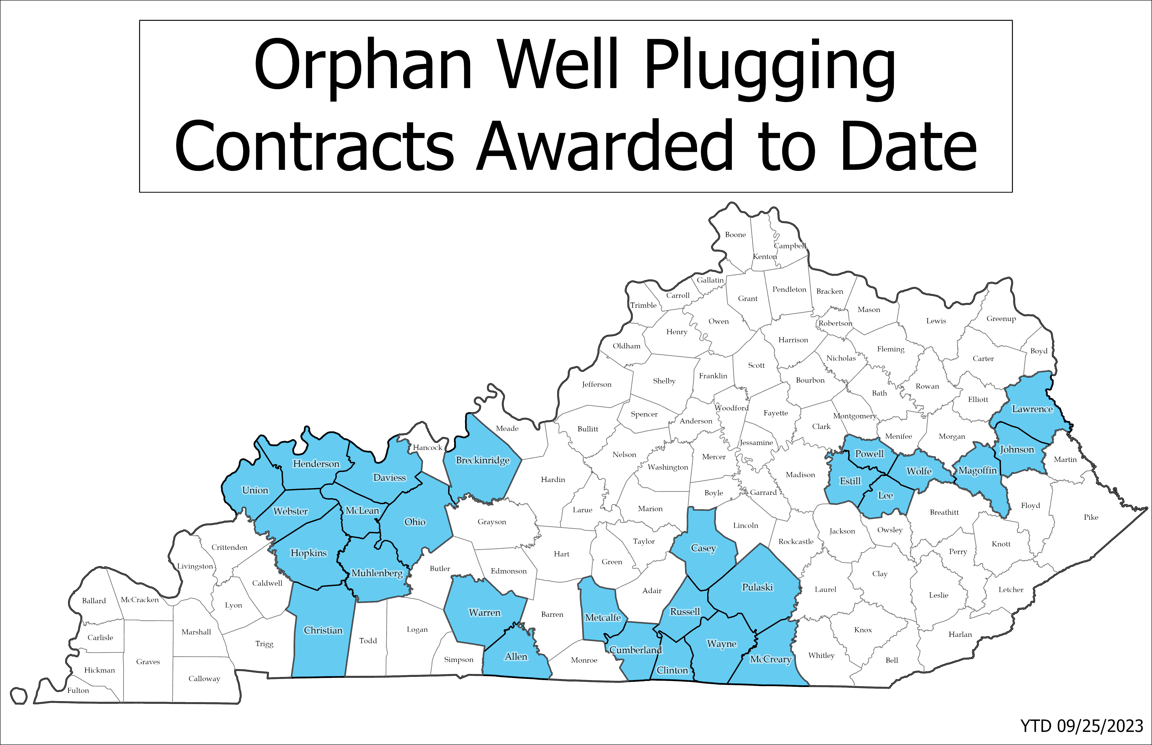
YTD 10/10/2023
Notes:
Twenty Seven Different Kentucky Counties saw BIL Plugging Projects Awarded.

Slide 9
Orphan Wells Plugged to Date:
627 Wells
*YTD 10/10/2023
Notes:
Plugging work has been completed in 26 of the 27 Kentucky counties seeing contracts awarded.

Slide 10
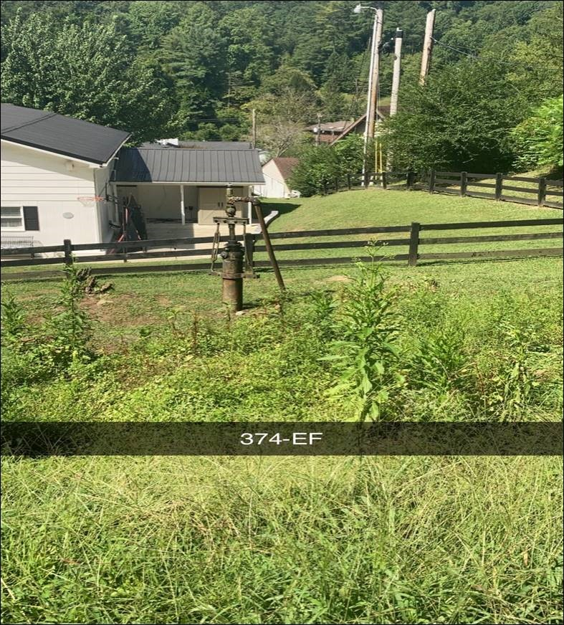
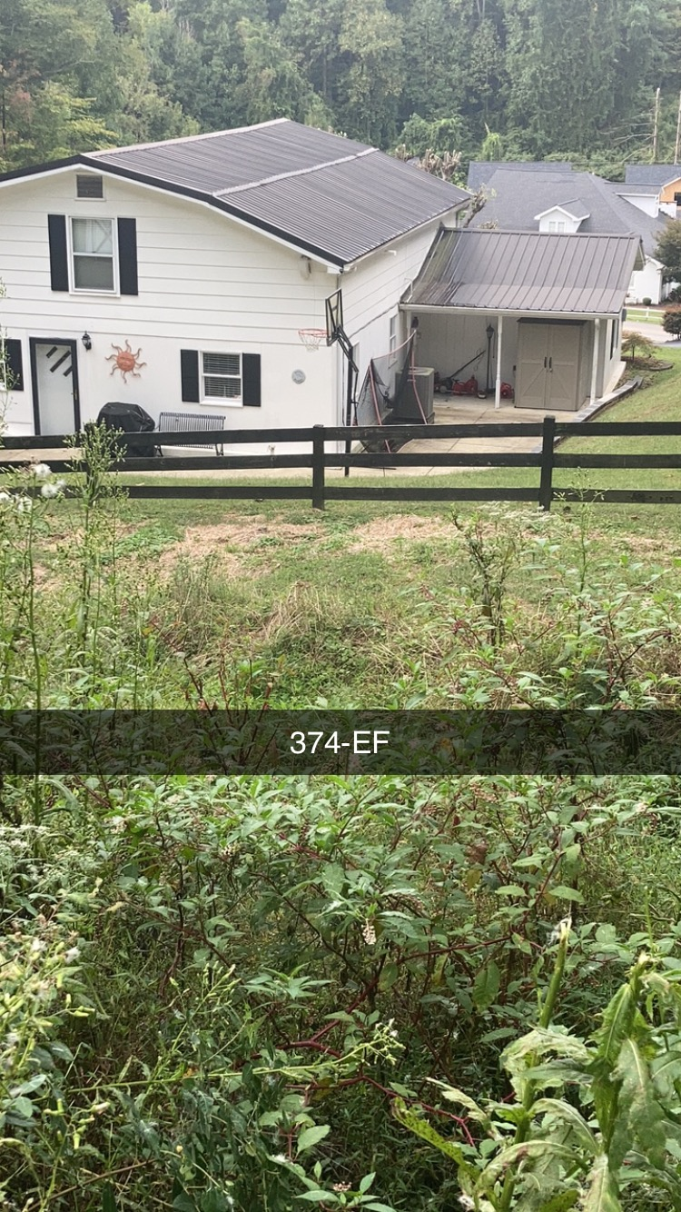
Notes:
Johnson County: BEFORE and AFTER Photos

Slide 11
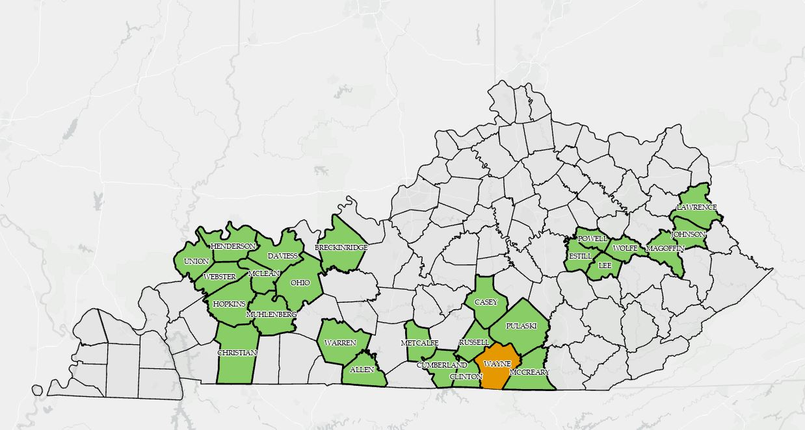
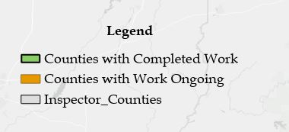
Notes:
Counties with work completed are green, only Wayne County has ongoing Federal Plugging Work.

Slide 12
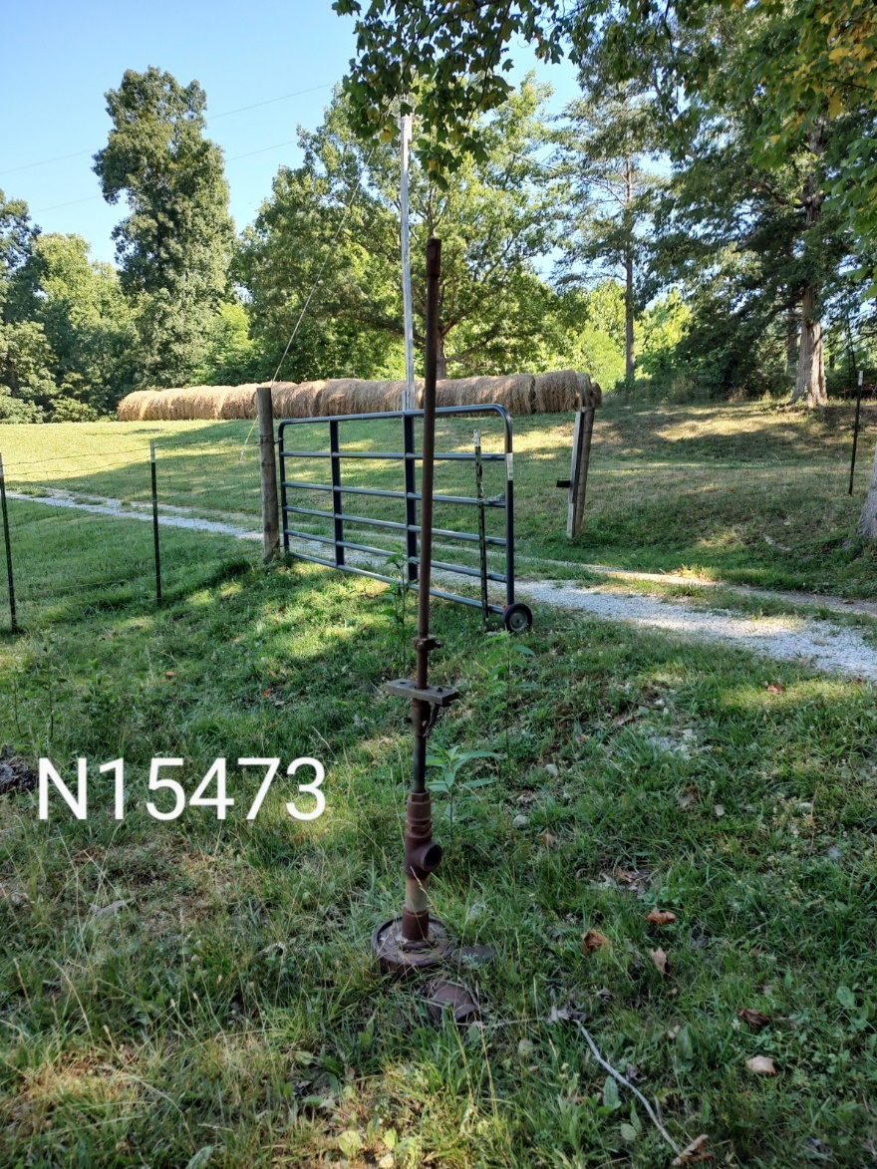
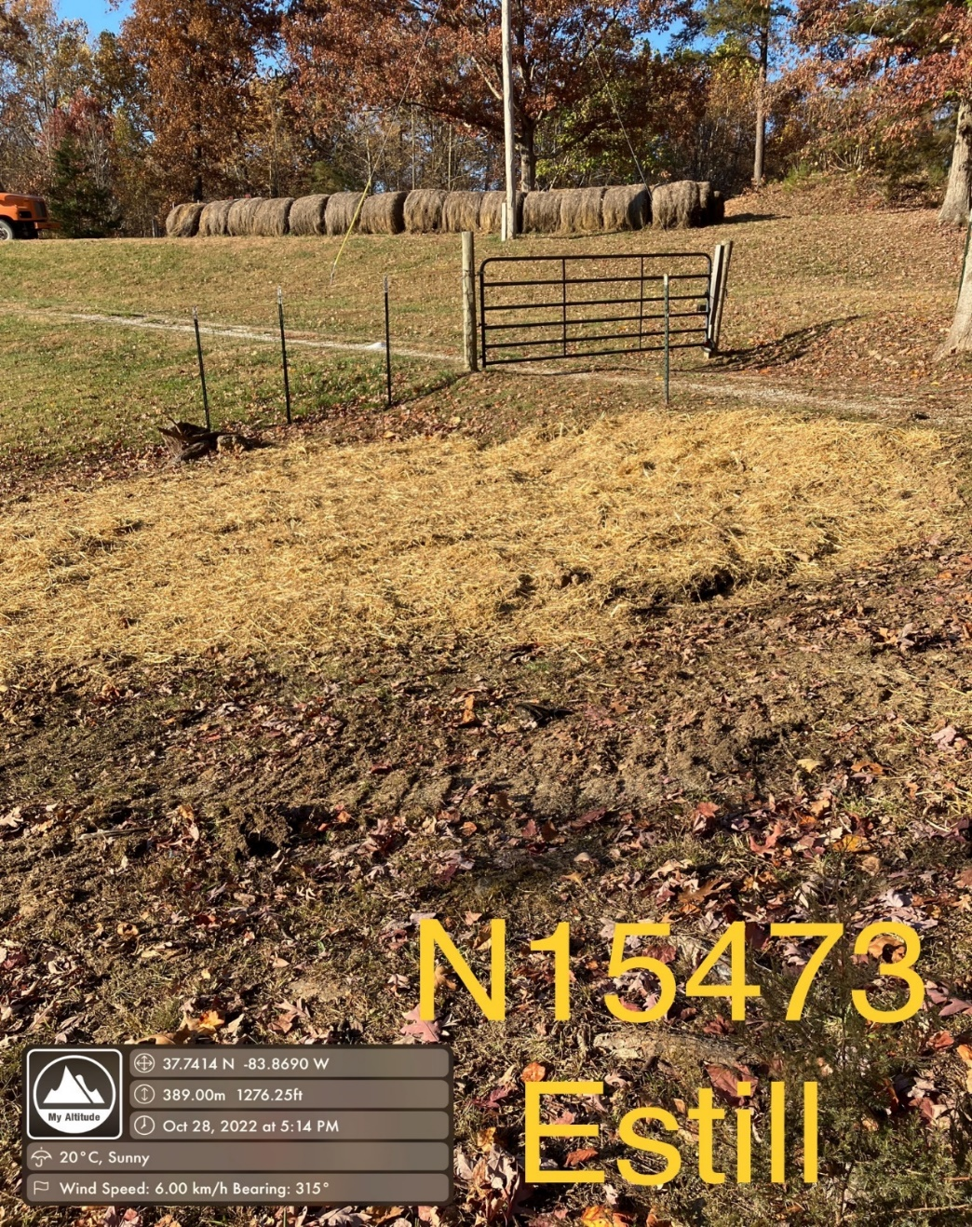
Notes:
Estill County: BEFORE and AFTER Photos

Slide 13
FORMULA GRANT
Kentucky made application in December 2021 to become eligible for a BIL Formula Plugging Grant.
The U.S. Department of the Interior (DOI) in March 2022 announced Kentucky Formula Grant eligibility to be $78.98M, but their requirements to apply for that grant only came out in July 2023.
Per DOI requirements, Formula Grant applications must be submitted as annual phases limited to $25M per year.
This Formula Grant will have numerous additional requirements beyond the earlier grant, primarily the required methane measurement of most wells targeted, and more DOI involvement in all aspects.
Notes:
The next step for KY is to secure additional plugging funds is to pursue a BIL Formula Grant.

Slide 14
FORMULA GRANT
Work is now underway by the Division of Oil and Gas to submit Kentucky’s application for Phase I of the Formula Grant in the amount of $25M to plug orphan wells.
Funds must be obligated within 5 years, but do not expire until September 2030.
The Formula Grant plugging work will go slower than seen with the Initial Grant, due to the more stringent DOI requirements.
However, the end result will still be positive for Kentucky through continued plugging of orphan wells.

Slide 15
THANK YOU!
Notes:
An unknown and unmapped Orphan Well found near Rockcastle County High School, yet to be plugged.

