Slide 1
Solar Energy Development in Kentucky
Office of Energy Policy

Slide 2
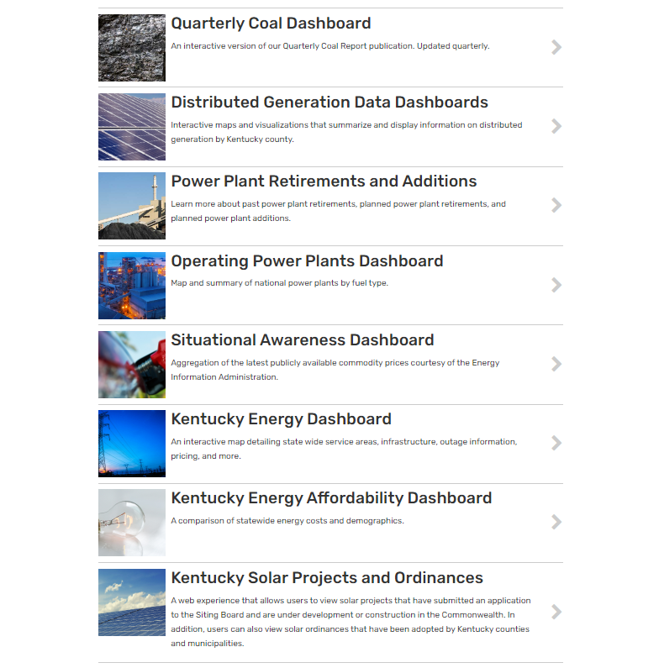
Office of Energy Policy
Our mission is to support the utilization of Kentucky’s energy resources for the betterment of the Commonwealth while protecting and improving our environment.
We are a non-regulatory agency.
Through federal grant partnerships, we fund projects throughout the state that are focused on energy education, affordability, grid resilience, data modeling, power sector modernization and more.
We produce the Kentucky Energy Profile and other interactive data visualizations.
We serve a co-lead agency for energy emergency response activities at the Emergency Operation Center

Slide 3
Fast Facts: Solar Energy Development in Kentucky
A megawatt (MW) describes the energy capacity of the project or the maximum output an electricity generator can physically produce. A gigawatt (GW) is 1000 megawatts.
Kentucky’s utility owned solar generation accounts for 0.07% of Kentucky’s net utility electricity generation and ~30 megawatts of solar capacity operational.
Rooftop solar or distributed solar generation (connects to distribution system) is outpacing utility owned solar with an aggregated capacity of ~63.5 megawatts with installations connected across the state, to the grid, via net metering and qualifying facility tariffs.
Merchant or independent solar power projects total ~4.0 gigawatts of capacity and are the single largest category of solar projects in the state.
There is a growing trend among all categories of solar power projects to pair the electricity generation with energy storage solutions for either economic or resilience concerns.

Slide 4
Types of Large Scale Solar Projects
“Large Scale” is generally defined across the industry as being 1 megawatt (MW) or larger.
These large scale projects can fall into three categories:
Merchant Power Production Projects or Independent Power Production Projects
Utility Owned Projects
Large Utility Customer Owned “Behind the Meter” Projects

Slide 5
What is a Merchant Electric Generating Facility
Defined in KRS 278.700
An electricity generating facility or facilities that, together with all associated structures and facilities:
Are capable of operating at an aggregate capacity of ten megawatts (10MW) or more; and
Sell the electricity they produce in the wholesale market, at rates and charges not regulated by the Public Service Commission;
Not a qualifying cogeneration facility or industrial energy facility (gasification facility)
No person shall commence to construct a merchant electric generating facility until that person has applied for and obtained a construction certificate for the facility from the board [Kentucky Electric Generation and Transmission Siting Board].

Slide 6
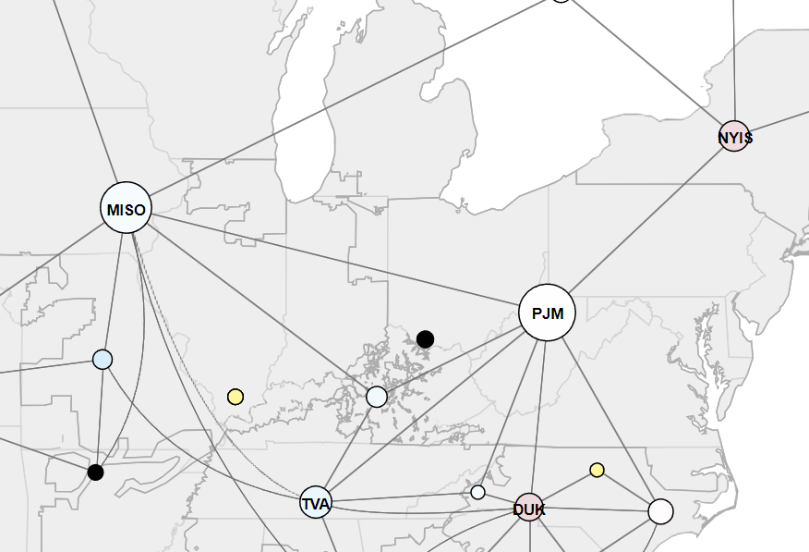
What is the “potential” for merchant and utility projects to develop in Kentucky?
The interconnection queues at each utility or regional grid operator provide a picture of potential projects.
The interconnection queue is a collection of power generation and transmission projects requesting to connect to the power grid.
In addition to the interconnection request, a series of studies are completed to ensure the project that will potentially join the power network meets the grid operator’s reliability, safety and facility standards, and is an overall best fit for the network.

Slide 7
The Queue “Potential” for Kentucky
Queue Name | # of KY Projects In-Progress ( Solar, Solar Plus Storage, Storage Only) | Capacity (MW) | # of KY Solar Plus Storage or Storage Only Projects In-Progress
PJM | 150 | ~17,944 | 41
MISO | 29 | ~3,362.5 | 13
LGE/KU | 21 | ~2,555 | 11
TVA | 13 | ~1,517 | 4
Total | 213 | ~25,378.5 | 69

Slide 8
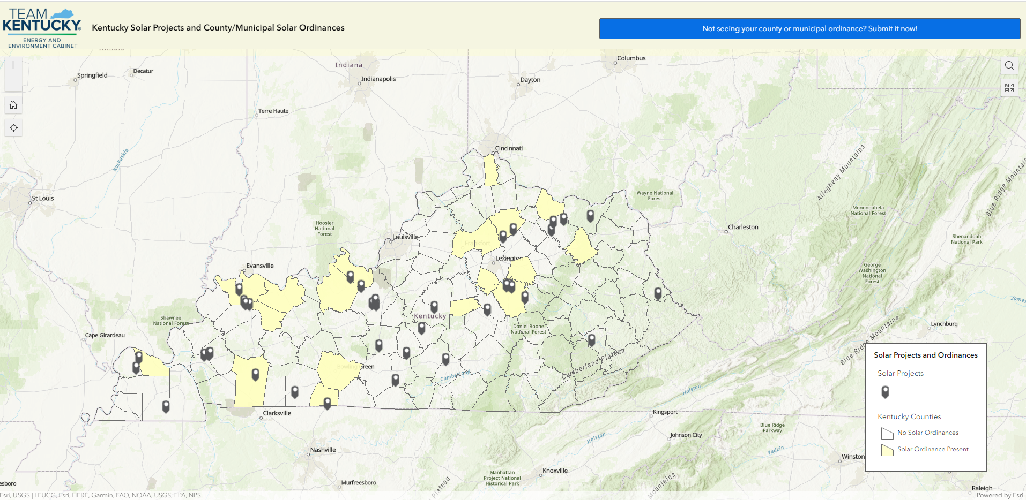
Merchant Solar Electric Generation Projects
Notes:
37 active siting board cases totally around ~4 GW of capacity
Battery Projects:
Glover Creek Solar
Ashwood Solar I
Martin County Solar
Bluebird Solar
Russellville Solar
Horseshoe Bend Solar
Mt. Olive Solar

Slide 9
Merchant Solar Project Types
Note: Independent solar project developers are not allowed to sell power directly to electric utility customers.
Therefore, these projects are developed through the following pathways:
Contracting with a commercial off-taker via a virtual power purchase agreement transaction in one of the wholesale electricity markets.
Contracting with a Kentucky retail electricity supplier to deliver the solar energy to a customer via a “green tariff” or “green procurement” program often utilizing some type of sleeved power purchase agreement where the commercial customer pays for the solar power procured through the retail electric supplier.
Contracting with the Kentucky Municipal Energy Agency to deliver the solar energy to their member municipal utility organizations.

Slide 10
Utility Solar and Solar+Storage Projects
POWER_PLANT |  | PLANT_OPERATOR | OPER_CAPACITY_PLANT (MW) | PLANNED_CAPACITY (MW)
Amazon Air Hub Rooftop Solar Project |  | Duke Energy Kentucky, Inc. | 2.0
Community Solar Project (Solar Share Program) |  | LG&E and KU Energy LLC | 2.5
Cooperative Solar One (Clark County Solar) |  | East Kentucky Power Cooperative, Inc. | 8.5
E.W. Brown Solar Project (Universal Solar Facility) |  | Kentucky Utilities Company | 10.0
E.W. Brown Battery Storage Project |  | Kentucky Utilities Company | 1.0
LGE-KU Solar Share Facility |  | Kentucky Utilities Company | 1.3
Mercer Solar Project |  | Kentucky Utilities Company | NA | 120.0
Shawnee Solar Pilot Project |  | Tennessee Valley Authority | NA | 100.0
Walton 1 |  | Duke Energy Kentucky, Inc. | 2.0
Walton 2 |  | Duke Energy Kentucky, Inc. | 2.0
Crittenden Solar Facility |  | Duke Energy Kentucky, Inc. | 2.7
Notes:
Kentucky has 18GW of total generation capacity online today.

Slide 11
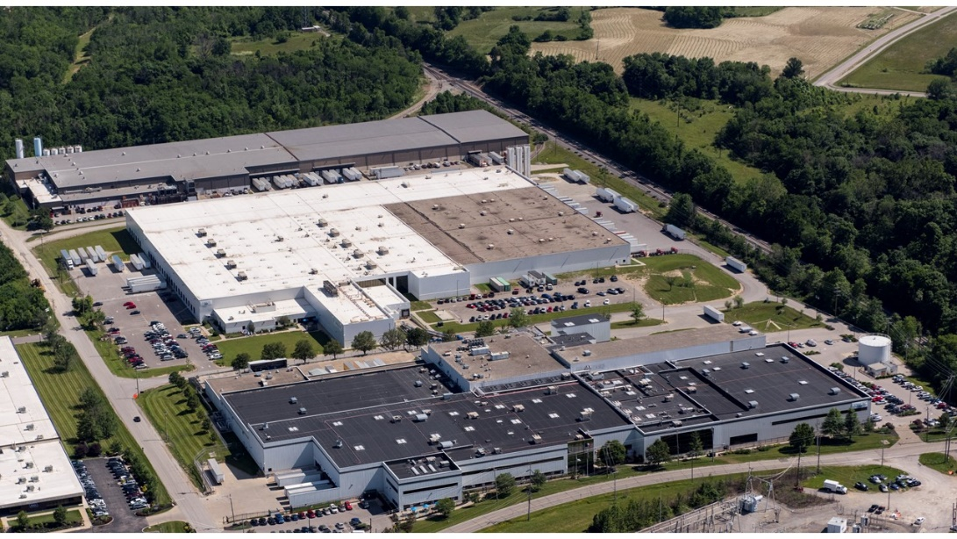
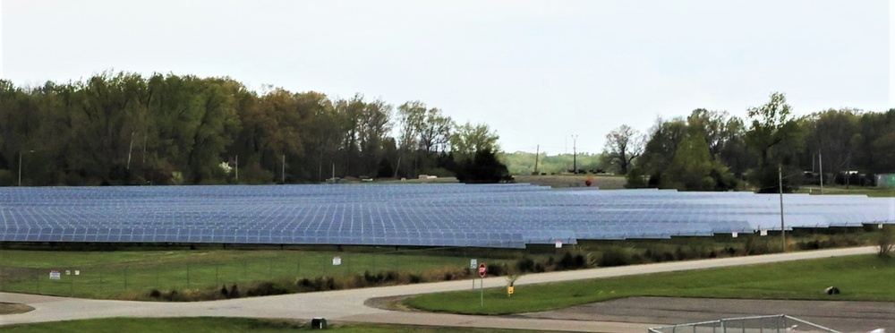
Large Commercial Solar Projects
Examples Include:
L’Oreal in Northern Kentucky
Lexmark in Lexington, KY
Ft. Campbell
Ft. Knox
KY National Guard

Slide 12
Factors Affecting Solar or Battery Deployment
Cost competitiveness with other electricity generating technologies.
Supply chain and domestic sourcing requirements including import tariffs.
Federal incentives and programs.
Wholesale market structures that value various types of resources:
Low carbon resources.
Firm (baseload) and fuel secure resources.
Black start resources or generation resources that are able to start up and produce power without the need for off-site power or grid connectivity to start-up.
Market access for aggregated distributed energy resources like rooftop solar and storage.
Consumer demand and Corporate goals.
Neighboring state policies or incentives.
Environmental regulations.
Interconnection queue processing.
Interconnection tariffs and compensation mechanisms.

Slide 13
Tools and Resources
Kentucky Solar Toolkit https://kentucky-solar-toolkit-kygis.hub.arcgis.com/
Solar Siting Potential and Suitability Tool https://solar-siting-potential-in-kentucky-kygis.hub.arcgis.com/
Consumer Energy Management and Access Guide https://eec.ky.gov/Energy/Documents/Consumer%20Guide%20Final%20Version%202.0.pdf
Residential Rooftop Solar Installation Resources https://eec.ky.gov/Energy/News-Publications/Pages/Residential-Rooftop-Solar-Resources.aspx

Slide 14
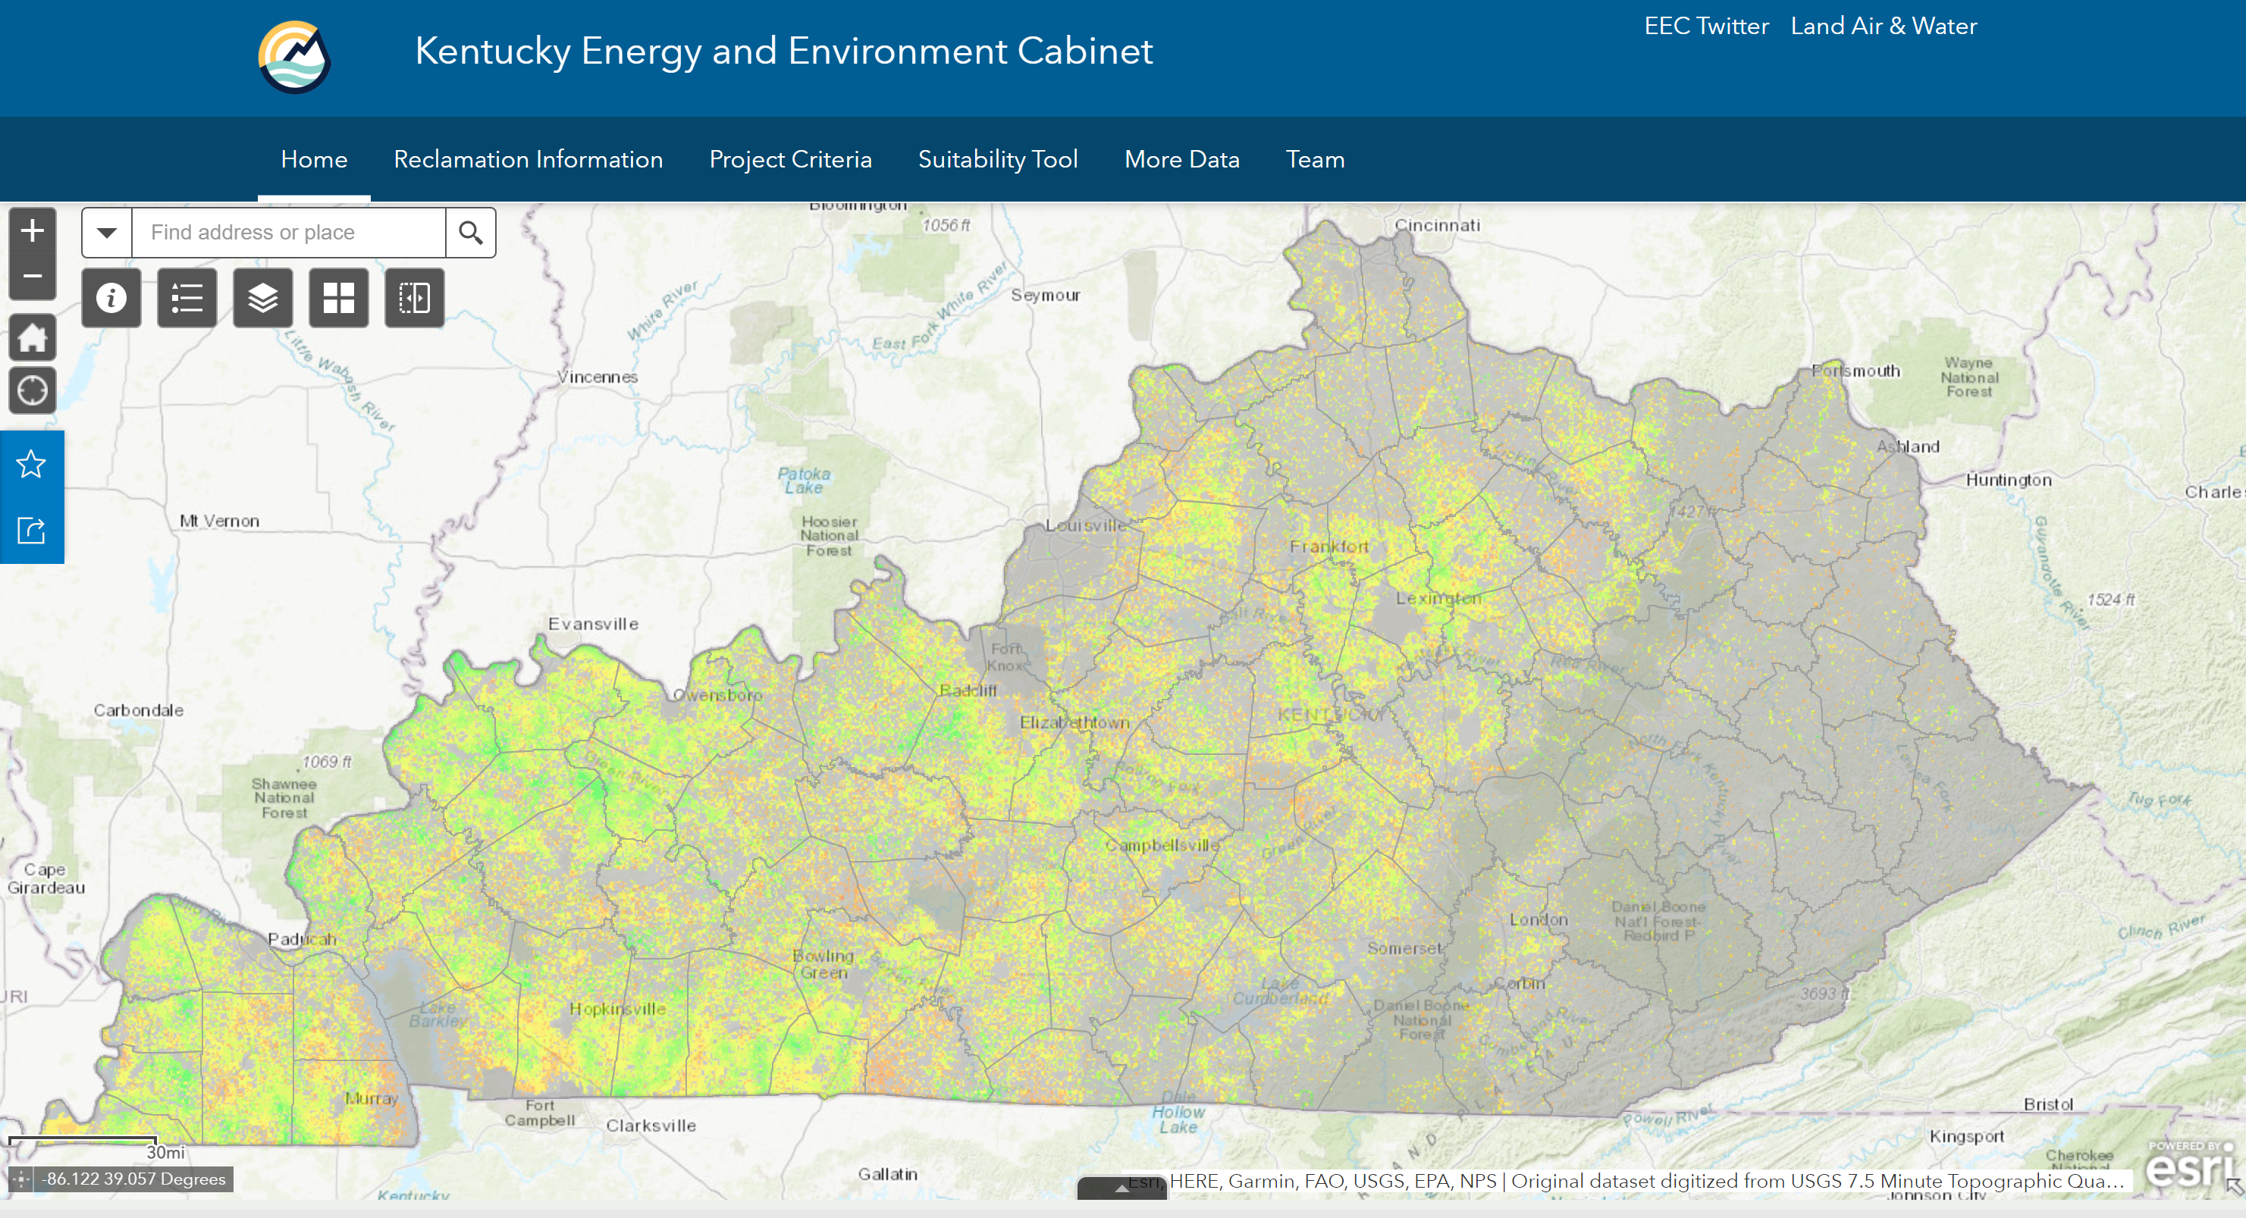
Solar Site Suitability and Reclaimed Mine Lands

Slide 15
Questions
Kenya.stump@ky.gov

