Slide 1
Kentucky Grid-Scale Solar Industry Update
Evan Vaughan November 16, 2023

Slide 2
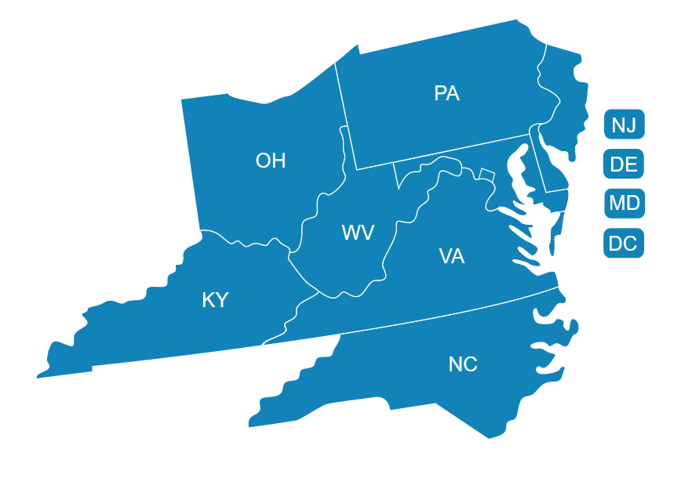
About MAREC Action
MAREC Action (informally “Mid-Atlantic Renewable Energy Coalition”) is a 501.c4 non-profit.
We represent over 40 solar, storage and wind businesses active in PJM states.
Our membership primarily consists of independent power producers (merchant generators), project developers, & manufacturers.
Our members’ business models include both owner-operators and early-stage developers.
We’re represented in Kentucky by Commonwealth Alliances – Karen Lentz and Collin Johnson.
MAREC’s regional footprint includes 9 states and DC

Slide 3
Kentucky Solar Industry Facts and Figures
First grid-scale merchant solar project recently came online – Turkey Creek Solar in Garrard County, Kentucky.
Other solar projects totaling 820 MW are under construction as we speak.
In all, more than 4,200 MW of solar capacity has been approved or is under consideration by the Kentucky Power Siting Board.
That’s enough solar to power more than 550,000 Kentucky homes.
The combined solar and energy storage industry employs 2,300 Kentuckians.
Solar boosts revenue for host communities through taxes or alternative payments negotiated through Industrial Revenue Bonds.

Slide 4
Kentucky Solar Project Map

Slide 5
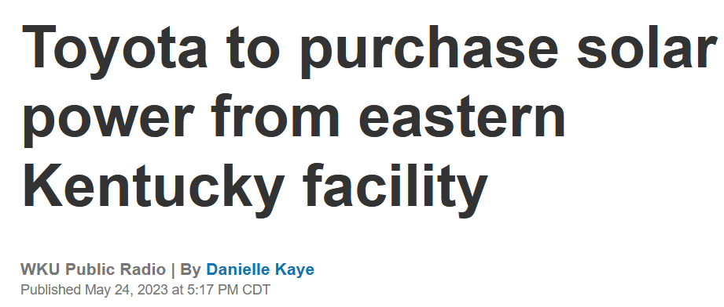
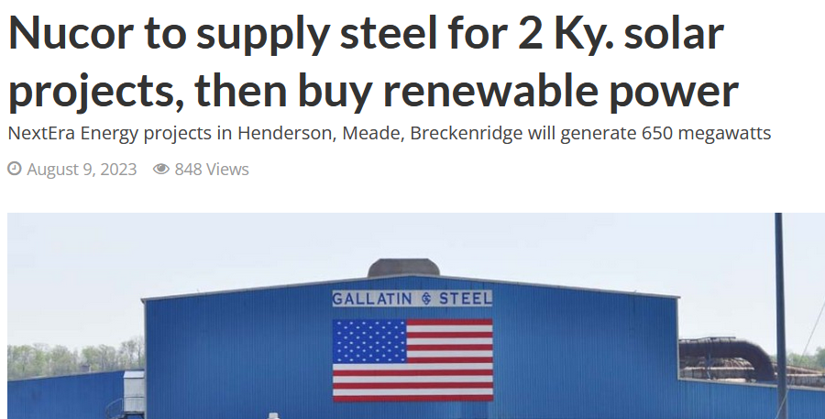
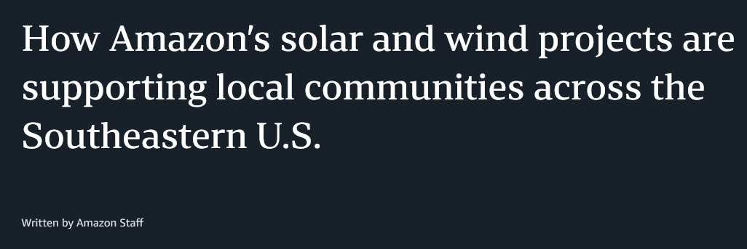
Kentucky Solar Announcements

Slide 6
Kentucky Solar Industry PJM Outlook
PJM queue includes 15,731 MW* of solar in Kentucky. Only some of these projects will be built depending on their estimated cost to interconnect, regulatory delays, and ability to find a buyers (among other factors).
Economic benefits are significant assuming historic rates of project completion.
Projected Solar Jobs: 18,035 job-years*
Projected capital investment ($2021): $2.7 Billion*
*Note that data points on this slide only consider the part of Eastern Kentucky in PJM territory, overall benefits would be larger.

Slide 7
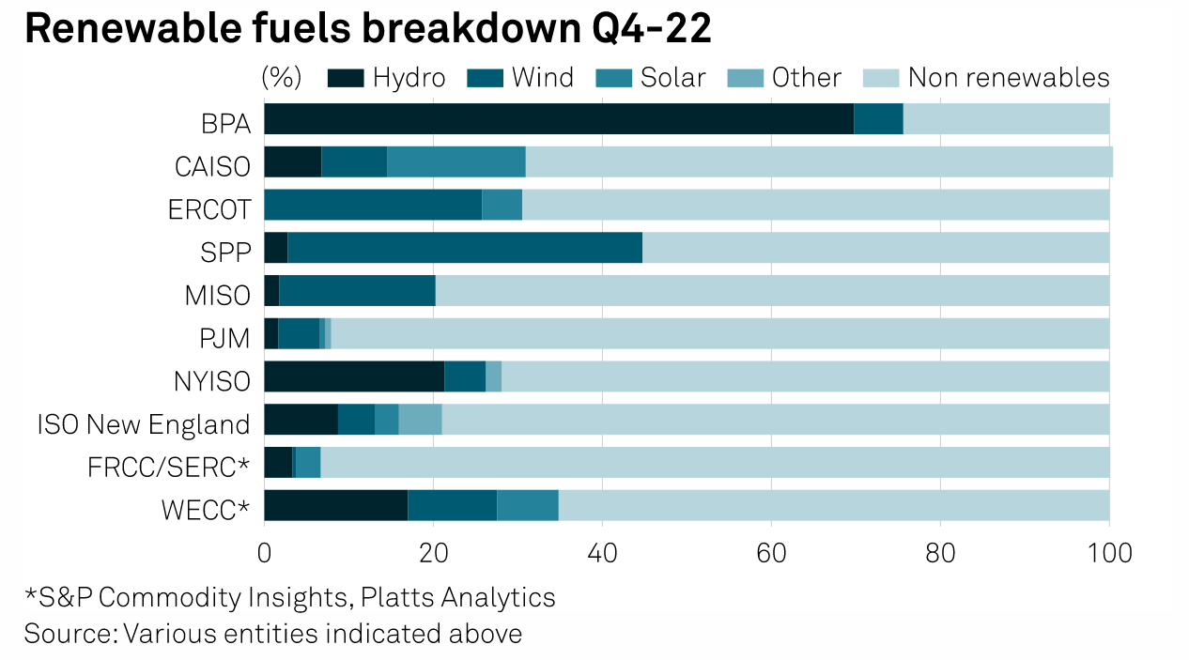
Solar’s Contribution to an Affordable, Reliable Grid
PJM projects a shrinking reserve margin by 2030.
Kentucky needs all the energy it can get—adding grid-scale solar alongside existing fleet of traditional energy sources and enhanced transmission infrastructure will help keep the lights on.
PJM’s queue of projects is largely solar with some storage, gas, and wind.
Solar production aligns with peak electricity demand in the afternoon—reducing overall cost to consumers.
Kentucky’s position straddling PJM, TVA, and MISO means it can draw on diverse mix of resources with the right transmission connections.

