Slide 1

Who are we and what do we do?

Slide 2
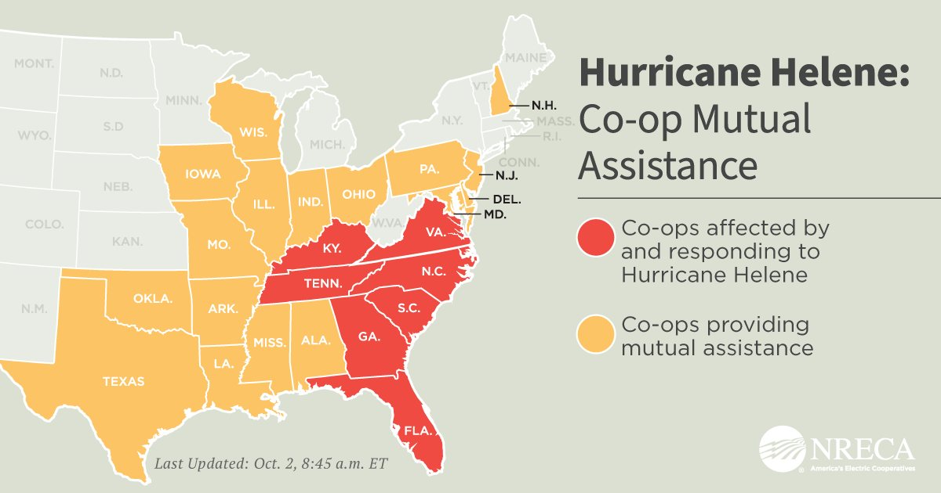

Slide 3
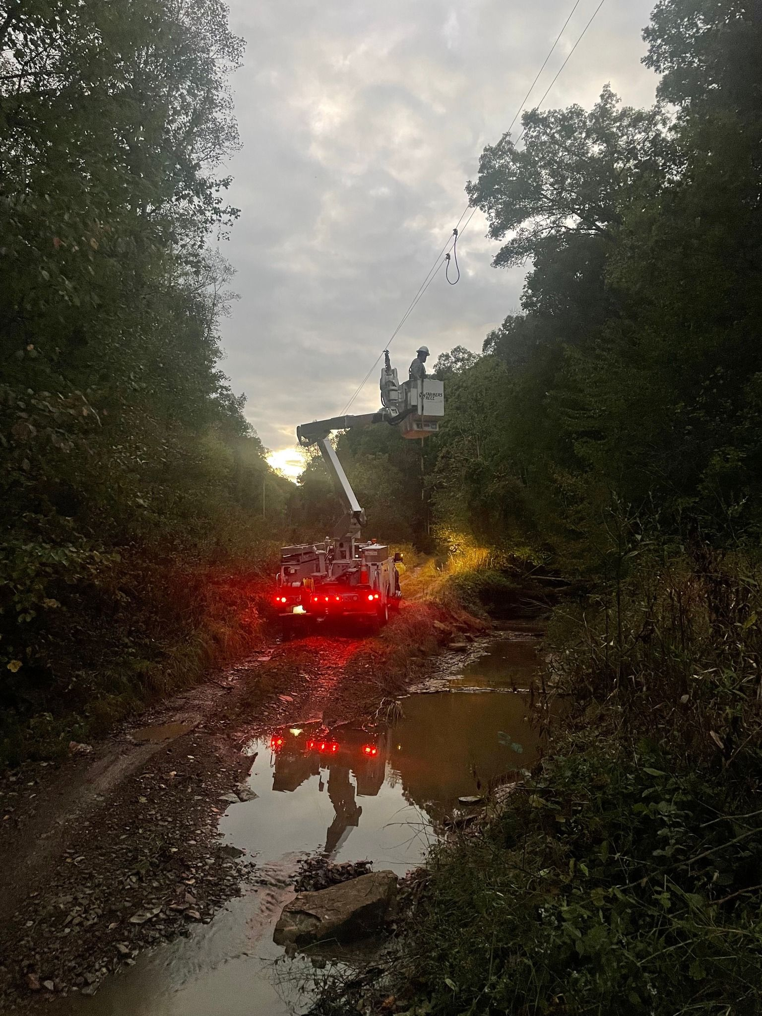
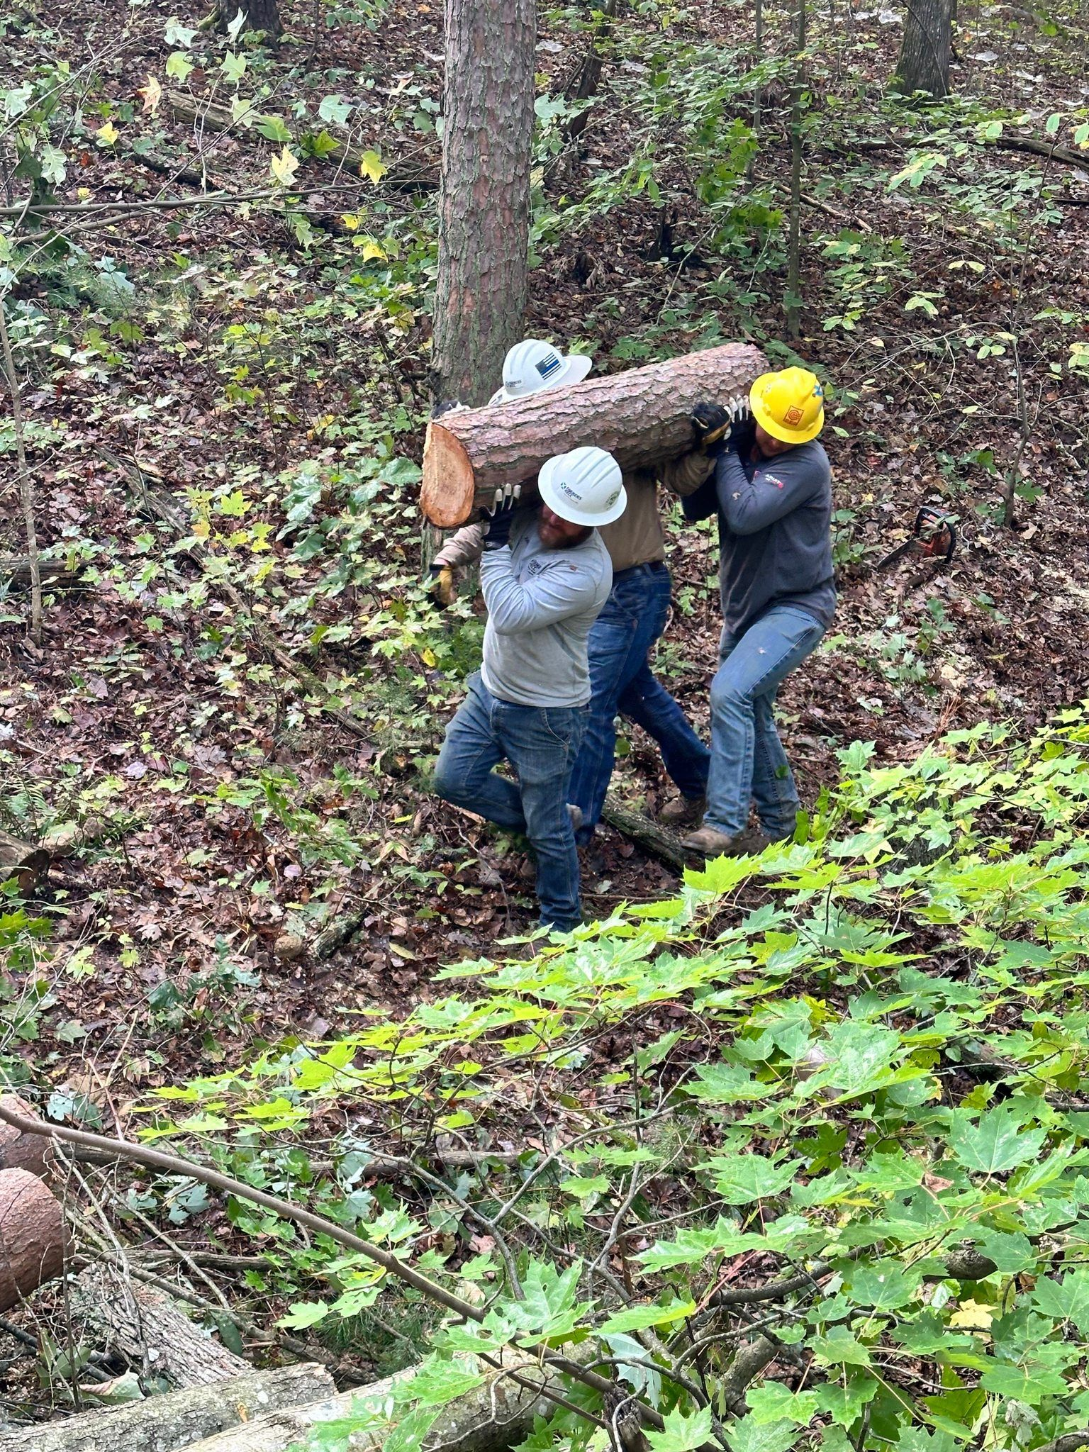
Mutual aid within Kentucky
September/
October
2024
Helene

Slide 4
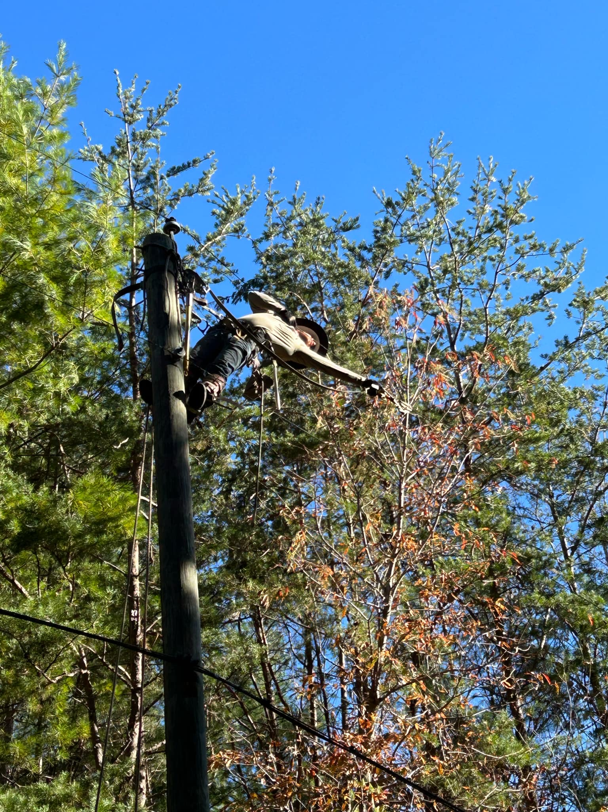
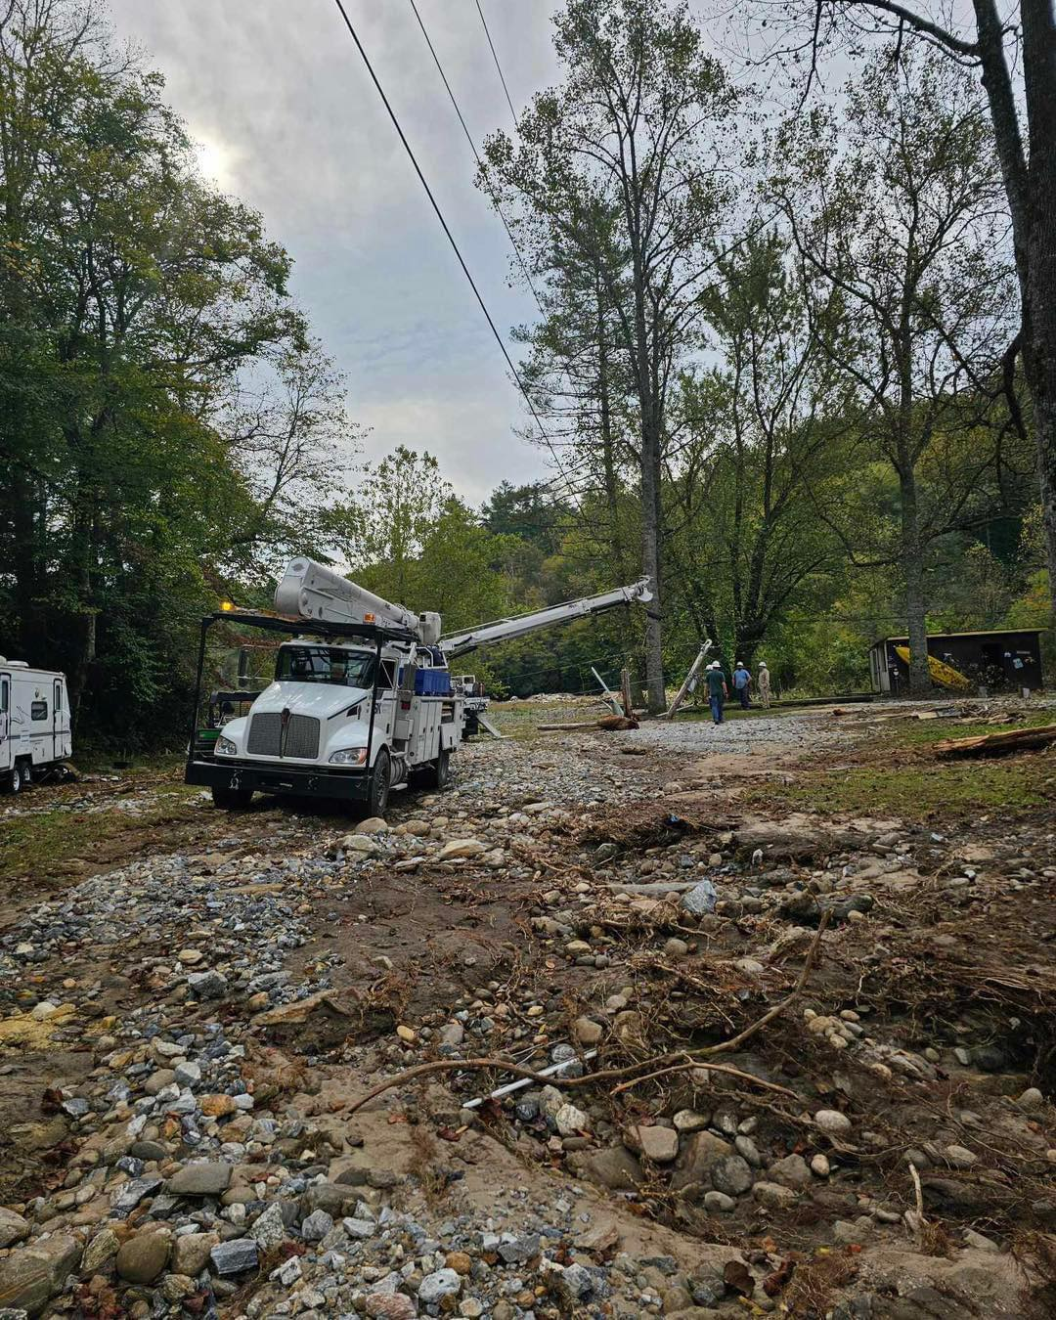
Mutual aid to North Carolina
September/
October
2024
Helene

Slide 5
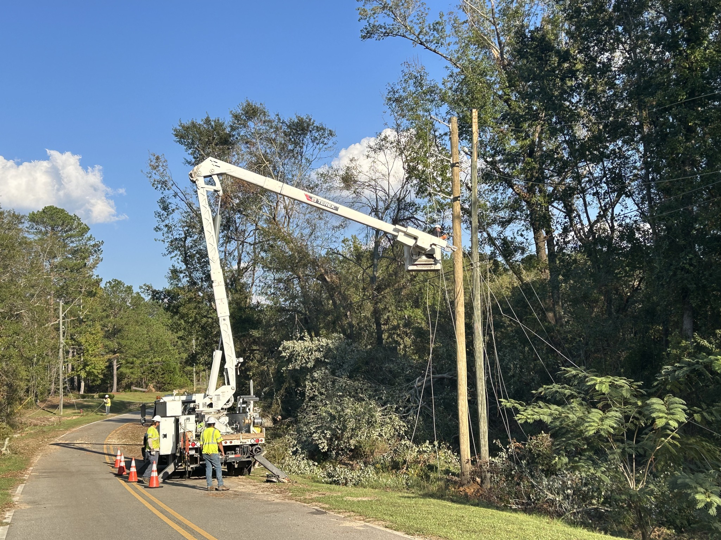
Mutual aid to South Carolina
September/
October
2024
Helene

Slide 6
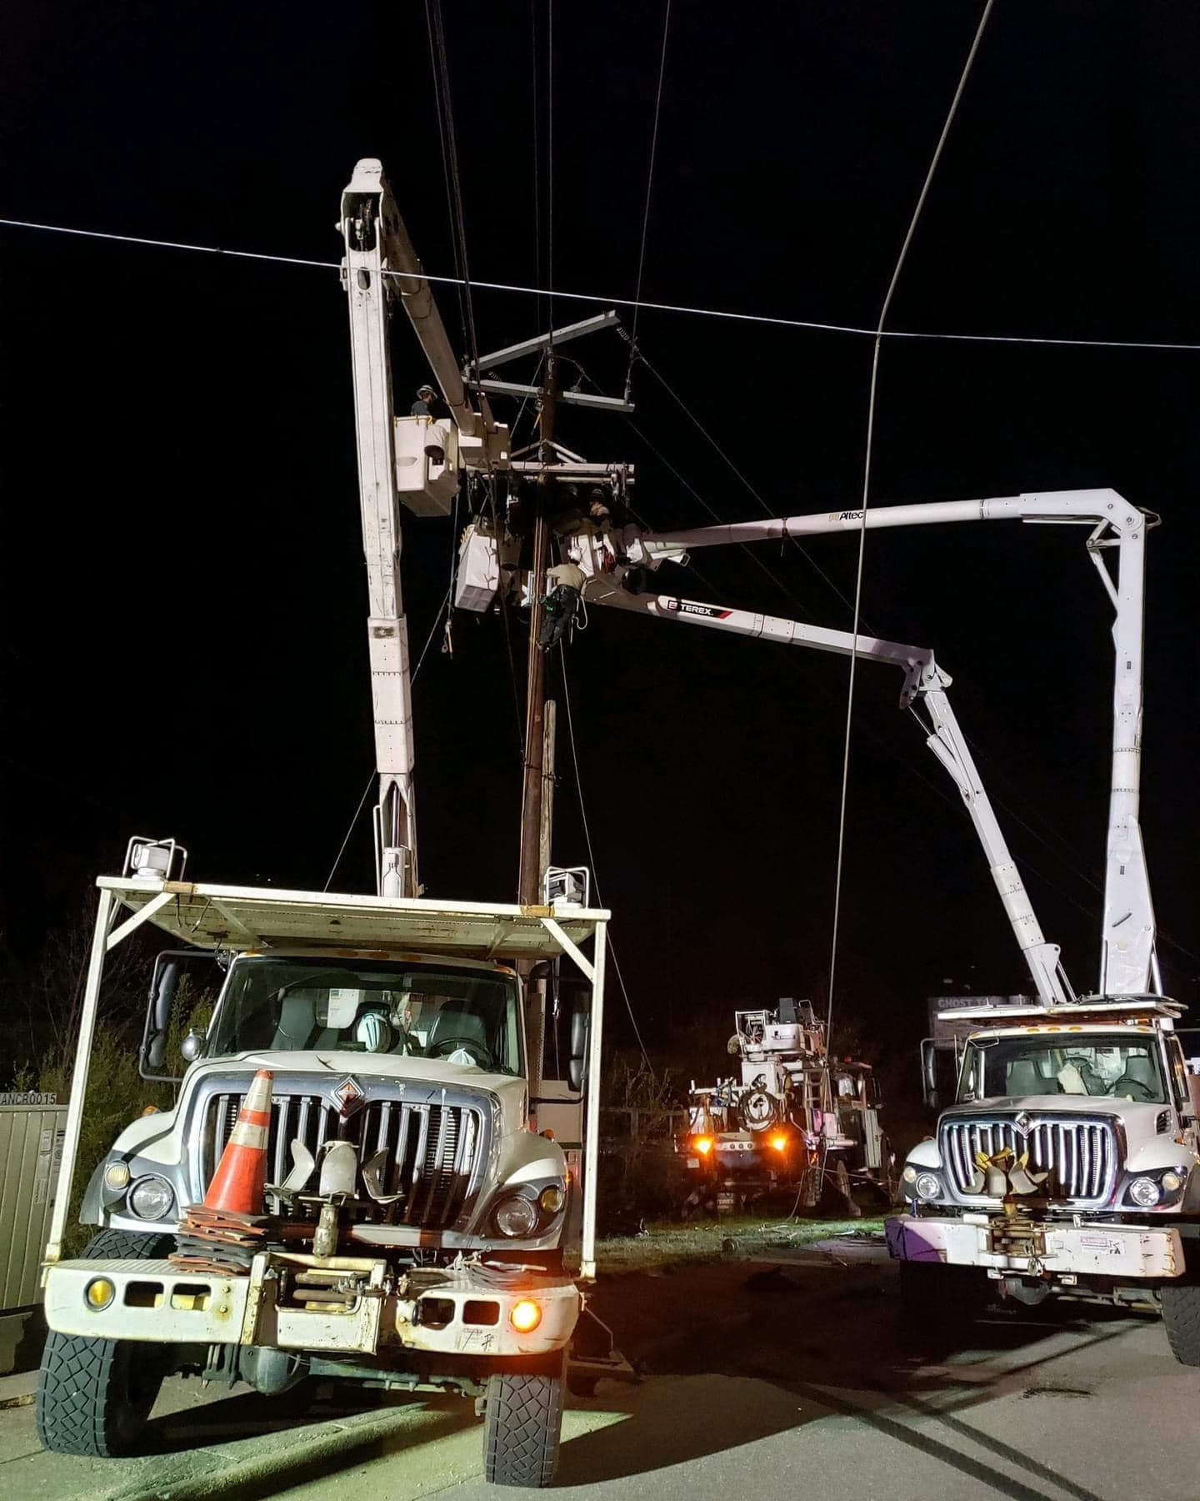
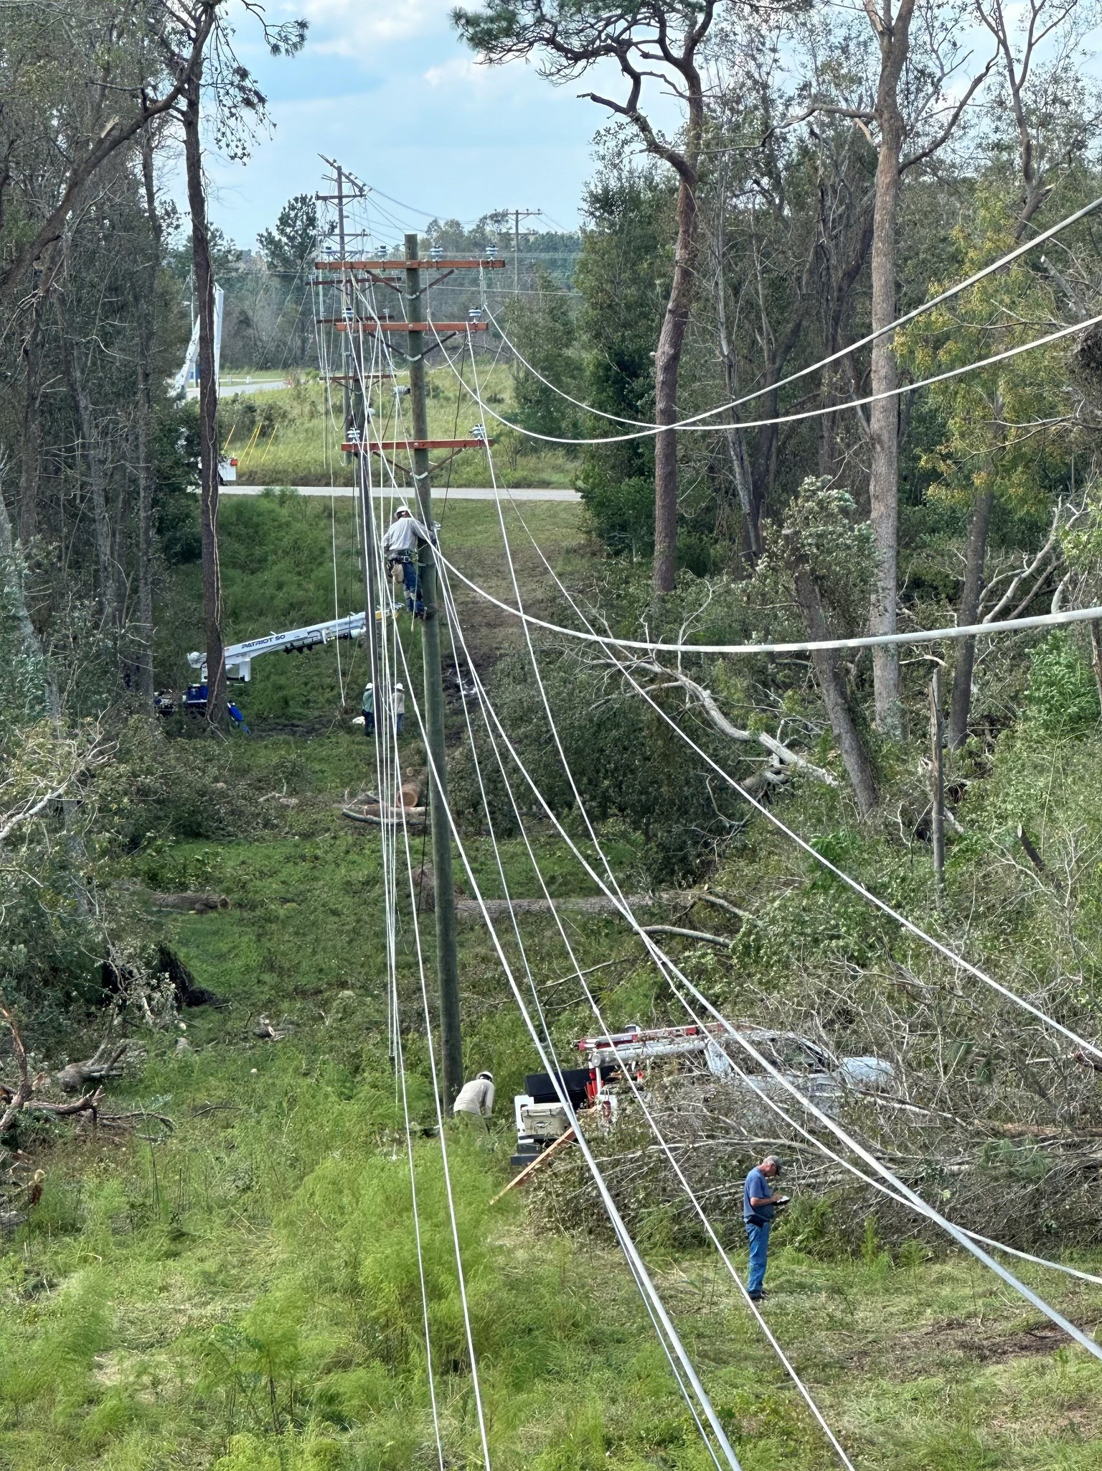
Mutual aid to
Georgia
October
2024
Helene

Slide 7
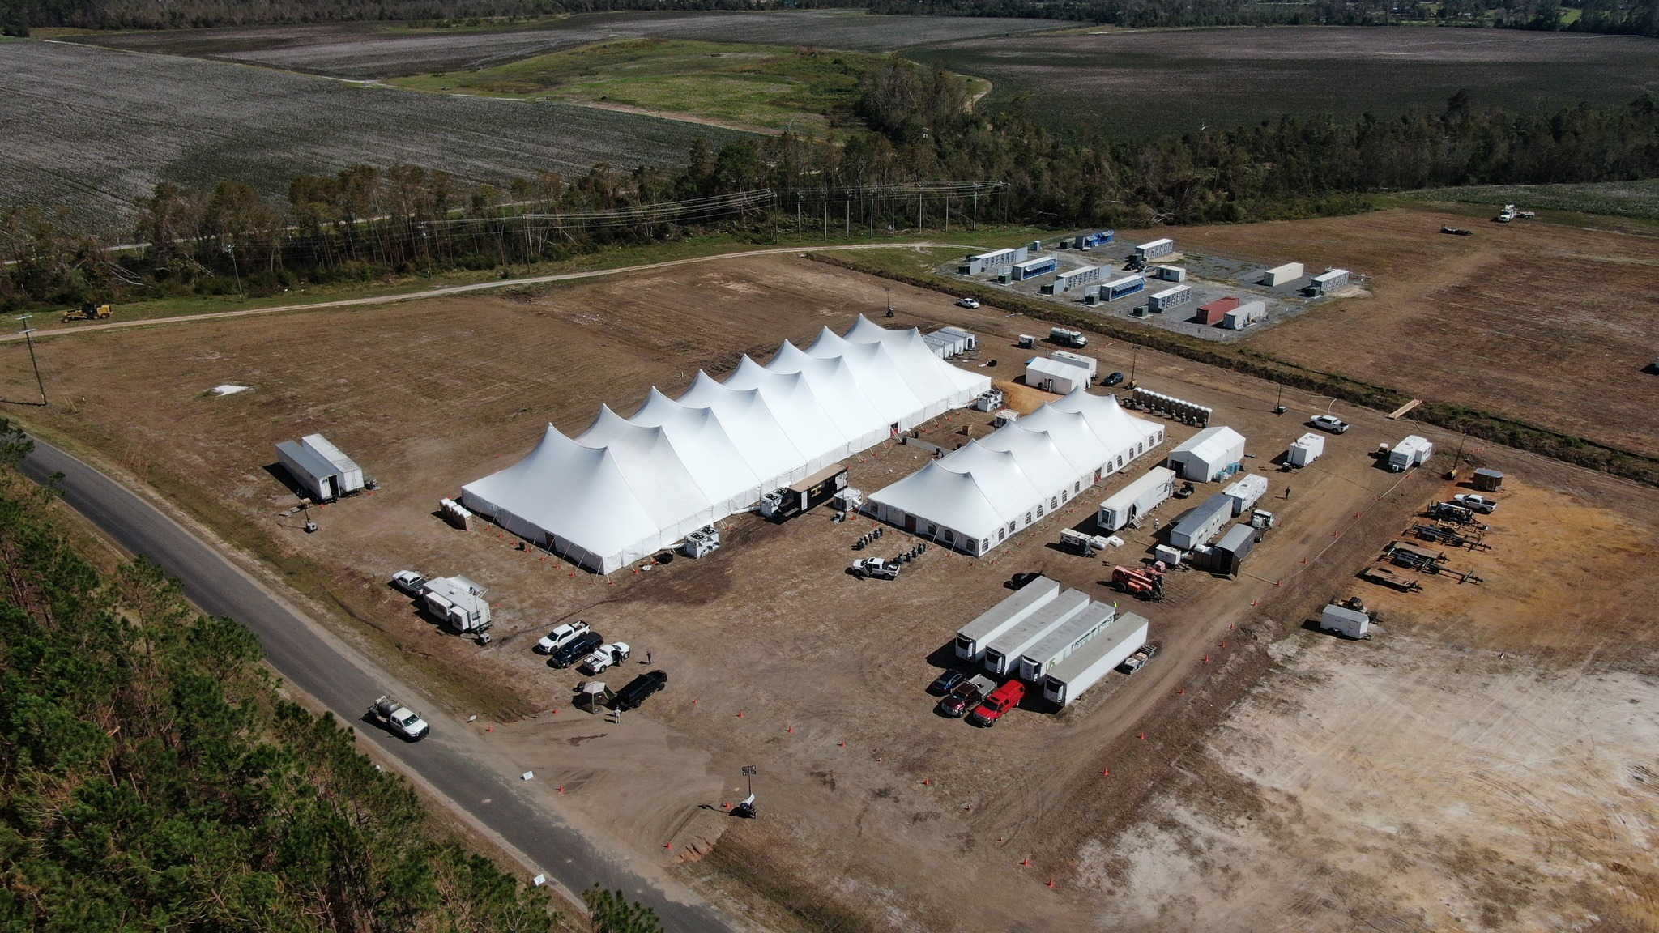

Slide 8
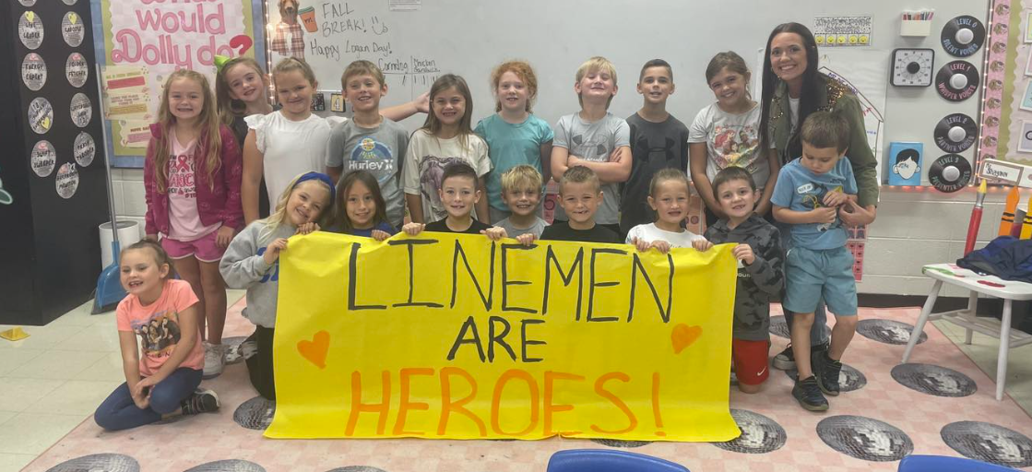
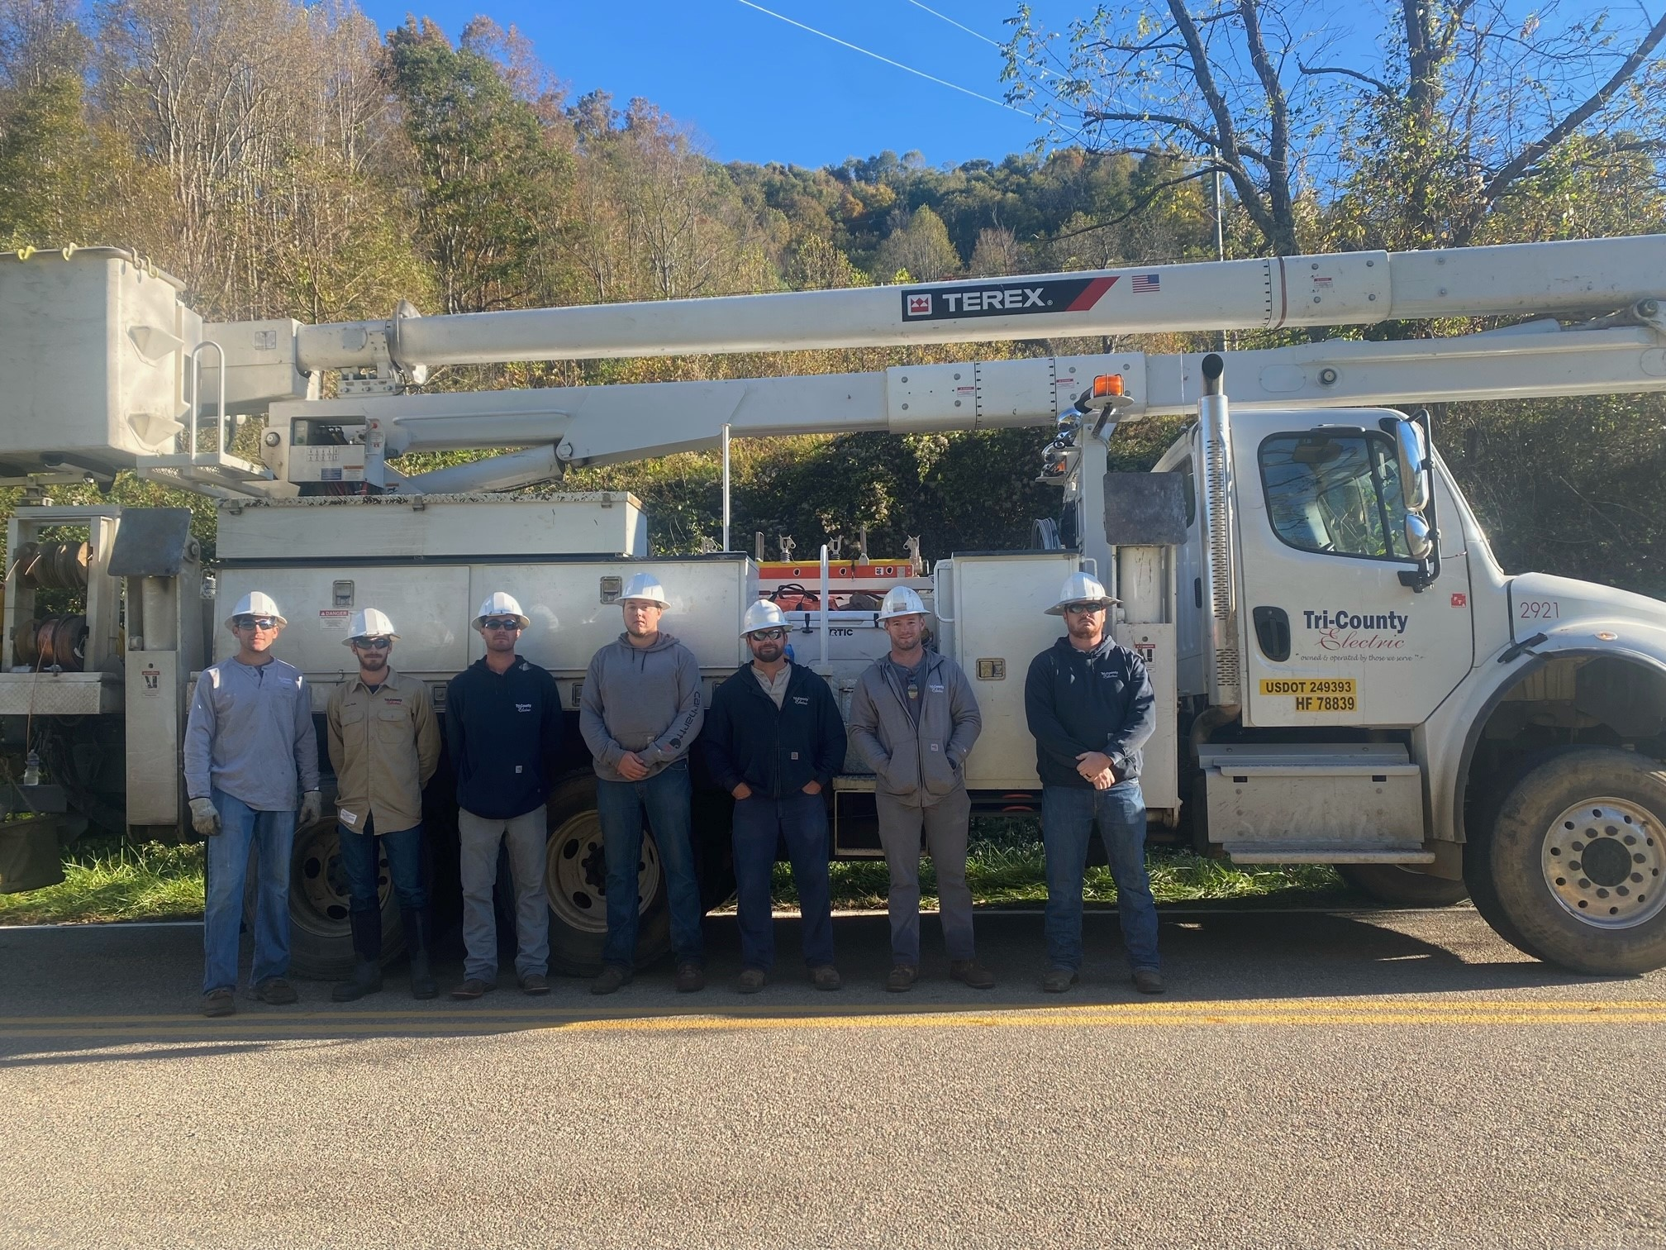
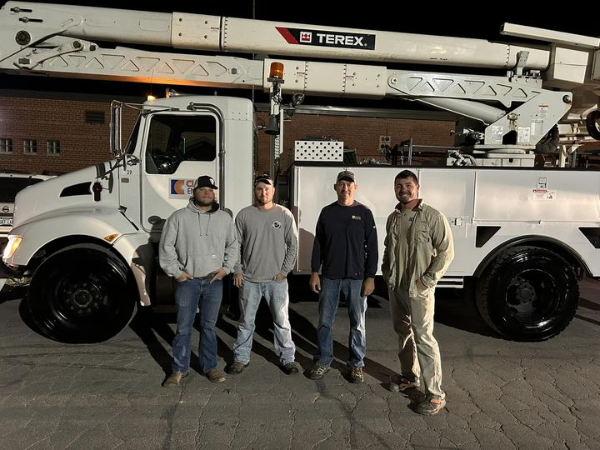
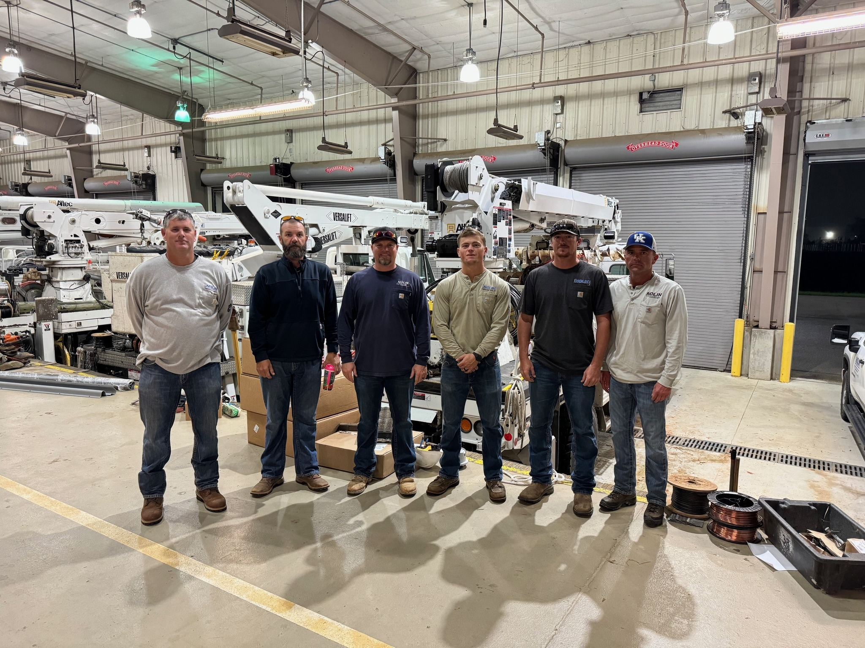
250+ lineworkers
100+ co-op contractors
Largest mutual aid deployment in the history of Kentucky’s electric cooperatives

Slide 9
900 electric co-ops
42 million consumers
48 states
Notes:
First, it’s important to understand that electric cooperatives are not unique to Kentucky.
There are 900 electric cooperatives in 47 U.S. states.
They serve 12% of the nation’s electric consumers. But they own and maintain 42% of the nation’s electric distribution lines that cover 75% of the country’s land mass.
This low density of consumers over a widespread area leads to some extraordinary challenges for electric cooperatives and we’ll talk about some of those later.

Slide 10
24 consumer-owned distribution co-ops
117 counties
900,000 homes & businesses
1.8 million Kentuckians
Notes:
This is a map of the service territories of those 24 distribution cooperatives.
As you can see, there are electric cooperatives in almost every Kentucky county.
We cover very wide and very diverse territories. Some areas are extremely rural, remote and rugged. Some areas are very suburban, with housing developments, office buildings, shopping malls and industrial parks.
If you look close, you’ll see white areas scattered throughout our service territories. These areas are served by other electric utilities, either a municipal utility or an investor-owned utility. Typically, those white areas are cities, towns and major corridors where there are high concentrations of houses and businesses.

Slide 11
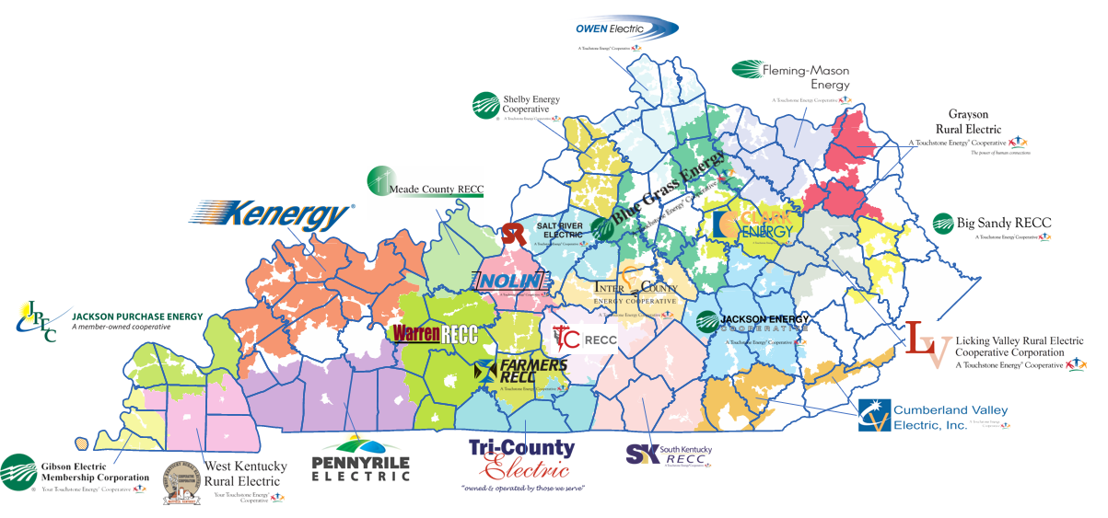
24 consumer-owned distribution co-ops

Slide 12



3 co-ops
16 co-ops
5 co-ops
Notes:
Here you can see the service territories of the co-ops served by those three organizations in relation to one another.

Slide 13
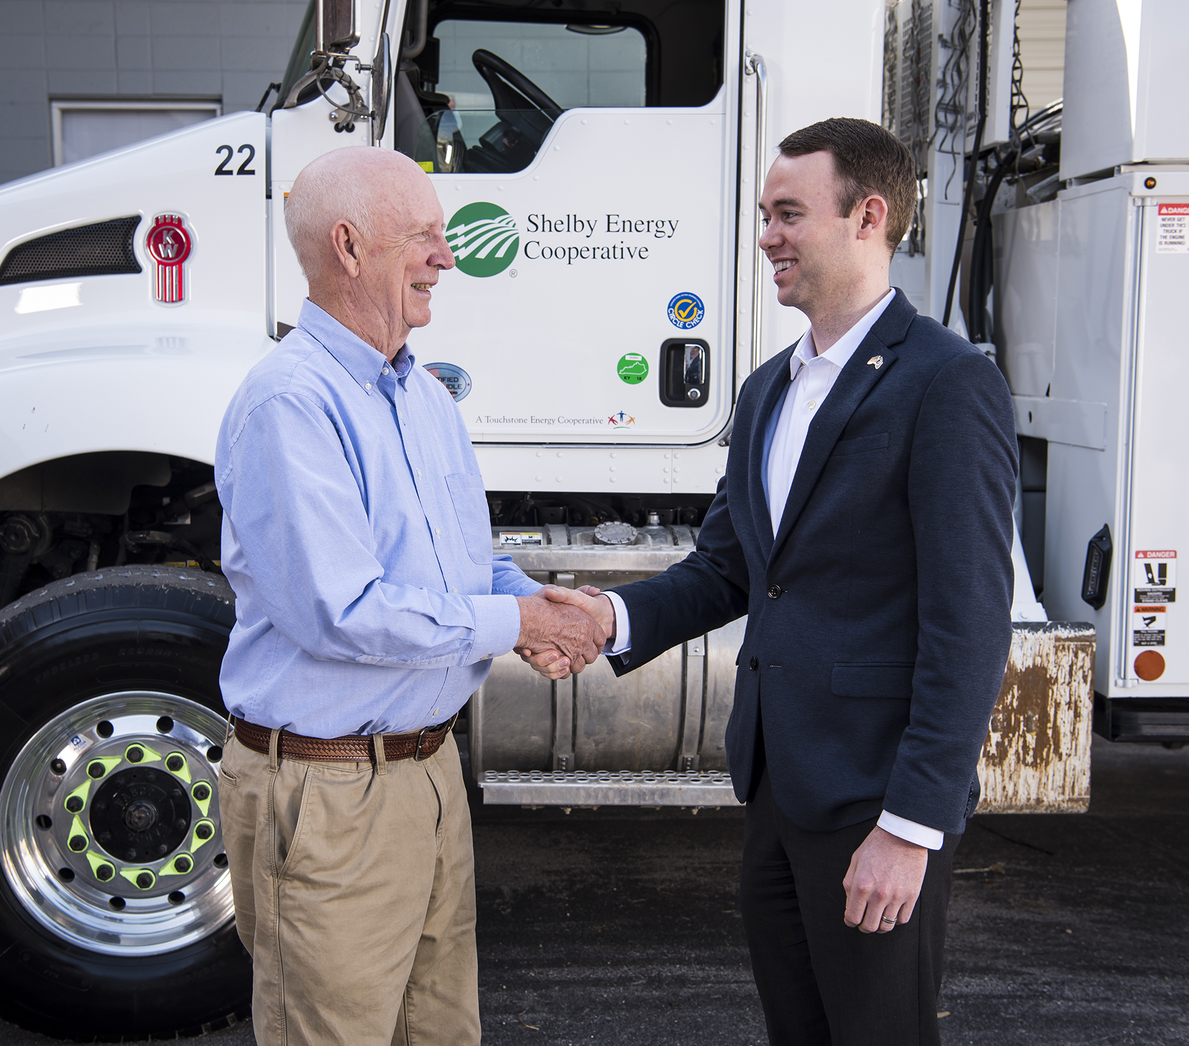
Co-ops are led by, belong to and were built by people in the local communities they serve.
Co-op members elect co-op board members who also live in the local community.
Notes:
This is a map of the service territories of those 24 distribution cooperatives.
As you can see, there are electric cooperatives in almost every Kentucky county.
We cover very wide and very diverse territories. Some areas are extremely rural, remote and rugged. Some areas are very suburban, with housing developments, office buildings, shopping malls and industrial parks.
If you look close, you’ll see white areas scattered throughout our service territories. These areas are served by other electric utilities, either a municipal utility or an investor-owned utility. Typically, those white areas are cities, towns and major corridors where there are high concentrations of houses and businesses.

Slide 14
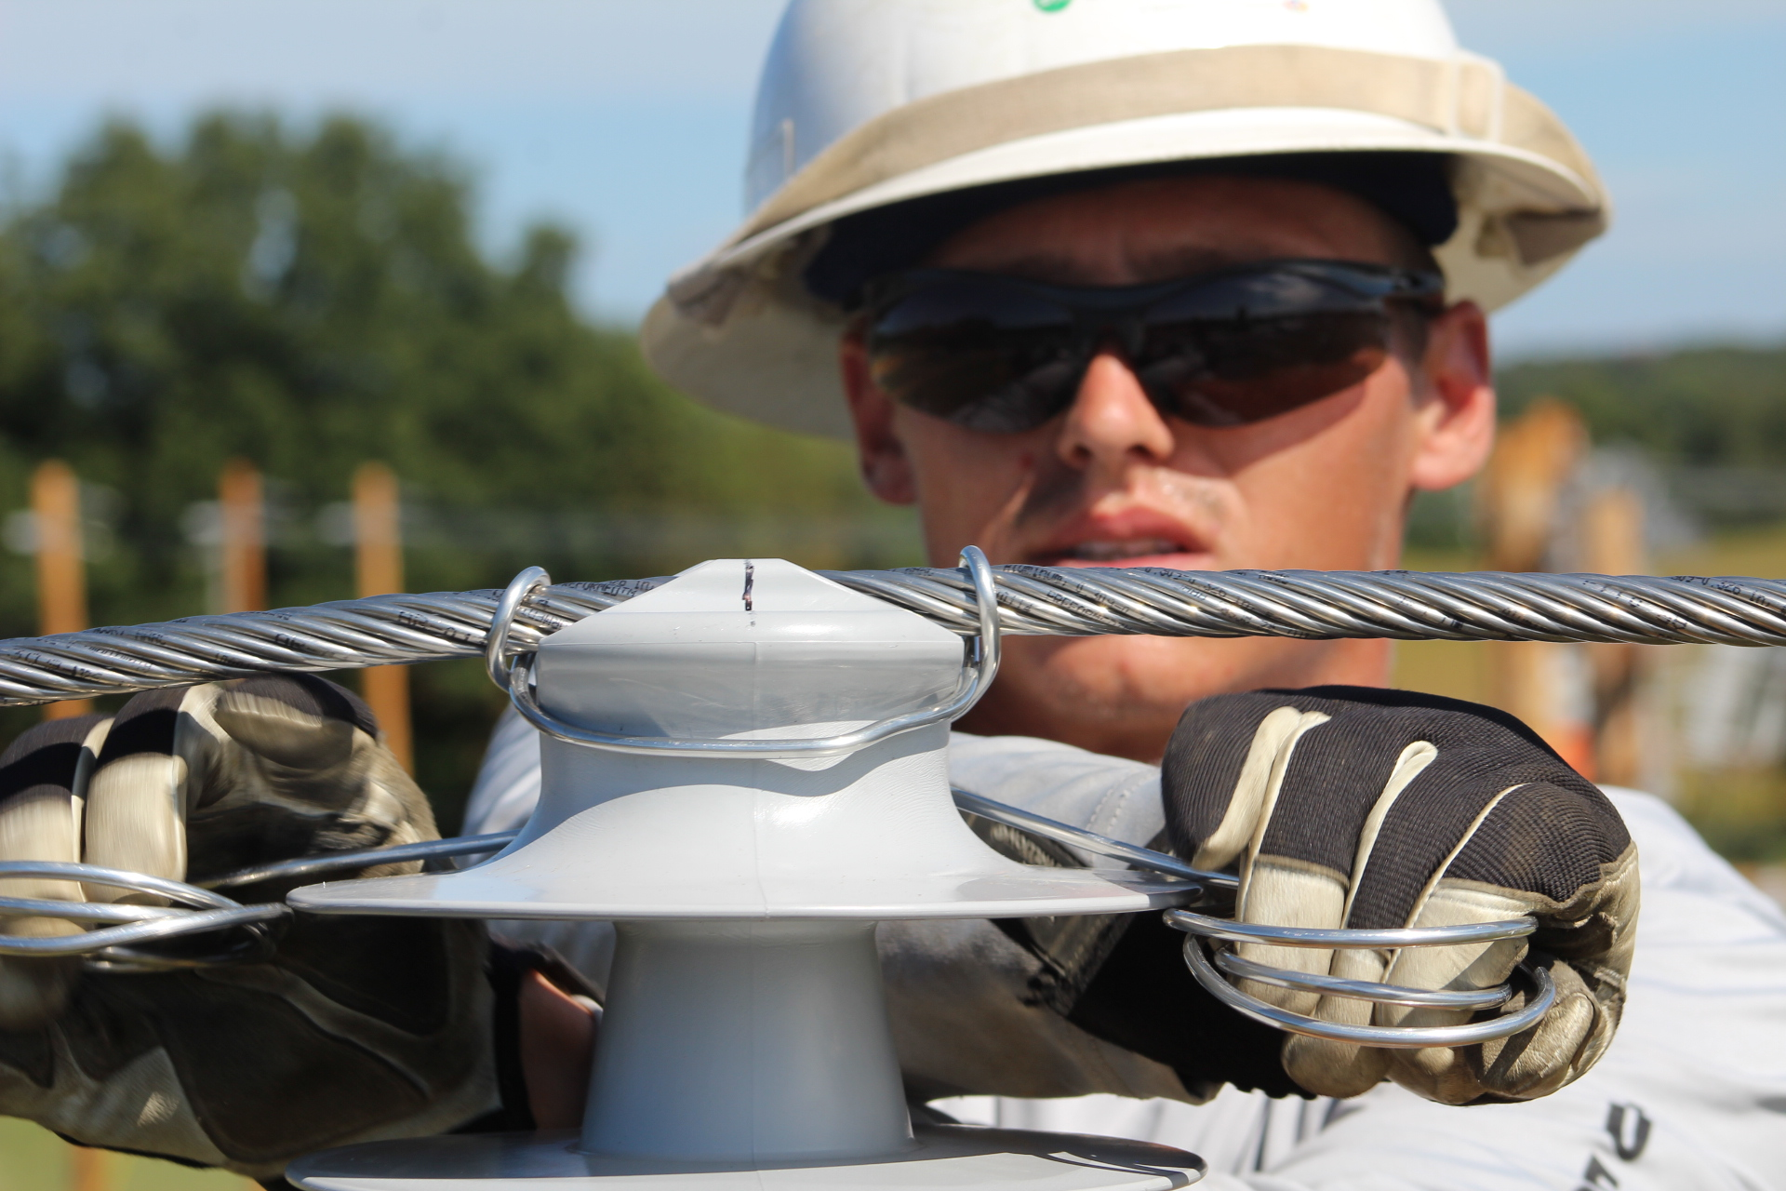
3,200 co-op employees
72 co-op offices & service centers
Co-ops pay state & local property, state & payroll taxes
Local franchise fees
PSC assessment
Notes:
This is a map of the service territories of those 24 distribution cooperatives.
As you can see, there are electric cooperatives in almost every Kentucky county.
We cover very wide and very diverse territories. Some areas are extremely rural, remote and rugged. Some areas are very suburban, with housing developments, office buildings, shopping malls and industrial parks.
If you look close, you’ll see white areas scattered throughout our service territories. These areas are served by other electric utilities, either a municipal utility or an investor-owned utility. Typically, those white areas are cities, towns and major corridors where there are high concentrations of houses and businesses.

Slide 15
Co-ops Are Not-For-Profit
No motive to maximize profits.
Co-ops provide service at cost.
Like any business, co-ops must make ends meet.
Co-ops must maintain equity levels and other financial measures to qualify for affordable financing.
Co-op members demand safe, reliable, affordable energy.
Notes:
I talked earlier about investor-owned utilities and about the stockholders who own shares of those utilities. Those stockholders expect something. They want to see dividend payments. They want to see the value of the stock go up. And there’s nothing wrong with that. I own shares of stock in some companies, and that’s what I want to see happen.
But cooperatives are not organized to maximize profits for a group of shareholders. Rather, we exist to maximize the benefits we provide to our members. When co-ops first started, people recognized that access to electricity improved the quality of life. Where stockholders want to receive a share of profits, our members want to receive safe, reliable, affordable electricity. That’s their top priority. And that’s what we strive to provide every day.
Of course, we are running a business. We must be efficient and thrifty. We must make ends meet, or we won’t be around for very long, especially when it costs so much to build and operate power plants and power lines.
Like any well-run business, our cooperatives also have to maintain an adequate level of financial health and stability as indicated by various financial measures.

Slide 16
Rural Service Areas: Less Revenue Per Mile
 | Consumers/mile | Revenue/mile
Electric cooperatives | 9 | $20,800
Investor-Owned Utilities | 37 | $82,800
Municipals | 48 | $115,200
Far less revenue per mile to cover fixed costs.
Notes:
Earlier, I pointed out on the map that municipals and IOUs serve many of the towns and cities in the Kentucky, while co-ops serve rural areas. Therefore, it’s no surprise that the density of customers per mile is much greater for those utilities.
Yet cooperatives still have to invest about the same amount of money to build a mile of power line to serve 9 customers as a municipal utility invests to build a mile of line to serve 47 customers. But, of course, co-ops have fewer customers to help pay that cost, so the cost per-customer is higher. That’s one reason IOUs weren’t interested in serving rural areas
Cooperatives derive about one-fourth as much revenue from a mile of power line as do IOUs.
And that mile of line generates about one-fifth as much revenue for a co-ops as it does for a municipal utility.

Slide 17
Electric co-ops serve some of the most remote areas of Kentucky
Co-op members’ average household income:
  7.4% below Kentucky’s average
  22.1% below the U.S. average

Slide 18

2024 Session….THANK YOU
SB 91
$3 million Electric Reliability Defense Fund
HB 6
$45 million State Parks Utility Infrastructure
$2 million pole attachment worker funding
SB 349
EPIC Commission
Statutory Deadline for PSC Decisions
PSC Vendor Transparency
Notes:
I am certain that everyone here is acutely aware of people in need in your districts. Poverty exists everywhere—in cities, suburbs and rural areas.
But, in the areas we serve, services for the poor are less available because people are more spread out.
We recognize the challenges of serving rural Kentucky and we are happy to take them on. In fact, we have over 70 years of experience meeting the needs of rural Kentucky.

Slide 19
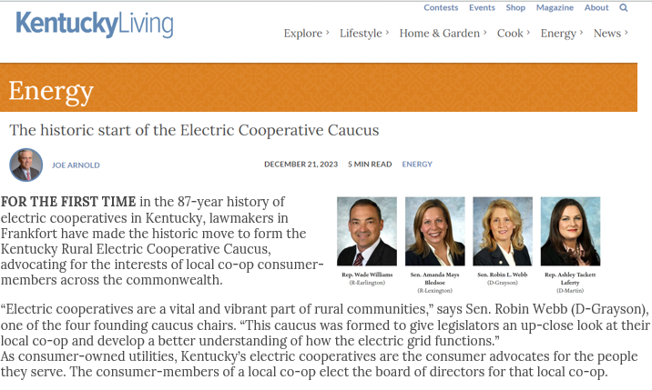
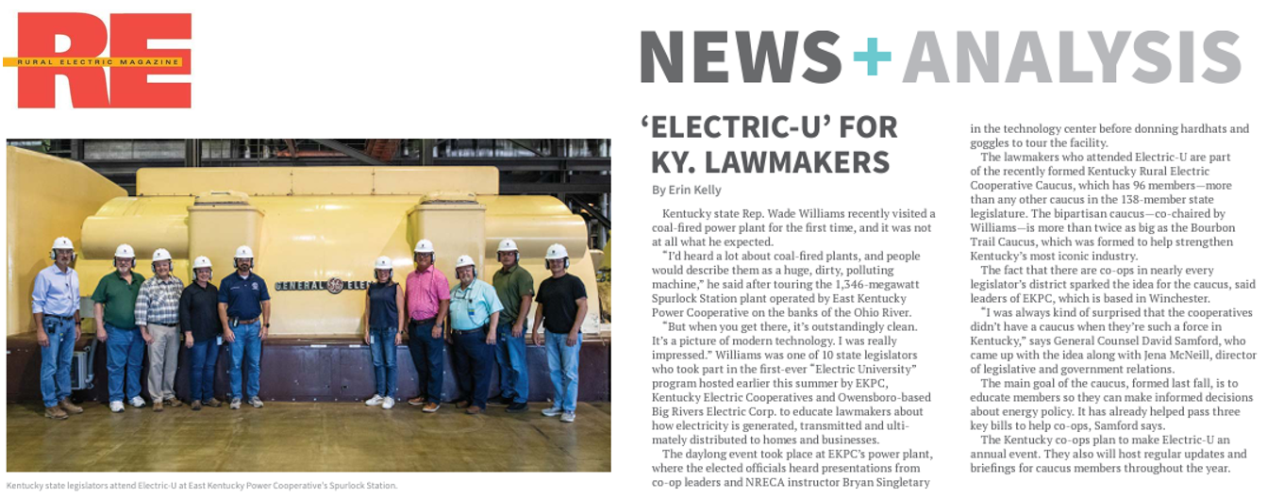
Kentucky Rural Electric Cooperative Caucus
96 members
Largest legislative caucus in Kentucky

Slide 20
East Kentucky Power Cooperative Update
October 17, 2024

Slide 21
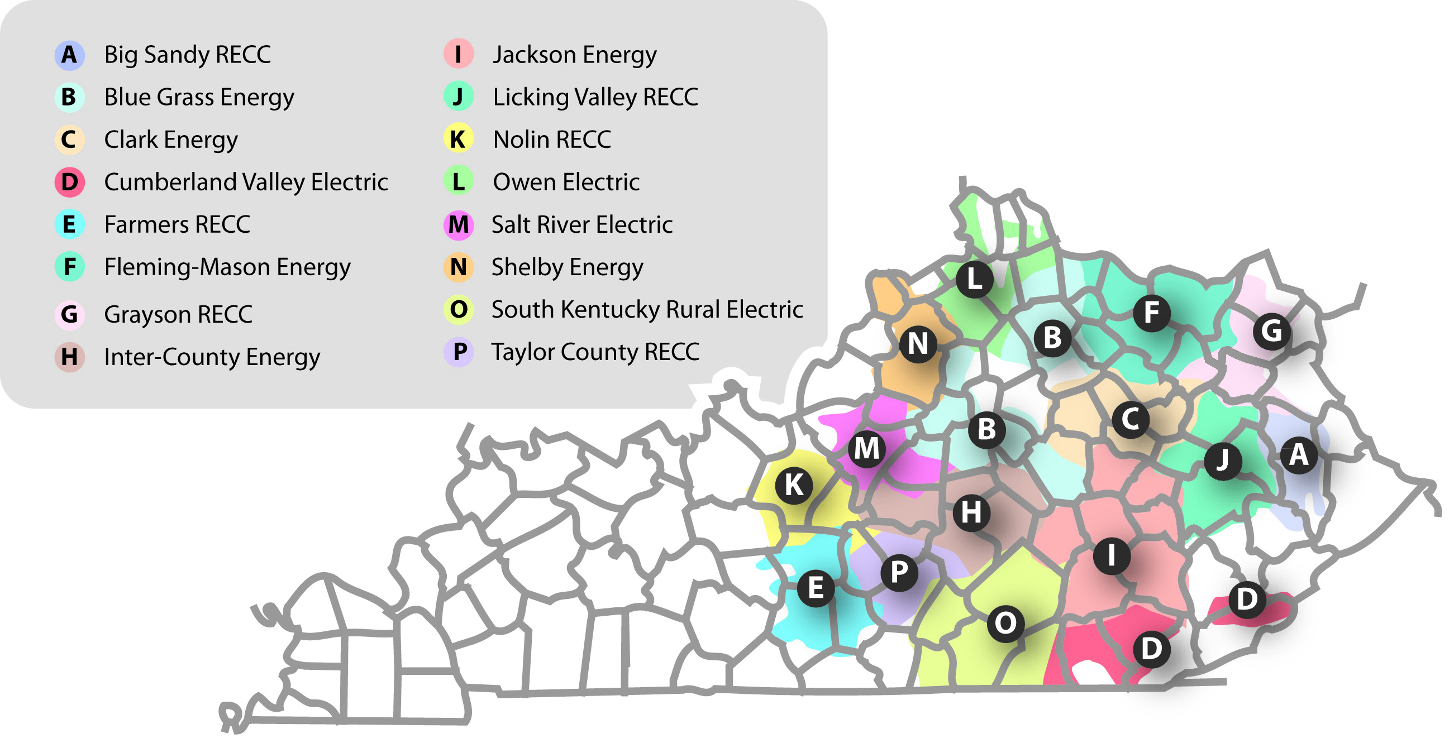
EKPC’s Overview
EKPC is a $4 Billion electric generation and transmission cooperative that provides power to 16 Owner-Member distribution cooperatives that in turn serve 1.1 Million Kentuckians in 89 Kentucky counties.

Slide 22
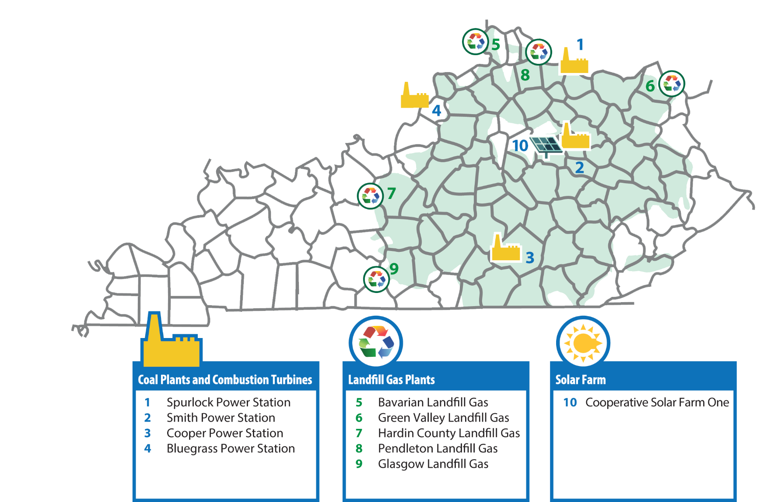
EKPC’s Overview
Our goals:
Assist our Owner-Members as they help their communities grow and thrive.
Ensure our electric transmission infrastructure is available and ready to deliver energy 24/7/365.
Maintain a firm financial foundation.
Increase fuel diversity, decrease carbon emissions and promote environmental stewardship.
Attract and retain a sustainable skilled workforce.

Slide 23


Resources in PJM are Increasingly Constrained
“I think the United States is heading for a very catastrophic situation in terms of reliability. The core of the problem is actually very simple. We are retiring dispatchable generating resources at a pace and in an amount that is far too fast and far too great and is threatening our ability to keep the lights on.”
- Mark Christie, FERC Commissioner testimony before the Senate Energy and Natural Resources Committee (5/4/23).

Slide 24
Resources in PJM are Increasingly Constrained
Capacity pricing has been stagnant or declining over the past decade.
Existing generating resources are increasingly stressed due to:
  Retirement of a large number of coal-fired generation;
  Increasing demand from the technology sector;
  Onshoring and economic development;
  Increasing EV penetration.

Slide 25
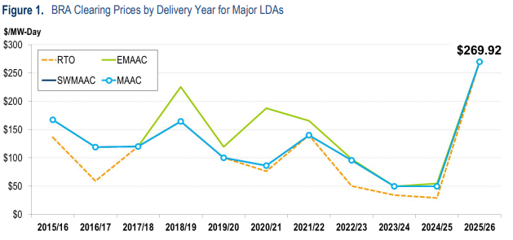
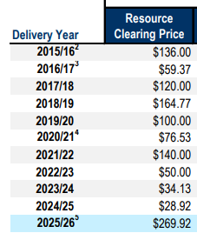
Resources in PJM are Increasingly Constrained

Slide 26

Industry Uncertainty Driven by Multiple Factors
Fuel Security
Permitting/Interconnection Delays
Supply Chain
Interest Rates
Infrastructure Protection
Environmental Regulation

Slide 27

Industry Uncertainty Driven by Multiple Factors
Environmental Regulation
  Greenhouse Gas Rule
  Ozone Rule State SIP/Federal FIP
  MATS Rule
  CCR Rule
  ELG Rule
  PM 2.5 Rule
  Title V “Affirmative Defense” Elimination
  NEPA Amendments
  Implementation Rule

Slide 28
In the Face of Uncertainty, EKPC will be Bold
EKPC has CPCN applications pending before the PSC for two major projects:
  Solar Projects totaling 146 MW located in Marion and Fayette Counties (COD 2029)
  A 216 MW Reciprocating Internal Combustion Engine (RICE) gas peaking facility located near Liberty, KY – COD 2028
EKPC will soon be filing CPCN applications for additional/modified resources:
  A 745 MW Combined Cycle Gas Turbine (CCGT) at Cooper Station
  Co-firing Cooper 2 and the four Spurlock Units
EKPC is working with the Rural Utilities Service to finalize a Commitment Letter on funding for carbon-intensity reducing resources through the New ERA Program.

Slide 29


Bottom Line
EKPC will make several billion dollars in investments in the Kentucky communities we serve in order to continue to assure our ability to provide safe and reliable electric power to our Owner-Members at rates that are competitive and attractive to new investment and job creation.

Slide 30
Thank you to the General Assembly and Attorney General
The General Assembly has done much to protect reliability by enacting SB 4 (’23RS) and SB 349 (‘24RS).
Appropriations in SB 91 (’24RS) has provided resources to the Attorney General to be able to challenge federal rules that imperil reliability.
Attorney General Coleman has been very aggressive in protecting Kentucky consumers by asserting Kentucky’s interests in multiple federal courts actions.

Slide 31
Interim Joint Committee – Natural Resources & Energy
OCTOBER 17, 2024
Tyson Kamuf, General Counsel & Vice President

Slide 32
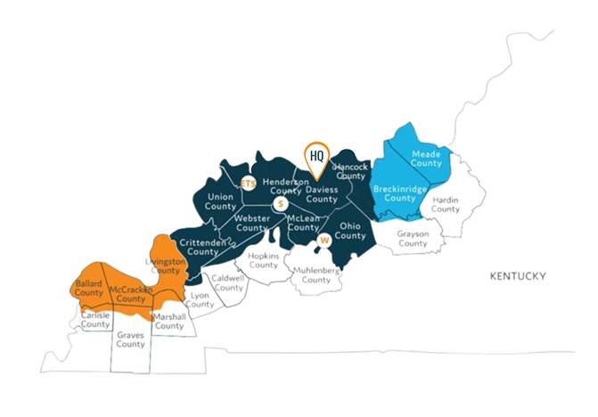
We are BIG RIVERS
Big Rivers is a not-for-profit electric G&T cooperative owned by the three Member-Owners we serve:
  Jackson Purchase Energy Corporation (JPEC) – Paducah, KY
  Kenergy Corp. (Kenergy) – Henderson, KY
  Meade County Rural Electric Cooperative Corporation (Meade Co. RECC) – Brandenburg, KY
Combined, our Member-Owners provide electric service for approximately 120,000 homes and businesses in 22 western Kentucky counties.
Big Rivers joined MISO in 2010. This allows Big Rivers to take advantage of opportunities to buy and sell into the market to maximize the value of our generation assets.
S
Sebree Station (Green & Reid Units)
W
Wilson Station
ETS
ET&S (Energy Transmission & Substation)

Slide 33
Future Big Rivers CAPACITY Mix –
“all of the above” approach
BY 2025 BIG RIVERS WILL GENERATE AND ACCESS POWER FROM A DIVERSE PORTFOLIO
Owned Generation – 936 MW
  Reid CT (Sebree) – 65 MW (natural gas)
  Robert Green Units 1 & 2 (Sebree) – 454 MW (natural gas)
  D.B. Wilson (Centertown) – 417 MW (coal)
Other Available Generation
  Southeastern Power Administration (SEPA) – 178 MW (Hydro)
Solar PPA
  National Grid Renewable – 160 MW - (Q1 2025)
Total Available Resources – 1,274 MW
Fuel mix associated with generation in 2023 was 95% coal and 5% natural gas – which reflects the importance of coal to our base load generation for system reliability and affordability

Slide 34
Reduction in carbon emissions
(71%)
(74%)
(67%)
(66%)
Big Rivers expects to achieve a 74% reduction in CO₂ from 2010-2025 - exceeding the requirements of the Clean Power Plan. Big Rivers has diversified its generation portfolio while balancing capacity and member load. However, the new EPA proposed Greenhouse Gas (GHG) limits are untenable. Compliance with the GHG limits would require closure of coal assets or carbon capture – technology that does not exist at utility scale at this time.

Slide 35
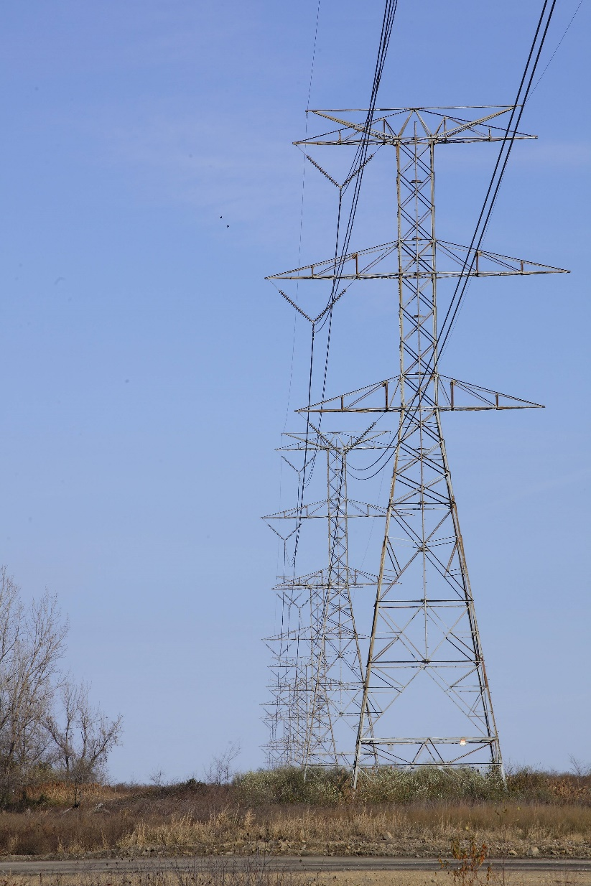
Big Rivers transmission
Big Rivers owns and operates a 1,353-mile transmission system to provide power transmission in our footprint
Twenty-five transmission interconnections link the Big Rivers system with several surrounding utilities
In 2023, Big Rivers achieved 1.404 SAIDI score. Said another way, the transmission service was available 99.99% of the time, a top quartile performance for utilities
  SAIDI – System Average Interruption Duration Index calculated by the sum of all customer interruption duration (customer minutes) divided by the total number of customers served

Slide 36
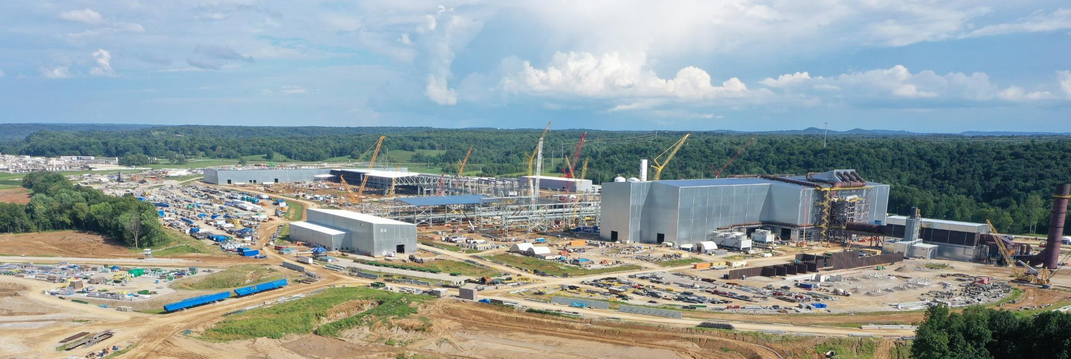
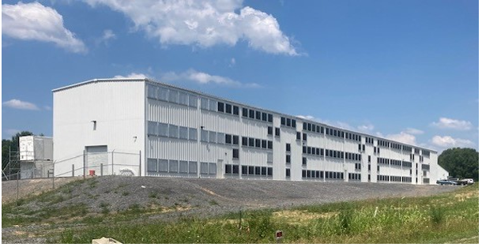
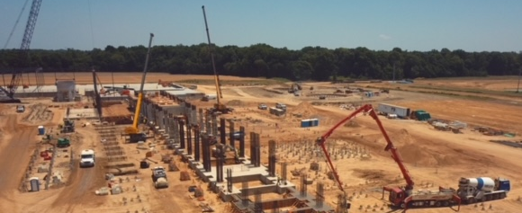
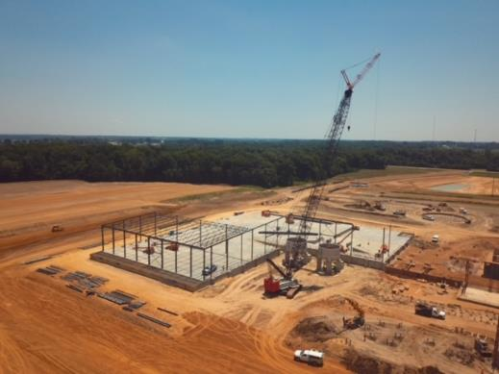
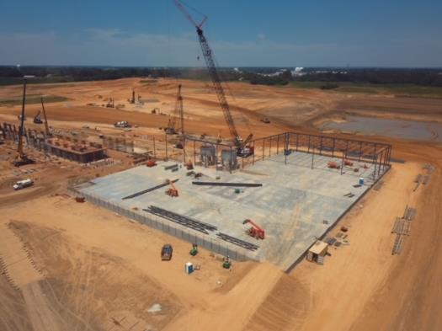
Economic Development
NUCOR
BLOCK MINING
PRATT PAPER
$1.7B steel mill in Meade County RECC service territory
400 full-time employees at average annual salary of $75,000
$50M investment in a new cryptocurrency facility in JPEC service territory
20 new employees
$500M corrugated box recycling and paper mill complex in Kenergy service territory
321 full-time employees with average wages of $30/hour
Big Rivers continues to pursue opportunities in our footprint that bring value to our Members.

Slide 37
Big Rivers recent transitions
New President and CEO, Don Gulley, joined Big Rivers in January 2024
  Brings over 35 years of diverse utility management experience working for regulated & merchant investor-owned utilities, as well as generation and transmission (G&T) cooperatives. He was President and CEO of Southern Illinois Power Cooperative (SIPC), a G&T cooperative, for ten years before joining Big Rivers.
Strategic Plan designed around our foundational principle of Safety. Priorities are focused on operational excellence, financial strength, risk managed portfolio, rate management, enterprise risk management, people and culture, and member services & economic development. This focus serves as guidelines for the company as we move into the future and gives each employee an understanding of how we personally contribute to Big Rivers future.
Big Rivers continues to evaluate future generation and transmission needs while mitigating financial risks.

Slide 38
Challenges & opportunities
Maintaining reliability and affordability with increasing pressures from environmental regulations.
  Greenhouse Gas (GHG)
  Coal Combustion Residuals (CCR)
  Effluent Limit Guidelines (ELG)
  “Good Neighbor” Rule – currently on hold pending legal challenges
Encourage and support economic development in western Kentucky by offering competitive energy rates and a diversified energy portfolio.
Funding opportunities under multiple federal programs to pursue economic development and investments in generation and transmission projects – but it has to make sense for Big Rivers.
Big Rivers made fleet changes necessary to survive the loss of 850 MW of load when the smelters stopped buying power from us in 2014. We are continuing to pay off those assets, as well as the closure and demolition costs.

Slide 39
A look to the future
Big Rivers is taking an “all of the above” approach to resource planning that prioritizes reliable baseload electricity. We are taking bold steps to preserve key generation facilities, allowing power plants to continue valuable energy production while cutting emissions and saving Members money.
Big Rivers is evaluating the need and timing for our next generation resource with a fresh look at our current resources, the regulatory environment and our Member needs, Big Rivers is embracing change while keeping safe, reliable, and affordable power for our Member-Owners at the core of what we do.
Big Rivers will continue to work with public and private partners to balance the impacts of ongoing regulatory changes with the need for safety, resilient resources, and reliability.

Slide 40


Questions?

