Slide 1
Public Service Commission Energy Review and Outlook
Kent Chandler, Chairman
Kentucky Public Service Commission
June 2024
Any views expressed in this presentation are those of the presenter and do not reflect official positions of the PSC.

Slide 2
Public Service Commission
Independent Regulatory Agency
Three-member Commission
Quasi-judicial function
Regulates rates and service provided by jurisdictional utilities:
1,100 jurisdictional utilities
Water and sewer utilities (small systems comprise the bulk of regulated utilities)
Natural gas distribution systems and intrastate pipelines
Electric utilities (investor-owned and jurisdictional cooperatives)
Telecommunications (small number)
Does not regulate municipal utilities except for gas pipeline safety.
Does not regulate cooperatives served by TVA.

Slide 3
Service and Rates
Since 1934, the primary statutory directive of utility regulation in Kentucky revolves around:
Rates
Fair, just and reasonable
Service
Adequate, efficient and reasonable
Most everything in retail utility regulation comes back to one or both of these principles.

Slide 4
2022- Energy Profile in Review
2022 saw a massive increase in wholesale power prices over 2021
This increase was driven largely by an increase in fuel prices (coal and gas)
Gas prices were driven higher by the war in Ukraine
Concern for natural gas availability drove European gas prices higher
US Natural gas prices rose modestly, as they get closer to parity with global prices as a result of increased LNG export capability in the US
As gas prices rose, fuel switching occurred, increasing demand for coal, and thus increasing coal prices
Coal and natural gas generation are economic alternatives

Slide 5
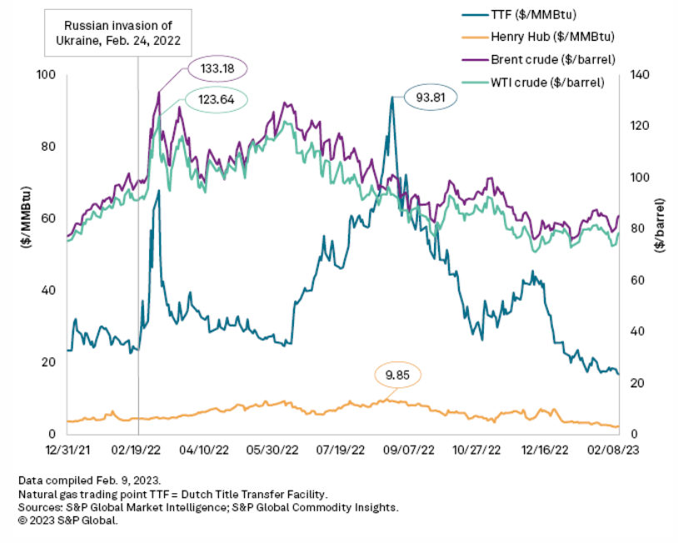
2022- Energy Profile in Review
War in Ukraine drove up
natural gas prices in Europe

Slide 6
2022- Energy Profile in Review
Given export of LNG and increasing parity of global natural gas prices, domestic natural gas prices rose
EIA, 2024

Slide 7
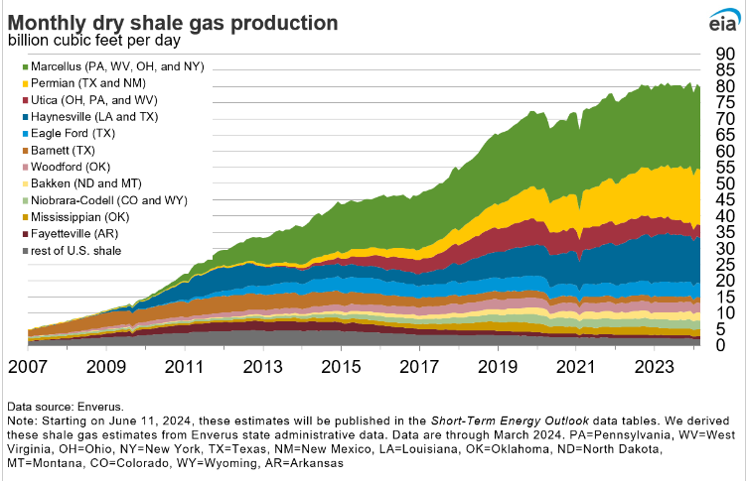
2022- Energy Profile in Review
Given the transportation constraint, global natural gas prices have been significant higher than US prices since increases in Shale production

Slide 8
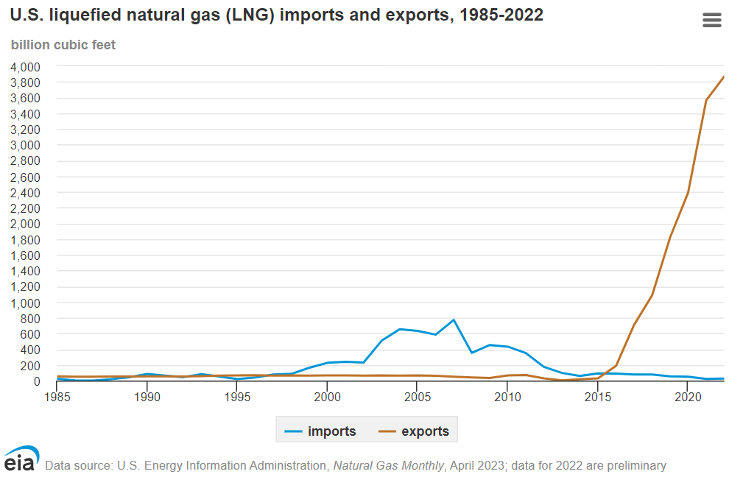
2022- Energy Profile in Review
Transportation constraint is being reduced, as evidenced by the material increase in the amount of US LNG exports

Slide 9
2022- Energy Profile in Review
Increase in input costs drove higher electricity prices in 2022
By way of example, in PJM, the price of energy rose from a weighted average of less than $40 MWh in 2021, to more than $80 MWh, with more than half of that increase driven by consumables (fuel)
PJM IMM 2022 Annual Report

Slide 10
2022- Energy Profile in Review
Decrease in input costs drove lower electricity prices in 2023
By way of further example, in PJM, the price of energy dropped from a weighted average of more than $80 MWh in 2022, to almost $31 MWh in 2023, with nearly 65% of the reduction attributable to fuel and consumables
PJM IMM 2023 Annual Report

Slide 11
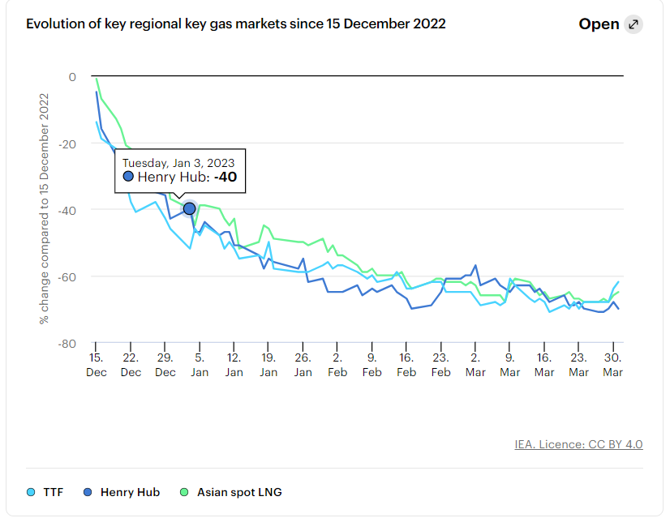
2024-2025 What to look forward to?
Gas Prices are way down,
domestically and abroad
post-’22

Slide 12
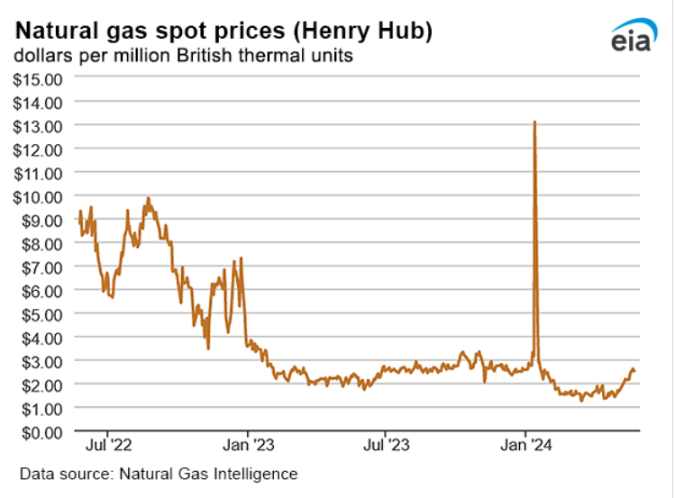
2024-2025 What to look forward to?
Gas Prices are way down,
domestically and abroad
post-’22

Slide 13
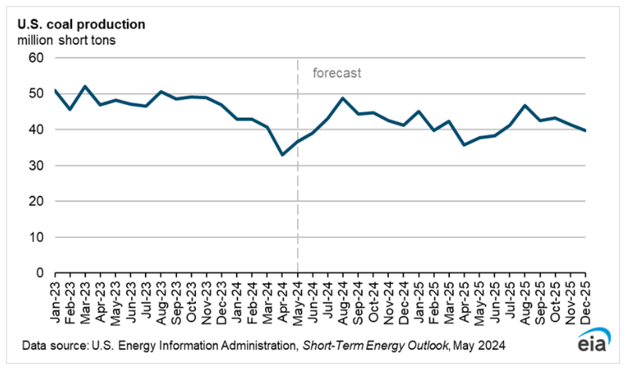
2024-2025 What to look forward to?
Coal production is expected to be consistent through ‘25

Slide 14
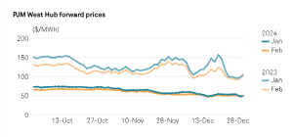
2024-2025 What to look forward to?
Power prices are down
S&P Global, US Power Tracker: PJM forward power prices remain lower on year with gas prices down

Slide 15
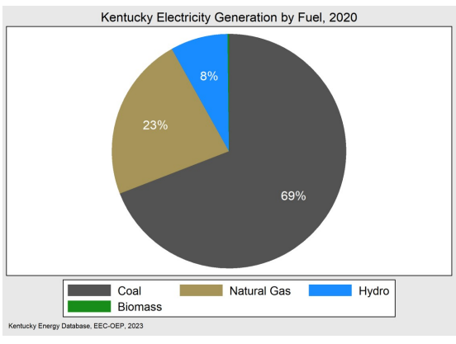
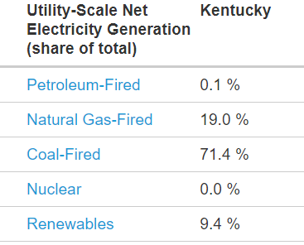
Current Generation in Kentucky
February 2024
EIA, 2024

Slide 16
Current Generation and Load in Kentucky
No expected material changes in generation capacity through 2025
Modest generation retirements
Unknown amount of new solar (could be minimal or up to a few thousand megawatts
No unplanned additions of significant load
No material changes to the transmission or fuel delivery systems representing constraints

Slide 17
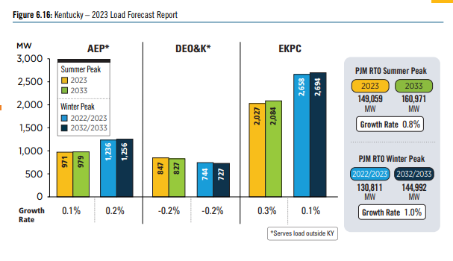
Current Generation and Load in Kentucky
Forecasted load growth in Kentucky, example
2023 PJM RTEP

Slide 18
Electricity Risks
I’ve previously expressed my personal concern with our ability to reliably and cost-effectively replace the energy that is lost from retirements of current resources
Pending or proposed environmental rules pose cost (making compliance investments) and reliability (retiring due to cost of environmental compliance, without convenient replacements) concerns
Transmission
Cost of inefficiently planning the transmission system
Allocation of transmission costs

Slide 19
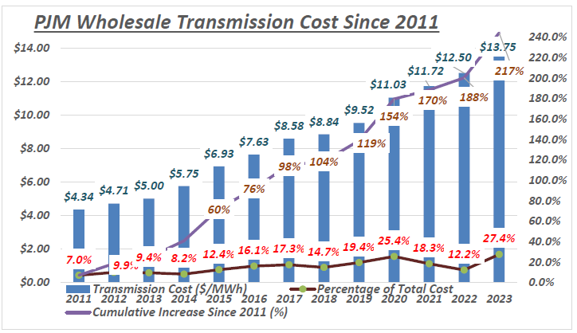
Transmission costs, example
AMP, 2024, Docket No. RM21-17-000

