Slide 1
Low-Income Home Energy Assistance Program (LIHEAP)
26 FFY Preliminary State Plan
Presented by:
Shannon Hall, Executive Advisor, DCBS
Rick Baker, Executive Director, Community Action Kentucky, Inc. (CAK)
July 24, 2025

Slide 2
LIHEAP
Low-Income Home Energy Assistance Program
Established in 1982 during the Reagan administration
Created to helps households with the lowest incomes that pay a high proportion of income for home energy

Slide 3
LIHEAP
Helps households manage high energy costs
  Particularly Winter and Summer when bills make it hard to budget
Reduces disconnects
Reduce need for assistance through weatherization
Promote responsibility through "Assurance 16"

Slide 4
LIHEAP
LIHEAP funds spent to date FFY 2025 total $43.4 M
Anticipated amount of funding for FFY 2026 is $58 million
100% federally funded
No cash payments are made to households.
Payments are made directly to vendors / utilities

Slide 5
LIHEAP
90% of federal LIHEAP award is used for benefits to Kentucky citizens
$400,000 is retained by DCBS for the Preventive Assistance Program to assist families receiving child protective services with a needed energy payment
Up to 15% of the amount can be allocated for weatherization
Up to 10% of the amount can be used for administrative costs

Slide 6
LIHEAP Eligibility
150% of the 2025 Federal Poverty Guidelines (percent of poverty)
Household Size | Monthly Income
1 | $ 1,956
2 | $ 2,643
3 | $ 3,331
4 | $ 4,016
5 | $ 4,706
6 | $ 5,395
7 | $ 6,018
8 | $ 6,768
For each additional household member above 8, add $673 to the monthly income limit.
Notes:
2023 FPL levels updated.

Slide 7
LIHEAP Components
LIHEAP offers the following types of benefits to Kentucky citizens:
Bill payment assistance for heating and cooling:
  - Subsidy component
  - Crisis component
Emergency assistance
Weatherization activities to increase the energy efficiency, health, and safety of eligible low-income individual’s dwellings

Slide 8
LIHEAP Fall Subsidy
One time credit on the household's bill
Prevents disconnects during colder winter months.
Benefits are a fixed amount based on energy type and household income.
Application process begins in early November, ending Mid-December
  Early Applications accepted in October for the elderly and individuals with disabilities
  Appointments are available for working individuals
No payments are made to households.

Slide 9
LIHEAP Winter Crisis
Assistance to prevent crisis disconnects
Household must demonstrate a Crisis, such as "disconnect notice".
Application process begins early January through mid-March or longer pending fund availability
Benefits are limited to the amount necessary to relieve the crisis.
Maximum amount is capped based on the fuel type.
No payments are made to households.

Slide 10
LIHEAP Spring Subsidy
Prevents disconnects during summer months
Offsets home cooling costs (Electric utilities)
Benefits are a fixed amount based on household income.
Application period was open from April 15 through May 30, 2025

Slide 11
Recent LIHEAP Components
63,734 households received Summer Cooling Subsidy Benefits
-Average benefit $185.40
-Total of $11.8 million
71,494 households received Fall subsidy Benefits
- Average benefit: $136.19
-Total $10.2 million
68,059 households received Crisis Benefits
-Average benefit: $345.07
-Total of $24 million
50,980 households received Spring Subsidy Benefits
-Average Benefit: $163.36
-Total of $8.3 million

Slide 12
LIHEAP Weatherization Program
Increase the energy efficiency
Reduce energy costs of dwellings
Reduce need for other assistance programs
Reduces risk of utility disconnect
Improves Health and Safety

Slide 13
Weatherization Priorities
Households containing elderly, disabled, or children
Households with young children at risk of removal from the home due to substandard conditions
High energy burden households, where the energy costs exceed 15% or more of the household’s income

Slide 14
LIHEAP Weatherization
Partnership with Kentucky Housing Corporation (KHC)
Funds home repairs related to energy efficiency
Serves low-income households if income does not exceed 200% of the Federal Poverty Guidelines
Two hundred and ninety-five (295) homes weatherized from July 2024 through May 31, 2025
Average benefit of $11,894 using a combination of Division of Energy (DOE), and LIHEAP funds.

Slide 15
Weatherization Measures
Measures are evaluated by "Savings to Investment Ratio or SIR"
  "return on investment"
Common Weatherization Activities or “Measures"
  Air sealing
  Insulation
  Caulking

Slide 16
Weatherization Health and Safety
Testing for gas leaks, carbon monoxide, and other health and safety issues
Checking combustible appliances, such as stoves, furnaces, and water heaters
Installing fire and carbon monoxide detectors

Slide 17

LIHEAP and Community Action

Slide 18
LIHEAP and Community Action
LIHEAP is operated in partnership with Community Action Kentucky, Inc. (CAK)
23 subcontracting agencies
Kentucky’s Community Action Agencies administer LIHEAP assistance in all Kentucky counties

Slide 19
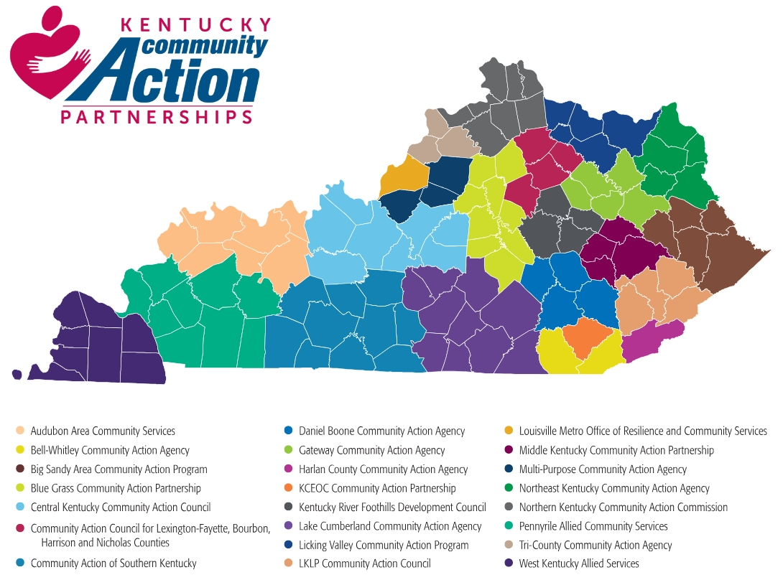

Slide 20

Questions

