Slide 1
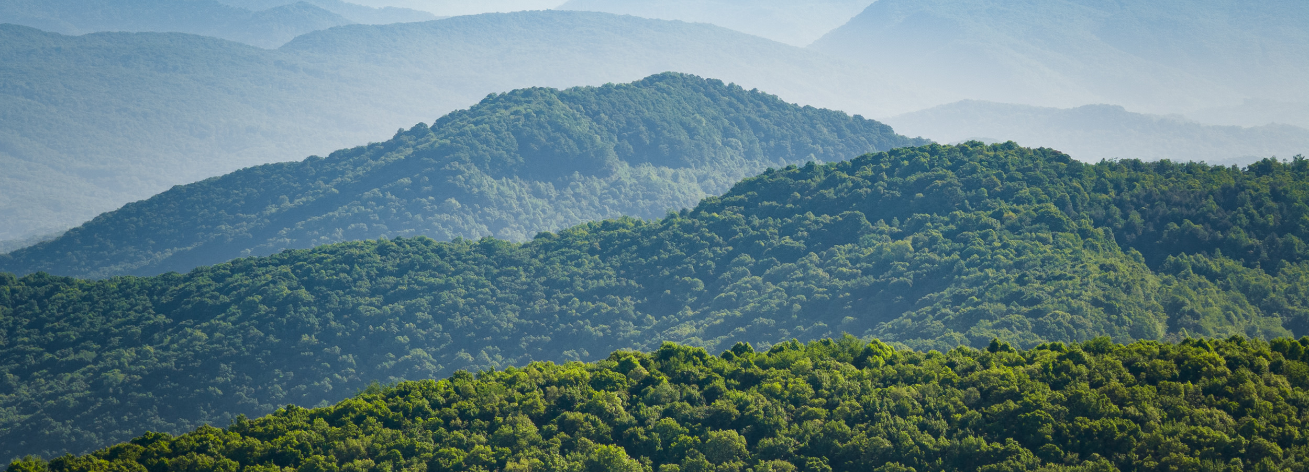
The Conservation Opportunity in Kentucky
Presented to Kentucky’s Interim Joint Committee on
Natural Resources & Energy | July 24, 2025
Heather Jeffs
Director of External Affairs
The Nature Conservancy
© Photo by Mike Wilkinson

Slide 2
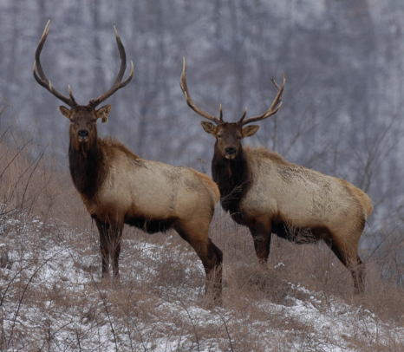
Kentucky’s Conservation Legacy
  Recent Conservation Success
  Cumberland Forest Project
  Research & Technical Assistance
  Needs Assessment
  Feasibility Research
  Update Public Opinion Research

Slide 3
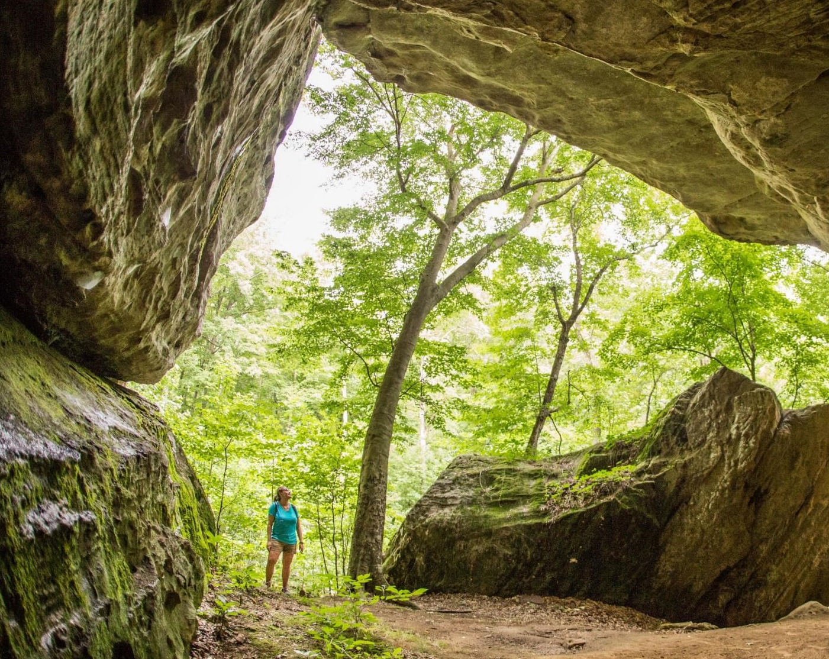
Benefit - Tourism
Out of state visitors to Kentucky spend $1.3 billion on recreation
  13 percent of all visitor spending
  Does not include associated food and beverage, lodging, transportation, and retail spending
Supporting
  12,400 jobs
  $315 million in wages
© Mike Wilkinson

Slide 4
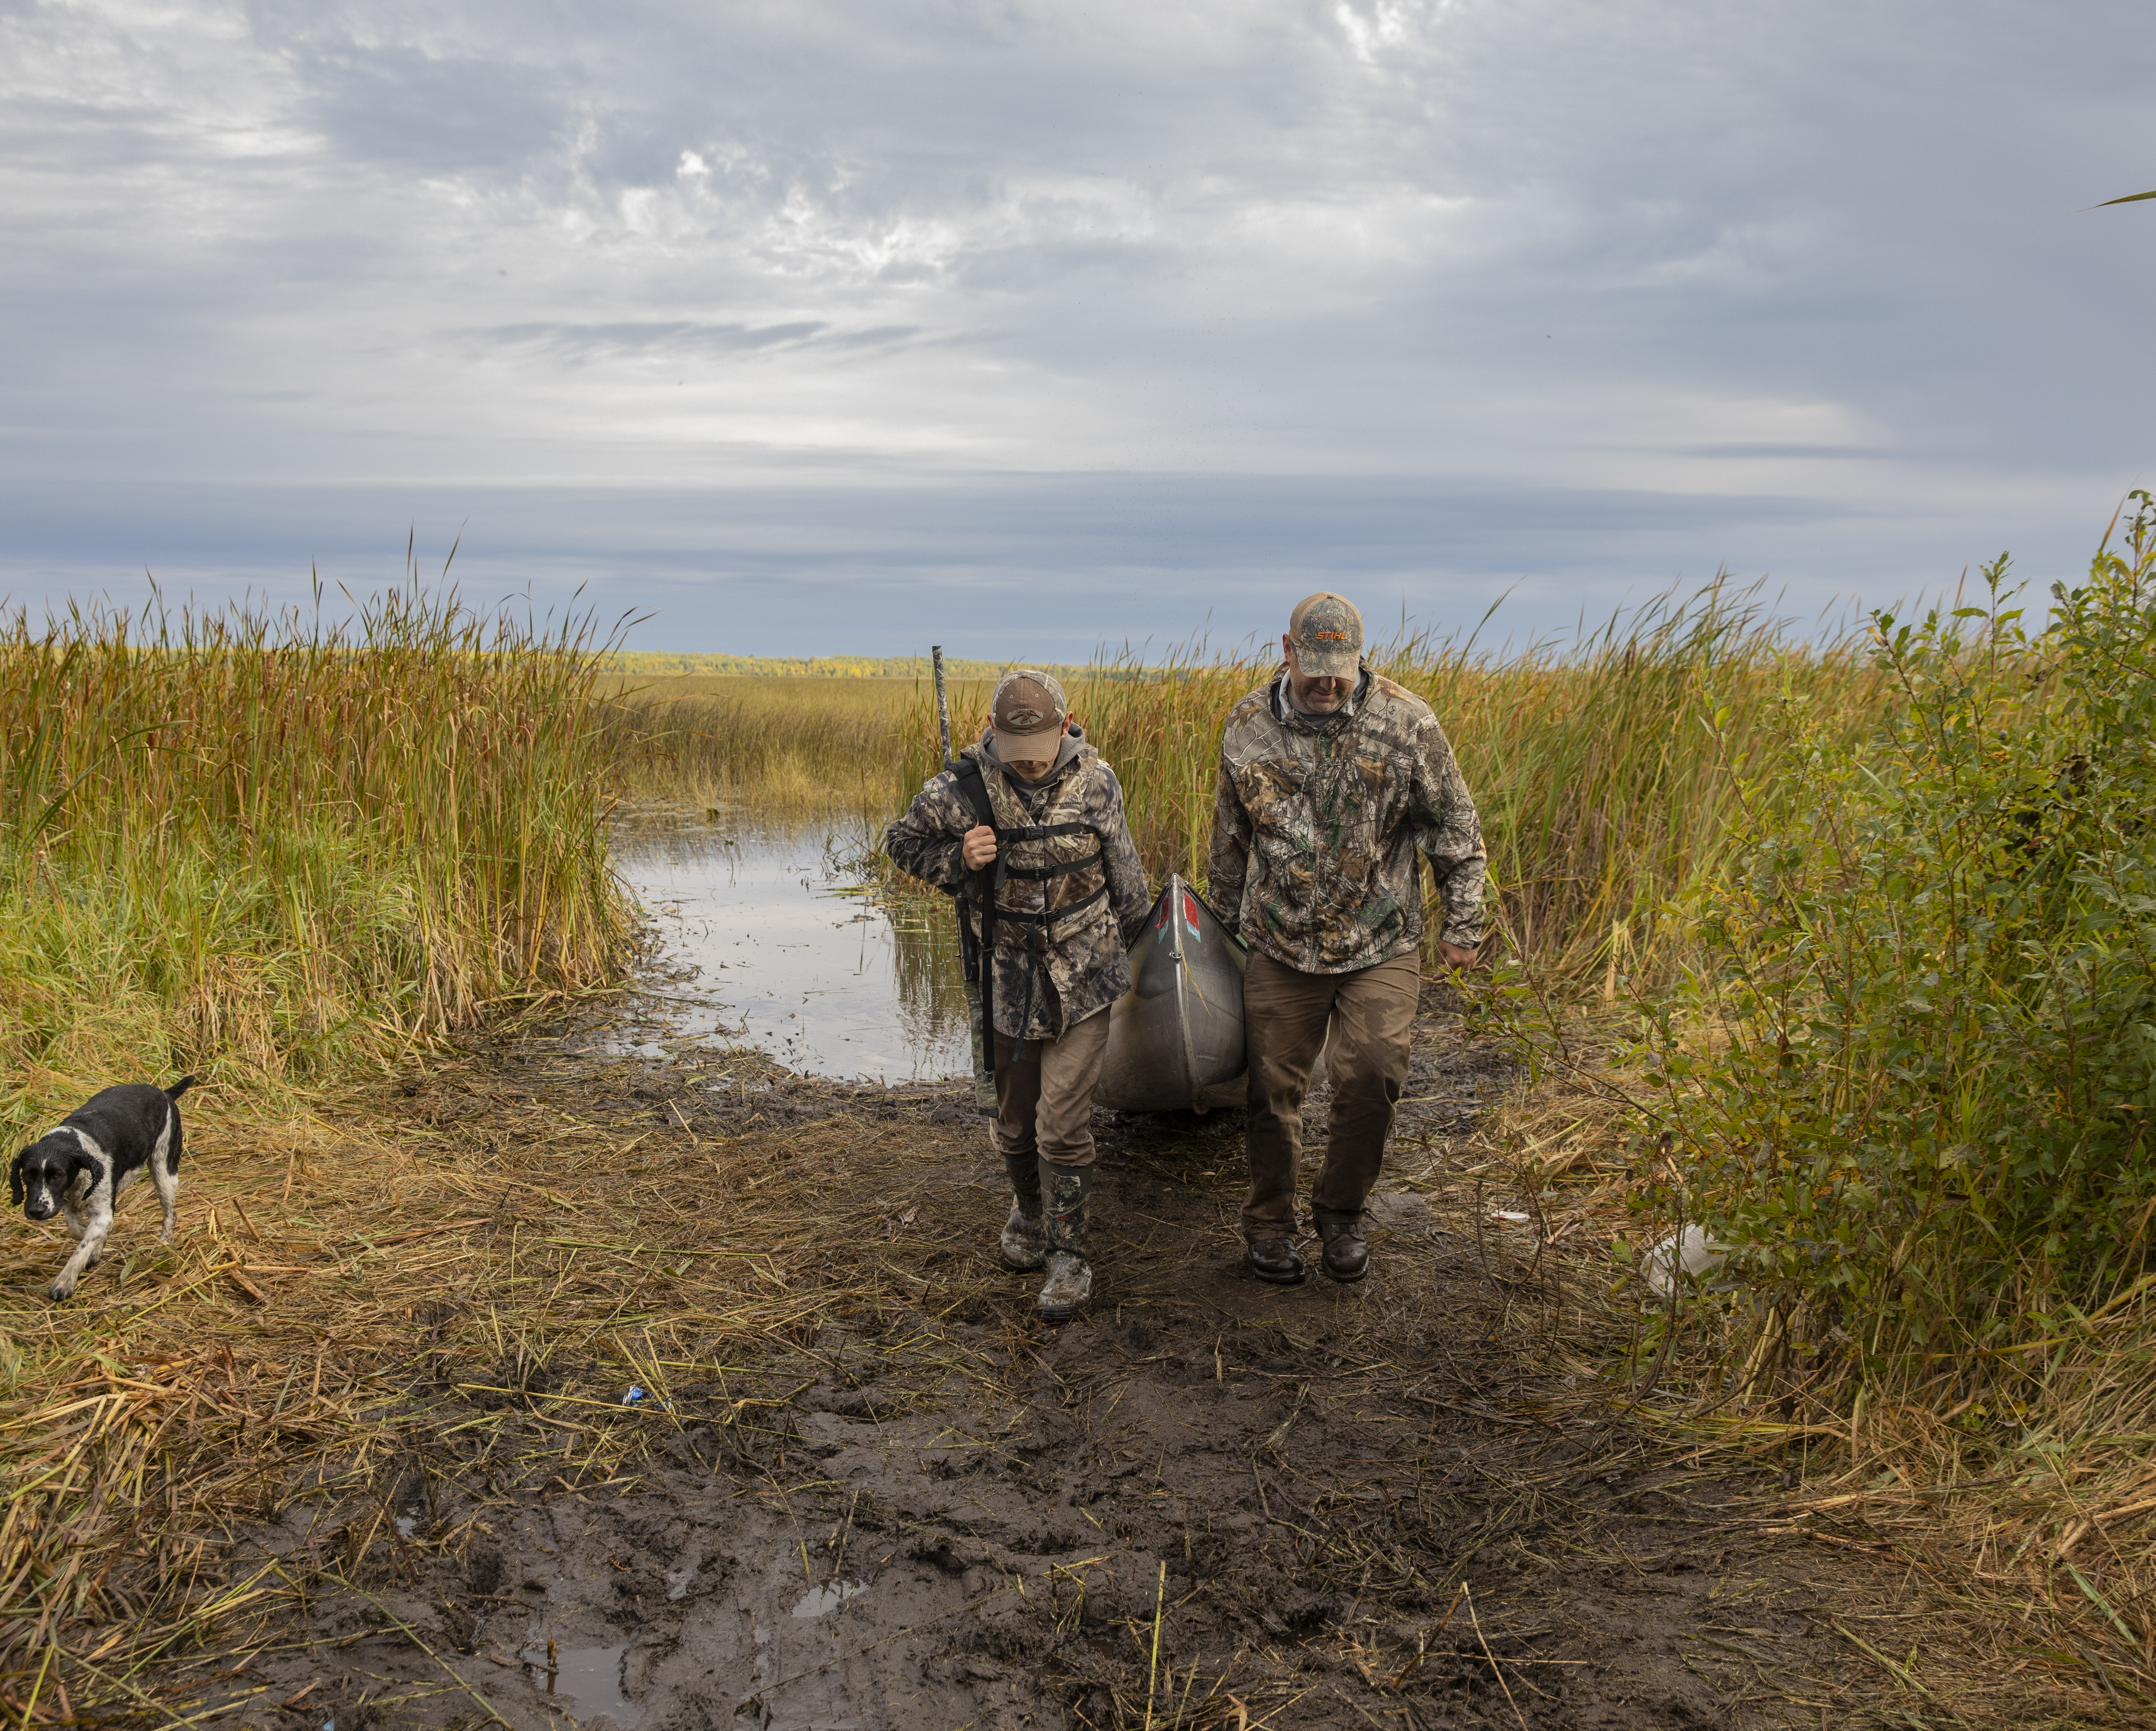
Benefit – Hunting, Fishing, and Wildlife Watching
Rely on publicly accessible lands
4.3 million residents and visitors participate
Spending $11.2 billion
© Mike Wilkinson

Slide 5
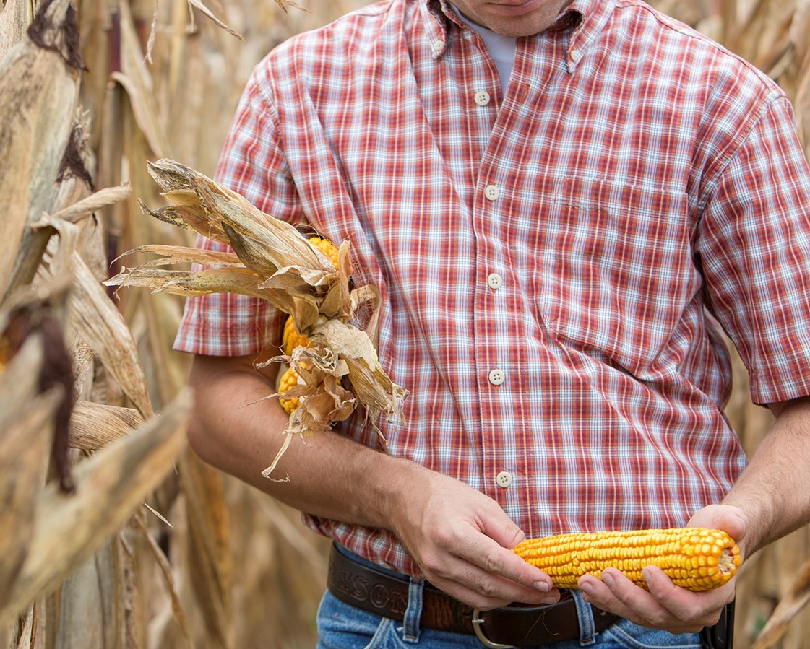
Benefit - Agriculture
Conservation supports family farms
Agriculture industry
  $49.6 billion of output
  272,000 jobs
  $10.3 billion in wages
© Mike Wilkinson

Slide 6
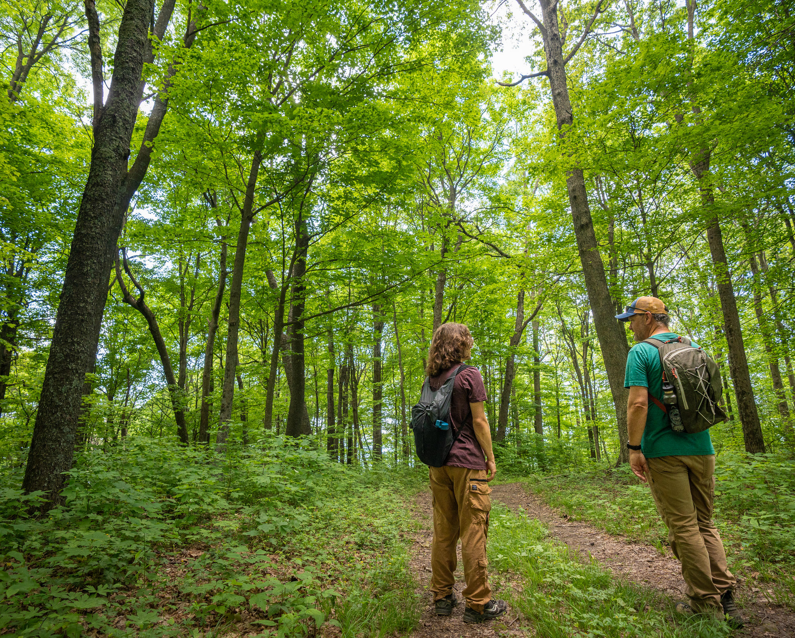
Benefit - Forestry
Forestry depends on healthy forests
Forestry industry
  $18.6 billion in output
  57,000 jobs
  $3.9 billion wages
© Mike Wilkinson

Slide 7
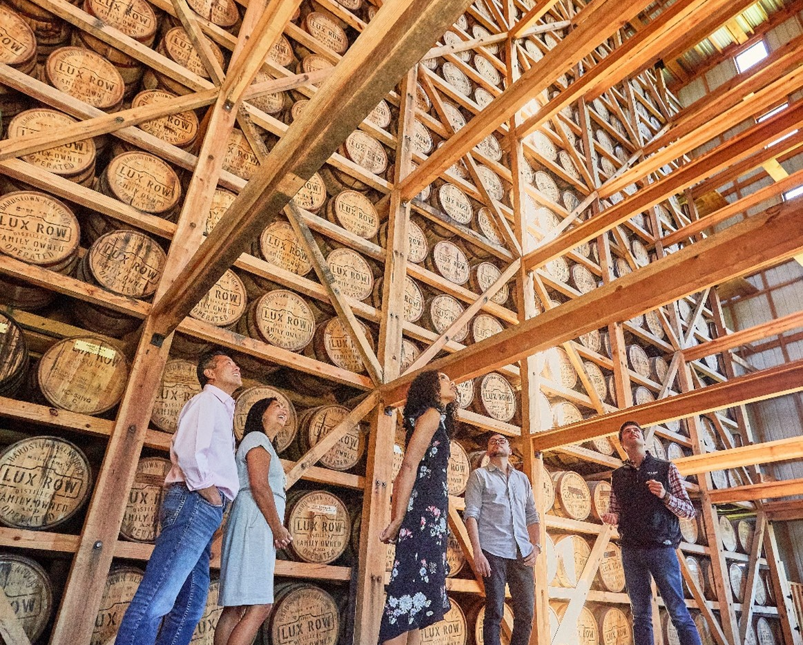
Benefit – Bourbon Industry
Bourbon sector relies on Kentucky’s agricultural and forest lands and waters
Bourbon industry
  $9 billion in output
  23,100 jobs
  $1.63 billion in wages
© Kentucky Tourism

Slide 8
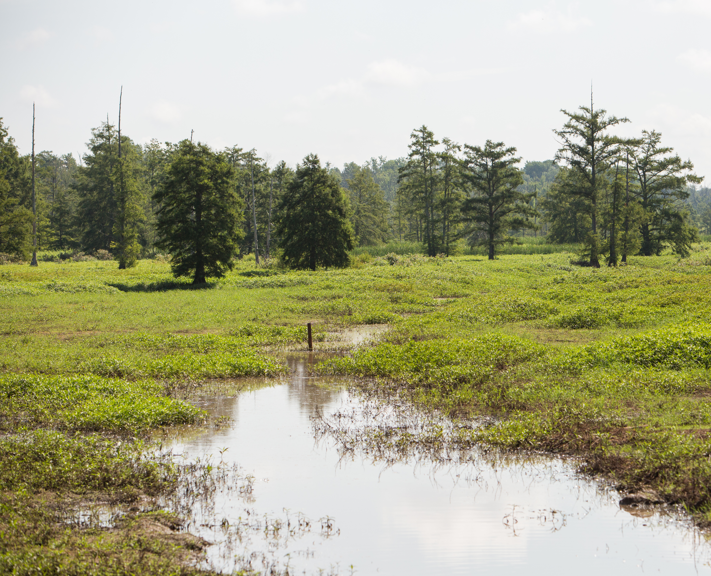
Benefit – Flood Protection
Flooding is a persistent and increasingly deadly problem in Kentucky
Wetlands, and particularly forested wetlands, perform critical flood control, water storage, erosion reduction, and nutrient filtration functions

Slide 9
State Conservation Programs
Kentucky Heritage Land Conservation Fund (KHLCF)
  Public use, outdoor recreation and education
  Important natural functions
  Habitat for rare and endangered species
  Migratory birds
Purchase of Agricultural Conservation Easements (PACE)
  Conserve farmland through voluntary conservation easements
  *PACE is currently only able to accept donated conservation easements

Slide 10
Programs in Comparison States
State | Number of Conservation Funding Programs | Approximate Annual Amount
Texas | 3 | $251,000,000
Tennessee | 5 | $81,200,000
North Carolina | 4 | $67,500,000
Arkansas | 5 | $47,000,000
Ohio | 1 | $37,500,000
Mississippi | 3 | $24,500,000
Missouri | 3 | $24,000,000
Georgia | 2 | $20,000,000
Alabama | 1 | $15,000,000
Virginia | 3 | $14,400,000
Indiana | 2 | $11,500,000
Kentucky | 1 | $2,390,000

Slide 11
Conservation Funding in Comparison States
Significant Funding Mechanism | State
 | TN | OH | VA | MO | IN | NC | MS | AL | GA | AR | TX
Appropriations | l |  | l |  | l | l | l |  |  |  | l
Real Estate Transfer Taxes | l |  |  |  |  | l |  |  |  | l
Bonds |  | l | l
Tax Credits |  |  | l |  |  | l | l |  | l | l
Voluntary Contributions |  |  | l |  | l
Sales Tax |  |  | l | l |  |  |  |  | l | l | l
In-Lieu-Fee |  |  |  | l | l
Conservation License Plates |  |  | l |  | l |  |  | l
Budget Surplus |  |  |  |  |  |  |  |  |  |  | l
Land Leases |  |  |  |  |  |  | l
Offshore Natural Gas Royalties |  |  |  |  |  |  |  | l

Slide 12
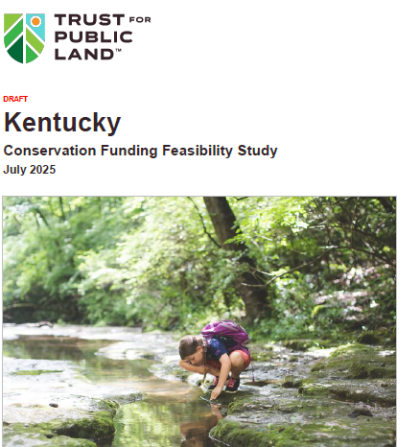
Kentucky Conservation Funding Feasibility Study

Slide 13
Feasibility Study Overview
Additional Best Practices
Conservation Tax Credits
Purchase of Development Rights
Enable Local Financing
State Incentives for Local Conservation
Public-Private Partnerships
Federal Partnerships
State Revenue Options for Conservation Funding
Sales tax
  Existing general sales tax that comes from the purchase of outdoor sporting goods or similar type of purchase
Bonds
Increased Real Estate Transfer Tax
Implementation
Legislation
Constitutional Amendments

Slide 14
  Sporting goods retailers in Kentucky generate approximately $53.9 million in sales tax revenue per year
  Some states dedicate all/most of this revenue to conservation
  Dedicating even a portion, 80 percent for example, could provide $43.1 million to conservation efforts
  $43.1 million represents less than one percent of sales tax collections in FY2025

Slide 15
Examples of Dedicating a Portion of Existing Sales Tax (Sporting Goods)
Georgia
Georgia Outdoor Stewardship Trust Fund - protect forests, wildlife habitat, and land critical to clean drinking water
83 percent of voters supported constitutional amendment (Nov. 2018)
$200 Million over 10 years, with option to extend another 10 years
Texas
Parks and conservation
88 percent of voters supported constitutional amendment (Nov. 2019)
Permanent dedication of the estimated portion of state tax revenue collected from the sale of sporting goods
FY ‘23 generated $249 Million
+ $1 Billion from surplus funds for acquiring and developing state parks

Slide 16
Additional Best Practices
Conservation Tax Credits
Purchase of Development Rights
Enable Local Financing
State Incentives for Local Conservation
Public-Private Partnerships
Federal Partnerships

Slide 17
What’s Next?
  Research & Technical Assistance
  Needs Assessment
  Feasibility Research
  → Update Public Opinion Research

Slide 18

Nearly all ARC voters view funding for conservation as something that helps support jobs and the economy.
Investing in clean water and the conservation of natural areas and parks helps support jobs in our tourism, farming and other natural resource industries and helps support our economy.
Strongly Agree
Total Agree
54%
92%
Next is a list of statements. For each one, please indicate whether you generally agree or disagree with that statement.

Slide 19
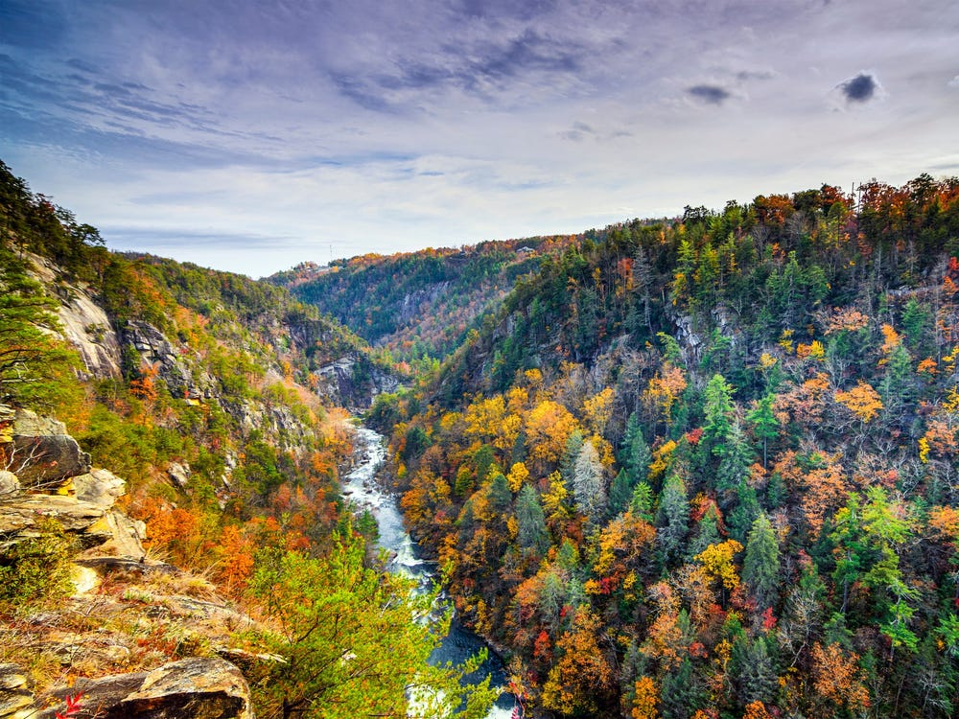
More than four-in-five Appalachian voters say that funding for conservation should be maintained even if state budgets are tight.
Even when the state budget is tight, we should still find the money to invest in protecting our land, water and wildlife.
Strongly Agree
Total Agree
51%
87%
Next is a list of statements. For each one, please indicate whether you generally agree or disagree with that statement.

Slide 20
Kentucky, Tennessee, and Virginia voters are very supportive of dedicating additional state/local funding for conservation.
51%
Strongly Support
51%
Strongly Support
48%
Strongly Support
5%
Strongly Oppose
+72 | +76 | +81
In general, would you support or oppose dedicating additional state or local funding for land, water and wildlife conservation in STATE?

Slide 21
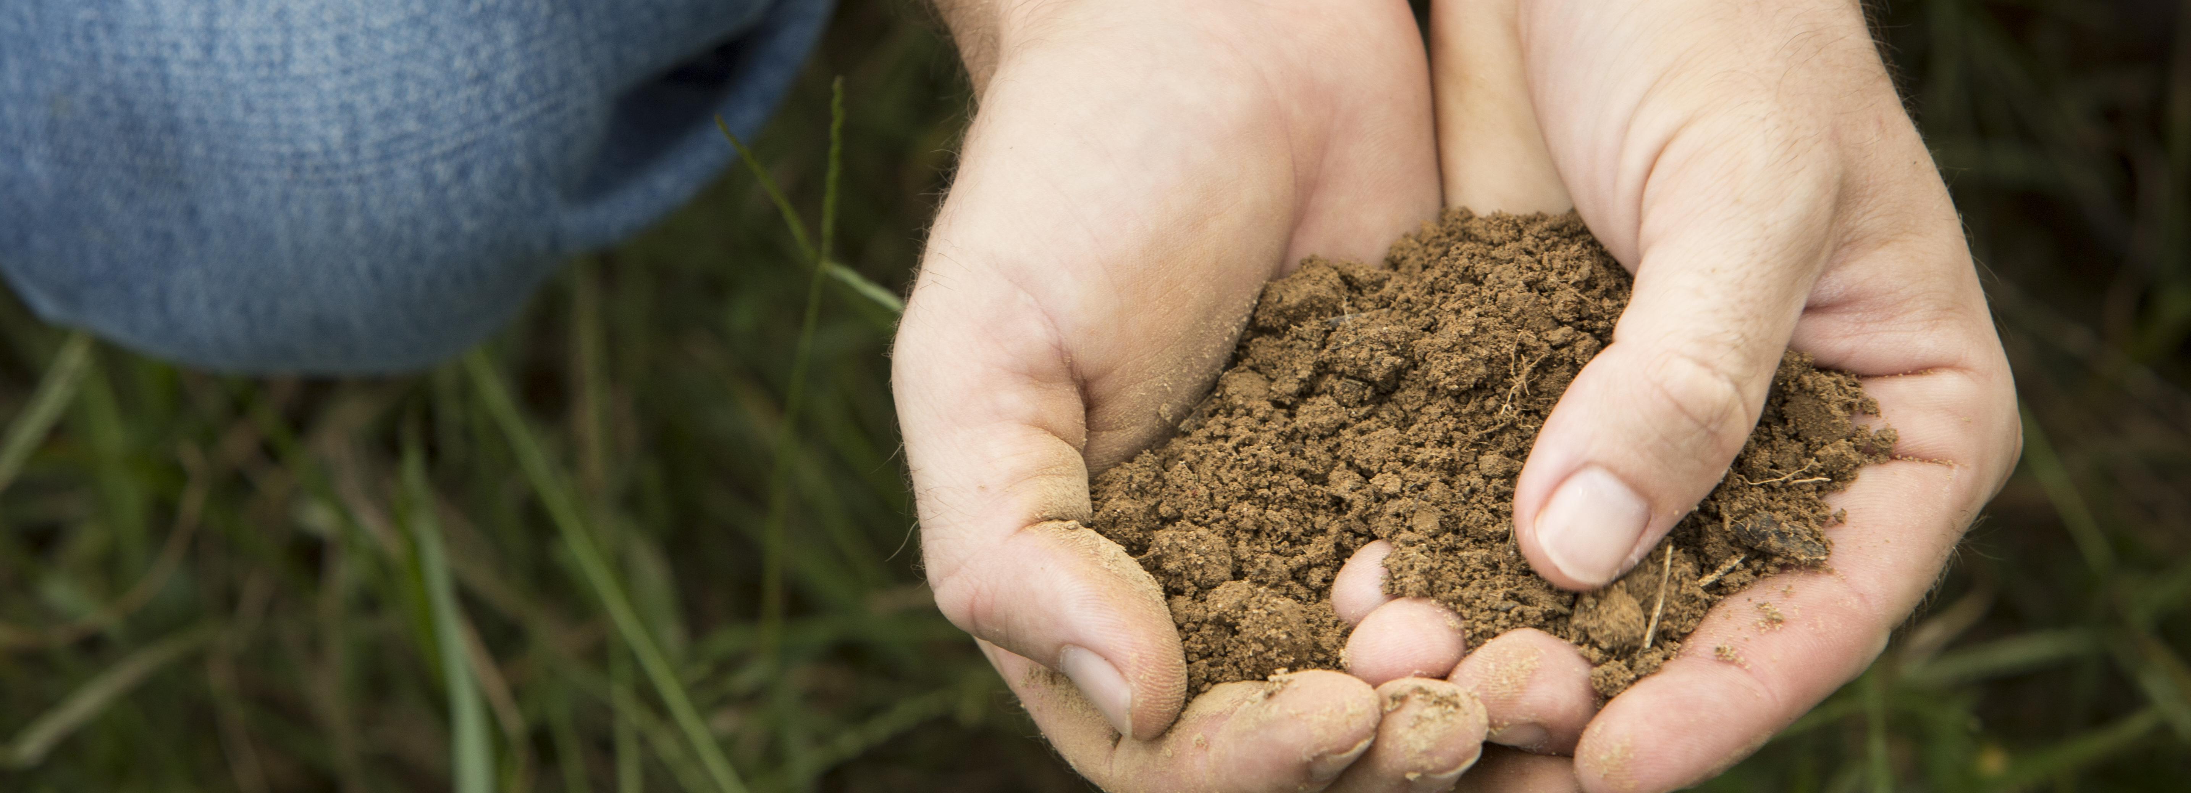
For more information
Contact:
Heather Jeffs
Director of External Affairs
The Nature Conservancy
heather.jeffs@tnc.org
© Mike Wilkinson

