Slide 1
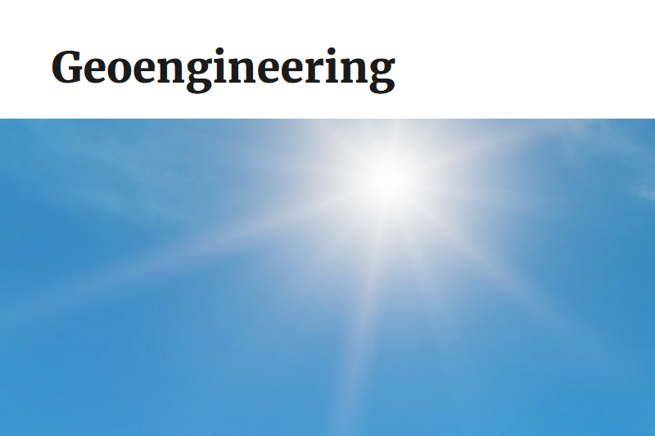
August 2025 – Hodgson and Rawlings

Slide 2
What is Geoengineering?
Attempts by government or NGO actors to modify the global climate or temperature, aka: "playing God" with the weather
  SRM – Solar Radiation Modification - adding material to the atmosphere to increase the amount of incoming sunlight reflected back to space, in an attempt to cool the earth
    Stratospheric Aerosol Injection (SAI) – adding small reflective particles to the upper atmosphere (stratosphere) to reflect incoming sunlight. Sulfur dioxide (SO₂), one of the types of chemicals considered for SAI, can chemically react in the stratosphere to form reflective sulfate aerosols.
    Marine Cloud Brightening (MCB) – adding particles, such as sea spray, to the lower atmosphere (near the surface) to increase the reflectivity of clouds over the ocean.
    Other techniques, such as Cirrus Cloud Thinning (CCT) or space-based methods have been far less researched due to uncertainty in the processes, high potential costs, and more limited feasibility.

Slide 3
US EPA Recently Made Full Disclosure on Geoengineering Activities: its not new https://www.epa.gov/geoengineering
1947 Project Cirrus: GE Labs, the Naval Research Laboratory, and Army Signal Corps used Air Force aircraft to conduct the first hurricane cloud seeding experiment with dry ice.
1967 Operation Popeye: A classified military weather modification program carried out during the Vietnam War that attempted to extend monsoon season to disrupt select supply routes in North Vietnam and Laos. Later banned by Treaty.
1971 Project Stormfury: Led by NOAA and the U.S. Navy, this program sought to modify hurricane strength through seeding with silver iodide to reduce the most destructive wind speeds.

Slide 4
What Geoengineering is NOT:
Ordinary jet engine exhaust from unadulterated fuel – vapor trails or contrails, the thin white lines in the sky. These are dependent on upper atmosphere humidity level and typically occur above 30,000 feet. There are ~ 45,000 jet flights a day over the USA potentially leaving such visible trails.
Crop-dusting - agricultural spraying carried out below 500 ft AGL, with appropriate federal and state permits.
Ground Source pollution - smoke and exhaust plumes from factories and other earth-anchored sources.
Airport Fog control - low altitude efforts to mitigate fog banks

Slide 5
The Case for Action in KY
There is no prohibition on the Federal government or others from carrying out weather modification or geoengineering activities in KY.
  The chemical fallout of reflective materials is potentially toxic to KY farmland
  Potential SRM results are not well understood, and could be catastrophic, affecting crop yields, energy production, health, etc.
  "Cloud Seeding" operations are legal in some western states, with unproven effects, and potential toxicity of silver iodide used
The Biden Whitehouse published a study favorable to government experiments with geoengineering to support "green" environmental policy
The Trump Whitehouse has curtailed such studies, and published the EPA disclosure website
Future federal policy is unknown. KY must act now to assert its 10th Amendment sovereignty, and forbid experimentation over the skies of KY, joining states like TN, LA and FL, among 33 states with policies in work

Slide 6
Public Concerns
“More than seven in ten adults say they are very or somewhat concerned that solar geoengineering (74%) or cloud seeding (72%) will be used before we fully understand how they affect the earth’s ecosystems.” Pew Research Center, June 11, 2021 https://www.pewresearch.org/short-reads/2021/06/11/u-s-adults-have-mixed-views-on-whether-geoengineering-would-help-reduce-effects-of-climate-change/
Critics warn that techniques like aerosol injection may:
  Worsen air pollution
  Trigger severe weather events
Although cloud seeding has been used for over 80 years, its effectiveness remains unproven by scientific standards, and questioned by experts due to lack of reliable evidence (GAO)
Some scientists caution that cloud seeding could lead to extreme droughts or flooding under certain conditions, like the recent Texas flood tragedy, or Dubai flooding a few years ago.

Slide 7
KY Geoengineering Ban Forbids:
"Atmospheric polluting intervention" means any manipulation or interference with earth's natural systems or processes by altering atmospheric or environmental conditions, including but not limited to:
  (a) Stratospheric aerosol injection;
  (b) Cloud seeding;
  (c) Solar radiation modification; and
  (d) The intentional release of an atmospheric contaminant, excluding any release from a ground level source such as an industrial or commercial facility, residence, vehicle, or agricultural operation, that occurs in the atmosphere and that may have harmful consequences on human health, the environment, or agriculture;

