Slide 1
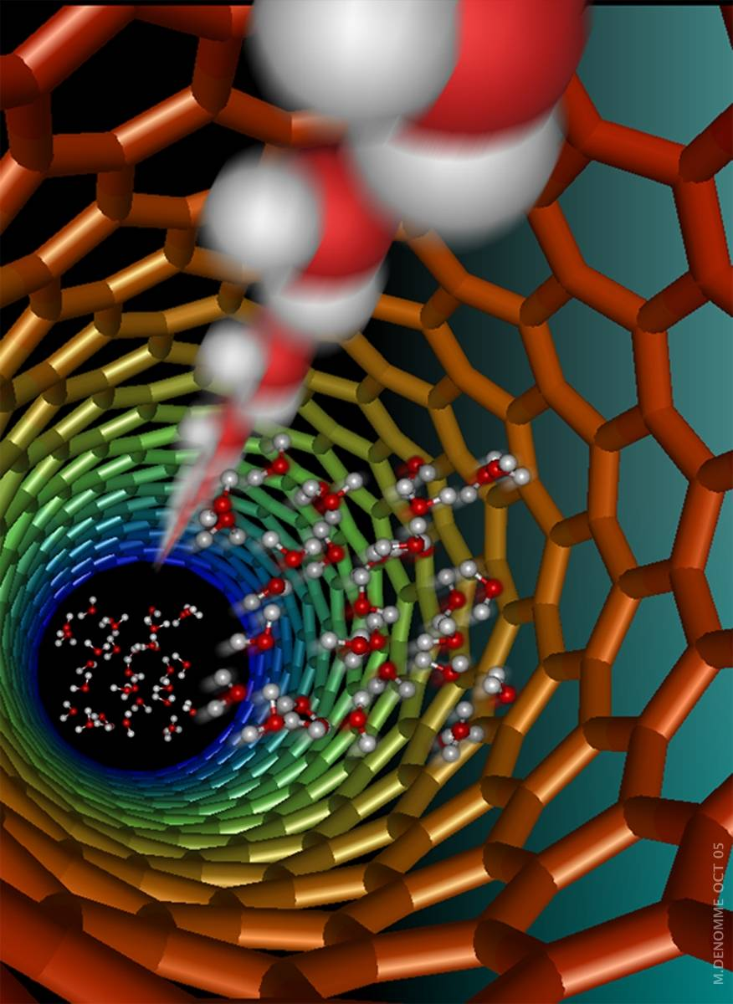
Nanotechnologies in Energy Applications
University of Kentucky
Center for Applied Energy Research
Department of Chemistry
Chemical and Materials Engineering
Rodney Andrews, PhD PE
Director
Email: andrews@caer.uky.edu
Water molecules traveling through core of a carbon nanotubes

Slide 2
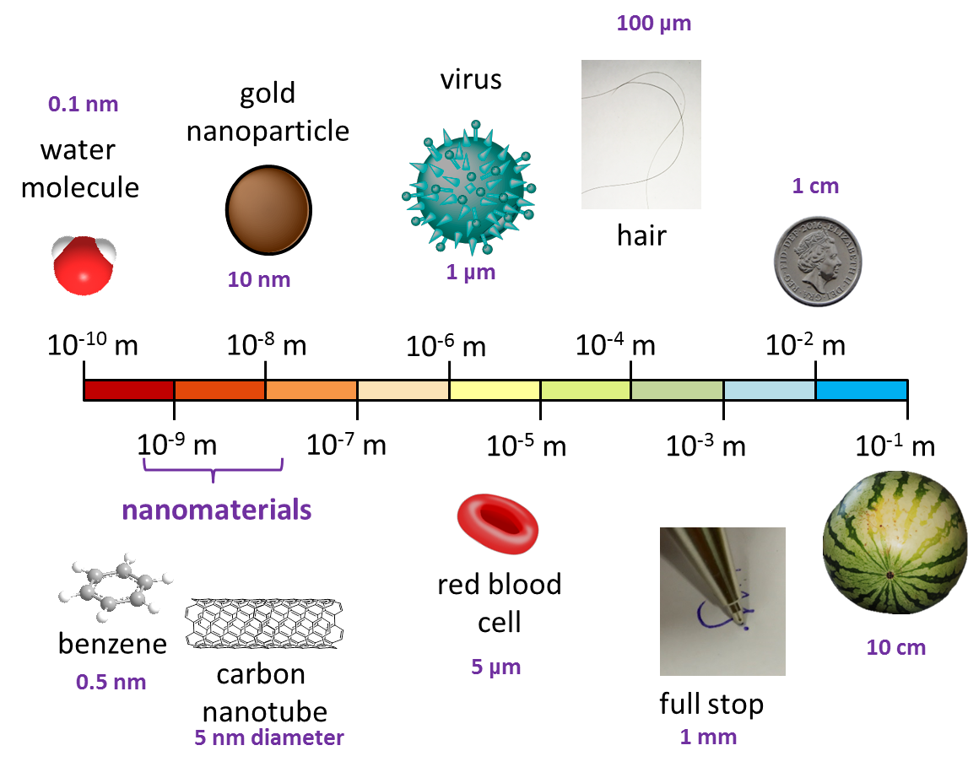
What is special about nano?
really really tiny
Nano generally means working at size scales of 1-100 nanometers
This is 1/1,000,000,000 (1 billionth) of a meter
At this scale, materials behave differently
2D and 1D structures (nanotubes and graphene)
Huge surface area to volume ratios
Bulk properties and inherent properties merge
More direct manipulation of matter
Structure – atomic level control
Function – faster, higher selectivity
https://chembam.com/definitions/nanotechnology/
BACKGROUND

Slide 3

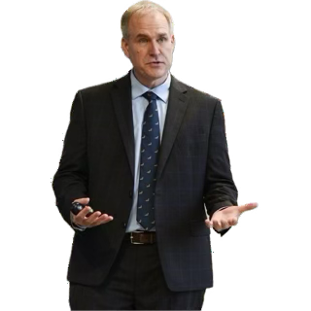
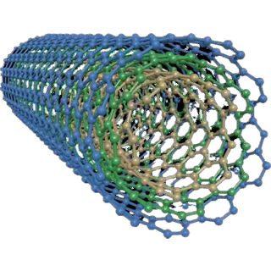
How small is small?
1 7,000,000
1 18,000,000
NOT TO SCALE
BACKGROUND

Slide 4
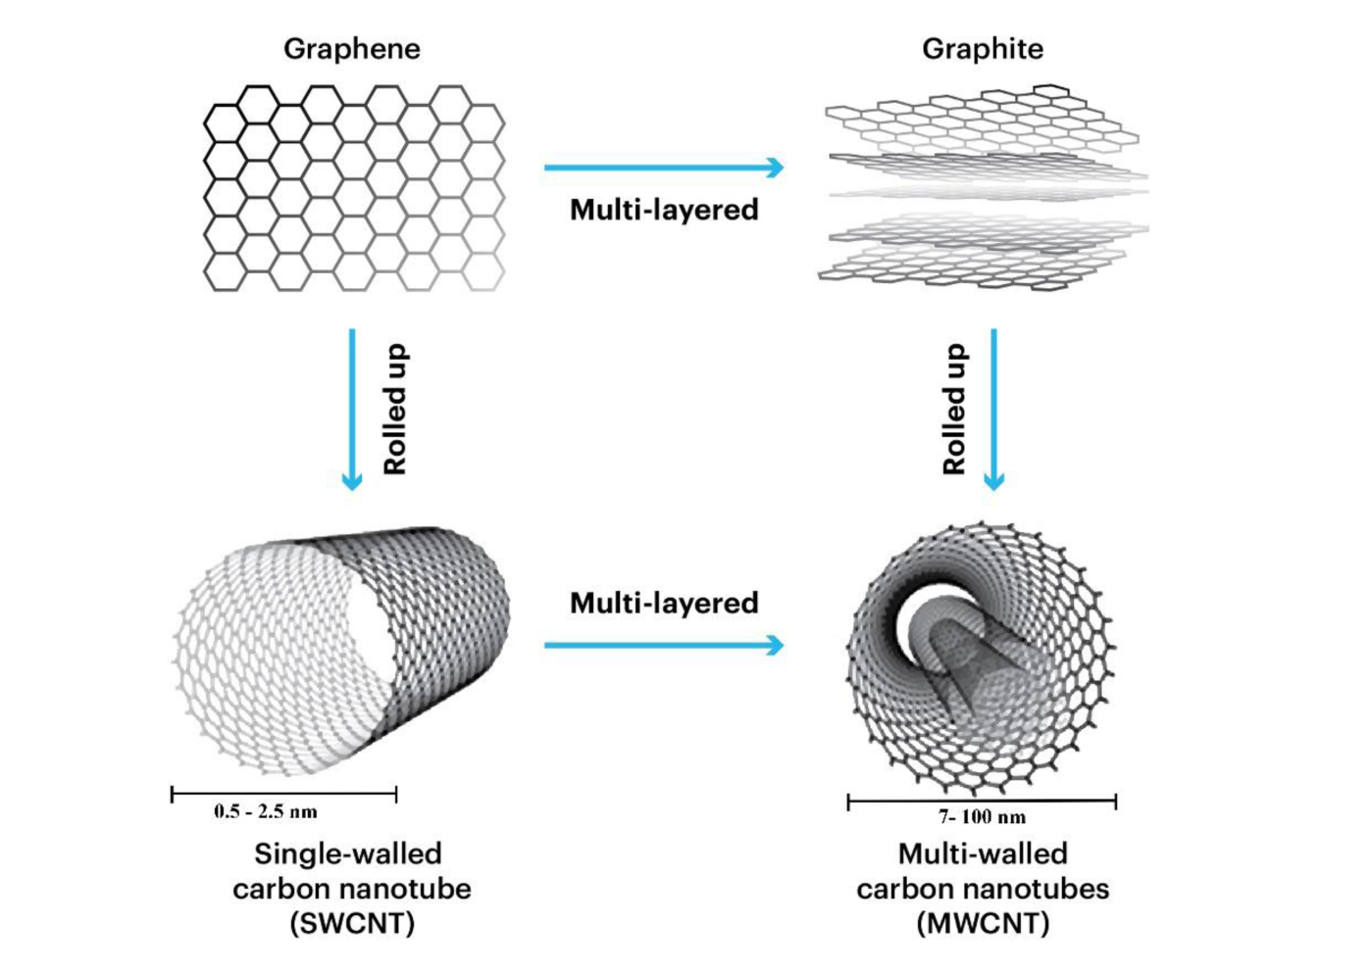
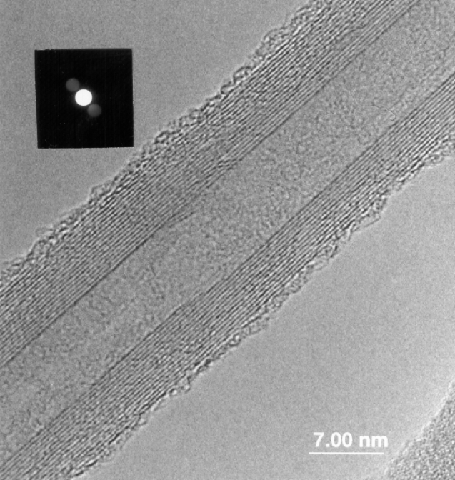
Example – Carbon nanomaterials
BACKGROUND
Goyal, ChemistrySelect, Jun 2024

Slide 5
Current applications
The Biggest Uses:
Sunscreen - probably the most widespread consumer use
Computer chips - Intel, AMD, etc. have been at nanoscale for years
Catalytic converters - been using nanoparticles since the 1970s
Tires - carbon black nanoparticles have been used for over 100 years!
Consumer Electronics
QLED and OLED TV screens (quantum dots)
Scratch-resistant coatings on phone screens and glasses
Improved lithium-ion batteries in phones, laptops, EVs
Computer chips (transistors are now measured in nanometers)
Cosmetics & Sunscreen
Sunscreens with titanium dioxide or zinc oxide nanoparticles
Anti-aging creams with nano-encapsulated vitamins
Makeup with nanoparticles for better coverage
Medicine & Healthcare
Rapid COVID-19 tests (gold nanoparticles)
Some cancer drug delivery systems
Automotive
Catalytic converters (platinum nanoparticles - used for decades)
Improved tire rubber with carbon black nanoparticles
Construction & Building
Stronger, lighter concrete with nano-silica
Aerogel insulation
Sports Equipment
Tennis rackets and golf clubs (carbon nanotubes for strength)
Anti-vibration
Bicycle frames
Paints & Coatings
Anti-fouling boat paint
Anti-corrosion coatings
Anti-reflective coatings
BACKGROUND

Slide 6
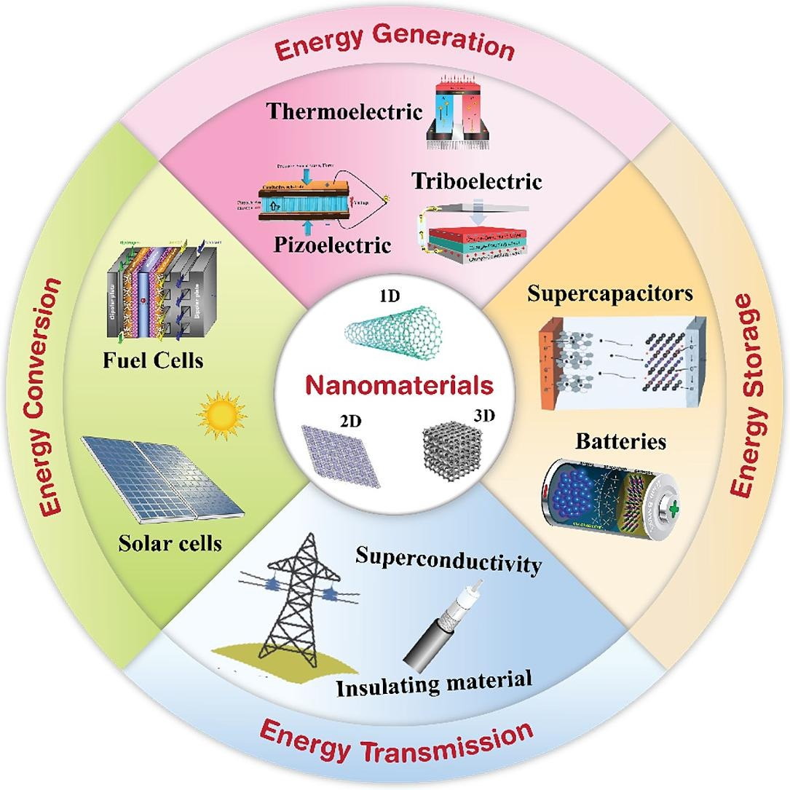
Nanotechnology and Energy
Gohar, Materials and Design, 2024
BACKGROUND

Slide 7
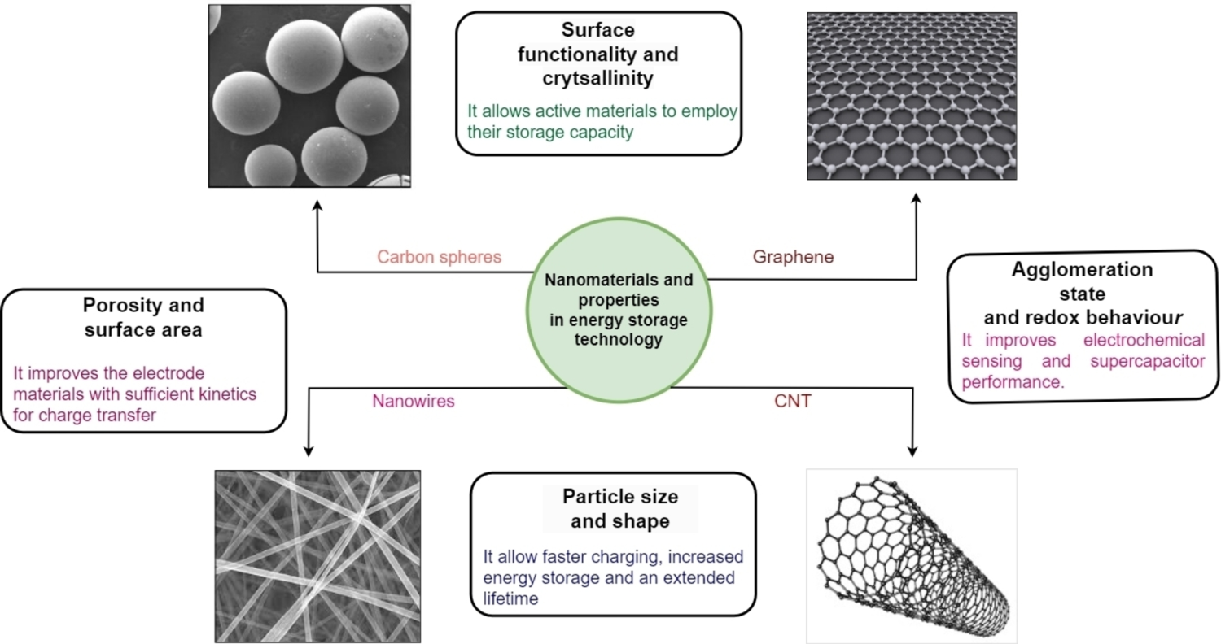
Energy Storage
Nanoscale design of the structure and chemistry of electrode materials may enable us to develop a new generation of devices that approach the theoretical limit for electrochemical storage and deliver electrical energy rapidly and efficiently. Y Gogotsi
Goyal, ChemistrySelect, Jun 2024
ENERGY STORAGE

Slide 8

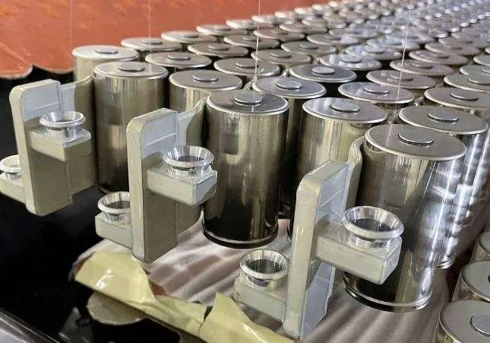
Improved batteries
Faster charging speeds - much shorter distances for ions to travel, allowing batteries to charge in minutes instead of hours.
Higher energy storage capacity - increased surface area provides more sites for storing energy, significantly increasing charge storage
Longer lifespan and durability - Nano-structured materials can better accommodate the expansion and contraction that occurs during charging cycles, extending battery life
Improved power delivery - enable faster charge and discharge rates, enabling bursts of high power (electric vehicles during acceleration)
Better performance at extreme temperatures - maintain conductivity and efficiency across wider temperature ranges, increasing reliability in very cold or hot conditions
Tesla battery with silicon nano-wire anode
ENERGY STORAGE

Slide 9
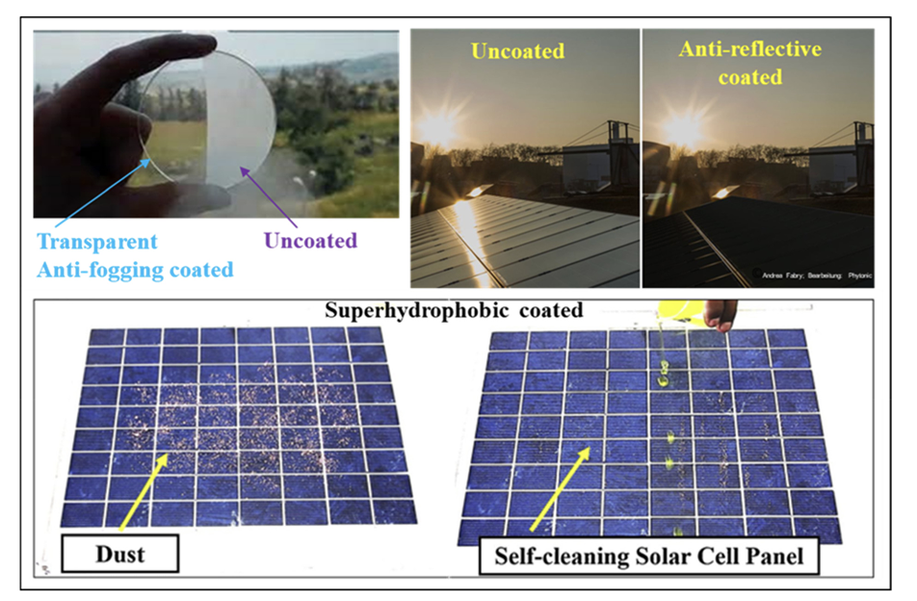
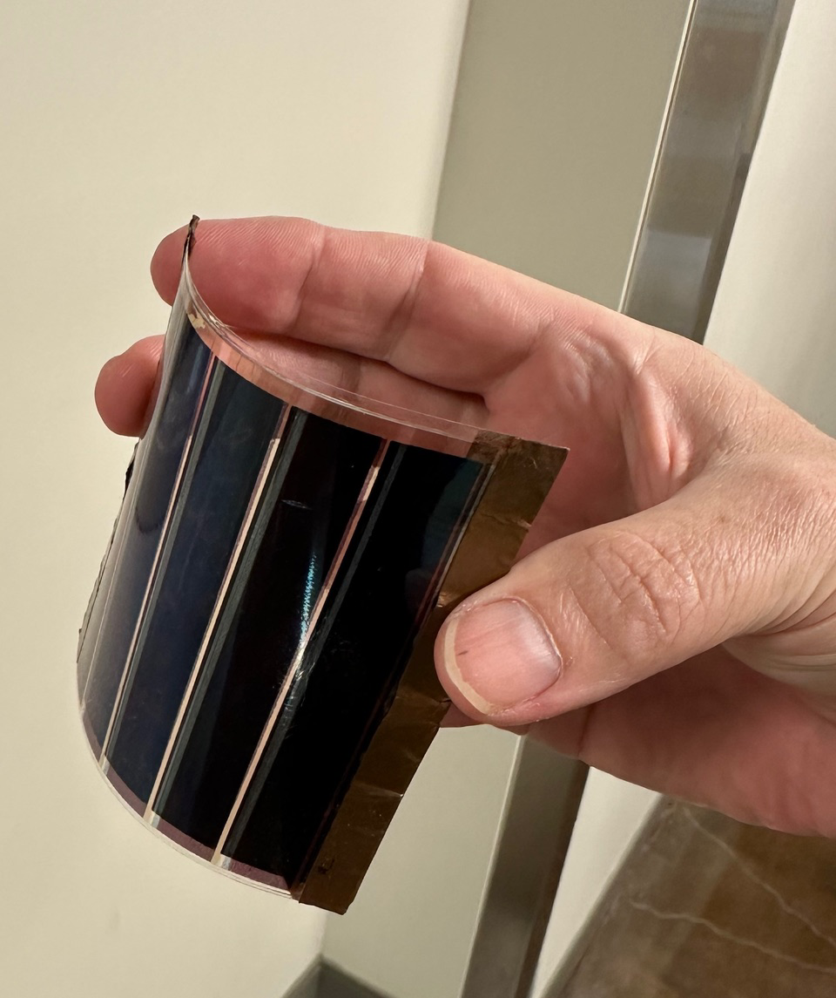
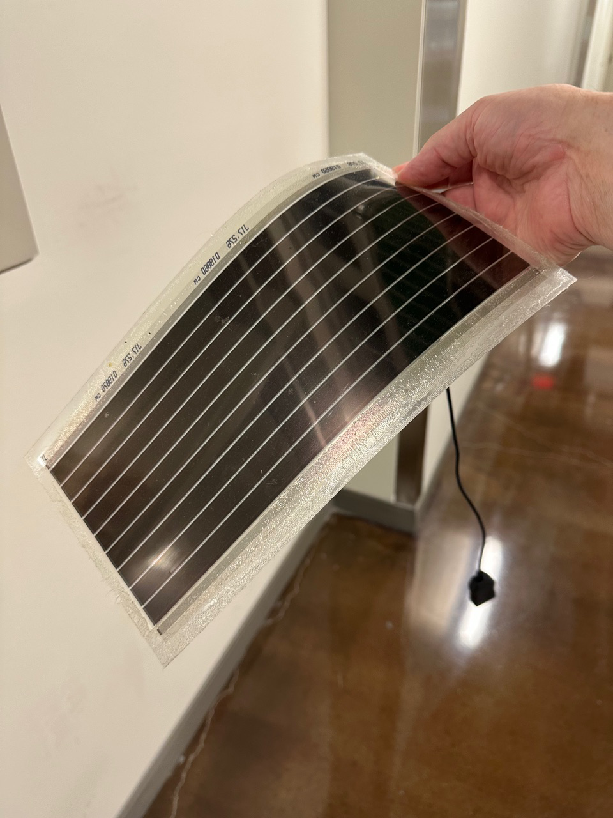
Solar Energy
Nanotechnologies are already used but can be better
Higher energy conversion efficiency - Quantum dots and nanostructured materials can be tuned to capture a wider range of the light spectrum, including wavelengths that traditional panels miss, converting more sunlight into electricity
Better performance in low-light conditions - Nano-engineered surfaces and materials work more effectively in cloudy weather, early morning, and late afternoon, generating power during times when conventional panels produce little to nothing
Lighter weight and flexible panels - Nanomaterial-based solar cells can be printed or coated onto flexible substrates, enabling solar panels on curved surfaces, fabrics, or building materials Reduced manufacturing costs - printed or sprayed rather than manufactured in expensive clean rooms, potentially making solar energy much more affordable at scale
Enhanced durability and anti-reflective properties - Nano-coatings reduce light reflection (more light gets in), resist dirt and water buildup (self-cleaning), and protect against UV degradation, extending panel lifespan and maintaining efficiency
Nano-coatings improve performance of solar panels 2-4%
PHOTOVOLTAICS
Flexible printed panels

Slide 10
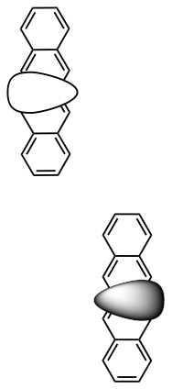
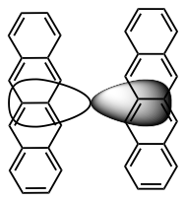
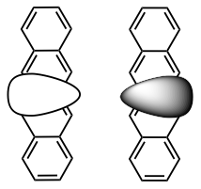
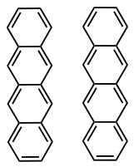
Fixing solar panels
• Silicon can only use light of a particular low energy
• Higher energy light is reflected as heat, causing massive ‘heat islands’ at solar farms
Engineered nanographenes (NGs), 1.5 nm long fragments of graphite, can fix this problem
ENERGY
light
time
time
NGs exchange energy to form two coupled lower-energy molecules
NGs split, creating two molecules that can contribute to solar energy
Two NGs
at rest
On NG absorbs light energy too high for Si
low energy light
low energy light
high energy light
• Eliminate heat islands
• Increase solar power output by 40%
high energy light
heat
nanographene film
Si solar panel
Si solar panel
energy
energy
energy
energy
energy
Traditional silicon
Nanographene enhanced silicon

Slide 11
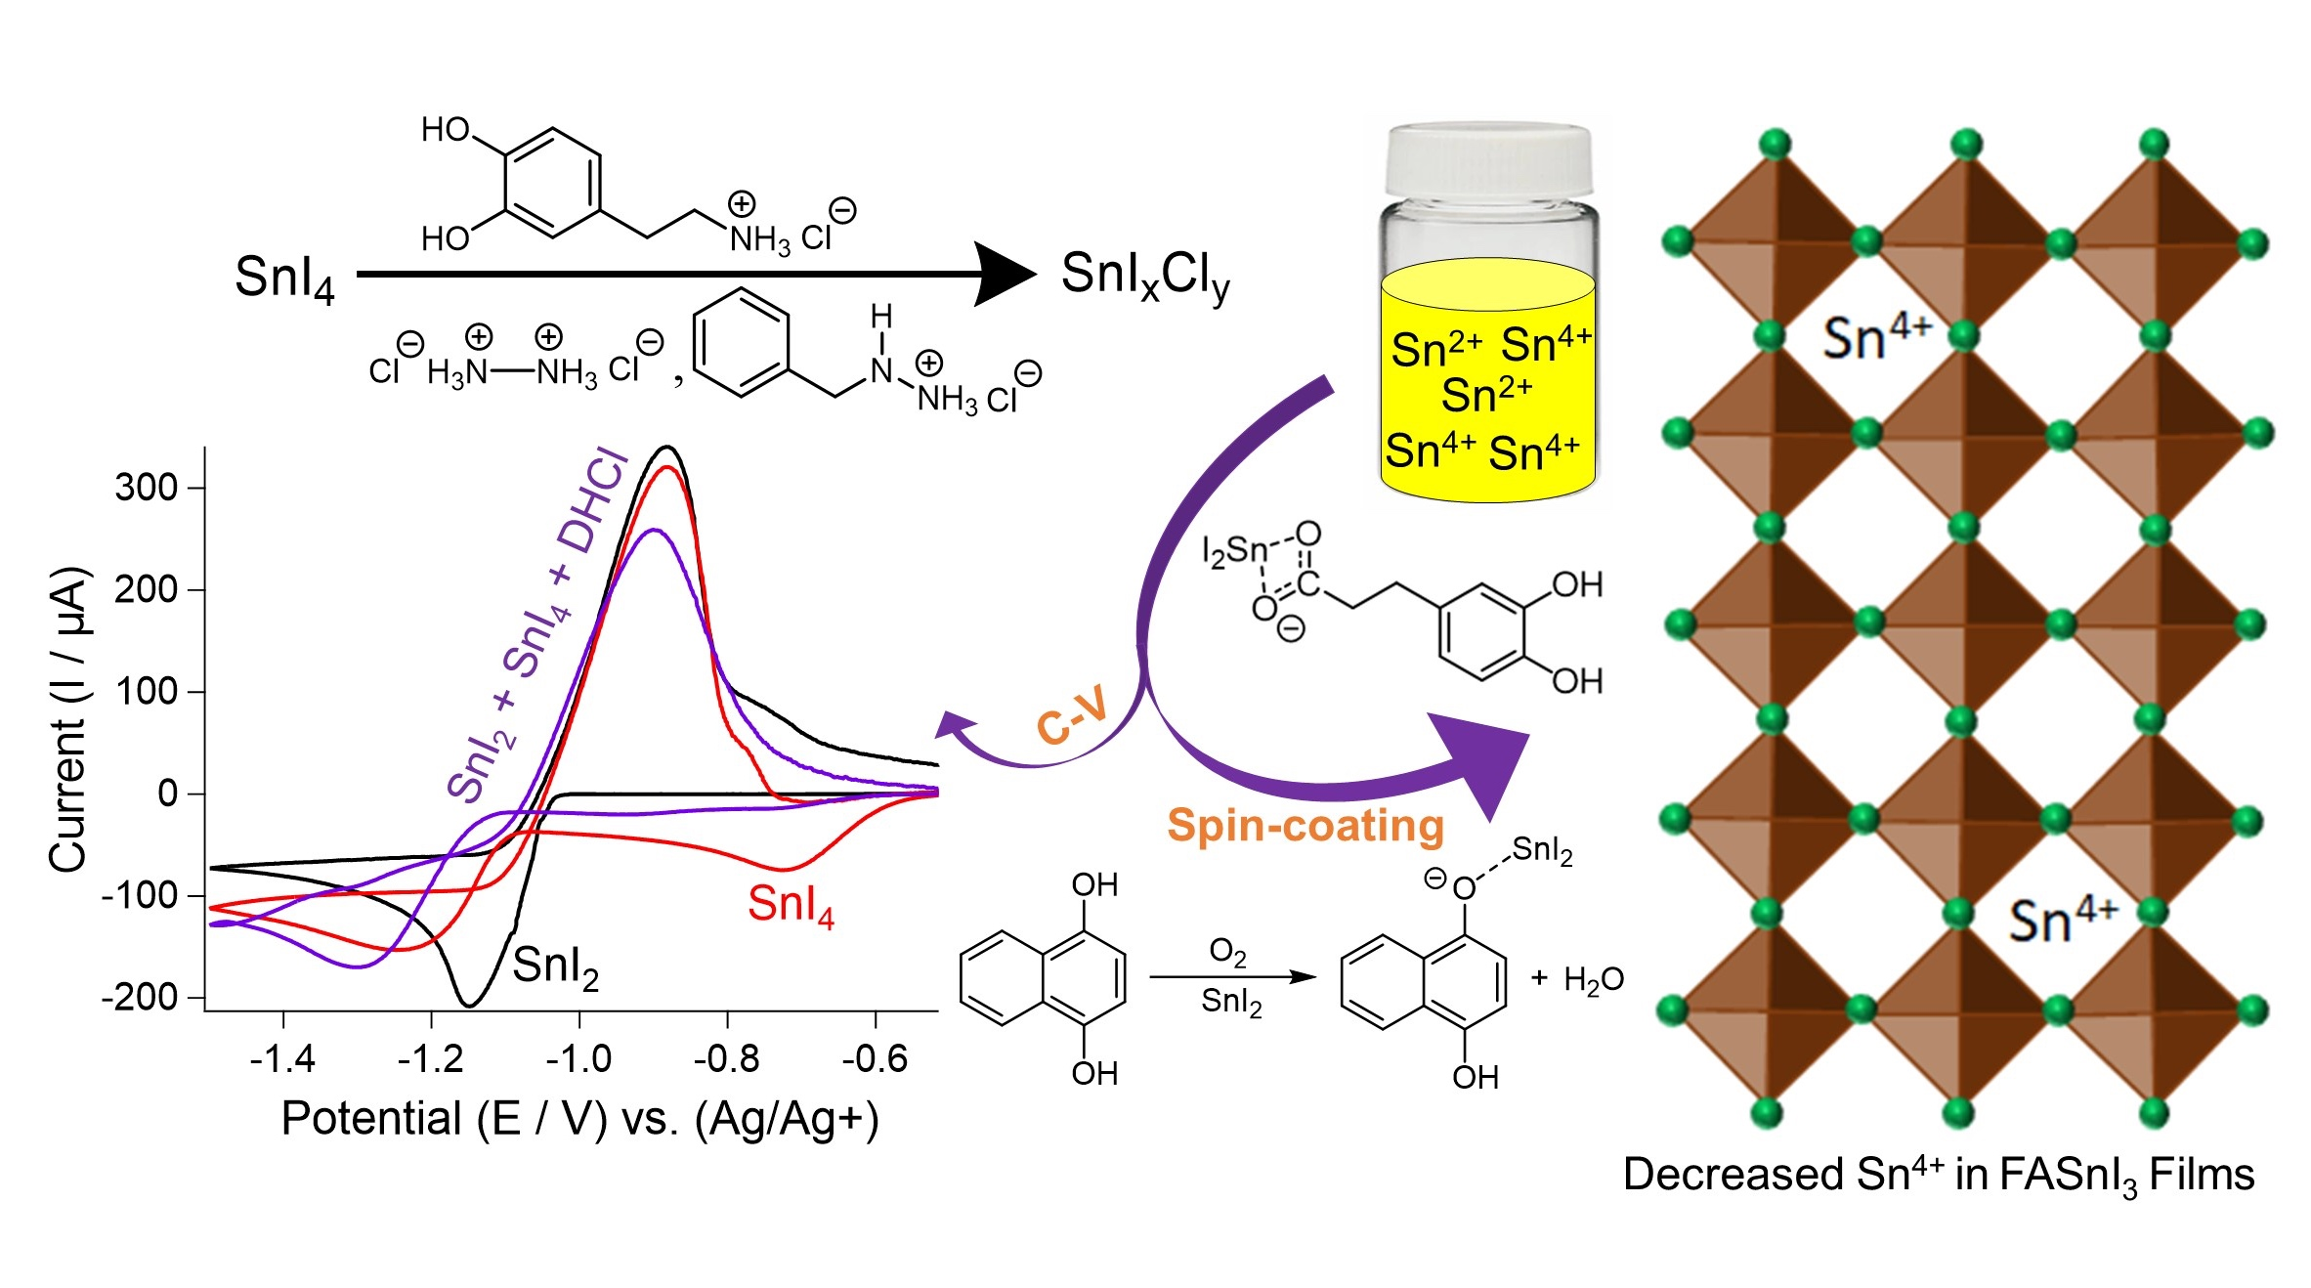
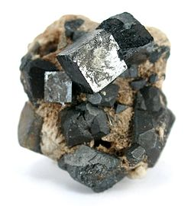
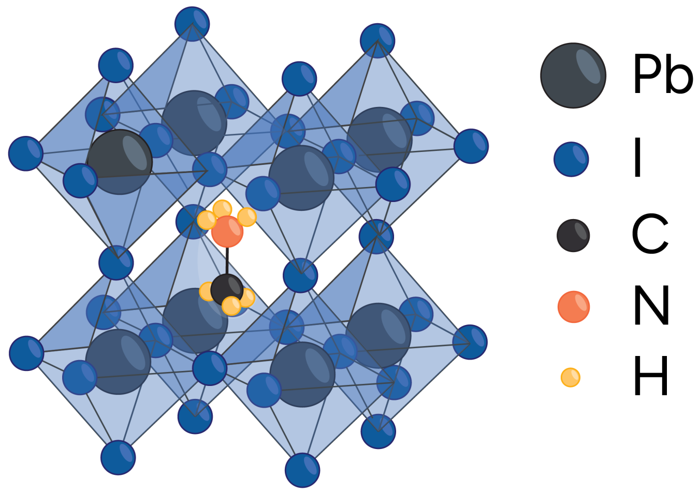
Perovskite Photovoltaics
Perovskite photovoltaics have the potential to further lower cost
Increasing stability
Graham group is working to improve stability and promote commercialization of perovskite PVs.
PHOTOVOLTAICS

Slide 12
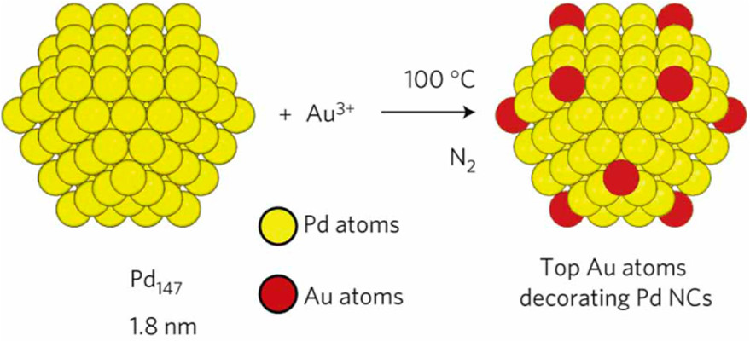
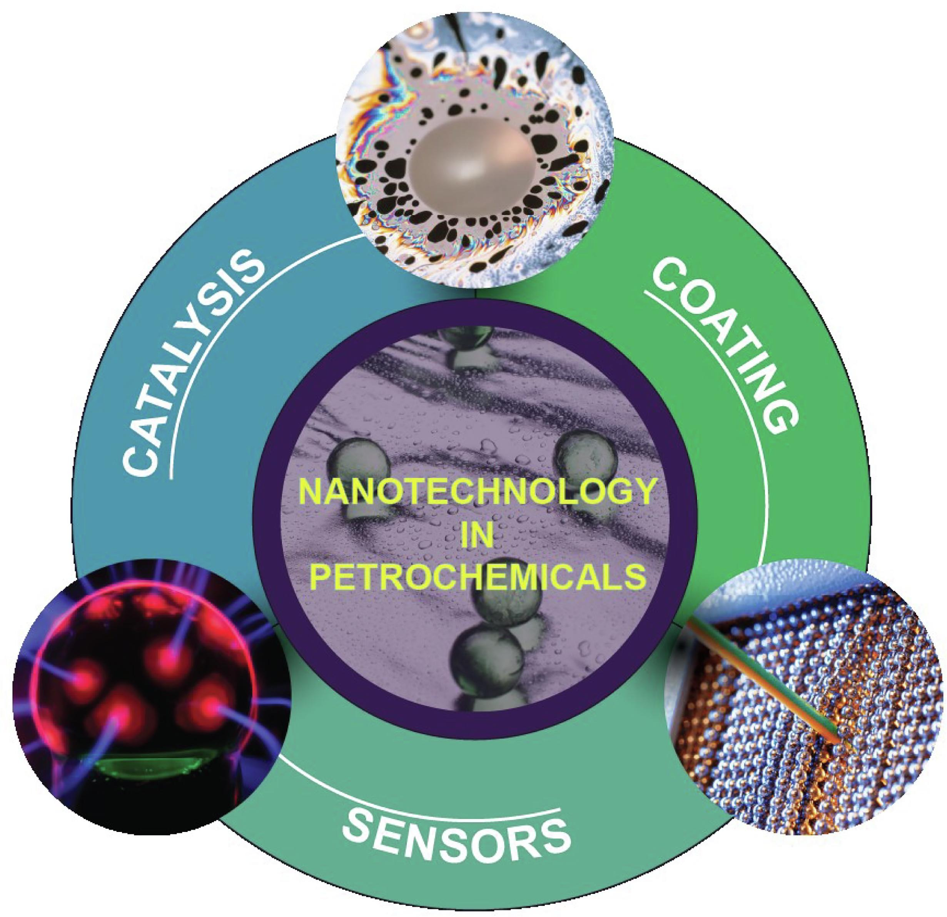
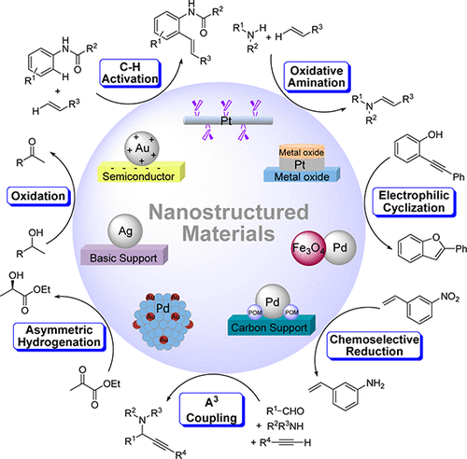
Nanotechnology in refining
FUEL PROCESSING
Tailored catalysts
Hydrotreating
methanation
Catalyst supports and promoters
Hydrogenation
Separations
Gas sensors
Corrosion inhibitors and coatings
Ferdous, Fuel (37) 2024 132020
CATALYST AND SUPPORT
Chng, Accounts of Chemical Research 2013, 46, 8, 1825-1837

Slide 13
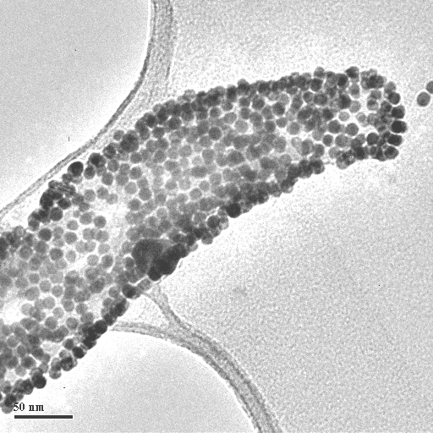
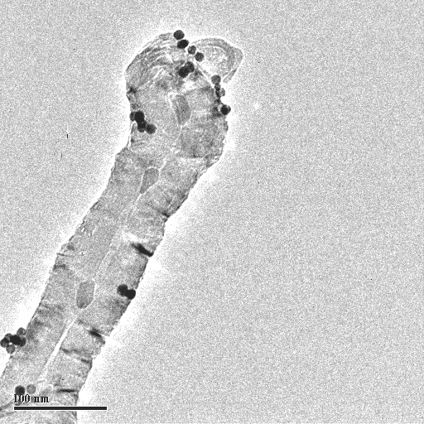
Gold nanoparticles on carbon nanotubes
We use chemistry to determine where the particles attach
CATALYST AND SUPPORT

Slide 14
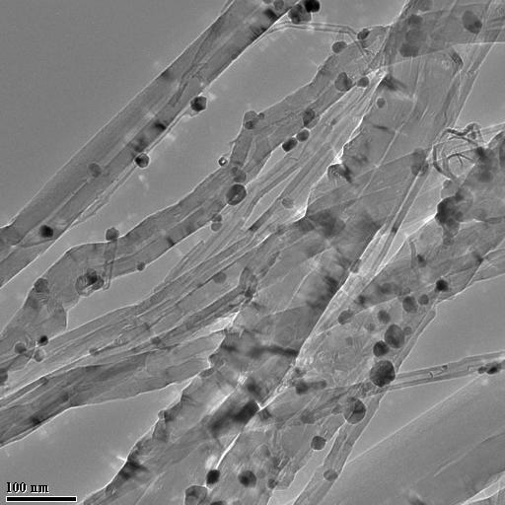
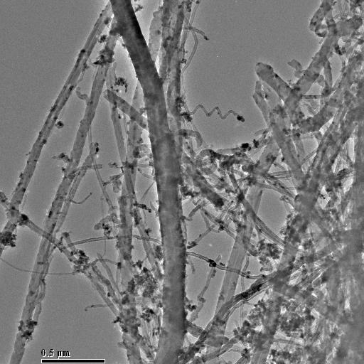
Catalytic Modifications
10 wt% Cu
3 wt% Pd
CATALYST AND SUPPORTS

Slide 15
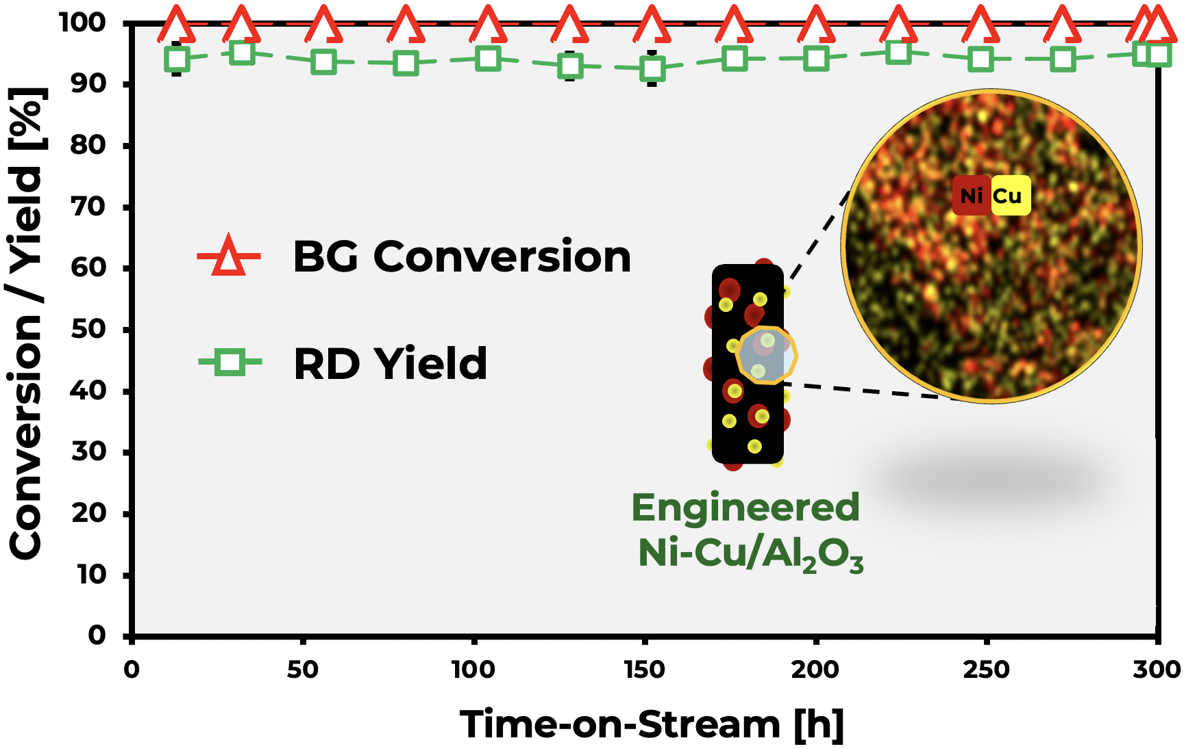
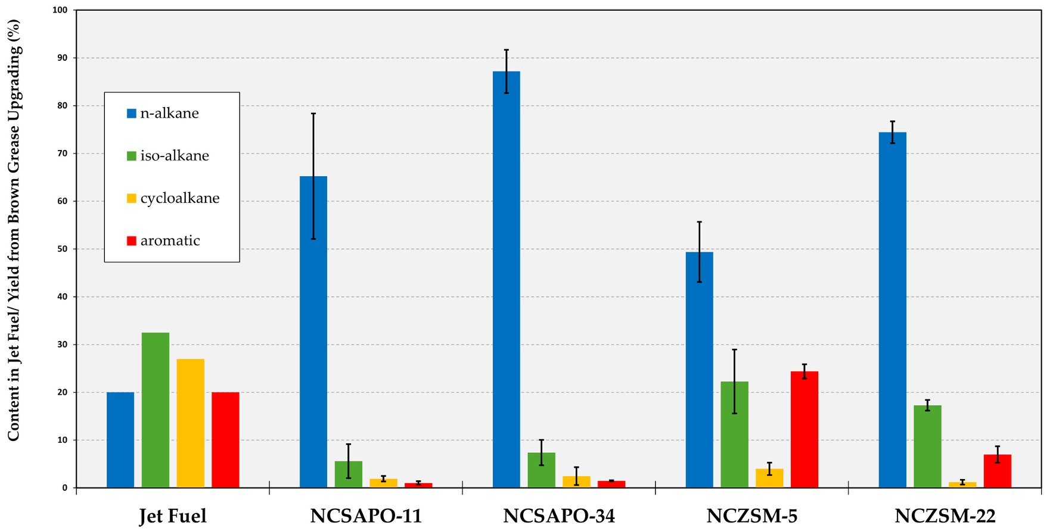
Conversion of brown grease to renewable diesel
C10–C26
https://pubs.rsc.org/en/content/articlehtml/2025/cc/d5cc01451d
Notes:
Funding from the U.S. DOE has allowed the development of engineered catalysts consisting of nickel and copper nanoparticles supported on alumina extrudates.
When this catalyst was tested in the conversion of brown grease to renewable diesel, the catalyst displayed 100% brown grease conversion and a selectivity to diesel-like C10-C26 hydrocarbons equal or higher than 93% irrespective of time on stream.
The brown grease as well as liquid product samples representative of the beginning, middle, and end of upgrading experiments were analyzed to determine the concentration of contaminants of interest as a function of time on stream.
Saliently, most contaminants present in the feed are effectively removed during upgrading to afford a product stream relatively free of contaminants.

Slide 16
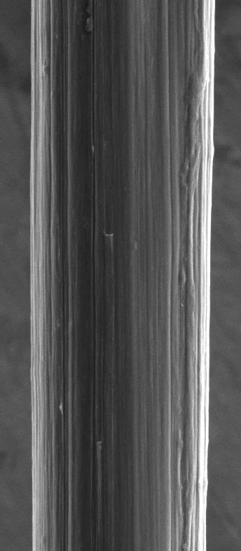
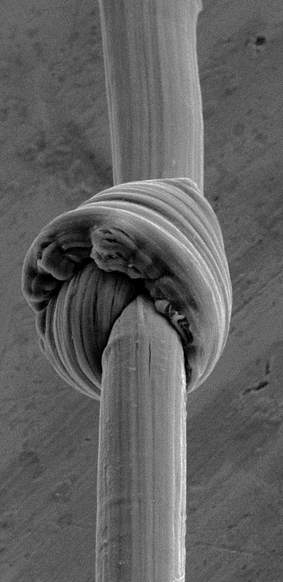
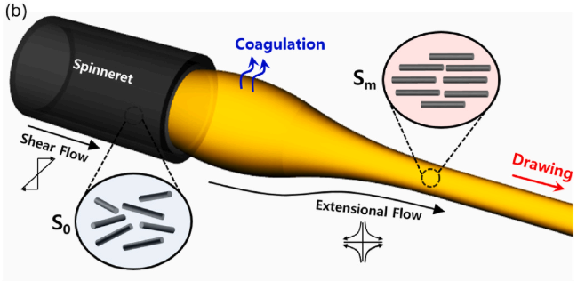
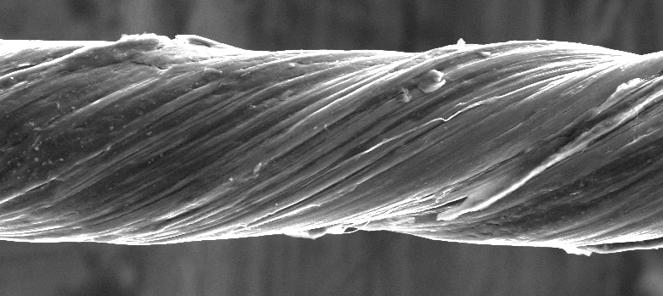
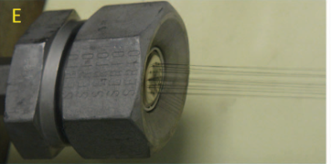
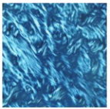
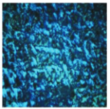

Carbon Nanotube Yarns
Multifunctional replacement for metals
CNT yarn
Fabrication of CNT yarn
LC (Liquid Crystal) phase of CNT dope
5 $μ$m
5 $μ$m
5 $μ$m
N. Behabtu et al. Science, 2013, 339, 182
S. G. Kim et al. Carbon, 2022, 196, 59-69
Strong, Supple and Conductive
CARBON MATERIALS

Slide 17
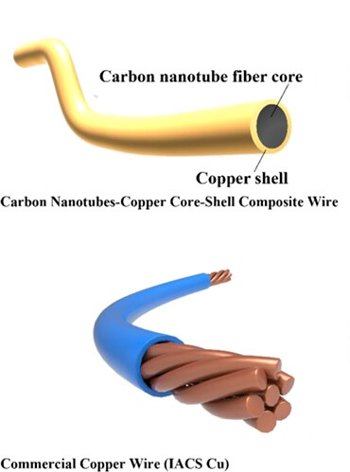
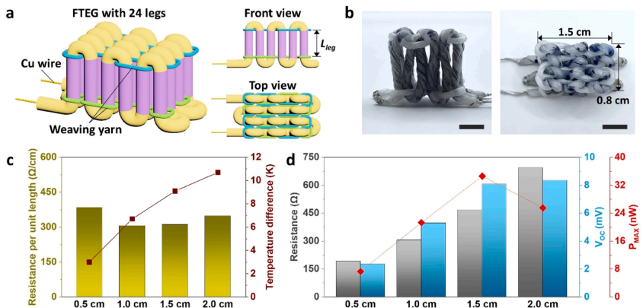
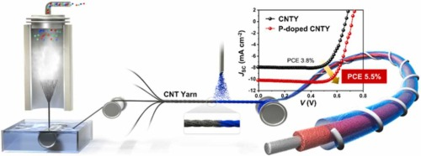
Nanotubes outperform copper
CNT can transport, store, and produce energy
CNT yarn properties
Application of CNT yarn
Power transmission cable
Thermoelectric fiber
Thermoelectric fiber
Tensile strength
(GPa)
S.-J. K. et al. Nano Energy, 2025, 140, 111054
Energy storage
Specific
electrical conductivity
(x10⁶ S m² kg⁻¹)
Tensile modulus
(GPa)
H. Chen et al. ACS Appl. Mater. Interfaces 2022, 14, 50, 56253-56267
J. H. Kim et al. Nano Energy 2022, 96, 107054
CARBON MATERIALS

Slide 18
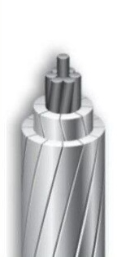
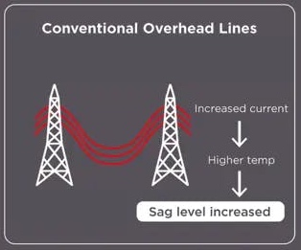
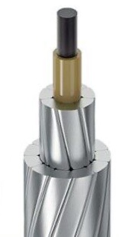
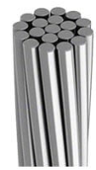
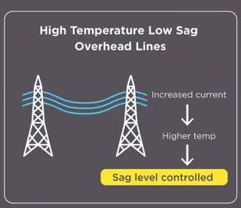
High temperature low sag power transmission
Structural characteristics
High temperature Low Sag (HTLS)
Power transmission
ACSR
AAAC
ACCC
(Steel core)
(Aluminum core)
Carbon fiber core
CTC Global
Mass of conductor
(kg/km)
987
731.3
Specific weight
(daN/m)
18.9
17.1
Ampacity
(A)
1.3
2.4
CARBON MATERIALS
P. Pavizi et al. Elec. Pow. Syst. Res. 2025, 239, 111251
Notes:
Mass per length of Core or wire
Span area
Tension and transmission
Lower sag (Most important)

Slide 19
Greater stability at high temperatures
Comparison of CNT yarn with carbon fiber
Tensile strength
(GPa)
Thermal Stability
Thermal conductivity
(W/mK)
Tensile modulus
(GPa)
Elongation
(%)
Electrical conductivity
(MS/m)
High electrical conductivity (6 MS/m)
Carbon fiber
CNT yarn
: CNT yarns exhibit significantly higher electrical conductivity, reducing line resistance and enabling transmission losses.
High thermal conductivity (380 W/mK)
: CNT yarns demonstrate much higher thermal conductivity, allowing efficient heat dissipation and suppression of local hot spots, thereby improving sag performance.
Ultra-low coefficient of thermal expansion (CTE)
: CNT yarns maintain an ultra-low CTE, ensuring dimensional stability under thermal cycling and reducing the risk of excessive sag
CARBON MATERIALS
S. G. Kim and S. J. Heo et al. Compos. B:Eng. 2022, 247, 110342

Slide 20
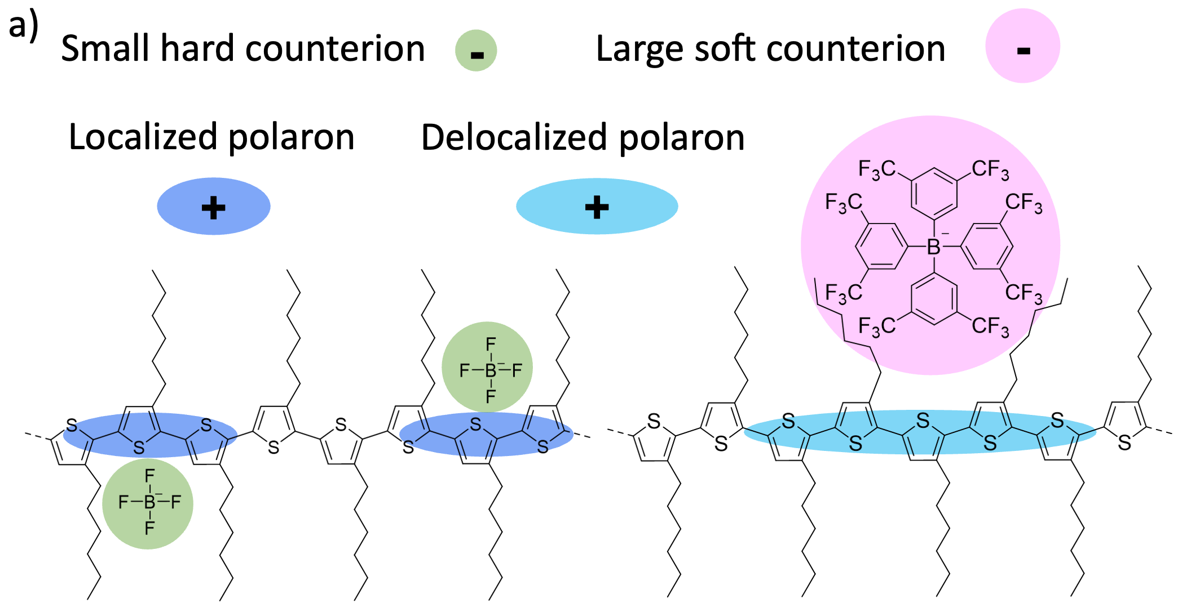
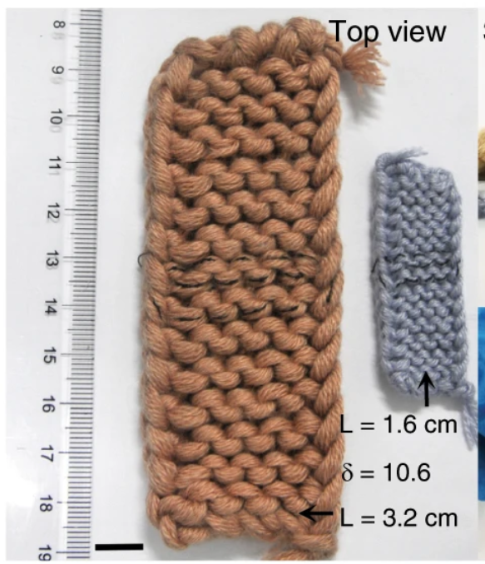


Flexible organic thermoelectrics
Generating electricity directly from heat
Thermoeletrics can convert heat directly to electricity with no moving parts
Thermoelectrics are useful in providing remote power, recovering waste heat (e.g., from a coal-fired power plant), powering wearable electronics, etc.
Organic
Inorganic
Power factor ~3 times higher with BArF⁻ as counterion
Expensive
Mechanically rigid
Inexpensive
Mechanically flexible
Sun, T., Zhou, B., Zheng, Q. et al. Nat Commun 11, 572 (2020)
Baustert, K. N….Risko, C.; Graham, K. R. Adv. Mater. 2024, 36 (29), 2313863
THERMOELECTRIC

Slide 21
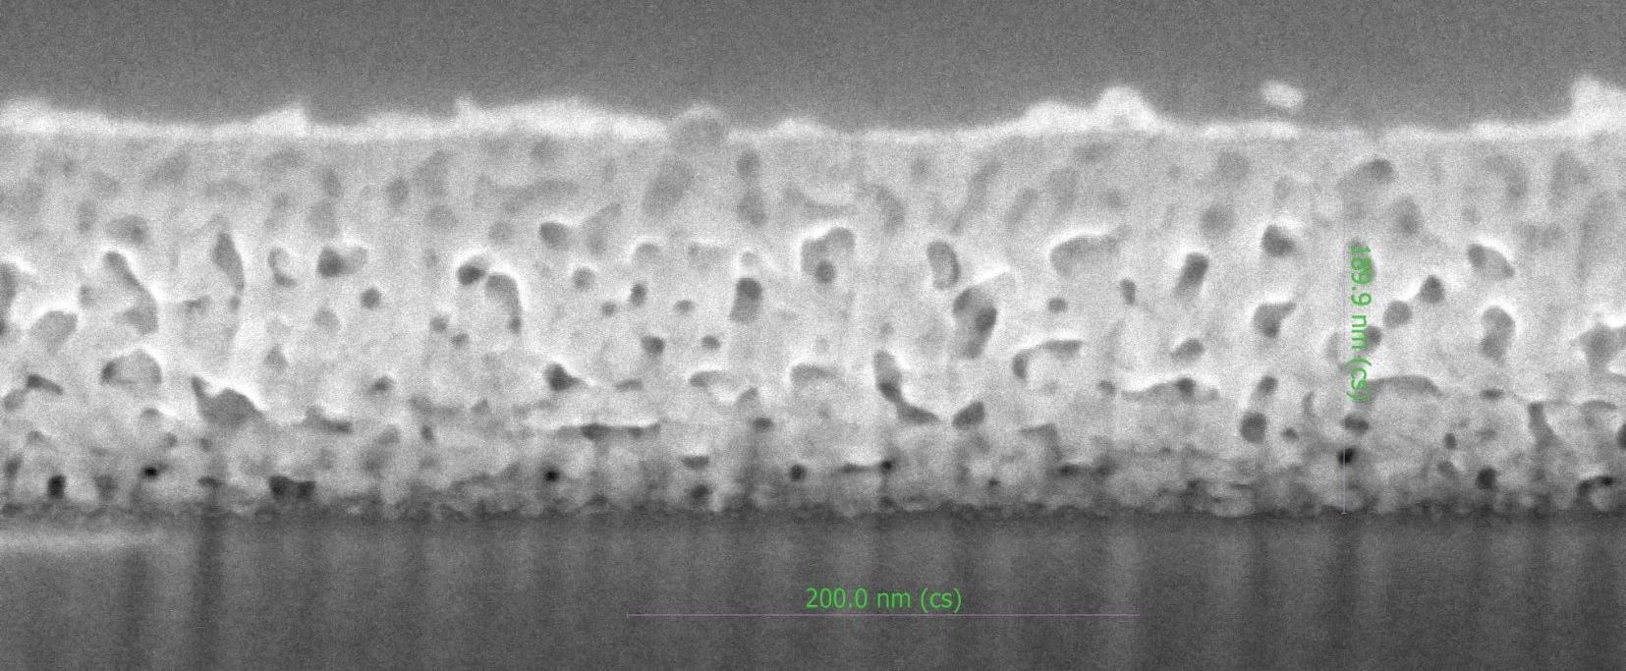
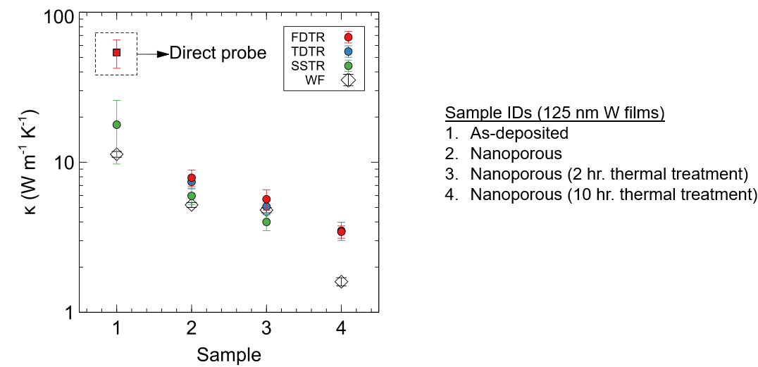
Fusion Energy
New materials to withstand plasma energy
Nanoporous Tungsten
Nanoporous metal thin-film filled with ceramic or nano-crystalline diamond
Cizek, J., Vilemova, M., Lukac, F., Koller, M., Kondas, J. and Singh, R., Cold Sprayed Tungsten Armor for Tokamak First Wall, Coatings 9 (2019)
NUCLEAR

Slide 22
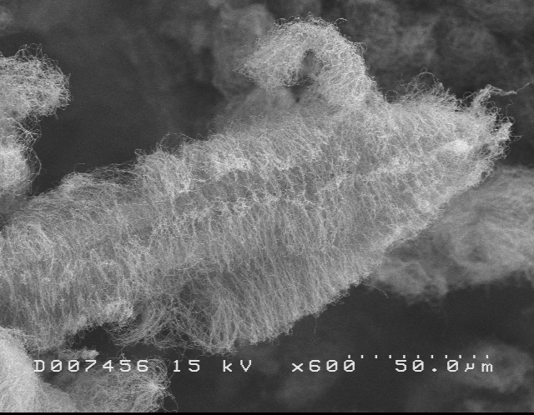
Other energy applications
This could be a 30 hr lecture course
Nano-fluids for cooling
Enhanced drilling muds
Joule heating materials for turbine blades
Dry lubricants for friction reduction (works in Space)
Electrostatic additives for low energy paint curing
Electromagnetic shielding
Thermal transport composites
Carbon nanotubes with carbon fibers
EVERYTHING ELSE

Slide 23
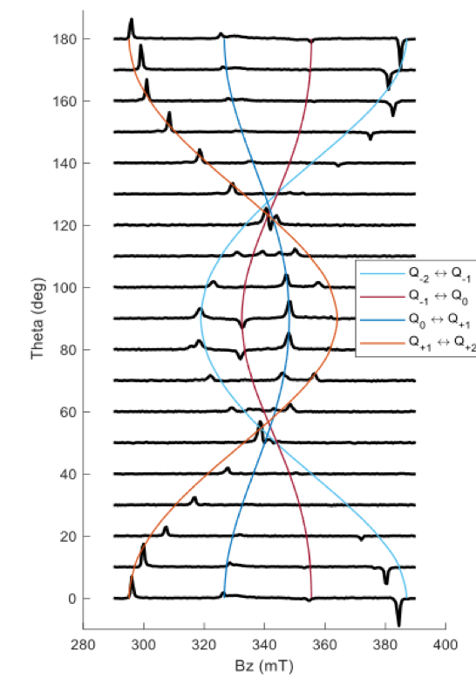
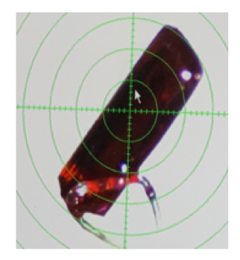
Quantum computing for grid optimization and security
The ability to solve complex problems very rapidly are also key to energy use forecasting and scaling
The qubit is the fundamental computer ‘bit’ of quantum computing, requires “entangled” molecules, which can usually only happen at ultra-low (-452 °F) temperatures - this is why quantum computing is expensive and consumes enormous amounts of energy
Our nanographenes for energy harvesting pass through a quantum entangled state as part of the process - at room temperature!
To use these NGs for quantum computing, we must design materials that remain in this state for a longer time
NGs exchange energy to form two coupled lower-energy molecules
• The qubit is initiated with light, and programmed with microwave energy
• When the quantum calculation is finished, the crystal emits light - the energy of the light shows the result
• We have quantum coherence of 720 nanoseconds at room temperature - almost enough for 1 computation
• DOE project goal is to achieve room temperature coherence up to 1.5 microseconds - enough for multiple quantum computations
First observation of a quantum coupled nanographene crystal
different coupled states for quantum computing
Dr. Justin Johnson

Slide 24
Questions
Rodney Andrews
rodney.andrews@uky.edu

