Slide 1
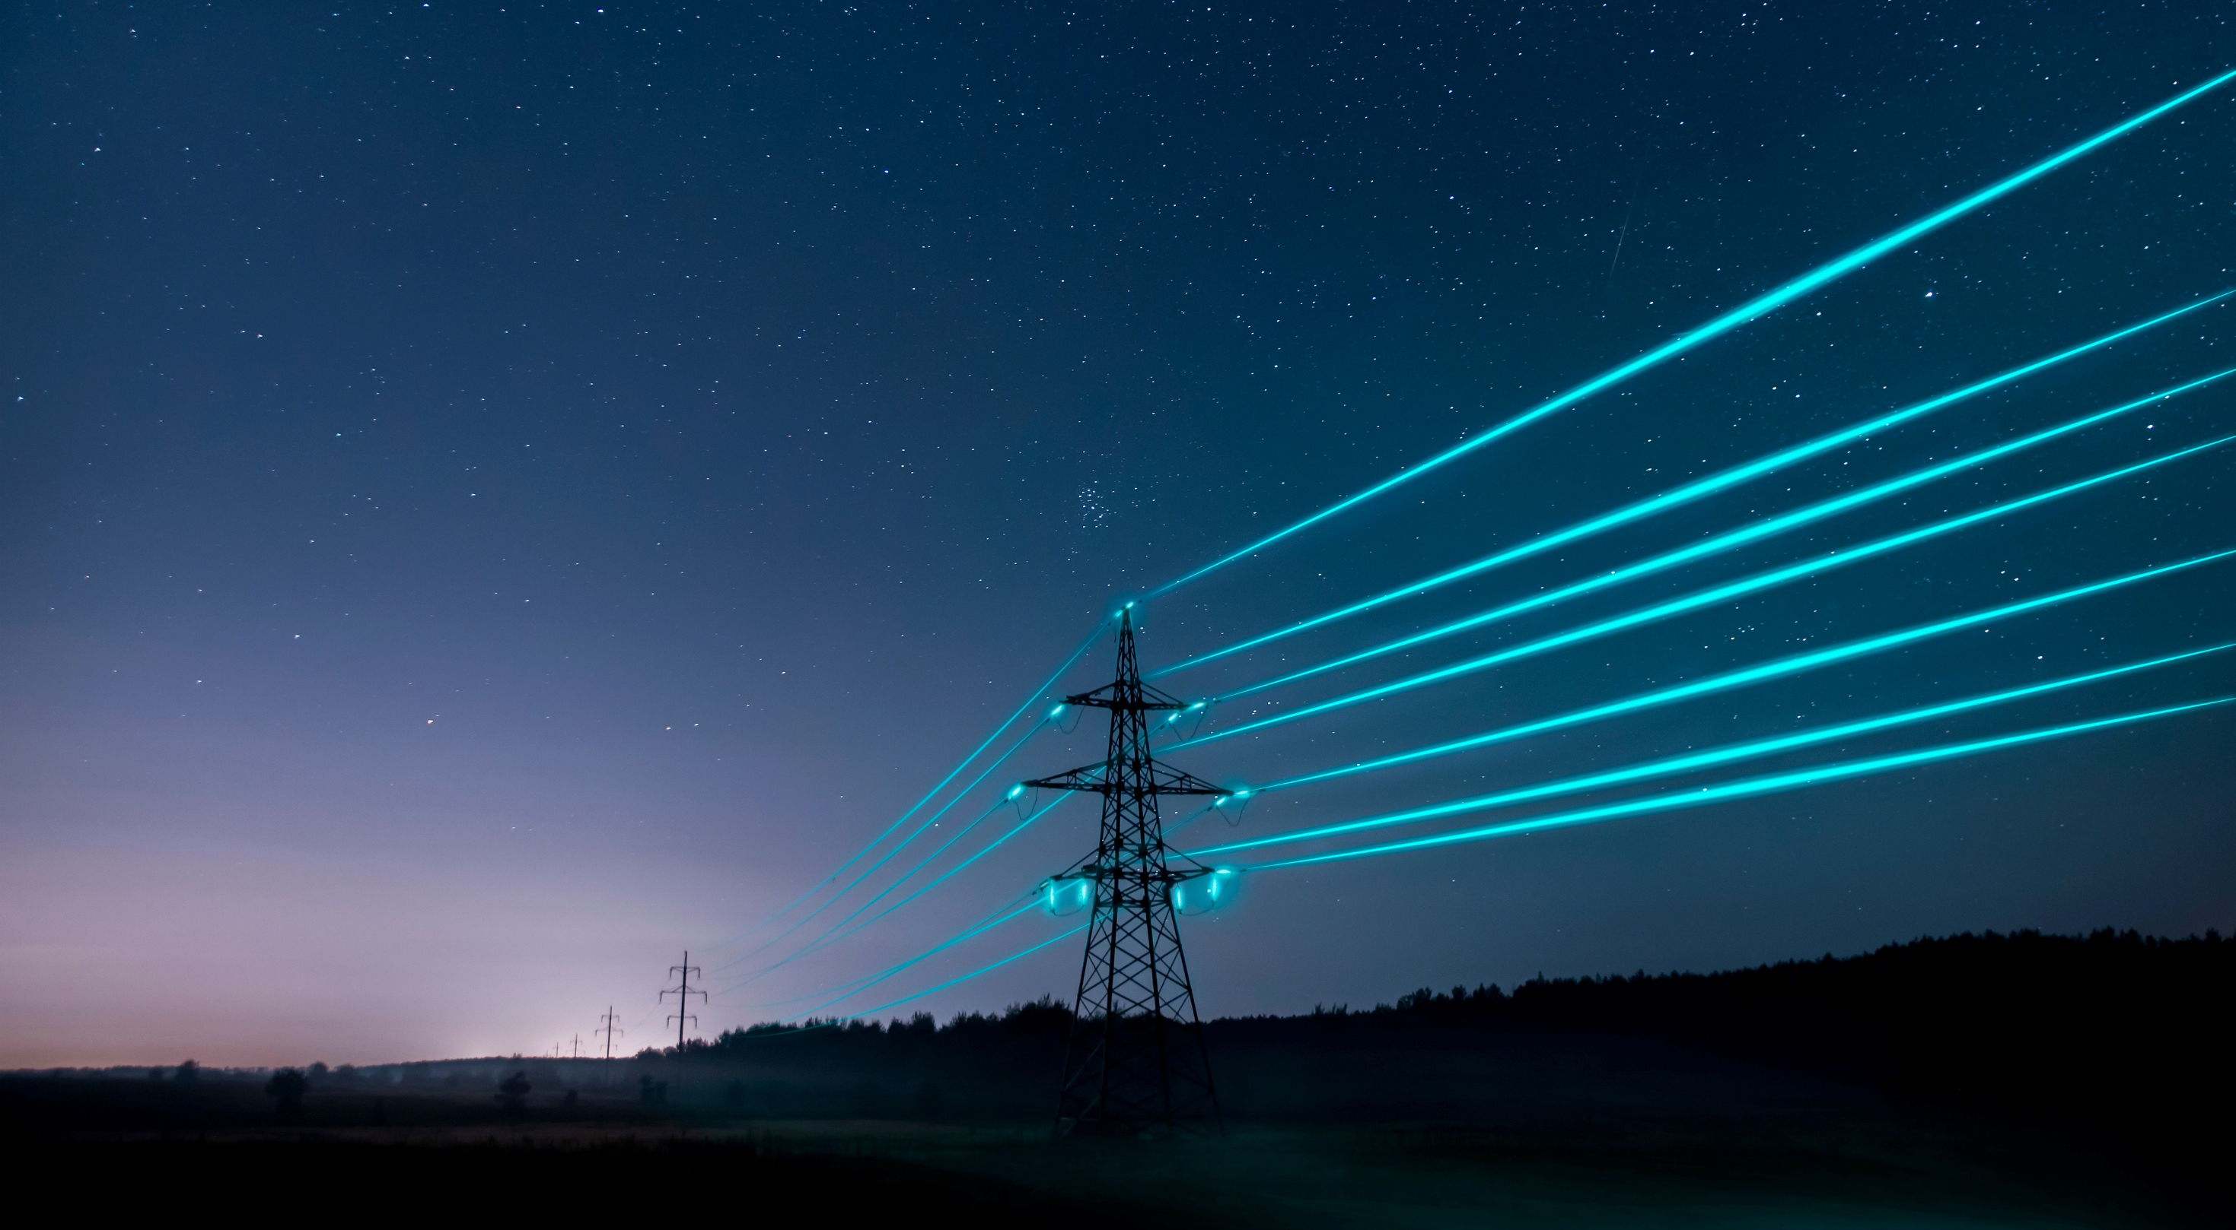

Slide 5
EKPC: Power Supply

Slide 6
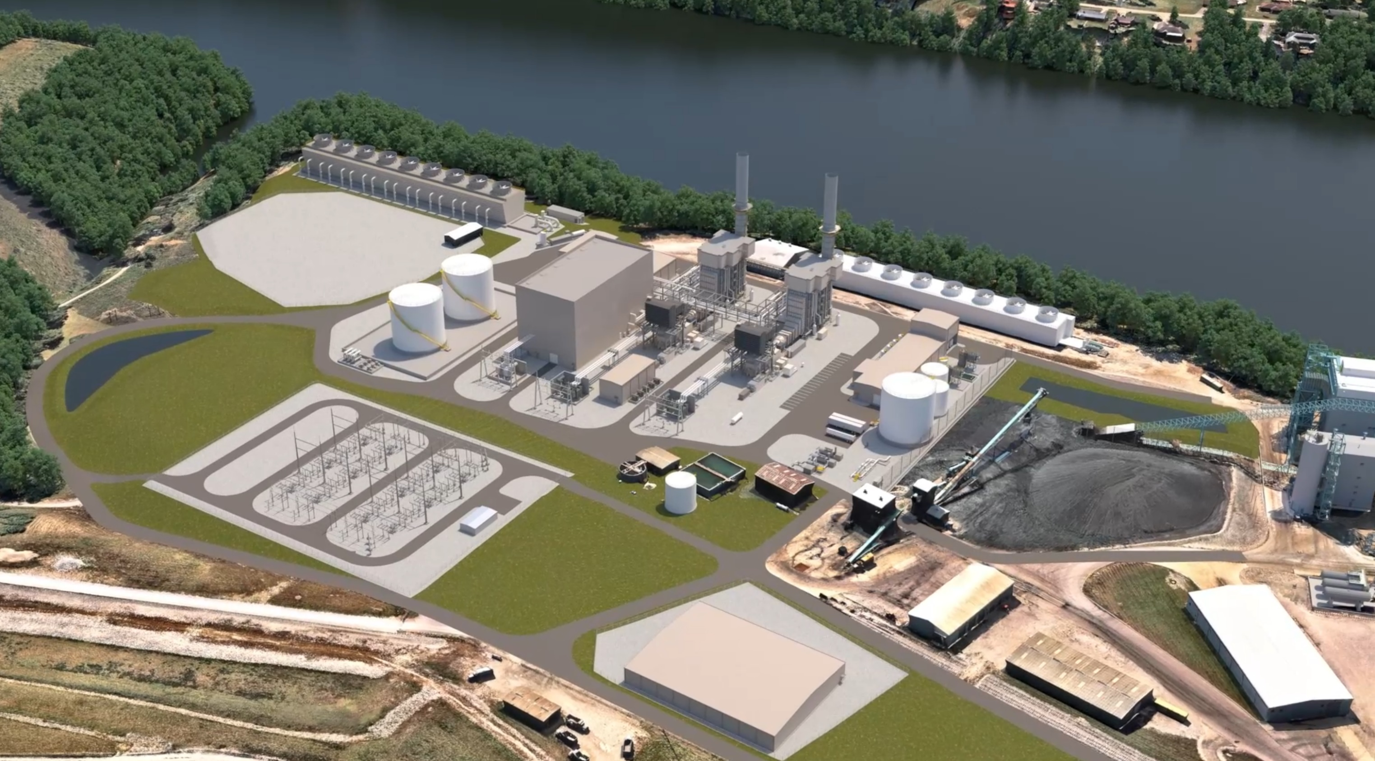
EKPC: Power Supply
Unit 3, Cooper Station
Burnside, Ky. (Pulaski County)
745 MW Combined Cycle Unit
Natural Gas Fired
$1.3 Billion Investment
Commercial Operation December 2030

Slide 7
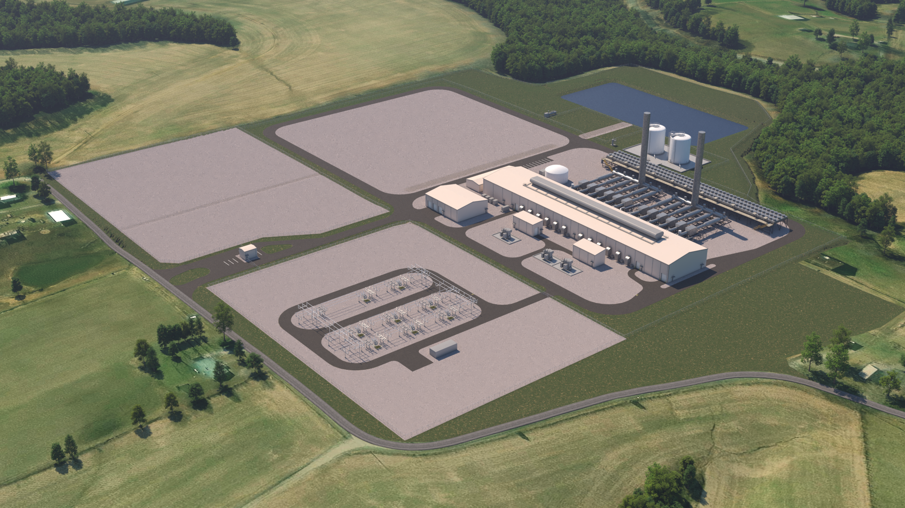
EKPC: Power Supply
Liberty Station
Liberty, Ky. (Casey County)
214 MW, 12 Reciprocating Internal Combustion Engines (RICE)
Natural Gas Fired
$500 Million Investment
Fully commissioned December 2028

Slide 8
EKPC: Power Supply
Co-fire Projects
Unit 2, Cooper Station
Units 1 – 4, Spurlock Station
Compliance with GHG Rule
Cooper - $73.8 Million
Spurlock - $187 Million
Commercial Operation December 2029

Slide 9
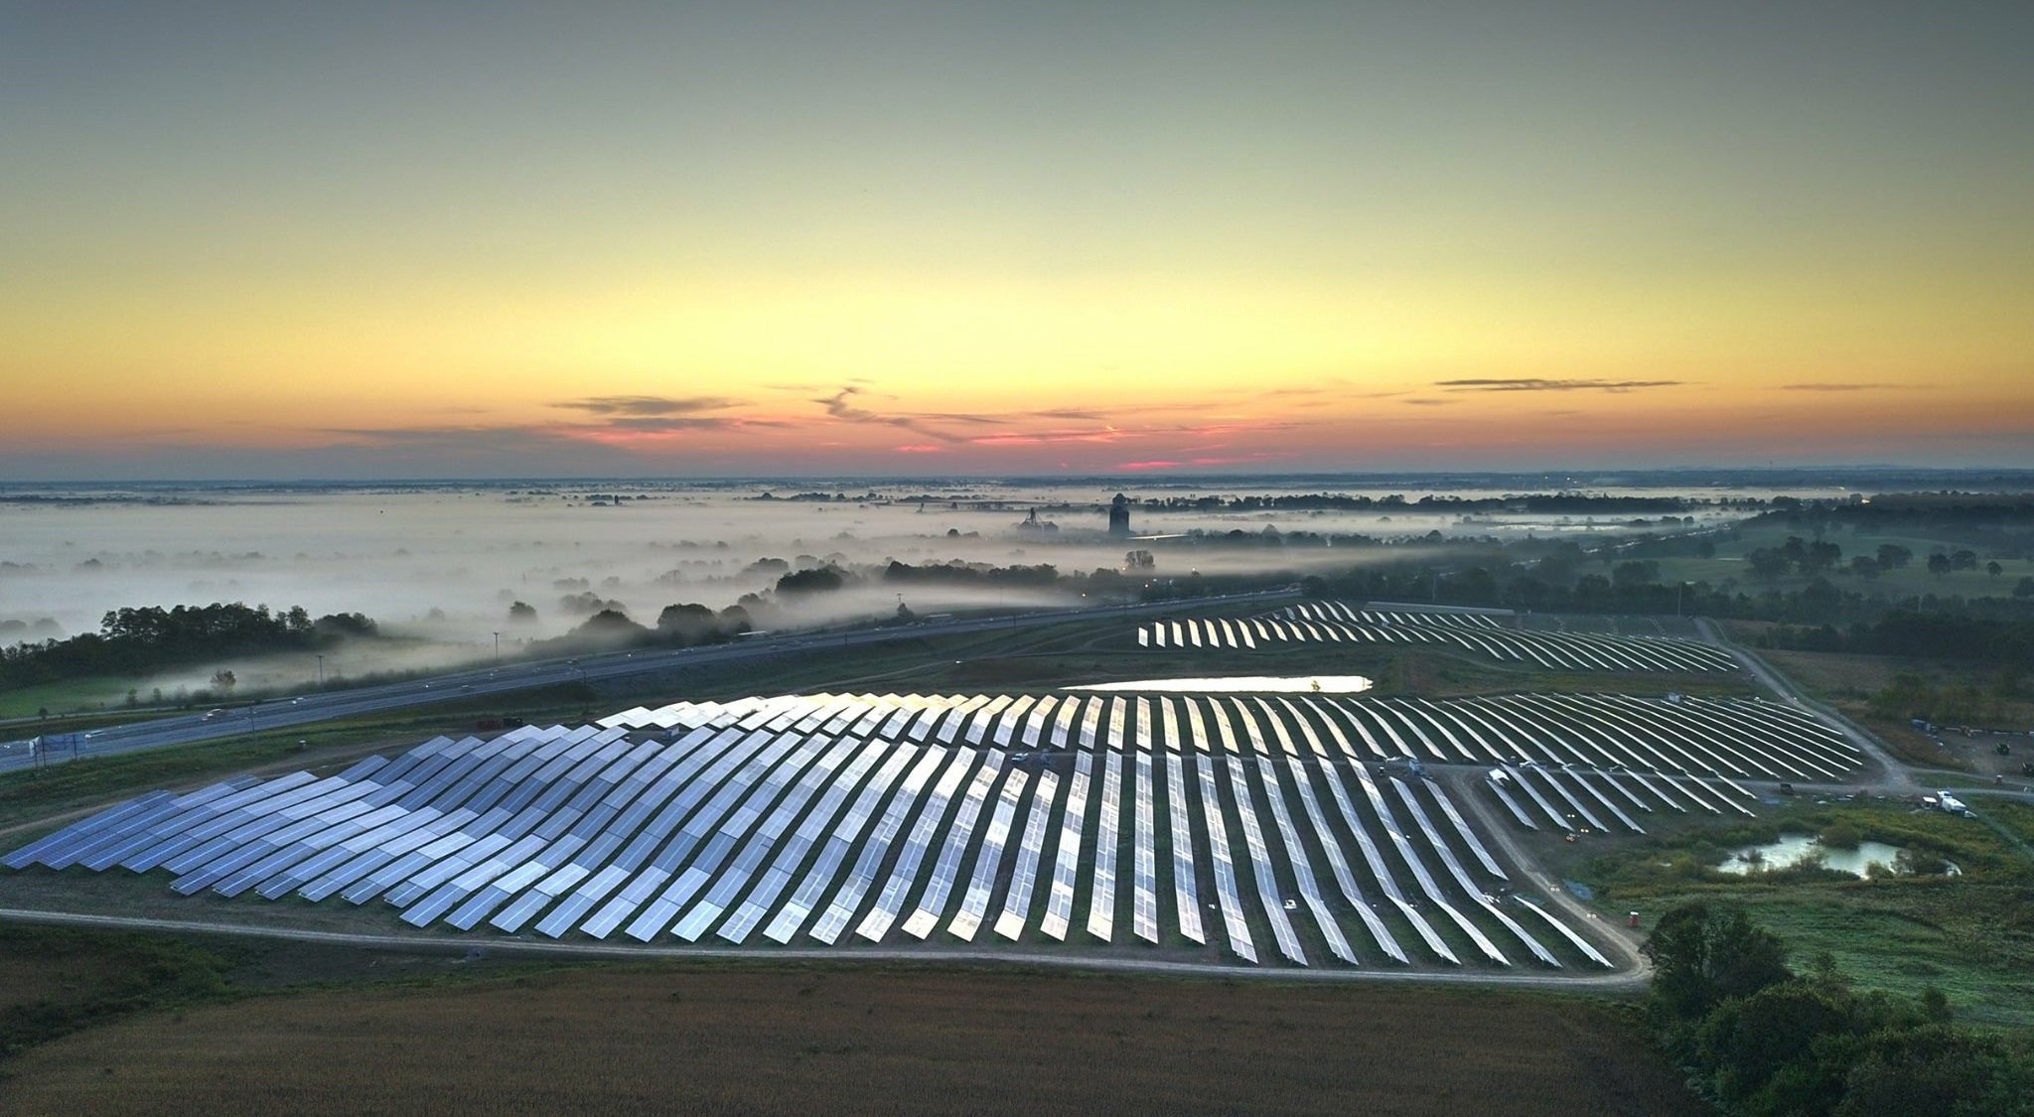
EKPC: Power Supply
Cooperative Solar
Farm Two – Fayette and Three – Marion approved, 136 MW
Farm Four – Star Hill Farms 0.5 MW
New ERA Additional Solar
www.cooperativesolar.com

Slide 11
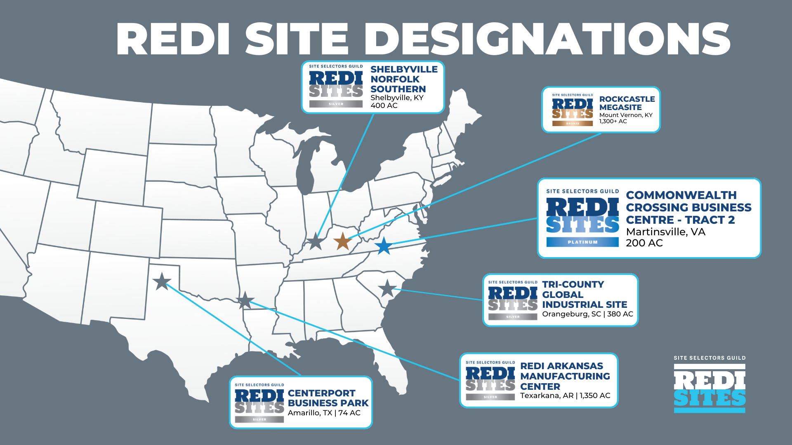

Slide 12
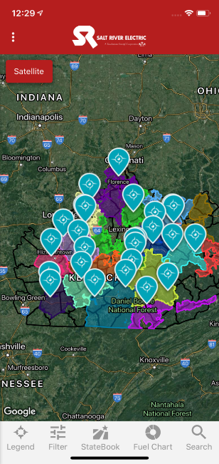
Economic Development Impact Totals
Since 1/1/2015
Announced
Investment
Over $13.77 Billion
Announced
Jobs
Over 20,000
Increased Industrial
Electric Load
Over 46.5%

Slide 14
Notes:
Need high res photo

