Slide 1
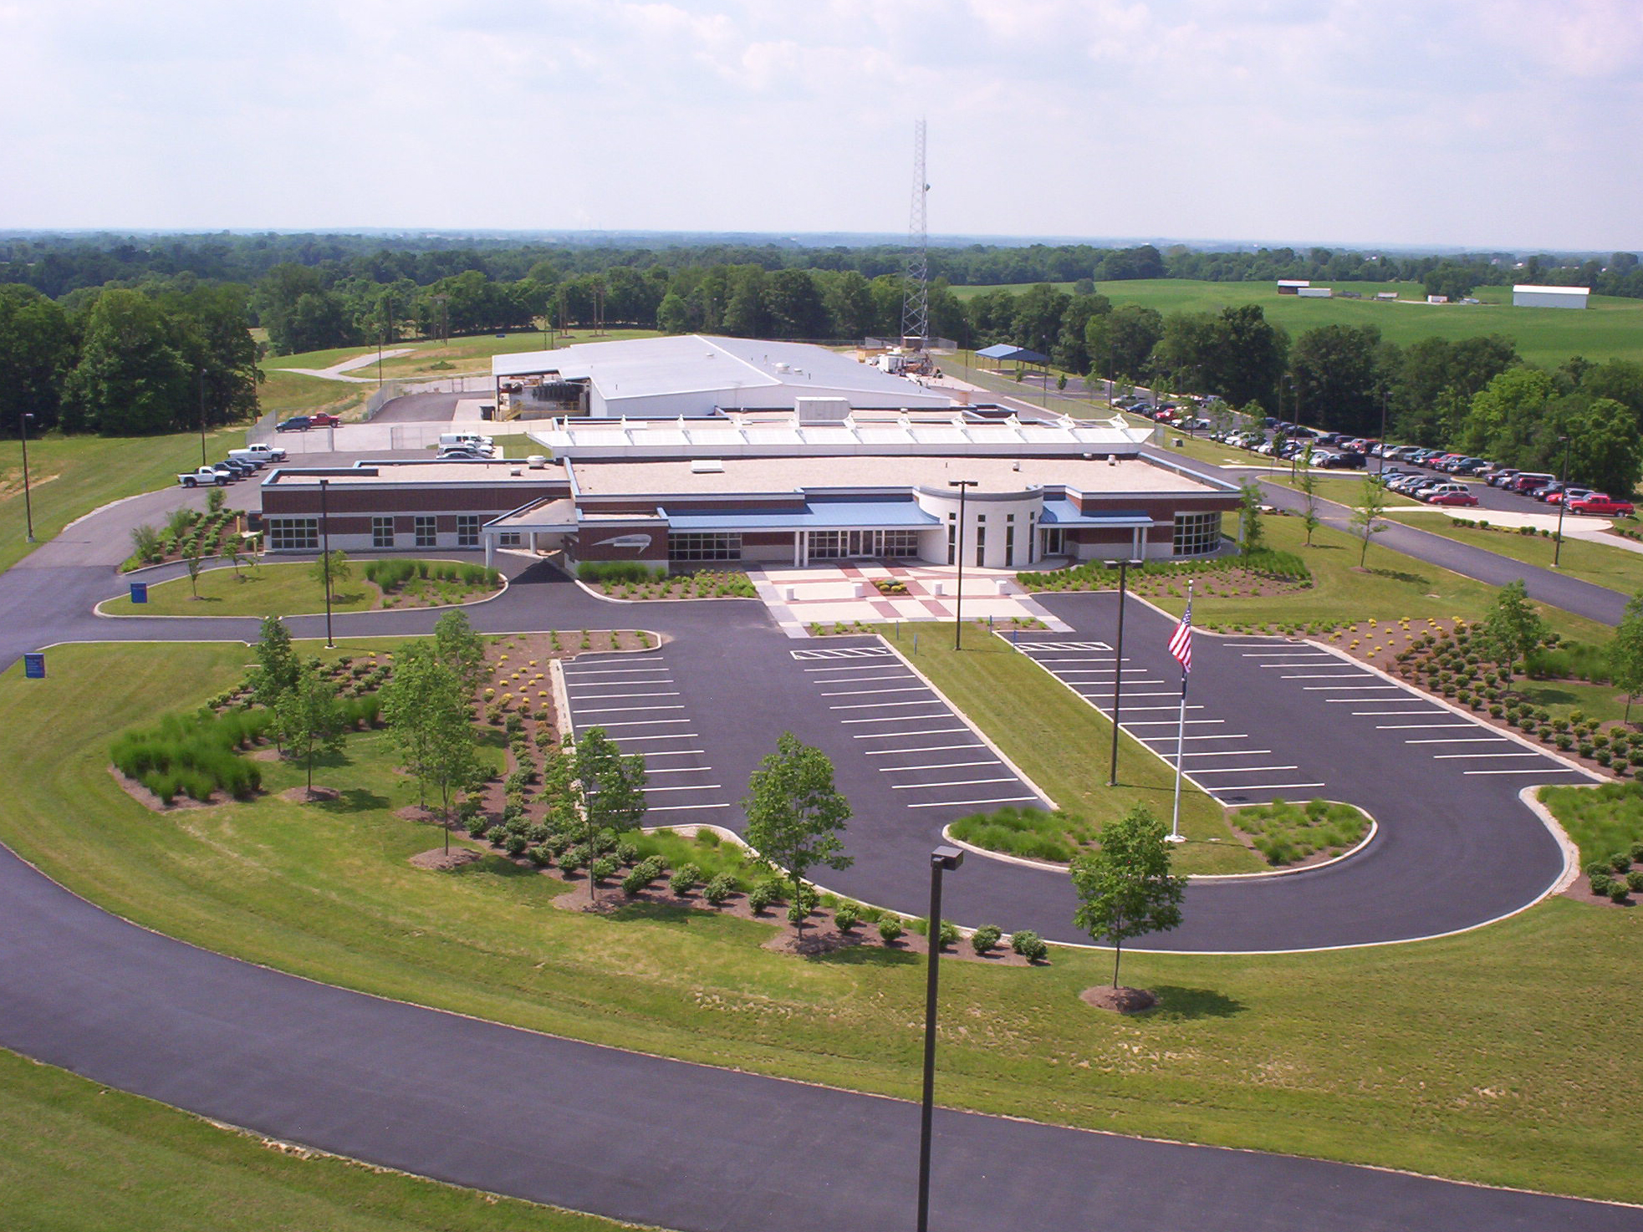

Slide 2
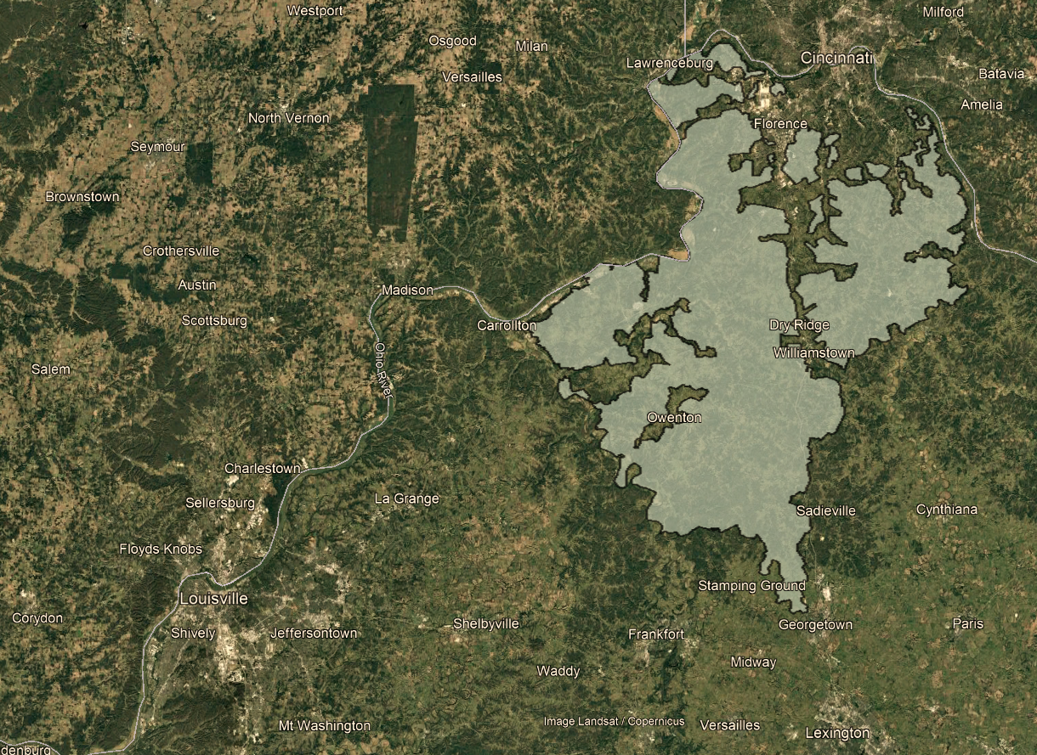
BOONE
KENTON
CAMPBELL
powers communities in 9 north-central KY counties
owned by 55,000 members
Serves > 67,000 meters
> 350 MW of industrial load
supports over 3,000 commercial/industrial operations
GALLATIN
PENDLETON
CARROLL
GRANT
OWEN
SCOTT

Slide 3
