Slide 1

Kentucky PFAS Drinking Water Update for the
Interim Joint Committee on
Natural Resources and Energy
Amanda W. LeFevre, Deputy Commissioner
Department for Environmental Protection
June 4, 2026

Slide 2
Per-/Poly Fluoroalkyl Substances (PFAS)
PFAS are a group of chemicals first developed in the 1940s that have been widely used around the world.
  They consist of a carbon-fluorine bond, which is very strong.
  They allow products to be resistant to heat, oils, stains, and water.
They have been widely used in consumer and industrial products.
  Food packaging and paper products
  Aqueous Film Forming Foam (AFFF)
  Industrial products
Because of the strong bond, PFAS do not break down in the environment, so they migrate readily in groundwater and accumulate in aquatic organisms.

Slide 3
Drinking Water Sampling
The Energy and Environment Cabinet (Cabinet) began sampling drinking water in 2019
The US Environmental Protection Agency (US EPA) issued National Primary Drinking Water Regulations in 2024
The US EPA requires initial monitoring to determine compliance monitoring frequency and the need for PFAS treatment
The Cabinet is currently monitoring 17 systems with at least one result above the current EPA Maximum Contaminant Levels (MCLs)*
Less than 10% of public water systems that produce drinking water in Kentucky have had at least one result above an MCL*
* Based on available data from the Cabinet and the US EPA’s Fifth Unregulated Contaminant Monitoring Rule results, and evaluated using the US EPA’s
guidelines for significant figures and rounding

Slide 4
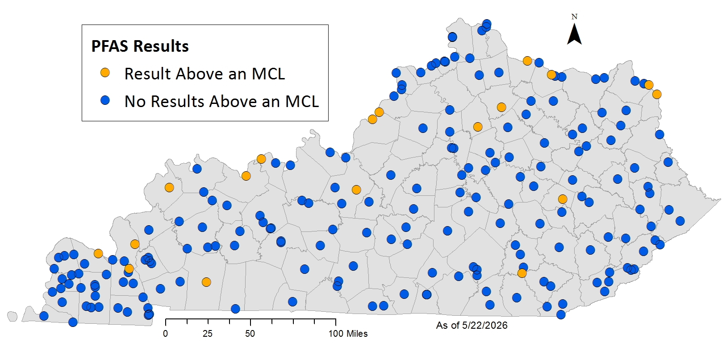
Drinking Water Results
Water Treatment Plants with at Least One Result Above the 2024 PFAS MCLs
Results based on US EPA compliance guidelines for significant figures and rounding, and data collected since 2019.
Permanently closed plants have been removed.

Slide 5
National Primary Drinking Water Regulations
Maximum Contaminant Levels | 2024 Final Rule | 2026 Proposed Rule Updates
PFOA | 4.0 ppt (parts per trillion) | No change
PFOS | 4.0 ppt | No change
PFHxS | 10 ppt | Rescind
PFNA | 10 ppt | Rescind
HFPO-DA (GenX) | 10 ppt | Rescind
Mixture of two or more: PFHxS, PFNA, HFPO-DA, PFBS | Hazard Index: 1 | Rescind
Deadlines
Initial monitoring completed | April 2027 | No change
Compliance with the MCLs | April 2029 | April 2029 Systems may request an extension to April 2031

Slide 6
Drinking Water Treatment and Potential Costs
US EPA-approved treatment options for PFAS:
  Granular activated carbon (GAC), anion exchange, reverse osmosis (RO), and nanofiltration
Estimated capital costs for PFAS treatment: $2.5 million - $30 million
Annual operation and maintenance costs per system: $350,000 - $2,000,000
based on plant capacity*
Examples of treatment costs:
Water System | Treatment Technology | Costs
Crittenden-Livingston Water District | GAC | $7.9 million
Cynthiana Municipal Water Works | GAC | $14.3 million
Morganfield Water Works | GAC | $8.1 million
Lewisport Municipal Water Works | RO Water Treatment Plant | $18.0 million
* Based on US EPA estimates for a granular activated carbon system

Slide 7
Federal Funding for PFAS in Drinking Water
Emerging Contaminants in Small or Disadvantaged Communities Grant
  2022-2026 allocation for Kentucky: $53.7 million
Drinking Water State Revolving Funds – Emerging Contaminants
  2022-2026: $34.3 million available for public water systems

Slide 8
Additional PFAS Monitoring
The Cabinet continues to collect data to protect public health
PFAS sampling is part of ambient monitoring programs for rivers and groundwater
  Many of these waters are sources for drinking water
Fish tissue sampling is targeted toward known fishing locations
  PFOS has been detected in every sample
The Cabinet has provided sampling at private wells near certain known PFAS releases

Slide 9


Drinking Water Exposure Route
The Top Priority
The Cabinet continues to support public water systems in addressing PFAS in drinking water
  Technical assistance and sampling for systems with higher results
  Sampling at small systems to meet federal initial monitoring requirements
  The Cabinet has provided ongoing sampling assistance to 49% of systems at present
PFAS results are available on the Kentucky PFAS Explorer
Drinking water information and reports are available at
https://eec.ky.gov/PFAS

