Slide 1
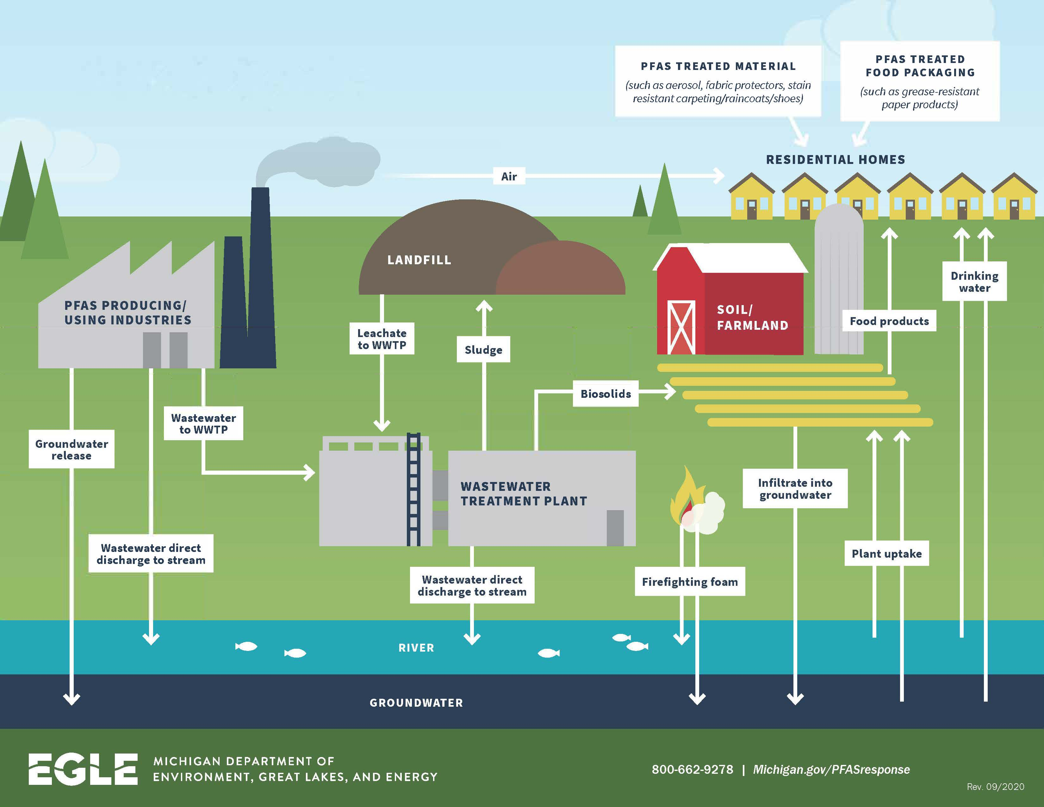
Notes:
PFAS are called “forever chemicals” because of their resistance to breaking down in the environment.
Once farmers spread sludge on their fields, PFAS can then be taken up by plants
From there, they make their way to us either by the plants being consumed directly or fed to livestock which we then eat
PFAS can also leach into water which can then be consumed directly by people, livestock, or put back on fields, including nearby farms, through irrigation
PFAS can also be spread through the air through emissions from industrial facilities or volatilization from contaminated soil or water and then deposited atmospherically onto farmland
Due to the bioaccumulative nature of PFAS in our systems, the health impacts can be ubiquitous.

Slide 2
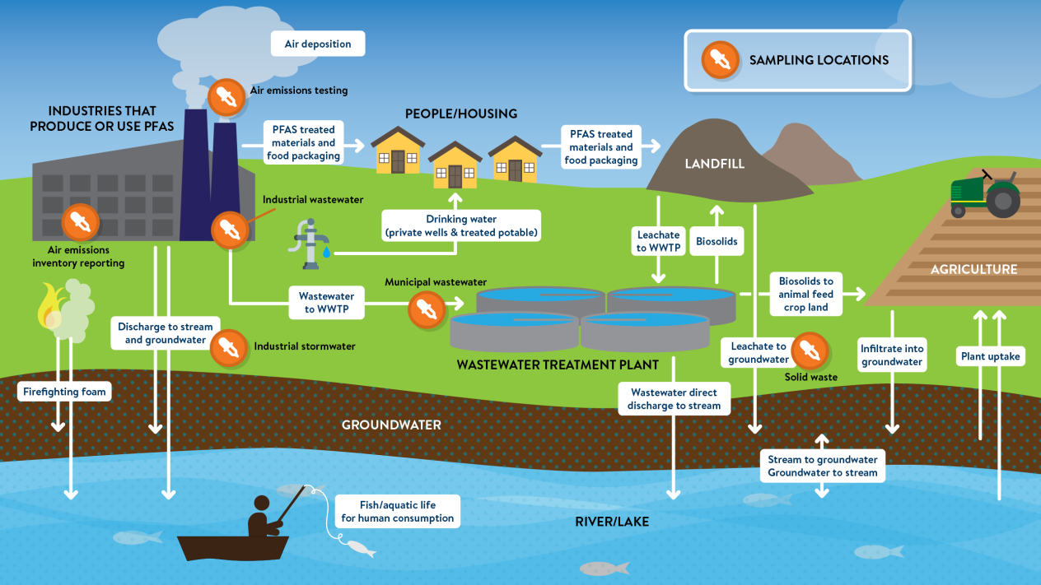
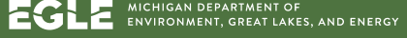
Notes:
Important to note where in the PFAS Cycle to sample. These include:
Air emissions testing at the facility site
Testing at Industrial wastewater sites
At Industrial stormwater sites
At municipal wastewater sites
The impact of these different sources on soil PFAS levels will vary. A single application of an amendment would likely have less of an impact than ongoing application of contaminated amendments or water.
So the basic questions for farmers will be:
How can I test my soil for PFAS?
How can I test my water for PFAS?
What do I do if I find PFAS in my soil or water?
Which brings me to the policy arena and some possible solutions

Slide 3
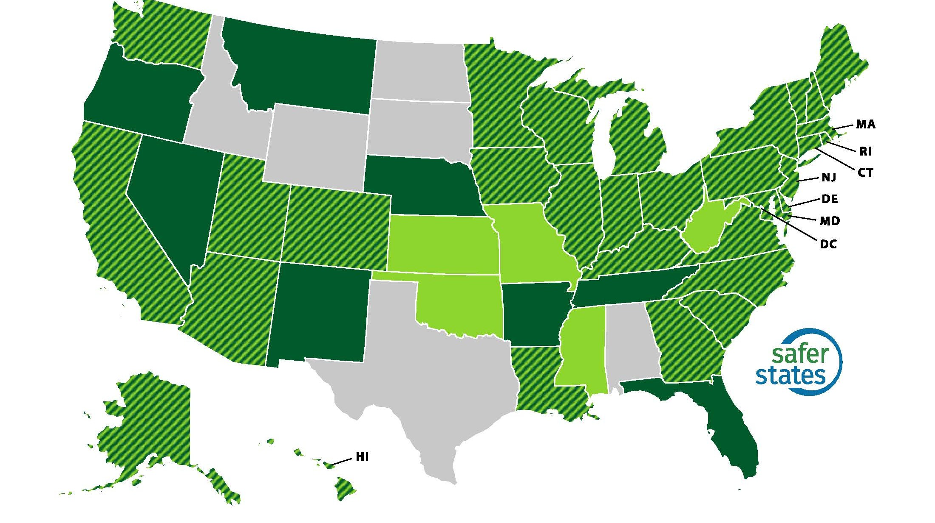
Introduced
Adopted
Introduced & Adopted
Notes:
40 states, adopted over 400 policies

Slide 4

Maine
(state-level)
PFAS in Products Program:
Mandates manufacturers to report products containing intentionally added PFAS to the Maine Department of Environmental Protection.
Prohibition of PFAS in Products:
Starting January 1, 2032, Maine will ban the sale of products with intentionally added PFAS, except for cases where the DEP identifies specific uses as "currently unavoidable." This determination will be reviewed every five years to adapt to technological advancements and availability of alternatives.
Pesticide Regulations:
Effective January 1, 2030, Maine prohibits the sale and distribution of pesticides containing PFAS, aiming to prevent environmental contamination from agricultural sources.
Drinking Water Standards:
The Maine Center for Disease Control and Prevention has established Maximum Contaminant Levels (MCLs) for six PFAS compounds in public water systems, ensuring safe drinking water for residents. Public water systems are required to monitor and report PFAS levels, with remediation plans mandated if concentrations exceed the set MCLs.
Notes:
Maine was the first state to in the country to ban PFAS “forever chemicals” in all products in 2021 and has led the way with regard to state level policies to address PFAS contamination, including in drinking water, products with intentionally added PFAS, and in pesticides.
In 2022, Maine was the first state in the country to ban the spreading of PFAS-Laden Sludge and sludge-derived compost as fertilizer. ]
The bill included $60 million dollars to set up a fund for impacted farmers, which would help with income replacement, buyback funds, medical monitoring funds (for both farmers and impacted well owners), and funding for research on cropping alternatives and an additional $9.2 million dollars to increase testing capacity and provide more staff to the Department of Agriculture, Conservation, and Forestry.

Slide 5

Kentucky
2021—2023:
Called for the Cabinet to promulgate administrative regulations establishing maximum PFAS chemical limits and monitoring requirements for drinking water and for discharges into the waters of the Commonwealth.
Required that maximum PFAS chemical limits be designed to protect public health and be updated
2024—2026:
Establish a PFAS Working Group to: (a) Review the latest research on the effect that exposure to PFAS has on health outcomes amongst individuals within the Commonwealth; (b) Share state-level data gathered from studies conducted by members of the working group and others within the Commonwealth; (c) Consult with any federal, state, or local agencies, nonprofit organizations, private industry, or other impacted stakeholders on the presence and effect of PFAS within the Commonwealth; and, (d) Develop recommendations for the mitigation of the effect of PFAS on health outcomes in the Commonwealth.
Notes:
Many of the approaches that Maine has taken, as well as other states, with regard to PFAS in drinking water, consumer products, and pesticides are also provisions that have been considered in PFAS related legislation that I have filed.
A lot of my bills in particular are about starting the conversation. The first bill I filed was in 2021, and all it sought to do was direct our Energy and Environment Cabinet to monitor and regulate PFAS levels in our drinking water (based on federal guidelines) as well as prohibiting use of personal protection equipment for firefighting or firefighting training that contains intentionally added PFAS chemicals. I had bipartisan support for this legislation and filed it again in 2022 and 2023. Nobody was really talking about PFAS on a policy level in Kentucky at that time, and it was a lot of conversations just to explain what PFAS were.
In 2024 and 2025, my legislation around PFAS evolved to focus on identifying concentrations of PFAS throughout Kentucky based on health outcomes. The legislation would establish a PFAS Working Group; a reporting requirement for manufacturers that intentionally include PFAS in products manufactured for sale or distribution in the Commonwealth; a reporting requirement for PFAS release in the Commonwealth by manufacturers that intentionally include PFAS in manufactured products; and establish penalties for noncompliance with reporting requirements.
Attached to the Cabinet for Health and Family Services. The working group would include the commissioners of the Department for Public Health, Department for Environmental Protection, Department of Fish and Wildlife Resources, executive director of the Public Service Commission, director of the University of Louisville Center for Integrative Environmental Health Sciences, University of Kentucky Superfund Research Center, executive director of the Kentucky Conservation Committee, executive director of the Kentucky Resources Council, president of the Kentucky Association of Manufacturers, president of the Kentucky Retail Federation, 3 House Members and 3 Senators, AND county judges/executives for each of the five (5) counties with the highest PFAS chemical concentrations in their community public drinking water treatment plants.
Point is to get these people in a room to share data and strategy and to have accountability.

