Slide 1
Low-Income Home Energy Assistance Program (LIHEAP)
27 FFY Preliminary State Plan
Shannon Hall, Executive Advisor, DCBS
Roger McCann, Director, DFS
July 2, 2026

Slide 2
LIHEAP
Low-Income Home Energy Assistance Program - established in 1982
Created to help households with the lowest incomes that pay a high proportion of their income for home energy
Program Goals:
  Helps households manage high energy costs
  Reduces disconnects
  Reduces need for assistance through weatherization
  Promotes responsibility through "Assurance 16"

Slide 3
LIHEAP
LIHEAP funds spent to date FFY 2026 total $46.9 million
Anticipated amount of funding for FFY 2027 is $54 million*
100% federally funded
Payments are made directly to vendors / utilities, no cash payments are made to households
*President's proposed FFY27 budget would eliminate LIHEAP program

Slide 4
LIHEAP
$64,000 is retained by DCBS for the Preventive Assistance Program to assist families receiving child protective services with a needed energy payment
Up to 15% of the amount can be allocated for weatherization
Up to 10% of the amount can be used for administrative costs

Slide 5
LIHEAP Eligibility
150% of the 2026 Federal Poverty Guidelines (percent of poverty)
Household Size | Monthly Income
1 | $ 1,995
2 | $ 2,705
3 | $ 3,415
4 | $ 4,125
5 | $ 4,835
6 | $ 5,545
7 | $ 6,255
8 | $ 6,965
For each additional household member above 8, add $710 to the monthly income limit.

Slide 6
LIHEAP Components
LIHEAP offers the following types of benefits to Kentucky citizens:
Bill payment assistance for heating and cooling:
  - Subsidy component
  - Crisis component
Emergency assistance
Weatherization activities to increase the energy efficiency, health, and safety of eligible low-income individual’s dwellings

Slide 7
LIHEAP Fall Subsidy
One time credit on the household's bill
Prevents disconnects during colder winter months
Benefits are a fixed amount based on energy type and household income
Application process begins in early November, ending Mid-December
  Early applications accepted in October for the elderly and individuals with disabilities
  Appointments are available for working individuals
No payments are made to households

Slide 8
LIHEAP Winter Crisis
Assistance to prevent crisis disconnects
Household must demonstrate a crisis, such as "disconnect notice"
Application process begins early January through mid-March or longer pending availability of funding
Benefits are limited to the amount necessary to relieve the crisis
Maximum amount is capped based on the fuel type
No payments are made to households

Slide 9
LIHEAP Spring and Summer Subsidy
Prevents disconnects during summer months
Offsets home cooling costs (Electric utilities)
Benefits are a fixed amount based on household income
Application process is during spring and summer months pending availability of funding

Slide 10
SFY 2026 LIHEAP Components
56,956 households received Summer Cooling Subsidy Benefits
-Average benefit: $164
-Total of $9.3 million
63,681 households received Fall subsidy Benefits
- Average benefit: $157
-Total of $10 million
68,617 households received Crisis Benefits
-Average benefit: $356
-Total of $24.4 million
45,761 households received Spring Subsidy Benefits
-Average Benefit: $164
-Total of $7.4 million

Slide 11
LIHEAP Weatherization Program
Increase energy efficiency
Reduce energy costs of dwellings
Reduce need for other assistance programs
Reduces risk of utility disconnect
Improves Health and Safety

Slide 12
LIHEAP Weatherization
Partnership with Kentucky Housing Corporation (KHC)
Funds home repairs related to energy efficiency
Serves low-income households if income does not exceed 200% of the Federal Poverty Guidelines
Two hundred and seventy-two (272) homes weatherized from July 2025 through May 31, 2026
Average benefit of $11,875 using a combination of Division of Energy (DOE) and LIHEAP funds.

Slide 13
Weatherization Priorities
Households containing elderly, disabled, or children
Households with young children at risk of removal from the home due to substandard conditions

Slide 14
Weatherization Measures
Measures are evaluated by "Savings to Investment Ratio or SIR"
  "return on investment"
Common Weatherization Activities or “Measures"
  Air sealing
  Insulation
  Caulking

Slide 15
Weatherization Health and Safety
Testing for gas leaks, carbon monoxide, and other health and safety issues
Checking combustible appliances, such as stoves, furnaces, and water heaters
Installing fire and carbon monoxide detectors

Slide 16

LIHEAP and Community Action

Slide 17
LIHEAP and Community Action
LIHEAP is operated in partnership with Community Action Kentucky, Inc. (CAK)
23 subcontracting agencies
Kentucky’s Community Action Agencies administer LIHEAP assistance in all Kentucky counties

Slide 18
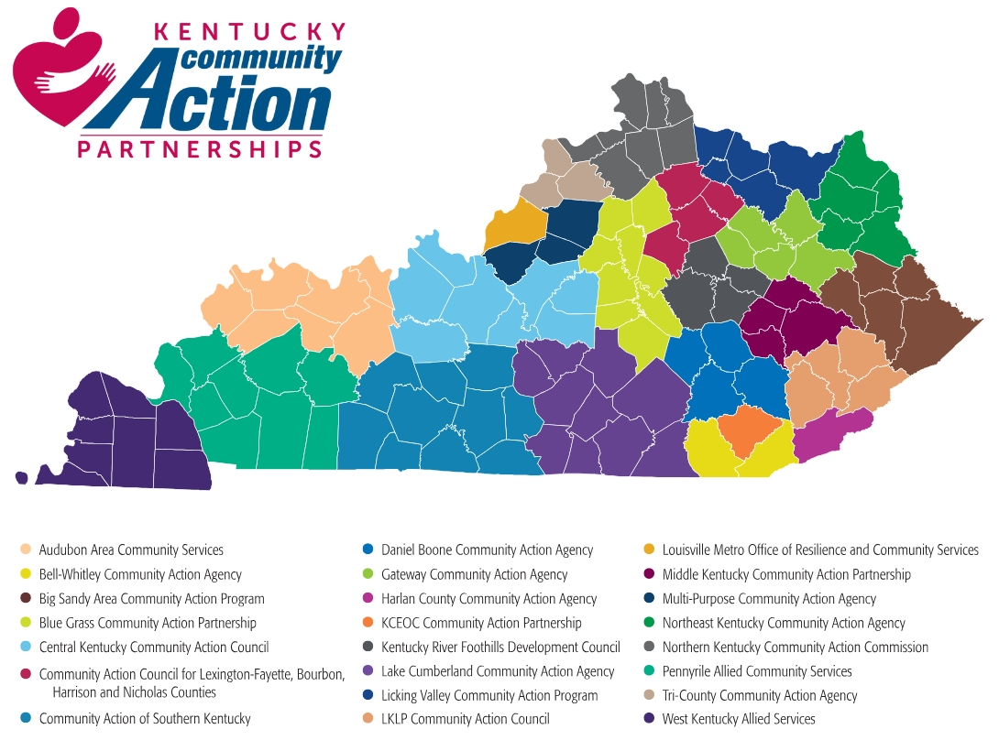

Slide 19

Questions

