Slide 1
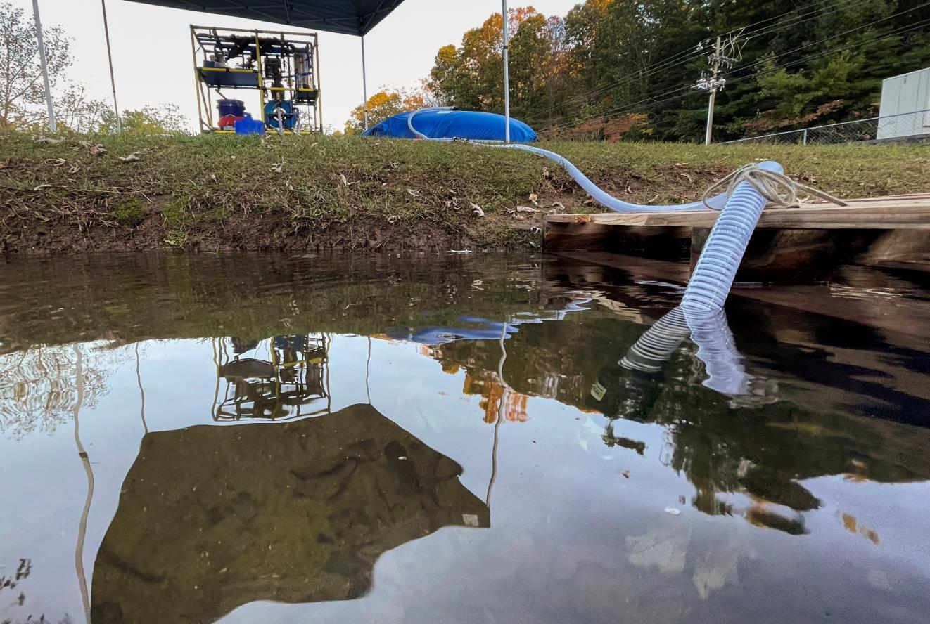

KENTUCKY LILYPAD
INITIATIVE
Legislative Presentation
Frankfort, Kentucky · July 2, 2026
Jason Underwood
Mark Hogg
Steve Combest

Slide 2
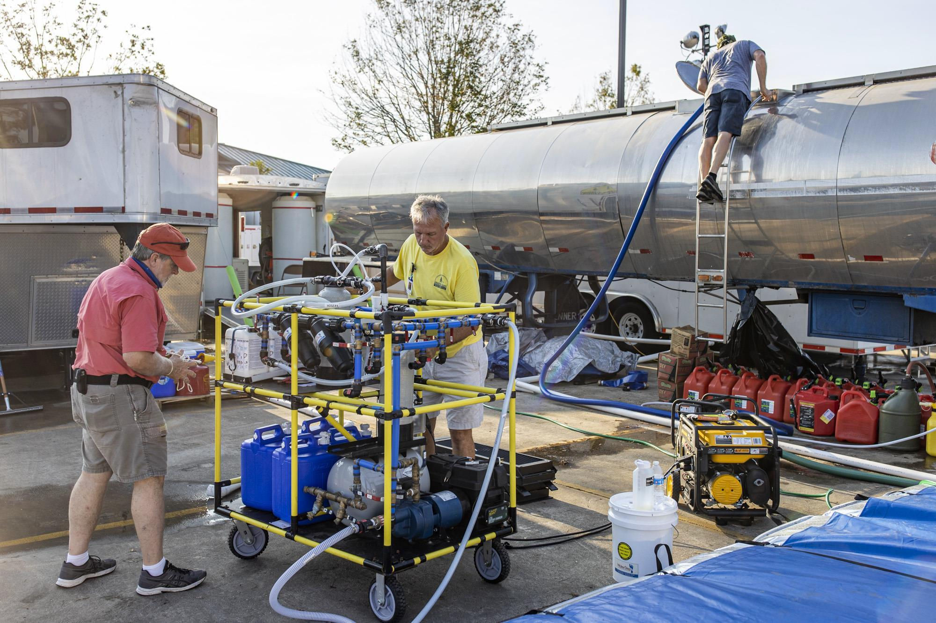
MARK HOGG
1
WaterStep · Founder & CEO
“When the water stops, everything stops.”

Slide 3
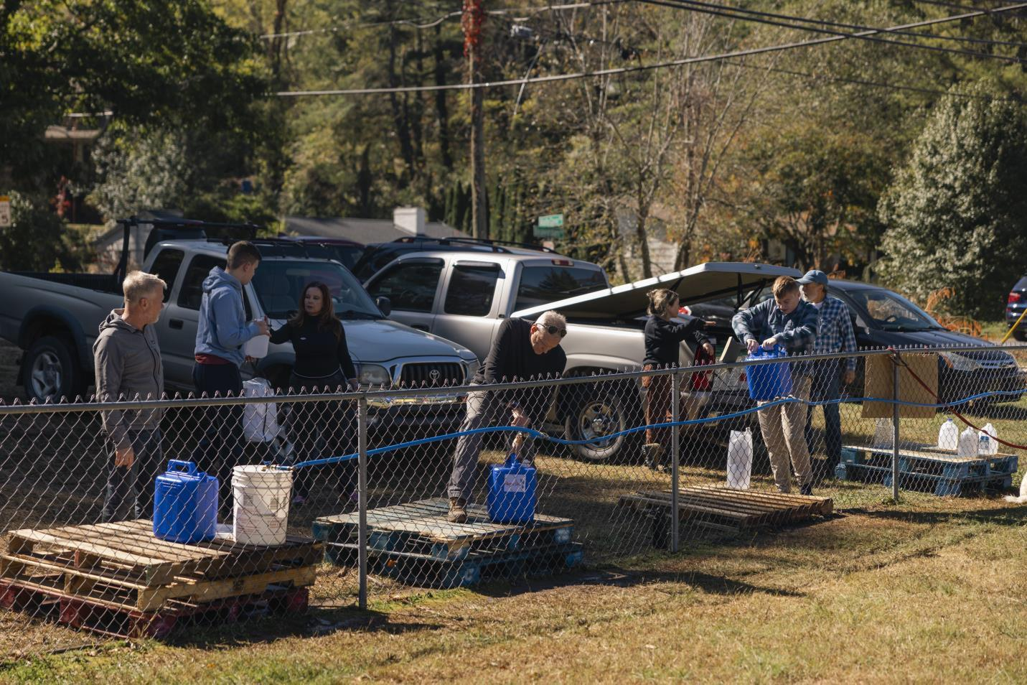


Kentucky has the partners.
Kentucky has the relationships.
Kentucky has the need.
What Kentucky needs now is the investment.

Slide 4

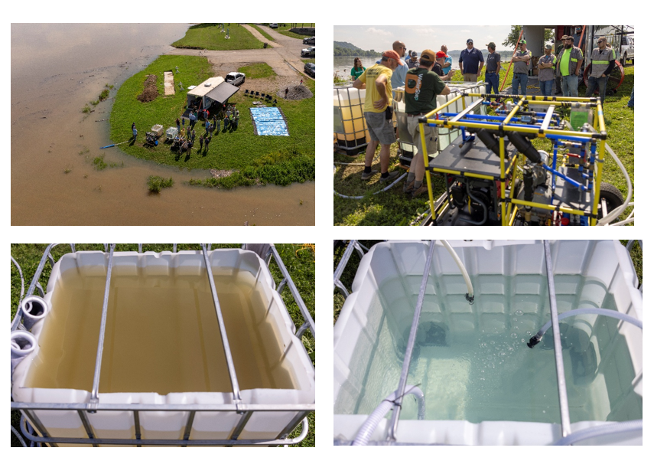
2
STEVE COMBEST
WaterStep · COO
“We didn’t show them a video. We drank the water.”

Slide 5

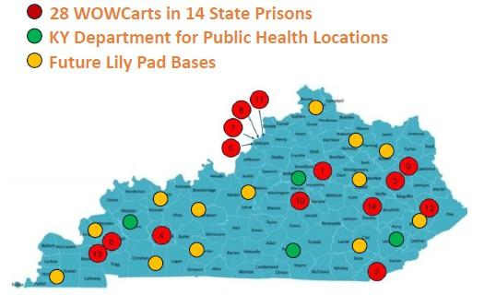
Kentucky’s LilyPad Network
Statewide coverage — one Mission-Ready Safe Water Package
in every EOC region
3
MARK HOGG
WaterStep - Founder & CEO
$10M 5-YEAR APPROPRIATION
“Director Gibson gave us the roadmap…
we are asking you to fund it.”

