Slide 1

Applications for Energy Storage for Data Centers
Why the backup battery stopped being a backup battery
Rodney Andrews, PhD, PE
Director, Center for Applied Energy Research
Senior Associate Vice President for Research
Notes:
15 minutes. Three acts: why, what, who.
Opening line: for fifty years a data center battery did exactly one job. In the last three years it picked up four more. That is the whole talk.

Slide 2
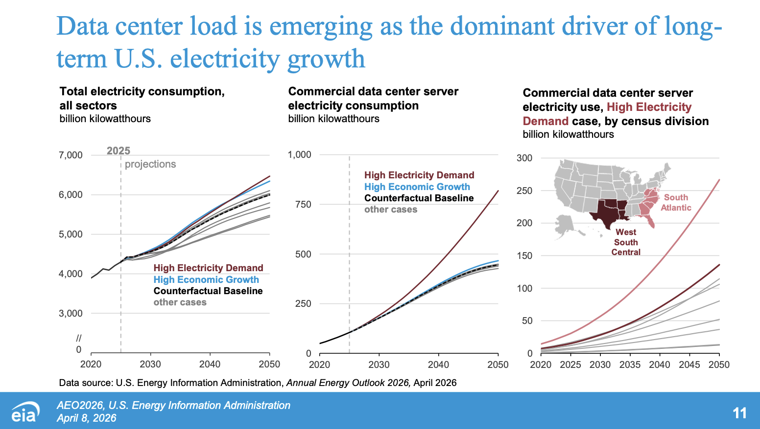
Long-term driver for energy demand
Long-term growth

Slide 3
But… data center demand is still small in 2050
This will be enough to cause issues if not planned well
Long-term growth

Slide 4
1
Why
What changed and why anyone is spending money on this

Slide 5
One job became five
Ride-through until the diesels start
10 s - 15 min
since 1975
Cooling ride-through
10 - 45 s
since 1975
Smoothing the AI load's own swings
1 ms - 10 s
NEW
Grid-facing energy and services
1 - 100 hours
NEW
Substituting for a grid connection
months - years
NEW

Slide 6
You can't get a grid connection
Build the data center
18 - 24 months
Get it interconnected
3 - 7 years
Storage installs on the short timeline and stands in for the missing connection. This is the driver moving the most money - not emissions, not arbitrage.

Slide 7
What a training run looks like to the grid
100%
67 MW
swing at the meter for a 100,000-GPU cluster
30%
one cycle = 1 to 10 seconds
what the cluster draws
what the grid was built for

Slide 8
Four more reasons that influence costs
3
Grid services revenue
The backup asset you already bought can earn money.
4
Demand response obligations
Increasingly written into the power contract itself.
5
Getting off diesel
Emissions targets, air permits, and community pressure.
6
Bill management
Demand charges run 30-70% of a commercial electricity bill.

Slide 9
2
What
The technology options and selection criteria

Slide 10
Nothing does all the durations
Supercapacitor
1 second
Flywheel
15 seconds
UPS battery
15 minutes
Li-ion BESS (LFP)
4 hours
CO2 battery
24 hours
Iron-air
100 hours
logarithmic scale
Beyond ~10 hours, lithium stops making sense: energy cost scales linearly with duration and there is no power/energy decoupling. That gap is the opening for iron-air, CO₂ and flow.

Slide 11
Applicable power ranges and discharge power duration of different energy storage technologies
D. Rastler, “Electric energy storage technology options: A white paper primer on applications, costs, and benefits,” EPRI, Palo Alto, CA, Tech. Rep. 1020676, 2010.
E. Barbour. (2014) Energy Storage Technologies [Online]. http://energystoragesense.com/energy-storage-technologies/

Slide 12
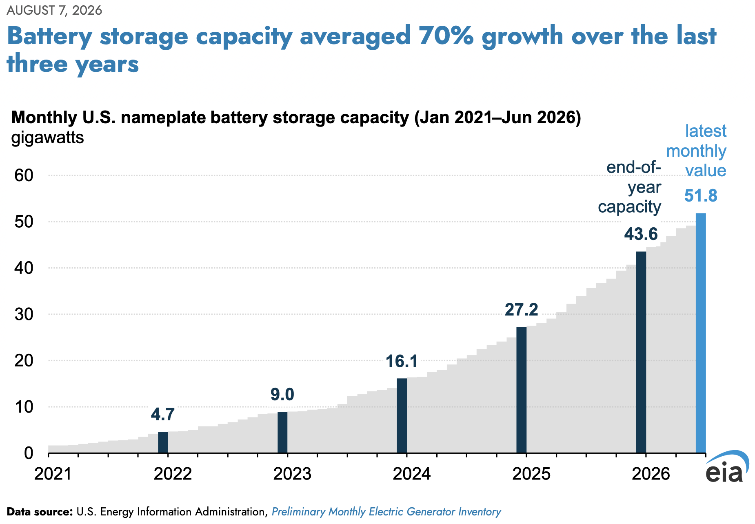

Large expansion in battery storage
Projected additional 54 GW through 2028
Long-term growth

Slide 13
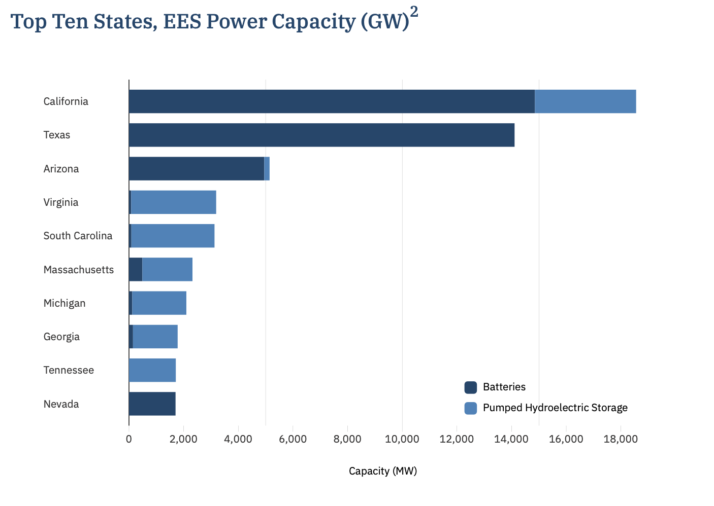
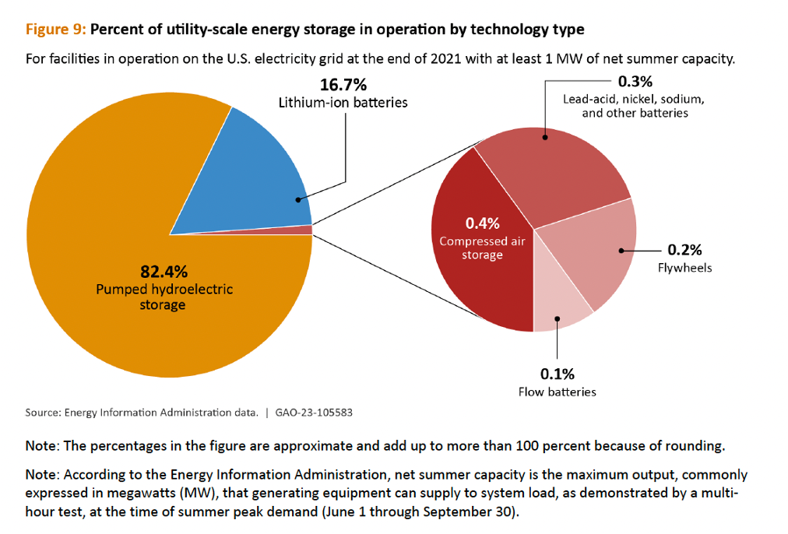
Batteries catching up with hydro storage
Storage technologies
Center for Sustainable Systems, University of Michigan. 2026. "U.S. Energy Storage Factsheet." Pub. No. CSS15-17.

Slide 14
Where it sits decides what it can do
Tier 3 - Outside the fence
hours to days
Containerized LFP - iron-air - CO₂ battery - flow - CAES
Tier 2 - The electrical room
seconds to 30 min
UPS batteries - lithium 54%, lead-acid 36%, nickel-zinc rising. Plus chilled-water tanks for cooling ride-through.
Tier 1 - Inside the rack
milliseconds to seconds
Supercapacitors - lithium titanate (LTO) - rack battery backup units - flywheels
Supercapacitors hold charge on carbon surfaces - no chemical reaction, so they cycle almost forever and store almost nothing. LTO trades energy density for 15,000+ cycles and abusive fast charging.

Slide 15
Lithium Iron Phosphate – safety wins
NMC - layered oxide
LFP - phosphate framework
Decomposition frees oxygen from the lattice. The oxygen feeds the fire, which frees more oxygen. The cell is its own oxidizer.
Oxygen is locked behind covalent P-O bonds and does not come out. Runaway onset ~270 C, against 150-200 C.
NMC brings its own oxygen to the fire. LFP doesn't.

Slide 16
Sodium-ion: real, and about two years out
What's good
What it costs today
Where it's made
No lithium. Sodium is abundant everywhere and cheaper to extract. Holds over 90% of capacity at -20 C, where LFP falls off badly. 10,000+ cycles.
LFP cells run about $70-80/kWh. Sodium-ion runs $70-120/kWh. It costs more, not less. Abundant materials set a lower cost floor, not a lower price today.
China holds over 95% of world sodium-ion capacity. Parity with LFP is projected for 2027-28. Natron, the US entrant, ceased operations in September 2025.
The cold-weather advantage is real and underrated.
The cost advantage is a 2028 statement, not a 2026 one.

Slide 17
The cheapest storage stores cold
The problem
The fix
When the grid drops, the UPS carries the IT load instantly. The chillers don't - they're on the generator bus.
A stratified chilled-water tank. Cold at the bottom, warm return at the top. Discharges instantly.
10 - 45 seconds with no active cooling
Hundred-year-old technology, suddenly load-bearing
At 80-130 kW AI racks this stops being a footnote and becomes a design constraint. And the economics are demand charges, not energy - those run 30 to 70 percent of a commercial electricity bill.

Slide 18
Fuel cells generate. They don't store.
They offer speed and may offer advantages over batteries. Someday.
55 days
2.8 GW
$2.65B
Bloom's delivery of a working
system to Oracle
Oracle master agreement,
1.2 GW already contracted
AEP 20-year offtake
for up to 1 GW
But solid-oxide fuel cells cost a premium per kWh against combined-cycle gas. Customers are paying it for speed and siting flexibility. Same motivation as the batteries, different physics.

Slide 19
Geothermal: skip the battery
Enhanced geothermal drills and fractures hot dry rock to circulates water through it. The output is firm and round-the-clock meaning no storage is needed whatever share of load it covers.
396 MW
~1 GW
2028
Fervo-Google power purchase
agreement, announced 1 Sept 2026
option to expand the same
agreement by June 2030
when Cape Station, Utah
delivers against it
Phase I begins delivering to the grid in late 2026, reaching about 100 MW by early 2027. Here firm generation and storage are competing for investment. Sept 1 announcement of Google Cape Station deal (Utah).

Slide 20
3
Who
Who is building out and what it cost them

Slide 21
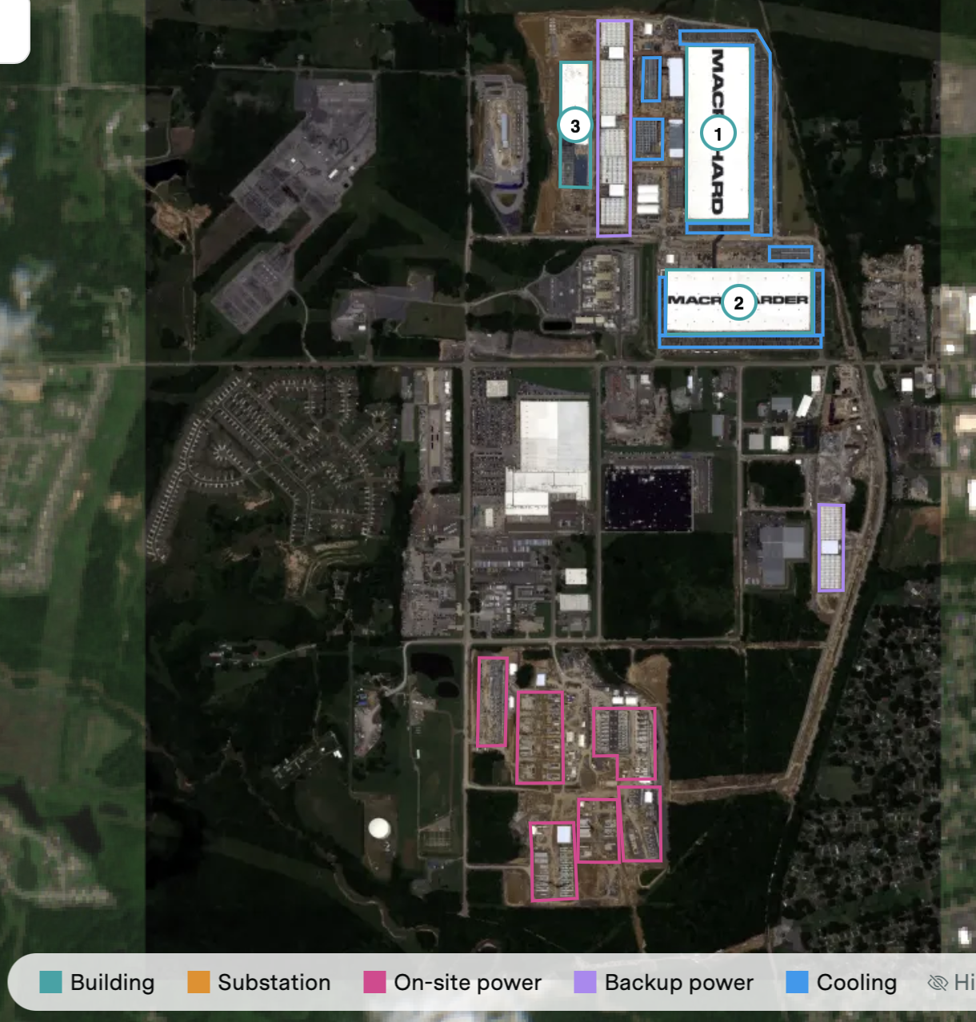
xAI Colossus, Memphis
156
Tesla Megapacks at Colossus 1
420 MW
of on-site gas turbines alongside them
97 days
to build a substation that normally takes 2.5 years
Nationally, about a third of announced on-site data center battery capacity is co-located with fossil generation. Storage is going in alongside gas, not instead of it.
Credit: Epoch AI

Slide 22
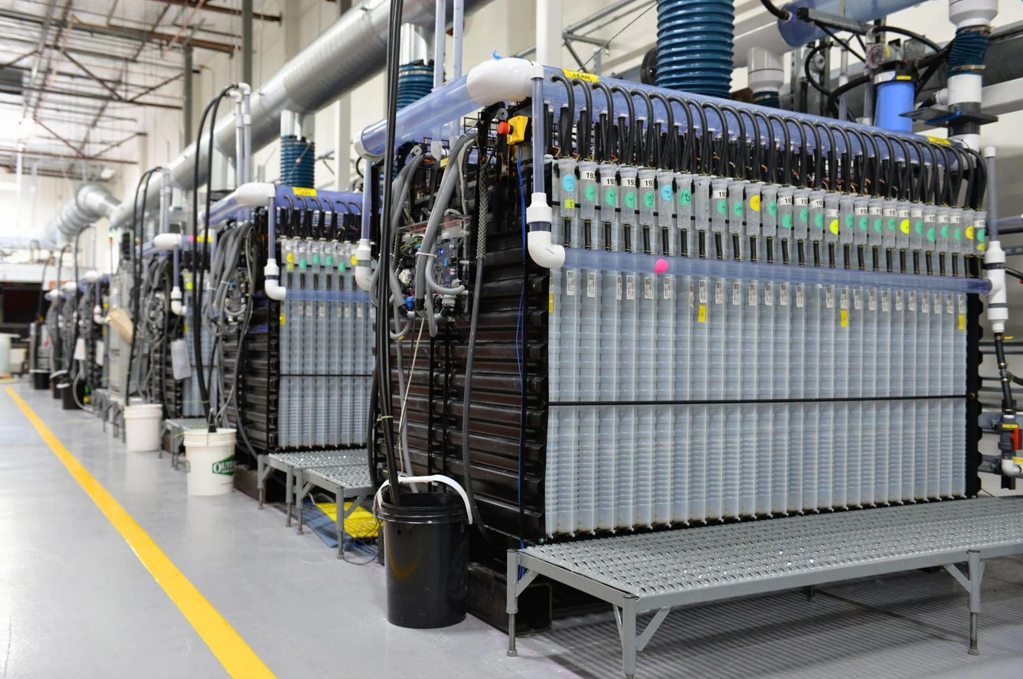
Google
1 GW
of contracted demand response across five utilities
30 GWh
of iron-air with Xcel at Pine Island, Minnesota
100 hours
of discharge - the largest yet announced, anywhere
Demand response and 100-hour storage solve the same problem from opposite ends: one moves the load, the other moves the energy.
Credit: Form Energy

Slide 23
Same battery, three different questions
$117
$219
$334
per kWh
per kWh
per kWh
Turnkey 4-hour system,
global average
Turnkey 4-hour system,
United States
Fully loaded US project -
labor, permitting, margin
Anyone quoting the first number to justify the third is going to have a bad day.
Turnkey figures: BloombergNEF, 2025. Fully loaded figure: NREL bottom-up benchmark, 2024 reference year.

Slide 24

Questions
Rodney Andrews
rodney.andrews@uky.edu

Slide 25
Two problems nobody has solved
Long-duration off-grid
Short-duration storage for a hyperscale facility is a solved, purchasable problem. Running one off-grid for days is not. There is no cost-effective long-duration option on the market - which is why every off-grid campus you hear about is really batteries plus gas turbines.
Waste heat
Capturing the heat is routine - district heating loops are common. Converting it into a form you can store and turn back into electricity is not solved. Beyond warming the building in cold weather, there is no good answer today.

Slide 26
Full technology comparison
Technology | Duration | Strength | Limit
Supercapacitor | 1 ms - 10 s | Cycles indefinitely, no chemistry | Holds almost no energy
Flywheel | seconds | No aging, outdoor-rated | Seconds only
Li-ion LTO | seconds - minutes | 15,000+ cycles, abusive fast charge | Low energy density, costly
VRLA lead-acid | 10 - 15 min | Cheapest capex, mature recycling | 4-5 yr life, needs 25 C room
Li-ion LFP | 15 min - 4 hr | 8-10 yr life, half the footprint | Higher capex, fire engineering
Nickel-zinc | 10 - 15 min | No thermal runaway pathway | Niche supply, higher $/kWh
Sodium-ion | 2 - 4 hr | Works cold, no lithium | Costs more than LFP today
Second-life EV packs | 2 - 4 hr | ~Half the installed cost | Heterogeneous state of health
Iron-air | up to 100 hr | Cheap, abundant materials | Low efficiency, large footprint
CO2 battery | 8 - 24 hr | No lithium, no geology needed | Early commercial
Vanadium flow | 8+ hr | Power and energy decoupled | Capex; supply concentration
CAES | 8 - 24 hr | 40+ years of operating history | 42-54% efficiency, geology-limited
Chilled-water TES | 10 - 45 s | Cheapest in the building | Large tank footprint

Slide 27
Acronyms
AGM
absorbed glass mat - a type of VRLA battery
NiZn
nickel-zinc
BBU
battery backup unit - one per server rack
NMC
nickel manganese cobalt
BESS
battery energy storage system
PCC
point of common coupling - the utility meter
BMS
battery management system
PPA
power purchase agreement
CAES
compressed air energy storage
PSC
Public Service Commission
EGS
enhanced geothermal system
SCR
selective catalytic reduction
GPU
graphics processing unit
SMES
superconducting magnetic energy storage
GW / GWh
gigawatt (power) / gigawatt-hour (energy)
SOFC
solid oxide fuel cell
HESS
hybrid energy storage system
TES
thermal energy storage
LFP
lithium iron phosphate
UPS
uninterruptible power supply
LTO
lithium titanate oxide
VRLA
valve-regulated lead-acid
MW / MWh
megawatt / megawatt-hour

