Slide 1
Green Solvents for Microplastics Removal from Water
Developing plant-based approaches for an emerging water-quality challenge
Jian Shi, Czarena Crofcheck, and Michael Montross
Biosystems and Agricultural Engineering
University of Kentucky

Slide 2
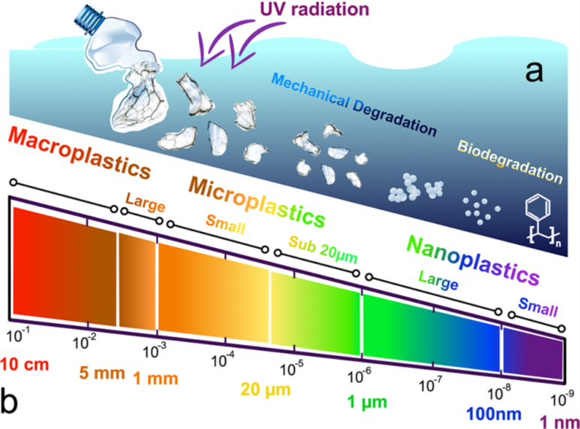
Microplastics: An Emerging Water-Quality Challenge
Microplastics are small plastic particles that persist in the environment.
The smallest particles are particularly difficult to detect and remove.
Geyer et al., 2017. Science advances, 3(7), e1700782.
Gillibert et al., 2019. Environmental science & technology, 53(15), 9003-9013.
Notes:
So, some background about this project. I believe everyone knows that Plastic pollution is one of the most pressing environmental issues. Too many plastics are simply discarded into environment. The plastic debris in the environment can gradually break into smaller particles under the physical and chemical impacts, such as UV irradiation and mechanical abrasion. These small sized plastics, often referred as micro and nanoplastics (MNPs) have been found in rivers, groundwater, oceans and sediments. However, currently, the exact definition of micro- and nano-plastics remains a topic of debate in the scientific community. Some researchers use a definition that MPs are plastic particles ranging from 100 nm to 5 mm and NPs are plastic particles with a size less than 100 nm, This is in consist with the definition of nanomaterials. However, more recently, more and more researchers are adopting a definition where NpPs are classified as plastic particles with a size below 1 um. This is driven by the growing evidence that plastic particles under1 um would exhibit distinctly different colloid behavior as compared to the larger counterparts. So in this study, I adopt the latter definition for NPs.

Slide 3


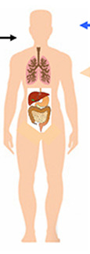


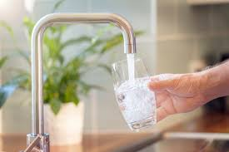
Why This Matters for Water Resources
Environment
Water
Organisms
Food Supply/Drinking Water
Human Exposure
Small organisms
Fishes, crabs, etc.
MNPs
Wastewater and drinking water treatment plant
Tap water
Dalberg et al., 2019. WWF. https://wwf.panda.org/wwf_news/?348337/Revealed-plastic-ingestion-by-people-could-be-equating-to-a-credit-card-a-week
Lehner et al., 2019. Environ. Sci. Technol. 53, 1748−1765.
Wang et al., 2021. J Hazard Mater. 401, 123415

Slide 4
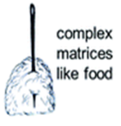
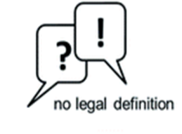
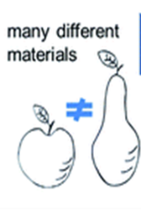

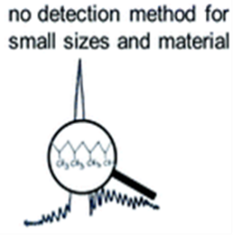

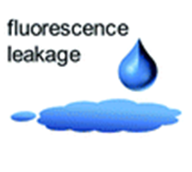


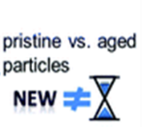
Targeting the Smallest Particles
Conventional approaches such as filtration and centrifugation become inefficient or expensive at these very small particle sizes.
  Large plastic → easy to capture
  Microplastic → harder
  Nanoplastic → really hard
no efficient removal method
Liu et al., 2022. Sci Total Environ, 851,157991
Hou et al., 2021. Chem Eng J. 406, 126715.

Slide 5
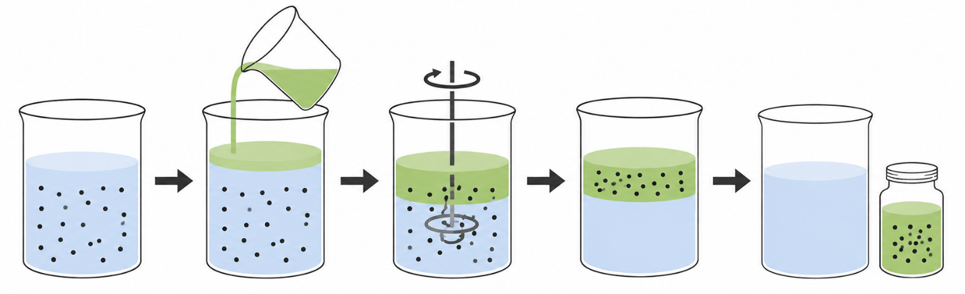
Our Approach: Green Solvent Extraction
Natural DES (NADES) — made from naturally occurring components
  Liquid solvent with an affinity for plastic
  Readily available plant-derived ingredients
Our 2023 study demonstrated that hydrophobic NADES could extract micro- and nanoplastics from water (UKnow Article).
*This work has been published in the Scientific Report

Slide 6

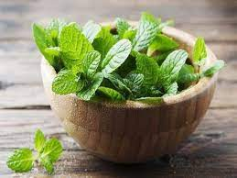
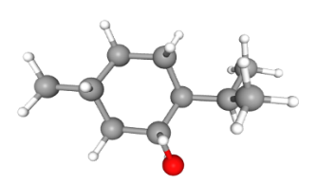
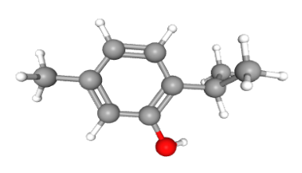
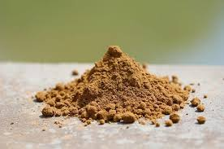
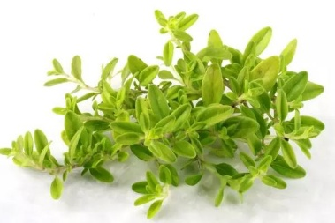
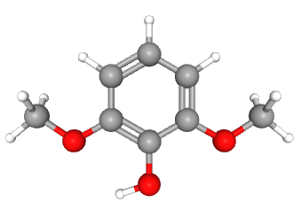
The Next Question: Can We Make an Even Better Green Solvent?
Hydrophobic DES (HDES)
  Attract the plastic
  Stay separate from the water
Biomass
Menthol
Mint
Thymol
Lignin
Thyme
*This work has been published in the Journal of Cleaner Production
And issued as an US Patent US12344537B2
Dmp

Slide 7
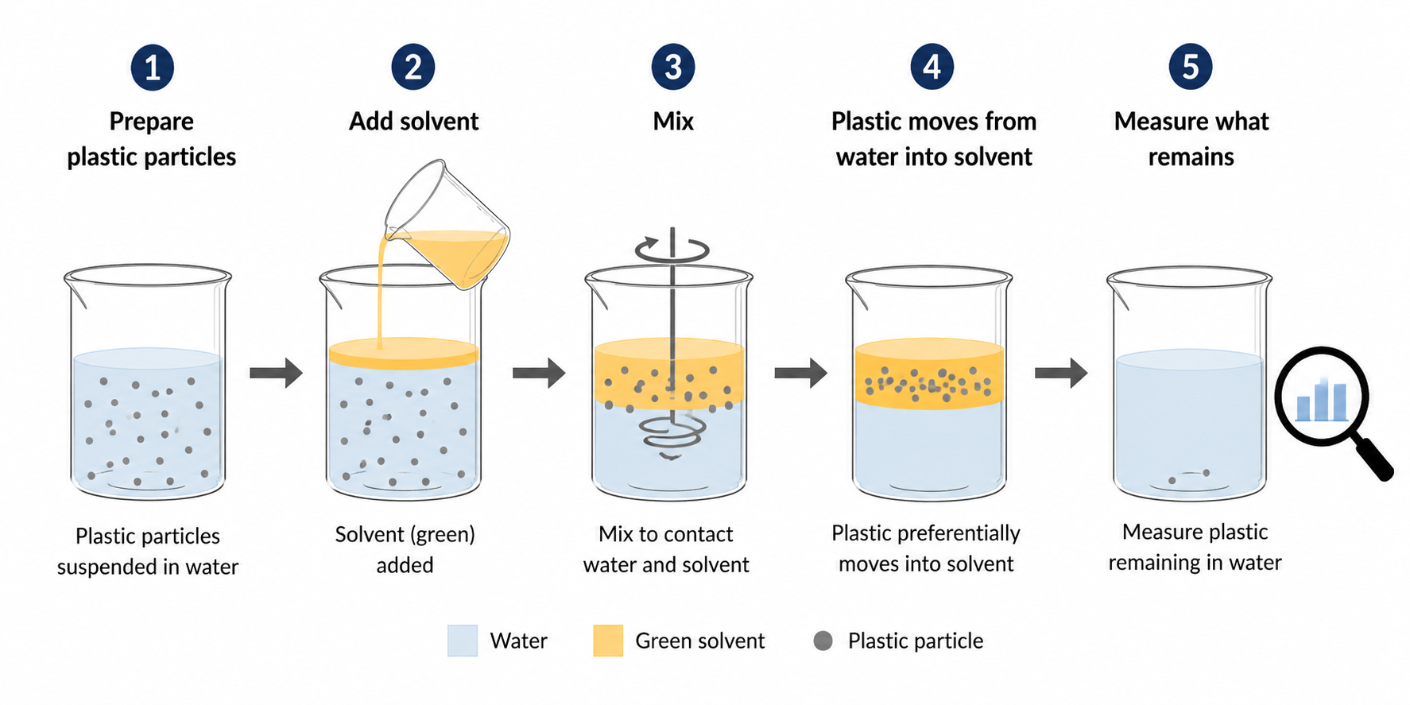
Nanoparticle Extraction with Green Solvents
Laboratory conditions; initial plastic concentration = 100 mg/L

Slide 8
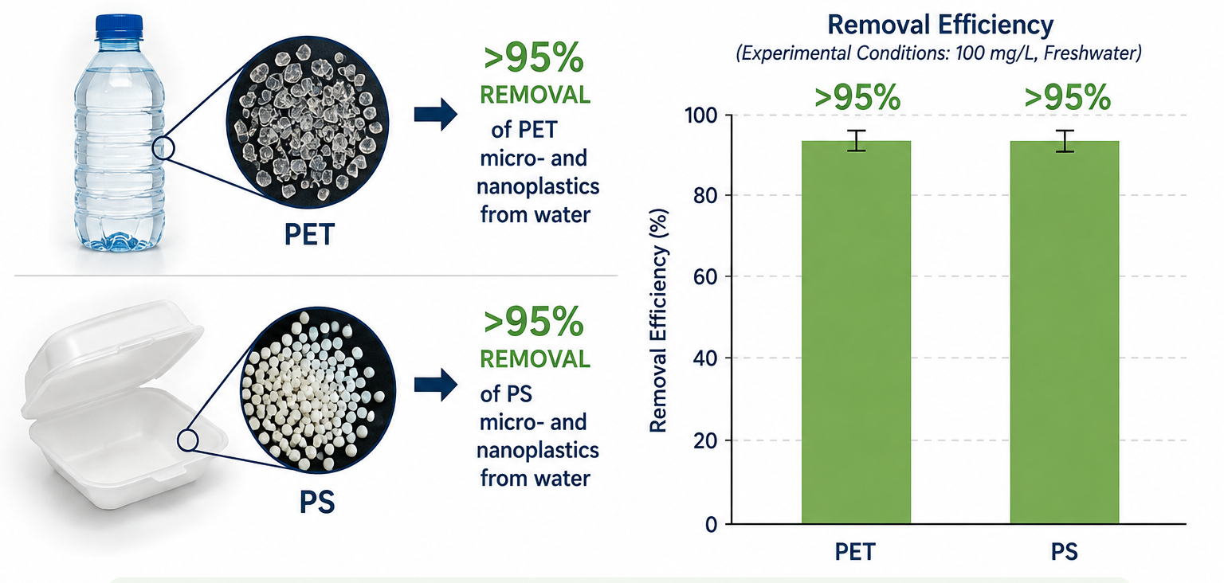
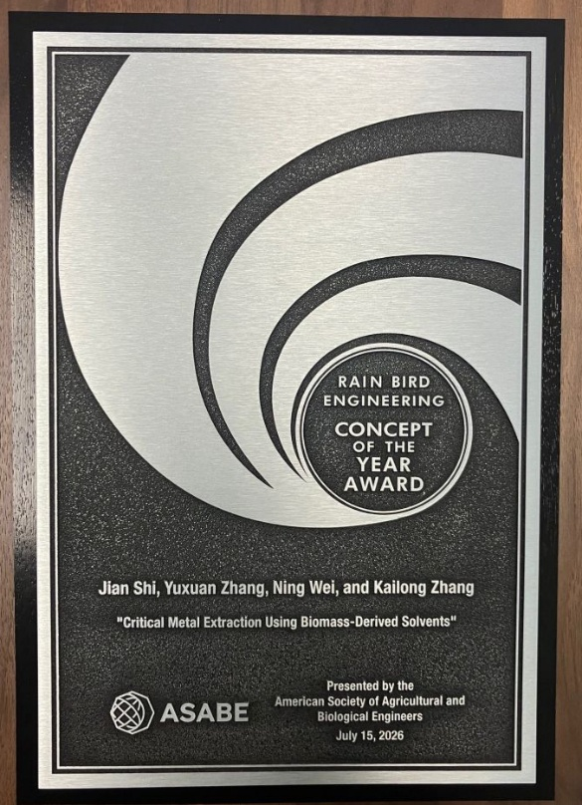
Lignin-based HDES Performance
Laboratory conditions; initial plastic concentration = 100 mg/L.
This work has been published in the Journal of Hazardous Materials
And granted a US Patent US11932557B2
Won 2026 “Rain Bird Engineering Concept of the Year Award" from the American Society of Agricultural and Biological Engineers

Slide 9
From Discovery to Application
Laboratory discovery
↓
Optimize materials
↓
Test real water
↓
Recover/reuse solvent
↓
Scale-up
↓
Potential water-treatment technology
Currently, we are working toward understanding and eventually translating this into a practical separation technology
Notes:
Kentucky researchers are developing new tools to address an emerging water-quality challenge.

Slide 10
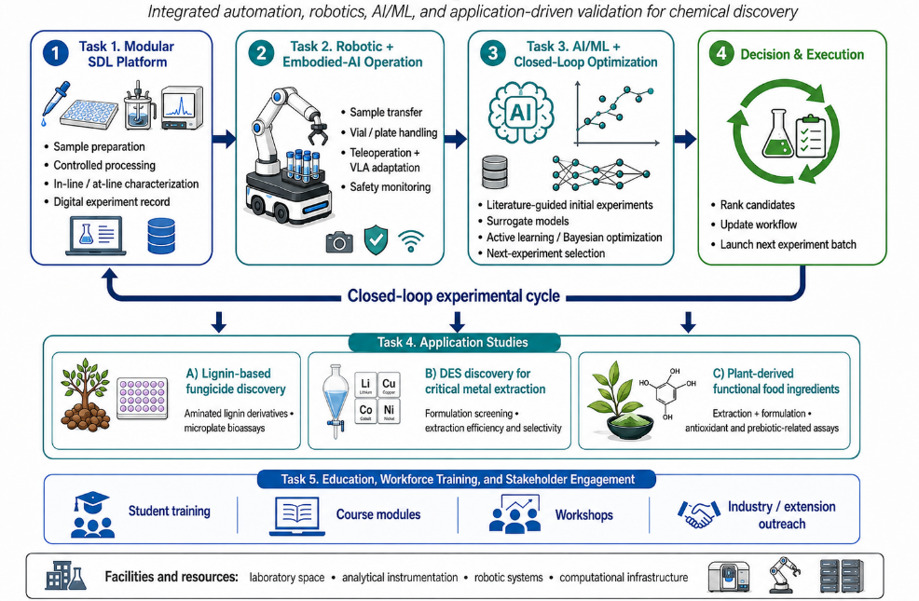
What is the next?
Figure. Overview of the AI-enabled Self-Driving Laboratory (SDL) platform.

Slide 11
Backup slides for technical details

Slide 12
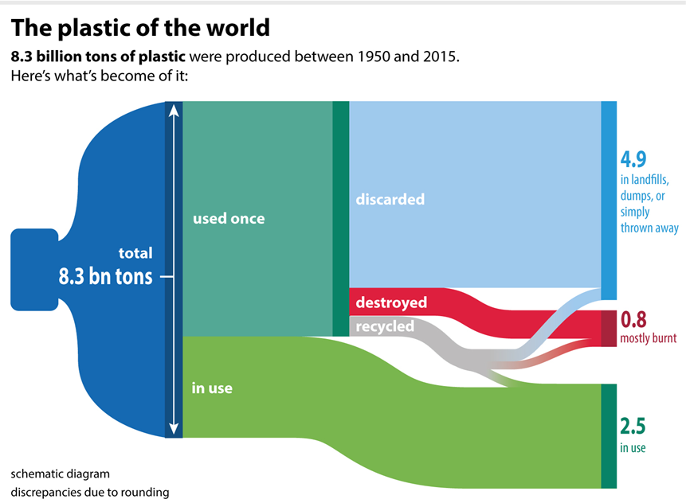
Background: Micro- and nano-plastics (MNPs)
Plastic debris break into micro- and nano-plastics (MNPs): in environment
Geyer et al., 2017. Science advances, 3(7), e1700782.
Gillibert et al., 2019. Environmental science & technology, 53(15), 9003-9013.
Notes:
So, some background about this project. I believe everyone knows that Plastic pollution is one of the most pressing environmental issues. Too many plastics are simply discarded into environment. The plastic debris in the environment can gradually break into smaller particles under the physical and chemical impacts, such as UV irradiation and mechanical abrasion. These small sized plastics, often referred as micro and nanoplastics (MNPs) have been found in rivers, groundwater, oceans and sediments. However, currently, the exact definition of micro- and nano-plastics remains a topic of debate in the scientific community. Some researchers use a definition that MPs are plastic particles ranging from 100 nm to 5 mm and NPs are plastic particles with a size less than 100 nm, This is in consist with the definition of nanomaterials. However, more recently, more and more researchers are adopting a definition where NpPs are classified as plastic particles with a size below 1 um. This is driven by the growing evidence that plastic particles under1 um would exhibit distinctly different colloid behavior as compared to the larger counterparts. So in this study, I adopt the latter definition for NPs.

Slide 13
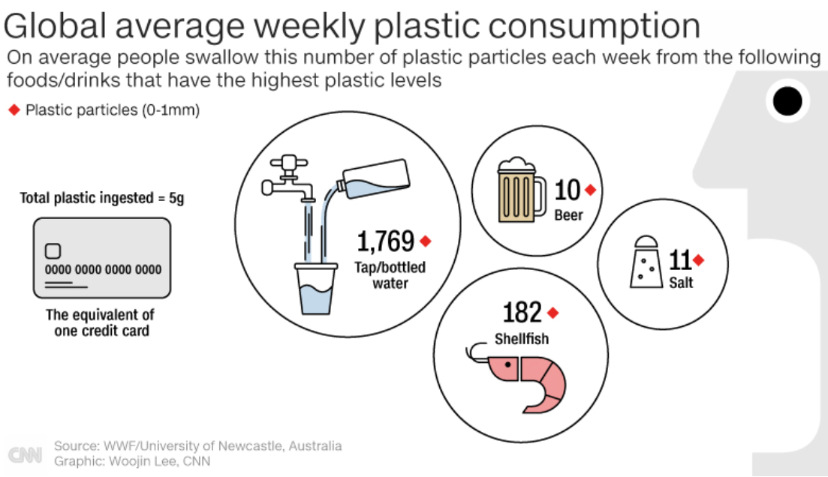
Background: MNPs-an emerging concern for ecosystem and human health
Small organisms
Fishes, crabs, etc.
MNPs
Wastewater and drinking water treatment plant
Tap water
Figure adopt from CNN health: https://www.cnn.com/2019/06/11/health/microplastics-ingestion-wwf-study-scn-intl/index.html
Dalberg et al., 2019. WWF. https://wwf.panda.org/wwf_news/?348337/Revealed-plastic-ingestion-by-people-could-be-equating-to-a-credit-card-a-week
Lehner et al., 2019. Environ. Sci. Technol. 53, 1748−1765.
Wang et al., 2021. J Hazard Mater. 401, 123415
Notes:
Recently, MNPs, especially the nanoplastics, have become a worldwide concern because of the potential human exposure to them which is hard to notice. Due to the small size and lightweight, NPs can be easily suspended and distributed in water and are more possible to be ingested. This facilitates them to bio-migrate and bioaccumulate in organisms via the food chain or through the drinking water. And This bioaccumulation of nanoplastics could cause adverse impact on ecosystems and human health.

Slide 14
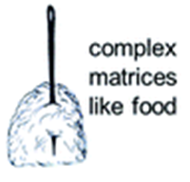
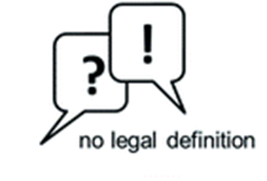

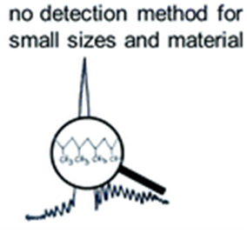


Background: Chaos in nanoplastics study
no efficient removal method
Liu et al., 2022. Sci Total Environ, 851,157991
Hou et al., 2021. Chem Eng J. 406, 126715.
Notes:
Given these fact, more and more researchers are dedicating to this field. However, The tiny size of nanoplastics, their diverse types, and their low concentration in the environment leads to many challenges in this field, especially considering the lack of suitable detection and removal methods

Slide 15
Lignin-based HDES: Source and environment impact
Biomass
Menthol
Mint
Thymol
Lignin
Thyme
Dmp
Notes:
Back to topic of lignin Based HDES, after evaluating their properties and potential environmental impact, i finally chose five DESs out from the 19 DES for further application. These five DESs are made from Men, Thy, and Dmp. Menthol and thymol are biomolecules that can be extracted from mint and thyme, respectively. Additionally, they can be also commercially produced from meta-cresol, which is a product from lignin pyrolysis. Dmp, also known as syringol, is another major product of lignin pyrolysis and is responsible for the smoky aroma in smoked foods. These compounds can be found as ingredients in everyday products, such as perfumes and mouthwash. As a result, we believe that DES composed of these compounds are likely to exhibit low toxicity and have a reduced environmental impact.

Slide 16
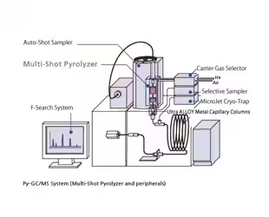
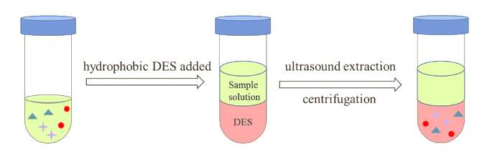
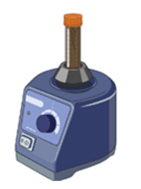
Extraction procedures
Vortex mixing
DES
water
Nanoplastics
PY-GC/MS analysis
Notes:
So aiming to advance this field, we conducted a fundamental work to study the extraction of NPs from water using HDES. We hope this kind of work may help the development of the NP detection and removal methods in the future.

Slide 17
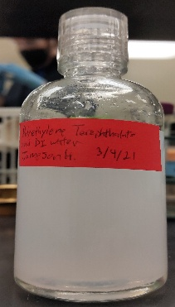
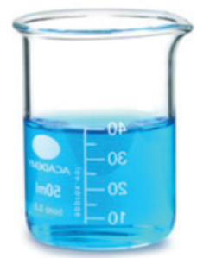

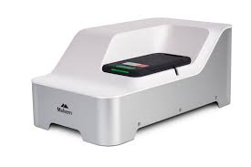
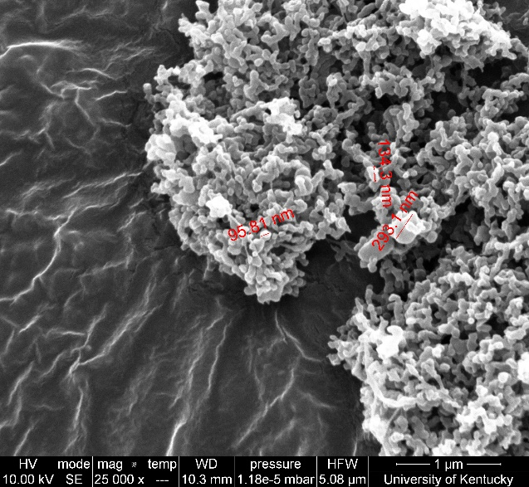
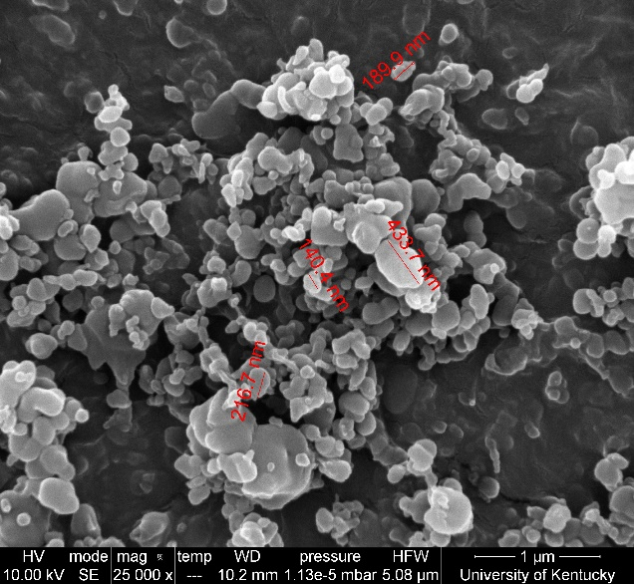
Nanoplastics: preparation and characterization
Organic solvents
Adding to anti-solvent
Transfer into water
Plastic-water Suspension
Ultrasonic treatment
Plastic pellets
Dissolution
Precipitation
PET: Polyethylene terephthalate PS: Polystyrene
SEM
DLS
PET
PS
Plastic | Z-average (nm) | PDI | Zeta potential (mV)
PET | 231 | 0.234 | -26.7
PS | 352.3 | 0.194 | -31.8
Notes:
Due to the challenges in obtain the nanoplastic samples from environment, In this study, we obtained nanoplastic water suspension using a dissolution and precipitation method The suspensions were able to be stable for at least three weeks. The zetasizer and SEM results confirmed that the plastic particles obtained were nano sized.

Slide 18
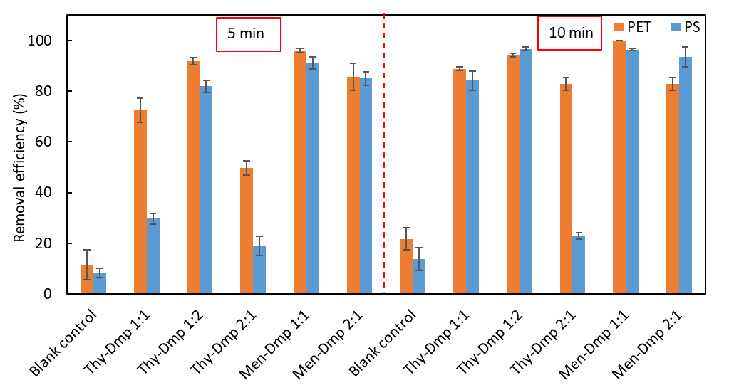
Lignin-based HDES performance: Comparison
Plastic concentration:100 mg/L
HDES can reach high removal efficiency (> 95%) for both PET and PS NPs
HDES with higher Dmp ratio shows better performance
Notes:
Here is the efficiency of different HDESs on the removal of PET and PS nanoplastics. It is exciting the lignin-based HDES can reach a high removal efficiency up to 95%, which indicates that these DESs are effective for the nanoplastic removal as compared to the blank control. We also observed differences in the removal efficiency among different HDES. For example, ….. This motivated us to investigate the mechanism behind, which help us better understand this process.

Slide 19


Extraction process: mechanism
Water
HDES
1.Diffusion
2. Adsorption/absorption
Notes:
Before go to the next results, I would like to introduce some theoretical background here. Generally，in the molecular level, the extraction process involves two steps: 1) transporting NPs from the bulk liquid to the surface of extractants, also called diffusion and 2) retaining NPs with extractants by their interactions. In our case, using different HDES mainly influence the second step

Slide 20
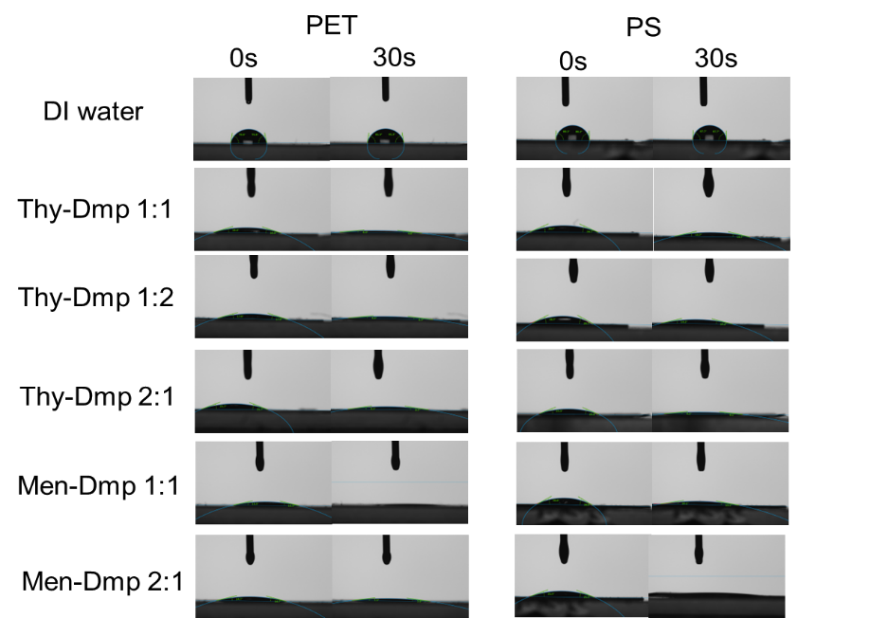
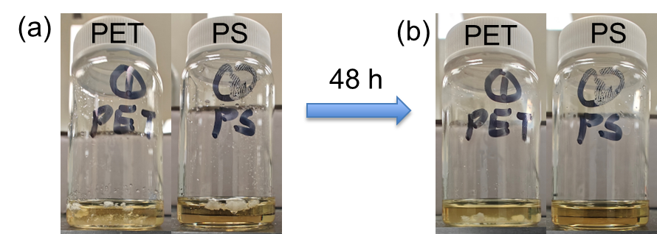
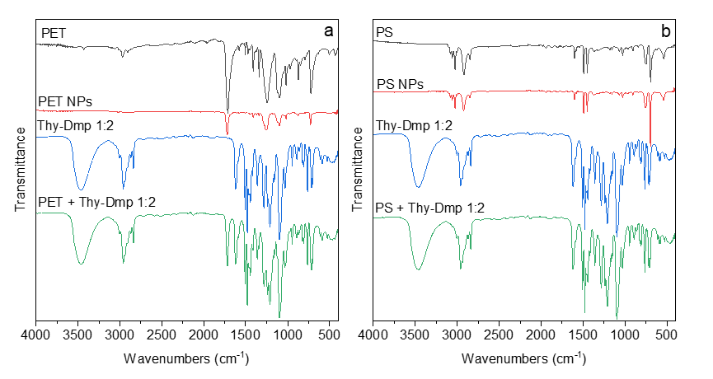
Nanoplastics: HDES-plastic interactions
Contact angle
Dissolution effects
HDESs have higher affinity for NPs
The affinity mainly comes from physical interactions
FTIR
Notes:
To study the mechanism behind, I did several investigations such as contact angle measurements and FTIR. It is clear that DES has a higher affinity with the plastics as indicated by the smaller contact angles between plastics and DES compared to that between plastics and water. And FTIR results indicate this affinity mainly comes from physical interactions. I also found HDES have some dissolution effects for PS at room temperature, which may contribute to its removal from water. This interactions provide the drive force for movement of plastic from aqueous phase to the DES phase as well as their retention with HDES.

Slide 21
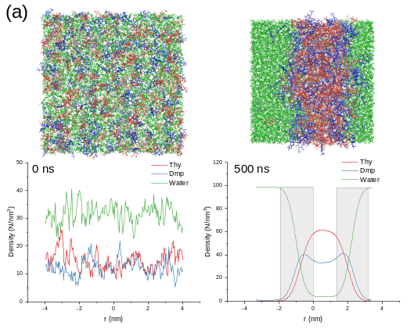
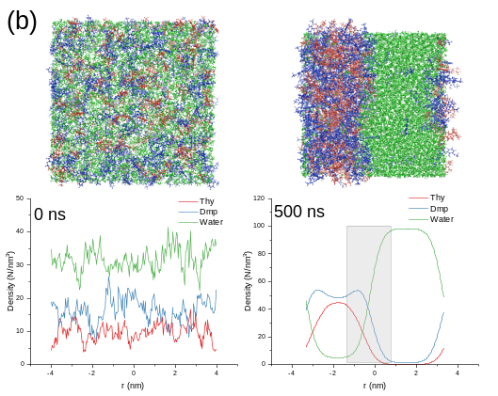
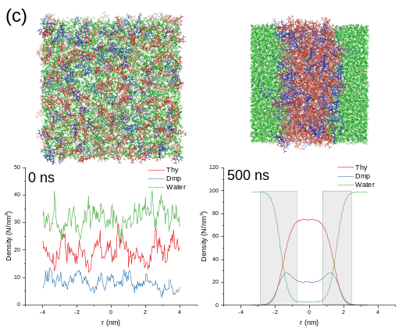
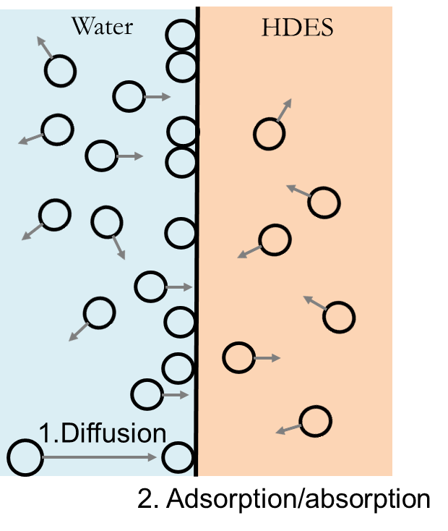
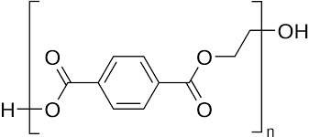
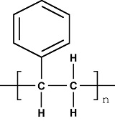
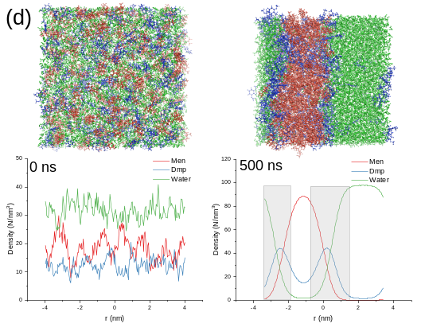
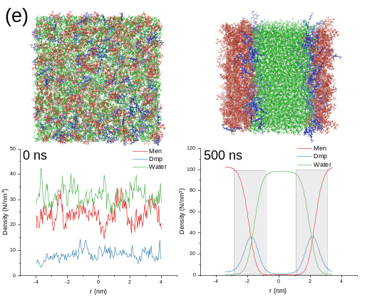
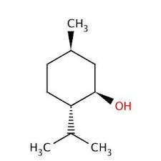
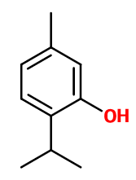
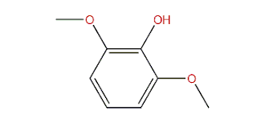
HDES-water interface
HDES-water interface
Interface
PET
PS
Men
Thy
Dmp
Fiugure S3-3. Density profile for (a) Thy-Dmp 1:1, (b) Thy-Dmp 1:2, (c) Thy-Dmp 2:1, (d) Men-Dmp 1:1, and (e) Men-Dmp 2:1. The typical snapshot of the system is presented above the plot where blue, green, and red colors represent Dmp, water, and the other component of DES, respectively.
Notes:
Another factor need to be take into account is the liquid-liquid interface. When mixing HDES with water, there will be an interfacial layer between them. This interface layer serves as a junction between the bulk water and HDES, and its features can also impact the mass transfer between the two phases. So I used MD simulations to study the interfical properties and found the accumulation of Dmp within the interface. This trend may explain the previous observation that the HDES with higher Dmp shows better performance. This is because Dmp is more active to form interactions than other components of the HDES, in view of their chemical structures.

Slide 22
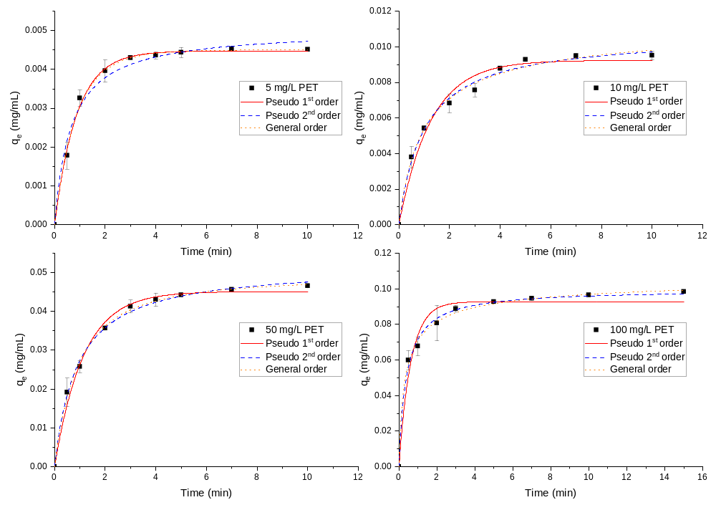
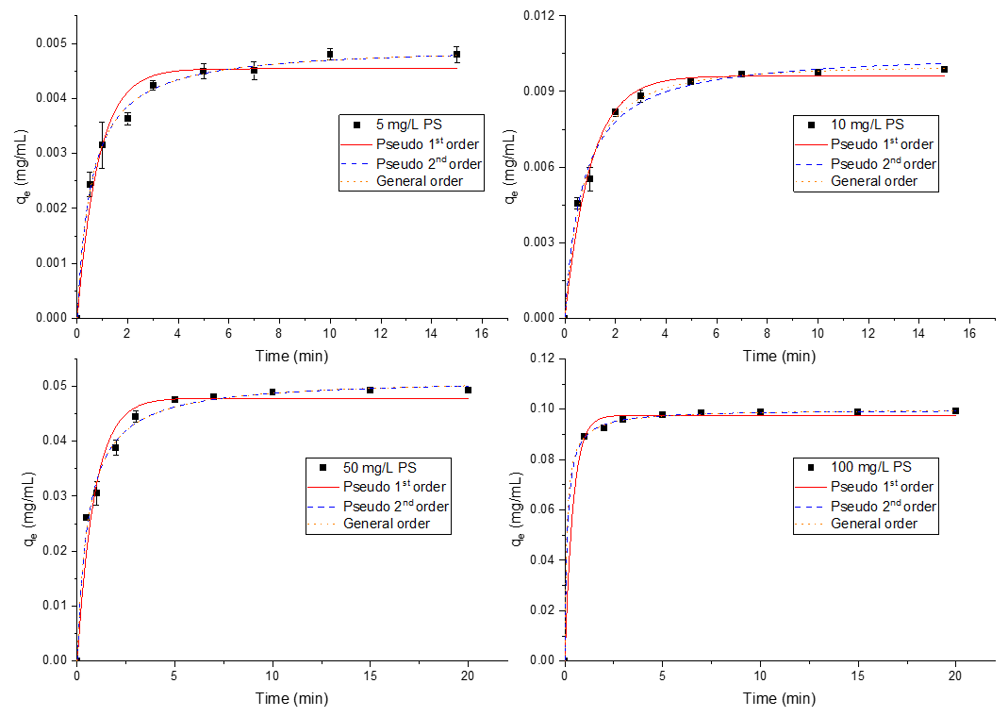

Kinetic study: NPs removal
PET
PS
HDES: Thy-Dmp 1:2
First order:
Second order:
General order:
High order model fits better the experimental data (except conc. at 5 mg/mL)
Second step is the rate-limiting step
Notes:
To further understand the extraction behavior of NP using HDES, I conducted the kinetic and isotherm studies and used models to fit the experimental results.. Here we can see the kinetic results. It was found that High order model fits better the experimental data, which means the removal process is rapid and the second step, namely, the retention of NPs with HDES is the rate-limiting step in the whole process.

Slide 23


Isotherm study
Plastic type | Isotherm model parameters
 | C_{max} (mg/mL) | K | n | R²
PET | 525.877 | 399.344 | 2.267 | 0.994
PS | 183.520 | 3376.027 | 2.257 | 0.994
Active carbon: 50-140 mg/g
Thy-Dmp 1:2 has high removal capacity for PET and PS
n > 2 indicates a multiple-layer mechanism
Notes:
From the isotherm study we can estimated that the adsorption capacity of the HDES is high, which can reach up to hundreds millgram per mL. This is much higher than other adsorbents like active carbon. The isotherm exponent >2 indicates the a multiple-layer mechanism. This implies that the removal process is likely driven by physical interactions, which is consistent with the FTIR results.

Slide 24
Summary
Lignin-based DES could effectively remove NPs from the aqueous system
The high affinity of HDES to plastic provided the drive force for plastic extraction
HDESs mainly physically interacted with the NPs
Generally, High order kinetic model fitted better the experimental data, indicating a rapid extraction process, which was primarily governed by the interactions between NPs and the HDES phase
HDESs possessed high removal capacity for NPs.
The process was a muti-layer extraction and is primarily governed by the interactions between NPs and the HDES phase
This research has been published in the Journal of Hazardous Materials
Notes:
A brief summary,

