Slide 1
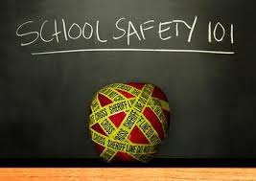
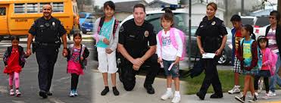
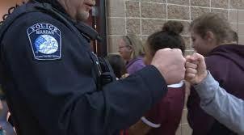
School Safety
Notes:
https://www.campussafetymagazine.com/safety/11-components-of-a-secure-school-front-entrance/

Slide 2
School Safety
Hardening the Target (Physical Security)
Detection & Prevention
School Resource Officers

Slide 3
Hardening the Target (Physical Security)

Slide 4
Critical Differences
Elementary schools
Shooter will be a stranger
Incident is likely to begin at or near front entrance
Sandy Hook
Middle and High schools
Shooter is likely to be a current or recent former student
Incident could begin anywhere in the building
Columbine

Slide 5
Most active shooter events are over quickly, usually in no more than five or six minutes.

Slide 6
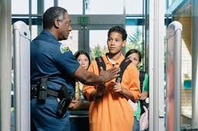
Hardening the Target (Physical Security)
Controlled outside access to all exterior doors during school day & school functions in building
KRS 158.162(3)(d)1

Slide 7
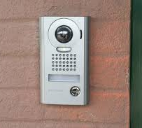
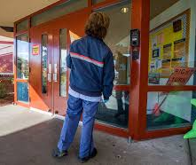
Hardening the Target (Physical Security)
Video-Intercom systems integrated with electronically locking doors
Approx. $11K to $15K per main entrance
KRS 158.162(3)(d)2

Slide 8
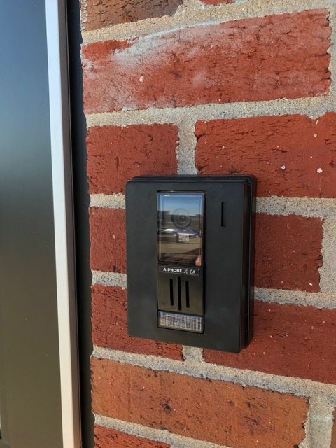

Slide 9
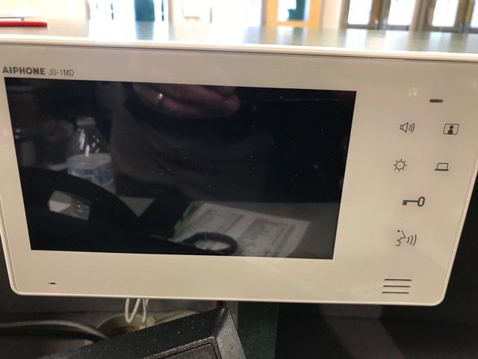

Slide 10
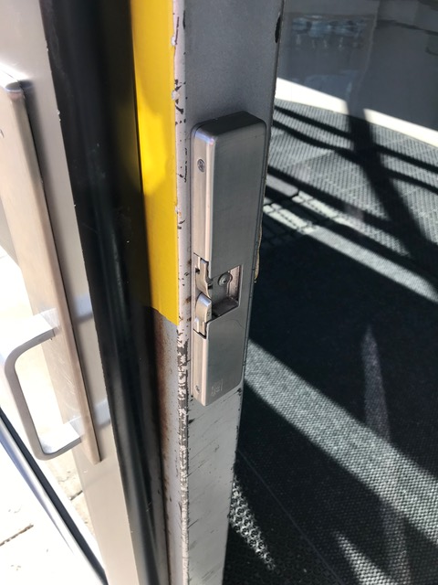

Slide 11
Cost? How do we pay for the upgrades ?

Slide 12
Hardening The Target (Physical Security)
School entrance doors should be metal – Glass reinforced with Safety & Security Film
Metal doors are ideal – Protective film over windows

Slide 13
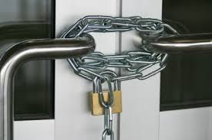
Hardening the Target (Physical Security)
Flush, Security Door Handles

Slide 14
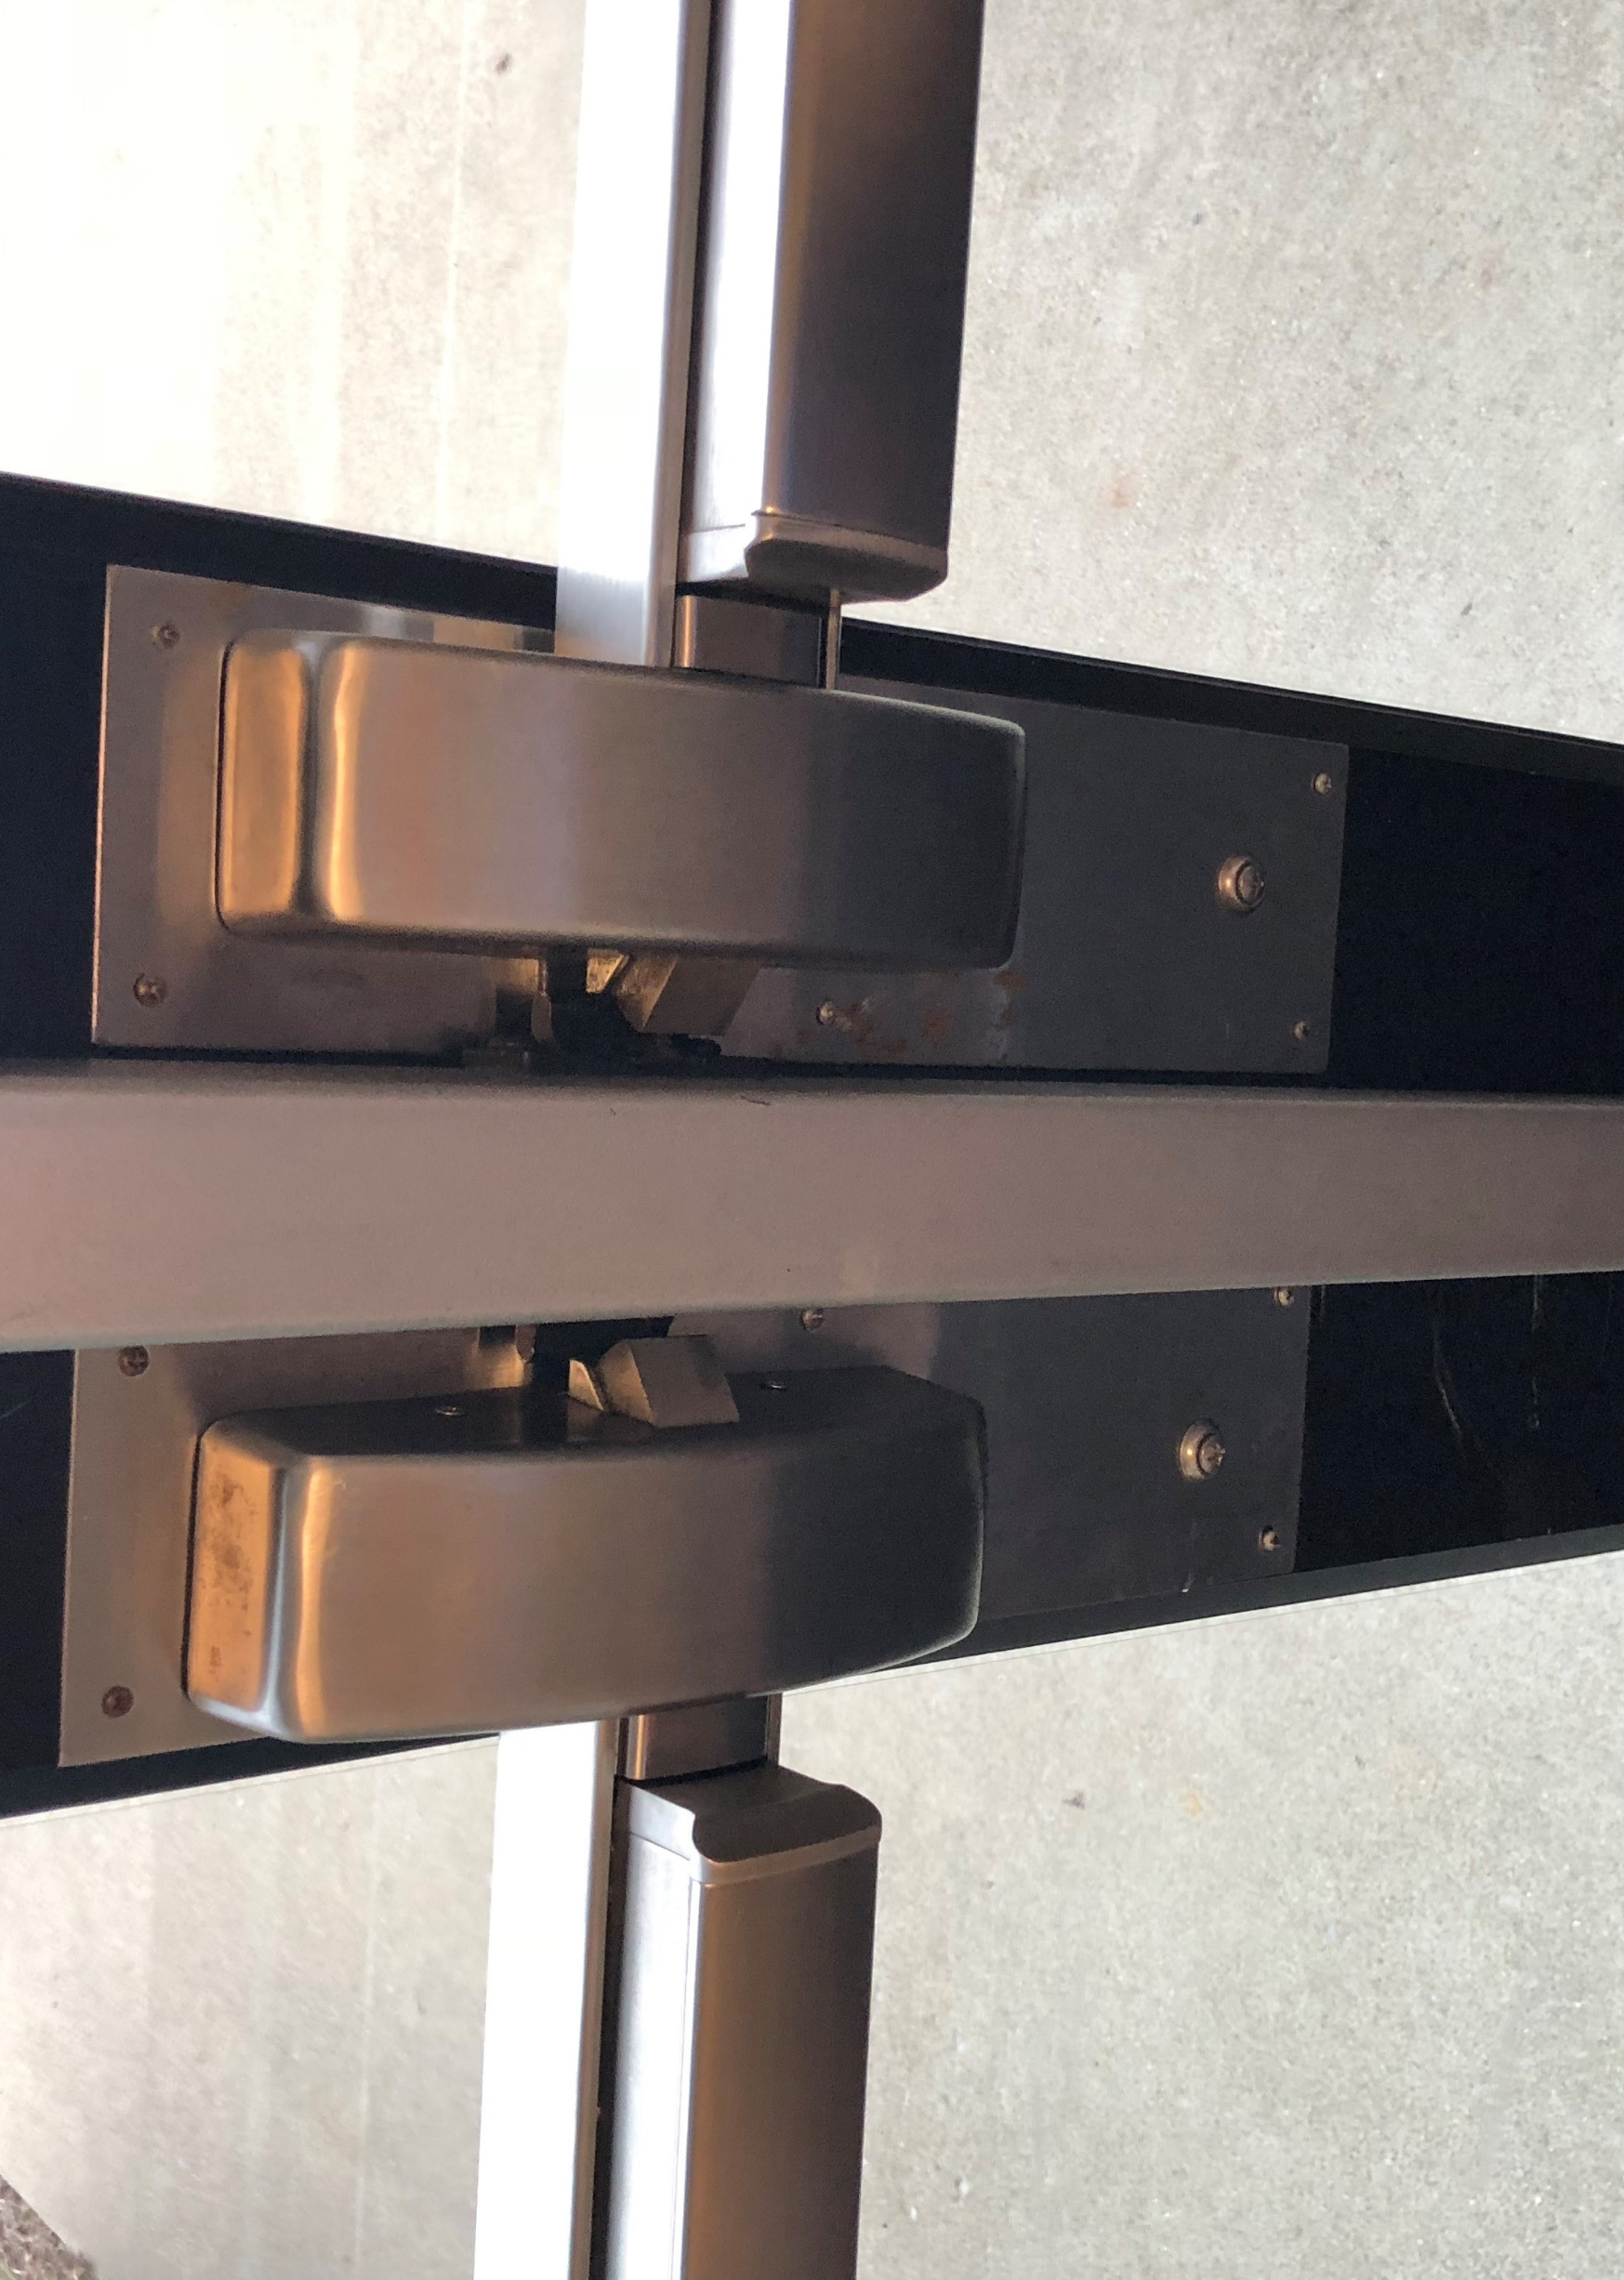
Hardening the Target (Physical Security)
Flush, Security Door Handles

Slide 15
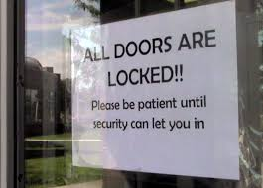
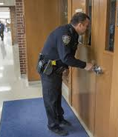
Hardening the Target (Physical Security)
Lock The Doors! Controlled access to school & classrooms
Exterior
Interior

Slide 16
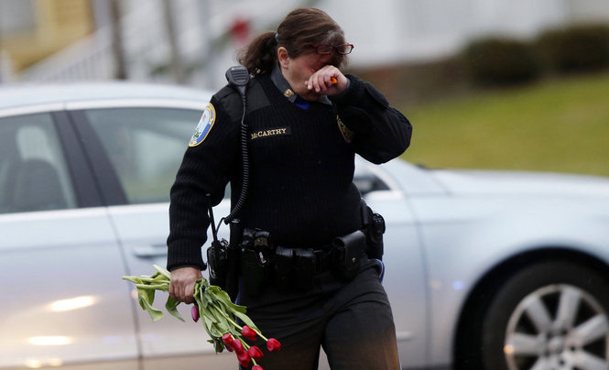

Slide 17
How can we save lives if a school shooting
does occur?
Front door of Sandy Hook Elementary School

Slide 18
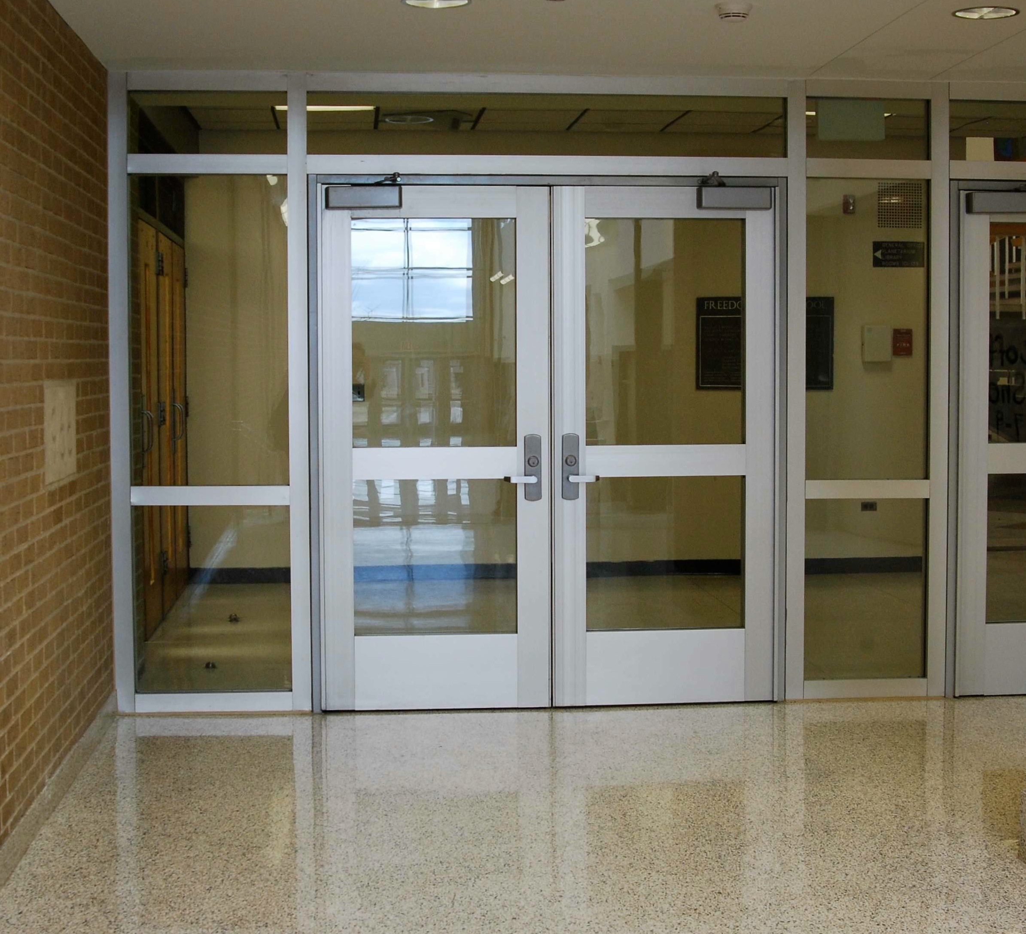
Hardening the Target (Physical Security)
Transoms
Sidelights
Safety & Security Films
Approx. $60 per square ft., plus framing & installation

Slide 19
Safety & Security Films
https://www.3m.com/3M/en_US/building-window-solutions-us/resources/window-film-for-schools/
Notes:
https://www.3m.com/3M/en_US/building-window-solutions-us/resources/window-film-for-schools/

Slide 20
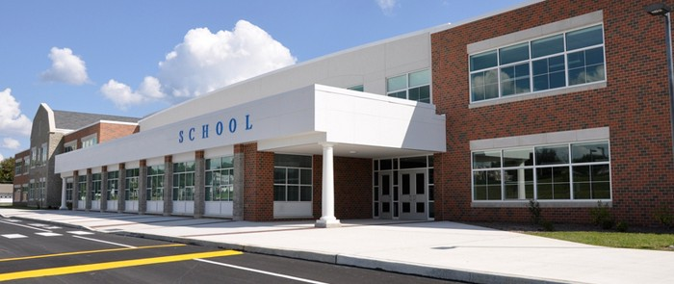
Hardening the Target (Physical Security)
Exterior ground-level windows
Safety & Security Films

Slide 21
Layered Redundant Approach
Detection and Prevention
Parking Lots – CCTV
Physical Building Security
Access Control
Close and Lock classroom doors
“If a perpetrator snuck into a school, how many doors could he open and how much harm could be done BEFORE a lockdown could be called?”
Armed Protection

Slide 22
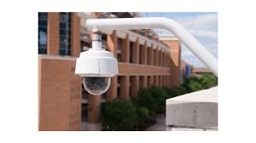
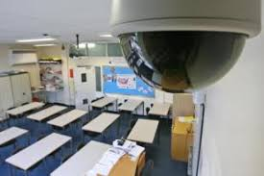
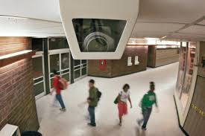
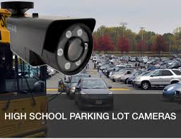
Hardening the Target (Physical Security)
Video Cameras

Slide 23
School Safety Plan
Detection / Prevention
Security cameras on all doors
6. Lock down procedure -Barricade doors
High School
5. Armed Protection (SRO / Retired LE)
Office -monitor for cameras and control of access.
Safe Room-camera monitor , PA speaker , phone
Main entry
3. Building Security – secure all doors (locked) with cameras and limit access to one entry way with access control .
4. Access Control to include policy, camera, speaker system, buzz in system.
2.Security Camera on parking lot
Initial observation of threat
Parking Lot

Slide 24
Training Law Enforcement Teachers * Students Parents

Slide 25
LOCKDOWN
Lock your classroom or office door.
If the door has a window, cover it.
Turn off the lights.
Get everyone into a blind corner.
Stay as quiet as possible.
Keep the door locked.
10 seconds
To date, no student or teacher has ever been
killed while behind a locked classroom door.*
*while in a blind corner.

Slide 26
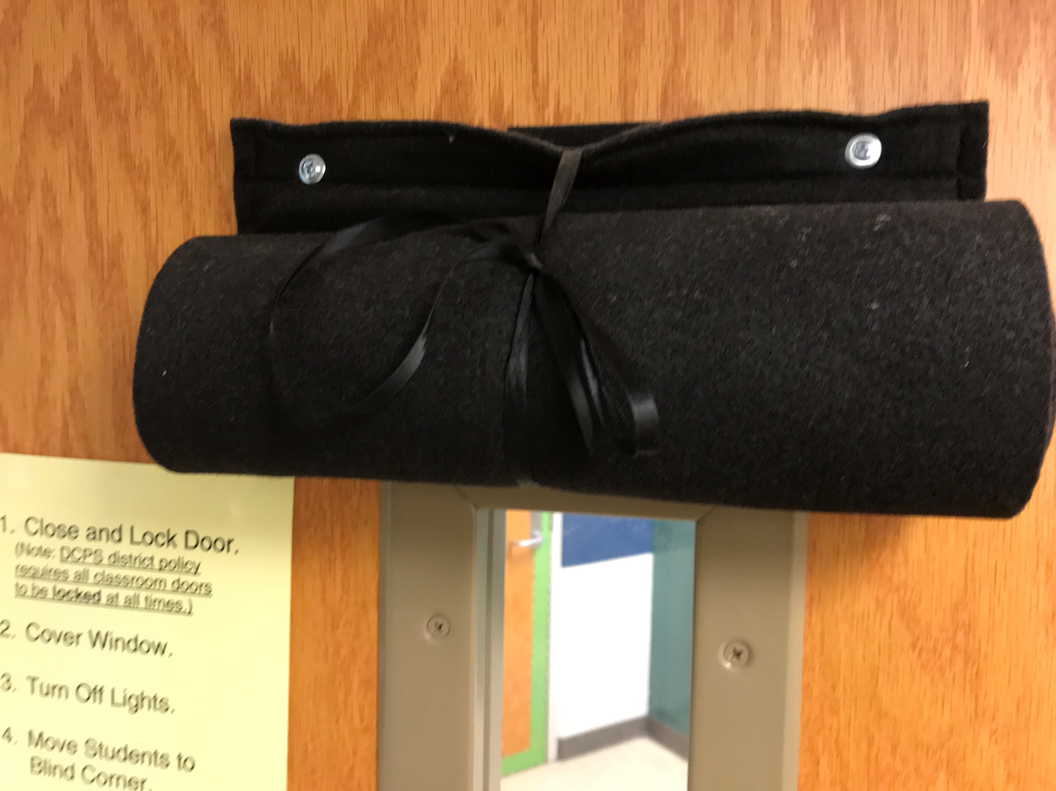

Slide 27
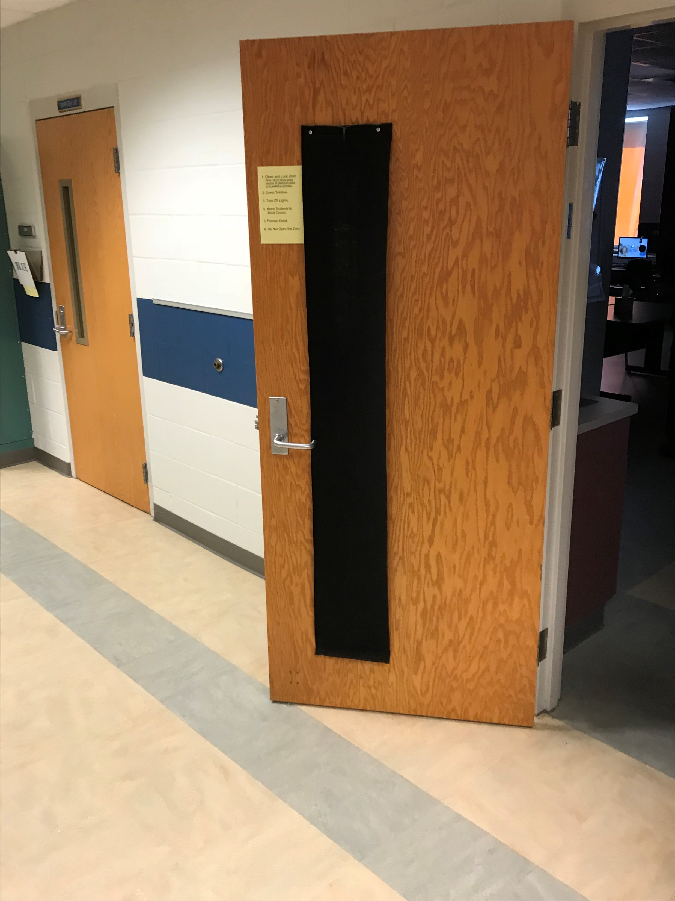
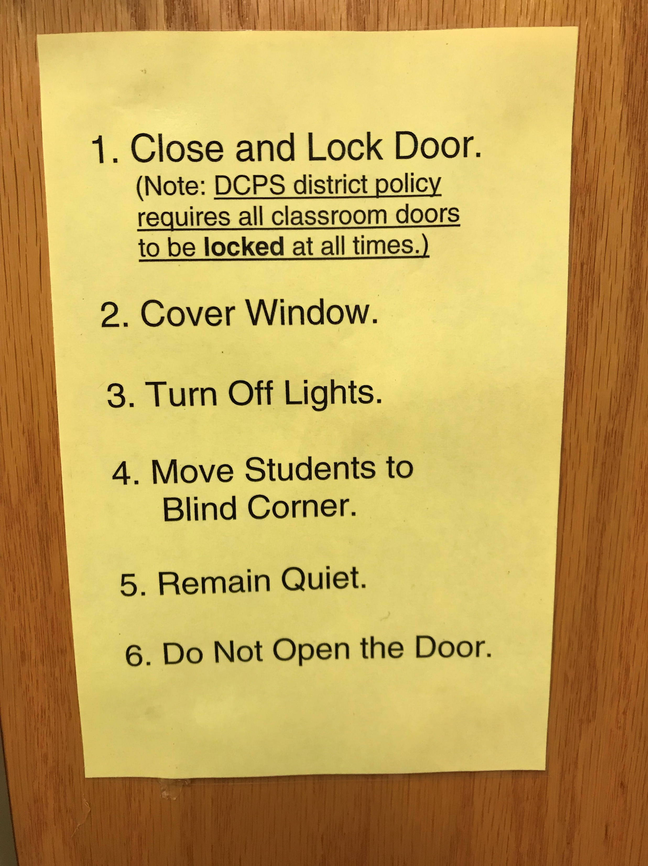

Slide 28
Detection & Prevention

Slide 29
Secret Service Study (2002) 10 Key Findings
Incidents were rarely sudden, impulsive.
Other people knew about the attacker’s idea and/or plan to attack.
Most attackers did not threaten their targets
There is no accurate or useful “profile”
Exhibited behavior prior to the incident that caused concern

Slide 30
Vestena Robbins, PhD Executive Advisor Kentucky Dept. for Behavioral Health, Developmental and Intellectual Disabilities
Strategies to promote psychological safety should occur within multi-tiered systems of support (MTSS) that facilitate prevention, early identification and intervention, and interventions that meet the needs of students at different levels of need

Slide 31
Enhance Capacity to Implement Trauma-Informed Practices.
Exposure to traumatic events can affect learning and/or behavior.
Traumatic stress can arise from a variety of sources –
Abuse
Bullying
Parental separation
Exposure to violence
Life-threatening weather events
School shootings
day-to-day exposure to events such as divorce or painful medical procedures.
Kentucky’s children have experienced, on average, more adverse childhood experiences than children nationwide.

Slide 32
Prevention Strategies
Identification
Notification
Evaluation
Intervention
Documentation & Dissemination

Slide 33
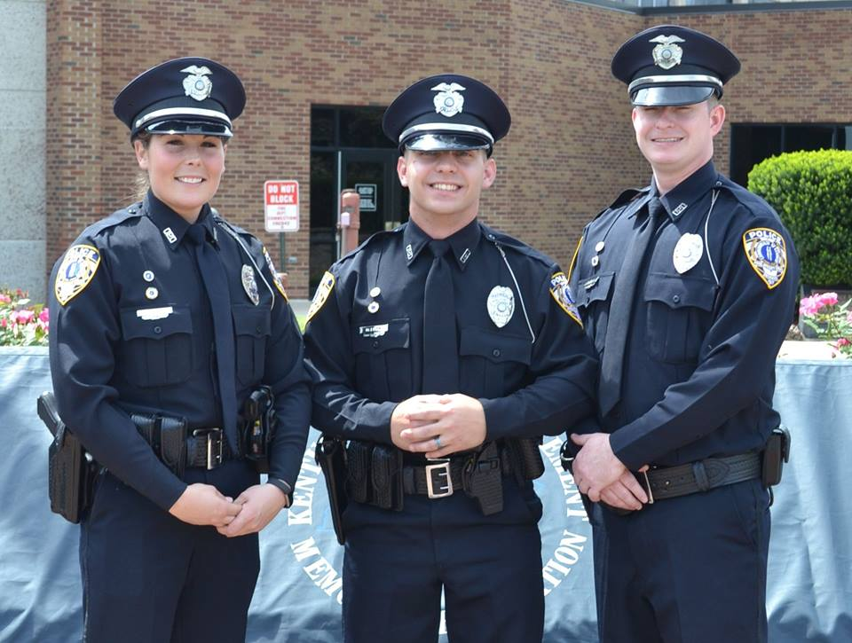

Slide 34
Employ Armed, Professional Law Enforcement in Our Schools
Funding for SRO’s?
501c3’s, parents, grandparents, teachers, corporate sponsors and other organizations to increase the number of officers in our schools
Some schools are utilizing LEOSA (Law Enforcement Safety Act) retired law enforcement as volunteers for armed protection.

Slide 35
Western Kentucky University's Social Science Department has released the results of their "Politics in Kentucky."
ARMED RESOURCE OFFICER
Overwhelming support from Kentuckians (70%).
Support for this was bipartisan Supported by:
78% of Republicans
72% of Independents
63% of Democrats
Crossed ideological lines, as it was supported by a majority of moderates, liberals, and conservatives.

Slide 36
Armed Resource Officer
63% of those in favor of this also supported a tax increase in order to pay for it.
Again, in each instance a majority of Republicans, Democrats, and Independents demonstrated support for this proposal.

Slide 37
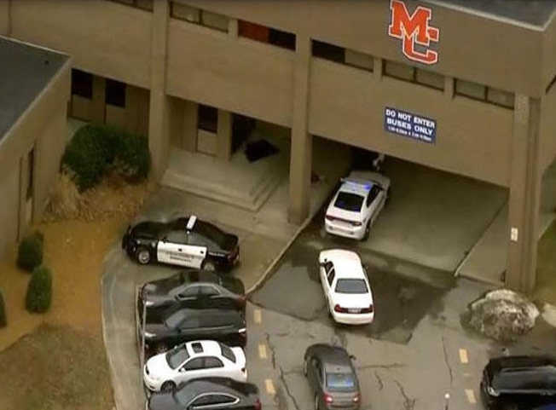
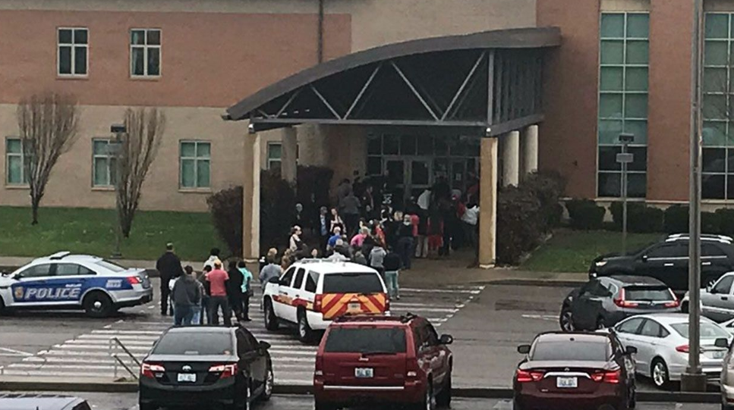
Marshall County Kentucky Radcliff Kentucky

Slide 38
Schools Utilizing SRO/ POPS Certified Law Enforcement Professionals Boone County - All Schools Pike County “Five” Deputy Sheriffs Marshal County “Five” SRO Montgomery County “Five” SRO

Slide 39
Security Changes in the Marshall County School District
MCHS and the two middle schools will not be allowed to carry book bags.
Metal detectors will be installed at Marshall County High School and at North and South
The number of district school resource officers will be increased from one to five.
All district schools will receive additional and/or updated camera systems.
The entrance to the high school will be altered to better control incoming traffic.
The entrances to these buildings will be configured to better control incoming visitors and late arrivals

Slide 40
School Safety
Hardening the Target (Physical Security)
Detection & Prevention
School Resource Officers

Slide 41
Chris Barrier Director of Law Enforcement Montgomery County Schools

Slide 42
The Kentucky Center for School Safety advises that the following, leading Kentucky educational organizations oppose arming teachers:
Kentucky Center for School Safety (KCSS)
Kentucky Department of Education (KDE)
Kentucky School Boards Association (KSBA, school board members)
Kentucky Association of School Administrators (KASA, all school administrators)
Kentucky Educators Association (KEA, teachers and classified employees in schools)
Kentucky Association of School Superintendents (KASS)

