Slide 1
Kentucky Academic Standards for Reading and Writing and Mathematics
Interim Joint Education Committee
July 9, 2018

Slide 2
SB1 (2017) Standards Revision Requirements
The standards revision to the content standards shall:
Focus on critical knowledge, skills, and capacities needed for success in the global economy;
Result in fewer, but more in-depth standards to facilitate mastery learning;
Communicate expectations more clearly and concisely to teachers, parents, students and citizens;
Focus on critical knowledge, skills, and capacities needed for success in the global economy;
Result in fewer but more in-depth standards to facilitate mastery learning;
Communicate expectations more clearly and concisely to teachers, parents, students and citizens.

Slide 3
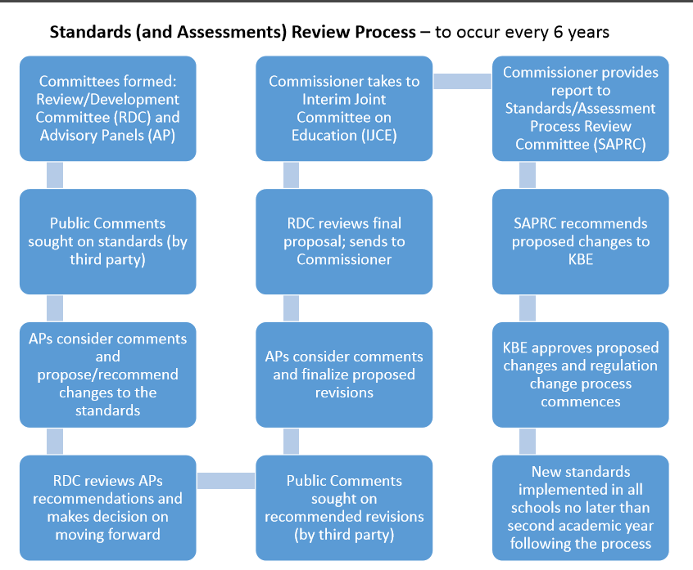

Slide 4
KAS for Reading and Writing Timeline Overview
December/January – Open standards for public comment/feedback
January – Initial Reading and Writing Advisory Panel (AP) meetings
February – Initial Reading and Writing Review and Development Committee (RDC) meetings
March/April – Reading and Writing AP meet for review and revision; Reading and Writing RDC meet for review and revision
May – Open draft Reading and Writing standards for public comment/feedback
June – Finalize draft Reading and Writing Standards
July –Interim Joint Committee on Education reviews draft standards
July – Standards/Assessment Review and Process Committee reviews draft standards
August – First reading by Kentucky Board of Education
October – Second reading by Kentucky Board of Education

Slide 5
Public Comment Period: Survey Details and Respondent Roles
456 people participated in the survey
Roughly 76% of all Kentucky counties provided responses

Slide 6
Public Comment Period: Framework Overview (Agree/Strongly Agree)
The standards are easy to identify on the page. (87.50%)
It is easy to identify the strand category. (81.64%)
The placement of the interdisciplinary Literacy Practices is convenient and useful. (83.54%)
The possible student and teacher actions included after each Interdisciplinary Literacy Practice helps to clarify for teachers the intended use of the practices. (84.51%)
The standard breakdown view helps better understand a standard. (86.62%)
It is helpful to have the Guiding Principle visible in the standard breakdown view. (91.72%)
The standard progression (grade before and grade after) provided in the breakdown view is convenient and useful. (92.46%)
The framework is user-friendly. (81.76%)

Slide 7
Draft Kentucky Academic Standards for Reading and Writing
Highlights:
Reconstructed framework and vision to align the goals and purposes of the standards
10 Interdisciplinary Literacy Practices, which provide the overarching goals for literacy instruction for each student across the state
Revised standards for early literacy that denote comprehension strategies, development of schema and increased analysis
Multidimensional approach highlights three dimensions of Literacy: Comprehension, Analysis and Content
Standard K-12 progressions in addition to the grade-level view

Slide 8
Draft Kentucky Academic Standards for Reading and Writing

Slide 9
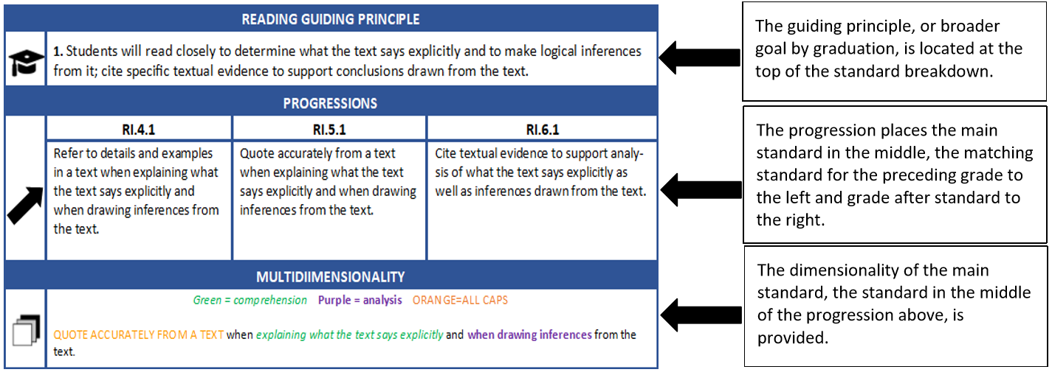
Draft Kentucky Academic Standards for Reading and Writing

Slide 10
KAS for Mathematics Timeline Overview
December/January – Open standards for public comment/feedback
January – Initial Mathematics Advisory Panel (AP) meetings
February – Initial Mathematics Review and Development Committee (RDC) meetings
March/April – Mathematics AP meet for review and revision; Mathematics RDC meet for review and revision
May – Open draft Mathematics standards for public comment/feedback
June – Mathematics AP and RDC finalize draft Mathematics Standards
July –Interim Joint Committee on Education reviews draft standards
July – Standards/Assessment Review and Process Committee reviews draft standards
August – First reading by Kentucky Board of Education
October – Second reading by Kentucky Board of Education

Slide 11
Public Comment Period: Survey Details and Respondent Roles
821 people participated in the survey
Approximately 84% of Kentucky counties were represented with respondents

Slide 12
Public Comment Period: Framework Overview (Agree/Strongly Agree)
Standards are easy to identify. (93.13%)
Cluster headings are easily identified. (85.95%)
Clarification section is useful. (93.31%)
Standards for mathematical practice section is useful. (86.34%)
Placement of standards for mathematical practice is convenient and useful. (85.72%)
Coherence links are useful and convenient. (81.89%)
Framework is user-friendly. (87.8%)
Notes:
Yes!

Slide 13
Draft Kentucky Academic Standards for Mathematics
Highlights:
Architecture is structured to emphasize essential ideas or conceptual categories in mathematics.
Standards emphasize the importance of the mathematical practices; whereby, equipping students to reason and problem solve.
Connections between content standards and practice standards were identified.
Intentional alignment to early numeracy trajectories.
Coherence/vertical alignment is included to indicate the mathematics connections within and across grade levels.
Clarification section communicates expectations more clearly and concisely to teachers, parents, students and stakeholders through examples and illustrations.

Slide 14
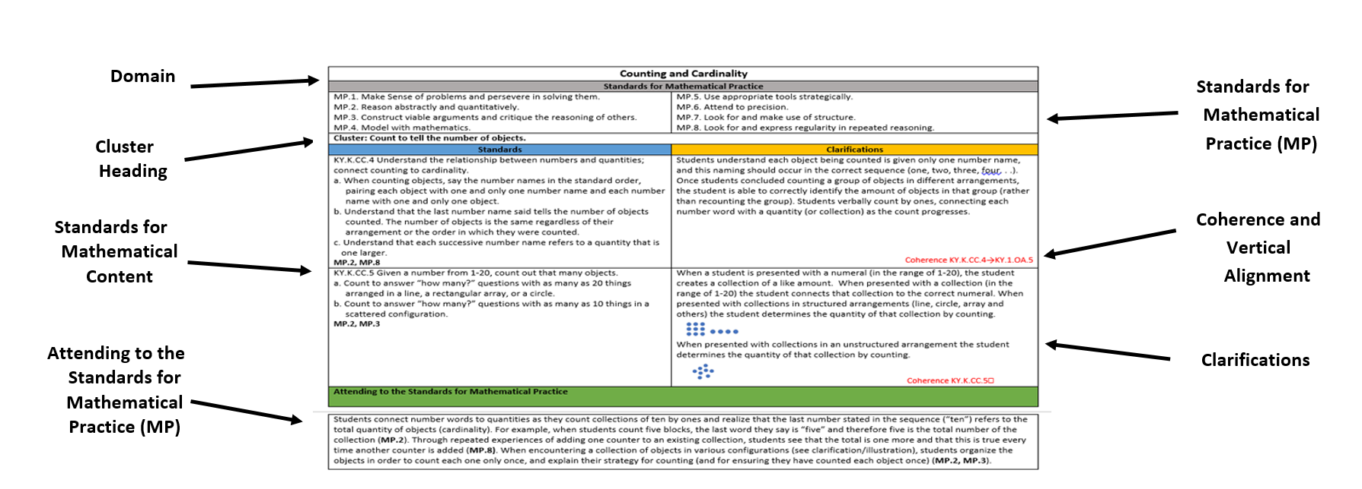
Draft Kentucky Academic Standards for Mathematics

Slide 15
Draft Kentucky Academic Standards for Reading and Writing and Mathematics
Questions?

Slide 16
Draft Kentucky Academic Standards for Reading and Writing and Mathematics
Contact Information
Amanda Ellis, Ed.D. Jennifer Fraker
Associate Commissioner Interim Director
Office of Teaching and Learning Division of Program Standards
(502) 564-9850 (502) 564-9850
Amanda.Ellis@education.ky.gov Jennifer.Fraker@education.ky.gov

