Slide 1
Ensuring the Psychological
Safety of our Students
Vestena Robbins, PhD
Executive Advisor, Kentucky Department for Behavioral Health, Developmental and Intellectual Disabilities
Kathryn Tillett, MSSW, CSW
Project Director, Kentucky AWARE
Kentucky Department of Education
Notes:
Good afternoon!
Let me begin by thanking Representative Carney and the Committee for the invitation to speak about the importance of psychological safety measures and mental health supports as part of our efforts to improve school safety, school climate and learning among our students. As a former elementary school counselor and now as a mental health policy advisor and parent of a 9-year-old, I share the renewed sense of urgency to make our schools as safe as possible.
I am honored to have with me my colleague, Kathryn Tillett from the Kentucky Department of Education. She is Project Director for the Kentucky AWARE grant that you’ll hear about in a moment. We sit before as partners in this presentation just as our departments partner in co-designing policies, practices, and programs to ensure that mental health supports are in place for all students and that student mental health is included in school safety plans.

Slide 2

Key Messages
Physical Safety + Psychological Safety = Student Safety
Psychological Safety requires Multi-Tiered Systems of Support
Kentucky has best practices in place that can be taken to scale
Notes:
So, we thought we would begin by “teaching to the test” and giving you the take home messages at the beginning of the presentation. There are 3 primary messages that we’d like for you to take with you today.
The first message is that student safety requires both physical safety and psychological safety measures. We will discuss why it’s important to balance these measures.
The second message is that psychological safety and mental health supports are best delivered within a multi-tiered system of support (or MTSS). We will describe what that system of supports should look like.
Our final message is that Kentucky has schools across the state that are implementing some of these best practices and we believe we have practices and programs in place that can and should be taken to scale.

Slide 3
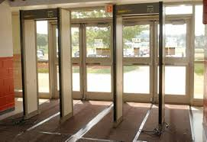

Psychological Safety
Physical Safety + Psychological Safety = Student Safety
Notes:
So, back to the first key message…
Student Safety requires both physical safety measures and strategies that support psychological safety.
I had the pleasure of observing the last Committee meeting in which Jon Akers and Mark Filburn shared best practices in the physical safety arena (measures such as double entry doors, ensuring classroom doors are locked, metal detectors, book bag checks, etc.). But while these gentlemen discussed physical safety measures, they also mentioned a very important word several times…. Relationships.
What we have learned from research and practice is that we must strike a balance between physical and psychological safety measures if we wish to achieve genuine school security. In fact, there is no clear research evidence that the use of metal detectors, security cameras, or guards in schools is effective in preventing school violence (Addington, 2009; Borum, Cornell, Modzeleski, & Jimerson, 2010; Casella, 2006; Garcia, 2003). In fact, some research has shown that their presence negatively impacts students’ perceptions of safety and even increases fear among some students (Bachman, Randolph, & Brown, 2011; Schreck & Miller, 2003) and can negatively impact the learning environments (Beger, 2003; Phaneuf, 2009).
So, to truly impact school safety, we must combine reasonable physical safety with measures of psychological safety. Let’s go back to the word Relationships…. Taking a positive and proactive approach to discipline to build a positive climate and culture; creating an environment where students feel safe and empowered to report potential threats to safety (such as a friend who is being bullied or a peer suffering from distress); and building a sense of belonging and connectivity among students, staff and families are some of the most important strategies we can use to foster trusting relationships with our students.

Slide 4
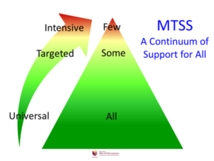
Multi-Tiered Systems of Support
Community
5%
15%
Community
Notes:
So, how do we operationalize strategies to support the psychological safety and mental health needs of our students?
The answer is not in a single curriculum or single program but requires comprehensive multi-tiered systems of support. School safety and learning are not separate endeavors but must be integrated. We believe this MTSS framework is the most effective means for accomplishing this.
Schools that implement MTSS have universal strategies in place that benefit all students (Universal), interventions that target small groups of students who need specialized assistance (targeted), and highly intensive interventions for individual students with complex needs (intensive). The framework encompass prevention, wellness promotion, and interventions that increase with intensity based on student need.
So, let’s pause for a moment and discuss what we know about the mental health needs among our students.
Studies show that one in five youth (or 20% - top of the triangle) from birth to age 18 years has a diagnosable mental disorder (Stagman & Cooper, 2010). Putting that into perspective, that means in a classroom of 30 students, 6 of them has a diagnosable mental health disorder.
We also know that about 5% of students (top of the triangle) have mental health conditions severe enough to impede their ability to function effectively at home, in the school and in the community. So, again in a classroom of 30 students that’s about 1 to 2 students.
We also know that Kentucky’s students face significant adversity (I believe you’ve had a presentation on the Adverse Childhood Experiences Study or ACES). A recent state by state examination using 2016 data revealed that Kentucky (26.9%) was higher than the national percentage (21.7%) of 0-17 year olds with 2 or more ACES. We also know that our students experience significant trauma that can contribute to mental health conditions and impact their learning. And, as those of you who are educators are well aware, students do not shrug the impact of these adversities off as they enter our school house doors. They carry those into the school with significant impacts on their school performance and achievement.
Unfortunately, research shows that large numbers of children and adolescents have undiagnosed mental disorders and the majority of those youth whose disorders are diagnosed do not receive treatment. Approximately half of all lifetime mental health disorders start by the mid-teens (about age 14), and the onset of all major mental illnesses happen as early as 7 to 11 years of age (Stagman & Cooper, 2010). Thus, detecting and addressing mental health needs early is critical to ensuring school safety and student learning.

Slide 5
Examples of Excellence In Action
Notes:
Third key message: Kentucky has best practices in place that can be taken to scale

Slide 6
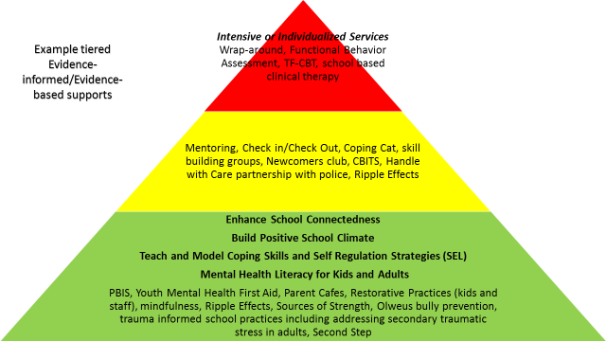
MTSS in Action
Notes:
UNIVERSAL – these are strategies that benefit ALL students
MH Screening is Vital - Given the impact that emotional disturbances can have on student success, and the difficulty of diagnosing these issues, experts say universal mental health screenings are the best way to ensure students get the care they need–and early enough to make a real impact. The American Academy of Pediatrics recently released new guidelines that call for yearly screenings for childhood depression starting at the age of 12. More importantly, experts recommend that these screenings come in the form of private, self-reported questionnaires that allow students to answer sensitive questions without fear of stigma or ridicule.
Youth MH First Aid – Katherine will discuss
Sources of Strength and other programs that build student protective factors and mitigate risk factors
Relationship building at no cost – greet all students by name (no child should go through the school day without an adult referring to them by name); increase positive to negative ratios of interaction; social network analysis
TARGETED – Strategies for students at-risk
Handle with Care – partnership with law enforcement in which the school is given a “heads up” when a child has been identified at the scene of a traumatic event - It could be a meth lab explosion, a domestic violence situation, a shooting in the neighborhood, a drug raid at the home. Police are trained to identify children at the scene, find out where they go to school and send the school a confidential email or fax that simply says . . . “Handle Johnny with care”. That’s it. No other details.
Check In/Check Out – to support students in your building who need a little extra help managing their behavior; Students check in with an adult at the beginning of each day to be sure they are prepared for class and ready to learn. Throughout the day, students check in with teachers and receive points on a card (0, 1, or 2) related to how closely they met school-wide behavior expectations. At the end of the day, students check out with an adult who totals up the points. The cycle repeats itself each day.
Mentoring –
INTENSIVE – Individual student or very small group services and supports for those with the most chronic and complex needs
Individual therapy – TF-CBT, for example, delivered at a local behavioral health clinic
Wraparound Supports – intensive care coordination approach that involves bringing together a multi-disciplinary team of professionals, the child and family, and their natural supports who create an individualized plan of services for the child and family
FBA Based Behavior Intervention Plan

Slide 7
Samhsa’s “now is the time” initiatives
Making schools safer
SAMHSA’s
“Now Is The Time”
Initiatives
Increasing access to
mental health services
Project
AWARE
Healthy
Transitions
A.K.A. “TAYLRD”
*Project
AWARE SEA*
TAYLRD & AWARE
Common goals:
Mental health awareness and stigma reduction
Prevention and early intervention
Youth as partners
Common tool:
Youth Mental Health First Aid
Fayette, Pulaski, Kentucky School for the Deaf
Project
AWARE LEA
Project
AWARE-C
Notes:
AWARE (Advancing Wellness and Resilience in Education) SEA is a 5 year award from the U.S. Dept of Health and Human Services, SAMHSA the purpose of which is to increase student access to mental health services and make schools safer.
Some AWARE SEA activities benefit school communities statewide, and some AWARE SEA work occurs only in our 3 designated “Local Lab” districts: Fayette County Public Schools, Pulaski County Schools, and Kentucky School for the Deaf
The AWARE-C and AWARE LEA initiatives function independently from Kentucky AWARE and consist of 2-3 year community level grants focused exclusively on providing Youth Mental Health First Aid training in their districts. 6 communities and districts across Kentucky received these smaller grants, most of which are complete or in their final year of work.
AWARE initiatives will not be re-funded by U.S. Department of Health and Human Services once the current grant period expires in September 2019

Slide 8
Kentucky AWARE Key Impacts
Building mental health literacy among youth serving adults through Youth Mental Health First Aid
Improving mental health support coordination and access
Changing school culture and practices to better serve students impacted by trauma/Adverse Childhood Experiences
Helping schools support wellbeing for all kids through adoption of resiliency building strategies

Slide 9
Mental Health First Aid is the initial help offered to a person developing a mental health or substance use problem, or experiencing a mental health crisis. The first aid is given until appropriate treatment and support are received or until the crisis resolves.
Notes:
Help offered to a person developing a mental health problem or experiencing a mental health crisis
Like CPR, Given until appropriate treatment and support are received or until the crisis resolves
Not a substitute for counseling, medical care, peer support or other professional treatment

Slide 10
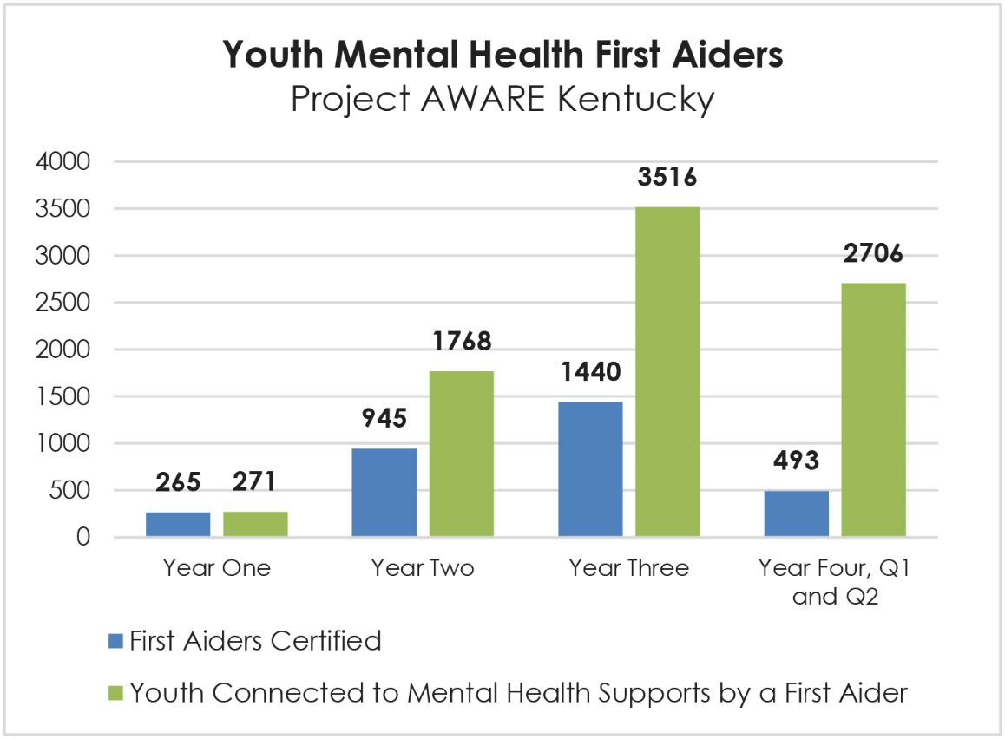
Enhancing Knowledge & Skills
Youth Mental Health First Aiders Training—At the end of March 2018,
3,143 First Aiders have been certified, and 8,261 youth were connected to mental health supports by
^{a First Aider.}

Slide 11
Expanding Capacity – Creating Referral Systems
Mental Health and Substance Abuse Professionals
  97 Fayette County
  113 Pulaski County
  4 Kentucky School for the Deaf
^{The LEAs have entered into}
formal agreements (contracts/Memorandum of Agreements) with mental health and substance abuse professionals.
At the end of Year 3, 214 licensed mental health professionals were providing school-based mental health and substance abuse services in the three AWARE school systems.

Slide 12


Formal process for student access to a continuum of mental health and other supports
Data-driven identification of student needs (universal screening, absenteeism, grades)
Teacher/School Staff identification of student who would benefit from additional supports
Parent/Family/Self identification of student needing additional supports
Youth and caregiver choice of pathway (may include both)

Slide 13
Mental Health Service
Evidence-based PBIS intervention
FRYSC Staff provide information to caregivers about school based and community based mental health options
School staff initiate PBIS intervention matched to student needs
Student data is reviewed at least monthly through the school PBIS team

Slide 14
If data suggest adequate improvements have been made and maintained, begin phasing out intervention and continue with Tier 1 supports
If data suggest adequate improvement but inadequate maintenance, continue with intervention and data monitoring
If data suggest inadequate improvement, ensure fidelity of intervention implementation and/or consider adding or altering an intervention
Behavioral health providers, parents and school staff understand the pathway for receiving supports and make decisions collaboratively

Slide 15


Trauma Informed Practices for Educators
Notes:
.

Slide 16

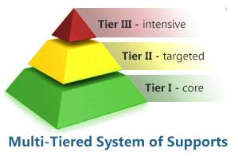
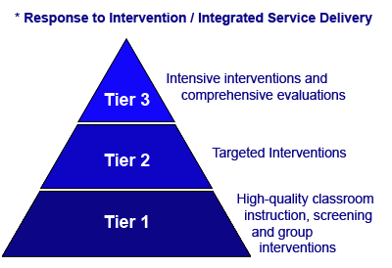
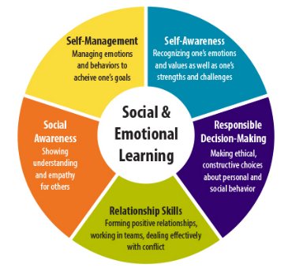
Trauma Informed Practices infused into…
…creates Trauma Sensitive Schools

Slide 17
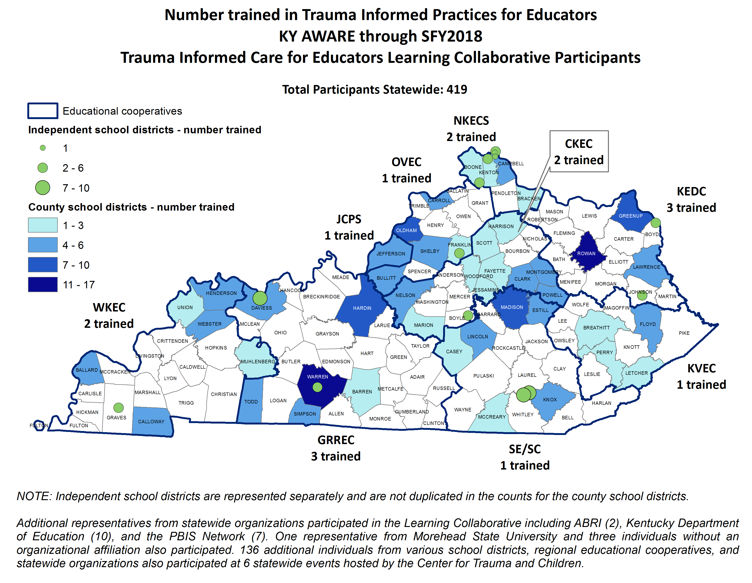

Slide 18
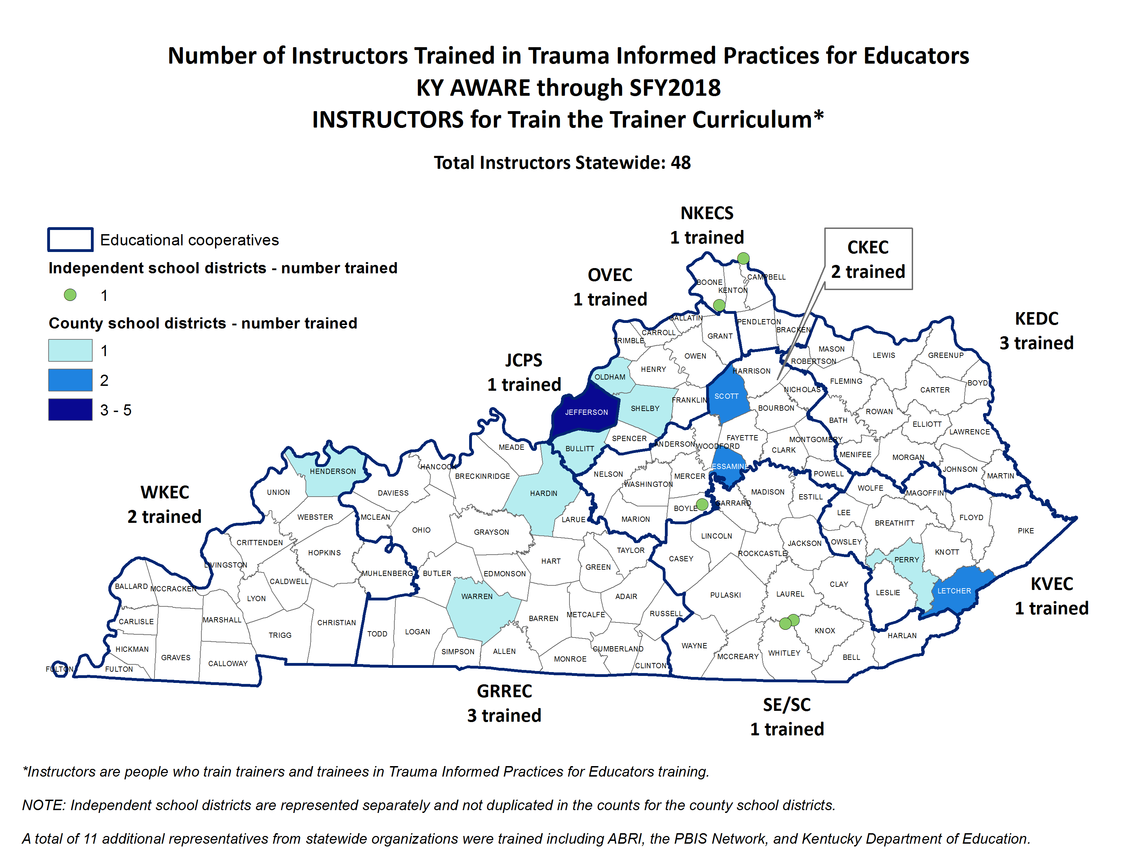

Slide 19
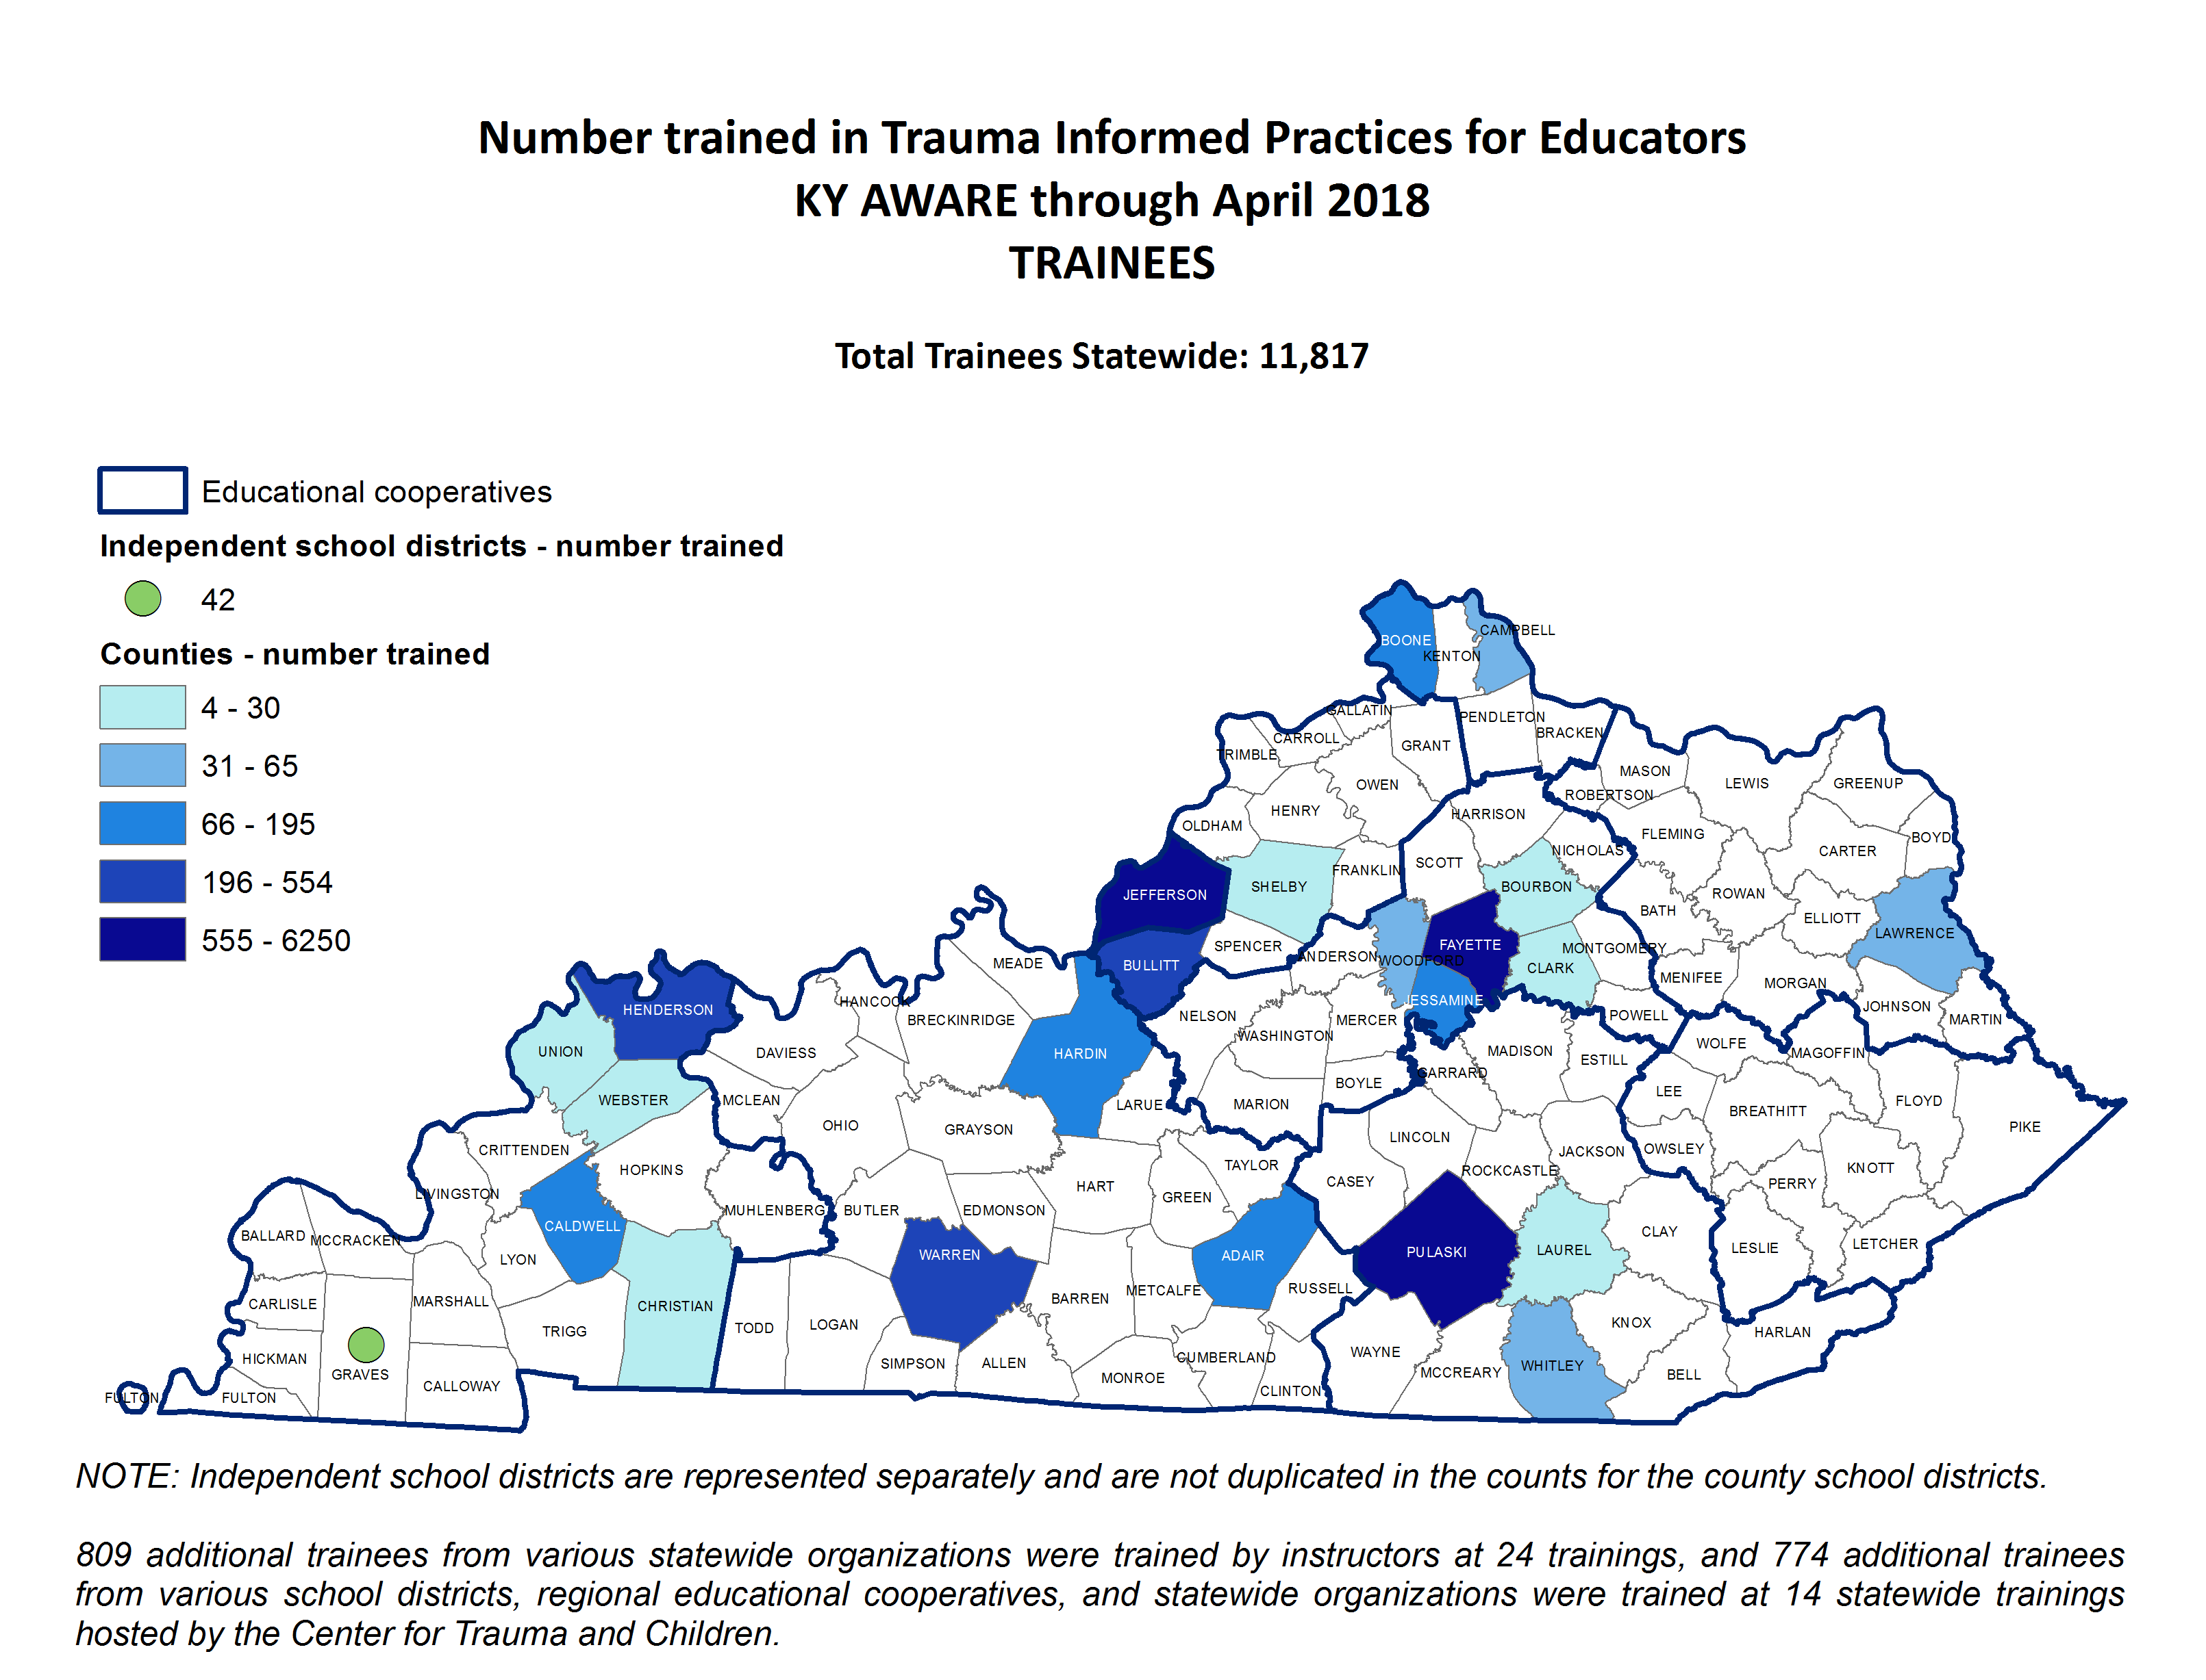

Slide 20
Best Practices
Integrate learning supports, instruction, and school management within a comprehensive approach that facilitates multidisciplinary collaboration.
Implement multi-tiered systems of support (MTSS) that encompass prevention, wellness promotion, and interventions that increase with intensity based on student need, and that promote close school–community collaboration.
Improve access to school-based mental health supports.
Integrate ongoing positive climate and safety efforts with crisis prevention, preparedness, response, and recovery plans.
Balance physical and psychological safety measures.
Employ effective, positive school discipline approaches.
Consider the context of each school and district and provide services that are most needed, appropriate, and culturally sensitive.
Acknowledge that sustainable and effective change takes time, and that individual schools will vary in their readiness to implement improvements and should be afforded the time and resources to sustain change over time.
Cowan, K. C., Vaillancourt, K., Rossen, E., & Pollitt, K. (2013). A framework for safe and successful schools [Brief]. Bethesda, MD: National Association of School Psychologists.
Notes:
http://sumo.ly/SVrt
1. Fully integrate learning supports (e.g., behavioral, mental health, and social services), instruction, and school management within a comprehensive, cohesive approach that facilitates multidisciplinary collaboration.
2. Implement multitiered systems of support (MTSS) that encompass prevention, wellness promotion, and interventions that increase with intensity based on student need, and that promote close school–community collaboration.
3. Improve access to school-based mental health supports by ensuring adequate staffing levels in terms of school-employed mental health professionals who are trained to infuse prevention and intervention services into the learning process and to help integrate services provided through school–community partnerships into existing school initiatives.
4. Integrate ongoing positive climate and safety efforts with crisis prevention, preparedness, response, and recovery to ensure that crisis training and plans: (a) are relevant to the school context, (b) reinforce learning, (c) make maximum use of existing staff resources, (d) facilitate effective threat assessment, and (e) are consistently reviewed and practiced.
5. Balance physical and psychological safety to avoid overly restrictive measures (e.g., armed guards and metal detectors) that can undermine the learning environment and instead combine reasonable physical security measures (e.g., locked doors and monitored public spaces) with efforts to enhance school climate, build trusting relationships, and encourage students and adults to report potential threats. If a school determines the need for armed security, properly trained school resource officers (SROs) are the only school personnel of any type who should be armed.
6. Employ effective, positive school discipline that: (a) functions in concert with efforts to address school safety and climate; (b) is not simply punitive (e.g., zero tolerance); (c) is clear, consistent, and equitable; and (d) reinforces positive behaviors. Using security personnel or SROs primarily as a substitute for effective discipline policies does not contribute to school safety and can perpetuate the school-to-prison pipeline.
7. Consider the context of each school and district and provide services that are most needed, appropriate, and culturally sensitive to a school’s unique student populations and learning communities.
8. Acknowledge that sustainable and effective change takes time, and that individual schools will vary in their readiness to implement improvements and should be afforded the time and resources to sustain change over time.

Slide 21
For More Information
Vestena Robbins, PhD
Executive Advisor, Kentucky Department for Behavioral Health, Developmental and Intellectual Disabilities
Vestena.Robbins@ky.gov
Kathryn Tillett, MSSW, CSW
Project Director, Kentucky AWARE
Kentucky Department of Education
Kathryn.Tillett@education.ky.gov

