Slide 1
Sources of Strength
Trigg County County High School - Cadiz, Kentucky
Hope-Help-Strength
July 9, 2018

Slide 2
Why SOURCES of STRENGTH?
POSITIVE, PROACTIVE ENGAGEMENT of STUDENTS & ADULTS
TO PREVENT SUICIDE, BULLYING, & VIOLENCE
PROMOTE CONNECTIONS AND POSITIVE RELATIONSHIPS BETWEEN PEERS & ADULTS
INCREASE HELP SEEKING BEHAVIORS
RECOGNIZE & DEVELOP PERSONAL STRENGTHS
SOCIAL & EMOTIONAL WELL BEING

Slide 3
SOURCES of STRENGTH at TCHS
SURVEYS
PARTNERSHIP
SELECTION (Peers/Mentors)
TRAINING
LEADERSHIP

Slide 4
SOURCES of STRENGTH: A Best Practice
PEER LEADERS & ADULT MENTORS
STRATEGIC MESSAGING
“UPSTREAM” PREVENTION
STATEWIDE PARTICIPATION
REQUIREMENTS

Slide 5
SOURCES of STRENGTH: Students’ Perspectives
HOPE
HELP
STRENGTH(s)

Slide 6
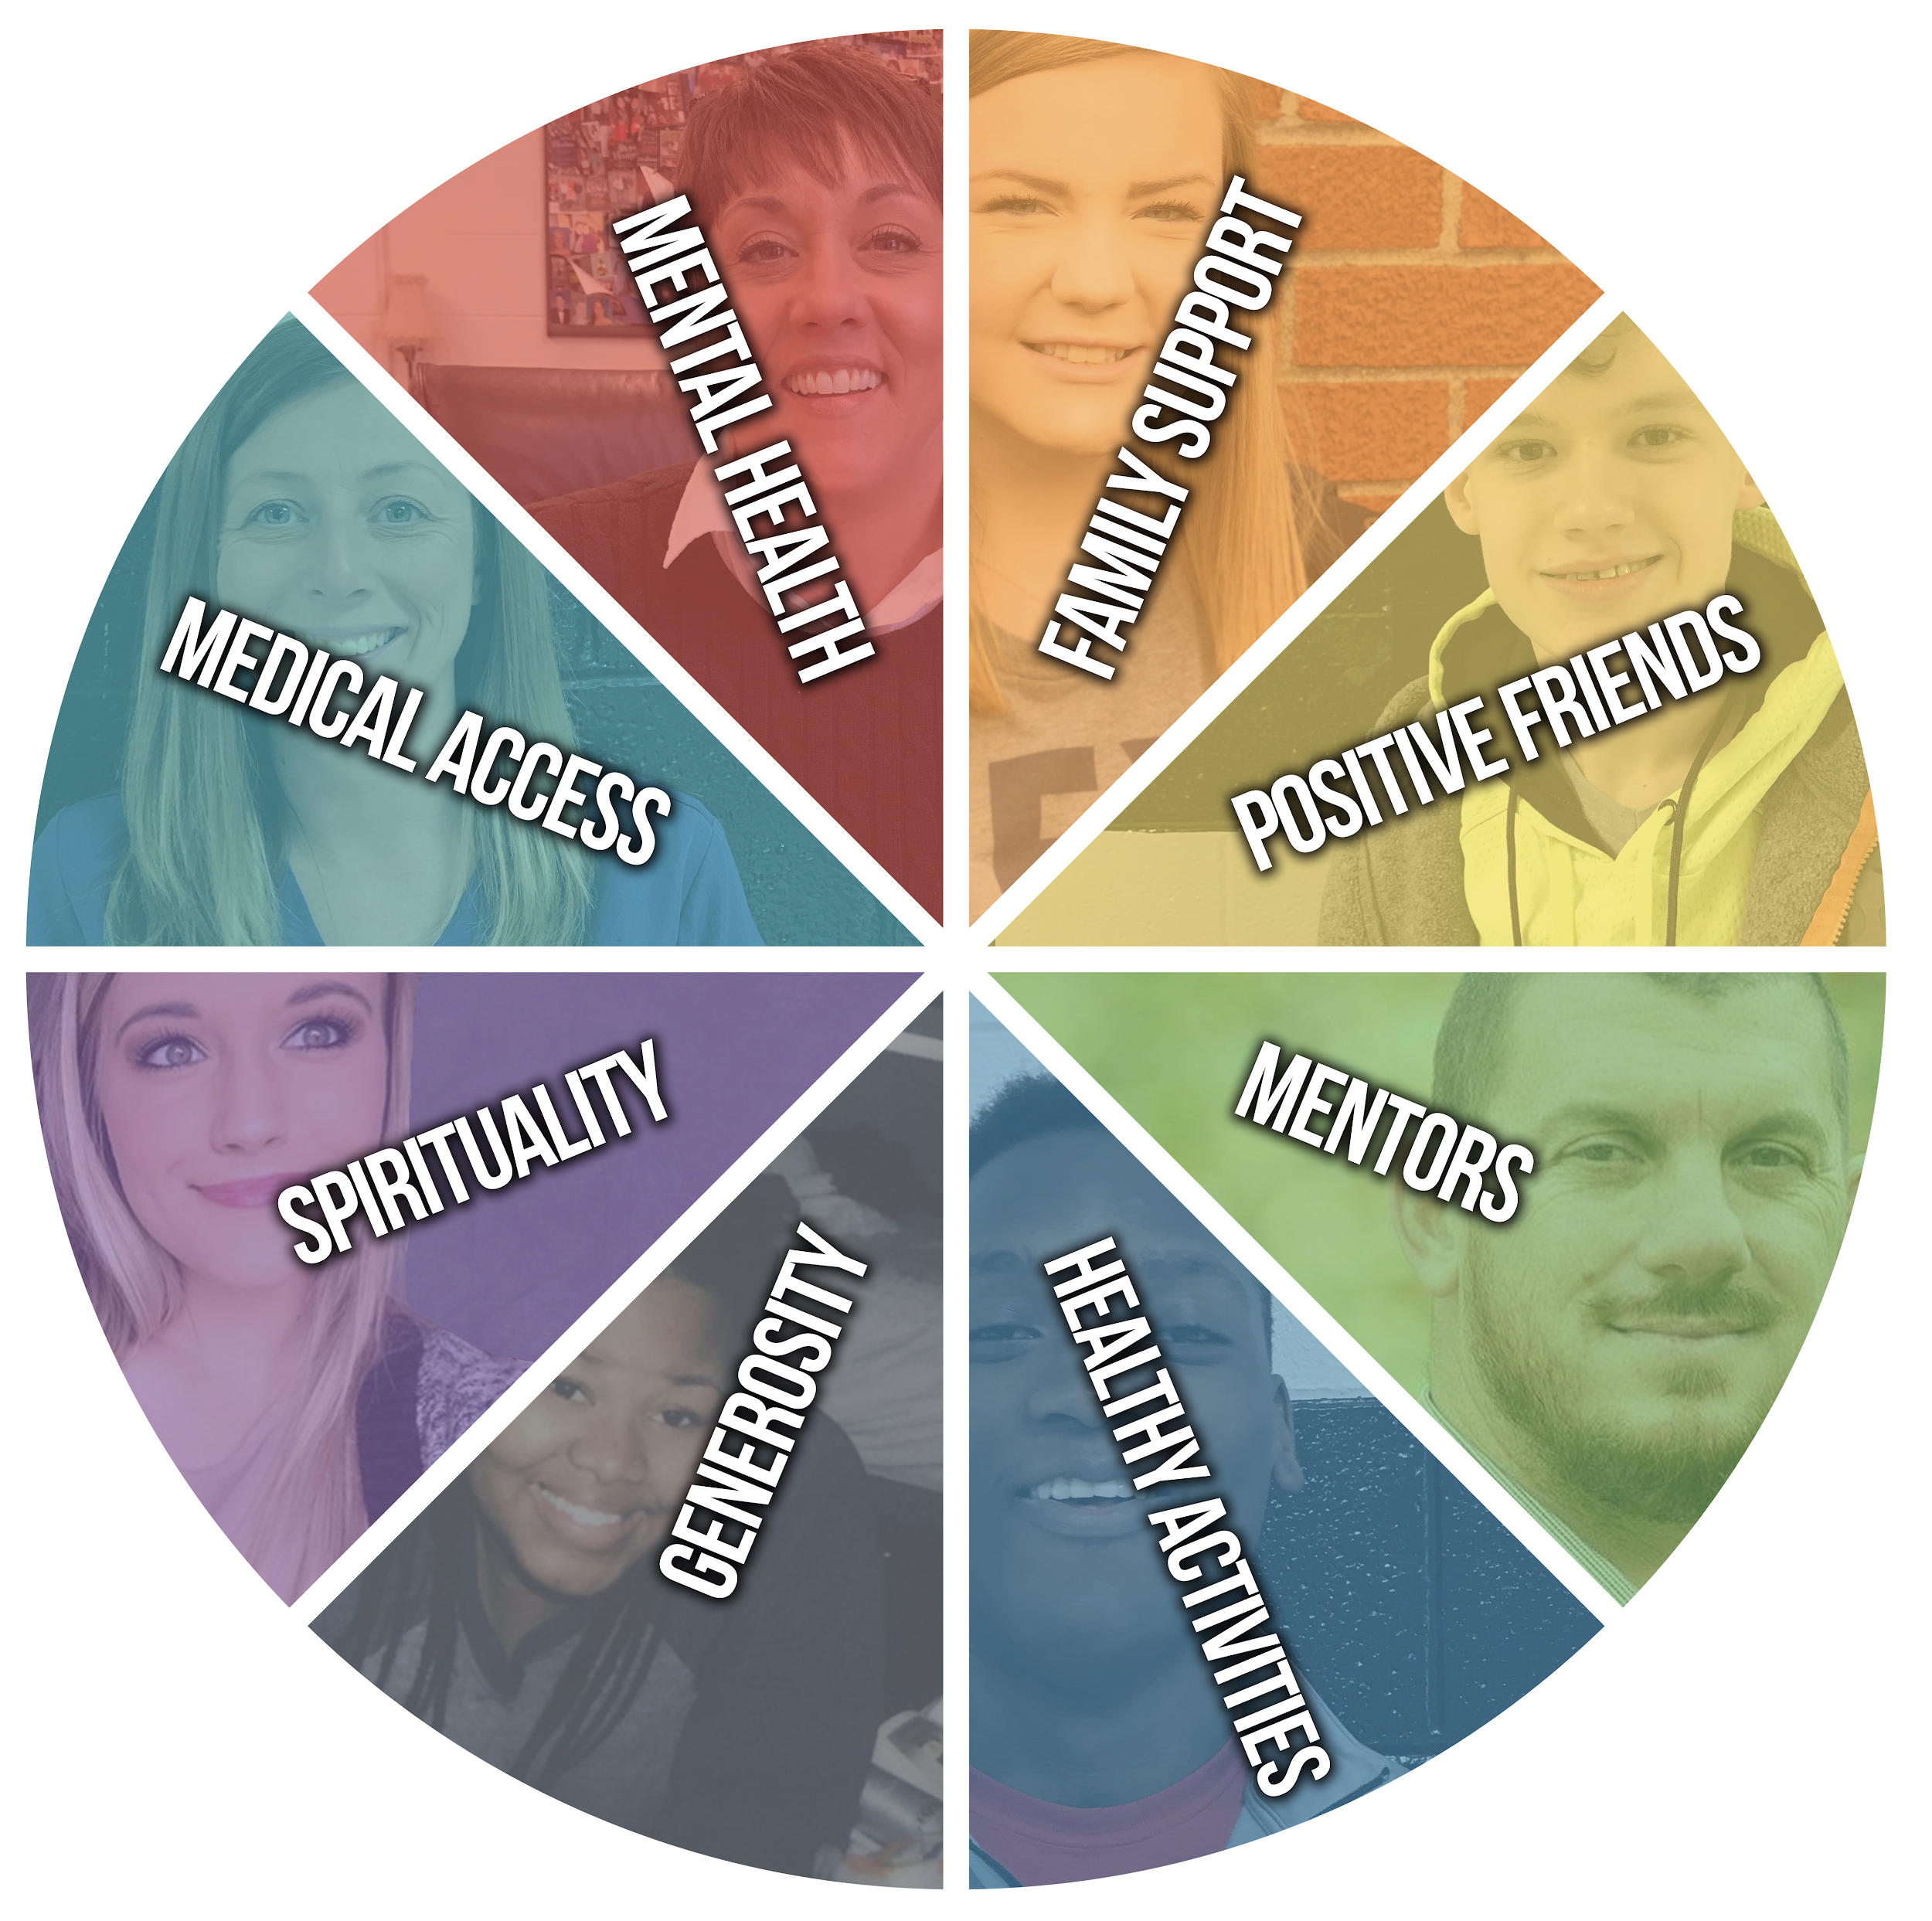
What are your SOURCES of STRENGTH?
Family Support
Positive Friends

Slide 7
What are your SOURCES of STRENGTH?
Mentors
Healthy Activities

Slide 8
What are your SOURCES of STRENGTH?
Generosity
Spirituality

Slide 9
What are your SOURCES of STRENGTH?
Medical Access
Mental Health

Slide 10
SOURCES of STRENGTH: Actions at TCHS
Social Media - positive messages through twitter, instagram, & remind
Art - designed t-shirts, sticky note bulletin board, box in front office & on announcements, banners in every hallway
Presentations - explanation to teachers during PLC meetings
Events - SOS dodgeball teams, sticky notes on every locker
Audio/Visual - plan to create new suicide prevention video

Slide 11
Next Steps at TCHS
CONNECTIONS
PLANNING
ACTIONS
TRAINING
IMPLEMENTATION

