Slide 1
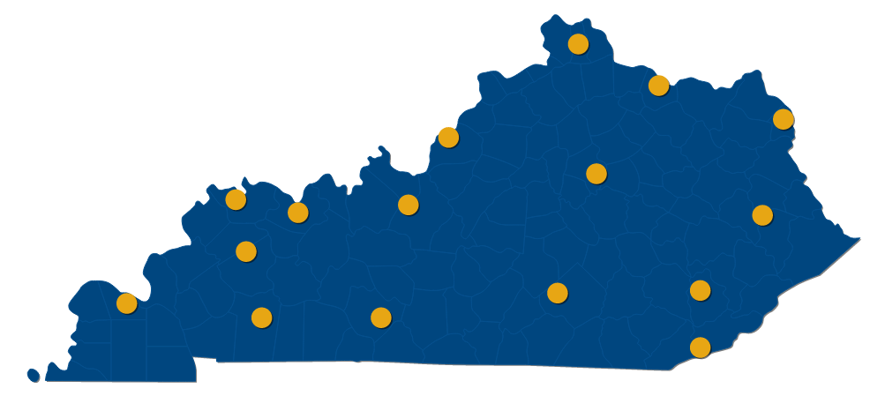
Dr. Jay Box President Interim Joint Committee on Education August 2018

Slide 2
We were created by you, the General Assembly, in 1997.
HB 1 transformed a highly fragmented and uncoordinated network of technology centers and secondary programs under the authority of the State Board for Adult and Technical Education and Workforce Development Cabinet and community colleges attached to UK into the
Kentucky Community and Technical College System.
OUR STATE MANDATED MISSION:
College and Workforce Readiness
Workforce Education and Training
Transfer Education

Slide 3
A System with Accredited Colleges
16 colleges, a System Office , 1 governing board, 16 advisory boards.
Sharing of physical and human resources and consistency with curriculum and programs.
Colleges have the flexibility to tailor programs to local workforce needs.

Slide 4
A Step in the Right Direction
Leap
1998 – 2008: new campus locations, new buildings, doubled enrollment, investment in technology and distance learning, focus is on access
2008 – 2012: economic decline leads to state funding cuts, rapid enrollment growth, average age of student is 28, transfer legislation passed, focus shifts from access to completion
2012 – 2018: enrollment decline lasts five years, economy improves but workforce shortage grows, dual credit legislation passed, demand for soft skills increases, become national leader in dual credit, all-time high for completion

Slide 5
IMPACT

Slide 8
WORKFORCE DEVELOPMENT

Slide 11
Technical Focus (since 2015)
13 new college presidents hired, with an emphasis on technical backgrounds.
292 new programs and certificates added systemwide with overwhelming majority being technical; suspended 570 programs that are no longer meeting the needs of the workforce (such as a Global Studies Certificate).
$64 million in grants FY 16-17 utilized for student retention, completion, and workforce needs.
Over 2,000 companies represented through participation in our colleges’ technical advisory committees.

Slide 12
Technical Focus (since 2015)
$15.4 million TRAINS funds used to provide training to incumbent workers, new & expanding companies to create new jobs, and developing new academic programs based on industry demand.
In FY17 alone, colleges served over 5,500 Kentucky companies and provided training to 42,000 participants.
In FY 2017 alone, the Workforce Assessment Centers administered 76,000 tests for industry certifications, licensing exams or skill assessments for hiring and promotion.
In spring 2018, 52.3% of KCTCS students took at least one technical course.

Slide 13
KCTCS uses labor market indicators combined with internal data to evaluate program alignment with workforce needs.

Slide 14
KCTCS colleges use their websites to communicate real-world information about the job market, prospects, and necessary education.

Slide 17
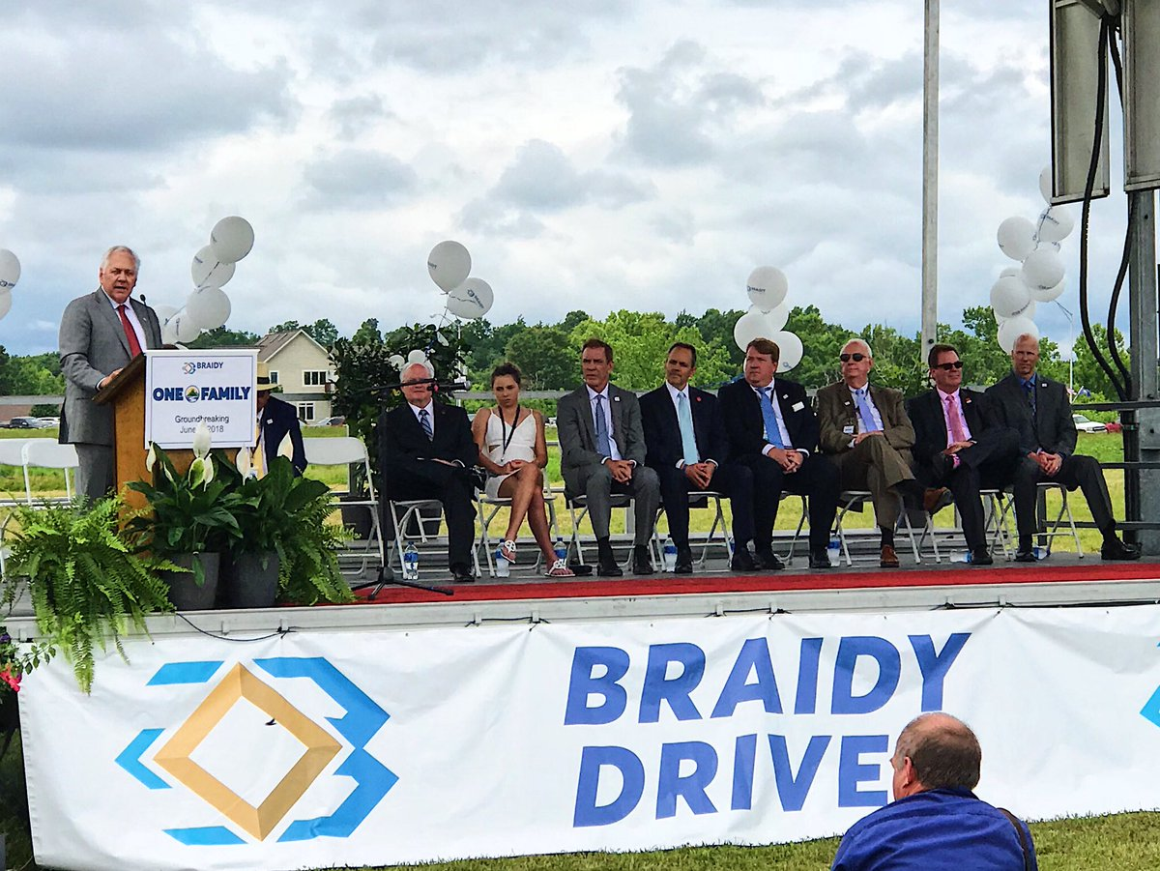
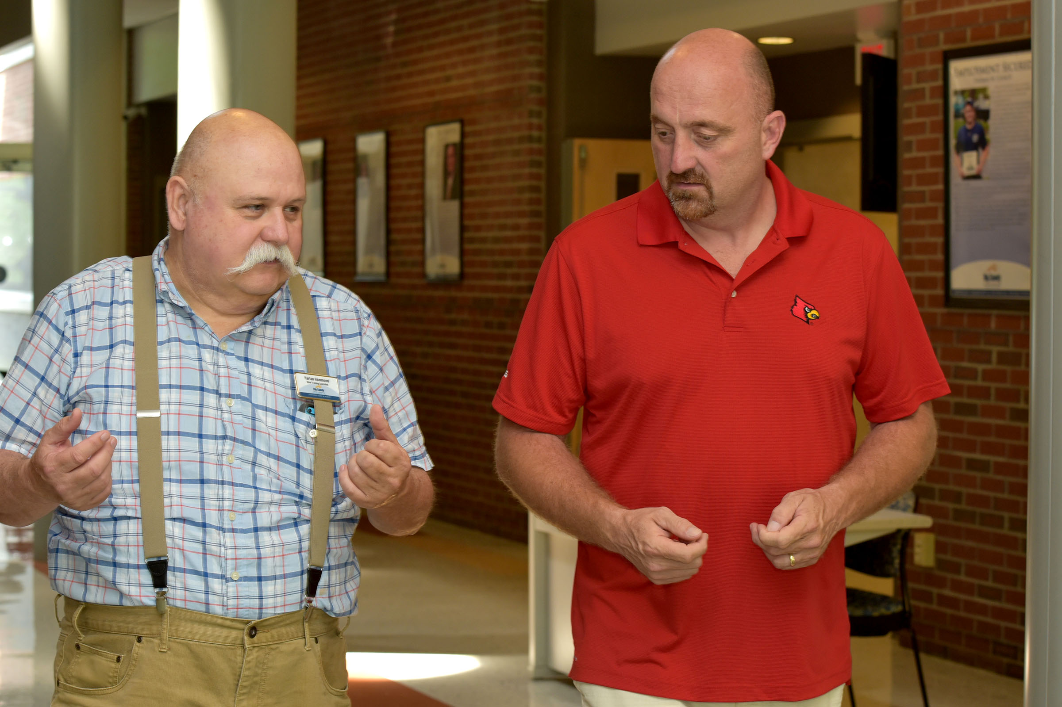
Technical Examples

Slide 18
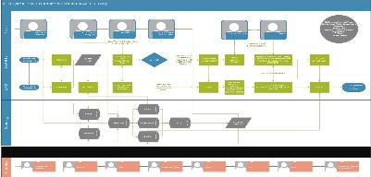
OnRamp: The Road to a Better Life for Adult Students
On Ramp
Off Ramp
Pre-AOKY
WRKS
TANF
HWHD Jobs
Certificate
Associates Degree
KCTCS/Skills-U
Partnership
AOKY
Dev.
Ed.
Medicaid
Career
Transfer
Bachelors Degree

Slide 19
DUAL-CREDIT

Slide 20
50%
of the
state’s dual-credit
enrollment

Slide 21
Dual-Credit
Dual-credit enrollment is up 11.5% year-to-date for Fall 18
Continued, steady growth since 2012 (up 45.4%)
High school students = 15.7% of total KCTCS enrollment
Overall pass rate over 97%

Slide 22
RETURN ON INVESTMENT

Slide 23
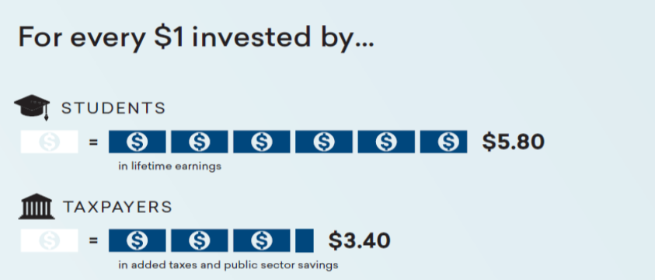
“The investment made by state taxpayers to KCTCS colleges creates a wide range of benefits to society and returns more to government budgets than it costs.” -- Economic Modeling Specialist Incorporated (EMSI), November 2017

Slide 24
KCTCS Student Rate of Return Economic Modeling Specialist Incorporated (EMSI), November 2017
19.6%
10.1%
0.8%
Average annual return for KCTCS students
Stock market 30-year average annual rate of return
Interest earned on savings account (national rate cap)

Slide 25
EFFICIENCY

Slide 26
A unified system creates value for taxpayers.
Based on an internal study in 2017, operating as a system saves $50 million. Shared services and pooled resources eliminates the need for 800 additional staff statewide.
Students would have to pay $31 more per credit hour in tuition if their college operated independently (based on 2017-18 tuition).

Slide 27
The Need for Efficiency
FY 2008 Enacted Net General Funds
$ 228,704,900
FY 2019 Enacted Net General Funds
$ 167,729,000
Dollar Change
$
(60,975,900)
Percent Change
-26.7%
The funding for FY 2019 is nearly the same
as it was for FY 2000.

Slide 28
Efficiency Initiatives (since 2015)
Eliminated 800+ faculty and staff positions and consolidated, realigned and deactivated over 570 credential/programs.
Savings of $27.3 million in 2016-17
Renegotiated, rebid, or expanded contracts for goods and services to lower costs and obtain improved services, service level agreements, and/or accountability measures.
Annualized savings of $550,000

Slide 29
Efficiency Initiatives (since 2015)
Reduction in utilities and fixed costs savings as a result of executing Energy Management Performance Saving Projects.
Nearly $29 million in savings during the 14-year payback period – Round 1
Nearly $39 million in savings during the 14-year payback period – Round 2
As a result of 6 colleges participating in the Commonwealth Energy Management System, the annual utility cost savings in FY 2018 was $1.9 million.

Slide 30
Efficiency Initiatives (since 2015)
KCTCS has made significant use of technology where and when possible to avoid, reduce, and eliminate cost or costs increases.
Annualized savings of $1 million
Outsourcing to third parties to gain efficiencies and control costs.
Total savings of $13.9 million
Centralized processes and automation of previously manual functions to gain economies of scale and great efficiency.
Annualized savings of $440,000

Slide 31
Efficiency Initiatives (since 2015)
As of January 1, 2014, new employees are no longer offered the defined benefit retirement plan (KERS/KTRS). Instead they are enrolled in a defined contribution retirement account (403(B)).
Annualized savings of $900,000

Slide 32
FINAL THOUGHTS

Slide 33
Final Thoughts
We are committed to performance funding – but the model needs to be fully funded to work as intended.
We have a workforce shortage, too.
We need help from business and industry, HS counselors, parents, and officials in overcoming the stereotypes.

Slide 34
Final Thoughts
We need businesses as much as they need us – partnerships are crucial.
General education is necessary from an economic and societal standpoint.
Dual credit is important, but it is not going to solve our workforce problem. We must continue to focus on adults.

Slide 35
Final Thoughts
We are, now more than ever, committed to being the most affordable and impactful higher education institution in the Commonwealth and we are always open to ideas on how to more expediently and efficiently fulfill our mission. We welcome review and input from the General Assembly and Administration.

Slide 37
Thank you. Together, let’s make an IMPACT on our Commonwealth.

