Slide 1
Joint Committee on Education Work Ready Skills Initiative Brooken Smith, Chief of Staff
Education and Workforce Development Cabinet
September 10, 2018

Slide 2
Work Ready Skills Initiative Goals
To bring together employers, educators and communities across the Commonwealth to create cutting edge programs through employer led partnerships and modernization of facilities and equipment that provide students and adults with the skills necessary to meet the demands of Kentucky’s priority sector employers:
Advanced Manufacturing
Health Science
Transportation & Logistics
Business & IT Services
Construction & Trades
HB 303 allocated $100 million in construction pool bonds for WRSI

Slide 3
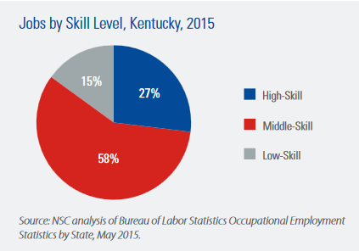
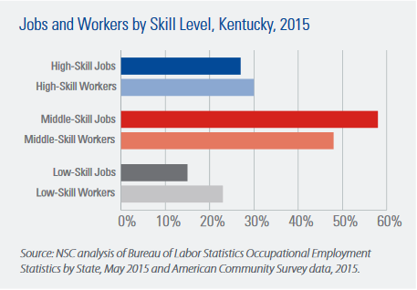
Kentucky Skills Gap

Slide 4
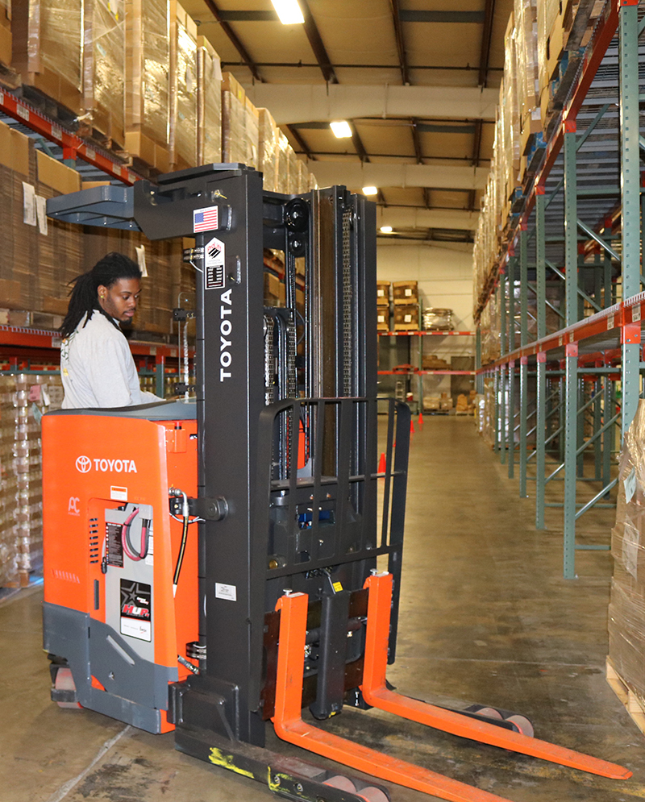
Public-Private Partnerships
Eligible applicants include commitment from public and private sectors:
Private sector employers;
High schools or secondary technical schools; and
Post-secondary institutions.
Applicants are encouraged to seek broad collaborative partnerships with:
Local Elected Officials;
Workforce Development Boards; and
Economic Development Agencies.
Projects are to provide necessary facilities, equipment, programs and curriculum to train and educate workers to meet demonstrated demand for jobs.
Minimum 10% local investment match of funds.

Slide 5
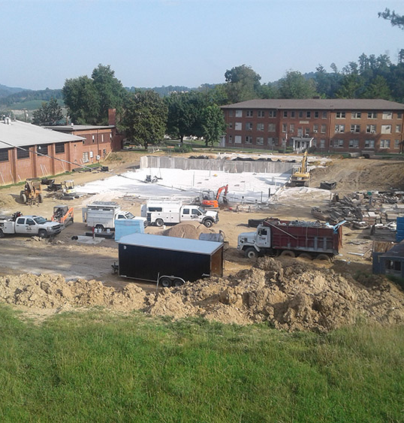
Multipurpose Use of Funds
Construction and equipping of new facilities to provide workforce training and education;
Renovation or upgrade of an existing facility;
Purchase of new or upgraded equipment, software and furnishings; and

Slide 6
WRSI Funding Allocations
85 applications submitted requesting a total of $998,918,275. Total includes match and grant monies combined.
Work Ready Skills Initiative funds requested = $516,281,697
Match proposed = $482,636,578
40 projects awarded for a total community investment of $220,058,700.
WRSI funds awarded = $98,763,907
Total project match committed = $121,294,793

Slide 7
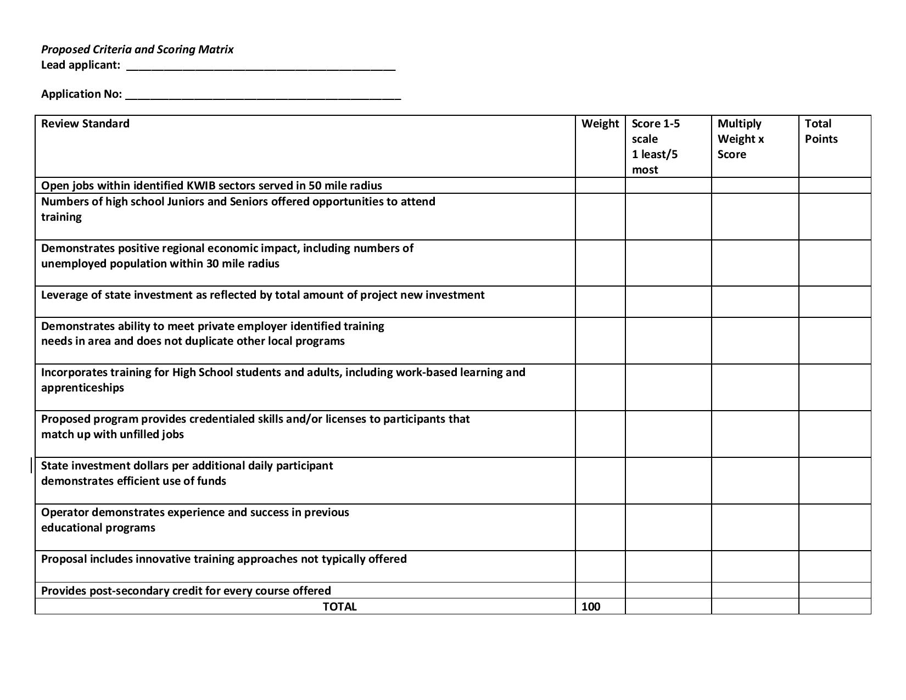
Work Ready Skills Application Process & Timeline
Funding awarded over the course of two rounds.
A ten-member committee publicly scored each proposal to determine the compatibility of each application in relation to the goals of the Work Ready Skills Initiative.
All committee meetings were livestreamed.
An agreement was negotiated between the applicant and the Education and Workforce Development Cabinet, including all negotiated terms, conditions and requirements.
Funds released on a monthly basis as costs are incurred and after local investment has been made.

Slide 8
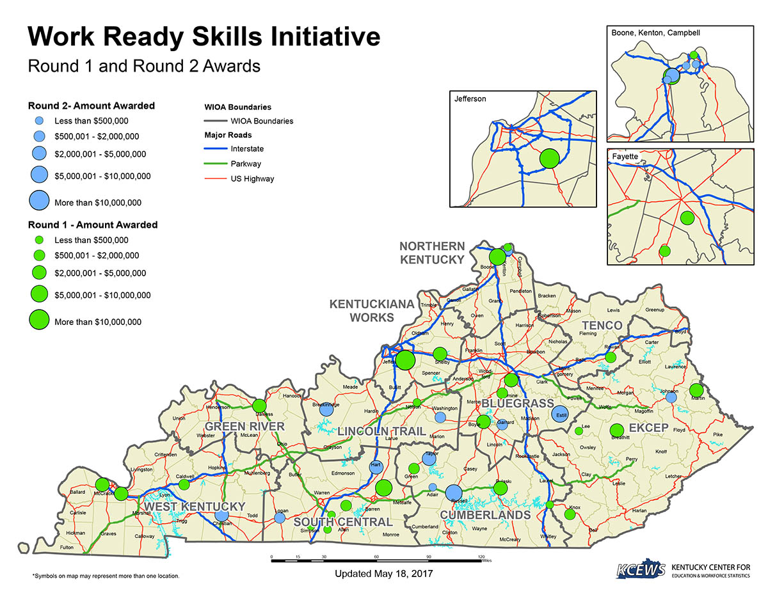
Work Ready Projects by Region
West Kentucky 4
Green River 1
South Central 7
Lincoln Trail 3
Kentuckiana Works 2
Northern Kentucky 6
Bluegrass 5
Cumberlands 6
TENCO 1
EKCEP 5

Slide 9
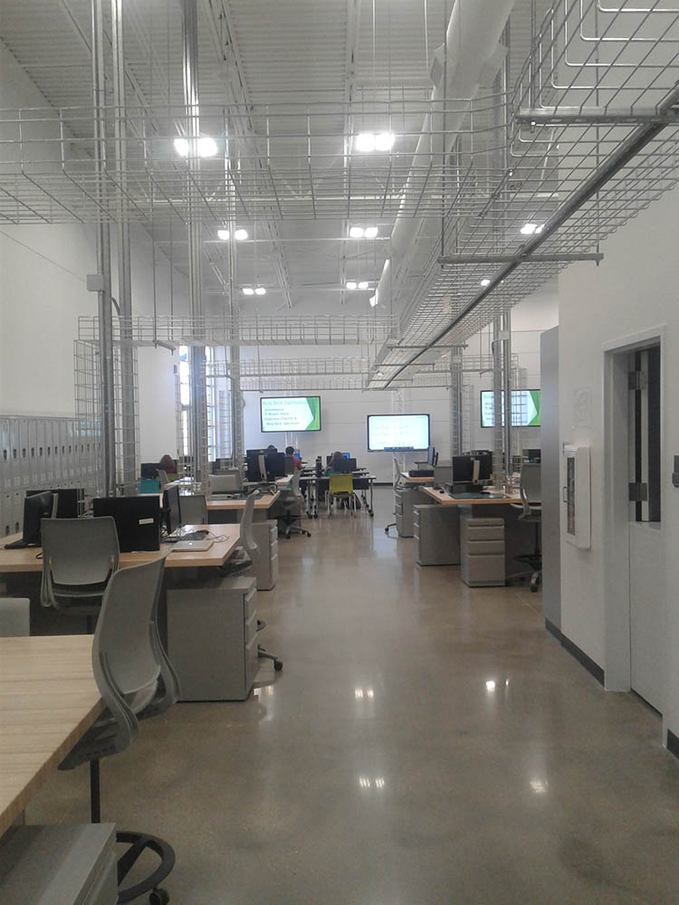
Project Status
Matches have been completed on 12 projects:
Western Kentucky Partnership, Allen County, Barren County, Bowling Green, Southcentral CTC, Nelson County, Jefferson CYC, Bluegrass CTC-Leestown, Green County, Maysville CTC, Freestore Foodbank, and Logan County.
WRSI funds being drawn on 10 projects:
Western Kentucky Partnership, Allen County, Barren County, Bowling Green, Nelson County, Jefferson CTC, BCTC Leestown, Green County, Freestore Foodbank, and Logan County.
23 of the 25 projects with a construction component are in the construction phase.
This does not include minor renovation projects.
8 projects near completion
EWDC to issue semi-annual reports on WRSI status

Slide 10
Work Ready Outreach Capacity
Current Adult Enrollment 6,727
Current Student Enrollment 15,563
Total Current Enrollment 22,290
Projected Adult Enrollment 14,838
Projected Student Enrollment 28,289
Total Projected Enrollment 43,127
Total Additional Students 20,837

Slide 11
Monitoring & Oversight
Education and Workforce Development staff visit 10 project sites per month to conduct the following:
Meet with stakeholders to discuss project status/concerns, and answer questions;
Take physical inventory of donated equipment-as needed;
Work with fiscal agents on portal functionality and match verification requirements;
Tour facilities and monitor progress;
Review change requests;
Share best practices;
Award recipients are required to upload invoices and proof of payment into the WRSI Project Portal.
All invoices are reviewed to ensure items purchased are project related, amounts and vendor on the pay document match the invoice. Once project match has been verified, the portal for WRSI reimbursement requests is opened.

Slide 12
Barren Regional Technical Campus

Slide 13
Barren Regional Technical Campus

Slide 14
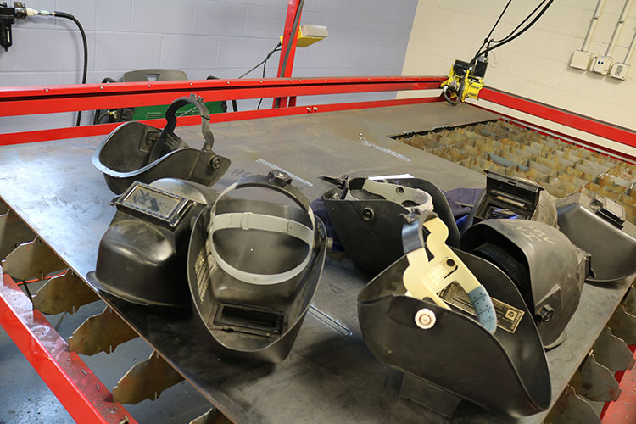
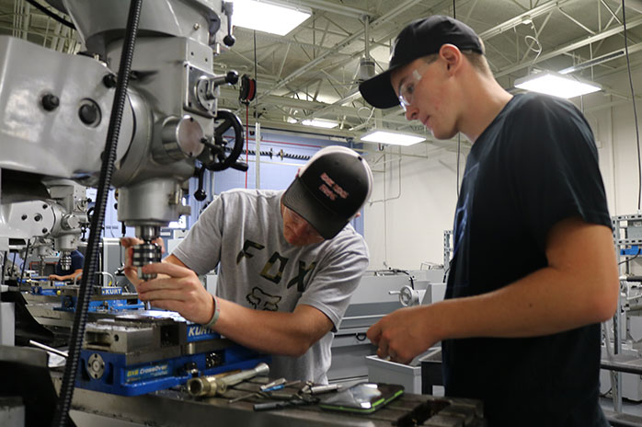
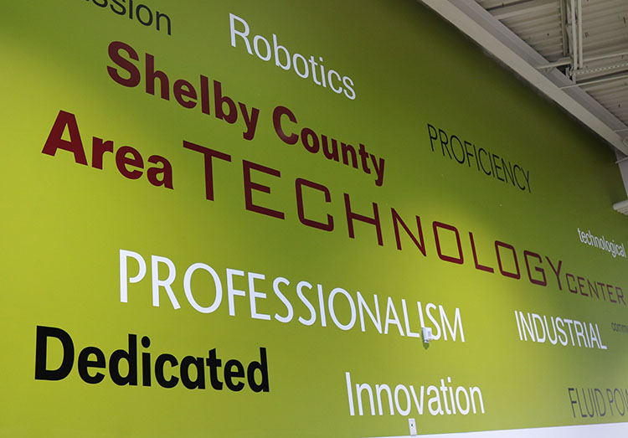
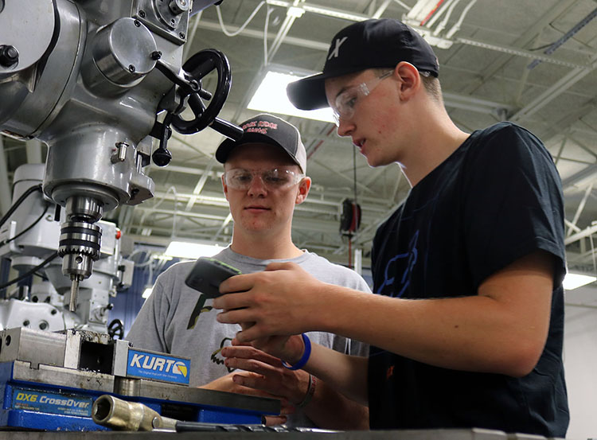
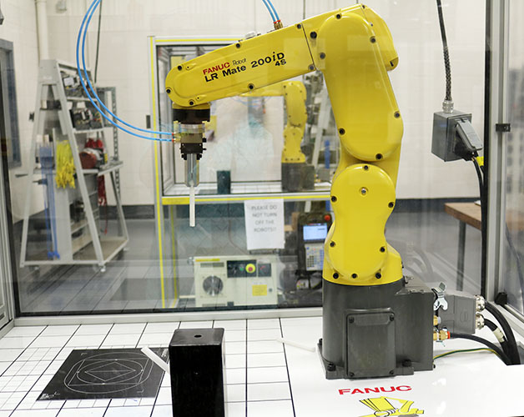
Shelby county AREA TECHNOLOGY CENTER

Slide 15
LOGAN COUNTY

