Slide 1
Kentucky Academic Standards for Social Studies

Slide 2
SB1 (2017) Standards Revision Requirements
The standards revision to the content standards shall:
Focus on critical knowledge, skills, and capacities needed for success in the global economy;
Result in fewer, but more in-depth standards to facilitate mastery learning;
Communicate expectations more clearly and concisely to teachers, parents, students and citizens;
Focus on critical knowledge, skills, and capacities needed for success in the global economy;
Result in fewer but more in-depth standards to facilitate mastery learning;
Communicate expectations more clearly and concisely to teachers, parents, students and citizens.

Slide 3
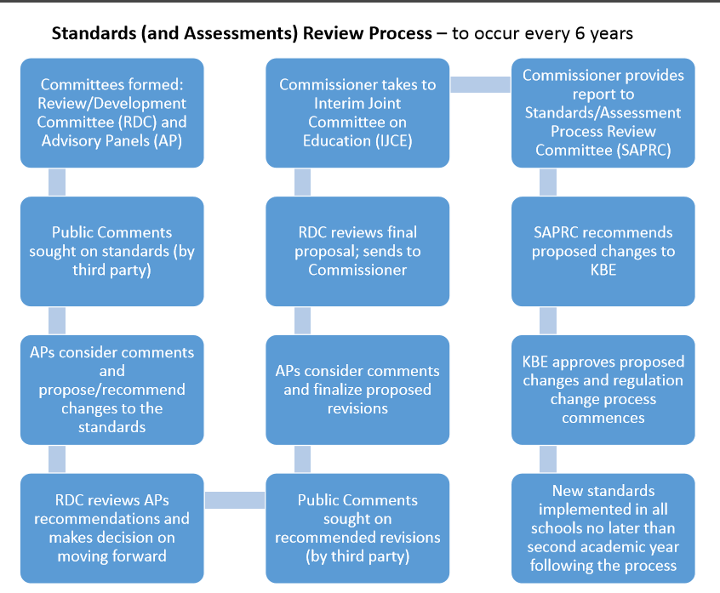

Slide 4
Standards and Regulation
704 KAR 8:060 Kentucky Academic Standards for Social Studies
​This administrative regulation adopts into law the Kentucky Academic Standards for Social Studies.

Slide 5
KAS for Social Studies Timeline Overview
January/February – Call for participation on standards committees; opened current social studies standards for public comment/feedback
March – Initial Social Studies AP meeting
April – Initial Social Studies RDC meeting; second Social Studies AP meeting
May – Joint subcommittees met to review and revise the draft standards; Social Studies RDC met for the second time
June – Joint subcommittees met to review and revise the draft standards
July/August – Opened draft standards for public comment/feedback
September/October – Social Studies APs met again; Social Studies RDCs met again
November – Interim Joint Committee on Education reviewed draft standards
December – First reading by the KBE
January – Standards/Assessment Review and Process Committee reviews
February – Second reading by KBE

Slide 6
Public Comment Period- Survey Details and Respondent Roles
1,227 total respondents
78% of respondents were current classroom teachers
Roughly 76% of all KY counties provided responses

Slide 7
Public Comment Period: Standard Ratings
Number of Standards (by Grade Level) to Receive Each Range of Agreement
GRADE | 100% | 90-99.99% | 80-89.99% | 70-79.99% | <70% | Total Comments
Kindergarten | 0 | 7 | 15 | 4 | 3 | 579
Grade 1 | 0 | 3 | 13 | 15 | 2 | 571
Grade 2 | 0 | 8 | 11 | 14 | 2 | 488
Grade 3 | 0 | 7 | 20 | 4 | 0 | 294
Grade 4 | 0 | 18 | 10 | 1 | 0 | 213
Grade 5 | 0 | 18 | 16 | 0 | 1 | 300
Grade 6 | 0 | 1 | 28 | 9 | 0 | 808
Grade 7 | 0 | 13 | 24 | 2 | 0 | 453
Grade 8 | 0 | 31 | 15 | 1 | 0 | 379
High School | 0 | 70 | 41 | 5 | 0 | 1,221

Slide 8
Additional Feedback
June – three focus groups
Current practicing classroom teachers, instructional coaches and district leaders
July – one focus group
Kentucky organizations: Kentucky Center of African American Heritage, Kentucky Native American Heritage Commission and the Muhammad Ali Center
September – three focus groups
Current practicing classroom teachers and pre-service teachers (in collaboration with the Kentucky Council of Social Studies)
Current high school students, grades 9-12
Throughout the process
National organizations: Council of Chief State Social Studies Specialists, National Council for the Social Studies Associated Group, National Geographic, …

Slide 9
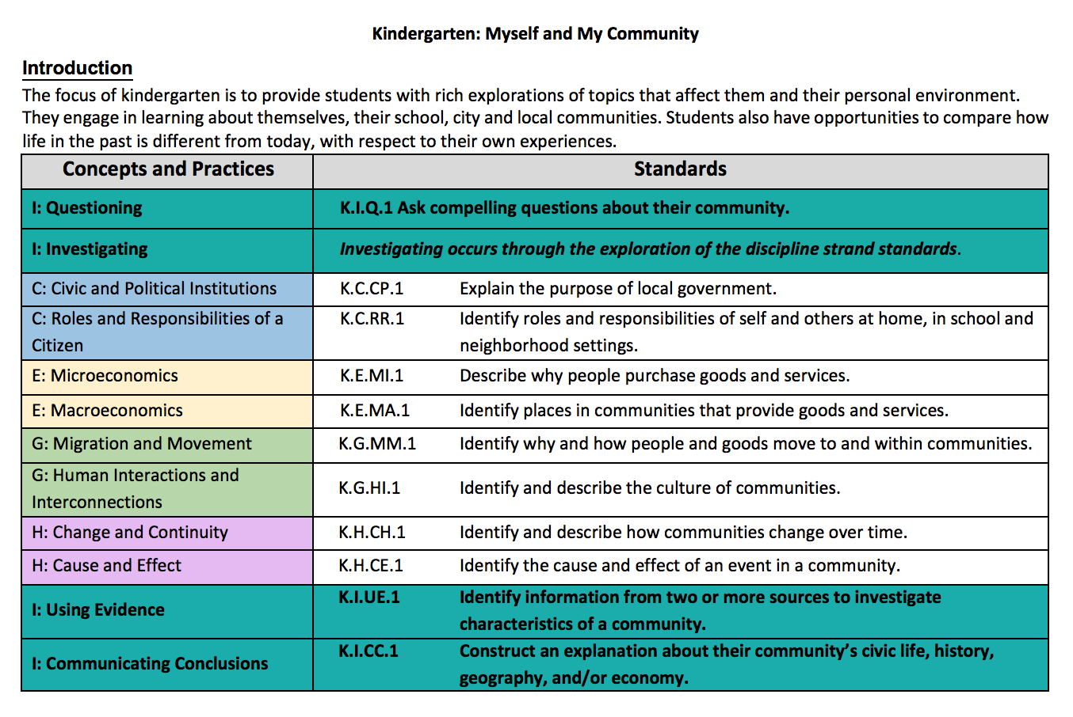
Draft Kentucky Academic Standards for Social Studies
Each elementary and middle school grade level is identified with a title and a theme.
Each grade level has an introduction to provide additional information about the theme.
The inquiry practices are color coded to indicate the integration of inquiry throughout the grade level standards.
Each grade level begins with the inquiry practice of questioning.
Students engage in the inquiry practice of investigation through the exploration of the discipline strand standards.
The disciplinary strands civics, economics, geography and history are color coded and identified with a corresponding character. The discipline specific character appears before the concept and practice title.
Each standard is coded for identification of its grade level, discipline, concept and practice and number within the larger set of standards.
Students complete the inquiry process by using evidence and communicating conclusions.

Slide 10
Public Comment Period: Framework Overview (Agree/Strongly Agree)
Standards are easy to identify on the page. (90.09%)
It is easy to identify the discipline strand category. (87.24%)
The color coding is useful and convenient. (90.74%)
The architecture conveys a unified vision of the disciplines and it establishes connections among the major areas of study. (84.56%)
The architecture focuses on the core concepts and/or content of the social studies disciplines. (87.03%)
The architecture promotes integration of inquiry throughout the social studies curriculum. (89.75%)
Notes:
Reduce amount of text.

Slide 11
Draft Kentucky Academic Standards for Social Studies
Additional Highlights:
Organized by the discipline strand – civics, economics, geography and history -- within the social studies
Grade level introductions included K-12
Grade level content standards to promote foundational learning in K-3
Grade level inquiry standards included K-12
Kentucky studies through a child’s social studies education K-12
Organized in progressions from K-12 by grade level, inquiry practice, discipline, and concepts and practices

Slide 12
Draft Kentucky Academic Standards Social Studies
Questions?

