Slide 1
Child Abuse Education
Helping Kentucky’s Children

Slide 2
Introductions
Amanda Underwood - Boyle County Middle School Teacher and Y-Club Advisor
Jenna Quinn - Child Sexual Abuse Survivor and Advocate for Children
Kennedy AUlick - Boyle County High School Freshman
Addisyn Woodard - Boyle County Middle School 8th Grader
Brooklyn Rockhold - Boyle County High School Freshman

Slide 3
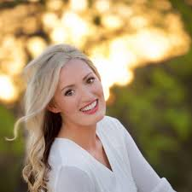
Jenna Quinn
Survivor of Sexual Abuse, Author, and TED Speaker

Slide 4
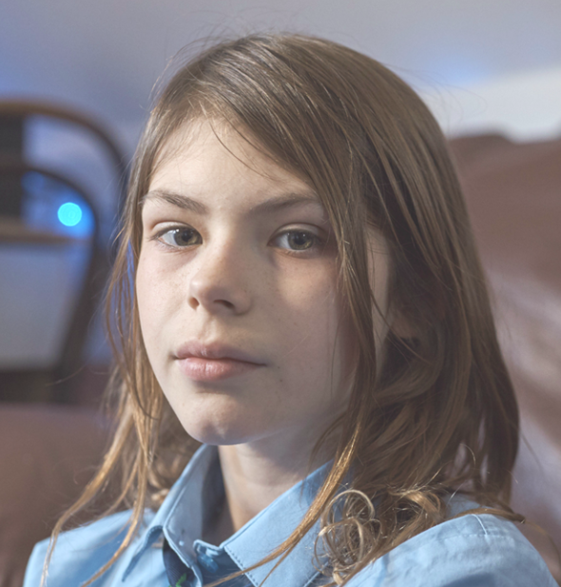
Addisyn Woodard
Statistics:
25% more likely to dropout of high school
80% of attempted suicides are abused
22 victims for every 1000 children
2013 through 2017, Kentucky increased more than 27%
15 new victims annually for every 1000 children

Slide 5
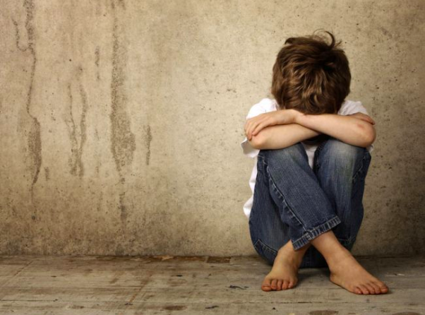
Kennedy Aulick
Friends and classmates are 10 times more likely to report
Reports increase slightly the first 2 years and drop thereafter
False reports account for 2-8% of total reports
Louisville KY Catholic Schools use “Speak up be Safe”

Slide 6
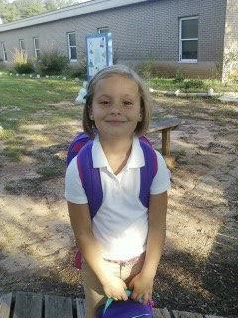
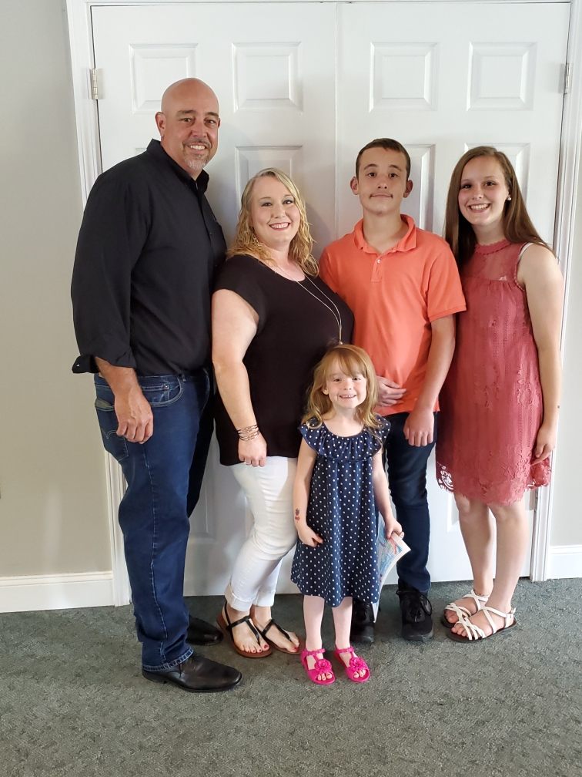
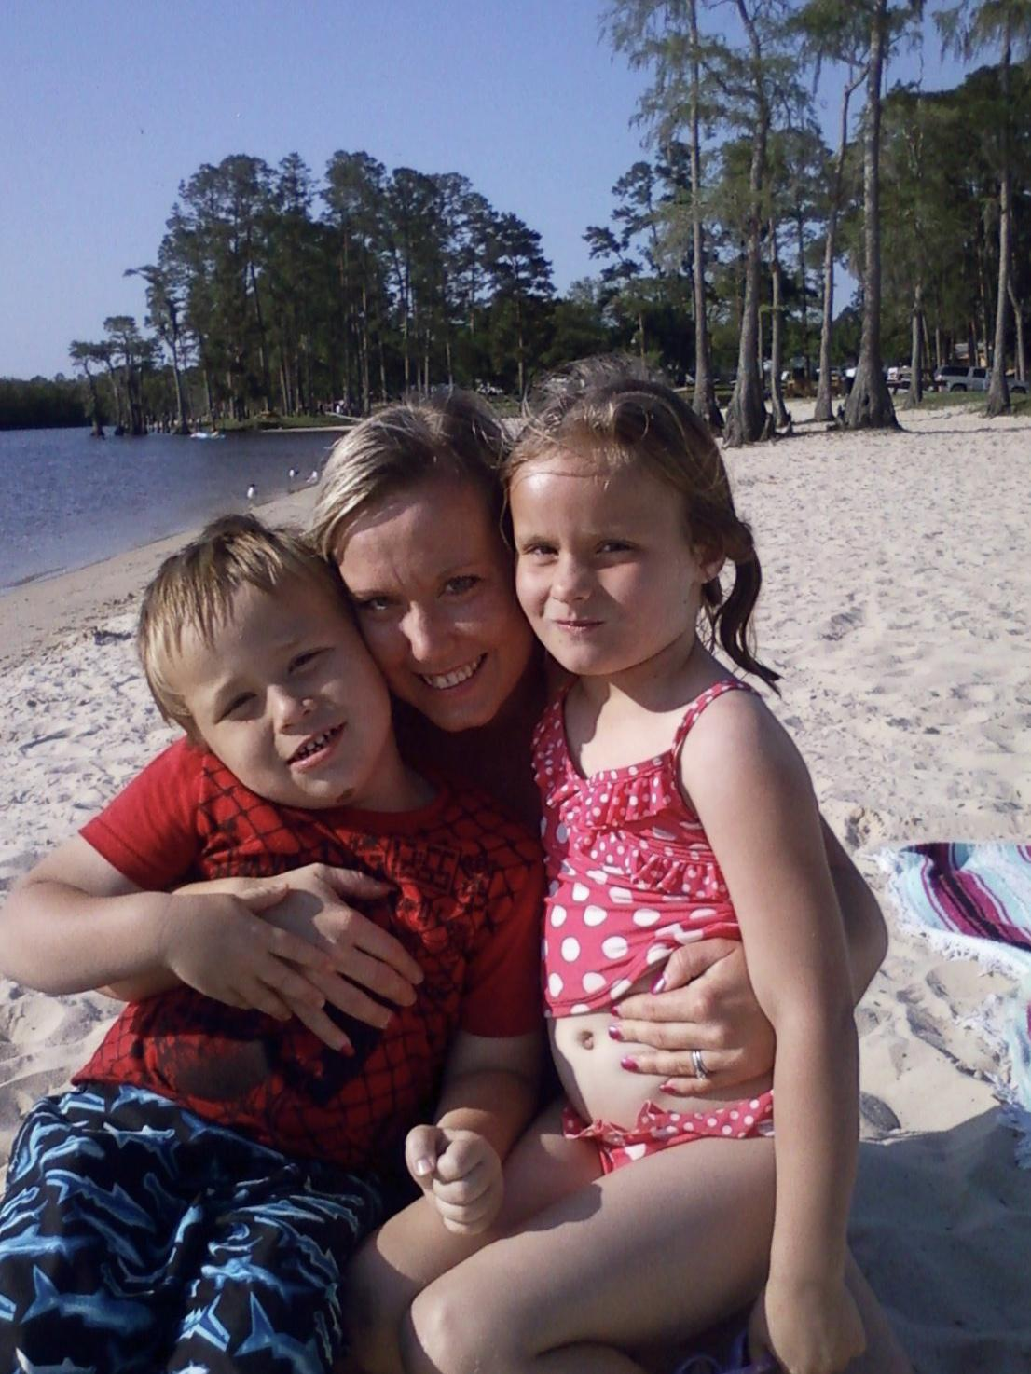
Brooklyn Rockhold

Slide 7
Brooklyn Rockhold
28 states across the nation implement this education
Kentucky averages 22 confirmed cases of child abuse for every 1000 children
The ratio in states with child abuse education is half that of Kentucky
April 6 Child Abuse Prevention Day
Age appropriate education to all students on or around this day
The specific education will be left up to the discretion of the Kentucky Department of Education but should include a minimum of:
signs of child abuse and neglect
information on how to report child abuse and child sexual abuse
who to reach out to at school if abuse is suspected
national child abuse hotlines

Slide 8
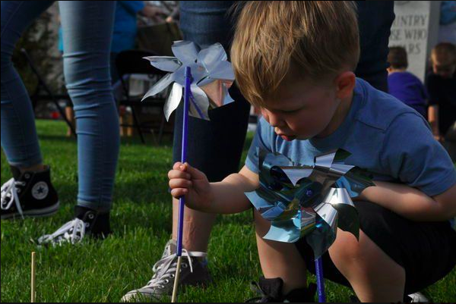
Closing
KRS 156.095 section 7
Prediction that the commonwealth will exceed 35,000 cases of child abuse and neglect this year
What’s holding us back?

Slide 9
Sources
The Enough Abuse Campaign (Massachusetts Citizens for Children)
2017 Child Maltreatment Report (U.S. Department of Health and Human Services)
National Association of Adult Survivors of Child Abuse (NAASCA)
National Society for the Prevention of Cruelty to Children
Louisville Courier Journal

