Slide 1
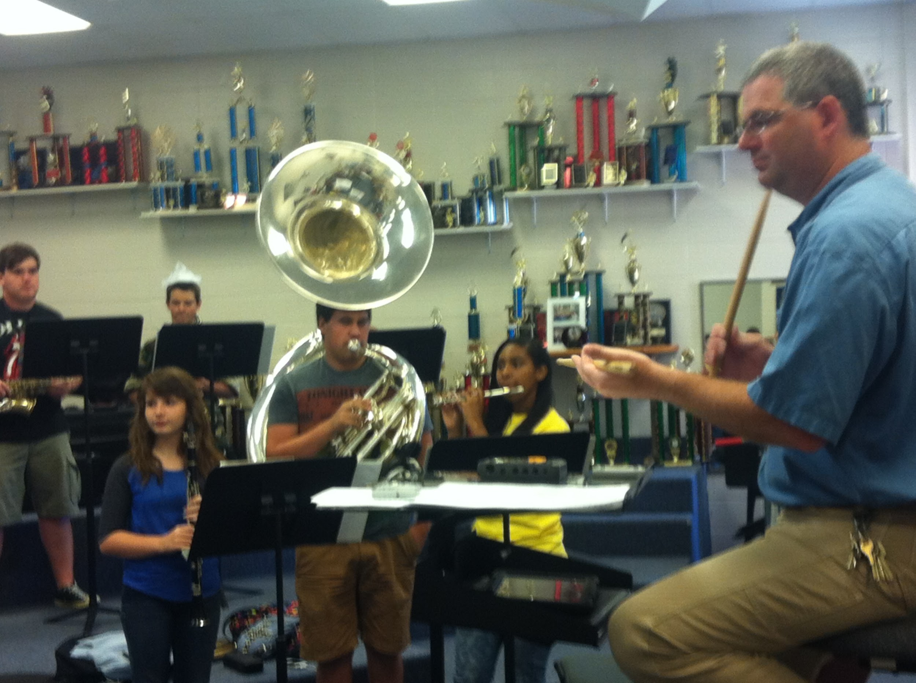
Arts Education Equity Act 20RS BR203
Fulfilling the Promise of KERA 30 years later . .
Notes:
Jane - Welcome and thank you for inviting us to present

Slide 2
An overview presented by
The Kentucky Coalition for Arts Education
Kentucky Art Education Association
Kentucky Music Educators Association
Kentucky Theatre Association
Kentucky Association for Health, Physical Education, Recreation, and Dance
Notes:
Jane - Good afternoon members of the Joint Education Committee. Those of us at the speaker’s table today represent the four major art education associations in the state through our Kentucky Coalition for Arts Education. Our coalition was formed shortly after Senate Bill 1 2009 Assessment and Accountability reform with the pupose of creating a better exchange of ideas between the arts education associations in order to more effectively advocation for public policy that supports strong visual and performing arts education for Kentucky’s children, We want to thank all of you and co-chairs Senator Wise and Representative Huff for allowing us the opportunity to presentation this bill today. We especially wish to thank Representative Hart, the sponsor of the bill for his support in drafting it and his help in seeking the counsel of important stakeholders as part of the drafting process. We particularly thank Education Commissioner Wayne Lewis, Deputy Commissioner Rhonda Sims, and the KDE who endorse the bill and Eric Kennedy, Director of Advocacy from the Kentucky School Board Association for his help in reviewing the considerations of the bill. We have sought to be inclusive in terms of input and feedback with all stakeholders and will continue to do so as we move toward the 2020 legislative session.
We believe this bill is one of those “cleaning up” tasks that often occur after major pieces of legislation, and we believe that it builds on some important components of Senate Bill 1, 2017 in regards to arts education, particularly for elementary and middle school students..
Although, Representative Hart cannot be here today, we have met with him on the presentation and appreciate his support of and confidence in our presentation to you in his absence.
Representative Hart asked that we convey to the committee, that in light of recent conversations concerning the bill, that a committee sub will be filed upon commencement of the 2020 session that will omit Section 3 refering to the responsibilities of school site based councils and any other refinements deemed prudent as a result of discussions with stakeholders. Thus pages 19-32 will be removed.

Slide 3
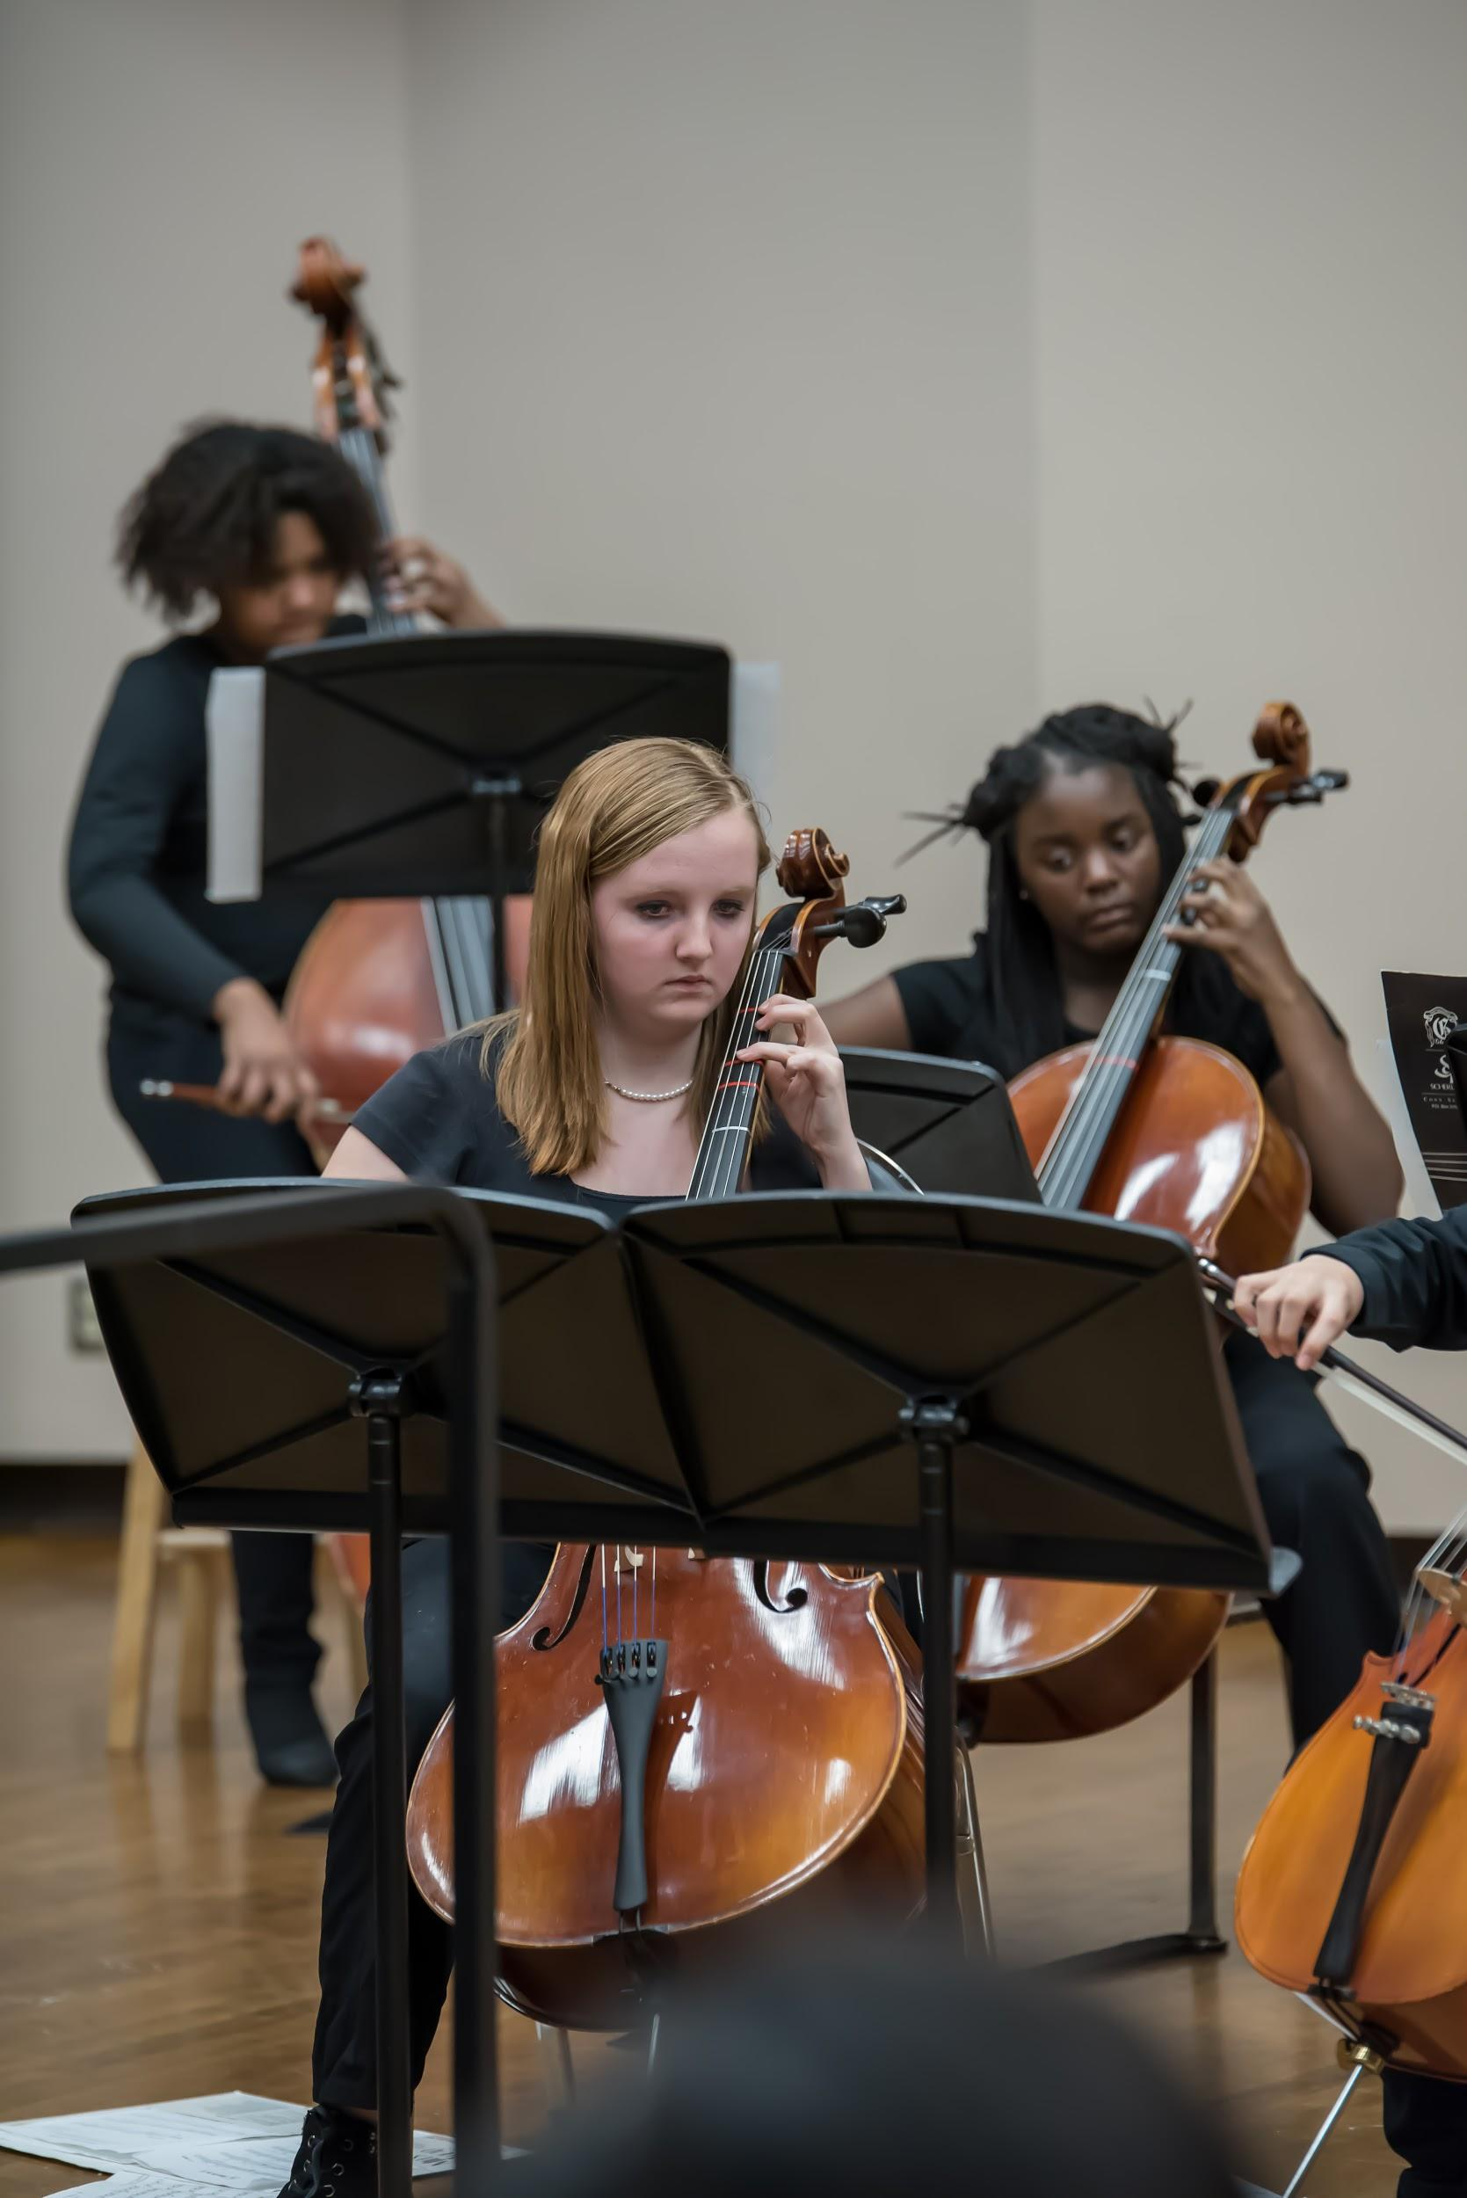
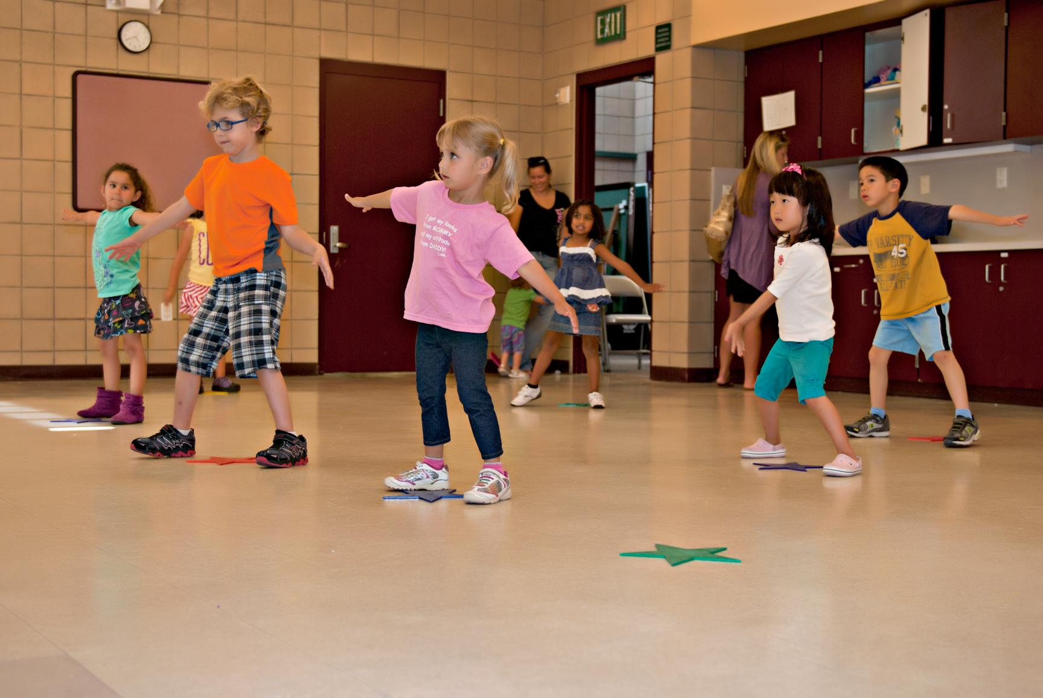
It's About Kids!
Creating
Arts education is important for all students
Responding
Performing, Presenting, Producing
Connecting
Notes:
Jane - Why do kids need the arts?
Program Standards and Program Models

Slide 4
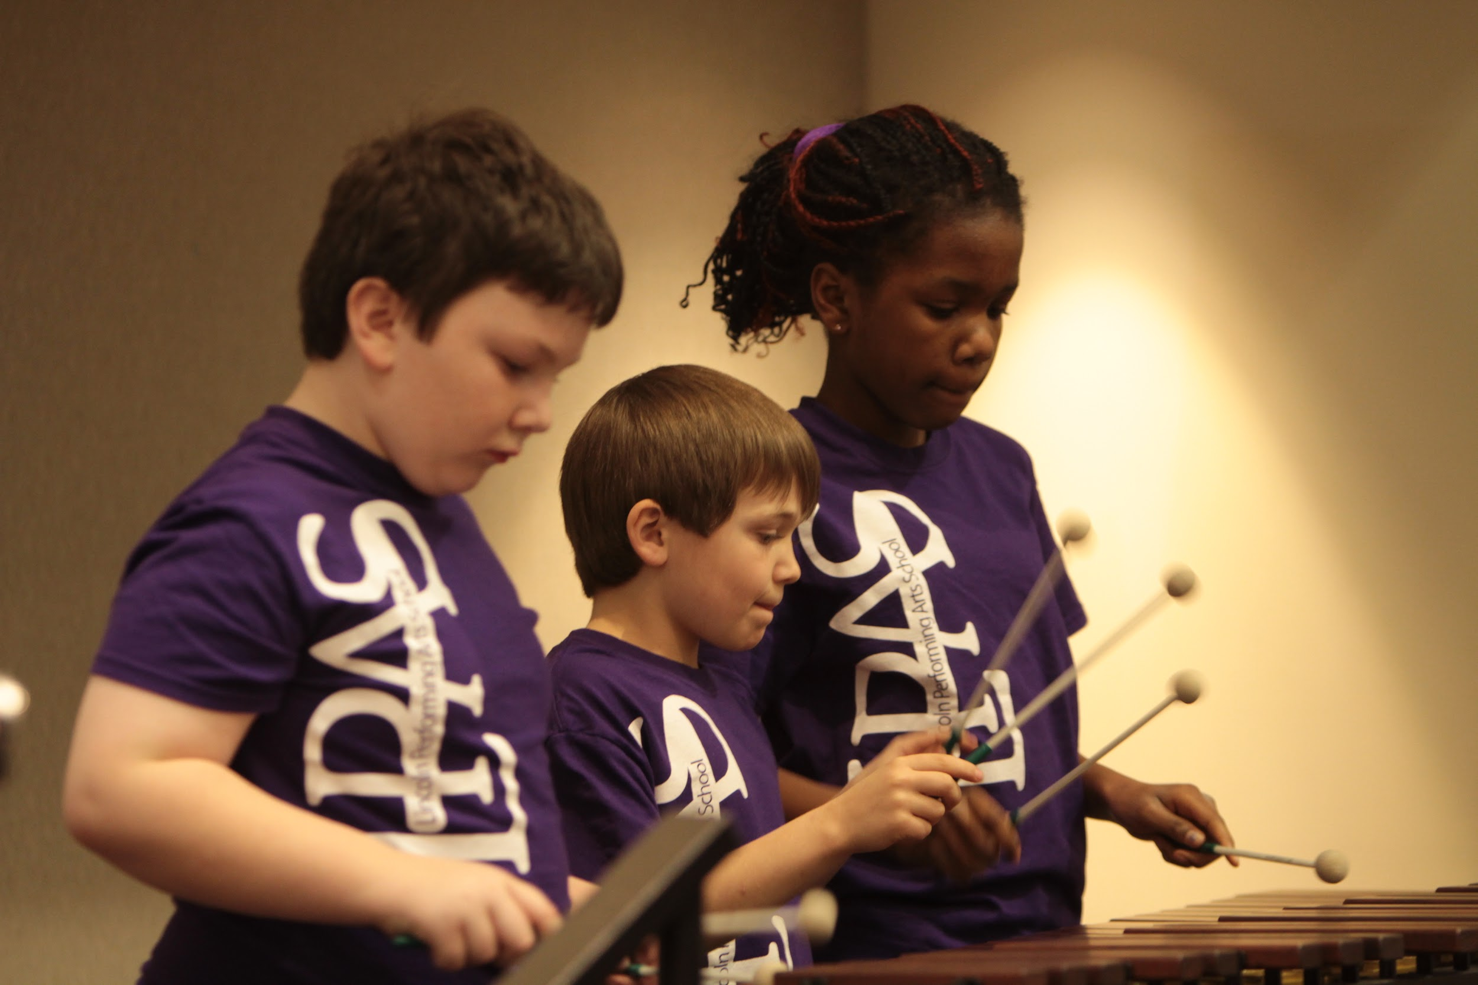
Art Education Equity Act
To ensure equity of opportunity--that all students, regardless of their academic or socioeconomic status, have equal access to a quality, standards-based, sequenced visual and performing
arts education as mandated in the
capacities and goals set forth by the
State of Kentucky
Notes:
Jane - The Arts Education Equity Act ensures equity of opportunity. Current research supports, and we hear evidence from the field that often students who are the more socio-economically disadvantaged or who are in need of greatest remediation are more likely to NOT have access to regular standards based arts instruction. Research overwhelmingly supports that these students have the same giftedness and deserve the same opportunity to develop that giftedness. These are students whose parents can perhaps not afford arts study unless it occurs as a part of formal public educatoin.
Further, multi pilot programs: Turn Around Schools, Dallas AAA program, Chicago’s CAPE program, Arts Basic in the Curriculum Schools in South Carolina, have confirmed that students are more engaged, have better attitudes toward school, and do better academically when they are highly engaged in the Arts.
ESSA acknowledges the importance of arts education and financially supports strategies and programs that contribute to well-roundedness.
In order to understand the context for this bill, Tanya will provide some background on previous education equity decisions and legislation that framework Kentucky’s arts education policies.

Slide 5
The Rose Decision 1989-Equity for Students
The Court declared education a fundamental right under the State Constitution and wrote:
“The children of the poor and the children of the rich, the children who live in the poor districts and the children who live in the rich districts must be given the same opportunity and access to an adequate education. This obligation cannot be shifted to local counties and local school districts.”
Notes:
Tanya
Kentucky has a long history of valuing the arts as part of our culture and heritage. In fact, the Allegorical figures on the pediment of our Capitol’s front portico represent Kentucky as the central female figure, with Progress, History, Plenty, Law, Art and Labor as her attendants.
Kentucky also has a strong history of support for public education that includes arts education. The Kentucky programs of studies as far back as mid-20th century outline specific expectations for arts education.
However, the most ground-breaking moment for public education--and arts education was the Rose decision of 1989 in which the Kentucky Supreme Court held that the General Assembly did not satisfy the constitutional requirement to provide an efficient system of common schools throughout the State.
The Court declared education a fundamental right under the State Constitution and wrote:
“The children of the poor and the children of the rich, the children who live in the poor districts and the children who live in the rich districts must be given the same opportunity and access to an adequate education. This obligation cannot be shifted to local counties and local school districts.”
To meet the constitutional requirement, the Court explained, the state education system must be adequately funded, ensure equality, and be designed to provide every child with seven delineated capacities.

Slide 6
Seven capacities that all students must obtain, includes:
“Sufficient grounding in the arts to enable each student to appreciate his or her cultural and historical heritage”
Notes:
Tanya
One those seven specific capacities included “Sufficient grounding in the arts to enable each student to appreciate his or her cultural and historical heritage:

Slide 7
Kentucky Education Reform Act (KERA)
1990 - 1992
KERA established, in statute, the seven capacities to be developed in all students that were identified in the Rose Decision--including a
“sufficient grounding in the arts”
Notes:
Tanya - With the foundation based on that court decision, the Kentucky General Assembly framed the Kentucky Education Reform Act -or KERA as we know it, which became a benchmark education legislation for the entire country.
The centerpiece of KERA was its vision of what every child should know and be able to do as a result of his or her school experience.1
KERA established, in statute, what the Rose decision identified as the seven capacities to be developed in all students--including a “Sufficient grounding in the arts to enable each student to appreciate his or her cultural and historical heritage;”
Courts in Alabama, Arkansas, Kansas, Massachusetts, New Hampshire, North Carolina, South Carolina, and Texas have adopted the “Rose capacities,” or a version of them, for their own states.

Slide 8
Kentucky Education Reform Act (KERA)
1990 - 1992
KERA outlined school responsibilities for achieving specific Learning Goals for ALL Students-- including that schools “shall develop their students’ ability to:
(2) “Apply core concepts and principles from . . the ARTS . . to situations they will encounter throughout their lives;”
Notes:
Tanya KERA outlined school responsibilities for achieving specific Learning Goals for ALL Students-- including that schools “shall develop their students’ ability to:
(2) “Apply core concepts and principles from . . the ARTS . . to situations they will encounter throughout their lives;”
Clearly, Kentuckians established that arts education was a component of the fundamental right to an education and that the state was responsible for setting conditions that ensured all Kentucky children equity of opportunity and access to that right.
Setting of those conditions included puting in place an assessment and accountability system that would measure progress in developing the capacities and achieving the goals set forth by the General Assembly.

Slide 9
Evolution of Visual and Performing Arts Assessment and Accountability
1982
1993
2009
2017
Mandated student assessment in the arts through performance events/paper pencil assessments
SB 1
Time mandates: elementary/middle schools; Multi-level course work: high school
Arts Program Reviews are part of school school accountability . . *seventh learner goal added for artistic skills
1982 - 1992 |  |  |  | 1993 - 2008
2009 - 2017
Arts Education Research: Champions of Change (1999), Critical Links (2002), Harris Poll (2005), Ready to Innovate (2008)
Research continues: College Bound Seniors (2011), Catterall The Arts and Achievement in At Risk Youth (2012)
1990
KERA new requirements are set in motion
Notes:
Jane Kentucky is ahead of the curve in recognizing the value of arts education and the need for accountability (1982) Mention handout
CATS testing provides additional arts accountability strengthening equity in visual and performing arts instruction for all students.
Champions - one fact
Critical Links - one fact
Harris Poll - as we’ve already mentioned showed overwhelming public support for arts education
Ready to Innovate - 72% of business leaders say creativity is the #1 skill they seek when hiring; 94% (and up depending on art form) of superintendents say visual and performing arts classes develop creativity

Slide 10
Arts Accountability 2017-2019
SB1 Mandated:
Visual and Performing Arts Standards
That KDE provides schools guidelines for including VPA programs in schools (time, courses, staffing, resources, facilities)
School Profile reporting on a school’s VPA program having:
No value in accountability
No mandated inclusion in the school report card
That KDE may develop program standards
High School Graduation regulation protects time at the high school level--1 credit.
Notes:
Tanya - maybe don’t use this first part if Jane addresses.
In 2009, After 20 years of KERA’s assessment and accountability sytem, the Kentucky General Assembly revisted KERA’s accountability framework.
It recognized that performance on standardized test alone, did not adequately measure student achievement, and that other factors and considerations such as quality programs, closing the gap, student growth contribute to overall school efficiency.
As sociologist, Bruce Cameron noted in 1958, “Not everything that can be counted counts, and not everything that counts can be counted.”
Further, it acknowledged the disconnect between paper/pencil testing and what students should and be able to do in the arts. To clarify that intent, a seventh learner goal was added that:
158.6451 (b) Schools shall develop their students' ability to: 7. Express their creative talents and interests in visual arts, music, dance, and dramatic arts.
The resulting legislation provided for developing an assessment and accountability system that considered multiple factors in determining a school’s effectiveness. For the arts, that meant that state arts accountability shifted from student performance on paper/pencil tests to reviewing the effectiveness of schools’ arts programs ----with the hopes that focus would be placed on doing the arts and empowering students with artistic skills rather than learning about the arts.
-------------------------------
The overall effect of SB1 2009 was a more authentic approach to accountability.
[for arts education, it also clarified in state learning goals that 158.6451 (b) Schools shall develop their students' ability to: 7. Express their creative talents and interests in visual arts, music, dance, and dramatic arts.]
However, many practitioners in the field found the new “Unbridled Learning” system cumbersome and time consuming.
In an effort to address this concern, SB 1 2017 focused on refining and streamlining statewide accountability, while still considering multiple factors in measuring school effectiveness, and removing the stigma cause by comparing school scores. Sen Wilson and Wise are still to be commended for the thoughtful and juried leadership approach they took to hear all stakeholders in that legislation.
In terms of arts education, the bill affirmed the expecation that schools would address academic standards in the visual and performing arts and provided that KDE had the option to develop program standards.
Having assurances from the KDE at that time that arts accountability would be addressed as part of an “opportunity and access” component of the new 5-star accountability system, legislators removed the program review as a mandated accountabiity component and replaced it with a School Profile report that included arts program data without connecting it in statute to accountability scoring or school report card accountability.
In 2018, the opportunity and access component was dropped from the new accountability system, leaving no school accountability in statute or regulation for arts education save for the protection of one credit of study at the high school level in state graduation requirements.¹
On April 5, 2019, Kentucky's new minimum high school graduation requirements became law, 704 KAR 3:305 this protected time for arts instruction at the high school level.

Slide 11
We need this bill in order to provide:
Equity of access for all elementary and middle school students
An efficient, manageable form of school accountability for providing equal opportunity and access to quality arts instruction
Support for schools in developing quality arts instruction
Data to inform decision-making for improving arts instruction
Notes:
Tanya -
In 2016, the KDE sought public input through statewide town meetings on school accountability. Overwhelming, the public supported an accountability system that included measures of opportunity and access to quality arts instruction.
Further, the KDE accountability task force of the same year recommended that opportunity and access for a well-rounded education (including the arts) be part of a streamlined school accountability plan.
It’s a simple fact, that In our high stakes accountability climate, what receives weight in accountability gets focus while non-weighed components get marginalized in the curriculum.
The release of yesterday’s accountability scores represents the first time in forty year that all schools were not held formally accountable in any statutory or regulatory manner for ensuring equity and access to Visual and Performing Arts Education.
Which brings us to why we need this bill . . . . .and, as we teachers would phrase it, some essential questions . . . .
How do we:
Hold schools accountable for developing the whole child--capacities and skills in the arts, while still keeping things simple so the KDE, administrators and teachers can focus on teaching kids.
Devise an efficient way to ensure that all students, regardless of their socio-economic status or academic prowess have equal access and opportunity to obtain a sufficient grounding in the arts and develop the artistic talents and skills that will have life-long benefit?
Develop a clear, strong, statewide vision of what good arts education and equal access looks like in order to help schools improve and strengthen arts education for all of our Kentucky children.

Slide 12
What does this bill do?
Supports that all students have equal access and opportunity to develop their talents and skills by
protecting time for arts instruction during the school day
120 minutes per week in the elementary, access to courses in the middle school
No use of arts instructional time for other remediations
No denial of arts instructional time as a means of discipline
Notes:
Tanya-
We believe this bill addresses those important questions.
It recognizes the difficulty of keeping accountability simple without excusing the responsibility of schools to be held accountable for providing all students equitable access to meaningful visual and performing arts instruction by simply:
targeting time at the elementary and access at middle school as the fundamental component of ensuring equity.
120 minutes minimum per week in the elementary,
the mandate that middle schools will provide instructional opportunities that develop artistic understandings, talents, and interest.
And specifically protecting that time-- by not allowing interventions of other types to encroach on that limited opportunity

Slide 13
Directs KDE to:
Develop arts program standards and resources
for helping schools improve arts programs
Identify strong arts programs, recognize and provide models
Develop an easy-to-use program-standards checklist for reporting program data on the School Profile
Include the School Profile on the School Report Card
Provide a yearly report on the status of arts education to the Interim Joint Committee on Education
Notes:
Tanya -
The bill further strengthens accountability for the arts and the improvement of statewide arts instruction by:
Directing the KDE to:
Provide for a framework with resources that can guide districts toward providing quality arts instruction without punitive consequences.
Make reporting easier and program data more reliable by mandating a clearly-defined, program standards checklist that is less subject to interpretation for reporting the status of a school’s arts program on the School Profile.
It further ensures that schools are help accountable to the public by reporting the attributes of a school’s arts program where it can be easily accessed and interpreted by parents--- in the school report card
The fourth component makes a provision to provide solid feedback to decision-makers on the status of arts education in Kentucky by an annual report to the Interim Joint Committee.
For example, how many certified arts specialist are teaching in each of the art forms? What is our teaching force in the arts? How many students leave our high schools with arts scholarships? How many schools meet program standards of time, facility, etc. in the arts? How many of our students are showing significant engangement in the arts? “
“We can’t make good decisions about arts education in our state, until we know the state of arts education?”
-------------
It is important to note that this bill will not impact the new 5-star accountability rating system or a school accountability score.
It seeks to achieve Accountability and equity by simply requiring minimum time and access to instructional opportunities;
and by reporting against established program standards on the school report card.

Slide 14
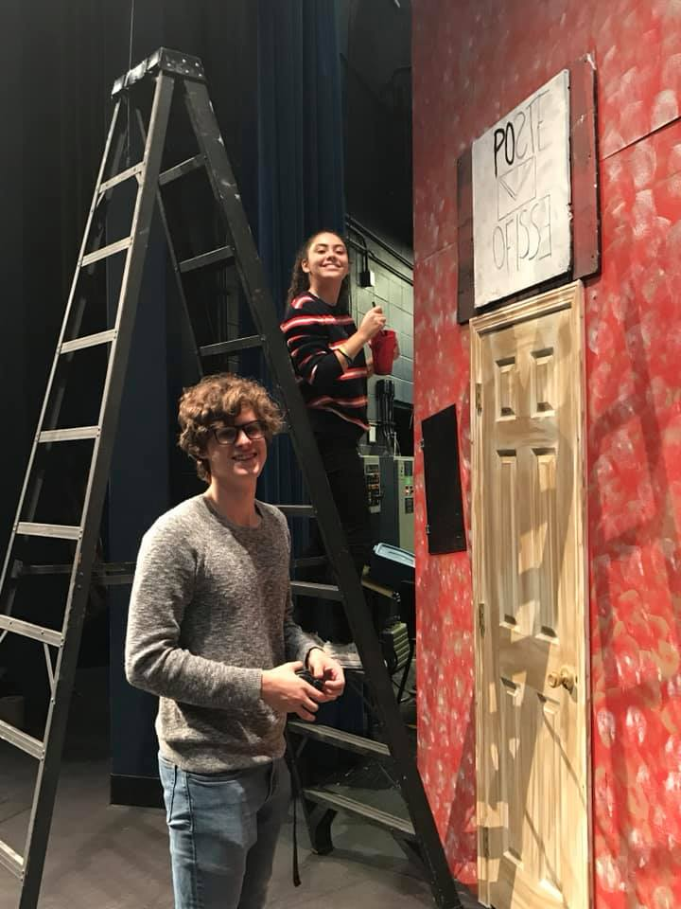
What’s your arts success story?
Libby Hale
Danville High School
Governor’s School for the Arts
Notes:
Jane - Direct their attention to Eileen Ramirez’s story and introduce Libby

