Slide 1
Dataseam
Workforce and Education Outcomes
Kentucky General Assembly IJC Education
October 2, 2019

Slide 2
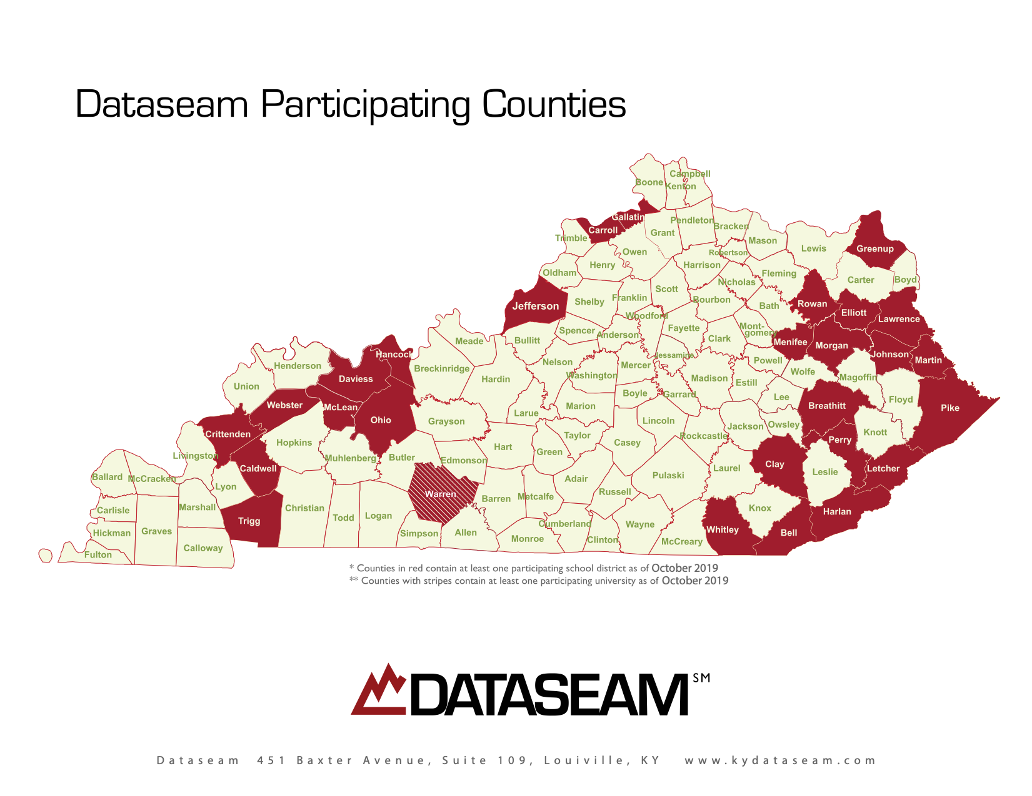

Slide 3
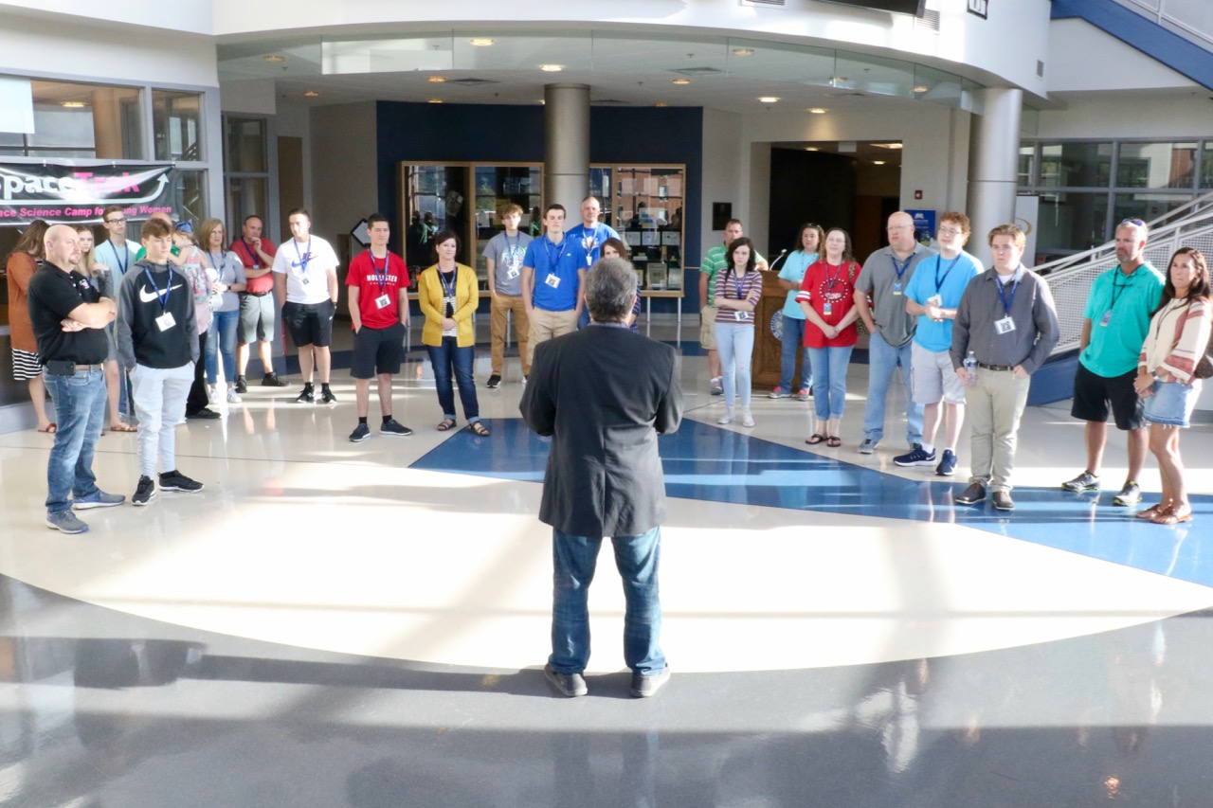

Slide 4
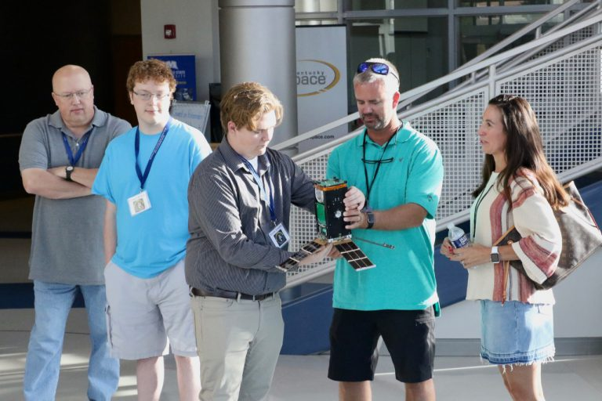

Slide 5
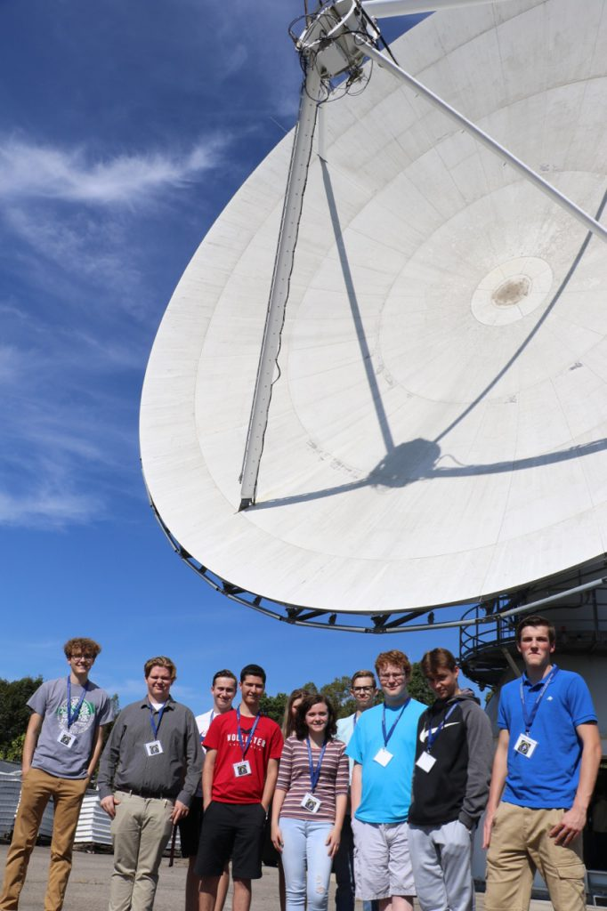

Slide 6
“Thank You!”
Dataseam Partner Districts, University of Louisville, University of Louisville Brown Cancer Center, Morehead State University, Morehead Space Sciences, Dataseam Scholars and Educators.

Slide 7
Questions?:

