Slide 1
Assessment Alignment Adjustment Process
In accordance with SB175 (2019 KY General Assembly)
Dr. Wayne Lewis, Commissioner
Rhonda Sims, Associate Commissioner
November 20, 2019

Slide 2
What does SB175 (2019) require of the revision process?
Beginning in fiscal year 2017-2018, and every six years thereafter, the KDE shall implement a process for reviewing Kentucky’s academic standards and the alignment of corresponding assessments for possible revision or replacement to ensure alignment with postsecondary readiness standards necessary for global competitiveness and with state career and technical education standards.

Slide 3
What does SB175 (2019) require of the revision process?
The department shall develop four standards and assessments review committees, with each committee composed of:
Minimum of six public school teachers;
Two representatives for Kentucky institutions of higher education; and
Business and industry representation.
Each committee member shall teach in his or her subject area and have no prior or current affiliation with a curriculum or assessment vendor.

Slide 4
What does SB175 (2019) require of the revision process?
Three advisory panels shall be assigned to each standards and assessments review committee. One panel shall review K-5, one shall review 6-8, and one shall review 9-12.
Each panel shall consist of a minimum of six public school teachers;
One representative from a Kentucky institution of higher education; and
Business and industry representation.

Slide 5
Assessment Alignment Process
Alignment of corresponding assessments to the standards is achieved through the creation of assessment blueprints.
The purpose of a blueprint is to outline the percentage of items that will be assessed within the domains of the Kentucky Academic Standards (KAS) in each content area.

Slide 6
Assessment Alignment Process continued…
Blueprints are created to guide the development of individual test items, serve as targets for assessment development, define how results from the assessment are reported, and to provide information to teachers as they make instructional decisions.
The blueprint drives the construction of the assessment.

Slide 7
Assessment Review Process (Amended after Senate Bill 175)
Committees formed: Review Committee (RC) and Advisory Panel (AP)
Commissioner takes to Interim Joint Committee on Education (IJCE)
Commissioner provides report to Standards/Assessment Process Review Committee (SAPRC)
Public Comments sought on standards (by third party)
RC reviews final proposal; sends to Commissioner
SAPRC determines if process is sufficient/deficient
AP considers comments and proposes/recommend changes
AP considers comments and finalizes proposed revisions
Kentucky Board of Education (KBE) approves proposed changes
RC reviews AP’s recommendations and makes decisions on moving forward
Public Comments sought on recommended revisions (by third party)
New assessments implemented in all schools no later than second academic year following the process

Slide 8
Timeline:
Call for Committee Member Applications – April 1, 2019
First Round of Public Feedback Survey (ARCC) – May 22 - June 21, 2019
Advisory Panel Meetings (Reading and Writing, Mathematics, and Social Studies) – July 8, 2019
Review Committees (Reading and Writing, Mathematics, and Social Studies) – July 25, 2019
Second Round of Public Feedback Survey (ARCC) – August 6 - September 5, 2019
Advisory Panel Meetings (Reading and Writing, Mathematics, and Social Studies) September 23 -24, 2019
Review Committees (Reading and Writing, Mathematics, and Social Studies) October 21, 25 and November 1, 2019
Interim Joint Committee on Education – November 20, 2019

Slide 9
Public Feedback and Comments
Open, transparent process that allowed Kentuckians an opportunity to participate.
An independent third party, which had no prior or current affiliation with a curriculum or assessment resource vendor, was selected by the department to collect and transmit the comments to the department for dissemination to the panels.
The department selected Appalachia Regional Comprehensive Center (ARCC) as the independent third party.
Blueprints were posted for 30 days each public comment period.

Slide 10
Public Feedback and Comments
The public had the opportunity to provide both positive and critical feedback.
Advisory Panels and Review Committees were able to review all public feedback and comments received from both public comment periods.

Slide 11
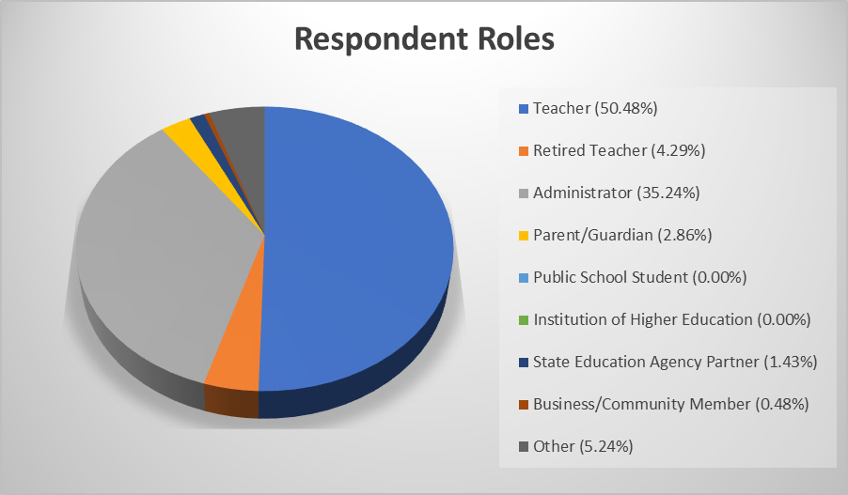
Reading and Writing

Slide 12
Public Feedback for Reading and Writing
At least 89.31% of respondents felt the domain levels for reading were “okay as is.”
At least 86.08% of respondents felt the prompt mode for writing was “okay as is.”
The blueprint is easy to read. (96.2%)
The blueprint is easy to understand. (94.94%)

Slide 13
Public Feedback for Reading and Writing continued…
The blueprint will provide instructional guidance to teachers. (76.93%)
The domains on the blueprint provide valuable information for schools to help inform the reading and writing program, overall. (85.34%)

Slide 14
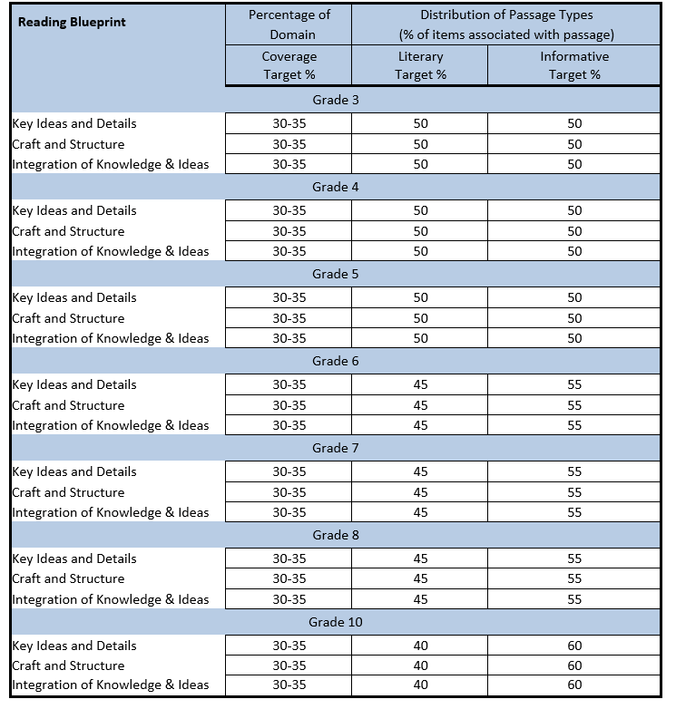

Slide 15
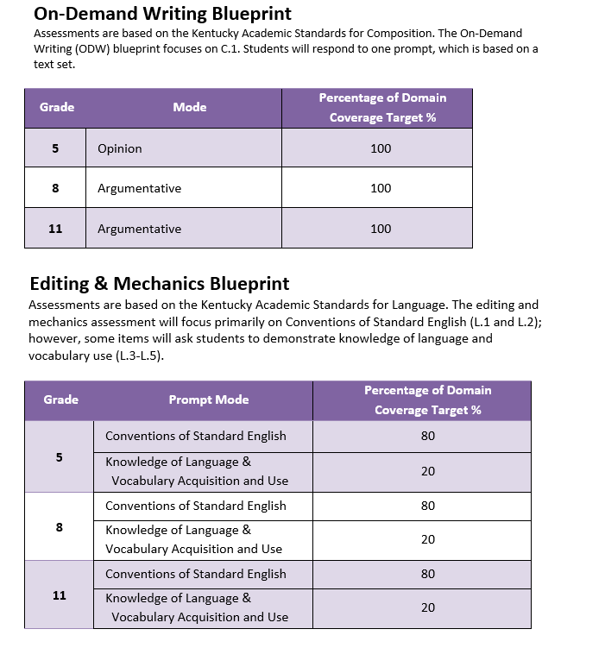

Slide 16
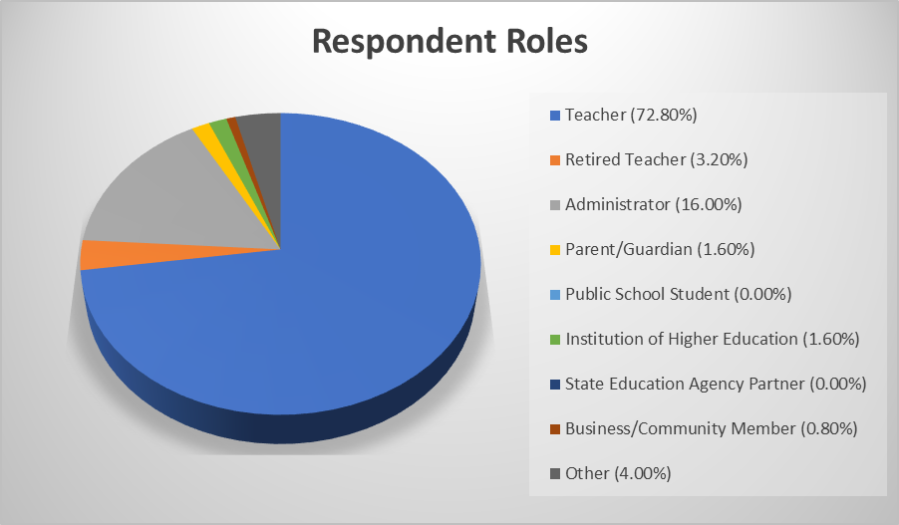
Social Studies

Slide 17
Public Feedback for Social Studies
At least 72% of respondents agreed that the domain levels are “okay as is.”
The blueprint is easy to read. (98.4%)
The blueprint is easy to understand. (95.31%)
The domains of the blueprint provide valuable information to schools to help inform the Social Studies program, overall. (85.94%)

Slide 18
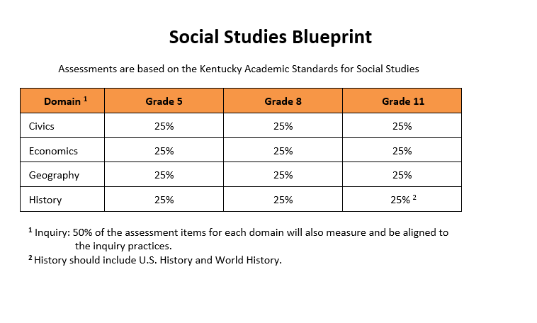

Slide 19
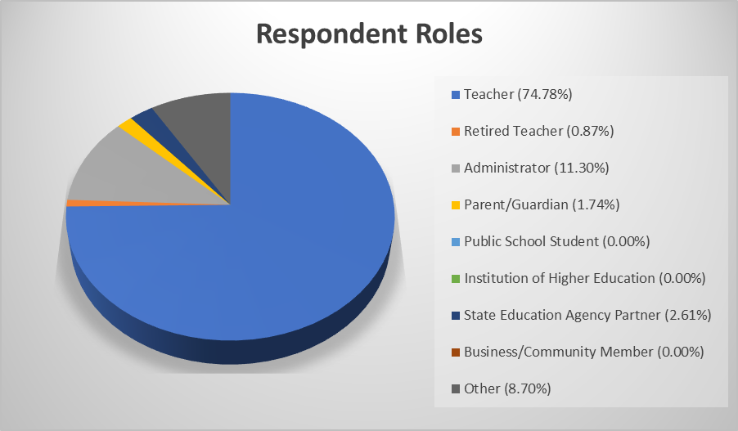
Mathematics

Slide 20
Public Feedback for Mathematics (Percent who Agree/Strongly Agree)
The blueprint is easy to read. (97.5%)
The blueprint is easy to understand. (97.5%)
The blueprint will provide instructional guidance to teachers. (85.0%)
The domains of the blueprint provide valuable information for schools to help inform the mathematics program, overall. (87.5%)

Slide 21
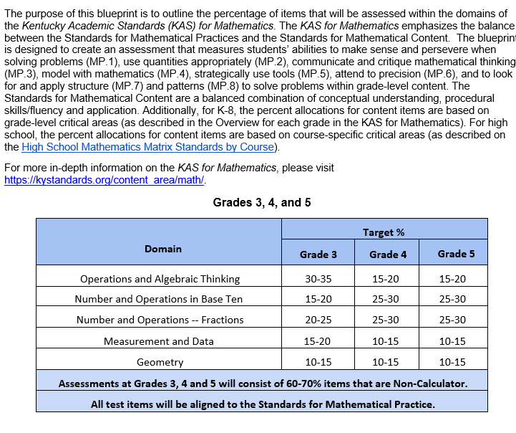

Slide 22
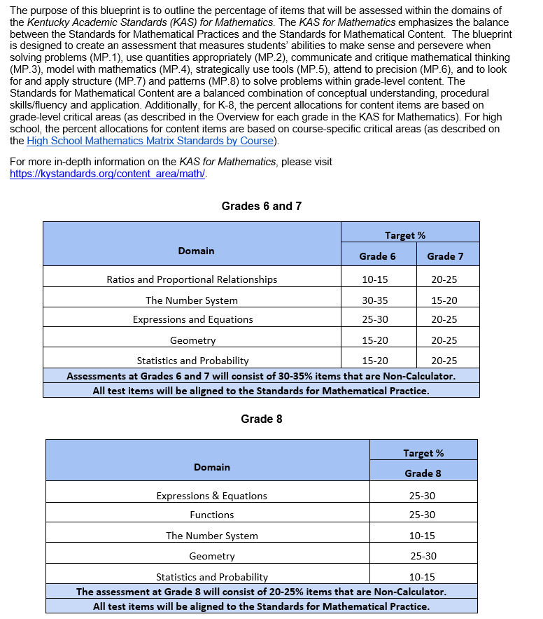

Slide 23
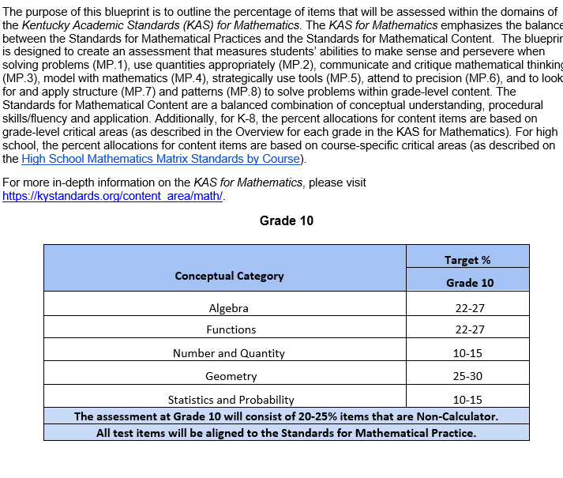

Slide 24
Binders and Electronic Google Folders
Blank application along with selected applications
Knowledge, Attitudes, Skills, Aspirations and Behaviors (KASAB) rubric used to select participants
Advisory Panel and Review Committee Participants
E-mail Communications to Committee Members
Press Releases, Agendas, and Minutes of Meetings
ARCC reports from public feedback and comments
Final Assessment Blueprints

