Slide 1
RACIAL EQUITY An update on the work
Interim Joint Committee on Education September 15, 2020

Slide 2
Who is Jefferson County Public Schools?
29th largest school system in the United States with 94,942 students
JCPS is a majority-minority district:
37% of students are Black
12% of students are Hispanic
41% of students are White
8% of students are another race
$100+ million in scholarships awarded to Class of 2020
1,000+ industry certifications earned through The Academies of Louisville
12,3655 students with special education needs
12,574 English Language Learners
125 languages spoken by JCPS students
2 out of 3 students are eligible for free or reduced-price meals.
4,915 homeless students

Slide 3
Racial Equity: Taking the First Step
Two years ago, the JCPS Board of Education adopted a Racial Equity Policy and charged the district with implementation. JCPS was one of only 11 other districts in the country to have passed such a policy at the time.

Slide 4
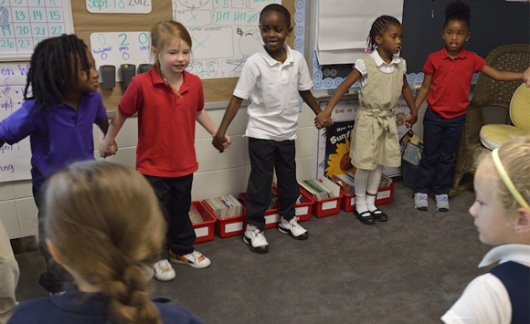
Racial Equity at JCPS: Building Systems
The district is working to reduce disproportionality in:
academic achievement
access to career and technical education
student discipline
enrollment in advanced placement and gifted and talented courses

Slide 5
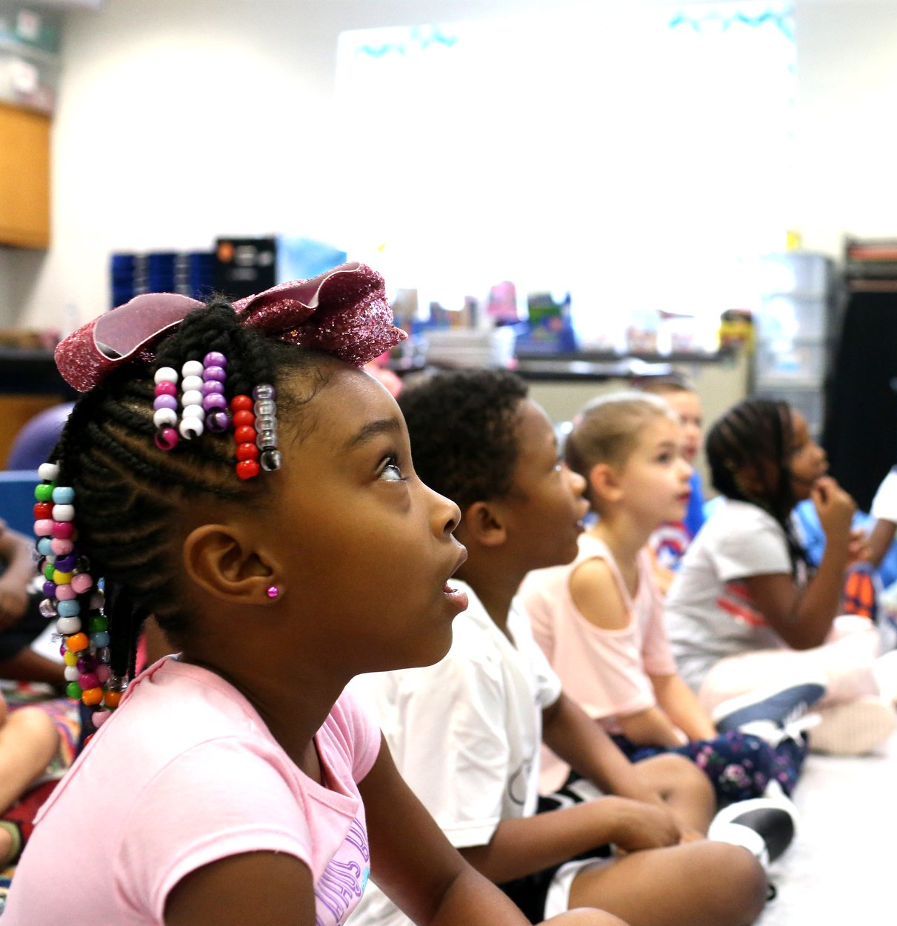
Racial Equity at JCPS: Building Systems
Increasing a sense of belonging for students & staff
Staffing the district in a way that more accurately reflects the demographic makeup of the students it serves
Increasing participation of minority-owned businesses
Instituting Black Student Unions at every middle and high school
Opened two new schools with an Afro-centric and gender-centric curriculum
W.E.B. Dubois Academy
Grace M. James Academy of Excellence

Slide 6
Racial Equity at JCPS Building Systems
Racial Equity Analysis Protocols for internal systems
Staff Training
Anti-racist training for each school building
Implicit Bias Training for all certified staff (7,000 staff have completed to date)
Equity Institutes (Biannual for ongoing growth and development)
Teacher Recruitment and Retention
Partnerships with Simmons College, University of Louisville

Slide 7
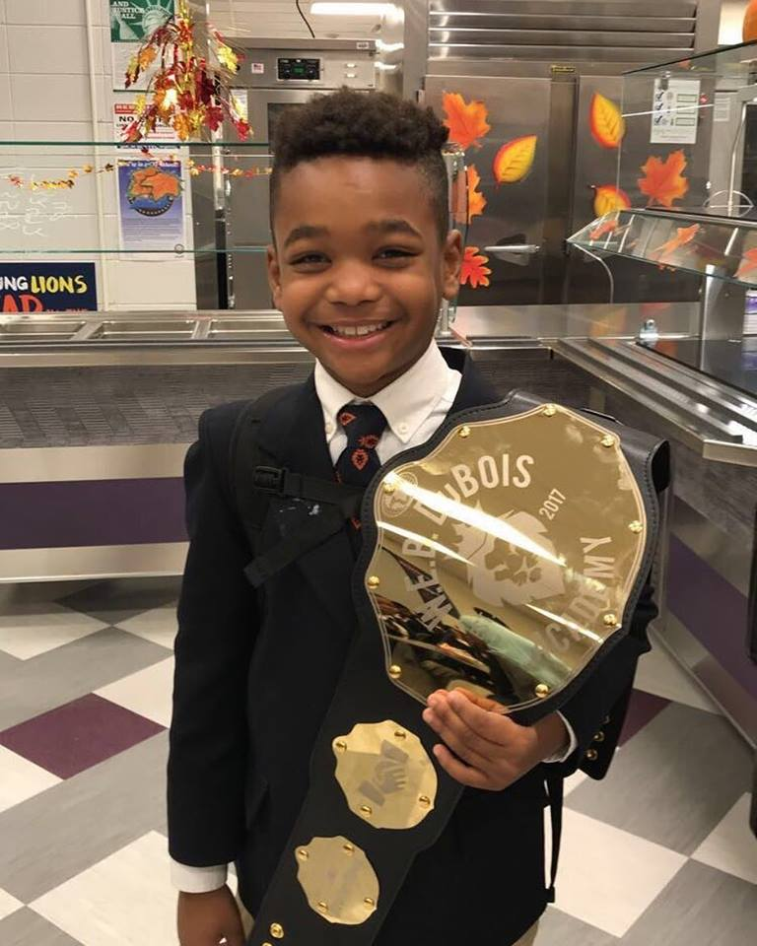
A Look at the Data
Suspensions still disproportionately impact Black and Brown students
As of March 13, Black students were 2.9 times more likely to be suspended than white students.
Proficiency Gap
Winter 19/20 MAP results show 31 point gap in projected proficiency rates between Black and White students.
Magnet Enrollment
In 2018, 51% of magnet enrollments were students of color; by 2020 that increased to 54%.

Slide 8
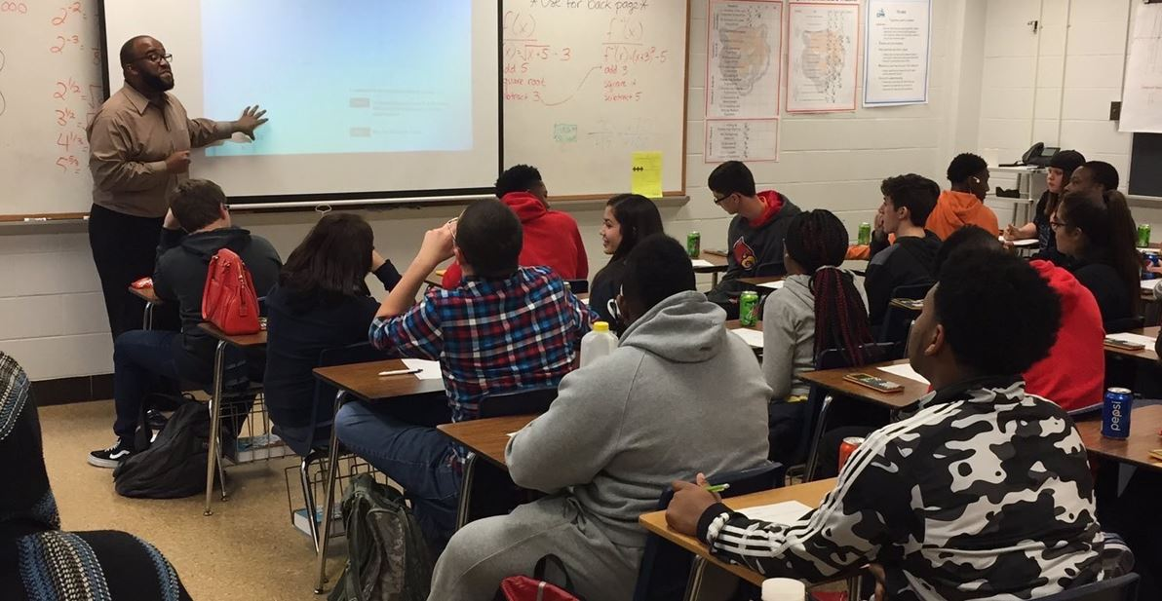
A Look at the Data
Teacher Retention
Attrition rate for teachers of color have
reduced by half from 14% to 7% between
2018 and 2020
Inclusive curriculum and added course opportunity
to explore Black historical consciousness
Targeted Recruitment, Advancement,
Development, and Equity in Skilled TRADES
Creating a workforce mirroring our student population
Expanding the number of skilled tradespeople from underserved and underrepresented populations

Slide 9
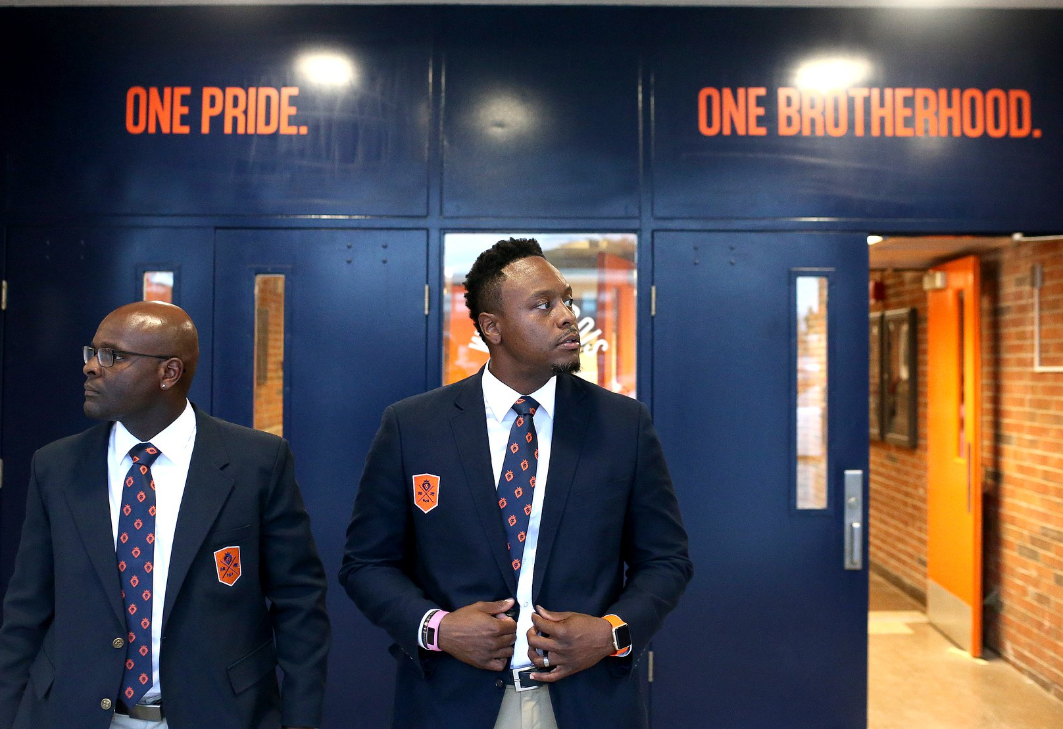
Challenges Ahead
Facilities
32 end-of-life buildings (1 in 5 JCPS buildings)
Athletic facilities
Implications for student assignment
Supporting Students During NTI
60,000+ Chromebooks
7,000+ Wifi Hotspots
Advocated for extension of USDA Summer Feeding with Commissioner Quarles
Supporting Students who Experienced Trauma in 2020
Mental health supports – 1 practitioner per school
Trauma Informed Care
Wraparound supports through community partnerships

Slide 10
Questions?
Questions not able to be answered due to time constraints can be sent to: Abby Piper, Executive Administrator of Government and Community Relations, at abby.piper@jefferson.kyschools.us.

