Slide 1
Leadership Institute for School Principals
Transforming education across Kentucky since 2011

Slide 2
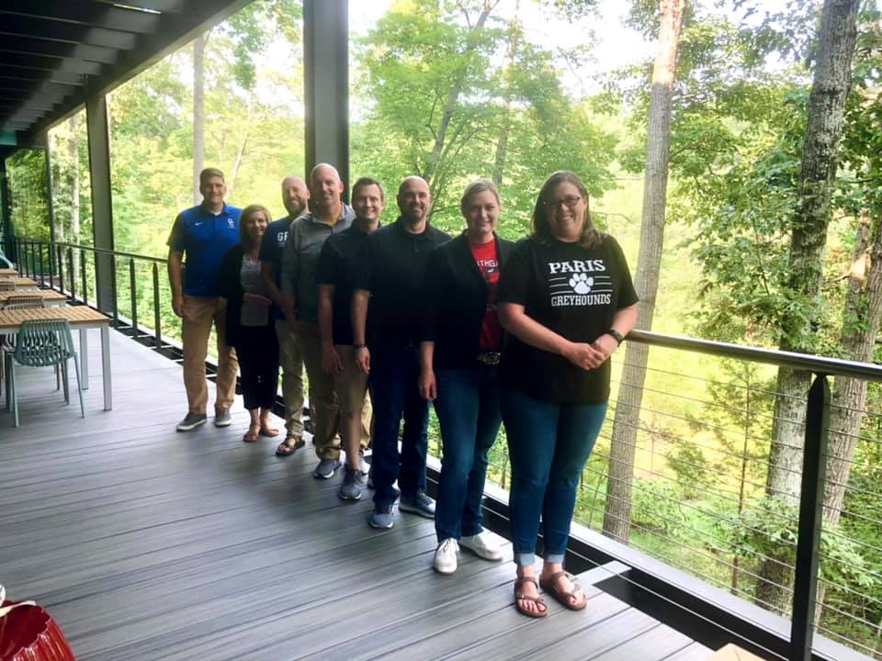
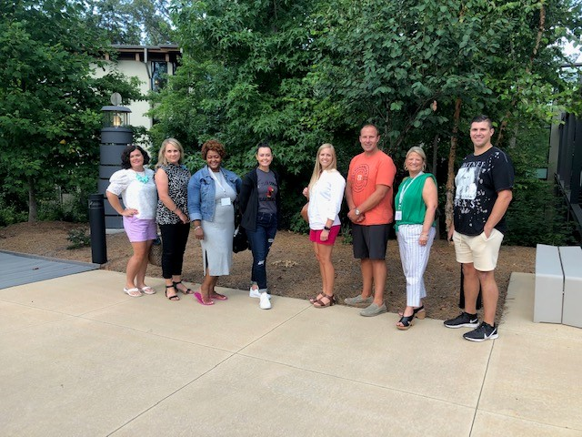
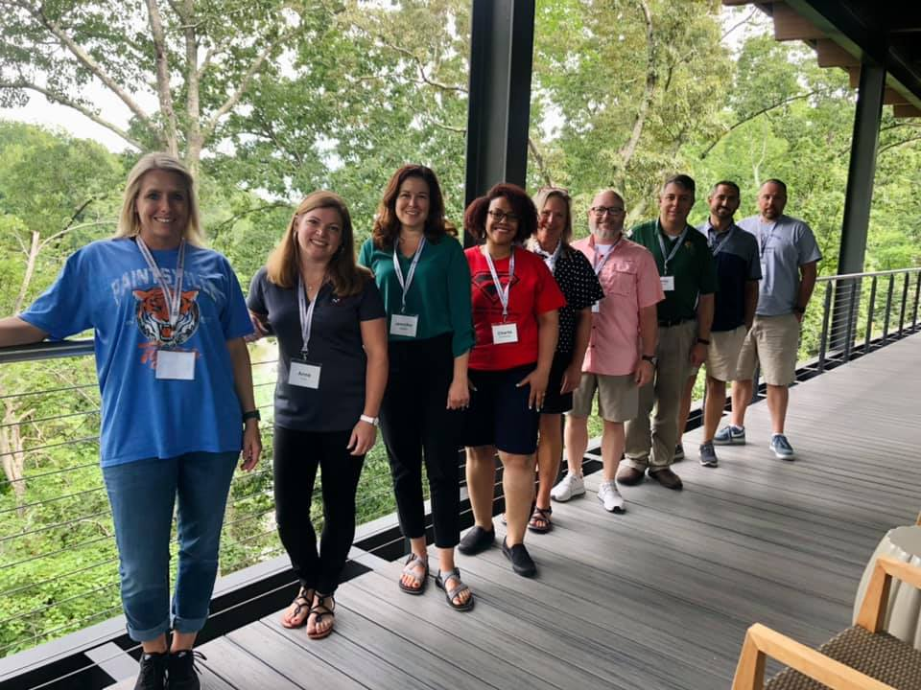
Notes:
35 participants – 2021-22 class

Slide 3
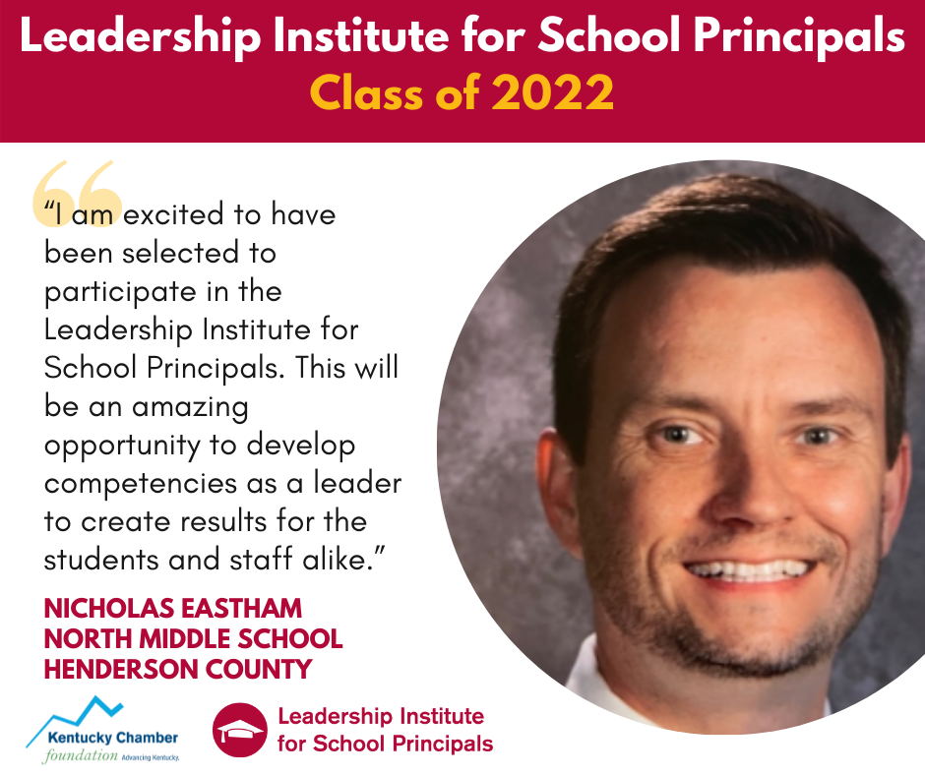
Notes:
Testimonies from current and past participants

Slide 4
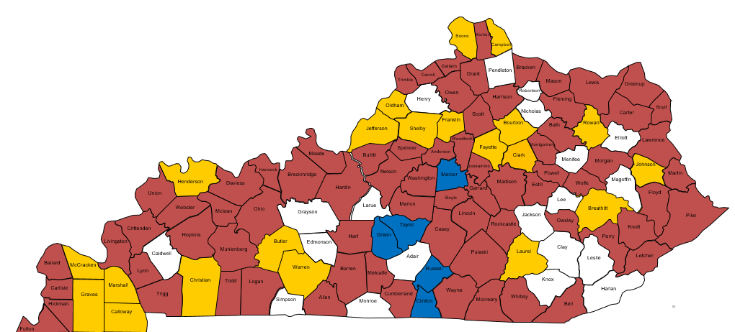
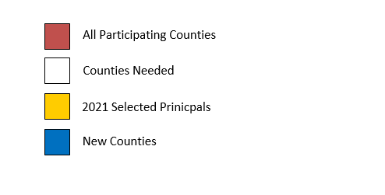
LISP Across Kentucky
Notes:
Yellow = states we have participating in 2021-22
Red = states that have had a participant in LISP
Blue = states that are newly represented in the class of 2021-22

