Slide 1
Jefferson County Public Schools
Dr. Marty Pollio
August 16, 2022

Slide 2
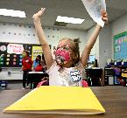
JCPS AT A GLANCE
96,500 students
6,890 teachers
165 schools
14 million meals served
79% Jefferson County children attend JCPS
139 languages spoken by students & families

Slide 3
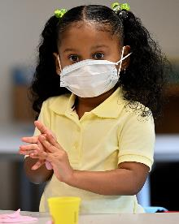
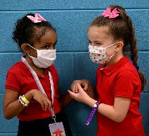
JCPS Student Demographics, 2020-21
Race | JCPS | Kentucky
African American | 37% | 11%
Asian | 5% | 2%
Hispanic/Latino | 13% | 8%
Two or More Races | 5% | 5%
White | 40% | 74%
Other Indicators
Free/Reduced Price Lunch | 67% | 61%
English Language Learners | 13% | 5%
Students with Disabilities | 13% | 16%

Slide 4
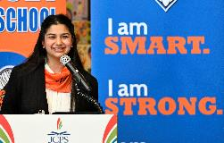
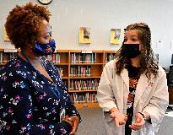
Current State: 2019
Inequitable Student Assignment Plan
Aging facilities with no improvement plan
Outdated technology
Inadequate investment in workforce development
Improve student outcomes

Slide 5
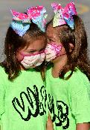
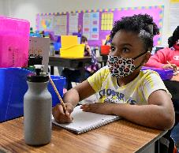
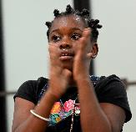
Future State: 2024
Student Assignment Plan
Facilities
Technology upgrades
Workforce development
Resourcing high poverty schools

Slide 6
Ongoing Challenges
Increased poverty
Teacher/workforce shortages
Rebounding from pandemic

Slide 7
“Society grows great when old men plant trees whose shade they know they shall never sit in.”
- Greek Proverb

