Slide 1
Teacher Recruitment and Retention Interim Joint Committee on Education June 7, 2022 Jason E. Glass, Ed.D., Commissioner

Slide 2
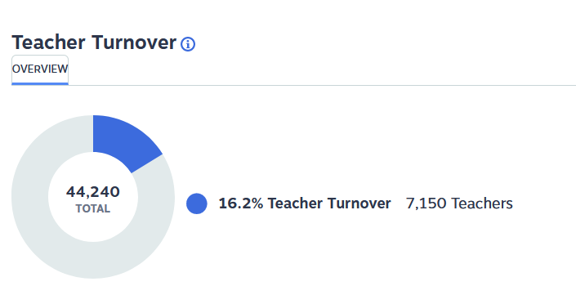
Retention
2020 -2021 Teacher Turnover Rate

Slide 3
Local Impact

Slide 4
Certifications Issued

Slide 5
Emergency Certifications

Slide 6
Attrition Risk (cont.)

Slide 7
Pathways Data

Slide 8
Key Considerations for Examining the Educator Workforce
Invest significant resources in GoTeachKY
Address compensation crisis
Raise the desirability of teaching

Slide 9
GoTeachKY Mission
Recruitment
Preparation
It is the mission of GoTeachKY to ensure that all students across the Commonwealth have equitable access to effective educators.
Grow-Your-Own
Supporting and Elevating Educators from Recruitment to Retirement
Induction
Retention

Slide 10
GoTeachKY Priorities
ELEVATE
the teaching profession
EMPLOY
strategies to certification
ENCOURAGE
early entry
ENGAGE
in actionable supports
ENTICE
to stay in the profession

Slide 11
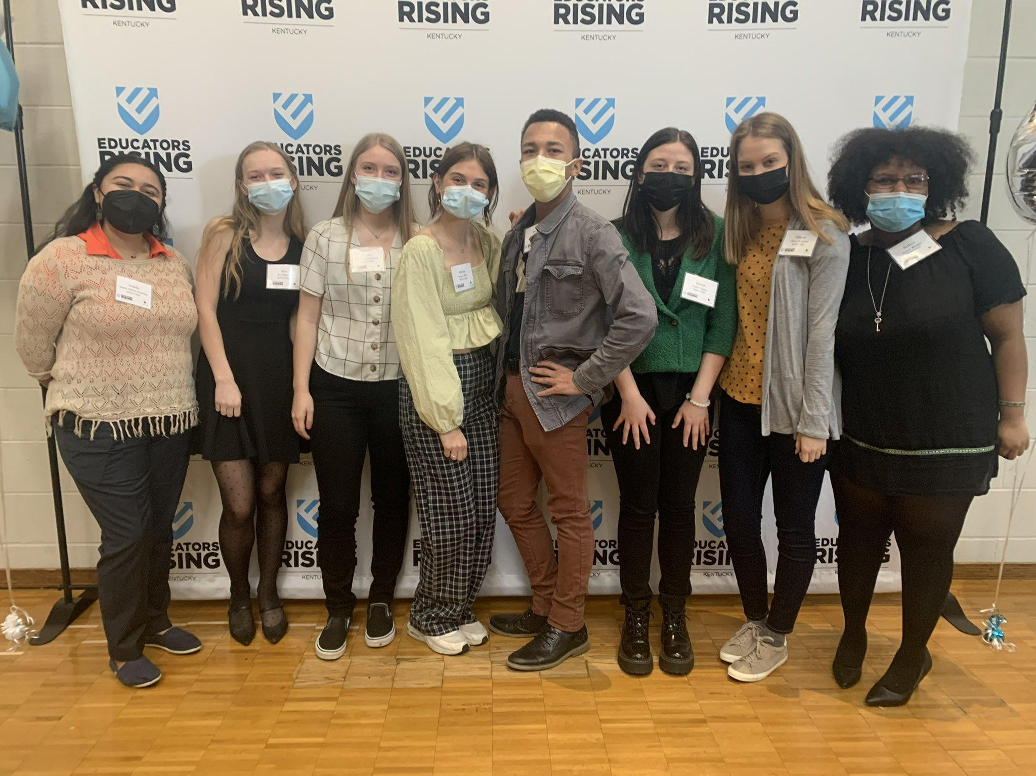
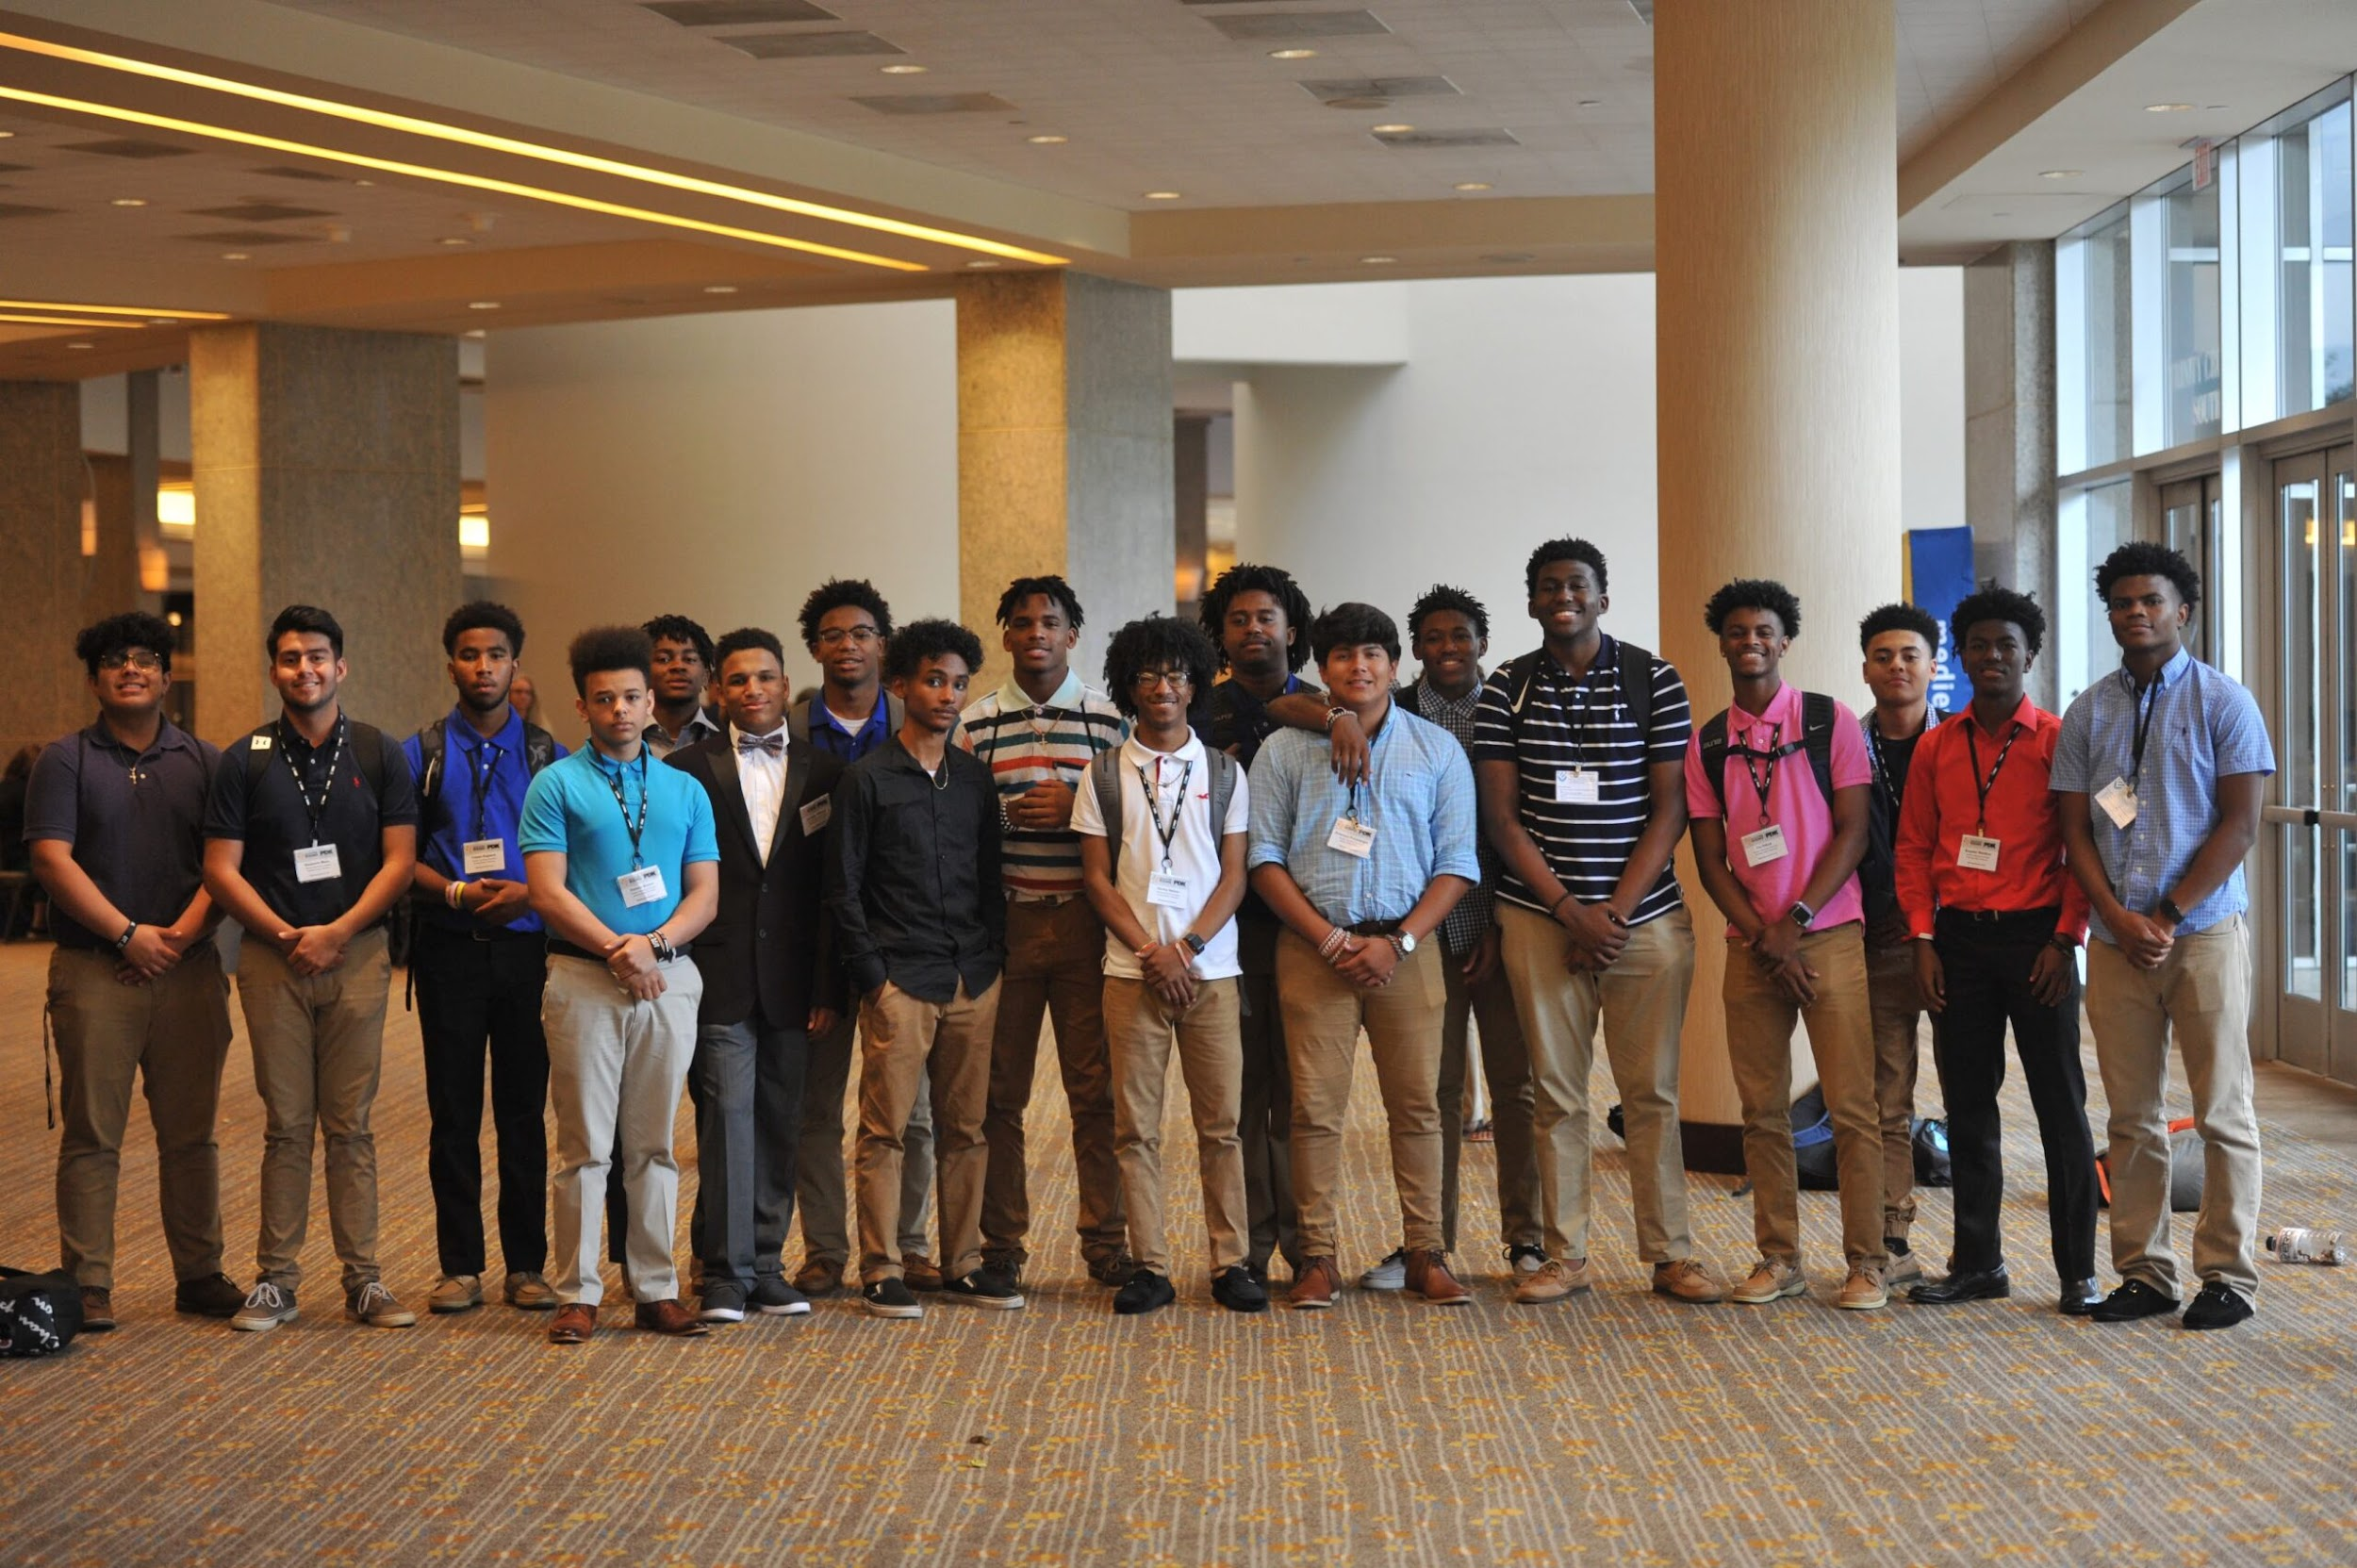
ENCOURAGE early entry
Inviting P-12 students to the profession

Slide 12
ENCOURAGE early entry (cont.)
Short-term Action
Access to Teaching and Learning career pathway for all Kentucky high school students
Create opportunities for scholarships associated with Educators Rising participation
Long-term Action
Expand grant opportunities for districts and schools to establish teacher recruitment programs

Slide 13
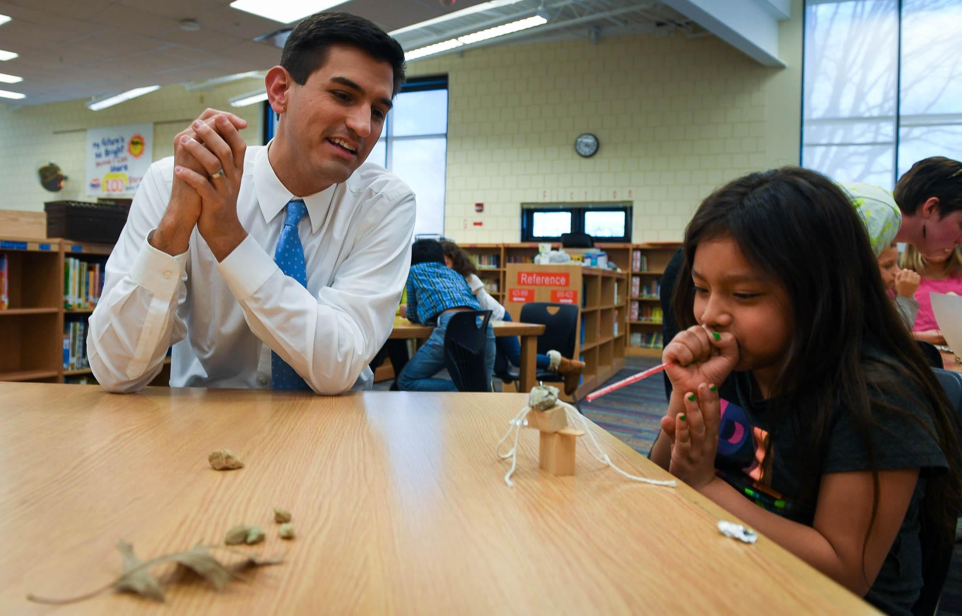
ELEVATE the teaching profession
Getting the facts out about the realities
and joys of teaching

Slide 14
ELEVATE the teaching profession (cont.)
Short-term Action
Increase investments in a comprehensive GoTeachKY marketing campaign
Long-term Action
Scale up the overall GoTeachKY initiative with significant financial contributions

Slide 15
ENGAGE in actionable supports
Providing right-on-time resources in needed areas of support

Slide 16
ENGAGE in actionable supports (cont.)
Short-term Action
Support identification of a district recruitment and retention coordinator
Provide dedicated funds to alleviate teacher recruitment barriers
Long-term Action
Support the development of recruitment and retention plans for districts

Slide 17
EMPLOY strategies to certification
Addressing the potential pipeline barriers
to attaining certification

Slide 18
EMPLOY strategies to certification (cont.)
Short-term Action
Accelerate existing mentoring and reimbursement for teacher licensing exams
Long-term Action
Reduce burden on candidates with state-paid student teaching
Create alternative licensure opportunities

Slide 19
ENTICE to stay in the profession
Incentivize and support high-quality educators to remain in the profession

Slide 20
ENTICE to stay in the profession (cont.)
Short-term Action
Increase funding for National Board Certification
Fund a professional development wallet for each teacher
Long-term Action
Create teacher leadership pathways
Professional and livable wages for Kentucky educators

Slide 21
Thank You
Questions?

