Slide 1

Prepared for the Interim Joint Committee on Education
July 15, 2022
Capitol Annex, Room 154

Slide 2
5-Year Longitudinal Regression Analyses
For Every Step Upward in the Continuum
GPA increases 15%
State standard test scores increase 9%
Significantly decreased rates of school suspensions, tardiness, and behavioral issues

Slide 3
Elementary school fall
semester
Elementary school spring
semester
Result Highlights
All categories showed an upwards improvement over a 6-month period
The survey and action plan was effective in all age groups
In all three age groups the average and optimal categories increased to >50% after just 6 months
The total number of ‘At-risk’ students decreased by an average of 39% across all age groups
Following our analysis for one of our partners, 53% of targeted students met their growth goal for Math Fall-to-Winter projected map growth; 59% of targeted students met their growth goal for reading Fall-to-Winter projected MAP growth
Middle school fall
semester
Middle school spring
semester
High school fall
semester
High school spring
semester
Example of Year to Year Monitoring

Slide 5
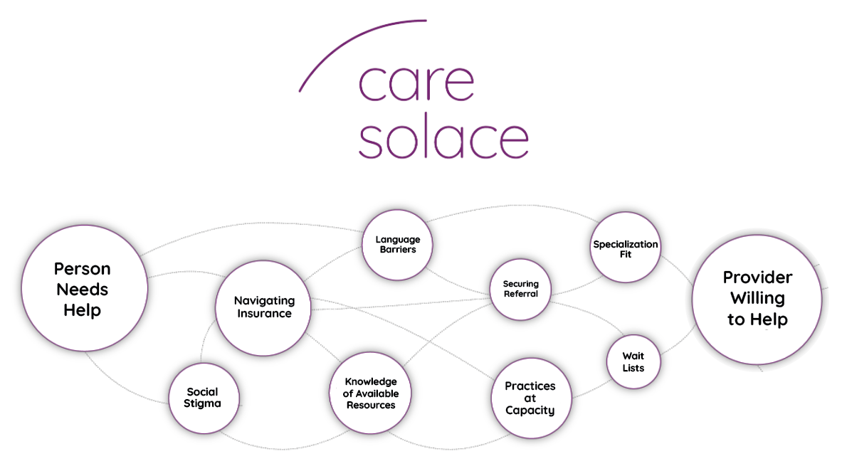
What’s the problem?
Notes:
On the left is a student, family member, faculty, or staff member who needs mental health care. On the right is a highly qualified mental health care provider.
The problem? All of the obstacles and barriers that prevent them from getting connected.
Data shows that only 18% if people who try to navigate these barriers on their own are able to get connected. 82% give up in frustration and never receive help.
Our team has become experts in navigating insurance for families and get around the long wait times to secure an intake appointment. We shrink the wait times from 3 months or longer to around 72 hours.
Dealing with social stigma is at the forefront of what we do and we tackle this by finding the tightest cultural identity match with providers who speak their preferred language or other specialization match.
Students, families, faculty, and staff can anonymously and confidentially seek mental health care

