Slide 1
“Kentucky Academic Standards for Social Studies”
Interim Joint Committee on Education
November 1, 2022

Slide 2
KRS 158.196
Per (3)(a), the “Kentucky Department of Education shall incorporate fundamental American documents and speeches into the grade-level appropriate middle and high school social studies academic standards and align corresponding assessments” by July 1, 2023.
(b) The revision shall not “delay or otherwise impact the existing schedule as set forth in KRS 158.6453(2).”

Slide 3
Fundamental Documents and Speeches KRS 158.196(3)(a)
The Mayflower Compact
The Declaration of Independence
The Constitution of the United States
The Federalist No. 1 (Alexander Hamilton)
The Federalist Nos. 10 and 51 (James Madison)
The June 8, 1789, speech on amendments to the Constitution of the United States by James Madison
The first ten (10) amendments to the Constitution of the United States, also known as the Bill of Rights
The 1796 Farewell Address by George Washington
The United States Supreme Court opinion in Marbury v. Madison, 5 U.S. 137 (1803)
The Monroe Doctrine by James Monroe
What to the Slave is the Fourth of July? speech by Frederick Douglass
The United States Supreme Court opinion in Dred Scott v. Sandford, 60 U.S. 393 (1857)
Final Emancipation Proclamation by Abraham Lincoln
The Gettysburg Address by Abraham Lincoln
Declaration of Rights of the Women of the United States by Susan B. Anthony, Matilda Joslyn Gage, and Elizabeth Cady Stanton
The September 18, 1895, Atlanta Exposition Address by Booker T. Washington
Of Booker T. Washington and Others by W.E.B. Du Bois
The United States Supreme Court opinion in Plessy v. Ferguson, 163 U.S. 537 (1896)
The August 31, 1910, New Nationalism speech by Theodore Roosevelt
The January 11, 1944, State of the Union Address by Franklin D. Roosevelt
The United States Supreme Court opinions in Brown v. Board of Education of Topeka, 347 U.S. 483 (1954) and Brown v. Board of Education of Topeka, 349 U.S. 294 (1955)
Letter from Birmingham Jail by Martin Luther King, Jr.
The August 28, 1963, I Have a Dream speech by Martin Luther King, Jr.
A Time for Choosing by Ronald Reagan

Slide 4
KRS 158.196 Implementation Timeline
April 2022: Senate Bill 1 (2022) signed into law.
June 2022: Committees reconvened for standards and assessments Review Committee (RC) and Advisory Panels (APs).
July 2022: APs consider requirements of KRS 158.196 and propose/recommend changes to standards. RC reviews APs recommendations on standards and makes decisions on moving forward.
September 2022: Public comment sought on recommended revisions to standards (by a third party).
October 2022: APs respond to comments and finalize proposed revisions to standards. RC reviews and approves the final proposal of standards and sends it to the commissioner.
November 2022: The commissioner presents feedback and recommended revisions to the Interim Joint Committee on Education.
The commissioner provides a report to Standards and Assessment Process Review Committee (SAPRC). SAPRC determines whether the standards review process is sufficient/deficient.
December 2022: KBE reviews proposed changes to standards; if approved, regulatory change process begins.
August 2023: Revised standards are implemented in all schools.

Slide 5
Standards and Clarification Statements
History Disciplinary Strand
Concepts and Practices | Standard | Disciplinary Clarifications
H: Change and Continuity | 5.H.CH.1 Describe the impact of fundamental documents on the development of the United States. | The founding documents, including, but not limited to, the Declaration of Independence, U.S. Constitution, and Bill of Rights, established the United States government and presented the philosophical, traditional, and political foundations on which the nation was built. New political ideologies influenced the democratic principles that guided the founding of the nation and formation of the government. Certain groups, including women, African Americans, and American Indians, did not receive equal rights or representation. Protections for slavery were embedded in the founding documents.

Slide 6
Public Comment Highlights

Slide 7
Public Comment Period: Survey Details and Respondent Roles
400 Respondents Total
Respondents represent 59% of all KY counties.
Role | Responses
Teacher | 276
Retired Teacher | 7
Administrator | 29
Parent/Guardian | 31
Institution of Higher Education | 5
Business and Community | 14
Student | 2
Other (Please specify.) | 36
Total | 400

Slide 8
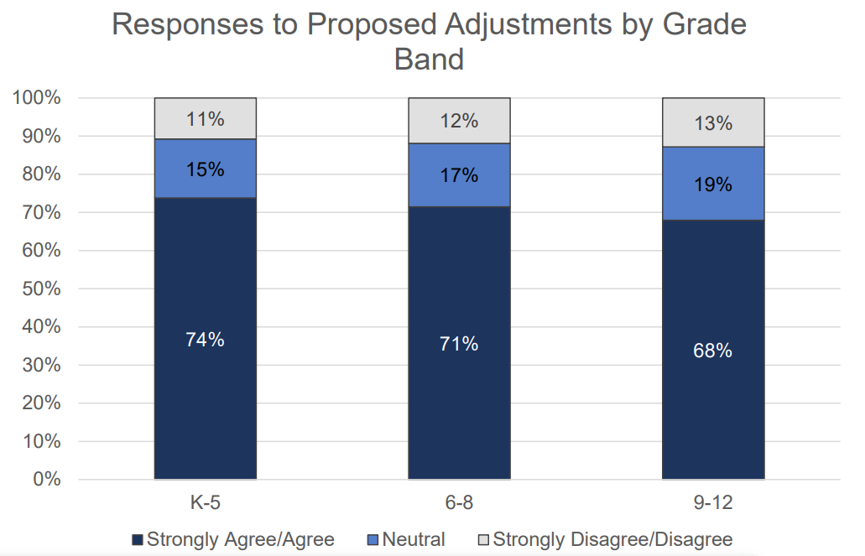
Summary of Public Feedback on Adjustments to Standards

Slide 9
Review Committee (RC) and Advisory Panels (APs) Response to Public Comments

Slide 10
KAS K–5 Standard
Concept and Practice | Standard | Disciplinary Clarifications
H: Change and Continuity | 5.H.CH.1 Describe the impact of fundamental documents on the development of the United States. | The founding documents, including, but not limited to, the Declaration of Independence, U.S. Constitution, and Bill of Rights, established the United States government and presented the philosophical, traditional, and political foundations on which the nation was built. New political ideologies influenced the democratic principles that guided the founding of the nation and formation of the government. Certain groups, including women, African Americans, and American Indians, did not receive equal rights or representation. Protections for slavery were embedded in the founding documents.

Slide 11
NEW 8th Grade Standard
8.H.CH.6 Analyze the impact of fundamental documents and speeches on the development of the United States from 1600 to 1877 that shall include but are not limited to the following:
The Mayflower Compact
The Declaration of Independence
The Constitution of the United States
The Federalist No. 1 (Alexander Hamilton)
The Federalist Nos. 10 and 51 (James Madison)
The June 8, 1789, speech on amendments to the Constitution of the United States by James Madison
The first ten (10) amendments to the Constitution of the United States, also known as the Bill of Rights
The 1796 Farewell Address by George Washington
The United States Supreme Court opinion in Marbury v. Madison, 5 U.S. 137 (1803)
The Monroe Doctrine by James Monroe
What to the Slave is the Fourth of July? speech by Frederick Douglass
The United States Supreme Court opinion in Dred Scott v. Sanford, 60 U.S. 393 (1857)
Final Emancipation Proclamation by Abraham Lincoln
The Gettysburg Address by Abraham Lincoln
Declaration of Rights of the Women of the United States by Susan B. Anthony, Matilda Joslyn Gage, and Elizabeth Cady Stanton

Slide 12
NEW High School Standard
HS.UH.CH.7 Evaluate the impact of fundamental documents and speeches on the development of the United States from 1877 to present that shall include but are not limited to the following:
The September 18, 1985, Atlanta Exposition Address by Booker T. Washington
Of Booker T. Washington and Others by W.E.B. Du Bois
The United States Supreme Court opinion in Plessy v. Ferguson, 163 U.S. 537 (1896)
The August 31, 1910, New Nationalism speech by Theodore Roosevelt
The January 11, 1944, State of the Union Address by Franklin D. Roosevelt
The United States Supreme Court opinions in Brown v. Board of Education of Topeka, 347 U.S. 483 (1954) and Brown v. Board of Education of Topeka, 349 U.S. 294 (1955)
Letter from Birmingham Jail by Martin Luther King, Jr.
The August 28, 1963, I Have a Dream speech by Martin Luther King, Jr.
A Time for Choosing by Ronald Reagan

Slide 13
Draft “Kentucky Academic Standards for Social Studies”
Questions?

